Slide 1
MID-REVIEW
CS-374 PROJECT
Project Guide :
Prof. Madhukant Sharma
Ms. Jhanvi Chauhan (Teaching Assistant)
Shantanu Tyagi - 201801015
Shivani Nandani - 201801076
Pratvi Shah - 201801407
Arkaprabha Banerjee - 201801408

Slide 2
Section 1: Root Finding Method
Part 1: Planck’s Radiation Equation
Problem: Find the wavelength for maximum energy density within an isothermal blackbody with absolute temperature=300K.
Solution: We used Planck’s Radiation Equation to find the iterative function for solving the given problem
Planck’s Equation: 𝝓(𝜆) = 8𝜋ch𝜆/(e^{ch/kT𝜆} -1 )
Iterative function: f(x) = e^{-x} − 1 + x /5 where x=ch𝜆/kT
Conclusion:
Steffensen and Newton Raphson method have the highest rate of convergence amongst the 5 methods used
From all the iterative methods we can conclude that the wavelength for maximum energy density of an isolated blackbody at temperature 300K is 9.6658 e-06 m.

Slide 3
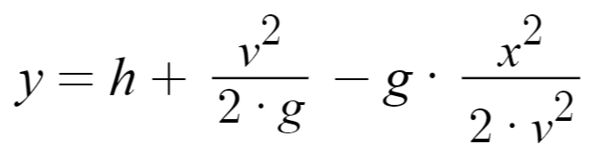
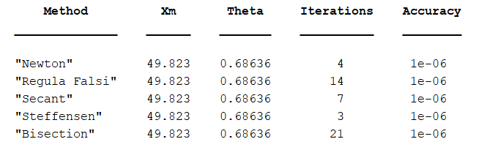
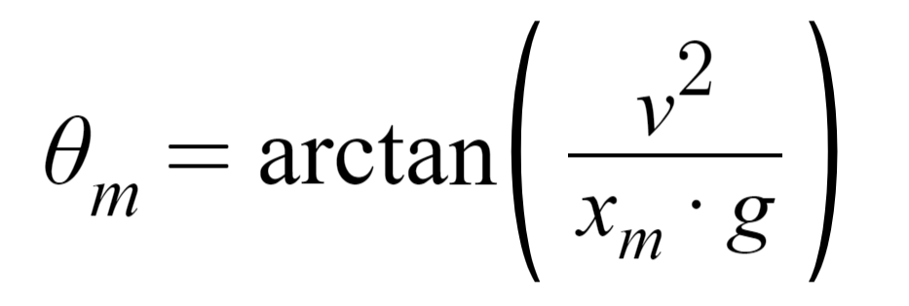
Section 1: Root Finding Method
Part 2: Projectile Motion Equation
The equation which gives us the maximum x for a given h, v and g = 9.8 m/s² is:
Following is the table we get using our code:
We then find θ_{m} using the following formula:

Slide 4
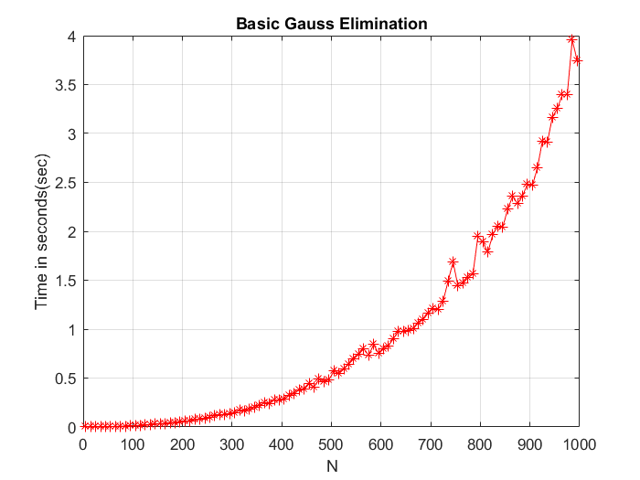
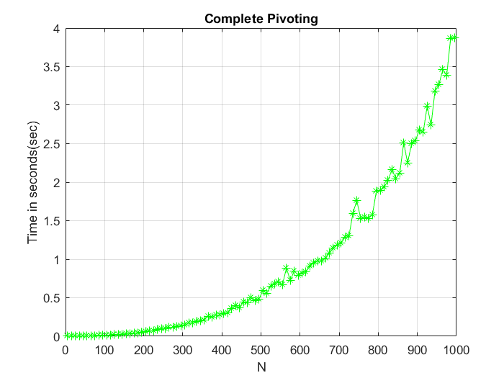
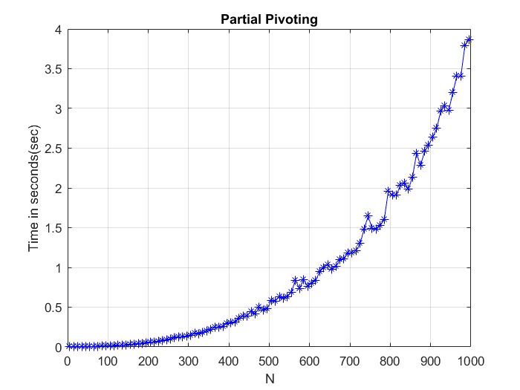
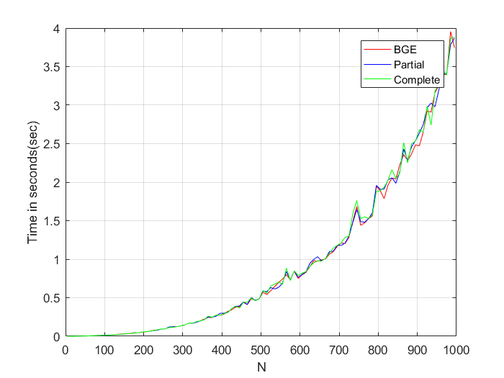
Section 2: Gaussian Elimination
Part 1: Time complexity of Gaussian Elimination
Problem: Evaluate the time complexity of solving system of linear equations using Gaussian Elimination .
Solution: We used MATLAB functions tic and toc to calculate the time taken to solve the system of linear equations by using Basic Gauss Elimination, Partial Pivoting and Complete Pivoting methods.
Conclusion: All the three methods used to perform Gaussian Elimination gave us the same time complexity of O(N³).

Slide 5
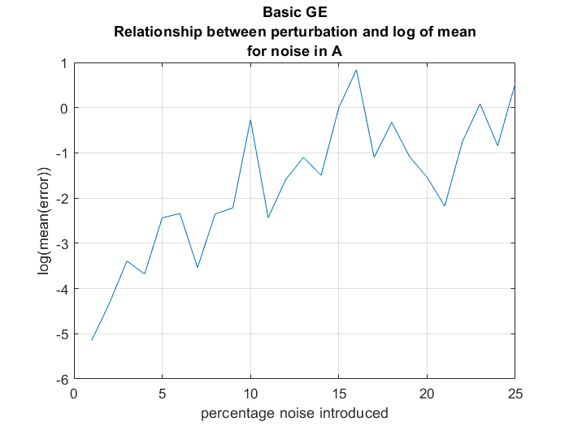
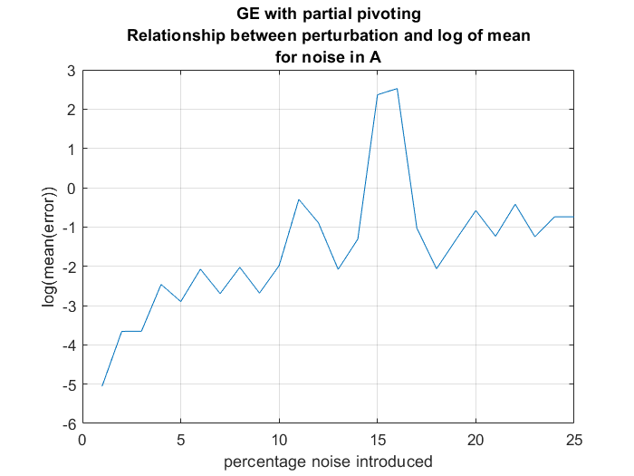
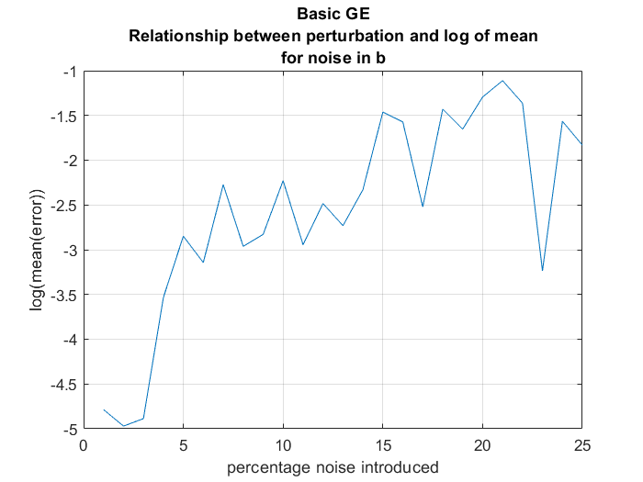
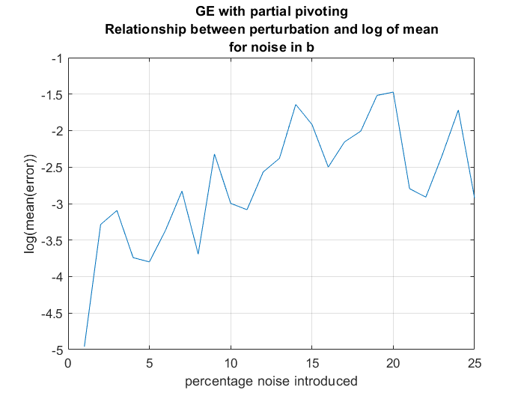
Section 2: Gaussian Elimination
Part 2: Perturbation Effect of Pivoting
Here we have added noise in the parameters A and b (keeping the other same as original) observed their effect on the solution x.
It is clear from these graphs that as the percentage noise added increases, the mean of error also increases.

Slide 6
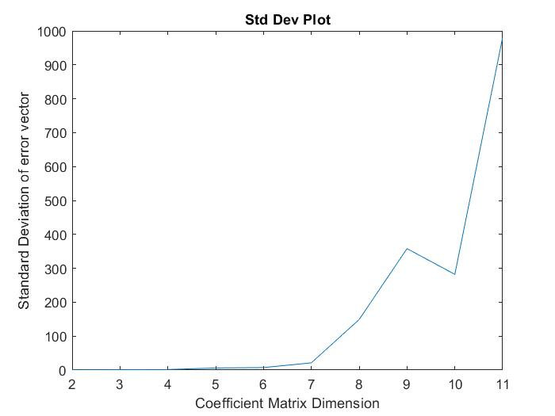
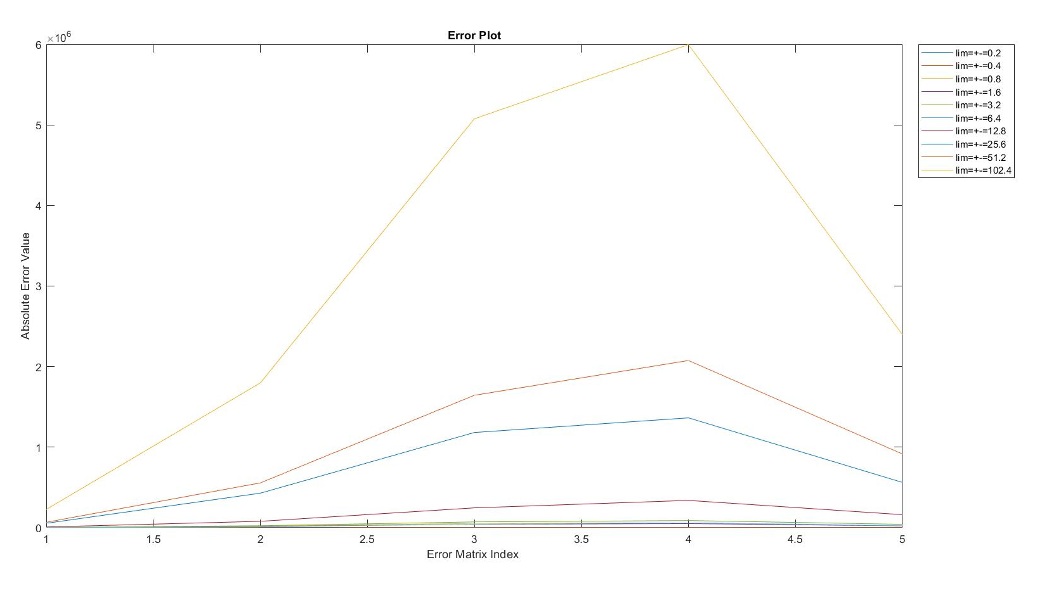
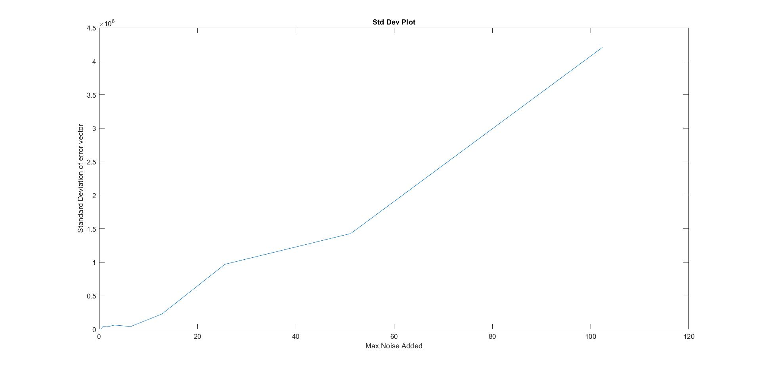
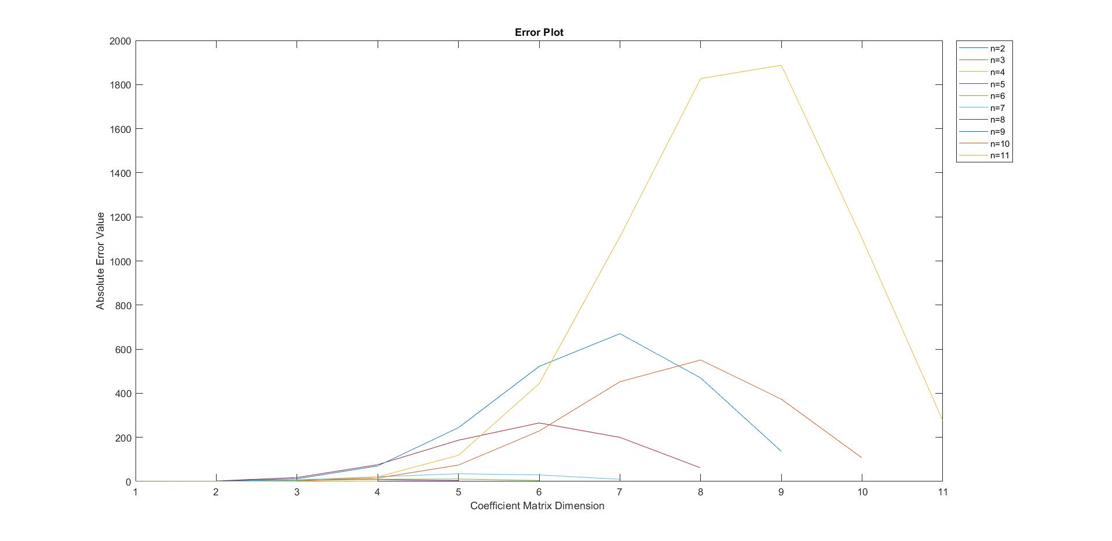
Section 2: Gaussian Elimination
Part 3: Analysis of Vandermonde Matrices
Vandermonde Matrices are inherently ill-conditioned.
Experiment 1 : Varying Noise in requirement vector
Experiment 2 : Varying Dimension of Vandermonde Matrix
Perform above two with Basic Gauss Elimination and Partial Pivoting
Analyze error vector, mean and standard deviation
Error increases significantly with increase in noise highlighting ill-conditioned behavior.
Error increases with increase in size of matrix.
Anomalies exist on account of random matrices.

Slide 7
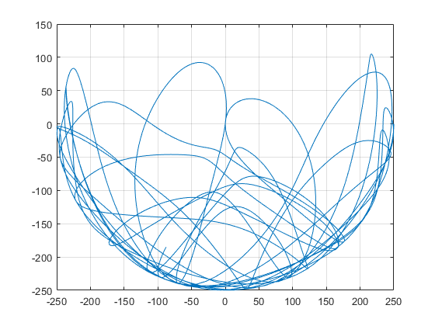
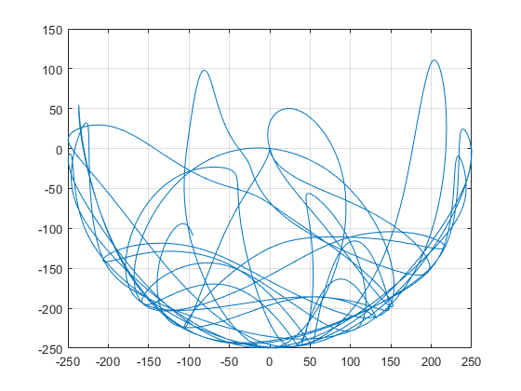
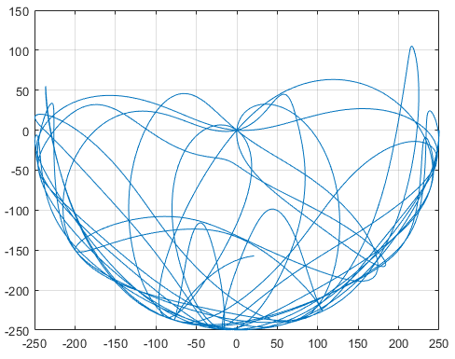
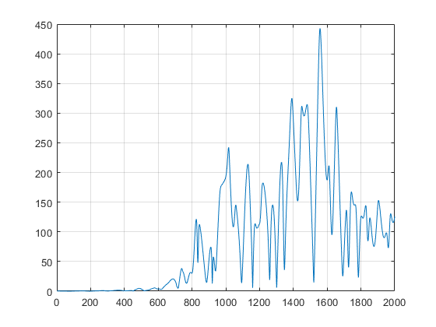
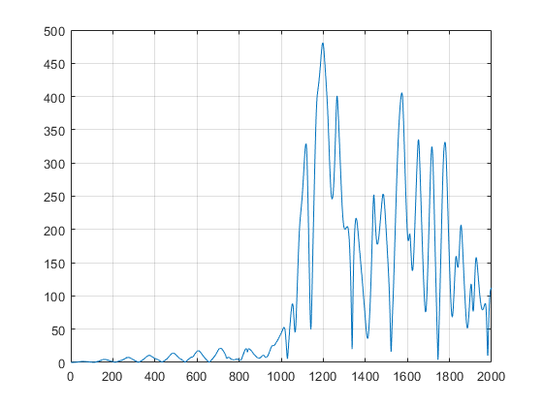
Section 3: Analysis of Double Pendulum
Problem: To verify that this system can be modelled numerically and deterministically and double pendulums with near identical initial conditions diverge over time displaying the chaotic nature of the system.
Solution: Using Euler method to linearly approximate the solution to the coupled ordinary differential equation and varying the input conditions to analyze the error propagation in the output.
Experiment 1: Perturbing the initial angle by 0.001 radians and finding the error in the output for 2000 iterations and 0.5 time step.
Experiment 2: Perturbing the time step by 0.001 radians and finding the error in the output for 2000 iterations and PI/2 initial angle.
Observation: Even a minute variation in input conditions leads to greater and greater errors in the final position. This highlights the inherent instability of the system. Thus, it exhibits rich dynamic behavior with a strong sensitivity to initial conditions.

Slide 8
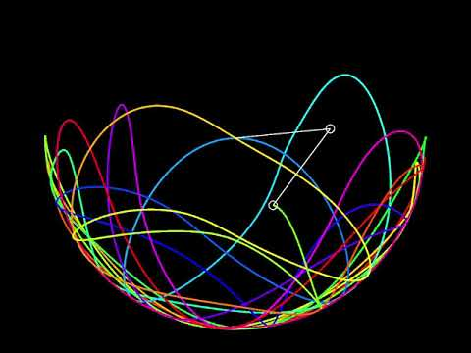
Double Pendulum motion visualization in Java

Slide 9
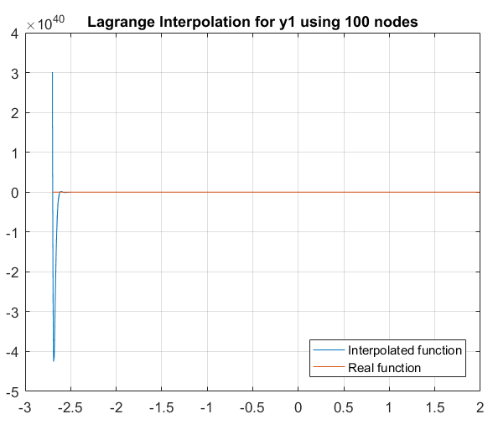
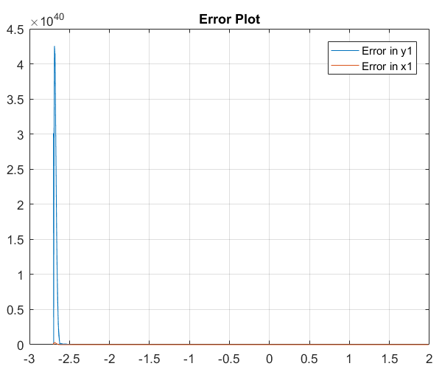
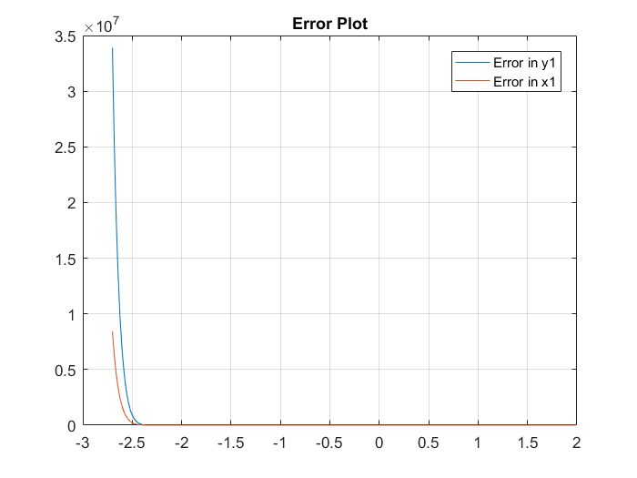
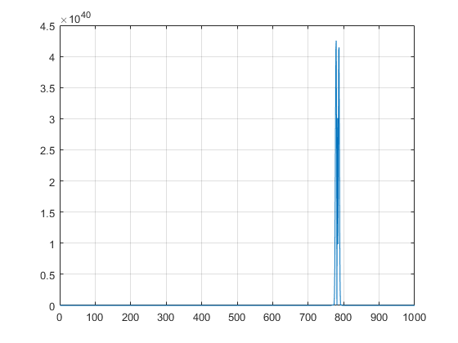
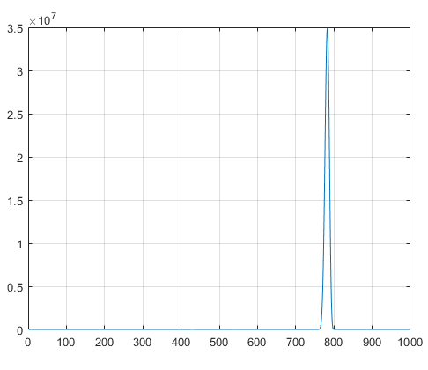
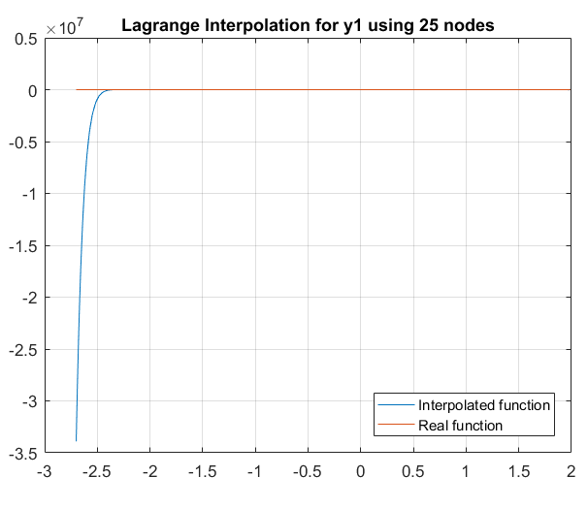
Section 4: Lagrange Interpolation
Problem: To approximate the polynomial x₁(Θ)and y₁(Θ) using the data obtained from previous section.
Solution:
Set of 25,50 and 100 pairs of (Θ₁,x₁) and (Θ₁,y₁) were considered for interpolation.
On increasing the number of points, there’s a general decrease in the net error.
Furthermore, these interpolated values of x₁ and y₁ were plugged into the equations of the double pendulum system and the values of x₂ and y₂ were also calculated.
Error analysis was also performed for them.They also show the same trend as mentioned above.

Slide 10
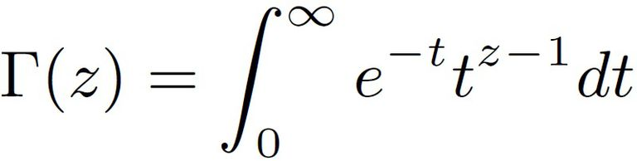
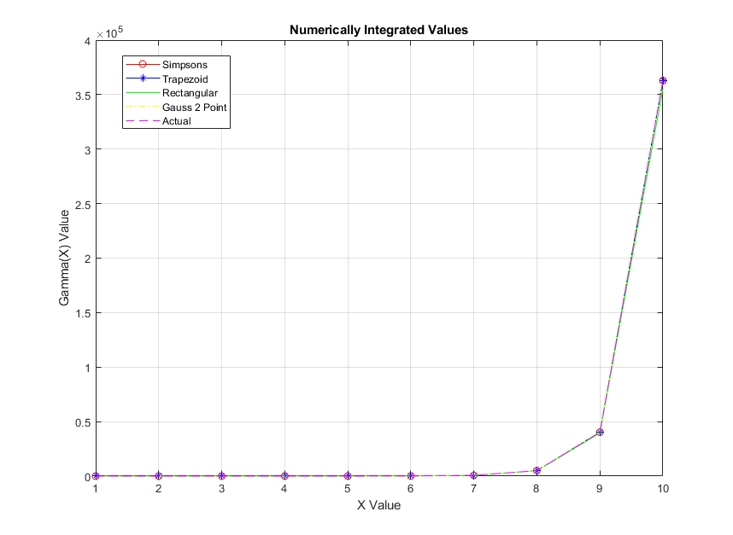
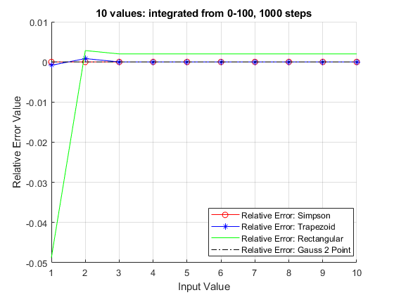
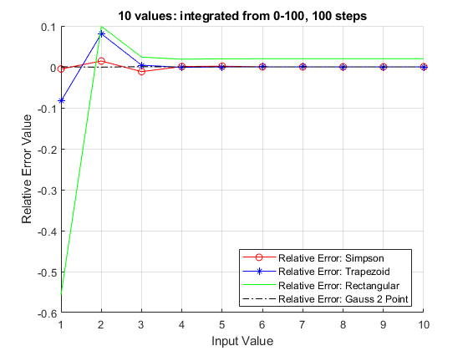
Section 5: Numerical Integration
Problem: To evaluated integral of various mathematically and physically significant equations using various numerical methods and compared their performance with actual values.
Part 1: Gamma Function
Methods used:
Simpson
Trapezoid
Rectangular
Gauss 2 point
Limits [0,100], steps = 100,1000.
Conclusions: All methods converge. Increasing the steps increases accuracy of all methods. Taking larger limits calls for taking many more steps and it increases accuracy by a negligible amount so 100 is a good upper bound value.

Slide 11
Fin.

