Slide 1
MID-REVIEW
CS-374 PROJECT
Project Guide :
Prof. Madhukant Sharma
Ms. Jhanvi Chauhan (Teaching Assistant)
Shantanu Tyagi - 201801015
Shivani Nandani - 201801076
Pratvi Shah - 201801407
Arkaprabha Banerjee - 201801408

Slide 2
Section 1: Root Finding Method
Part 1: Planck’s Radiation Equation
Problem: Find the wavelength for maximum energy density within an isothermal blackbody with absolute temperature=300K.
Solution: We used Planck’s Radiation Equation to find the iterative function for solving the given problem
Planck’s Equation: 𝝓(𝜆) = 8𝜋ch𝜆/(e^{ch/kT𝜆} -1 )
Iterative function: f(x) = e^{-x} − 1 + x /5 where x=ch𝜆/kT
Conclusion:
Steffensen and Newton Raphson method have the highest rate of convergence amongst the 5 methods used
From all the iterative methods we can conclude that the wavelength for maximum energy density of an isolated blackbody at temperature 300K is 9.6658 e-06 m.

Slide 3
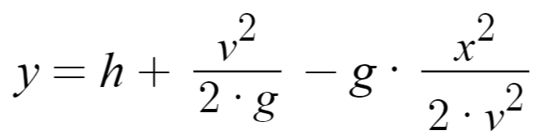
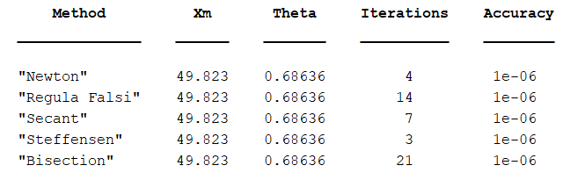
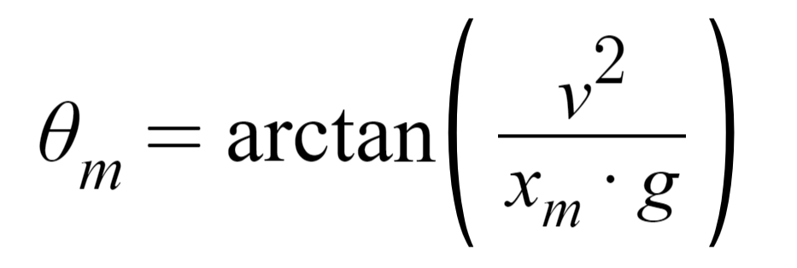
Section 1: Root Finding Method
Part 2: Projectile Motion Equation
The equation which gives us the maximum x for a given h, v and g = 9.8 m/s² is:
Following is the table we get using our code:
We then find θ_{m} using the following formula:

Slide 4
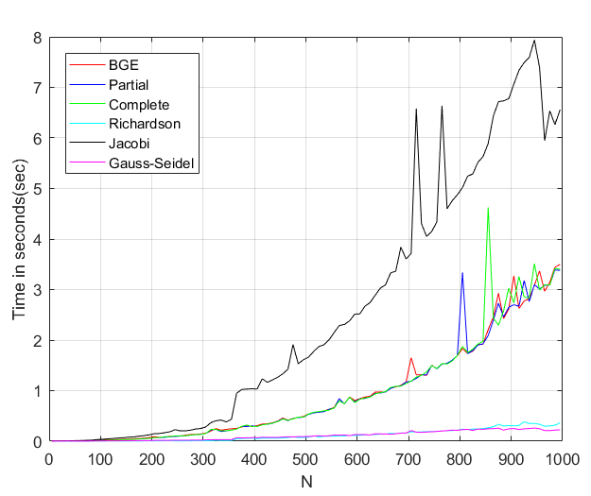
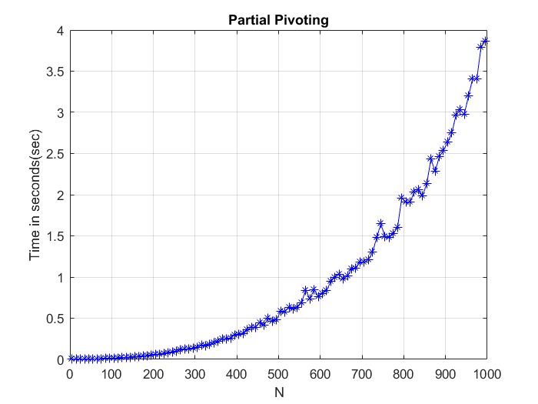
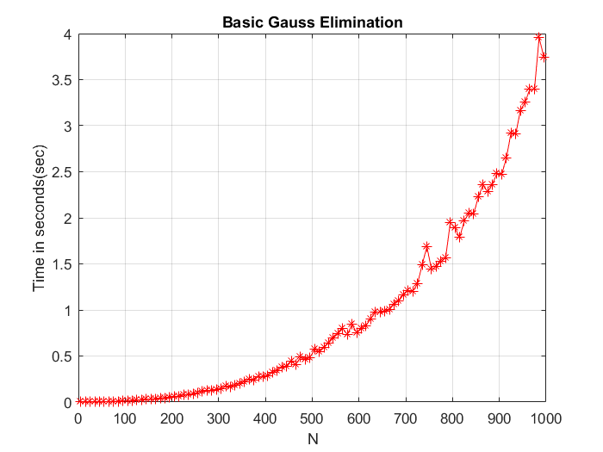
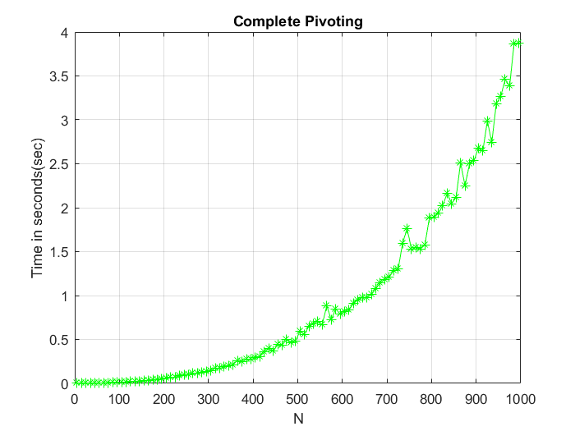
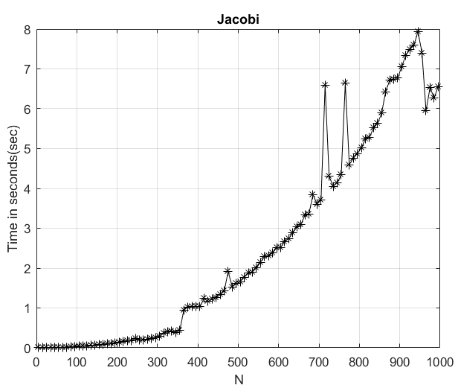
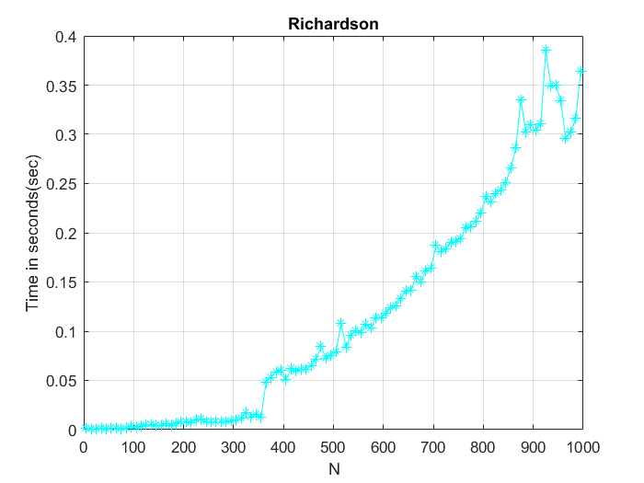
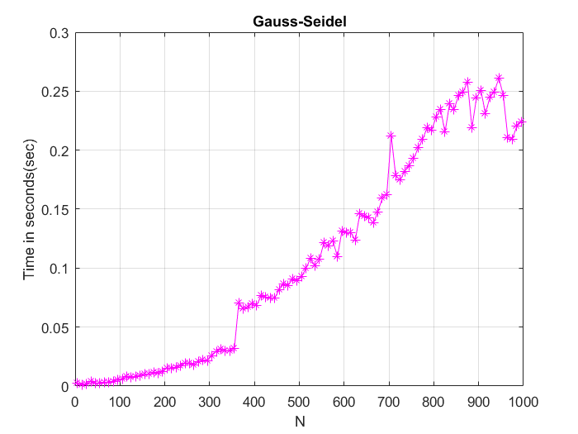
Section 2: Gaussian Elimination
Part 1: Time complexity of Gaussian Elimination
Problem: Evaluate the time complexity of solving system of linear equations using Gaussian Elimination .
Solution: We used MATLAB functions tic and toc to calculate the time taken to solve the system of linear equations by using Basic Gauss Elimination, Partial Pivoting and Complete Pivoting methods.
Conclusion: All the three methods used to perform Gaussian Elimination gave us the same time complexity of O(N³). When compared with iterative methods we saw that while richardson and Gauss-Seidel performed better Jacobi was worse off then all the Gauss Elimination techniques.

Slide 5
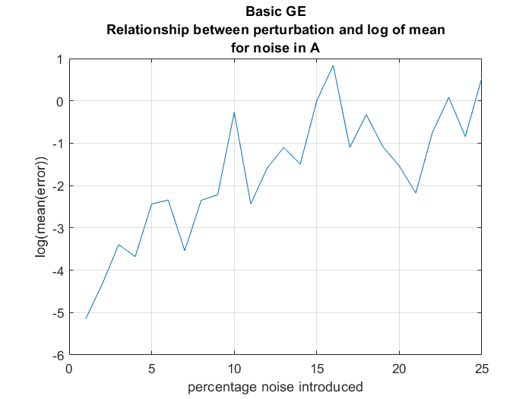
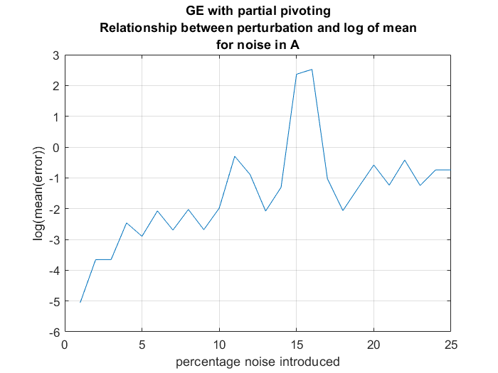
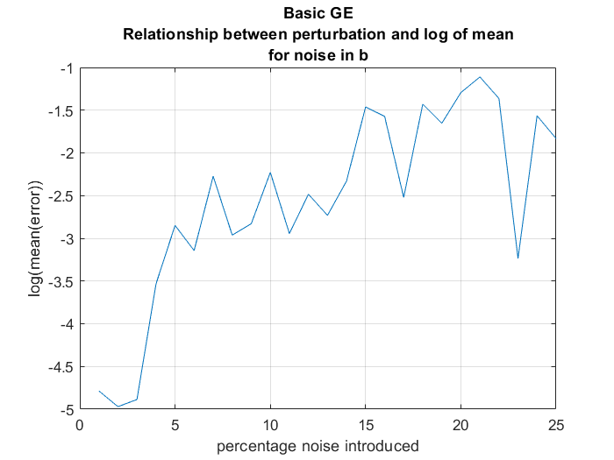
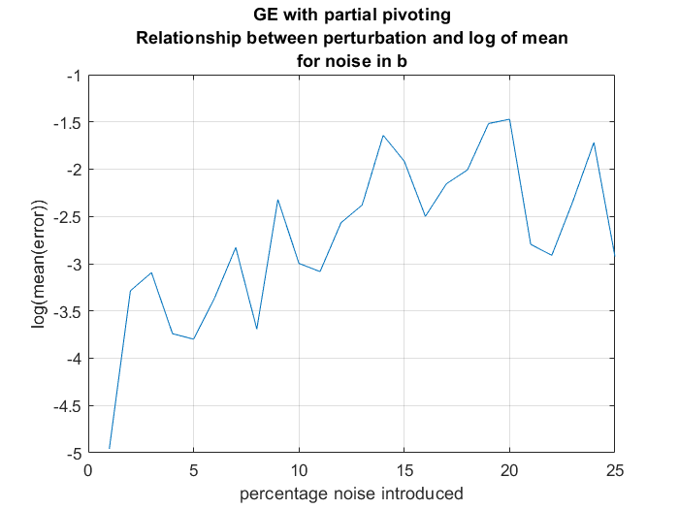
Section 2: Gaussian Elimination
Part 2: Perturbation Effect of Pivoting
Here we have added noise in the parameters A and b (keeping the other same as original) observed their effect on the solution x.
It is clear from these graphs that as the percentage noise added increases, the mean of error also increases.

Slide 6
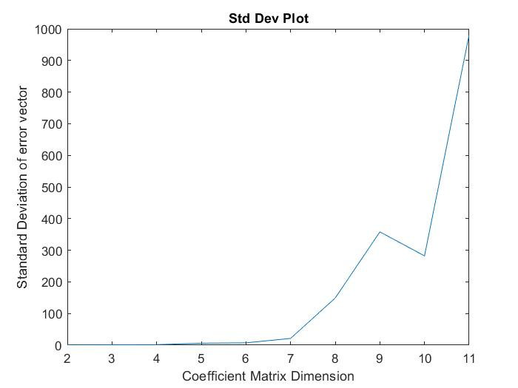
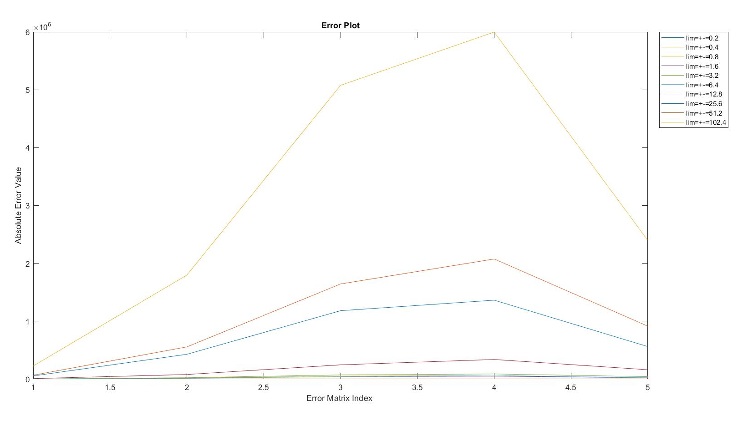
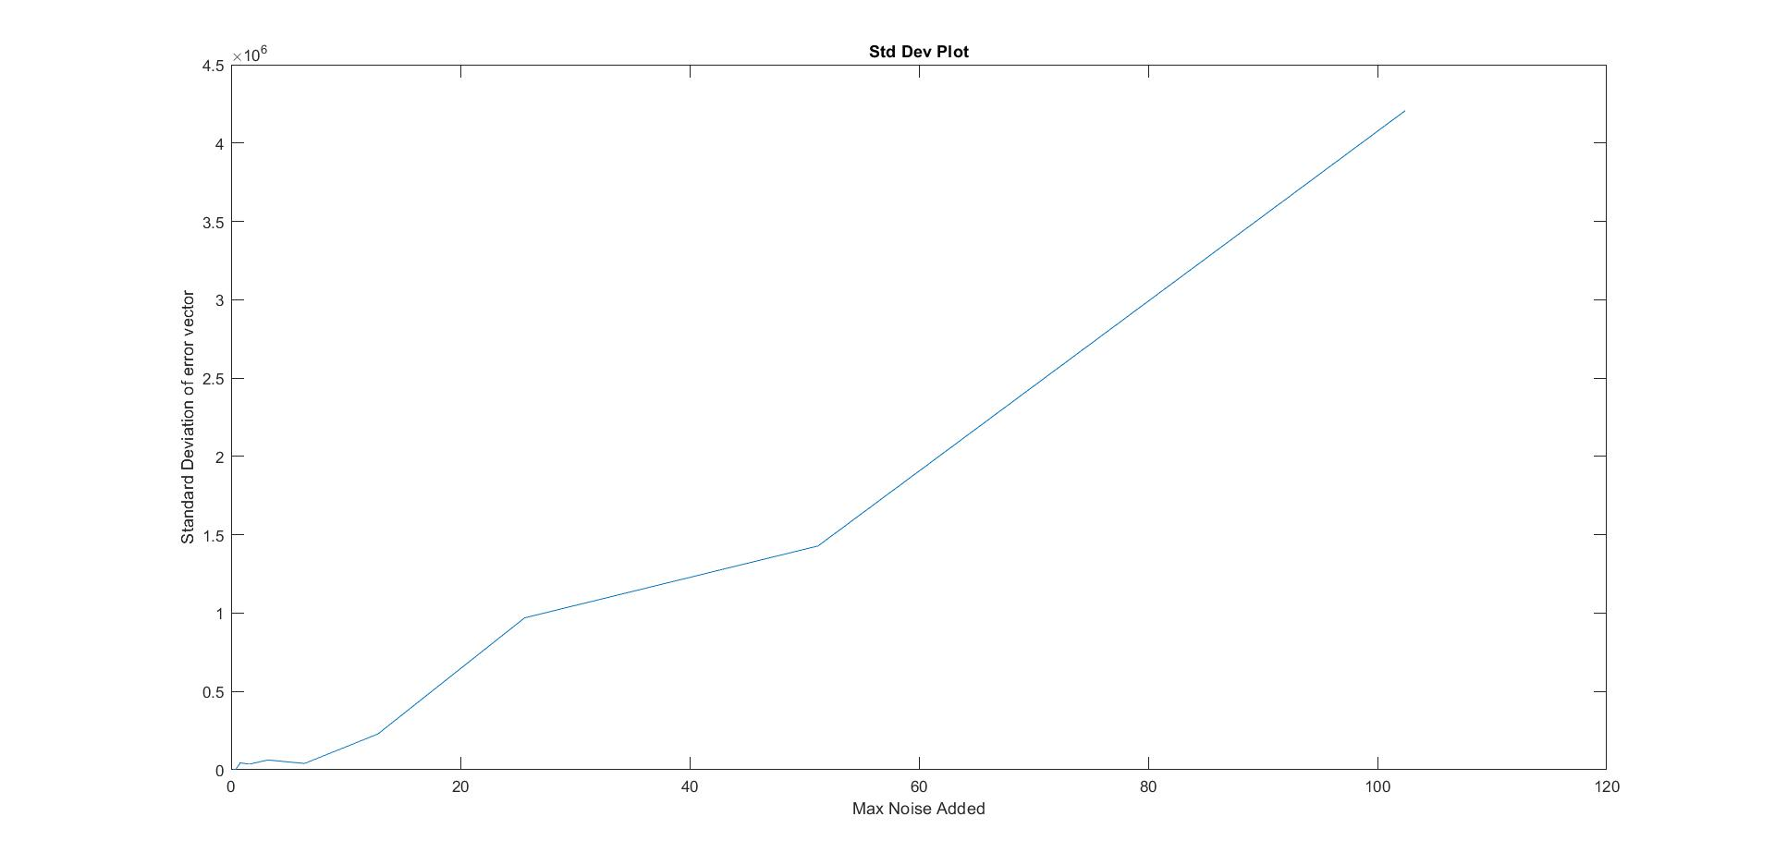
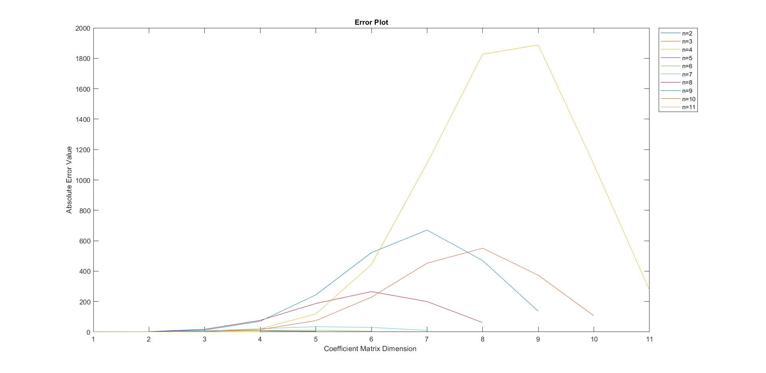
Section 2: Gaussian Elimination
Part 3: Analysis of Vandermonde Matrices
Vandermonde Matrices are inherently ill-conditioned.
Experiment 1 : Varying Noise in requirement vector
Experiment 2 : Varying Dimension of Vandermonde Matrix
Perform above two with Basic Gauss Elimination and Partial Pivoting
Analyze error vector, mean and standard deviation
Error increases significantly with increase in noise highlighting ill-conditioned behavior.
Error increases with increase in size of matrix.
Anomalies exist on account of random matrices.

Slide 7
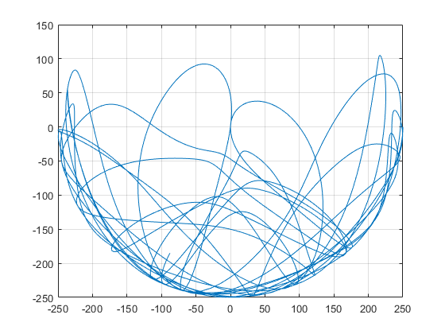
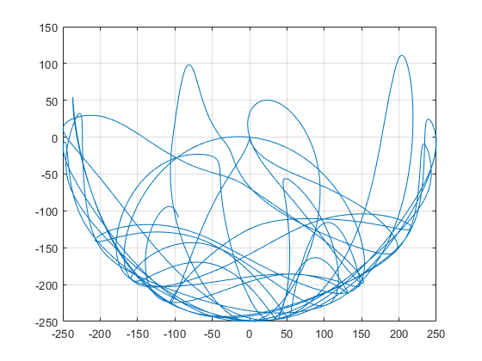
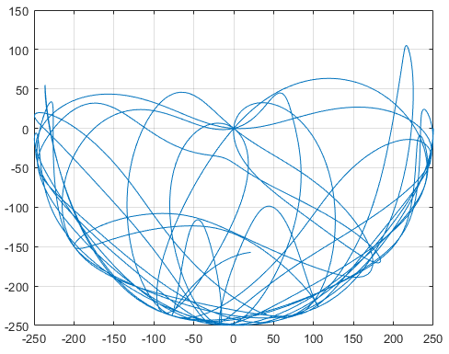
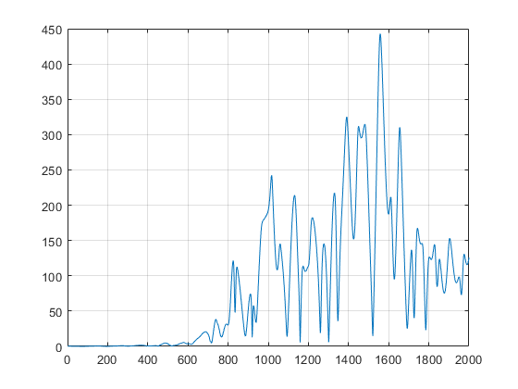
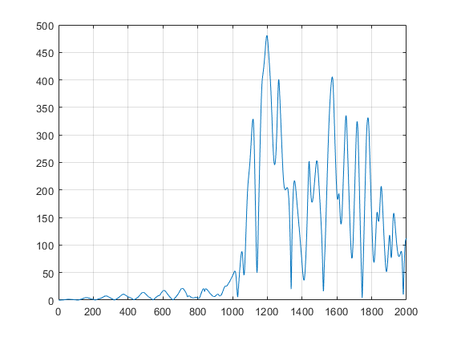
Section 3: Analysis of Double Pendulum
Problem: To verify that this system can be modelled numerically and deterministically and double pendulums with near identical initial conditions diverge over time displaying the chaotic nature of the system.
Solution: Using Euler method to linearly approximate the solution to the coupled ordinary differential equation and varying the input conditions to analyze the error propagation in the output.
Experiment 1: Perturbing the initial angle by 0.001 radians and finding the error in the output for 2000 iterations and 0.5 time step.
Experiment 2: Perturbing the time step by 0.001 radians and finding the error in the output for 2000 iterations and PI/2 initial angle.
Observation: Even a minute variation in input conditions leads to greater and greater errors in the final position. This highlights the inherent instability of the system. Thus, it exhibits rich dynamic behavior with a strong sensitivity to initial conditions.

Slide 8
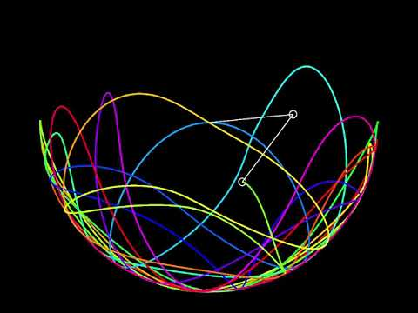
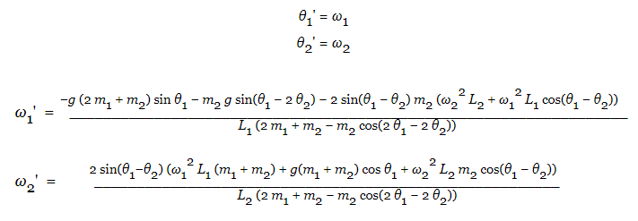
Double Pendulum motion visualization in Java
The motion of a double pendulum is governed by two coupled ordinary differential equations and it is chaotic. For smaller angles however, it acts like a simple pendulum. The jump in complexity is observed at the transition from a simple pendulum to a double pendulum. This is the numerical form that we can now plug into the algorithm to approximate the solution. Plot for final position(2D cartesian) of bob 2 after 2000 iterations with time step = 0.5 is shown.

Slide 9
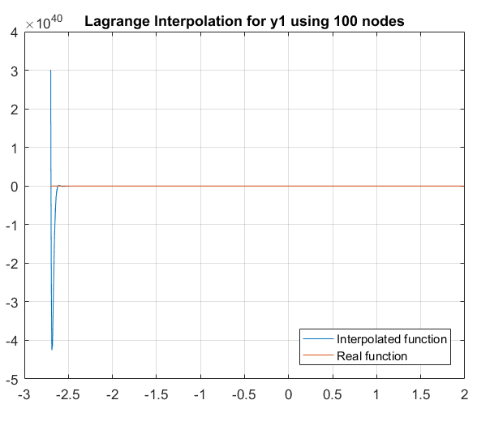
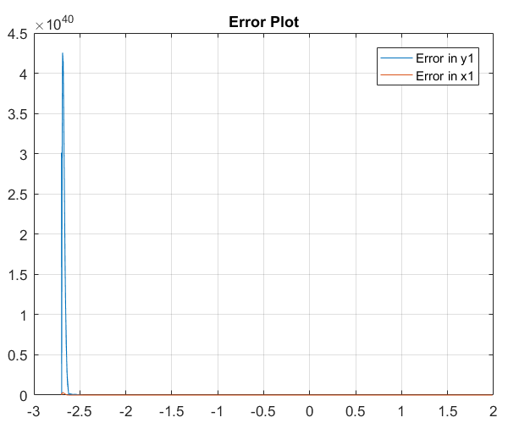
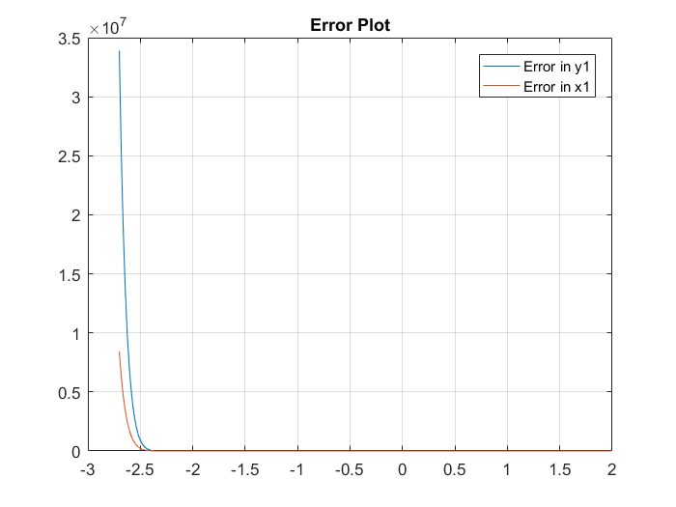
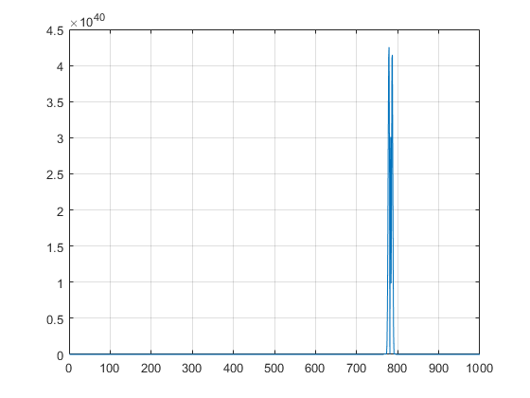
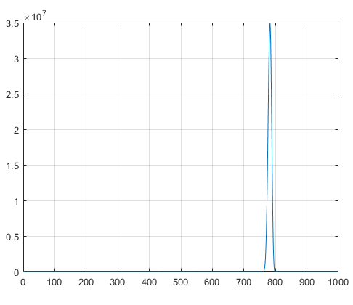
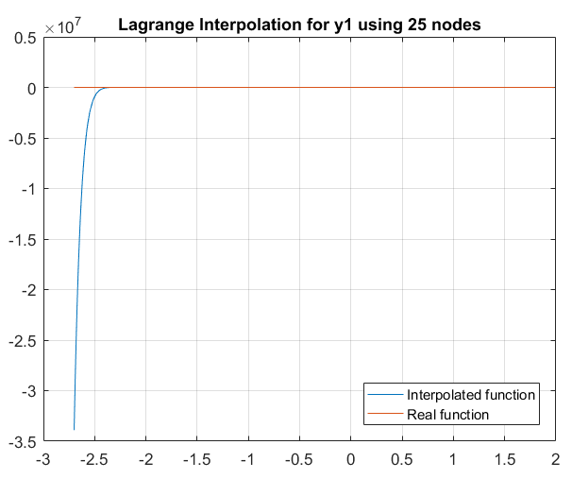
Section 4: Lagrange Interpolation
Problem: To approximate the polynomial x₁(Θ)and y₁(Θ) using the data obtained from previous section.
Solution:
Set of 25,50 and 100 pairs of (Θ₁,x₁) and (Θ₁,y₁) were considered for interpolation.
On increasing the number of points, there’s a general decrease in the net error.
Furthermore, these interpolated values of x₁ and y₁ were plugged into the equations of the double pendulum system and the values of x₂ and y₂ were also calculated.
Error analysis was also performed for them.They also show the same trend as mentioned above.

Slide 10
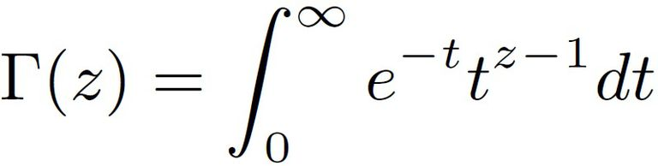
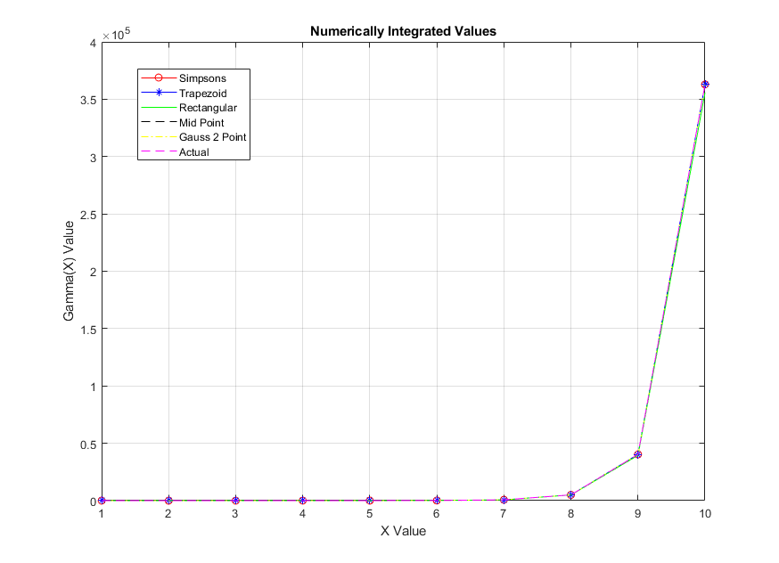
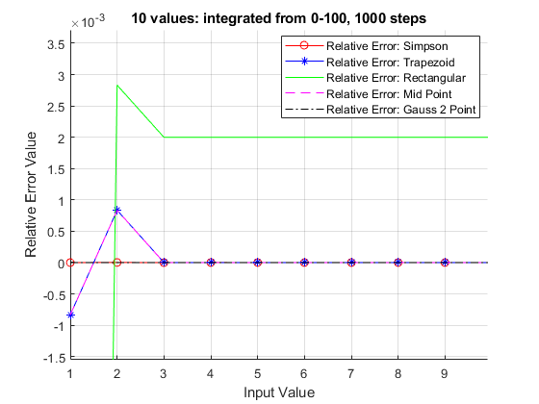
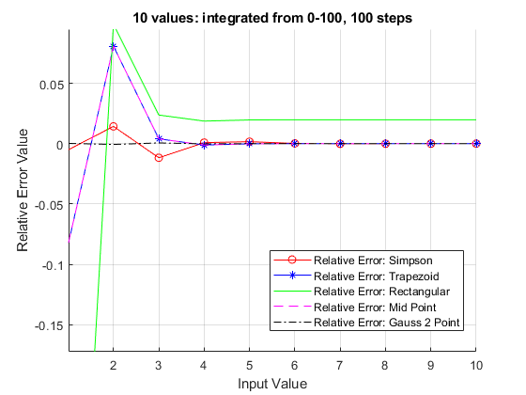
Section 5: Numerical Integration
Problem: To evaluated integral of various mathematically and physically significant equations using various numerical methods and compared their performance with actual values.
Part 1: Gamma Function
Methods used:
Simpson
Trapezoid
Rectangular
Mid Point
Gauss 2 point
Limits [0,100], steps = 100,1000.
Conclusions: All methods converge. Increasing the steps increases accuracy of all methods. Taking larger limits calls for taking many more steps and it increases accuracy by a negligible amount so 100 is a good upper bound value.

Slide 11

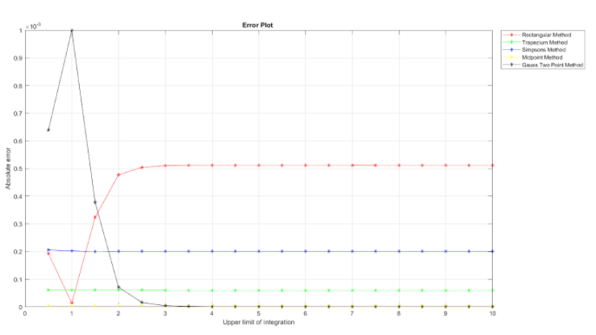
Section 5: Numerical Integration
Part 2: Complex Functions
Procedure:
We use Composite Midpoint Rule, Composite Rectangular Rule, Composite Trapezium Method, Gauss 2 Point Rule and Simpson's Method to calculate the definite integral value.
The upper limit of the integral is varied from 0.5 to 10 in increments of 0.5 for the error plot. Step size is kept constant. For the net integral plot (ref. report), the maximum upper limit is taken as 50. This has been done for better visualization.
Conclusion:
All the methods give a very close approximation of the actual integral.
The rectangular method gives maximum error.
Gauss two point rule gave the minimum error.
Rest of the methods lie between these two thresholds.

Slide 12

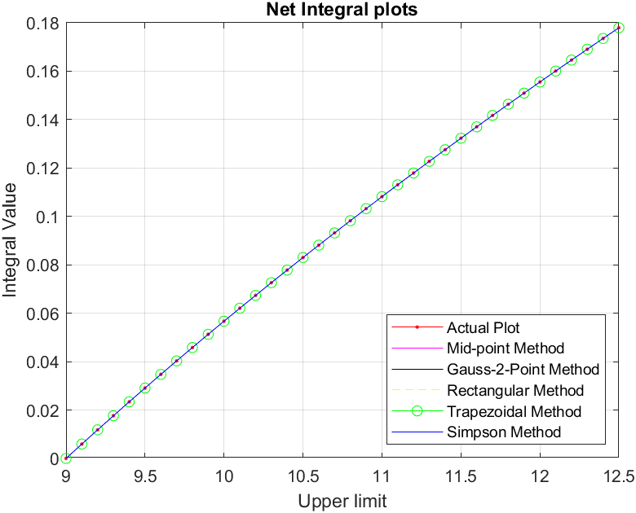
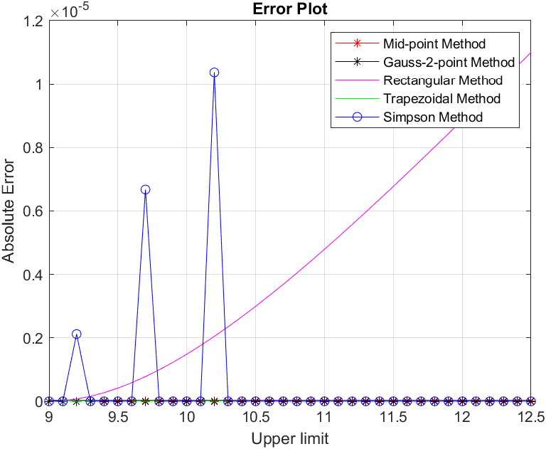
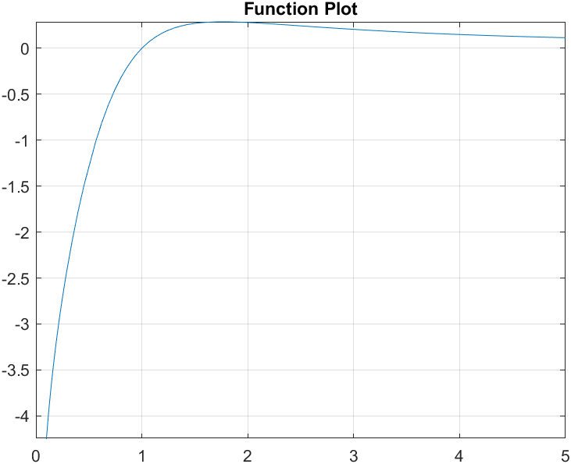
Section 5: Numerical Integration
Part 3: Complex Functions
We use Composite Midpoint Rule, Composite Rectangular Rule, Composite Trapezium Method, Gauss 2 Point Rule and Simpson's Method to calculate the value.
The upper limit of the integral is varied from 9 to 4𝜋 in increments of 0.1.
All the methods give a very close approximation of the actual integral.
The rectangular method gives maximum error.

Slide 13

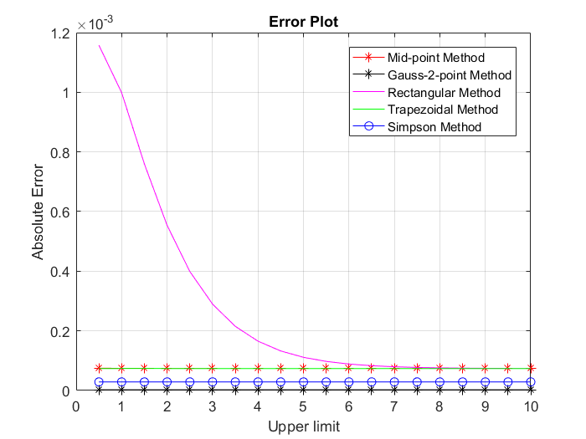
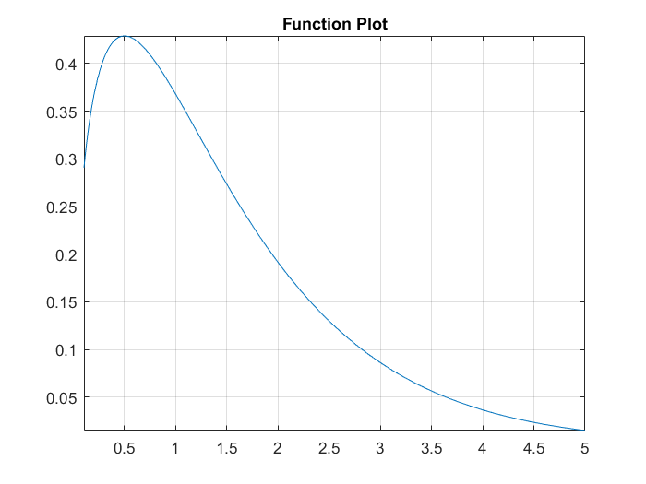
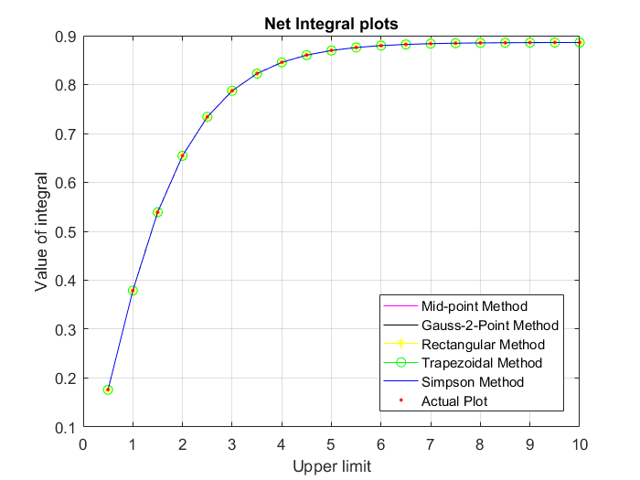
Section 5: Numerical Integration
Part 4: Notable Exceptions with Definite Integrals
Motivation: There are various functions which cannot be evaluated using elementary integrals but it is possible to get the value using definite integral in terms of famous mathematical constants.
Solution: 5 methods were used to evaluate the integral.
Conclusion: All the methods converged to the given constant value of the integral as and when the upper limit was increased. At around b= 10 the value obtained was within 10^{.-6} of the actual value. Gauss 2 point method gave the best result whereas the results of rectangular method deviated a lot from the actual value but eventually it converged.

Slide 14
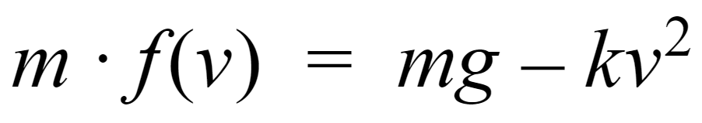
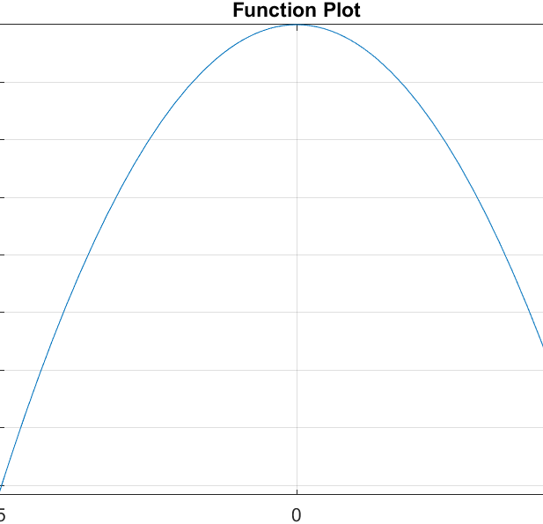
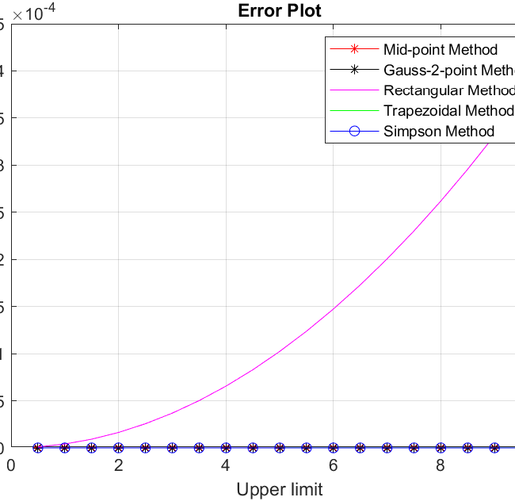
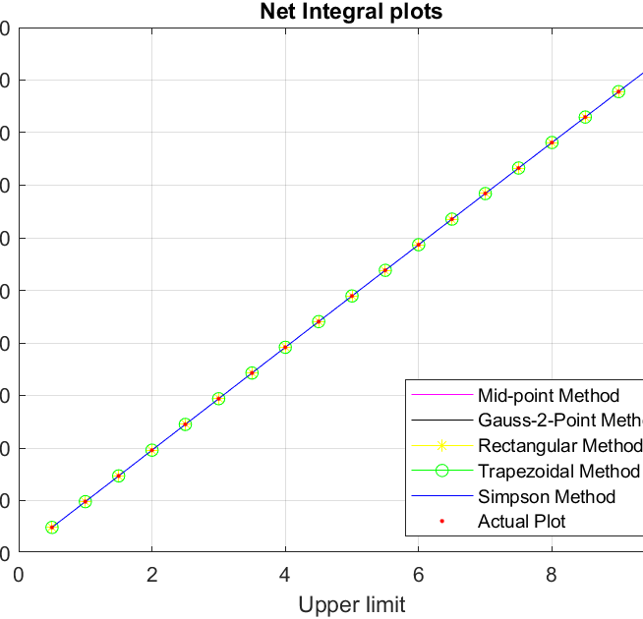
Section 5: Numerical Integration
Part 5: Velocity equation for freely falling body under influence of air resistance
We use Composite Midpoint Rule, Composite Rectangular Rule, Composite Trapezium Method, Gauss 2 Point Rule and Simpson's Method to calculate the value for m = 110 kg, k = 0.18 kg m⁻¹ , and g = 9.8 ms⁻²
The upper limit of the integral is varied from 0.5 to 10 in increments of 0.1.
All the methods give a very close approximation of the actual integral.
The rectangular method gives maximum error.

Slide 15
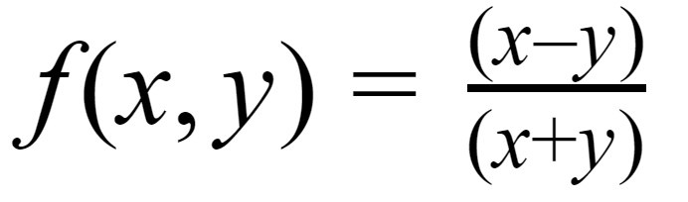
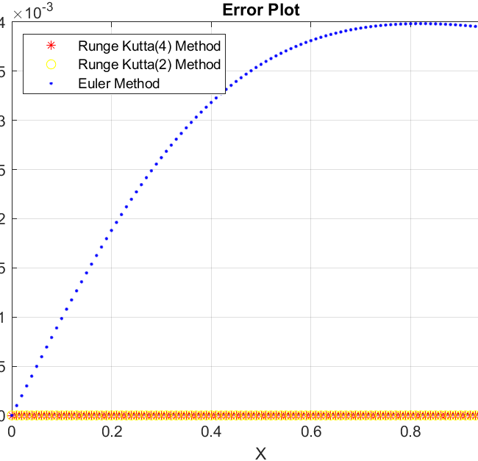
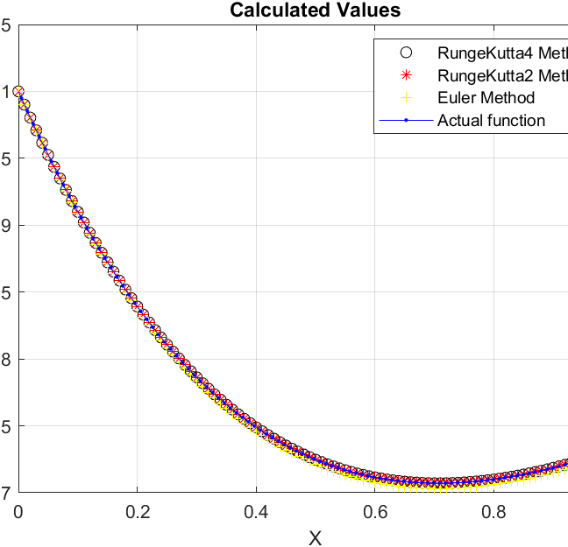
Section 6: Solution to Ordinary Differential Equations
Part 1:
Here we take a homogeneous differential equation and solve it using various methods - Euler method, Runge Kutta order 2 and Runge Kutta order 4.
Step size h=0.01 and total number of steps n= 100
Euler method has the maximum error while Runge-Kutta order 2 and Runge Kutta order 4 give relatively less error

Slide 16

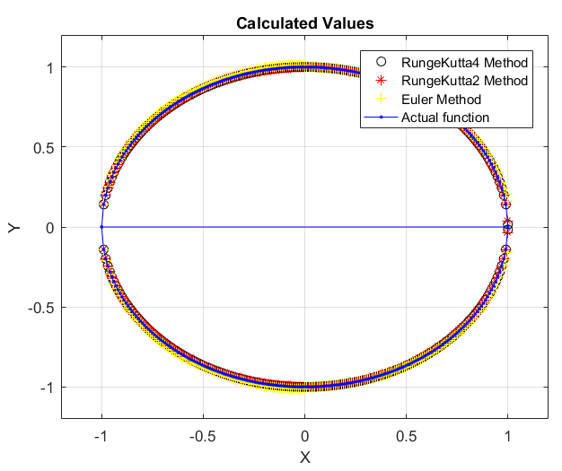

Section 6: Solution to Ordinary Differential Equations
Part 2: Equation of unit circle
We used the differential equation of a unit circle with different initial values to retrieve the circle.
Solution: 3 methods were used to evaluate the integral.
x₀ = 0 and y₀=1 for the first quadrant
x₀ = 0 and y₀=-1 for the second quadrant
x₀ = -0.99 and y₀=(1 - x₀² )^{½} for the third quadrant
x₀ = -0.99 and y₀=(1 - x₀² )^{½} for the fourth quadrant
Conclusion: All the methods converged to form a unit circle centered at zero. Euler method gave the highest error for both the cases x>0 and x<0. Runge Kutta fourth order gave the best results.

Slide 17
Fin.

