Slide 1
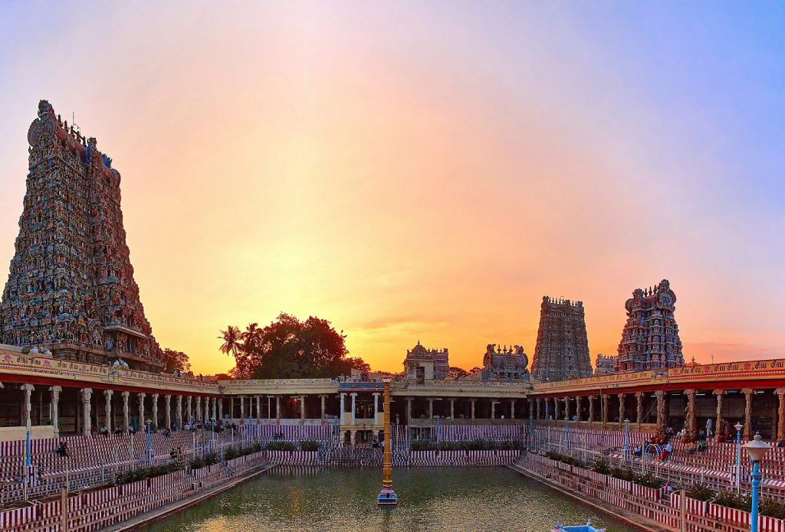

Slide 2
The south Indian Temple: authority, honour and redistribution
Arjun Appadurai
Carol Appadurai Breckenridge
GROUP-8

Slide 3
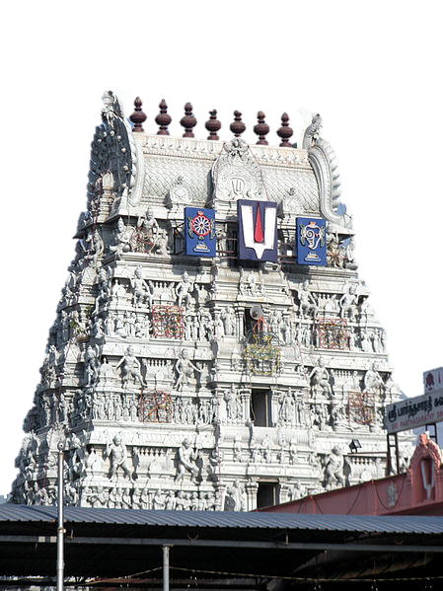
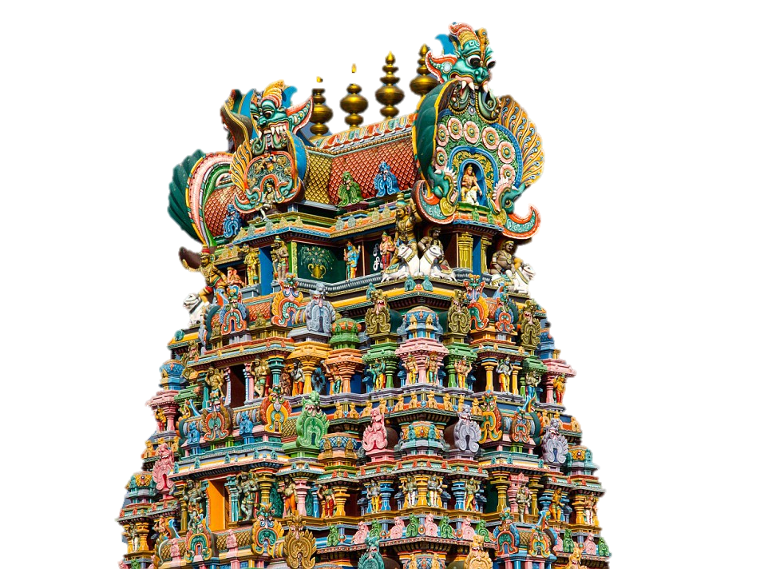
Introduction
Two separate studies:
SriParthasarathi Svami Temple, Triplicane,Madras
Sri Minaksi Sundaresvarar Temple, Madurai
Broader Social Context Of Temple
Four principles:
Sovereign figure
Transactional relationship
Endowments
Conflicts

Slide 4
Deity as a Paradigmatic Sovereign
Establishment of God
Deity is the economic and iconographic centre of the south Indian temples
Installation of God inside temple sanctum sanctorum (garbha griham)
Infusing life in the figure ( prana pratistai )making it a permanent and immovable centre
Then on daily basis deity is bathed, anointed(apisekan), fed(naivettiyam), adorned(alankaram), processed, etc through puja

Slide 5
Deity as a Paradigmatic Sovereign
Personification of God
Deity is thought of as person through evidence of his or her eligibility for marriage(tirukkalyanam), desire for holidays, playful acts(tiruvilaiyatal) etc.
Deity possesses ‘juristic personality’ and are capable of ‘owning property’ known as gifts (Tevatanam)
Both deity and the king live in a palace (Koyil)
They share a variety of ritual paraphernalia and command resources
This command over resources’ redistribution makes the deity the centre of transactional nexus

Slide 6
Deity as a Paradigmatic Sovereign
Rituals, worship methods, festivals
Rajopachara → Paying honour to Lord Shiva and Vishnu
There are 3 types of pujas:
Daily Puja consists of 16 rites of adoration. Puja is regularly performed 1-6 times a day depending on the size of temple and funds
Festival Puja is generally in the month of Cittirai (April-May), the Great Feast Brahmotsava takes place for deity for 10-20 days. The inevitable parts of Brahmotsava are two processions ( morning and evening)

Slide 7
Deity as a Paradigmatic Sovereign
Kamiyam Puja or Arccanai (Individual Worship) is meant solely for benefit of the donor
Arccanai offerings are made to the Lord and are occasional by a crisis, change of status or gratitude.
Kumbhabhiseka is a Hindu temple ritual that is believed to homogenize, synergize and unite the mystic powers of the deity. The temple’s towers, pictures, etc. are emptied of the divine power which is transferred to the water-pots.
Its believed that after Kumbhabhiseka, power of deity increases.

Slide 8
Worship, Redistribution and Honour
Difference between Reciprocity and Redistribution
Reciprocity is practice of exchanging things for mutual benefits.
Reciprocity is action and reaction meant for equal benefits of two parties
Redistribution is typically distribution to achieve greater social equality
Redistribution is socially within a relation or collective of a group.
The main model of south Indian temples is redistribution

Slide 9
Worship, Redistribution and Honour
The donor is referred to as yajamana and share is decided by donor.
This gradually initiates transactional relationship with deity which eventually leads to redistribution.
Puja and utsavam are types of redistribution model system while arccanai is type of reciprocal model.
The offerings such as food, garland, silk garments, pure water etc. are distributed.

Slide 10
Worship, Redistribution and Honour
These leavings of deity are termed as honours. For example, a significant honour is placing gold crown(symbolizing feet of Vishnu) on heads of worshippers
Sometimes conflicts arise due to improper redistribution

Slide 11
Decentralized authority and Endowments
Endowment as a Property
Every endowment reserves a distinct portion of ritual calendar, honours and shares for the donor
Endowment is a medium through which donors carve out a share in redistributive process of temple
Temple endowments are special kinds of trusts.
Donor maintains exclusive access to surplus cash or crops generated by capital or land related to endowment

Slide 12
Decentralized authority and Endowments
Endowments can be better understood as :
Represents the mobilization, organization and pooling of resources(capital, land or labour etc)
Generates one or more ritual contexts in which distribution and receiving of honours take place
Permits the entry and incorporation of corporate units into the temple( families, castes, monasteries, sects etc. ) either as temple servants(ie stanikars, priests, assistants, drummers, pipers) or as donors

Slide 13
Decentralized authority and Endowments
Supports however partially and however incompletely the reigning deity. But because the reigning deity is limited since it is made of stone, authority with respect to endowment resources and ritual remains in the hands of the donor or an agent appointed by him or her
Temple can be seen as complex radically decentralized organizations
Endowments link the temple to its agrarian hinterland or urban context
So who resolves the conflicts concerning endowments?

Slide 14
Protection and service
Control over endowment is centre of all conflicts
Various services are all autonomous forms of participation in ritual as well as redistributive process of temple
So what binds these ‘servants’ together??
Temple can be thought of as well disciplined organization of independent agents

Slide 15
Protection and service
In pre-British south India, king’s role was ensuring the protection of temple
Hence king was considered ‘supreme servant’ of deity and human agent of divine sovereignty embodied in deity
But since deity cannot arbitrate conflict among servants, human being is called upon at that time
Relationship of human kings with deities is an elegant and symbiotic division of sovereignity

Slide 16
Protection and service
Kings are obliged to interact with temples
Rights of kings as protectors are always potentially subject to challenge from other ‘servants’
The colonial period has complicated the framework of shared sovereignty of king and deity
The government is carrying out policy of pre British Hindu kings in management of temples and this conception is of great importance in understanding south Indian way of ordering despite of social, economic and political changes between state and temple

Slide 17
Conclusion
The sovereign deity, honoured in daily and calendrical worship, is the authoritative centre of the temple
Constitutive features of roles, rights and resources in temples are of greater importance in the redistributive process
Unavoidable conflicts need to be settles by authority of human rulers who render themselves to the deity, the model of their own status and power
The south Indian temples with these variety of functions owes its immense importance in the society and are a typical example of the flexibility and centrality of the south Indian society

Slide 18
Thank You…

