Slide 1
SC209 Project
Group 16
Under the able guidance of:
Prof. Ranendu Ghosh

Slide 2
Group Members
Margi Hingrajia - 201801014
Shantanu Tyagi - 201801015
Visaj Nirav Shah - 201801016
Mitesh Koradia- 201801017
Mahaveer Bohra - 201801018
Rohan Jasoria - 201801019
Kirtan Delwadia - 201801020
Prayush Dave - 201801021
Harshil Joshi - 201801022
Arihant Pratap Singh - 201801023
Akshay Mungalpara - 201801024
Hemang Shrimali - 201801025
Harshil Gandhi - 201801026
Nishit Jagetia - 201801027
Bhargav Patel - 201801465
Siddhraj Parmar - 201801466
Sudiksha Thusu - 201801469

Slide 3
The objectives of this project are:
Understanding different satellite data and GIS tools.
Relating phenology with CO2 and climate change.
Using satellite data and ML model and predicting these variables and the possible impact on CO2 levels and climate.

Slide 4
What is Phenology?
Phenology is the study of periodic plant and animal life cycle events and how these are influenced by seasonal and interannual variations in climate, as well as habitat factors. It is the study of the timing of the biological events in plants and animals such as flowering, leafing, hibernation, reproduction, and migration.
Phenology is the study of the timing of recurring biological events, the interaction of biotic and abiotic forces that affect these events, and the interrelation among phases of the same or different species. Changes in weather with the seasons, such as temperature and precipitation, signal many organisms to enter new phases of their lives.
Phenology is literally "the science of appearance." The word phenology comes from Greek words phaino, meaning to show or appear, and logos, which means to study.

Slide 5
What does it depend on?
Changes in the timing of phases of the plant life cycle, known as phenophases, are directly affected by temperature, rainfall, and day length. While these factors change through the year in places where there are distinct seasons, the first two – temperature and rainfall – are also changing in many regions because of climate change.
Leaf phenology depends primarily on the climatic conditions for a given biome. It strongly affects land-surface boundary conditions and the exchange of matter and energy with the atmosphere, inﬂuencing the surface albedo, roughness, and the dynamics of the terrestrial water cycle.

Slide 6
NDVI
NDVI, expanded as Normalized Difference Vegetation Index, is a simple graphical indicator that can be used to analyze remote sensing measurements, often from a space platform, assessing whether or not the target being observed contains live green vegetation.
NDVI is used around the world to monitor drought, forecast agricultural production, assist in forecasting fire zones and desert offensive maps.
NDVI ranges from -1 to +1.
Interpreting NDVI value:
NDVI value very close to -1 => it's most likely to be water
NDVI value close to +1 => then its high probability of dense green leaves.
NVDI value close to 0 => there aren't any green leaves, and it could be a city.

Slide 7
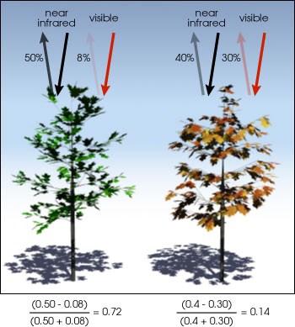
Calculating NDVI
Logic behind it:
Healthy vegetation absorbs most of the visible light that hits it and reflects a large portion of near-infrared light.
Unhealthy or sparse vegetation reflects more visible light and less near-infrared light.

Slide 8
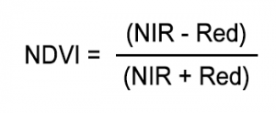
How is it Calculated?
Many different wavelengths make up the sunlight, when sunlight strikes an object, some wavelengths of the spectrum get reflected and some get absorbed. The pigment in plants leaves, named chlorophyll, strongly absorbs visible light (from 0.4 to 0.7 µm) for use in photosynthesis, while near-infrared lights (from 0.7 to 1.1 µm) get reflected. So NDVI can be calculated by taking the ratio of difference of absorbed and reflected light to the total light reaching the surface.
NDVI=

Slide 9
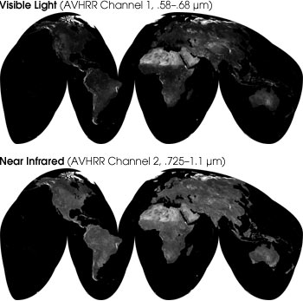
Satellites and Devices for NDVI
Satellites like Sentinel-2, Landsat and SPOT produce red and near-infrared images.
The NOAA AVHRR instrument is sensitive to the wavelengths of light ranging from 0.55–0.70 and 0.73–1.0 micrometers.
Using this, can measure the intensity of light coming off the earth in visible and near-infrared wavelengths. From these intensities, we can quantify the photosynthetic capacity of vegetation in a given pixel of the land surface. In general, if there is much more reflected radiation in near-infrared than in visible wavelength, then vegetation in that pixel is quite good. So in this way, we can calculate vegetation capacity for all pixels of an image to know the vegetation index of a land area.

Slide 10
Shortcomings of NDVI
NDVI was not designed to measure plant vigor. It was designed to simply detect living vegetation and distinguish it from other matter like rocks, soil, or dead vegetation.NDVI is loaded with potential errors and inaccuracies.
Its dependency on the time of day at which it takes images. As NDVI does not correct for changes in the angle at which sun shines on the leaves, NDVI produces very different results throughout the day even though the health of the vines has obviously not changed in just a couple of hours.
NDVI also produces inaccurate images due to a lot of factors like clouds, air moisture, shadow and variation in soil.

Slide 11
Enhanced Vegetation Index(EVI)
Enhanced Vegetation Index(EVI), as the name suggests, is an enhanced version of NDVI.
It was developed as an alternative vegetation index in order to address some of the limitations of NDVI. The EVI was specifically developed to :
Be more sensitive to changes in areas having high biomass.
Reduce the influence of atmospheric conditions on vegetation index values.
Correct for canopy background signals.

Slide 12

Calculating EVI
EVI is the same as NDVI but just a better version with fewer errors. So it is calculated with the same logic as of NDVI but to remove some errors, some additional wavelengths are added to it. EVI is calculated as:
where NIR, RED, and BLUE are atmospherically-corrected ( or partially atmospherically-corrected ) surface reflectances , and C₁ , C₂, and L are coefficients to correct for atmospheric condition (i.e., aerosol resistance). For the standard MODIS EVI product, L=1, C₁=6, and C₂=7.5.

Slide 13
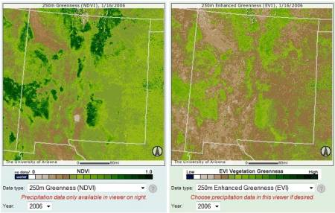
EVI VS NDVI
While the EVI is calculated similarly to NDVI, it corrects for some distortions in the reflected light caused by the particles in the air as well as the ground cover below the vegetation. The EVI data product also does not become saturated as easily as the NDVI when viewing rainforests and other areas of the Earth with large amounts of chlorophyll.
MODIS EVI (right) compared to NDVI (left) for a region over the same period. The NDVI image shows a greater area in dark green because NDVI loses sensitivity to changes in vegetation in areas of rainforest, higher biomass. The EVI image maintains a more consistent sensitivity to change in vegetation.

Slide 14
Satellites and Devices for EVI
With the launch of the two MODIS sensors on Terra (satellite) and Aqua in 1999, NASA adopted EVI as a standard MODIS product that is distributed by the USGS. MODIS will provide images over a given pixel of land just as often as AVHRR but in much finer detail and with measurements in a greater number of wavelengths using detectors that were specifically designed for measurements of land surface dynamics.
(MODIS is a sensor that provides much higher spatial resolution)

Slide 15
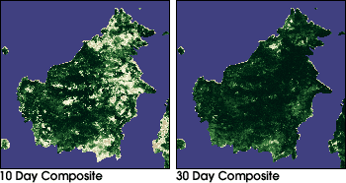
MODIS Vegetation Index Product
Neither NDVI nor EVI products can eliminate all obstacles. Clouds and aerosols can often block the satellites’ view of the surface entirely, direct rays from the sun can sometimes saturate certain pixels and sometimes disturbance in the satellite itself can distort an image.
So long term averages of vegetation data are taken to help remove as much error as possible. The below pair of images shows the difference between long term avg. and short term avg.

Slide 16
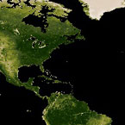
MODIS vegetation indices , produced on 16-day intervals and at multiple spatial resolutions, provide consistent spatial and temporal comparisons of vegetation canopy greenness, a composite property of leaf area, chlorophyll and canopy structure. Two vegetation indices are derived from atmospherically corrected wavelengths in red, near-infrared (NDVI) and blue wavelength (EVI).
The Normalized Difference Vegetation Index (NDVI) , which provides continuous data using NOAA's AVHRR record for historical and climate applications and the Enhanced Vegetation Index (EVI ) , which minimize canopy soil variation and improves sensitivity over dense vegetation regions. The two products more effectively characterize the global range of vegetation states.

Slide 17
The vegetation indices are retrieved daily from atmosphere corrected, bidirectional reflection from the surface. MODIS uses a method based on quality assurance metrics to remove low-quality pixels. From the remaining good quality VI values, a constrained view angle approach then selects a pixel to represent the compositing period (from the two highest NDVI values it selects the pixel that is closest-to-nadir). Because the MODIS sensors aboard Terra and Aqua satellites are identical, the VI algorithm generates each 16-day composite eight days apart (phased products) to permit a higher temporal resolution product by combining both data records. The MODIS VI product suite is now used successfully in all ecosystems, climate, and natural resources management studies and operational research as demonstrated by the ever-increasing body of peer publications.

Slide 18
Data Collection (NDVI and EVI)
Google Earth Engine(GEE)
Google earth engine is a planetary-scale platform for Earth science data & analysis.It is powered by Google’s cloud infrastructure.Google earth engine is used for collecting High resolution of satellite data for modelling. It is the most advanced cloud-based geospatial processing platform in the world. The easily accessible and user-friendly front-end provides a convenient environment for interactive data and algorithm development.
Google Earth Engine is used in this project to collect the satellite data from different regions of Gujarat at different durations. GEE has large dataset archives which were used for NDVI and EVI data collection .The code in the GEE code editor is written in javascript.

Slide 19
Main Components of GEE
Datasets: Google Earth Engine has Ready-to-Use Datasets .The public data archive includes more than thirty years of historical imagery and scientific datasets which are updated daily. It contains over twenty petabytes of geospatial data available for analysis.
APIs: The Earth Engine API is available in Python and JavaScript, making it easy to harness the power of Google’s cloud for your own geospatial analysis.
Code Editor: The code editor is an online Integrated Development Environment (IDE) for rapid prototyping and visualization of complex spatial analyses using the Javascript API.

Slide 20
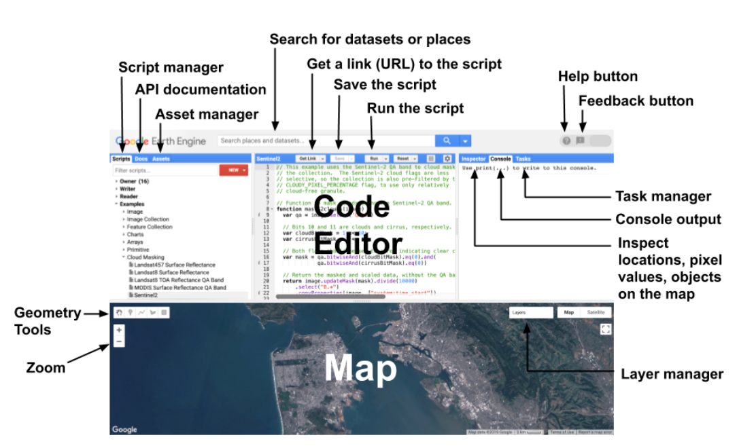
Image of Code Editor

Slide 21
Dataset used in this Study
MODIS(MODERATE RESOLUTION IMAGING SPECTRORADIOMETER)
The Moderate Resolution Imaging Spectroradiometer (MODIS) sensors on NASA's Terra and Aqua satellites have been acquiring images of the Earth daily since 1999, including daily imagery, 16-day BRDF-adjusted surface reflectance, and derived products such as vegetation indices and snow cover

Slide 22
1) MYD13A1.006 Aqua Vegetation Indices 16-Day Global 500m (MODIS)
This Dataset is used for NDVI and EVI data collection is
MYD13A1.006 Aqua Vegetation Indices 16-Day Global 500m (MODIS)
Dataset Availability - 2002-07-04T00:00:00 - Present
Dataset Provider - NASA LP DAAC at the USGS EROS CENTER
Resolution - 500 meters
Time Frame - 1 January 2010- 30 August 2019
(Used for this project)

Slide 23
The MYD13A1 V6 product provides a Vegetation Index (VI) value at a per pixel basis. There are two primary vegetation layers:
The first is the Normalized Difference Vegetation Index (NDVI) which is referred to as the continuity index to the existing National Oceanic and Atmospheric Administration-Advanced Very High Resolution Radiometer (NOAA-AVHRR) derived NDVI.
The second vegetation layer is the Enhanced Vegetation Index (EVI) that minimizes canopy background variations and maintains sensitivity over dense vegetation conditions. The EVI also uses the blue band to remove residual atmosphere contamination caused by smoke and sub-pixel thin cloud clouds. The MODIS NDVI and EVI products are computed from atmospherically corrected bi-directional surface reflectances that have been masked for water, clouds, heavy aerosols, and cloud shadows.

Slide 24
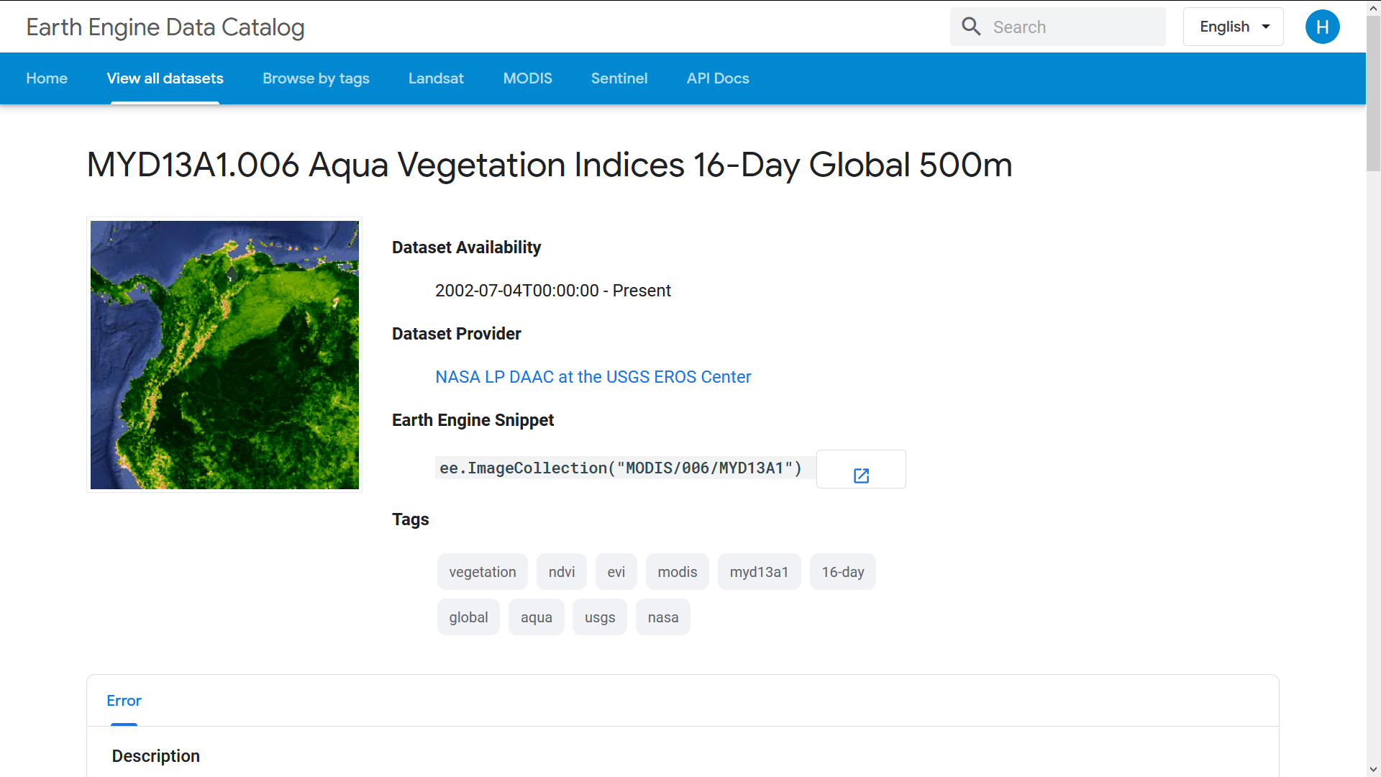
Image of Earth Engine Data Catalog

Slide 25
2) MOD11A2.006 Terra Land Surface Temperature and Emissivity 8-Day Global 1km
The MOD11A2 V6 product provides an average 8-day land surface temperature (LST) in a 1200 x 1200 kilometer grid. Each pixel value in MOD11A2 is a simple average of all the corresponding MOD11A1 LST pixels collected within that 8 day period. The 8 day compositing period was chosen because twice that period is the exact ground track repeat period of the Terra and Aqua platforms.
This Dataset is used for the collection of Temperature Data.

Slide 26
MOD11A2.006 Terra Land Surface Temperature and Emissivity 8-Day Global 1km
Dataset Availability - 2000-03-05T00:00:00 - Present
Dataset Provider - NASA LP DAAC at the USGS EROS CENTER
Resolution - 1000 meters
Time Frame - 1 January 2019- 1 January 2020
(Used for this project)

Slide 27
3) TRMM 3B43: Monthly Precipitation Estimates
This dataset algorithmically merges microwave data from multiple satellites, including SSMI, SSMIS, MHS, AMSU-B and AMSR-E, each inter-calibrated to the TRMM Combined Instrument.
Algorithm 3B43 is executed once per calendar month to produce the single, best-estimate precipitation rate and RMS precipitation-error estimate field (3B43) by combining the 3-hourly merged high-quality/IR estimates (3B42) with the monthly accumulated Global Precipitation Climatology Centre (GPCC) rain gauge analysis.
This Dataset is used for the collection of Precipitation Data.

Slide 28
TRMM 3B43: Monthly Precipitation Estimates
Dataset Availability - 1998-01-01T00:00:00 - Present
Dataset Provider - NASA GSFC
Resolution - 0.25 arc degrees
Time Frame - 1 January 2019- 1 January 2020
(Used for this project)

Slide 29
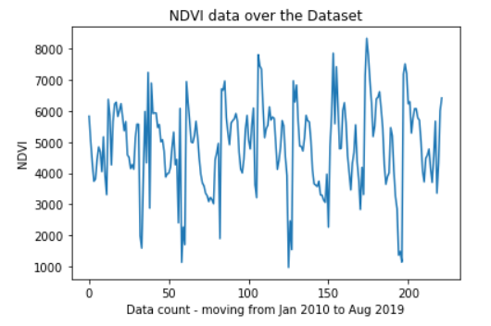
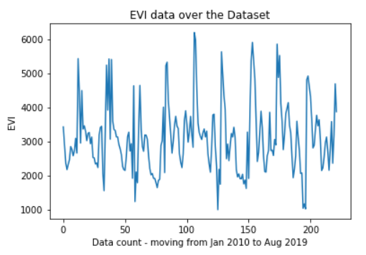
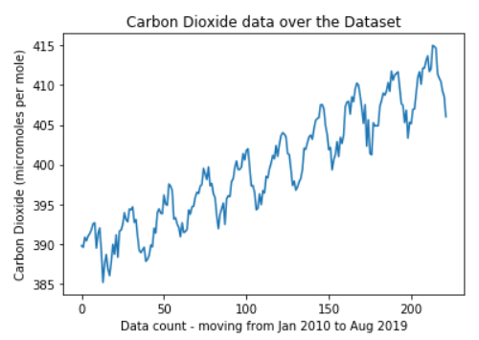
Trends of CO₂ and NDVI and EVI in yearly data:
Notes:
Which month do you think CO2 increase the most??

Slide 30
OBSERVATION:
From the above-mentioned graphs, we can observe that as the value of CO₂ increases as the value of NDVI and EVI decrease.
CONCLUSION:
As the value of NDVI or EVI increases, we can tell that the state of plant health in that region is quite good. If the state of plant health is good then we can safely say that the chlorophyll levels are quite high, which means that the process of Photosynthesis can be carried out in a more effective way. Due to more effective Photosynthesis the CO₂ is consumed, which can be seen in the bottom-most graph above.

Slide 31
Trends of CO₂ and NDVI and EVI in Whole Data-set:

Slide 32
OBSERVATION:
We observe that the extremum values(maximum and minimum) of NDVI and EVI don’t change in a year, whereas the values of CO₂ have a step function-esque shape.
CONCLUSION:
From this we can say that CO₂ can’t be solely predicted by NDVI and EVI, because they don’t produce the change which makes CO₂ climb. But we can surely say that the NDVI and EVI data of one year and corresponding levels of CO₂ may have a relation from our last conclusion (for the topic ‘Trends of CO₂ and NDVI and EVI in Whole Data-set’). Therefore, we can conclude that NDVI and EVI aren’t the only factors affecting the CO₂ levels, and we can also conclude at the same time that NDVI and EVI values do affect CO₂ levels.

Slide 33
Exploring Relationship Between NDVI & EVI with Carbon Dioxide Using Machine Learning:
We develop a Machine Learning model using the
Polynomial Regression algorithm.

Slide 34
Brief Overview of Machine Learning and Polynomial Regression
According to Wikipedia, Machine learning is the study of computer algorithms that improve automatically through experience. We create such algorithms to help the computer learn by analyzing pre-recorded data.
Here, for our research question, we will use a Machine Learning technique known as Polynomial Regression.
Polynomial Regression is a machine learning method in which the dependent variable is represented as a polynomial function of independent variables.
The degree of Polynomial Regression is the highest degree of the individual terms of the polynomial. For example, (A + B*X) has degree 1, (A + B*X + C*X^2) has degree 2, and so on. (X is the variable.)

Slide 35
Datasets Used
Training Set: Data available from January 2010 to August 2019. Frequency 32 days.
Test Set: Data available from Jan 2010 to August 2019. The frequency of data is 32 days.
The testing set contains data of 16 days after each day in the training set. For example, if January 9, 2010, is in the Training set, then January 25, 2010, is in the Testing set.
Region: Gujarat

Slide 36
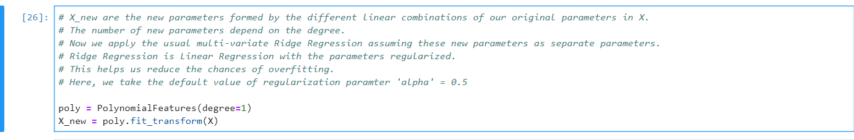
We will start with Polynomial Regression with Degree 1. This is also known as Linear Regression.
Once we have created a PolynomialFeatures object and transformed our original parameters, we create RidgeRegression objects (1 for each coordinate point).
We then train the model (fit the data). Using this, we predict the values of Carbon Dioxide (dependent variable).
Once we have the predicted values, we evaluate the performance of our model. We do this in two ways, through graphs (qualitative) and R-squared score and MSE (quantitative).

Slide 37
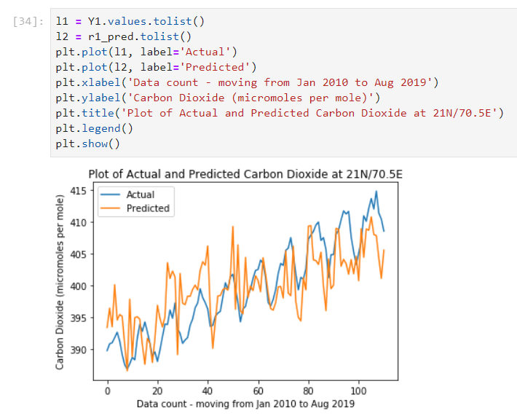
This image shows us the plot for the Training set.

Slide 38
Understanding Quantitative Measures
R-squared score: R^2 is a measure of how close the data is to the fitted regression curve. Higher the absolute value of R^2 (till 1), better is the model.
MSE (Mean Square Error): The mean of the squares of errors, i.e., the difference between the actual value and predicted value. Lower the MSE, better is the model.

Slide 39
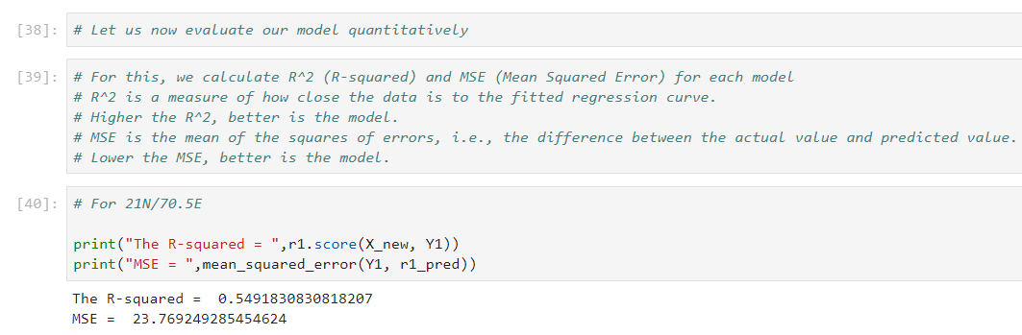
R-squared score and MSE for Training set.

Slide 40
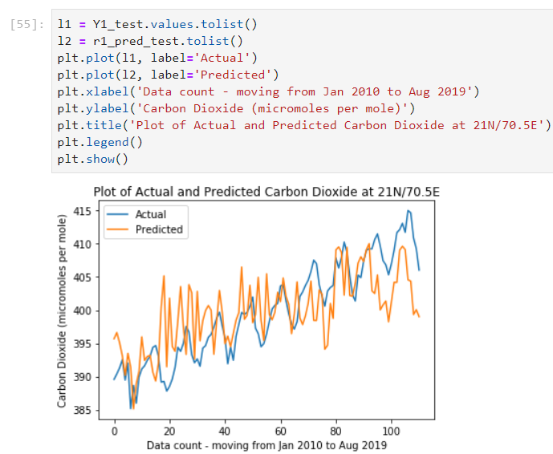
This image shows us the plot for the Testing set.

Slide 41
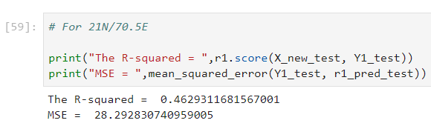
R-squared score and MSE for Testing set.

Slide 42
We can further increase the degree and create new models but, we observe that for our dataset, this leads to overfitting. Overfitting occurs when our model does very well in the training set but very bad in the test set. To avoid this, we do not increase the degree.

Slide 43
Kriging
Kriging is a method of interpolation for which the interpolated values are modeled by a Gaussian process governed by prior covariances. Under suitable assumptions on the priors, kriging gives the best linear unbiased prediction of the intermediate values.
We used kriging to determine the values of CO₂ at other locations (other than the 4 given coordinates) whose data was not predicted by our machine learning model. We used a Gaussian model for the same.
We used kriging here because CO₂ values do not change very erratically. So, with values CO₂ levels at 4 coordinates in Gujarat, we predicted values of other 89996 coordinates.

Slide 44
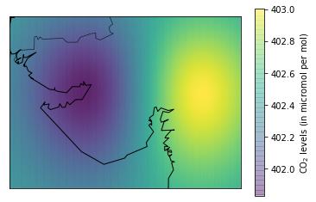
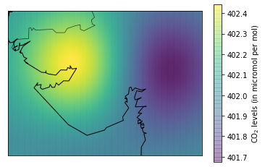
After obtaining the predicted data of carbon dioxide from our model for 4 coordinates (21N/70.5E, 23N/70.5E, 21N/73.5E, and 23N/73.5E), we use the Kriging method, to interpolate the values of carbon dioxide for the entire region of Gujarat.
The obtained values, after Kriging, are plotted on the above maps. These maps represent the Carbon Dioxide value for the entire region of Gujarat.

Slide 45
Exploring Relationship Between NDVI & EVI with Precipitation and Temperature:
The following graphs are plots of values of NDVI, EVI, Precipitation, and Land Surface Temperature for the Year 2019:

Slide 46
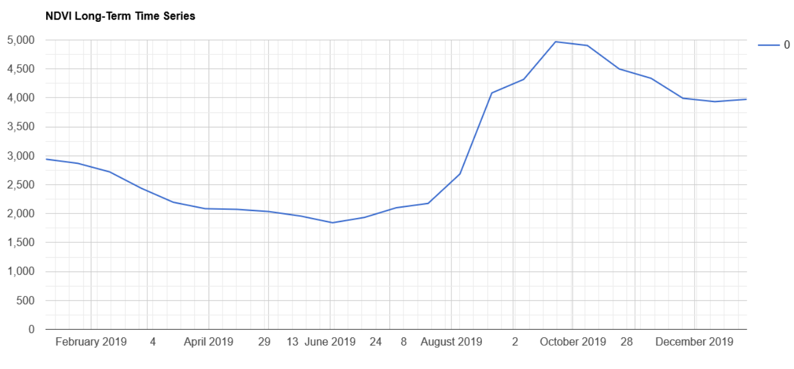
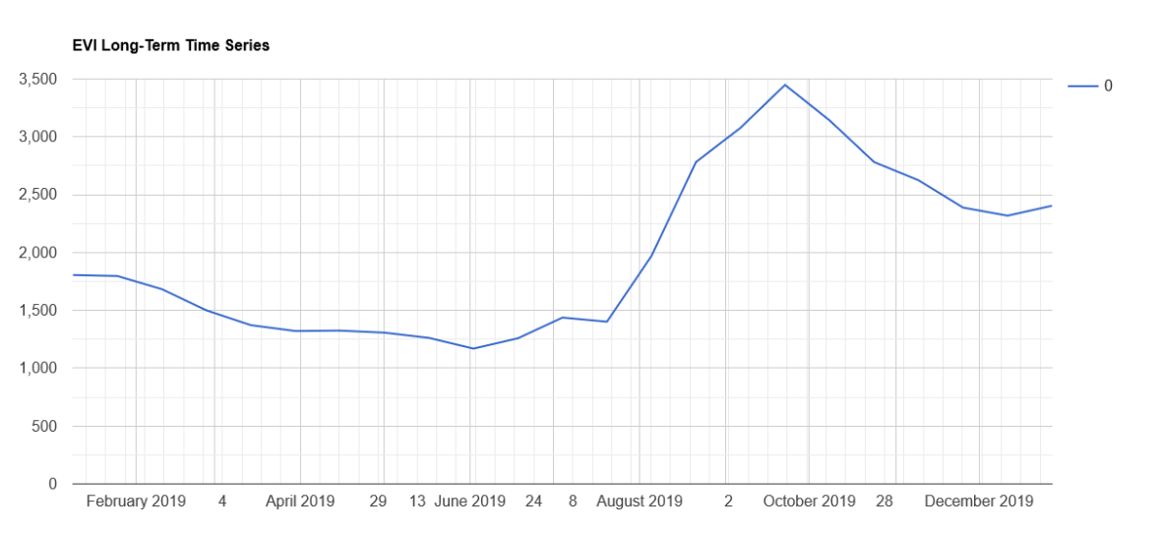

Slide 47
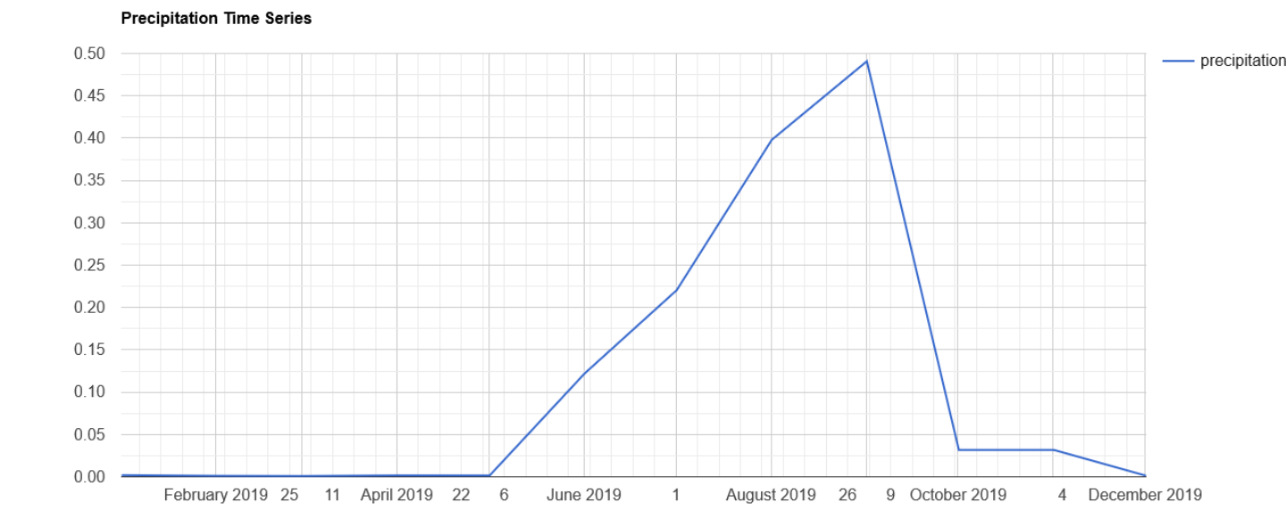
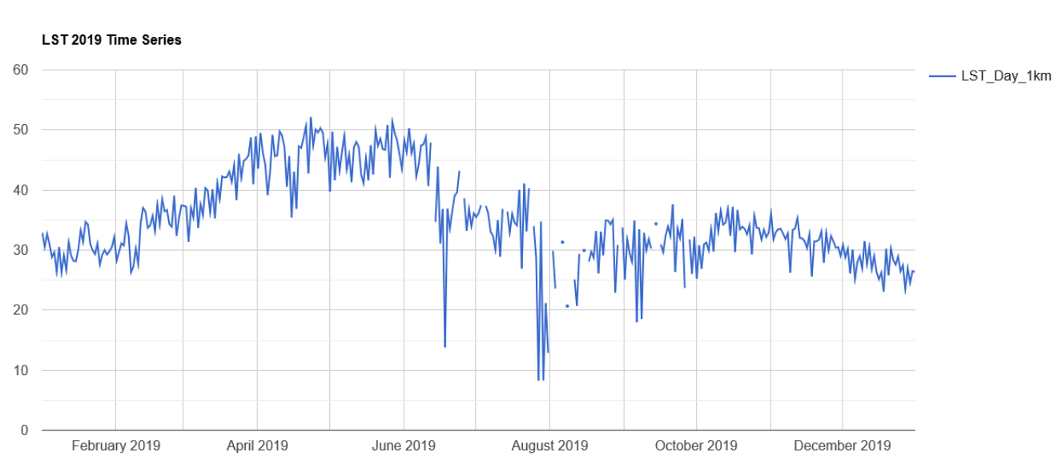

Slide 48
Observation 1 : NDVI, EVI, and Precipitation increase as the months July/ August approach. They continue to rise till October. This period, in India, is known as the monsoon season.
Conclusion 1 : NDVI and EVI, the phenological factors, denote the flourish of vegetation. In the monsoon season, when precipitation is high, plants are well-irrigated and their growth increases. This leads to an increase in the values of NDVI and EVI.
Observation 2 : As temperature increases, to some extent, NDVI and EVI also increase.
Conclusion 2 : When temperature increases, plants perform better photosynthesis. This eventually leads to increased consumption of carbon dioxide, reducing its amount in the atmosphere. Increased photosynthesis leads to better growth of vegetation, which in turn increases phenological factors, NDVI and EVI. Although, we must note that there is a saturation point of temperature, beyond which photosynthesis reduces.

Slide 49
Exploring Relationship Between NDVI & EVI with Temperature Using Machine Learning:
We develop a Machine Learning model using the Polynomial Regression algorithm with Degree 5.

Slide 50
Dataset Used
Training Set : Data available from January 2018 to December 2018.
Frequency 30 days.
Test Set : Data available for March 14, 2019
Region : Ahmedabad-Gandhinagar

Slide 51
How was the Data Scaled?
The entire data was scaled such that the mean of each variable becomes 0 and Standard Deviation (S.D.) becomes 1.
This is achieved by the preprocessing.scale() function from sklearn preprocessing library.
Let us know look at the results obtained by running our model.

Slide 52
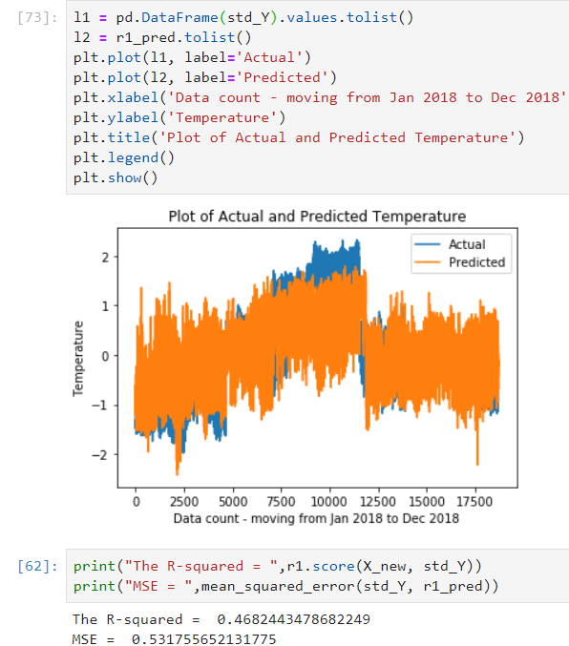
This image shows us the plot and accuracy score for the Training set.

Slide 53
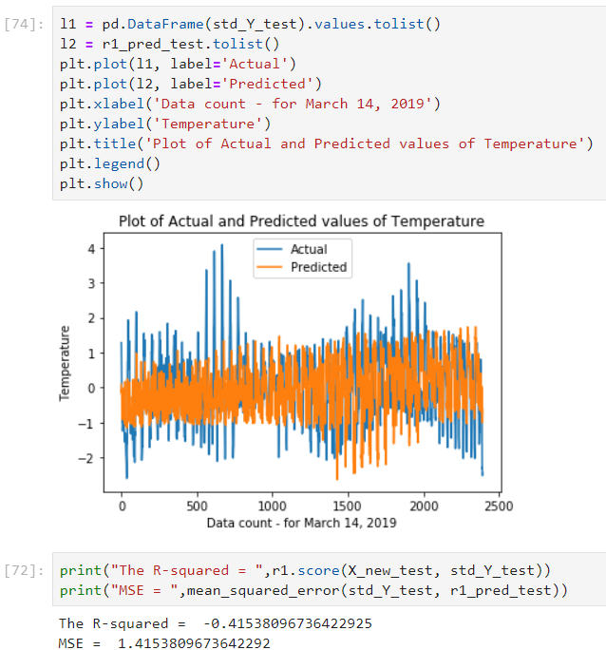
This image shows us the plot and accuracy score for the Testing set.

Slide 54
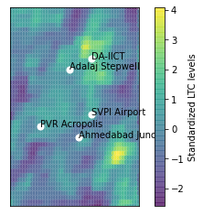
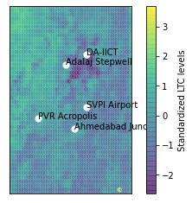
The above two images (left to right) show the real and predicted values of
standardized LTC values of 23 March 2019, respectively
OBSERVATION: The predicted values of many areas is close to the real ones. We also observe that many areas which had higher LTC values weren’t predicted correctly.

Slide 55
THE END

