Slide 1
McDA’s
Group 31
Canteen Automation
Mentor: Prof. Saurabh Tiwari Mentor TA: Ami Pandat

Slide 2

McDA’s
Problem Statement
Problem Statement
A technique for ordering food online applicable in any food delivery industry.
The main advantage of this system is that it greatly simplifies the ordering process for both, the customer and the canteen.
When the customer visits the ordering webpage, they are presented with an interactive and up-to-date menu, complete with all available options and dynamically adjusting prices based on the selected options.
After making a selection, the item is then added to their order, which the customer can review the details of at any time before checking out.
This provides instant visual confirmation of what was selected and ensures that items in the order are, in fact, what was intended.

Slide 3

McDA’s Interface
USER SIDE:
Web Interface for Canteen Owners/Users
User Can order food anywhere from campus and Owner will get real time update.
User will be updated with estimated time for order of food.
Canteen will have to proceed with the orders listed in our web app to increase the delivery speed.
Canteen owners can set the Food items of the day to show the users.
User will be shown the most related food items that matches to their taste, So user can easily find out the food item he/she want to eat- ML Part
ADMIN SIDE
Graphical Visualization for the data on financial profits concerning different food products. So as to do decide which combination gets you the most profit.

Slide 4

Functional Requirements:-
Canteen Owners:
Canteen Owners should get the real time orders.
Canteen Owners should be given the food items in some order to be cooked so that delivery time is reduced.
Canteen owners can see the list of pending, processing and delivered orders in a GUI so that they can improve their efficiency accordingly with add, update and delete.
New food articles can be added, while old ones can be deleted. Canteen Owners should be able update the food item available in the canteen.
Owners can easily change which items will be displayed to the users based on availability and automatically if the items are fixed according to the time of the day.
Owners can change the description and image of the food article whenever needed
Canteen owners can see the average rating of their food and also the average rating of that day.

Slide 5

Functional Requirements
Canteen Users:
Users can create, manage, log into their accounts.
Customers of the canteen should order food from any of the canteens.
Customers shall be notified after confirmation of order, and get real time updates when food is arrived or about to be prepared. Users will receive order confirmation along with estimated cooking time.
At the time of delivery or pickup the customer needs to prove his/her identity, for that they will be provided some code or QR code at the time of order.
Customers should be able to review the food and the canteen. - Customers should be able to see the status of their orders.
Customers can choose room delivery or pickup from the canteen option.
Customers should get E-menus for every canteen.

Slide 6

Functional Requirements
Users can give advanced orders for food for any time of the day. Will add a feature to set reminders to the Counters for the same.
The user will be able to customize or decide for themselves how and what they want to add to their order/ food.
Sales for each day and month so that recommendations can be optimised. Predict items most frequently during specific hours.
Account Book to keep a record of the due payments. The money will be automatically deducted at the end of the Month if the user enables the facility.
Paying money regularly may be a hassle for some, so we will provide a feature of accounting in which the transactions will be recorded and money will automatically be deducted at the end of the Month or as the counter owners demand.

Slide 7

Non-Functional Requirements
Users should Access the system using the secret token provided. So a Canteen owner should not have access to the data of total users, and vice versa for users.
Payments will be through a secure portal.
Users will not have to wait for too long for their food to be prepared(Estimated time), The database should be able to handle multiple and simultaneous users.
There will be 5000 requests supported for a day.
The service will be available for the duration of the entire day.
Since different types of people will interact with this process so our project should be very easy for them to understand. Users can navigate through pages of application.

Slide 8

Cross-platform portability should be implemented independent of the OS or device.
It should be convenient for people who have limited time and faster than physically ordering the food.
There will be atomicity in every transaction.
Graphical Visualization for the data on financial profits concerning different food products.
Limited Access for festival counters and customers.
Full Version Here

Slide 9

Elicitation Techniques
Brainstorming
A meeting was held and different ideas were heard out and expressed in the form of a healthy discussion.
The main Features of the application were kept.
The main issues/ hurdles were identified and tasks were assigned accordingly
Use Cases
We did use case modelling to understand how different components will interact with each other and their responses in accordance with the requirements
Analysis of existing systems
We looked up for existing systems and went through their SRS and other documentation to get a better idea about the requirements
Interviewing/ Questionnaires
We internally conducted surveys of our friends and family to better understand the needs and functionalities.

Slide 10

StakeHolders and Users
The Following are the Stakeholders and Users of this application:
Canteen Staff: [User, Actor]
Customers: [User,Actor]
Admin: [User,Actor]
Tracker Database: [Actor]
Payment Gateway: [Actor]

Slide 11
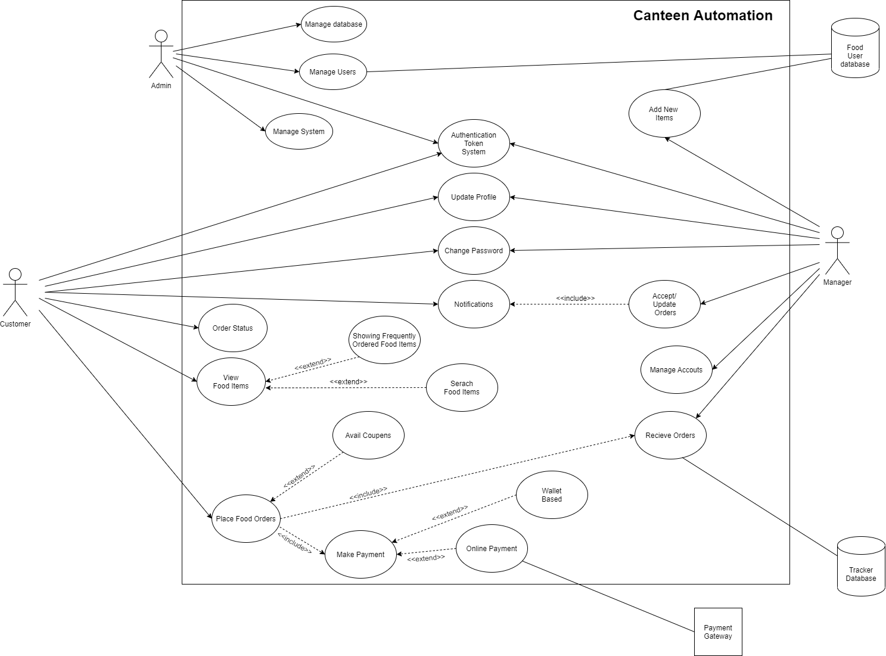
Use Case Model
Use Cases
Login
Place Order
Search Product
Manage Food Items
Update Profile
Make Payment
Order Status
Full Version Here

Slide 12

Future Prospects
We further plan to implement for the users / customers to be able to edit their orders, as in, add / remove items from their present order.
We also plan to implement a coupon feature, where users may avail to some discounts through these coupon codes, as provided by the owner.
More Reliable and Scalable System for Actual Use
Improvement in Algorithm of Ordering Food items on the owner side. Which will help speedup the delivery process.

Slide 13
Activity Diagram
See Here👈

Slide 14

Contributions
Hemang Nakarani - 201801158 | Leader, Project Manager Management of Infrastructure and Deployments Frontend/Backend Development and Documentation.
Shantanu Tyagi - 201801015 | Database Model and Schema Development Development of Backend APIs and Documentation
Harshil Joshi -201801022 | Database Model and Schema Development Requirements Elicitation and Documentation
Sudhanshu Mishra - 201801114 | UI-UX Interface and Graphics Designing Development of UI Framework and Documentation
Yash Shah - 201801131 | Front-End Development and Documentation Login and Signup Page Implementation

Slide 15
Contd...
Dharmin Hirapara - 201801135 | Front-End Development and Routing Setup Cart-Page and Its functionality Implementation
Sudarshan Kundnani - 201801140 | Front-End Development Developed and Implemented User-Profile Page Managing Assignments and Documents
Urvish Pandya - 201801170 | Requirements Elicitations Developed Use Case Model, Working on Front-End Part
Srinivas Talnikar - 201801406 | Front-End Development, Routing Setup Implemented Canteens Page and Development of Use-Case Model
Kiran Ravuri - 201801421

Slide 16

Assets Links
Source Codes:
Front End: https://github.com/HemangNakarani/31-Project-Canteen-Frontend
Back End: https://github.com/HemangNakarani/Project-Canteen-Backend
Deployed Applications:
Front End: https://canteenia.netlify.app/
Back End: http://canteeniaserverebs-env-1.eba-j4itp8q3.ap-south-1.elasticbeanstalk.com/

