Slide 1

Blockchain Based Secure Donation Platform Domain: Cyber Security
Final Review
Course Code: CS7610
Course Title: Capstone Project
Register Number: 24MSP3045
Name: Shantanu Vartak
Date:20/06/25

Slide 2
Abstract
Donate Now is a decentralized donation platform leveraging blockchain technology to ensure secure, transparent, and tamper-proof charitable contributions. Built using Solidity smart contracts and integrated with MetaMask for Ethereum transactions, the platform allows donors to fund verified campaigns directly from their wallets. An admin verifies campaigns and organizers, while smart contracts automate fund collection and release, enhancing trust and accountability. The application features real-time progress tracking, JWT-based authentication, and robust role-based access control. By combining blockchain transparency with user-friendly design, Donate Now aims to revolutionize digital philanthropy through innovation, integrity, and decentralized trust.

Slide 3
Introduction
With the rapid evolution of decentralized technologies, blockchain has emerged as a groundbreaking solution in many domains, including finance, healthcare, and now — philanthropy. Traditional donation systems suffer from a lack of transparency, slow fund processing, and minimal donor engagement post-contribution. Donate Now introduces a transparent, immutable, and decentralized way to contribute to charitable causes using cryptocurrency (ETH), empowering both organizers and donors with verifiable, trustless infrastructure.

Slide 4
Need of study
Lack of Transparency: Many traditional donation platforms fail to show how funds are used or where they go.
Security Concerns: Centralized platforms are prone to data breaches and fund mismanagement.
Verification Issues: Not all campaigns are genuine, leading to scams and donor hesitation.
Delayed Fund Access: Organizers often face delays in receiving the donations due to bureaucratic processes.

Slide 5
Problem Statement
Traditional fundraising and donation platforms lack accountability, transparency, and often pose security risks. This leads to donor distrust, misuse of funds, and loss of potential contributions. There is a need for a decentralized solution that ensures donations are secure, traceable, and only reach verified causes and recipients.

Slide 6
Objectives
✅ To develop a secure and decentralized platform for donations using Ethereum smart contracts.
✅ To allow users (donors and organizers) to interact with the platform via MetaMask.
✅ To integrate role-based authentication using JWT tokens.
✅ To enable real-time donation tracking and campaign progress monitoring.
✅ To ensure admin-level moderation for verifying and approving campaigns before they go live.
✅ To implement secure, conditional fund releases upon meeting campaign goals.

Slide 7
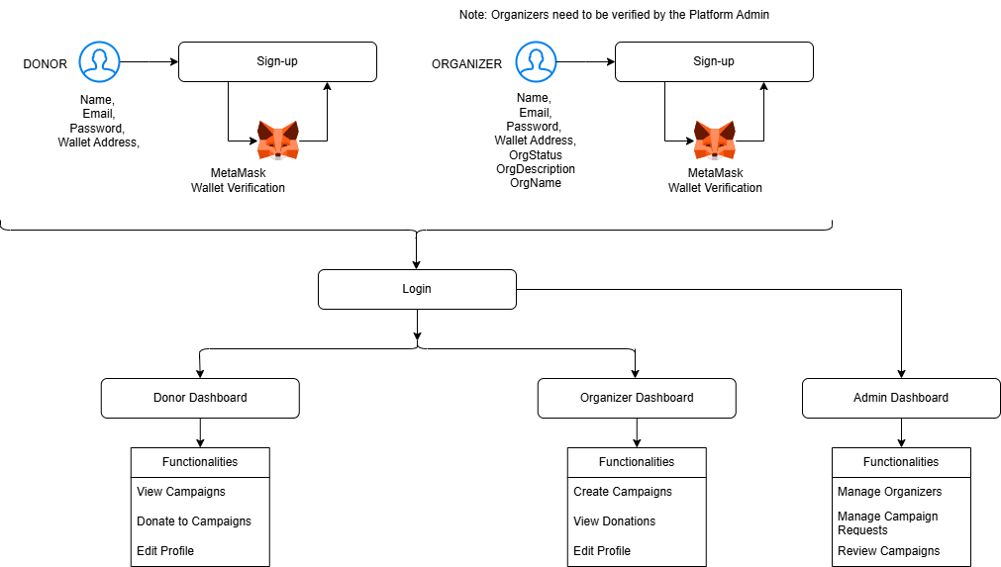
Proposed Methodology

Slide 8
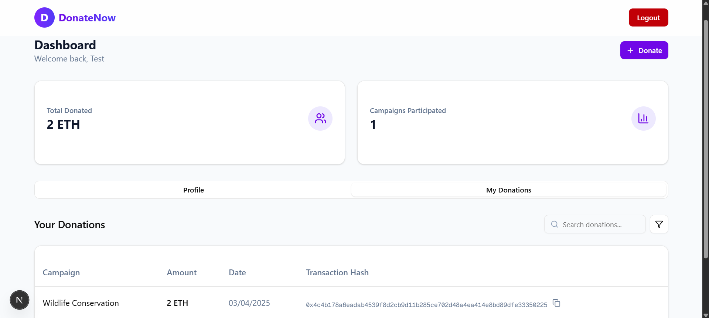
Implementation – Donor Dashboard

Slide 9
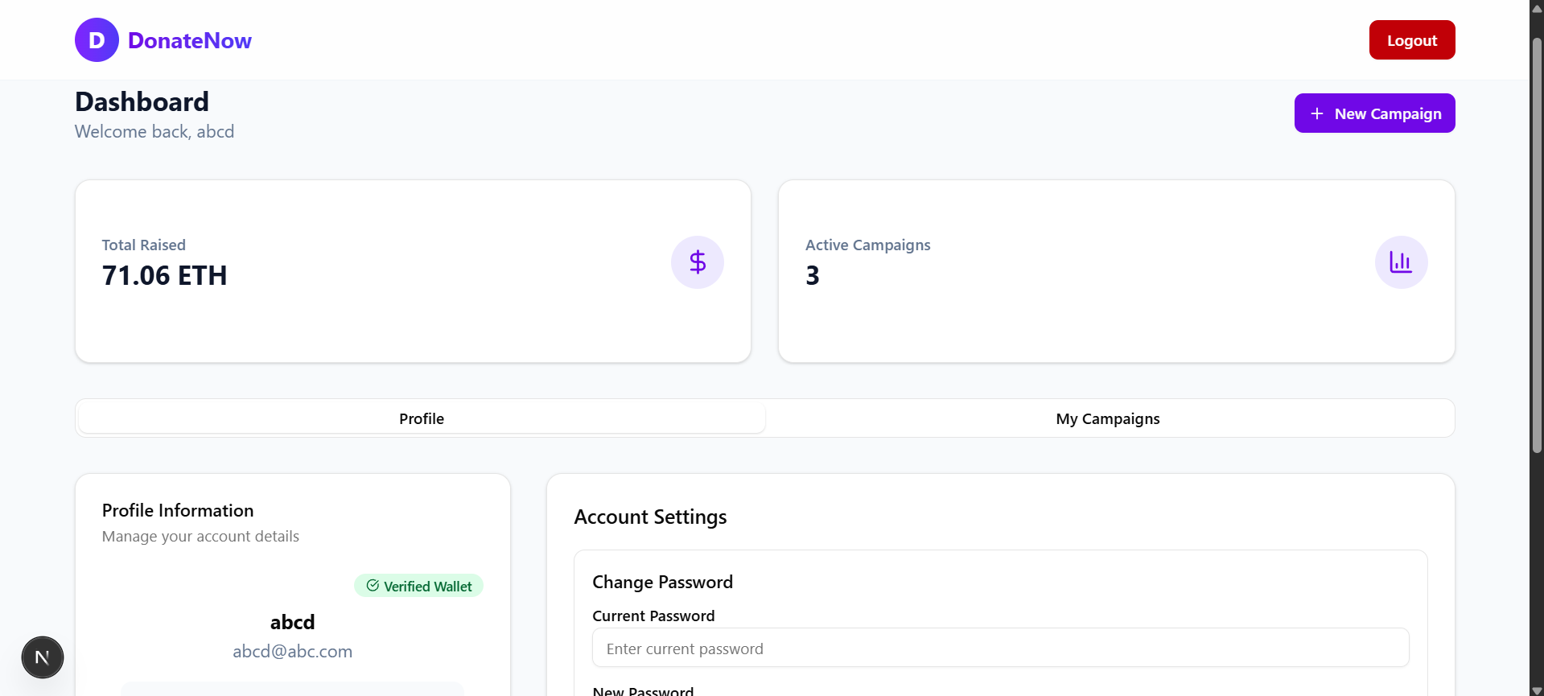
Implementation – Organizer Dashboard

Slide 10
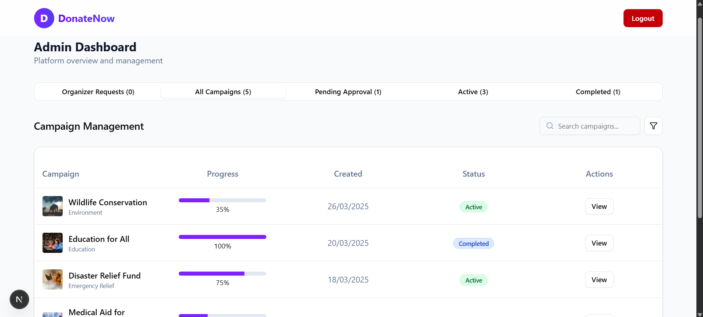
Implementation – Admin Dashboard

Slide 11
Technology / Tools
Solidity – DAPPS Development
Ganache – Local Eth Testnet
VSCode – IDE
HTML, CSS, NextJS– Frontend
NodeJS, ExpressJS, Prisma ORM – Backend
MongoDB – Database
RBAC using JWT Authentication
Metamask Integration for Wallet Validation

Slide 12
Future Enhancement
⚙️ Multi-Currency Support: Add support for other cryptocurrencies like BTC, USDT.
🔐 Zero-Knowledge Proofs (ZKPs): For privacy-preserving donations.
📱 Mobile App Integration: Build an Android/iOS version for greater accessibility.
📊 Advanced Analytics Dashboard: For both donors and organizers to track impact.
🌍 Globalization: Add support for multiple languages and local fiat conversions.

Slide 13
Conclusion
Donate Now is a step toward transforming digital philanthropy. By integrating blockchain with traditional donation workflows, this platform brings unmatched security, transparency, and efficiency to charitable contributions. Through smart contracts, every transaction is verifiable and irreversible, instilling greater confidence among donors. The project not only simplifies giving but also ensures that every coin counts, reaching the right cause at the right time, thereby making a meaningful impact.

Slide 14
References : APA format
Base Paper:
Swati, J., Nitin, P., Saurabh, P., Parikshit, D., Gitesh, P., & Rahul, S. (2022). Blockchain based Trusted Secure Philanthropy Platform: Crypto-GoCharity. 2022 6th International Conference On Computing, Communication, Control And Automation (ICCUBEA, 1–8. https://doi.org/10.1109/ICCUBEA54992.2022.10011026
Paper I:
(PDF) Blockchain-Based Decentralized Application: A Survey. (2024). ResearchGate. https://doi.org/10.1109/OJCS.2023.3251854
Paper II:
(PDF) Blockchain-Based System for End-to-End Donations Monitoring. (n.d.). ResearchGate. https://doi.org/10.1109/ACIT58888.2023.10453793
Paper III:
Singh, A., Rajak, R., Mistry, H., & Raut, P. (2020). Aid, Charity and Donation Tracking System Using Blockchain. 2020 4th International Conference on Trends in Electronics and Informatics (ICOEI)(48184), 457–462. https://doi.org/10.1109/ICOEI48184.2020.9143001

