Slide 1

Blockchain Based Secure Donation Platform Domain: Cyber Security
First Review
Course Code: CS7610
Course Title: Capstone Project
Register Number: 24MSP3045
Name: Shantanu Vartak
Date:06/06/25

Slide 2
Problem Statement
Traditional fundraising and donation platforms lack accountability, transparency, and often pose security risks. This leads to donor distrust, misuse of funds, and loss of potential contributions. There is a need for a decentralized solution that ensures donations are secure, traceable, and only reach verified causes and recipients.

Slide 3
Objectives
✅ To develop a secure and decentralized platform for donations using Ethereum smart contracts.
✅ To allow users (donors and organizers) to interact with the platform via MetaMask.
✅ To integrate role-based authentication using JWT tokens.
✅ To enable real-time donation tracking and campaign progress monitoring.
✅ To ensure admin-level moderation for verifying and approving campaigns before they go live.
✅ To implement secure, conditional fund releases upon meeting campaign goals.

Slide 4
Review of Related Literature
Base Paper:
Swati, J., Nitin, P., Saurabh, P., Parikshit, D., Gitesh, P., & Rahul, S. (2022). Blockchain based Trusted Secure Philanthropy Platform: Crypto-GoCharity. 2022 6th International Conference On Computing, Communication, Control And Automation (ICCUBEA, 1–8. https://doi.org/10.1109/ICCUBEA54992.2022.10011026
Paper I:
(PDF) Blockchain-Based Decentralized Application: A Survey. (2024). ResearchGate. https://doi.org/10.1109/OJCS.2023.3251854
Paper II:
(PDF) Blockchain-Based System for End-to-End Donations Monitoring. (n.d.). ResearchGate. https://doi.org/10.1109/ACIT58888.2023.10453793
Paper III:
Singh, A., Rajak, R., Mistry, H., & Raut, P. (2020). Aid, Charity and Donation Tracking System Using Blockchain. 2020 4th International Conference on Trends in Electronics and Informatics (ICOEI)(48184), 457–462. https://doi.org/10.1109/ICOEI48184.2020.9143001

Slide 5
Open-Source Tools and Techniques
Solidity – DAPPS Development
Ganache – Local Eth Testnet
VSCode – IDE
HTML, CSS, NextJS– Frontend
NodeJS, ExpressJS, Prisma ORM – Backend
MongoDB – Database
RBAC using JWT Authentication
Metamask Integration for Wallet Validation

Slide 6
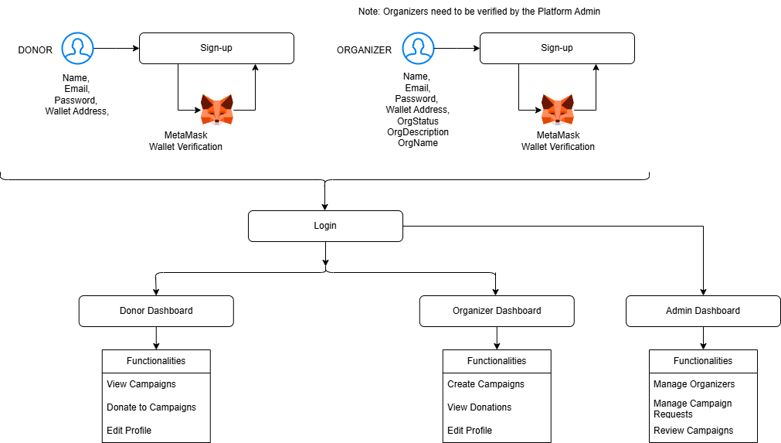
Proposed Methodology

Slide 7
Conclusion
Donate Now is a step toward transforming digital philanthropy. By integrating blockchain with traditional donation workflows, this platform brings unmatched security, transparency, and efficiency to charitable contributions. Through smart contracts, every transaction is verifiable and irreversible, instilling greater confidence among donors. The project not only simplifies giving but also ensures that every coin counts, reaching the right cause at the right time, thereby making a meaningful impact.

Slide 8
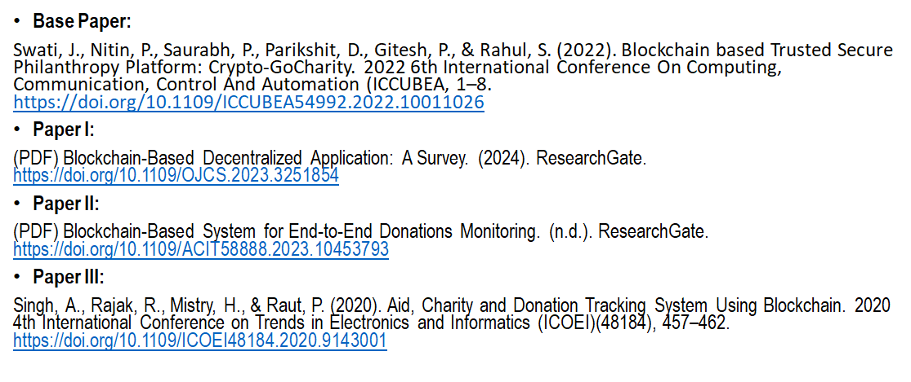
References : APA format

