Slide 1
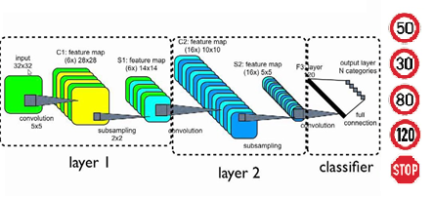
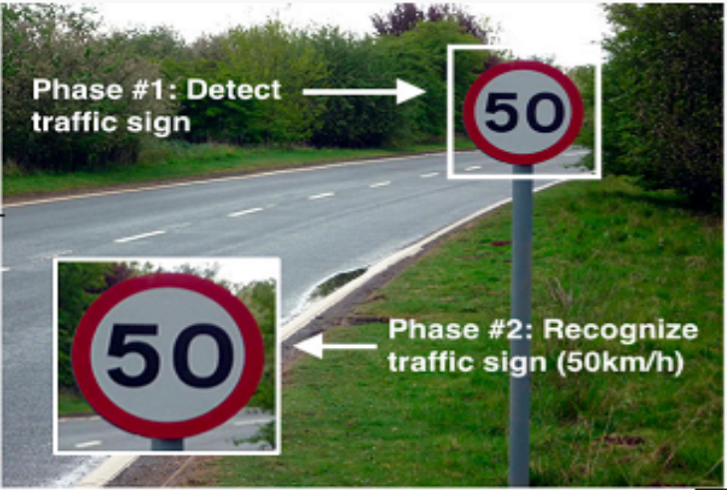
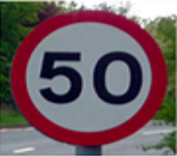



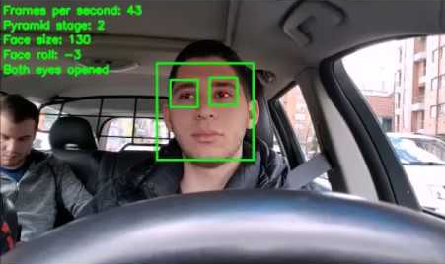



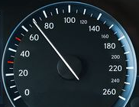


1. CNN to classify traffic signs
2. Detect and classify traffic signs
from live video feed
3. Image processing –
Grayscale and Binarization
7. Warning or alert to
the driver
6. Drowsiness detection
by monitoring blink rate
and eye position
5. Compare detected
speed and actual
speed
4. Apply OCR

