Slide 1
ZF SPORTIFY
Team: Alpha hackz
Your one-stop solution all types of sports Booking and events / Tournament updates
alpha_hackz_20
alpha_hackz_20

Slide 2
Introduction
Objective:
Centralized platform for booking events and accessing sports activity details.
Challenges Addressed:
- Lack of streamlined communication among players and organizers.
- Difficulty in tracking event statuses.

Slide 3
Key Features
Book Slots for all sports
Easy event slot booking within the platform
Detailed Event Listings
Organization-wide sports, games, and competitive activities
Track events based on status: ongoing, completed, canceled, or upcoming
Reduced Miscommunication:
Enhanced productivity by improving clarity between players and organizers.

Slide 4
Technology Stack
- Frontend: HTML & CSS
- Middleware/Backend: Node.js, React.js
- Database & Server Management: MongoDB (Hosted on local PC)

Slide 5
Workflow
Steps in the Platform:
- Booking: Users book event slots.
- Tracking: Admins and users monitor event statuses.
- Notifications: Automatic updates for ongoing and upcoming events.

Slide 6
Benefits
- Saves time with centralized event management.
- Increases player productivity by reducing miscommunication.
- Provides real-time updates on tournament progress.

Slide 7
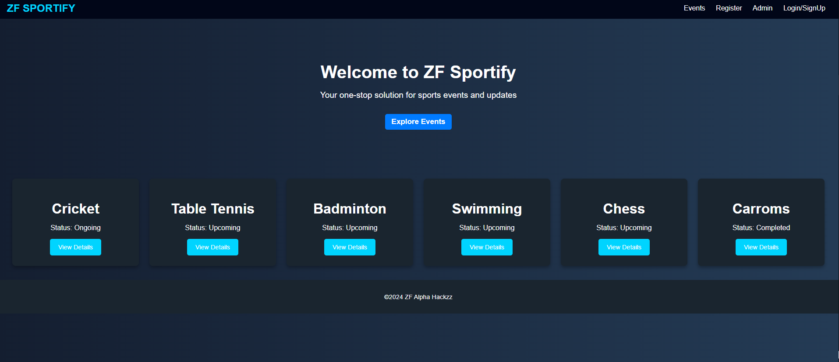
Outline of App

Slide 8
Timeline
- Requirements Gathering
- Platform Design
- Development Phase
- Testing and Bug Fixing
- Deployment and Launch

Slide 9
Conclusion
Summary:
The ZF Sportify platform simplifies tournament management by providing a one-stop solution.
Next Steps:
- Further development for scalability.
- Plan for cloud hosting and broader deployment.

Slide 10
Yet to include features in web app
❖Group Booking
⮚Location (Date and Venue)
⮚Team members , Volunteers, Jury
⮚Other important info
⮚Live scores
⮚Pictures or gallery
⮚Post event update status
⮚Social Connect

Slide 11
Best regards Team ALPHA HACKZZ_20
Shanthan Manne
Prakash Reddy Malasani
Rajib Saha
Hemanth Kumar Chintha
Maanvitha Garapati

