Slide 1

The Tech Wizard: E-Magazine Project
Shanthi Ravi
Web Design 189

Slide 2
How Things Work
A simple yet informative look behind the curtain of the range of technology we depend on everyday.
Examine new and upcoming technologies that have potential.
Examples:
Wifi: How it works and how it could soon be charging our devices
Self-Driving Cars
Touch Screens

Slide 3
Audience
Somewhat educated students and adults who are curious about the devices they use everyday.
They have some basic science knowledge or the interest in looking things up.
Will try to cater to a range of knowledge levels. For the most part want articles to be informative but not drawn out.

Slide 4
Mission
Illuminate what goes on behind the screens and plastic of the many items they use everyday.
Engage people in new innovations and encourage them to think about their own ideas.
Encourage further curiosity!!

Slide 5
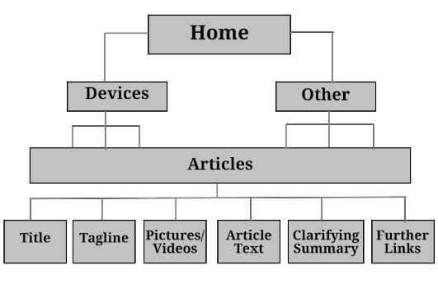
Site Map

Slide 6
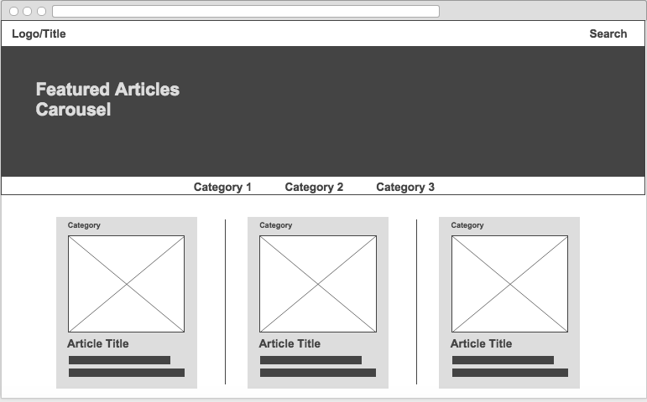
Home Wireframe

Slide 7
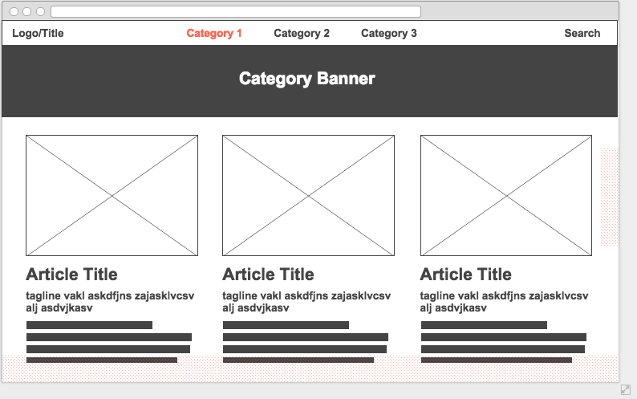
Category Wireframe

Slide 8
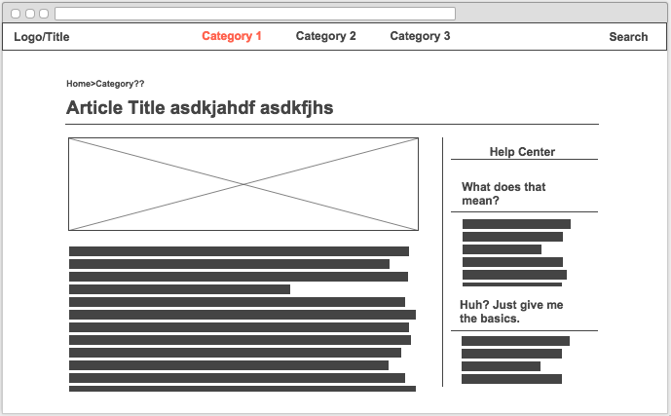
Article Wireframe

Slide 9
