Slide 1
Application Deployment Approaches
Traditional vs Maven vs Spring Boot

Slide 2
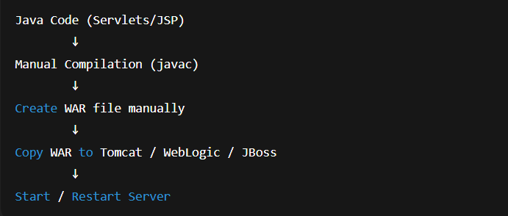
Traditional Deployment – Diagram

Slide 3
Traditional Approach – Key Points
Manual dependency management
Manual build and deployment
Requires external web server
Time‑consuming and error‑prone

Slide 4
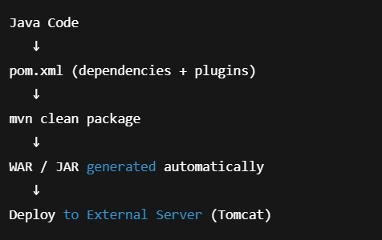
Maven Deployment – Diagram

Slide 5
Maven Approach – Key Points
Automatic dependency management
Standard build lifecycle
Easy packaging (WAR/JAR)
External server still required

Slide 6
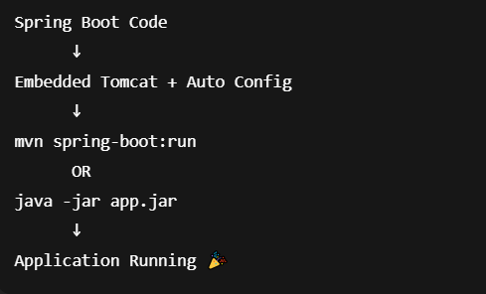
Spring Boot Deployment – Diagram

Slide 7
Spring Boot – Key Points
Embedded server (Tomcat/Jetty)
No WAR or server setup
Standalone executable JAR
Fastest deployment

Slide 8
One‑Look Comparison
Traditional: Manual build + manual deployment
Maven: Automated build, external server needed
Spring Boot: Embedded server, one‑command run

