Slide 1
@SpringBootApplication
Spring Boot Core Annotation – Notes

Slide 2
What is @SpringBootApplication?
- Main annotation to start Spring Boot application
- Placed on main class
- Entry point of Spring Boot app
- Defines configuration, scanning, and auto setup

Slide 3
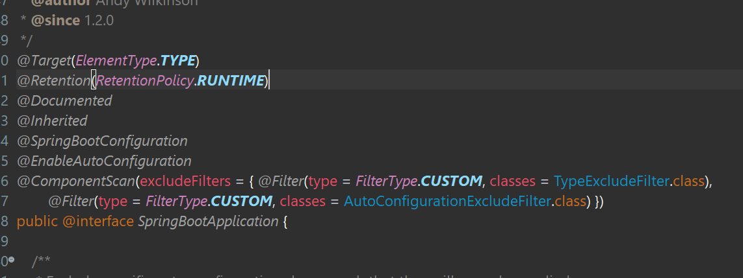
@SpringBootApplication Internally
@SpringBootApplication is a combination of:
- @Configuration
- @EnableAutoConfiguration
- @ComponentScan

Slide 4
@Configuration
- Marks class as configuration class
- Used to define beans using @Bean
- Replaces XML based configuration
- Java-based configuration

Slide 5
@EnableAutoConfiguration
- Enables Spring Boot auto-configuration
- Configures beans automatically based on:
• classpath dependencies
• application.properties
- Reduces manual configuration

Slide 6
@ComponentScan
- Scans components automatically
- Detects:
• @Component
• @Service
• @Repository
• @Controller
- Scans current package and sub-packages

Slide 7
Custom Component Scan
- Used when components are outside base package
Examples:
@SpringBootApplication(scanBasePackages = "com.app")
@ComponentScan(basePackages = {"com.app", "com.common"})

Slide 8
Spring Boot Startup Flow
1. JVM starts
2. static blocks execute
3. main() method starts
4. SpringApplication.run() called
5. ApplicationContext instance CREATED ✅
6. ApplicationContextInitializer runs
7. Bean definitions loaded
8. Auto-configuration applied
9. Beans instantiated
10. ApplicationContext refreshed
11. CommandLineRunner / ApplicationRunner

Slide 9
Key Points
- Entry point of Spring Boot application
- Combines 3 core annotations
- Enables auto-configuration
- Simplifies development
- Must be placed in root package

