Slide 1
Spring & Spring Boot IoC Containers
Spring 6 / Spring Boot 3
Interview & Learning Notes

Slide 2
What is IoC Container?
IoC means Spring controls object creation and dependency management instead of the programmer.
You don’t create objects using new, Spring creates and manages them.
This makes applications:
Loosely coupled
Easy to test
Easy to maintain
👉 IoC is implemented using Dependency Injection (DI).

Slide 3
The IoC Container is the core of Spring Framework.
It is responsible for:
Creating objects (beans)
Injecting dependencies
Managing bean lifecycle
Managing configuration
In short:
IoC Container = Bean Factory + Dependency Manager

Slide 4
Core Truth
Spring and Spring Boot use the SAME IoC container
No new container introduced in Spring Boot
Difference is in creation and configuration

Slide 5

Types of Spring IoC Containers
1️⃣ Bean Factory
Basic container
Uses lazy initialization (bean created only when requested)
Lightweight
Rarely used in real applications

Slide 6
Types of Spring IoC Containers
Spring 6 – BeanFactory Hierarchy Change (Explained Simply)
🔹 Before Spring 6 (Old Hierarchy)
Spring had a deep and confusing inheritance chain:

Slide 7
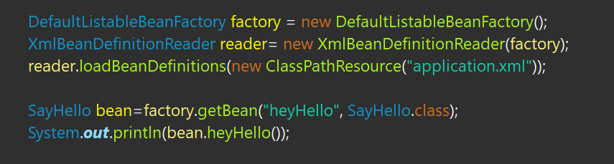
Types of Spring IoC Containers
BeanFactory
└── ListableBeanFactory
└── ConfigurableBeanFactory
└── ConfigurableListableBeanFactory

Slide 8
Types of Spring IoC Containers
2️⃣ ApplicationContext (Most Used ✅)
Advanced container (extends BeanFactory)
Uses eager initialization (beans created at startup)
Supports:
AOP
Event handling
Internationalization (i18n)
Annotation-based configuration
Examples:

Slide 9
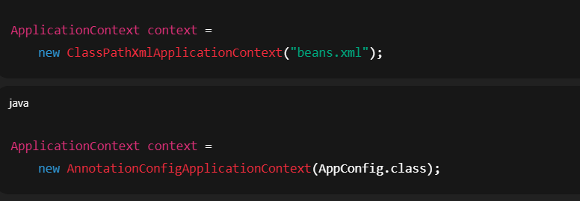
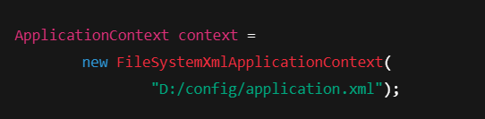
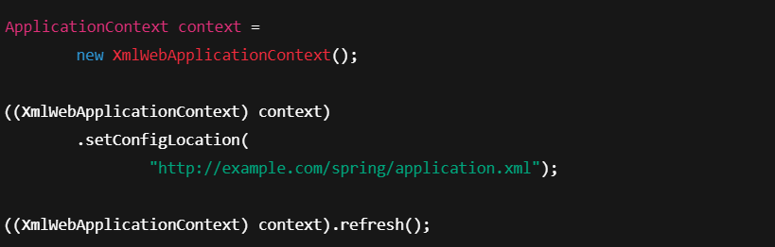
Types of Spring IoC Containers

Slide 10
Container Hierarchy
BeanFactory – core, low-level container
ApplicationContext – advanced container
ApplicationContext extends BeanFactory

Slide 11
Spring IoC Container
ApplicationContext is the main container
Created manually by developer
Supports XML, Java config, annotations

Slide 12
Spring Container Creation
ClassPathXmlApplicationContext
AnnotationConfigApplicationContext
Developer controls configuration and scanning

Slide 13
Spring Boot IoC Container
Uses ApplicationContext internally
Created automatically by Spring Boot
Developer does not create it manually

Slide 14
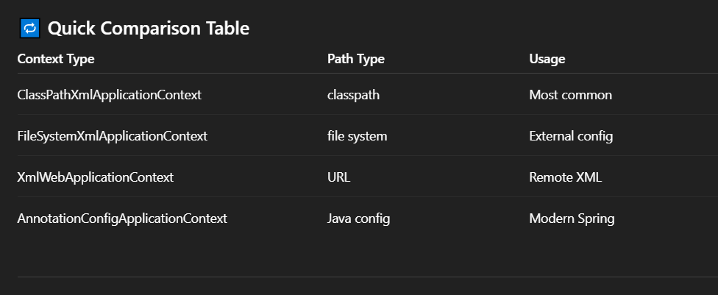
Spring Boot Container Implementations
Non-web: AnnotationConfigApplicationContext
Web (MVC): ServletWebServerApplicationContext
Reactive: ReactiveWebServerApplicationContext

Slide 15
How Spring Boot Creates Container
SpringApplication.run()
Detects application type
Loads environment & auto-configuration
Creates ApplicationContext

Slide 16
Bean Creation Behavior
Default scope is singleton
Singleton beans are eagerly created
Prototype beans are created on getBean()
Same behavior in Spring and Spring Boot

Slide 17
BeanFactory
Low-level IoC container
Lazy initialization by default
Beans created only when getBean() is called

Slide 18
ApplicationContext
High-level IoC container
Eager initialization of singleton beans
Supports events, AOP, i18n

Slide 19
Deprecated: XmlBeanFactory
Used in older Spring versions
Deprecated since Spring 3.1
Removed in Spring 5 and Spring 6

Slide 20
Modern Replacement for XmlBeanFactory
DefaultListableBeanFactory
XmlBeanDefinitionReader
Separation of container and XML loading

Slide 21
Spring vs Spring Boot IoC Containers
Same ApplicationContext container
Spring: manual setup
Spring Boot: automatic setup
Spring Boot adds auto-configuration

Slide 22
BeanFactory vs ApplicationContext
1️⃣ What they are
BeanFactory
Lowest-level IoC container
Core interface of Spring
Provides basic dependency injection
ApplicationContext
Advanced IoC container
Extends BeanFactory
Adds enterprise-level features

Slide 23
BeanFactory vs ApplicationContext
2️⃣ Bean creation strategy
Aspect | BeanFactory | ApplicationContext
Default initialization | Lazy | Eager (singletons)
When bean is created | On getBean() | At context startup
Startup time | Faster | Slightly slower
Error detection | Late | Early

Slide 24
Final Summary
IoC container = ApplicationContext
BeanFactory is the core abstraction
Spring Boot simplifies container setup
Modern Spring removed XmlBeanFactory

