Slide 1
spring-boot-starter-logging
Provides default logging support in Spring Boot
Automatically included in most Spring Boot projects
No manual configuration required

Slide 2
What is spring-boot-starter-logging?
Default logging starter in Spring Boot
Comes with spring-boot-starter / spring-boot-starter-web
Configures logging automatically

Slide 3
What does it provide?
SLF4J – Logging API
Logback – Logging implementation
Log4j to SLF4J bridge
JUL to SLF4J bridge

Slide 4
Why do we need it?
Avoids manual logging setup
Unified logging across libraries
Production-ready defaults

Slide 5
What can we do with it?
Use log.debug(), info(), warn(), error()
Control log levels via application.properties
Consistent log format

Slide 6
Example Logger Code
Logger log = LoggerFactory.getLogger(MyService.class);
log.info("Application started");

Slide 7
Configure Log Levels
logging.level.root=INFO
logging.level.com.myapp=DEBUG

Slide 8
File Logging
logging.file.name=app.log
Stores logs in a file automatically

Slide 9
When to remove this starter?
When using Log4j2 instead of Logback
Exclude starter-logging and add starter-log4j2
Feature | logback.xml | log4j2.xml
Default in Spring Boot | ✅ Yes | ❌ No
Performance | Good | ⭐ Excellent
Async logging | Limited | ✅ Native & fast
Configuration style | Simple | More structured
Large apps | OK | ✅ Preferred
File naming | RollingPolicy | RollingFile + Policies

Slide 10
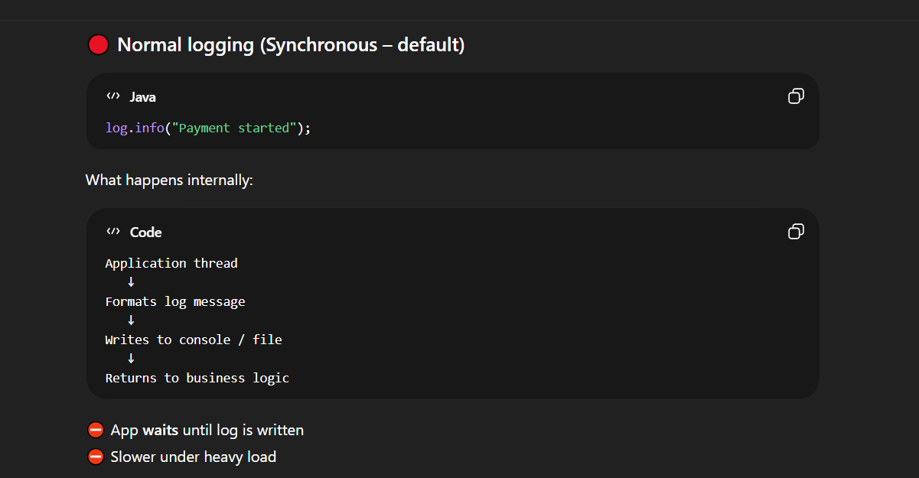

Slide 11
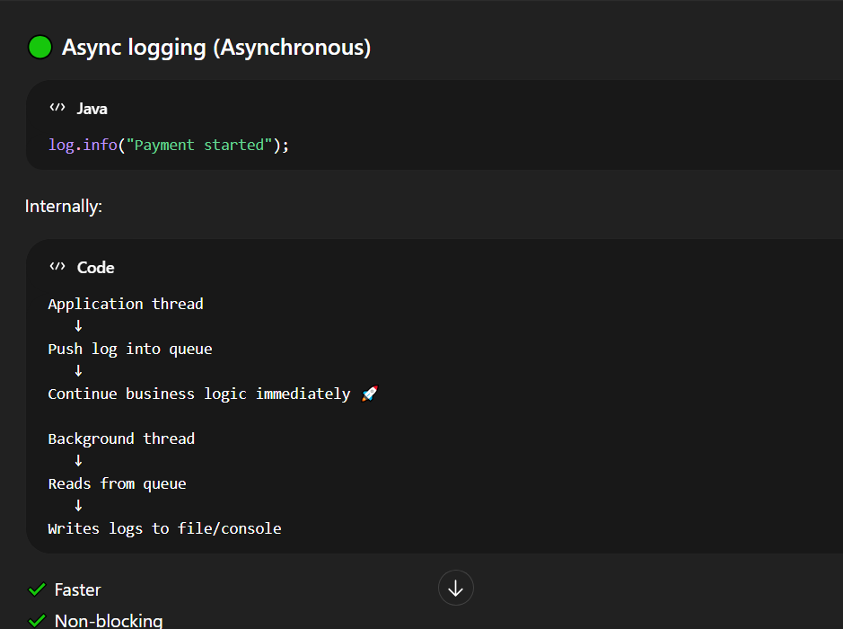
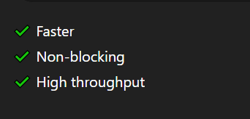

Slide 12
Summary
Out-of-the-box logging
Powered by SLF4J + Logback
Zero configuration needed

