Slide 1


Bank of Baroda Hackathon - 2022
Technology Partner
Your Team Name :PHANTOM TRIO
Your team bio :research and identification
Date :19/09/2022

Slide 2
Problem Statement
Signature verification is one of the biometric techniques frequently used for personal identification. In many commercial scenarios, such as bank check payment, the signature verification process is based on human examination of a single known sample. Although there is extensive research on automatic signature verification, yet few attempts have been made to perform the verification based on a single reference sample.
Our project aim to automate the process of signature detection and verification using deep learning.

Slide 3
User Segment & Pain Points
Bank sectors are the main user segments for signature verification , other than Bank sectors our solution can be used for government rely also.
Pain points:
The proposed deep learning based methodology of signature forgery detection system needs a large number of samples to train their system and hence execution time of the algorithm is high.

Slide 4
Pre-Requisite
Existing technology :
A wavelet based feature extract0r and Handcrafted feature extraction method
The Local Binary Pattern (LBP) and Uniform Local Binary Patterns (ULBP) as their texture based – feature extraction method .
Meta-learning approach and one-class support vector machine (OC-SVM) classifier
These are the methods used in existing signature verification and the process are more complicated.

Slide 5
Azure tools or resources
Matlab software

Slide 6


BLOCK DIAGRAM
Result of Classification Result of Classification
based on Online Based on both Online and Offline based on Offline
Camera
Handwritten Images
Data Acquisition
Data Acquisition
Preprocessing
Preprocessing
Feature Extraction
Feature Extraction
Classification
Classification
Combined Classification

Slide 7
Key Differentiators
Our solution “Increases the detection accuracy of signature” compared to the existing solution, as it analyses the input data from ICDAR dataset with the help of DCNN(deep learning and convolutional neural network).

Slide 8
Adoption Plan
Duration | Work
Ist Month | Literature Review
IInd Month | Completion of Module I (Preprocessing)
IIIrd Month | Completion of Module II (Feature Extraction)
IVth Month | Completion of Module III (Signature Forgery Detection and Classification)
Vth Month | Results Comparisions
VIth Month | Report Submission

Slide 9
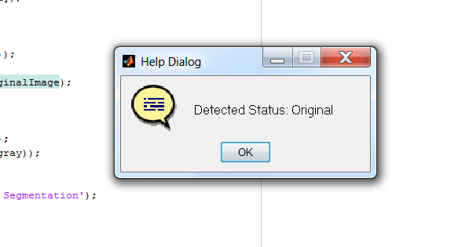
GitHub Repository Link & supporting diagrams, screenshots, if any
Output

Slide 10
Thank You
Team member names
Shanthosh Kumar K ECE(3RD YEAR)
Vignesh K ECE(3RD YEAR)
Ranjith Kumar M ECE(3RD YEAR)

