Slide 1
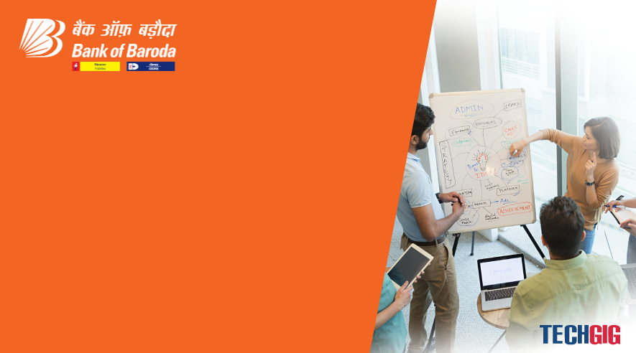

Bank of Baroda Hackathon - 2022
Technology Partner
Your Team Name : Phantom Trio
Your team bio :Shanthosh Kumar K,Ranjith Kumar M,Vignesh K
Date :06/11/2022

Slide 2
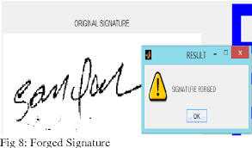

Problem Statement
Signature verification is an important technique that aims to detect whether a given signature is forged or not
Our project aim to automate the process of signature verification using deep learning.

Slide 3


User Segment & Pain Points
Bank sectors are the main user segments for signature verification , other than Bank sectors our solution can be used for government rely
Pain points:
It needs a large number of samples to train their system.

Slide 4
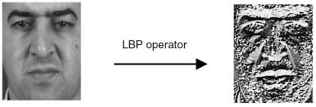
Pre-Requisite
Existing technology :
A wavelet based feature extracter and Handcrafted feature extraction method
The Local Binary Pattern (LBP) and Uniform Local Binary Patterns (ULBP) as their texture based – feature extraction method . Meta-learning approach and one-class support vector machine (OC-SVM) classifier
These are the methods used in existing signature verification and the process are more complicated.

Slide 5
Key Differentiators & Adoption Plan
How is your solution better than alternatives and how do you plan to build adoption?
Our solution “Increases the accuracy of signature” compared to the existing solution, as it analyses the input data from ICDAR dataset with the help of DCNN(deep learning and convolutional neural network).
We are planning to aproach our solution to banks in a way it will be adopted.

Slide 6
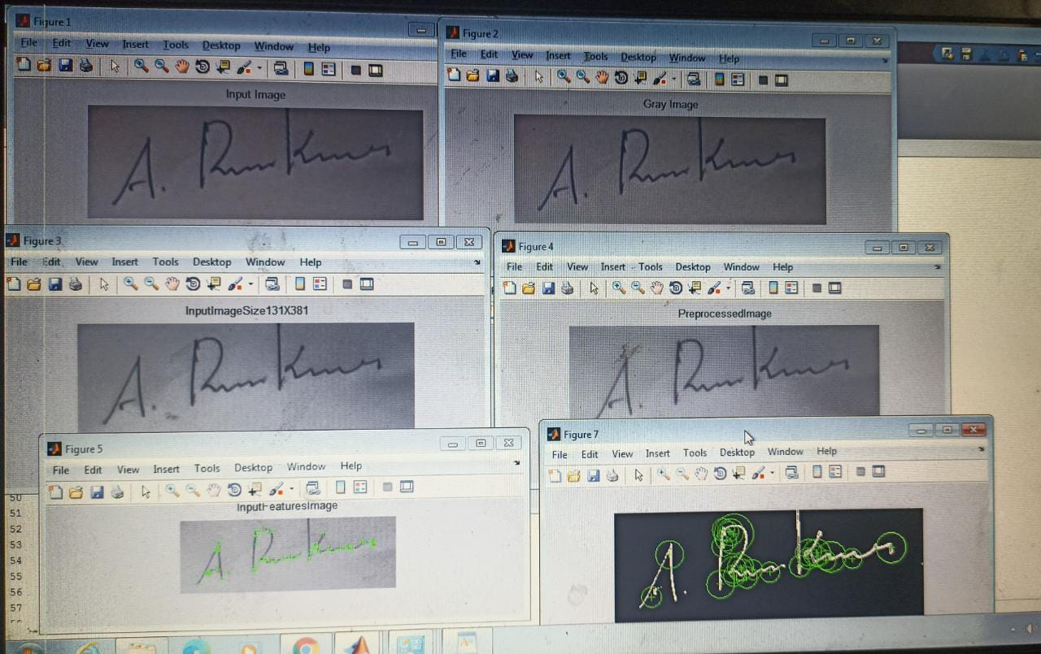
GitHub Repository Link & supporting diagrams, screenshots, if any
Input to Output extraction Process:

Slide 7
Thank You
Team member names
SHANTHOSH KUMAR K
RANJITH KUMAR M
VIGNESH K

