Slide 1
OptimusPrime
Carlos ribeiro
Marcus garcia
Renato rudnicki
Vagner Vidor

Slide 2
Problem:
Cross data from incidents amounth with disruptive events (patchs, networks issues, power issues)
Try to predict how many incidents our support grups will recieve if any of this events happen.

Slide 3
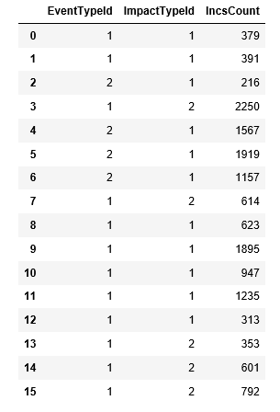
Data Used
Real data extract from Eview applciations...
Eview has a lot of bad (Random) data, it could leaded us to
A really bad result....

Slide 4
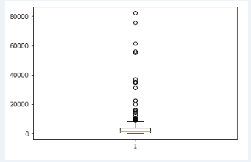
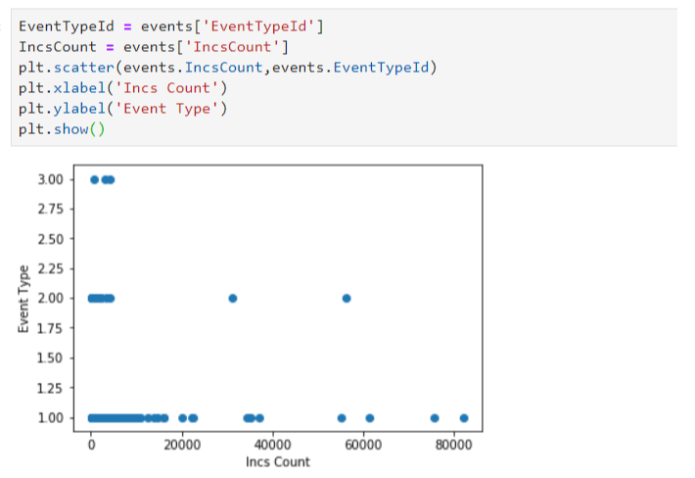
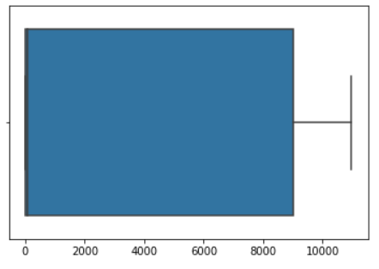
We are not good coachs...

Slide 5

Accuaracy....
We will keep trying....

