Slide 1
Powerdata which power source will light brazil in the future?
André Ramme
Giovanni Silva
Guilherme Schá
Michel Trettim

Slide 2
Data + problem
Average GigaWatt/hour generated per month by Energy Source
Dataset Source: ANEEL (National Agency of Electric Energy)
Will renewable energy soon overcome non-renewable energy?

Slide 3
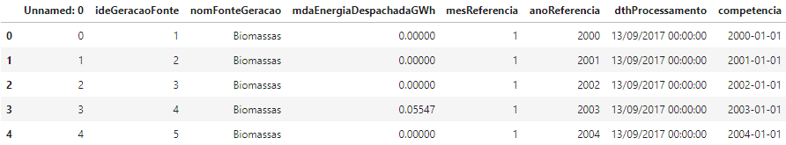
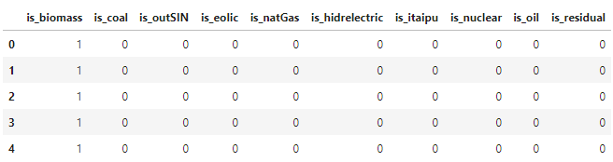
Data transformation
Datetime (Dataset has separated month and year)
Energy Source (From label to one-hot-encoding)

Slide 4
How to analyze time series data?
Time Series Analysis

Slide 5
Which time series algorithm to choose?
Autoregression (AR)
Moving Average (MA)
Autoregressive Moving Average (ARMA)
Autoregressive Integrated Moving Average (ARIMA)
Seasonal Autoregressive Integrated Moving-Average (SARIMA)
Seasonal Autoregressive Integrated Moving-Average with Exogenous Regressors (SARIMAX)
Vector Autoregression (VAR)
Vector Autoregression Moving-Average (VARMA)
Vector Autoregression Moving-Average with Exogenous Regressors (VARMAX)
Simple Exponential Smoothing (SES)
Holt Winter’s Exponential Smoothing (HWES)

Slide 6
Which time series algorithm to choose?
Autoregression (AR)
Moving Average (MA)
Autoregressive Moving Average (ARMA)
Autoregressive Integrated Moving Average (ARIMA)
Seasonal Autoregressive Integrated Moving-Average (SARIMA)
Seasonal Autoregressive Integrated Moving-Average with Exogenous Regressors (SARIMAX)
Vector Autoregression (VAR)
Vector Autoregression Moving-Average (VARMA)
Vector Autoregression Moving-Average with Exogenous Regressors (VARMAX)
Simple Exponential Smoothing (SES)
Holt Winter’s Exponential Smoothing (HWES)

Slide 7
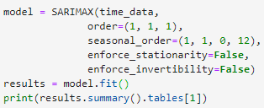
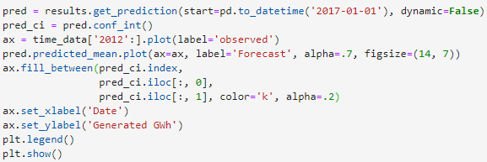
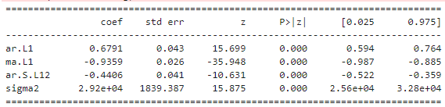
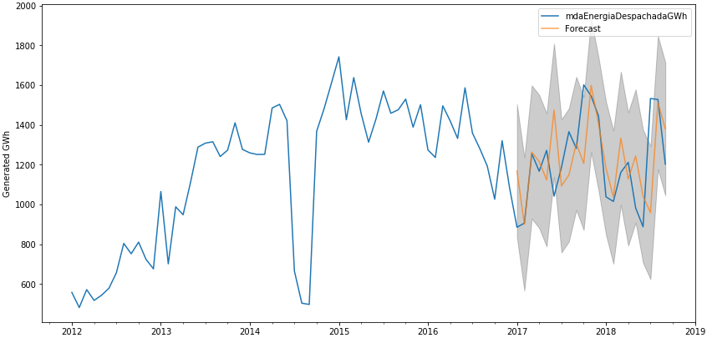
Sarimax model prediction

Slide 8
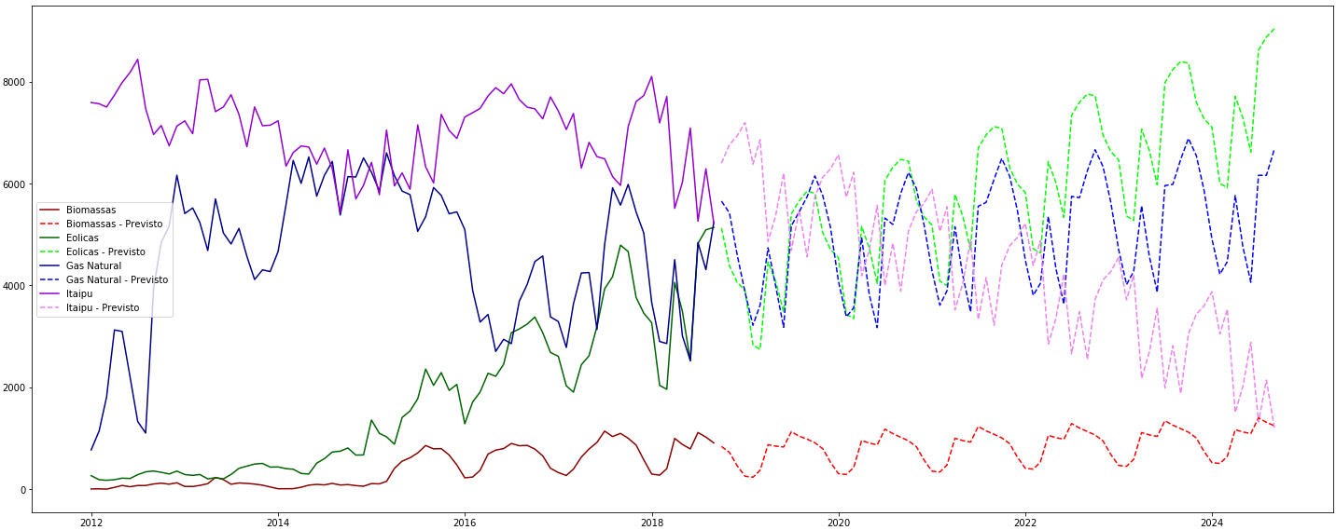
Results – multiple sources

Slide 9
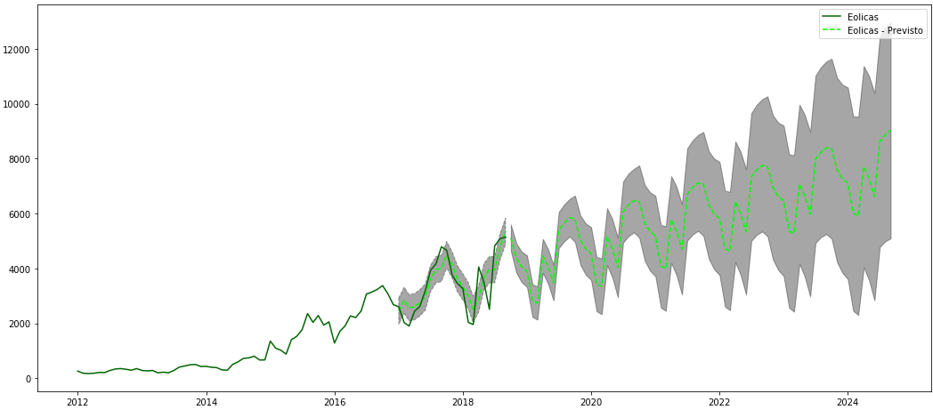
Results – source with confidence interval

Slide 10
Questions?

Slide 11
Thank you!

