Slide 1
TellCo: User Analytics in the Telecom Industry
Overview, Engagement, Experience & Satisfaction analysis to decide: buy or not?
Nexthikes IT Solutions | Data Science project | October 2026

Slide 2
The problem & our approach
Business problem
Data we had
An investor wants to buy TellCo, a mobile operator in Pefkakia. Owners shared financials but never analysed their own network data. Is TellCo worth buying and where can profit grow?
One month of xDR data: 150,000 sessions, 55 columns, 106,856 unique users (MSISDN). Per-app DL/UL bytes, RTT, TCP retransmission, throughput, handset.
1
2
3
4
User Overview
Engagement
Experience
Satisfaction
Handsets, app usage, EDA, PCA
Sessions, duration, traffic, k-means
RTT, TCP, throughput, handsets
Scores, regression, SQL, tracking

Slide 3
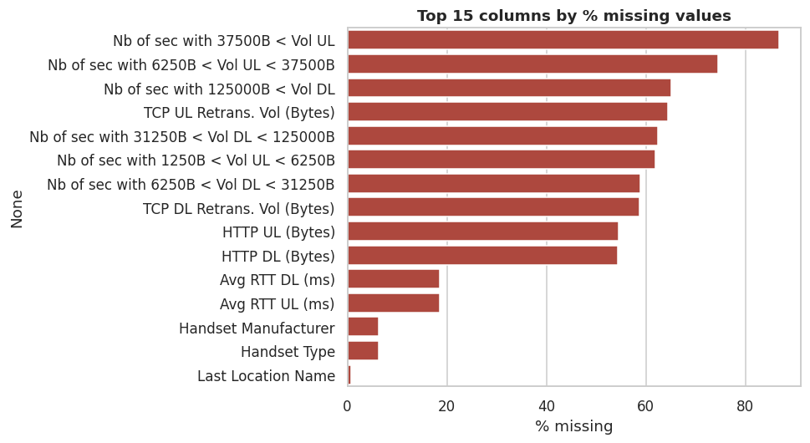
Data quality: what we found & fixed
Missing numeric values replaced with the column mean; text (handset) with the mode.
Outliers (beyond 3 x IQR) replaced with the mean of the normal values.
"undefined" handsets (6.4%) treated as unknown, not as a brand.
TCP retransmission is 59-64% missing; mean-imputed as the brief requires.
Check failed: app volumes add up to ~1.85x the Total DL+UL in every session.
Last blank row of the file removed. Aggregation key: MSISDN/Number.

Slide 4
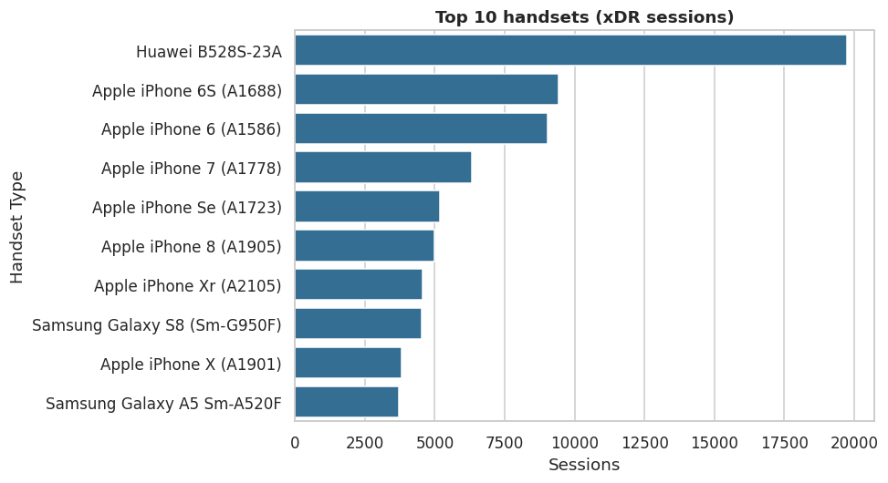
Task 1: Top 10 handsets
19,752
sessions on Huawei B528S-23A, #1 device
6 of 10
top handsets are Apple iPhones
The #1 device is a home 4G router, not a phone.
Old iPhones (6S, 6) are still huge.

Slide 5
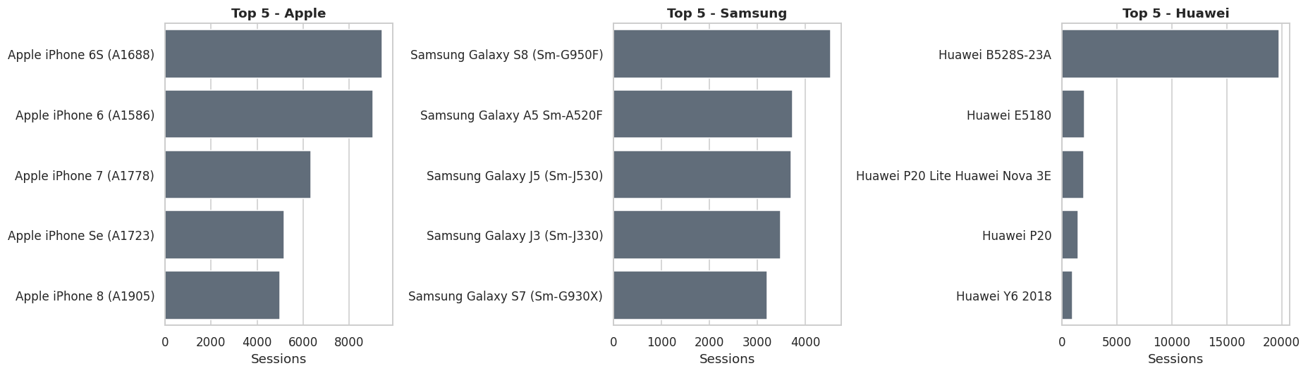
Top 3 manufacturers & their top 5 handsets
39.7%
27.2%
23.0%
Marketing: upgrade offers for iPhone 6/6S users; home-internet bundle for router owners.
Apple (59,565)
Samsung (40,839)
Huawei (34,423)

Slide 6
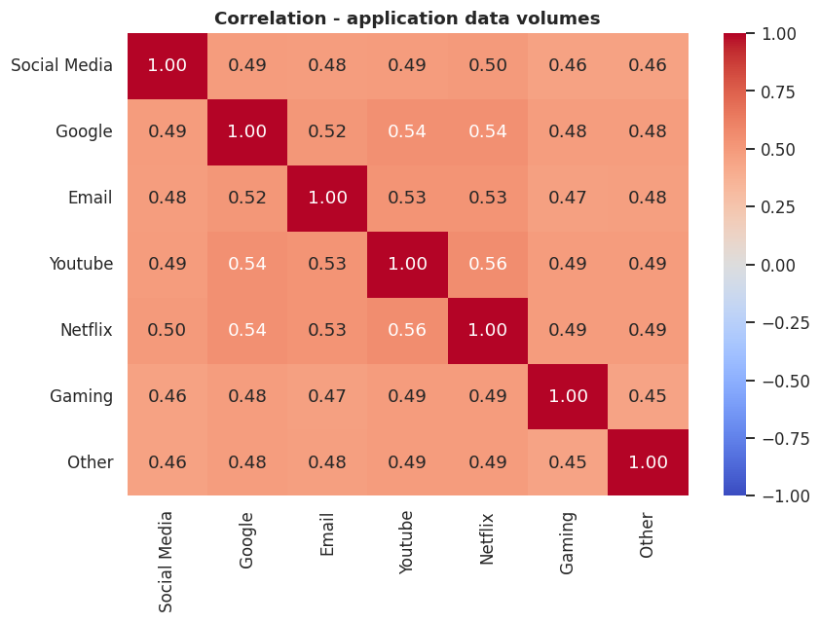
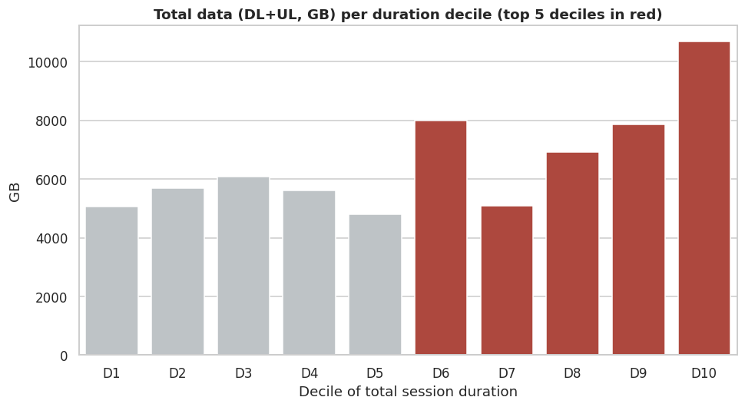
Task 1: Who uses the data? Deciles & correlation
Top 5 duration deciles (D6-D10) carry 58.6% of all data; D10 alone is the biggest block (10.4 TB).
App volumes correlate only moderately (r about 0.45-0.50): heavy users are heavy on everything, no redundant app.

Slide 7
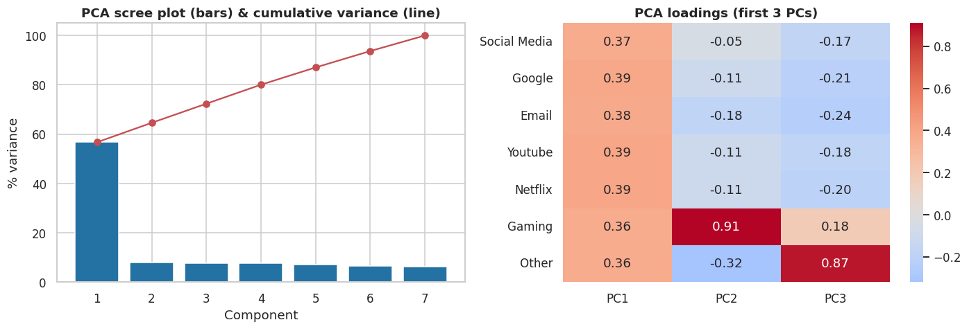
Task 1: Dimensionality reduction (PCA)
PC1 = 56.7% of variance with equal loadings on all 7 apps: a general "heavy-user" factor.
PC2 (7.9%) is Gaming (+0.91); PC3 (7.7%) is Other (+0.87).
3 PCs explain ~72%, 5 PCs ~87%.
Use PC1 for segmentation, add gaming offers for high-PC2 users.

Slide 8
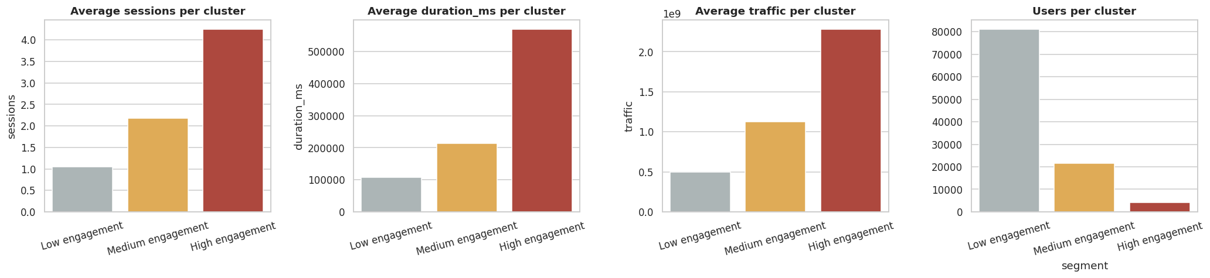
Task 2: Engagement clusters (k-means, k=3)
76%
20%
3.8%
Low engagement (81,163 users) = 54.5% of traffic
Medium (21,645 users) = 33% of traffic
High (4,048 users) = 12.5% of traffic
High group: 4.3 sessions and about 2.1 GB per user vs 1.0 session and 0.46 GB for the low group.

Slide 9
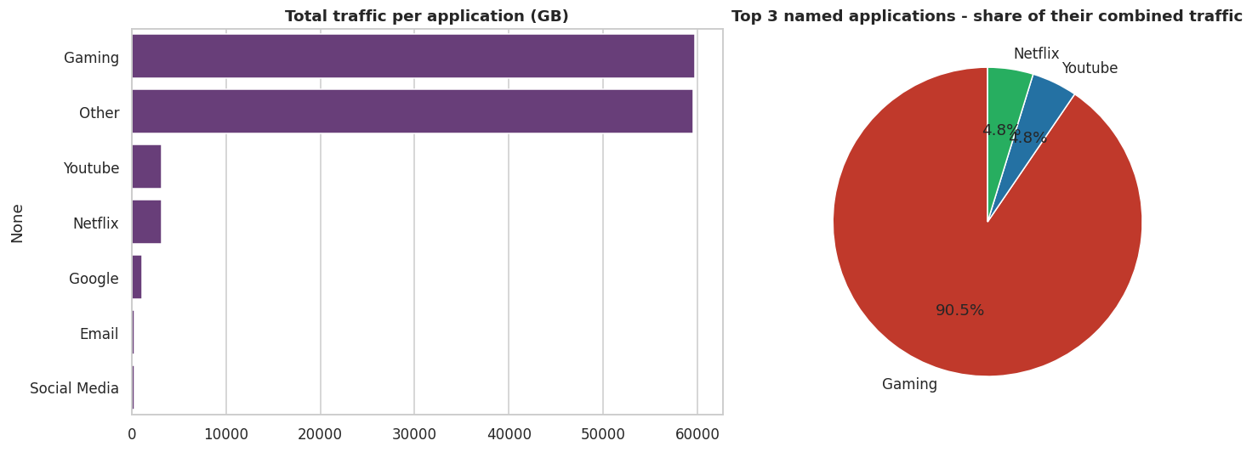
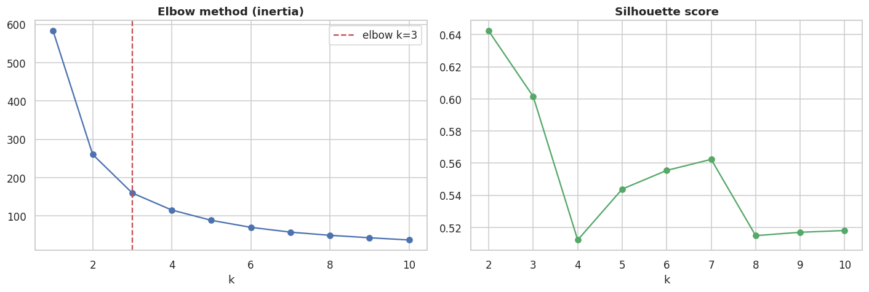
Task 2: Most used applications & optimal k
Gaming (58.3 TB) and Other (58.2 TB) are 96.6% of app traffic. Top 3 named apps: Gaming, YouTube, Netflix.
Elbow method confirms k = 3 clusters.
Caution: app volumes exceed session totals, so treat absolute app numbers carefully.

Slide 10
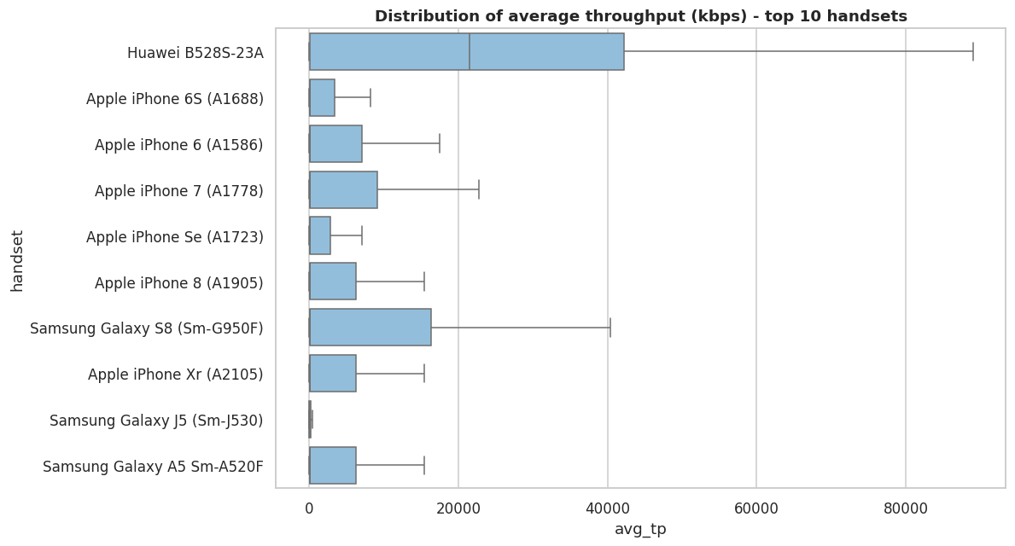
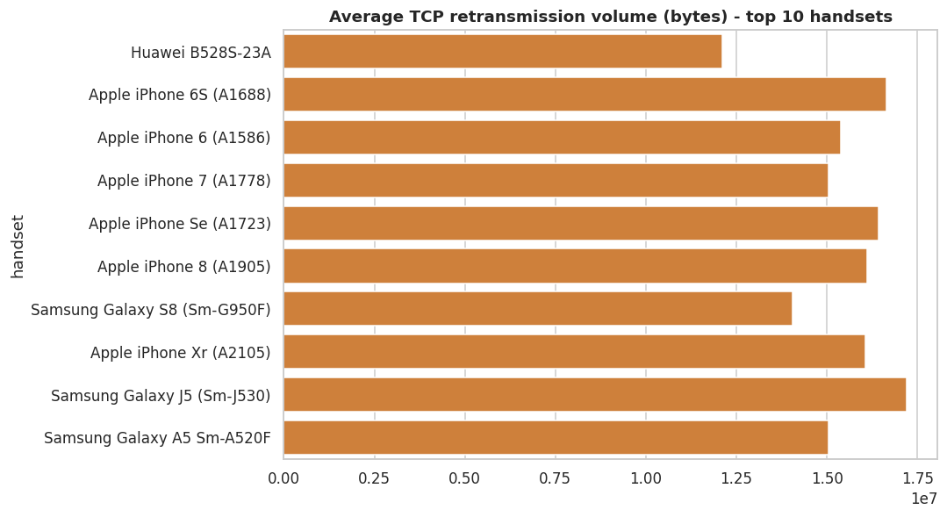
Task 3: Experience by handset
Huawei routers (E5573, E5180, B528S) reach 25-32 Mbps average throughput; iPhone 4/4S, ZTE MF259 and Galaxy J5 are far slower.
Highest TCP retransmission: iPhone 6S/7 and Galaxy J5 (~17M bytes per user).

Slide 11
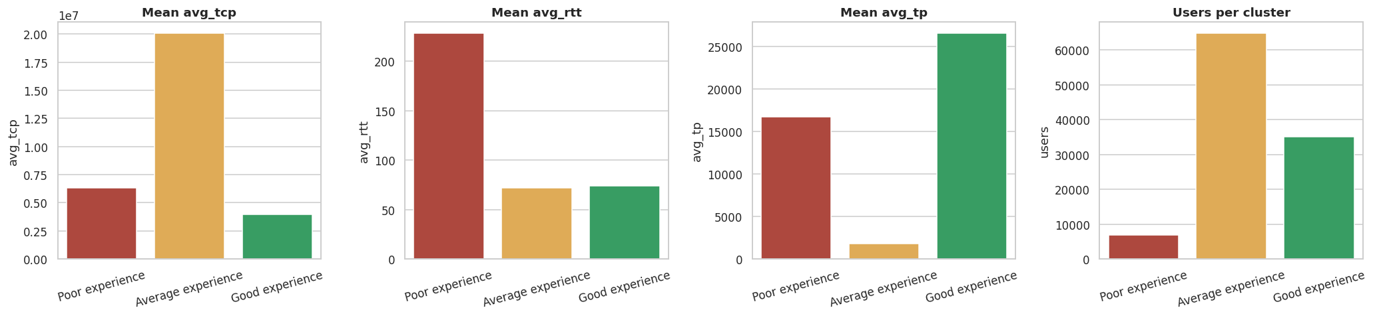
Task 3: Experience clusters (k = 3)
Poor: 6.4% (6,886)
Average: 60.7% (64,824)
Good: 32.9% (35,146)
RTT about 228 ms, 3x the others. Laggy for browsing and gaming. Highest churn risk.
Normal RTT (72 ms) but low throughput (1.8 Mbps) and high retransmission. Biggest upgrade chance.
Throughput about 26 Mbps with low retransmission. Mostly routers and flagship phones.

Slide 12
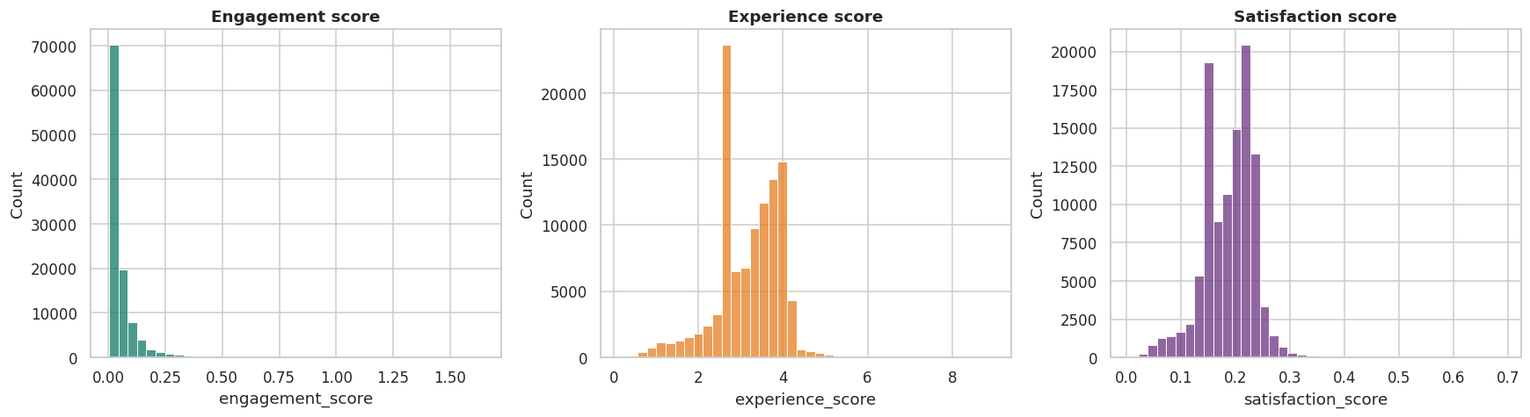
Task 4: Engagement, experience & satisfaction scores
Engagement score = distance to the least-engaged cluster centre; experience score = distance to the worst-experience cluster centre.
Both scaled to 0-1, then averaged = satisfaction score (mean 0.19, max 0.69).
Top satisfied customer: 33625779332 (score 0.69). Full top-10 list is in the CSV.

Slide 13
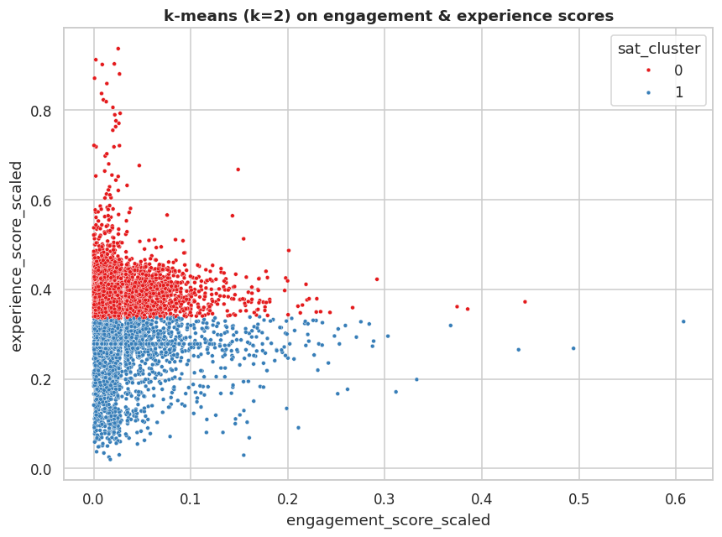
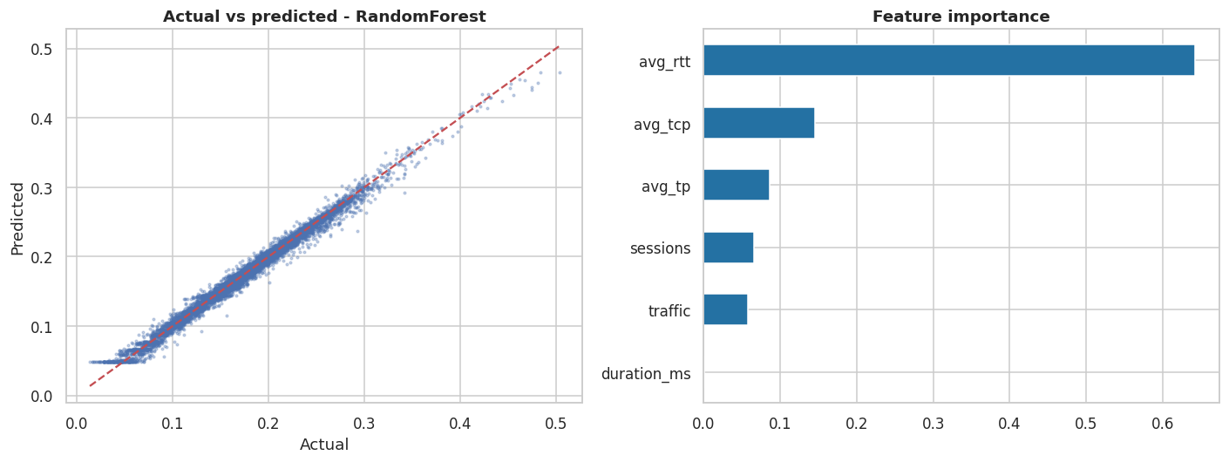
Task 4: Regression model & satisfaction clusters
Linear regression R2 = 0.76; Random Forest R2 = 0.99, RMSE 0.0047.
Very high R2 is expected: the score is built from these same inputs, so it shows consistency, not real-world prediction.
k=2: cluster 0 = 60,431 users (satisfaction 0.219, experience 3.74); cluster 1 = 46,425 users (0.147, 2.43).

Slide 14
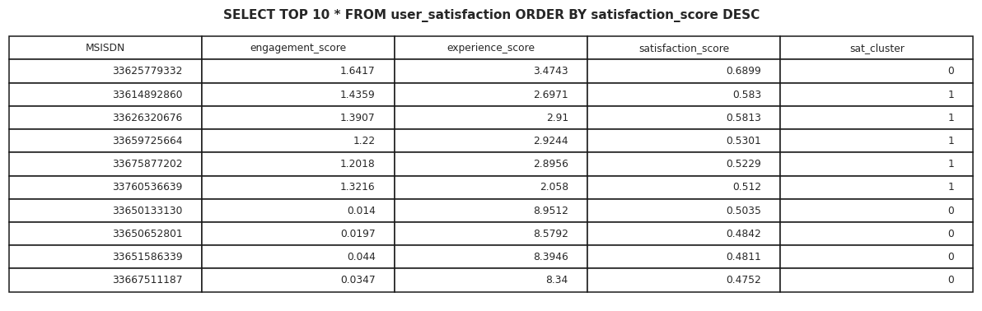
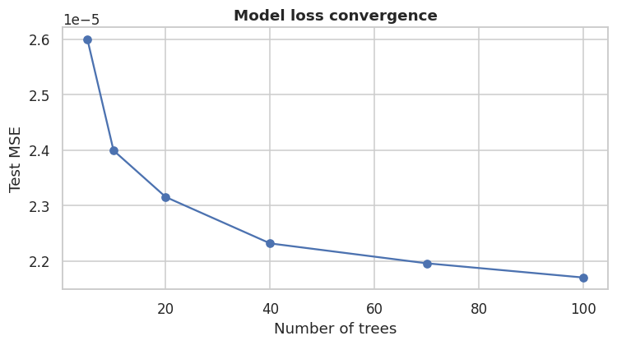
Task 4: SQL Server export & model tracking
SQL Server export
Model tracking
The script writes table user_satisfaction to database telecom_db on .\SQLEXPRESS (Windows login, ODBC Driver 17). The output above is a SELECT TOP 10 test on a local copy; re-run on the SQL Server PC for the final screenshot.
Every run logs code version, start/end time, source, parameters, metrics and the saved model to model_tracking.csv (and MLflow if installed).

Slide 15
Recommendation: buy, with conditions
Growth potential: positive
Upsell the base
Fixed-wireless
76% of users are low-engagement (about 1 session/month). Moving them to the medium cluster adds data volume.
Home routers are the #1 device and the fastest. Push home-internet plans.
Fix the network
Video & gaming bundles
6.4% of users have poor latency, 60% have slow throughput. Targeted upgrades reduce churn.
Gaming, YouTube and Netflix dominate traffic: sell passes for them.
Condition: confirm revenue, ARPU and churn data (not in this dataset) before the final offer.

Slide 16
Limitations of this analysis
Only one month of data: no trend, seasonality or churn can be measured.
No revenue, ARPU, cost or subscriber-status data, so profitability is inferred from usage only.
App volumes do not reconcile with Total DL+UL (about 1.85x higher); Gaming and Other look unusually large.
59-64% of TCP values are missing; mean imputation hides variation and creates a spike.
Replacing outliers with the mean removes genuine heavy users from some charts.
Satisfaction score is a constructed index, not a survey; the regression R2 is inflated by design.
Few users have more than 1-2 sessions, so per-user behaviour is thin.

Slide 17
Deliverables & references
TellCo_Analysis.ipynb: full Python code with all charts inside
TellCo_Project_Report.pdf: problem, solution, method
SQL Server table: telecom_db.user_satisfaction on .\SQLEXPRESS
Data: telcom_data.xlsx and Field_Descriptions.xlsx (Nexthikes IT Solutions)
Tools: Python, pandas, scikit-learn, seaborn, SQL Server Express

