Slide 1
Why you need to Practice Programming

Slide 2
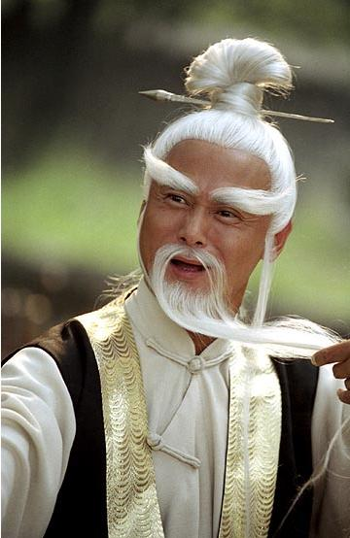
Folk Wisdom says:
“Unless the code is flowing from your fingers, you won't learn”

Slide 3
You don't learn programming by:
Reading tutorials
Watching videos
Reading tech books
Buying expensive courses / joining “hacker schools”
All of these things help, but the only thing that works is...............

Slide 4
The Code Must
Flow From
YOUR Fingers

Slide 5
What does that mean?
Tutorials etc are good, but unless you are typing the code yourself (no copy paste), you will not learn
You need to independently type the code and debug it yourself.

Slide 6
What does it mean for this course?
It's not enough to watch the videos, run the code
You need to repeat the code. See if you can get the same results I can.
If you get stuck, it is Perfectly okay to look at my solution.
Also do the practice sessions. Some of the practice sessions will just build on the previous examples, some will be new exercises with new data.
There will be a guiding video to tell you how to do the practice session

