Slide 1
Project 4
CS2365 Team 4 Presentation

Slide 2
Team List and Video Presentation
Team Members:
Sadman Ahmed Shanto
Cierra Ditmore
Meghan Engert
Video Presentation Link

Slide 3
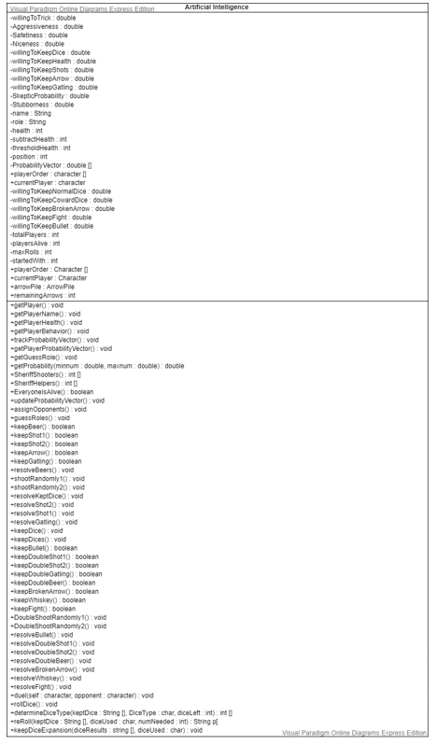
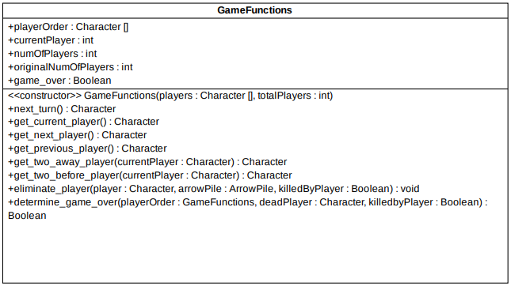
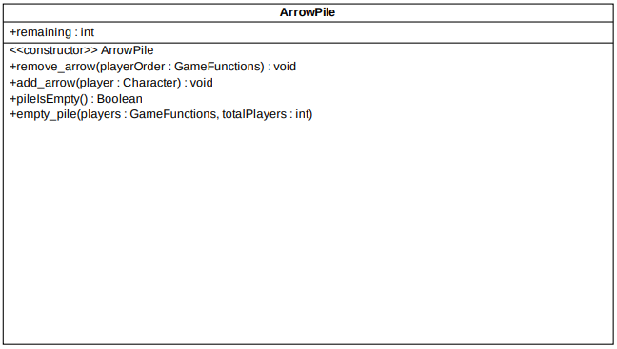
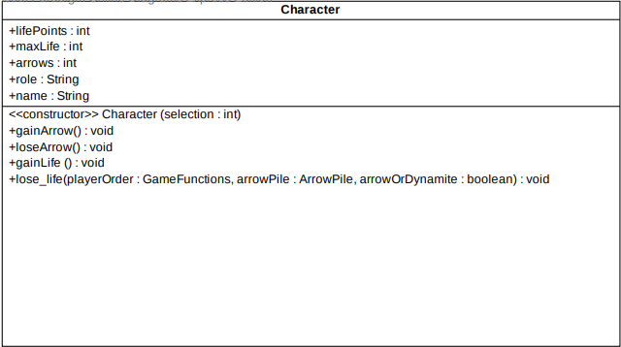
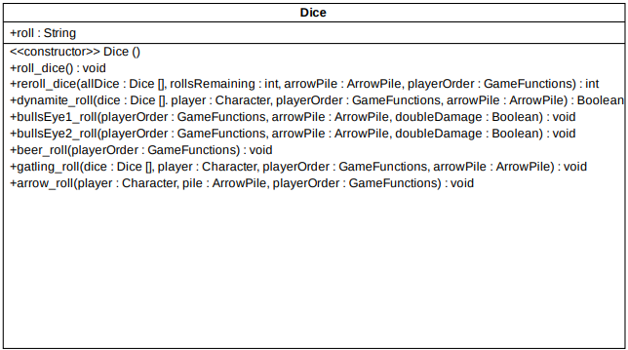
UML Class Diagrams
Artificial Intelligence UML Class Diagram
GameFunctions and Character UML Class Diagrams
ArrowPile and Dice UML Class Diagrams

Slide 4
Classes Developed
Game Functions Class
Cierra Ditmore
Dice Class
Cierra Ditmore
Sadman Ahmed Shanto
Arrow Pile Class
Meghan Engert
Character Class
Cierra Ditmore
Artificial Intelligence Class
Sadman Ahmed Shanto
Simulate AI Class
Sadman Ahmed Shanto
AI Dice Class
Sadman Ahmed Shanto
Arrow Pile Class
Meghan Engert
BangDiceGame
Meghan Engert

Slide 5
MVC Report: Model
The Bang Dice Game implemented in Java works correctly with minor bugs in the code.
All bugs and problems in the code were solved.
Lack of Team Communication caused this project to lack a GUI because two other members left the group.
Fixed Bugs:
The character class was built using the static arrays, when players died they got a NullPointer exception
AI with negative lifePoints were still playing the game.
AI could keep more than 5 dice in some cases with more than one dynamite roll.
The dynamics of Arrows in the game were not resolved accurately in some test cases.
Problems Solved:
AI:
Initially, the program was based on taking user inputs so they were not compatible with the AI, leading to problems with the AI not working simultaneously with a user.
Solved by implementing AI classes separately from the initial classes, then making them work with user input.
Probability Vectors:
Challenging program to build, but critical to the AI
Solved by working with code until the probability vectors were solved.

Slide 6
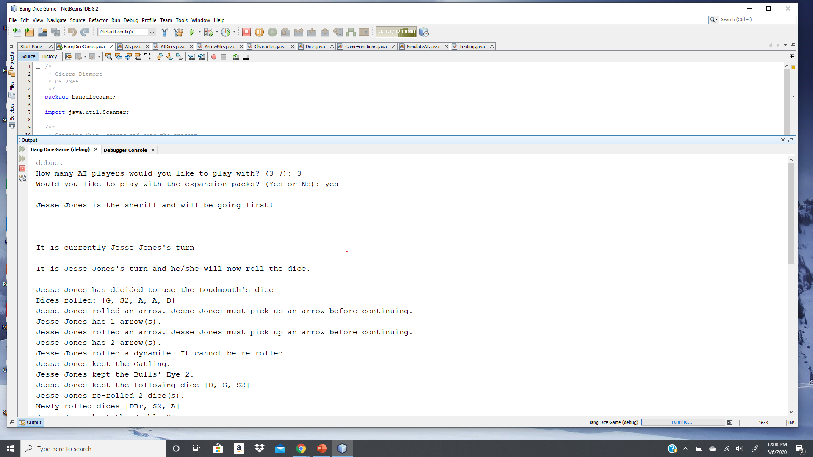
MVC Report: View
This project is does not have a GUI due to team difficulties, but the game was fully implemented and runs in the console.
BangDiceGame running in the console

Slide 7
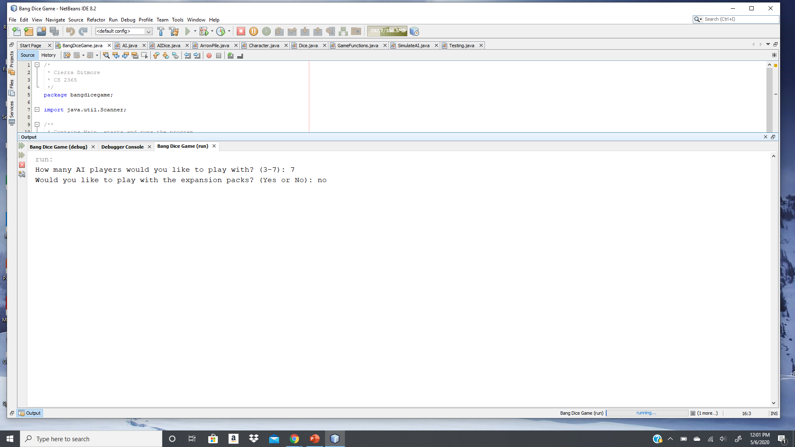
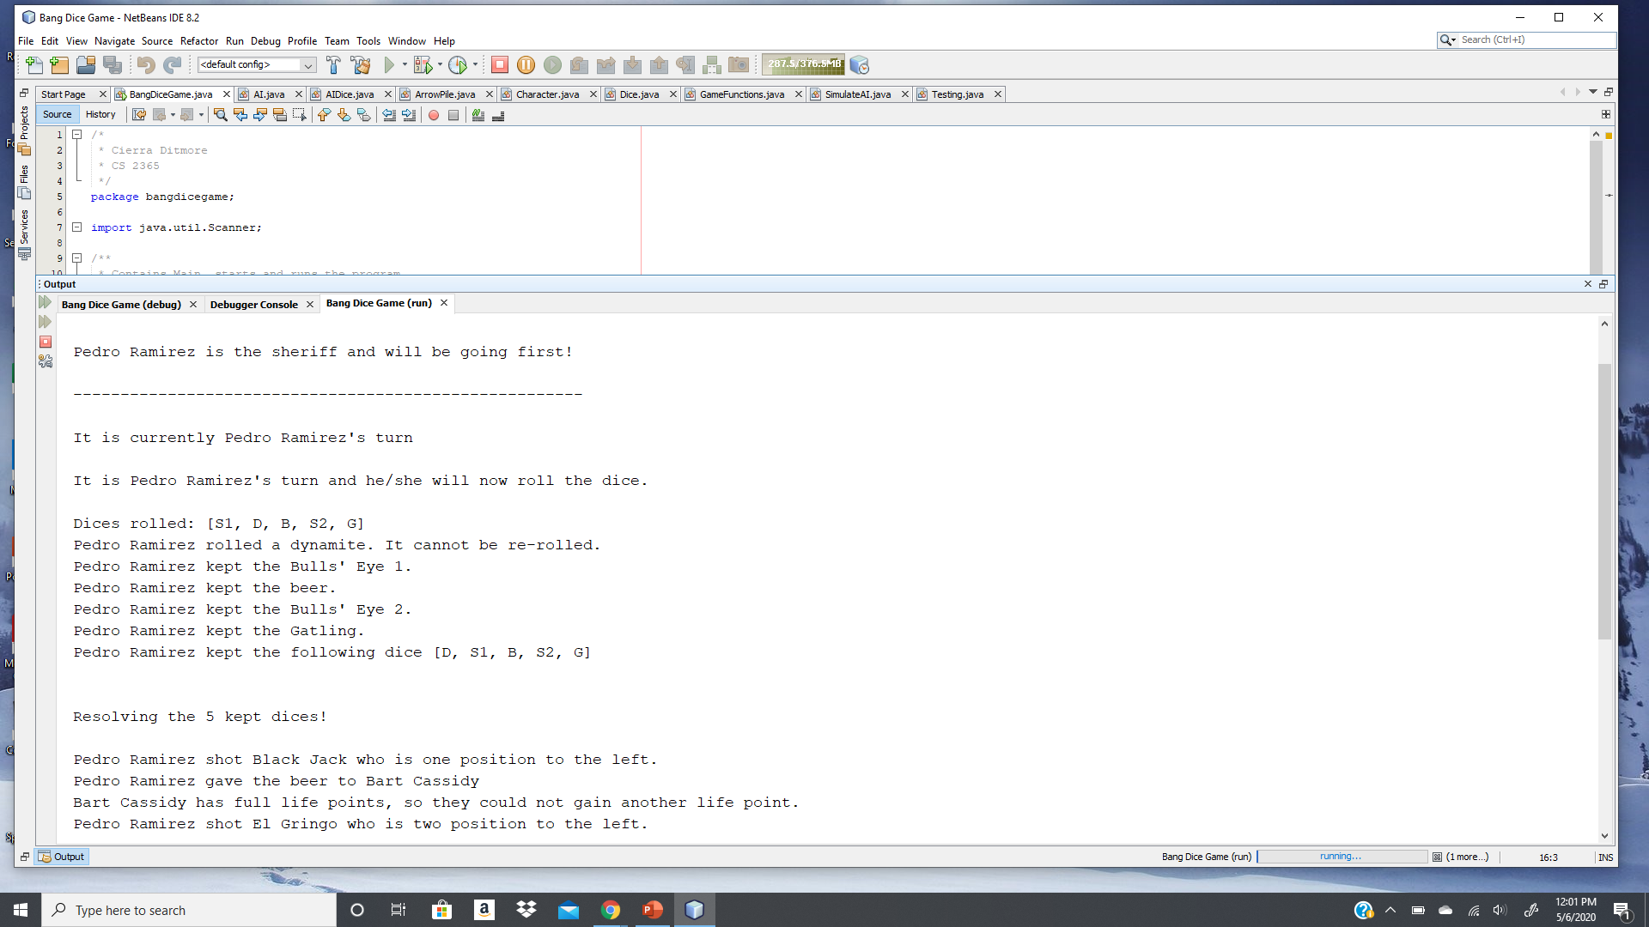
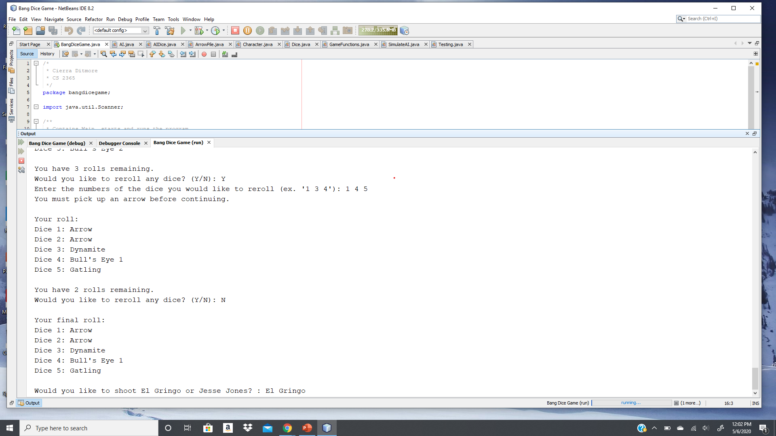
MVC Report: Controller
The console is the controller.
The project is completely integrated with all classes working together so the user can:
play the game by giving input to the computer,
play with 3 to 7 Artificial Intelligence players,
and play the game using a Graphic User Interface (GUI).
Prompting user for input
AI turn is printed to the screen
Prompting user for their turn

Slide 8
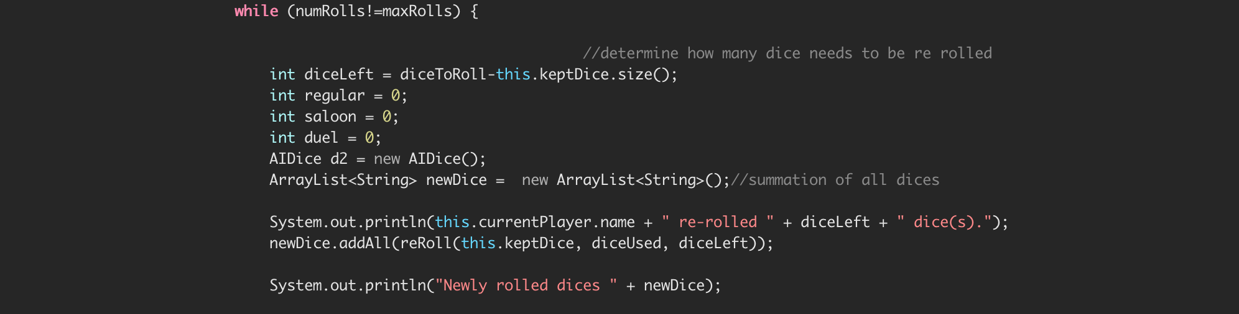
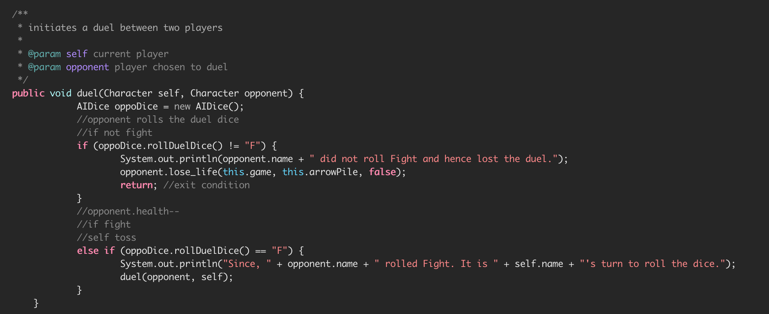
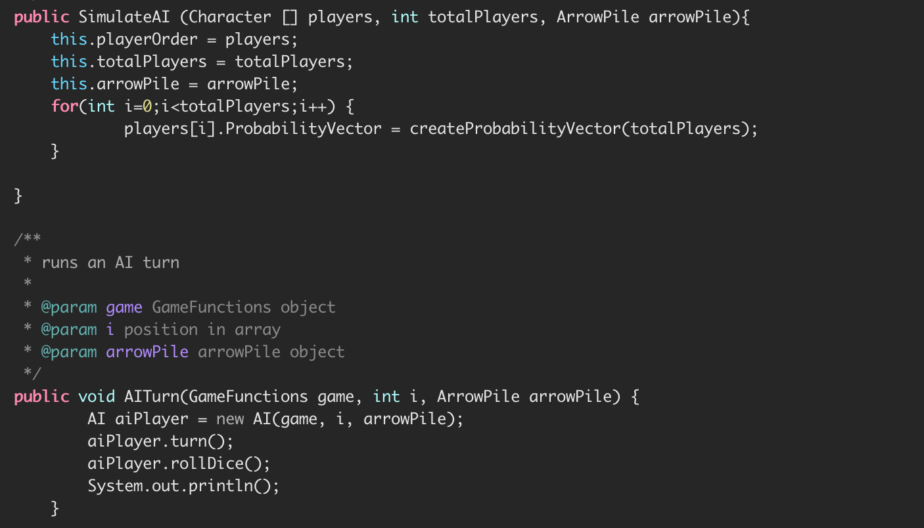
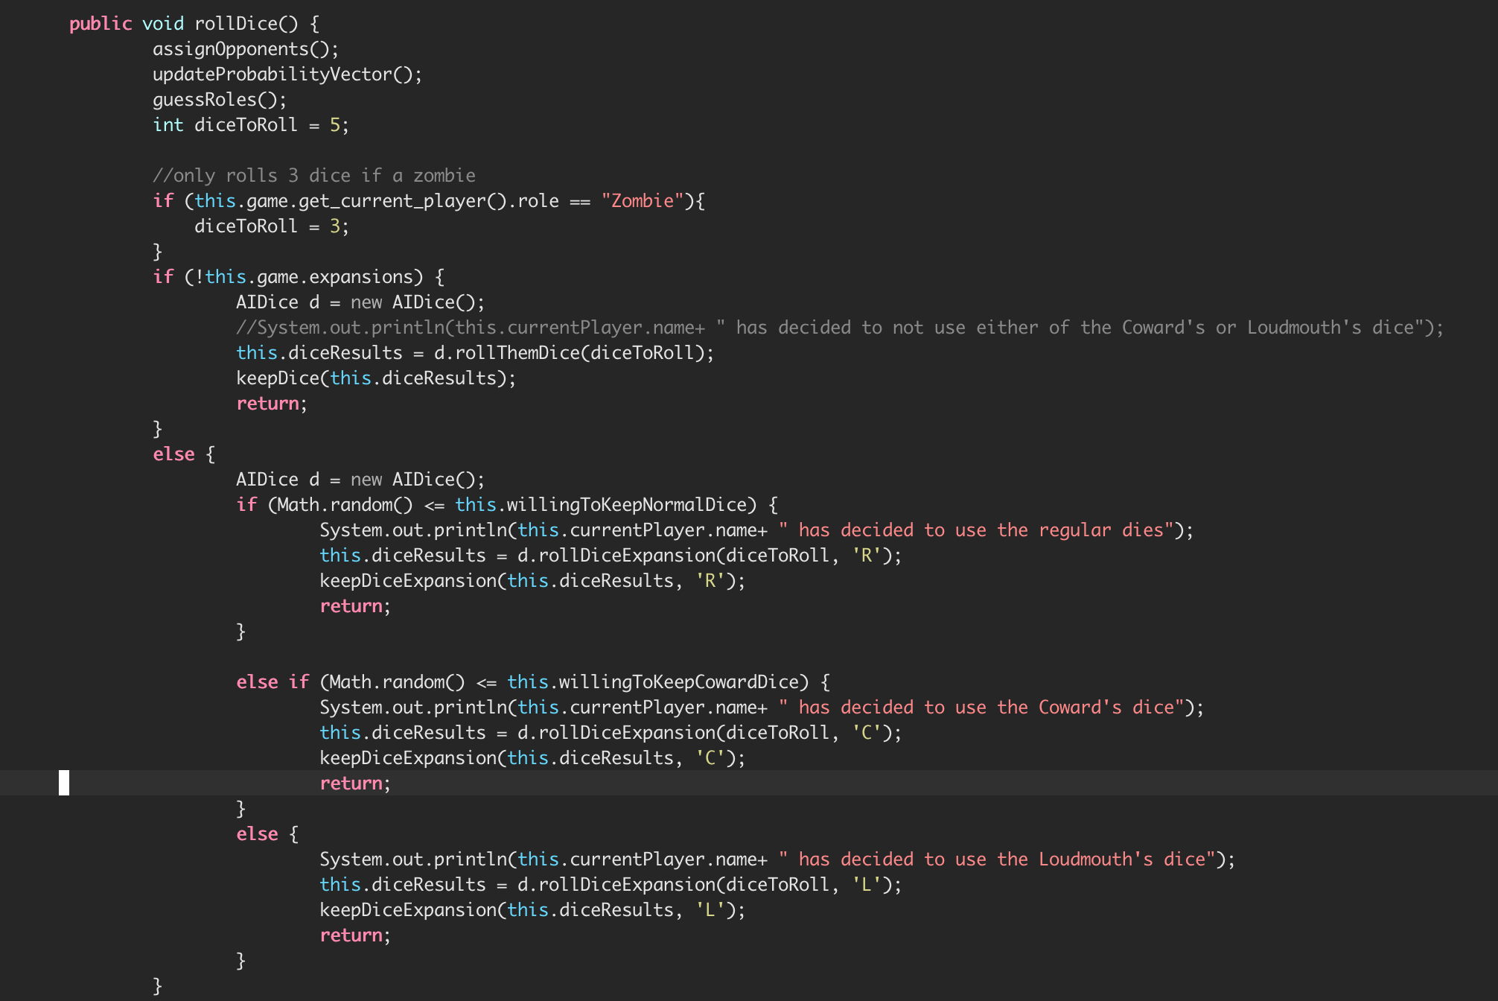
Code Highlights
The AI Dice Class
The AI Class could not exist without the SimulateAI Class (composition).
The AI Dice Class is dependent upon the AI class, thus the class also depends on the Simulate AI class.
Simulate AI Class

Slide 9
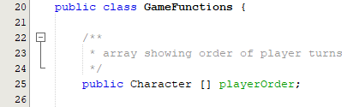
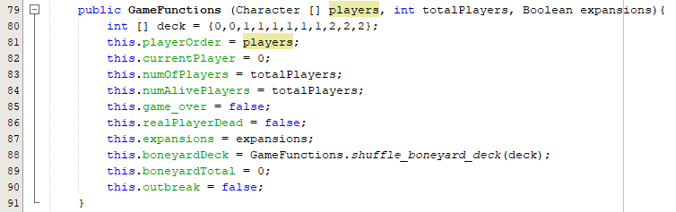
Code Highlights
GameFunctions Class using Character Class Code Fragment
The GameFunctions class makes an array of Character class objects (composition).

Slide 10
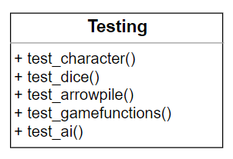
Code Highlights
The Unit Testing for the Character, Dice, ArrowPile, GameFunctions, and AI classes was completed by Cierra Ditmore.
Unit Testing UML Class Diagram

Slide 11
Project Demo
Bang Dice Game Video Demo Link

Slide 12
Submission Files
UML Class Diagrams, UML Use-Case Diagrams
Class JavaDoc documentation
Sourcecode
Powerpoint file

