Slide 1

CSV CHUNKING OPTIMIZER
Presented by
Notes:
1

Slide 2
Problem Statement: Challenges with CSV Data
The Challenge with CSV Data
Manual & Inefficient: Traditional CSV processing struggles with complexities such as commas within values, varying delimiters, and multi-line entries.
Poor Searchability: Simple keyword searches do not capture user intent or semantic meaning, resulting in irrelevant results.
One-Size-Fits-None: Basic chunking techniques generate poorly sized text fragments, limiting retrieval relevance.
Lack of Insight: Valuable metadata like sentiment or entity recognition within rows is often neglected, restricting advanced filtering capabilities.
Notes:
2

Slide 3
Tech Stack: Open-Source Foundations
Component
Primary Tools
Core Framework
LangChain
Data Processing
Pandas, BeautifulSoup4
All tools are open-source and installable via pip, except monitoring tools which run as separate services.
NLP & Enrichment
spaCy (NER), TextBlob (Sentiment)
Chunking
LangChain Text Splitters
Embedding Model
Sentence Transformers
Vector Database
ChromaDB
This stack supports scalable, maintainable,
and extensible pipeline development.
UI/API Framework
Streamlit
Monitoring
Prometheus, Loki, Grafana
Notes:
3

Slide 4
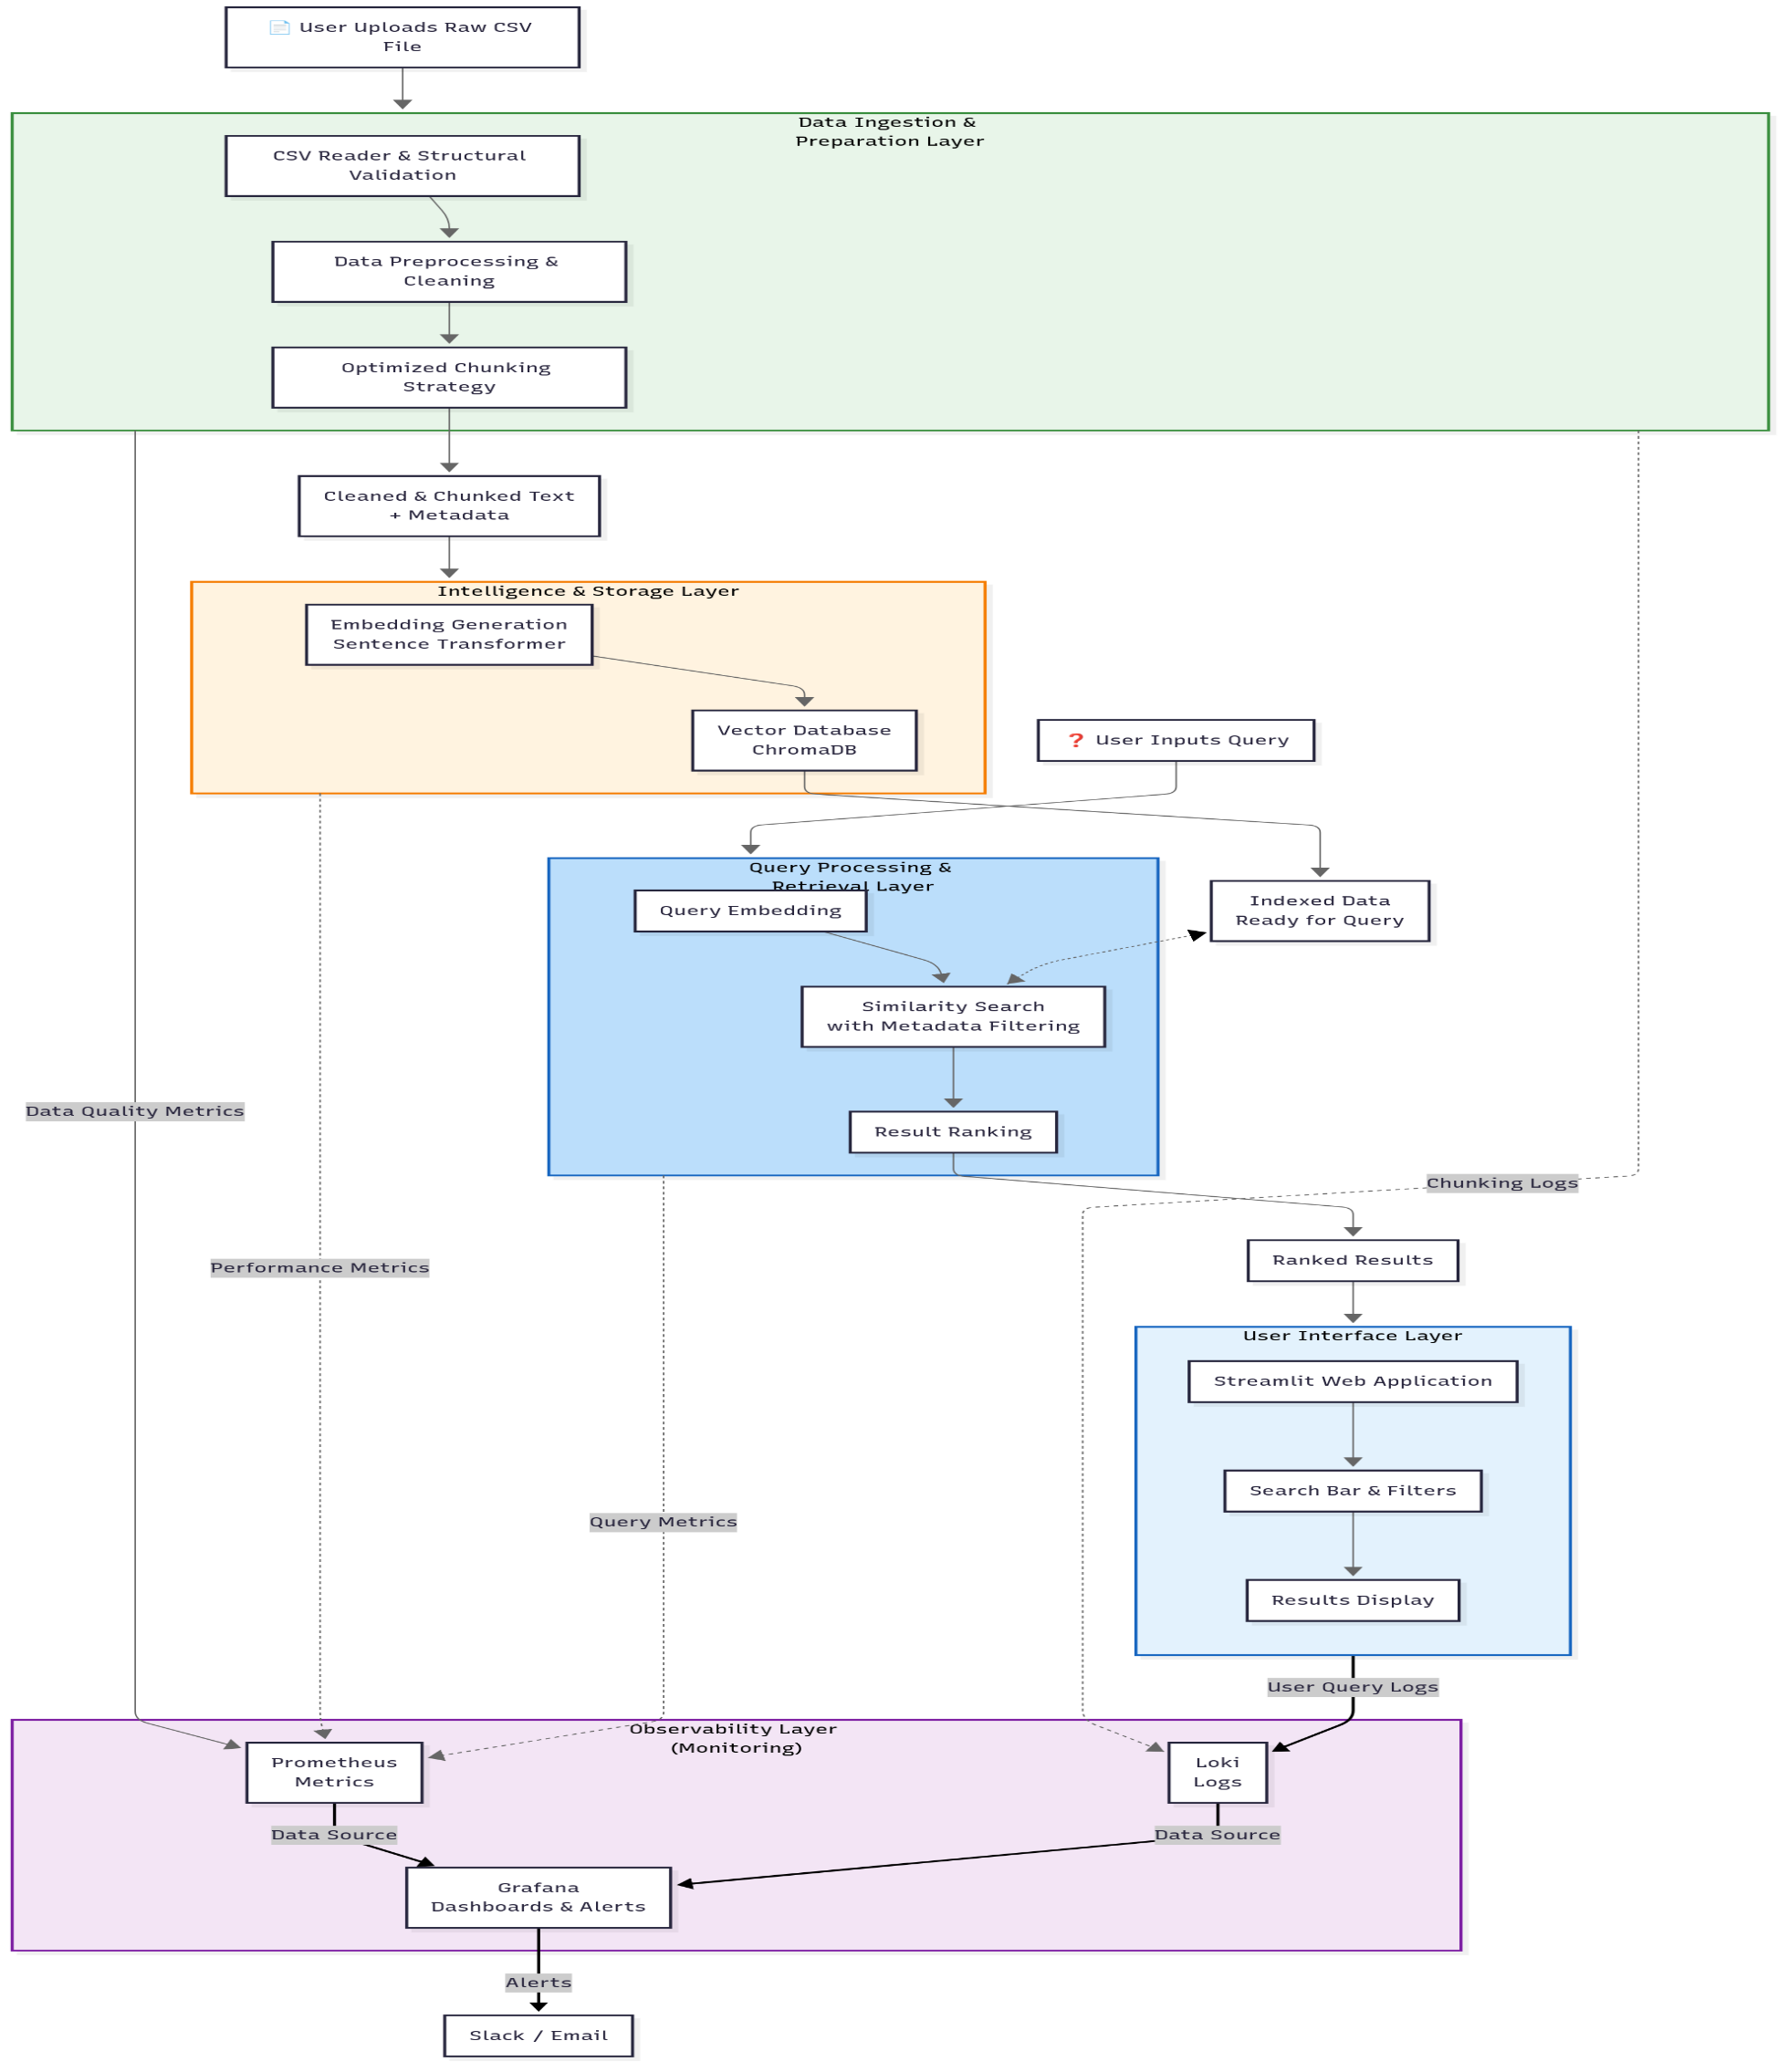
Solution Overview: A Layered Intelligent Architecture
Automated Pipeline from Raw CSV to Semantic Search
End-to-End Automation: Ingest, clean, chunk, and transform CSV data seamlessly.
Semantic AI Integration: Converts raw text into a knowledge base that understands meaning for precise query results.
Fast & Accurate Answers: Enables rapid retrieval
of relevant information through intelligent processing layers.
This architectural overview sets the stage for detailed
exploration of each processing layer.
Notes:
4

Slide 5
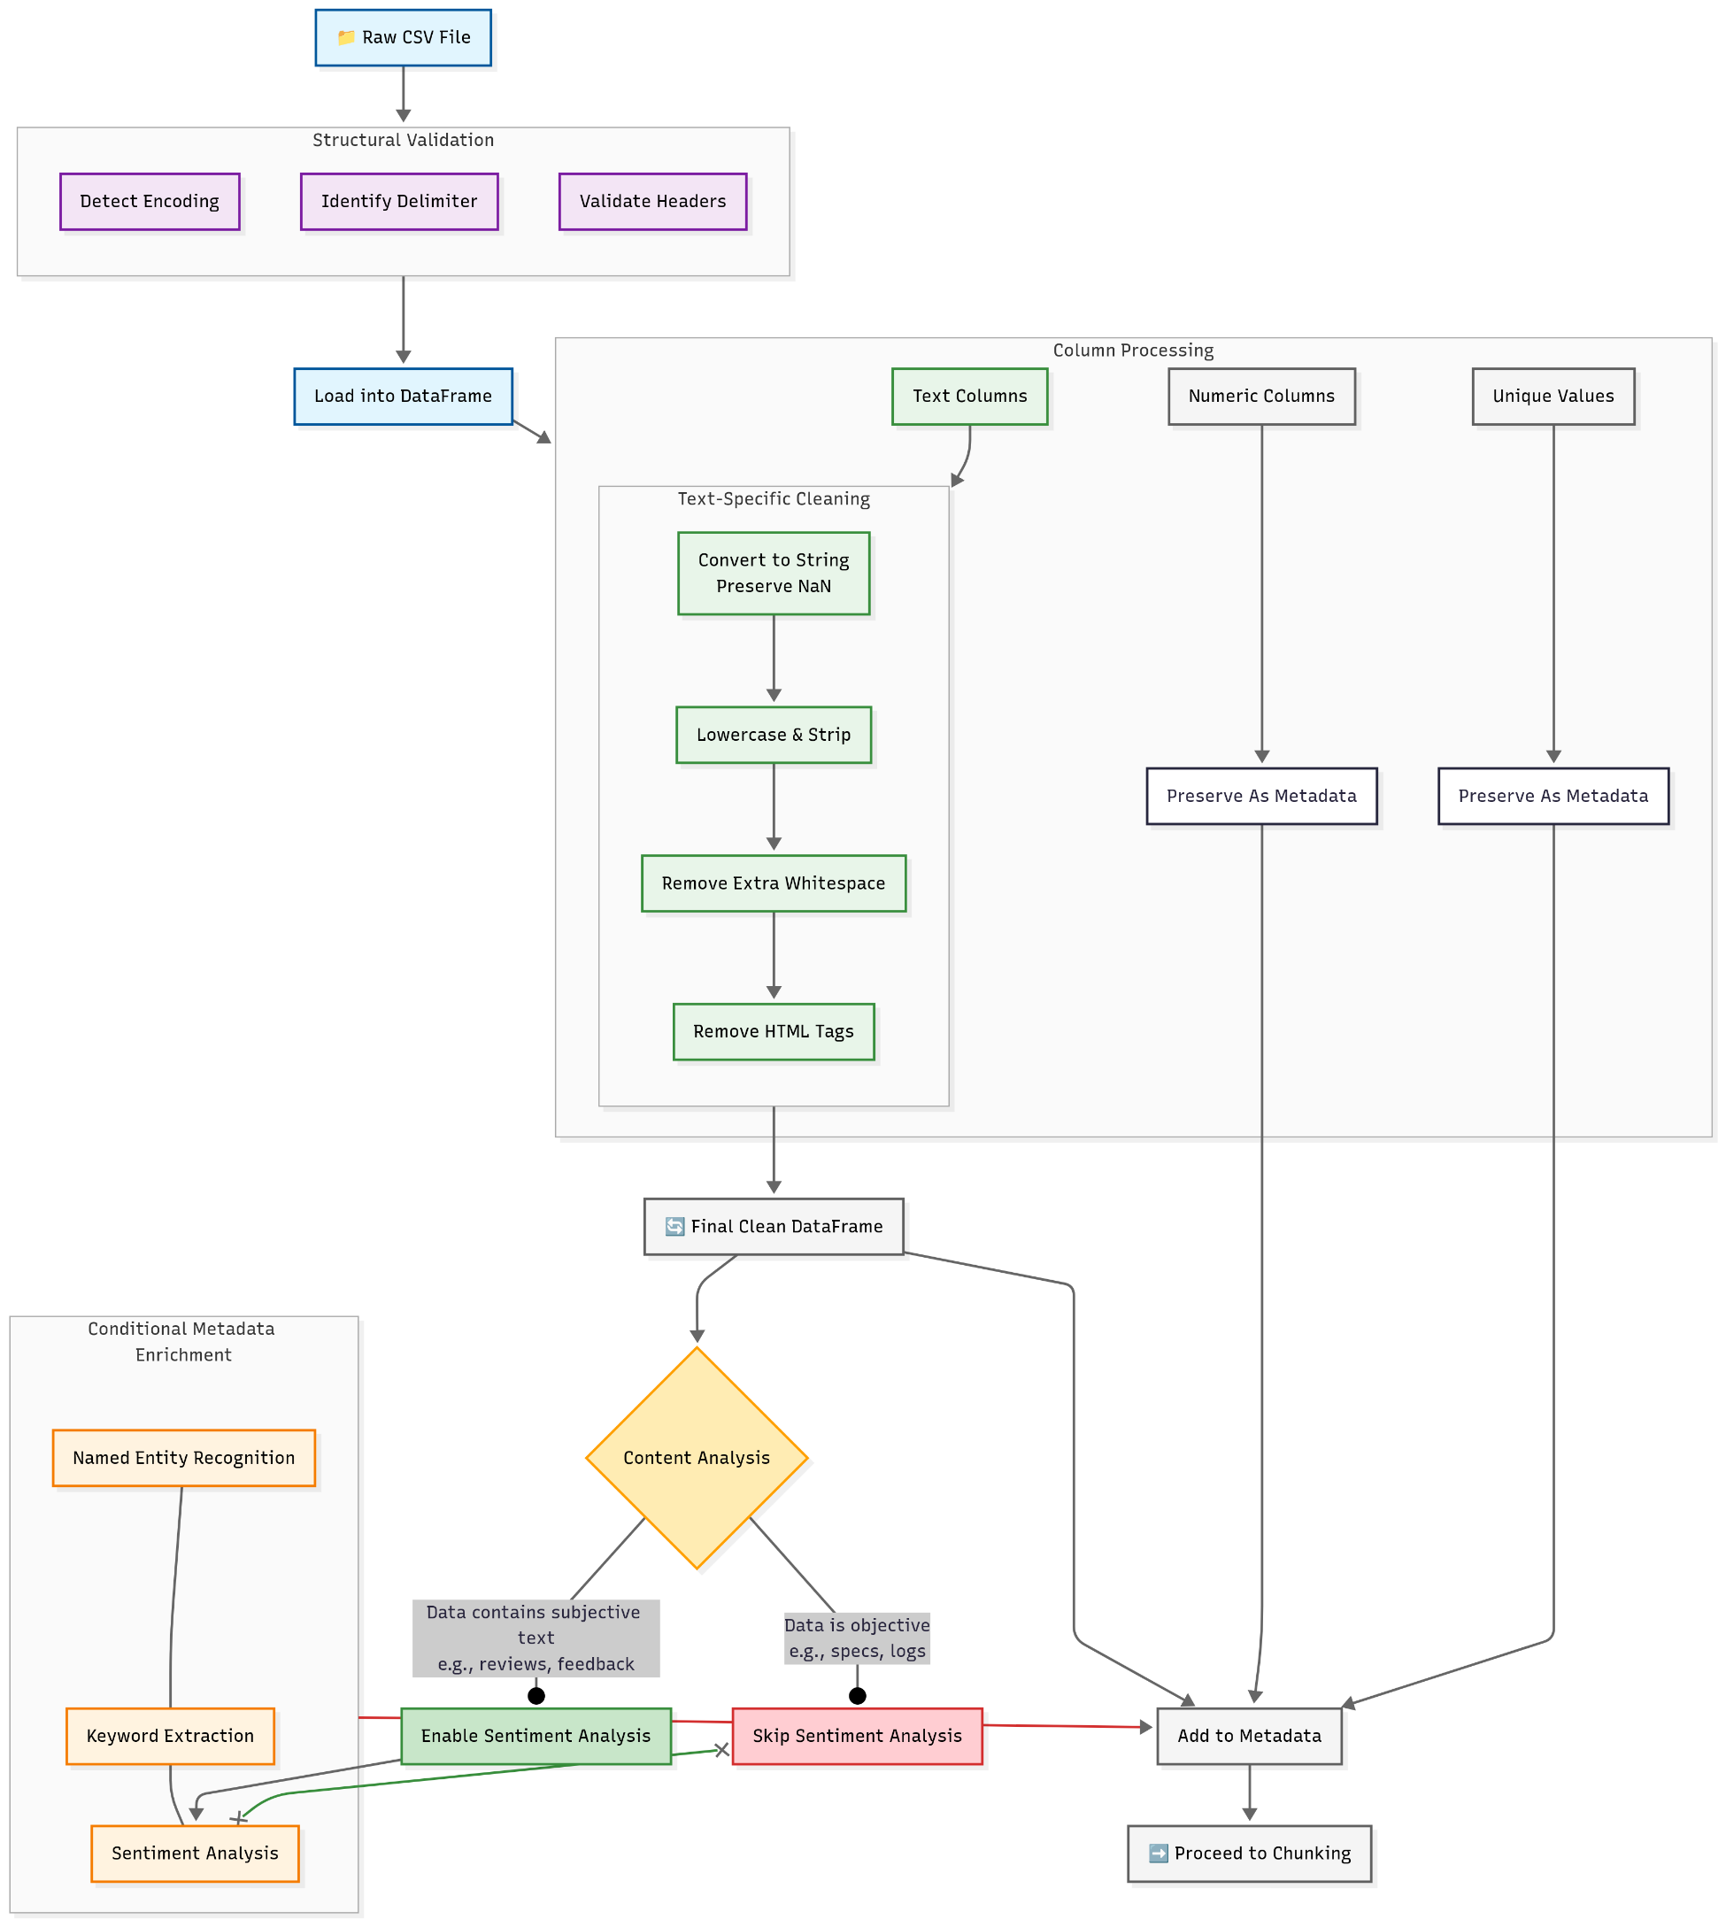
Architecture Layer 1: CSV Reader & Preprocessing
Purpose: Reliable Parsing and Cleaning of Raw CSV Data
Robust Parsing: Handles complex CSV structures, including embedded commas and multi-line cells.
Structural Validation: Auto-detects encoding, delimiters, and verifies header integrity.
Smart Cleaning: Normalizes text (e.g., lowercasing, HTML stripping) while preserving numeric fields as metadata for downstream filtering.
This foundational layer ensures data quality and integrity for subsequent stages.
Notes:
5

Slide 6
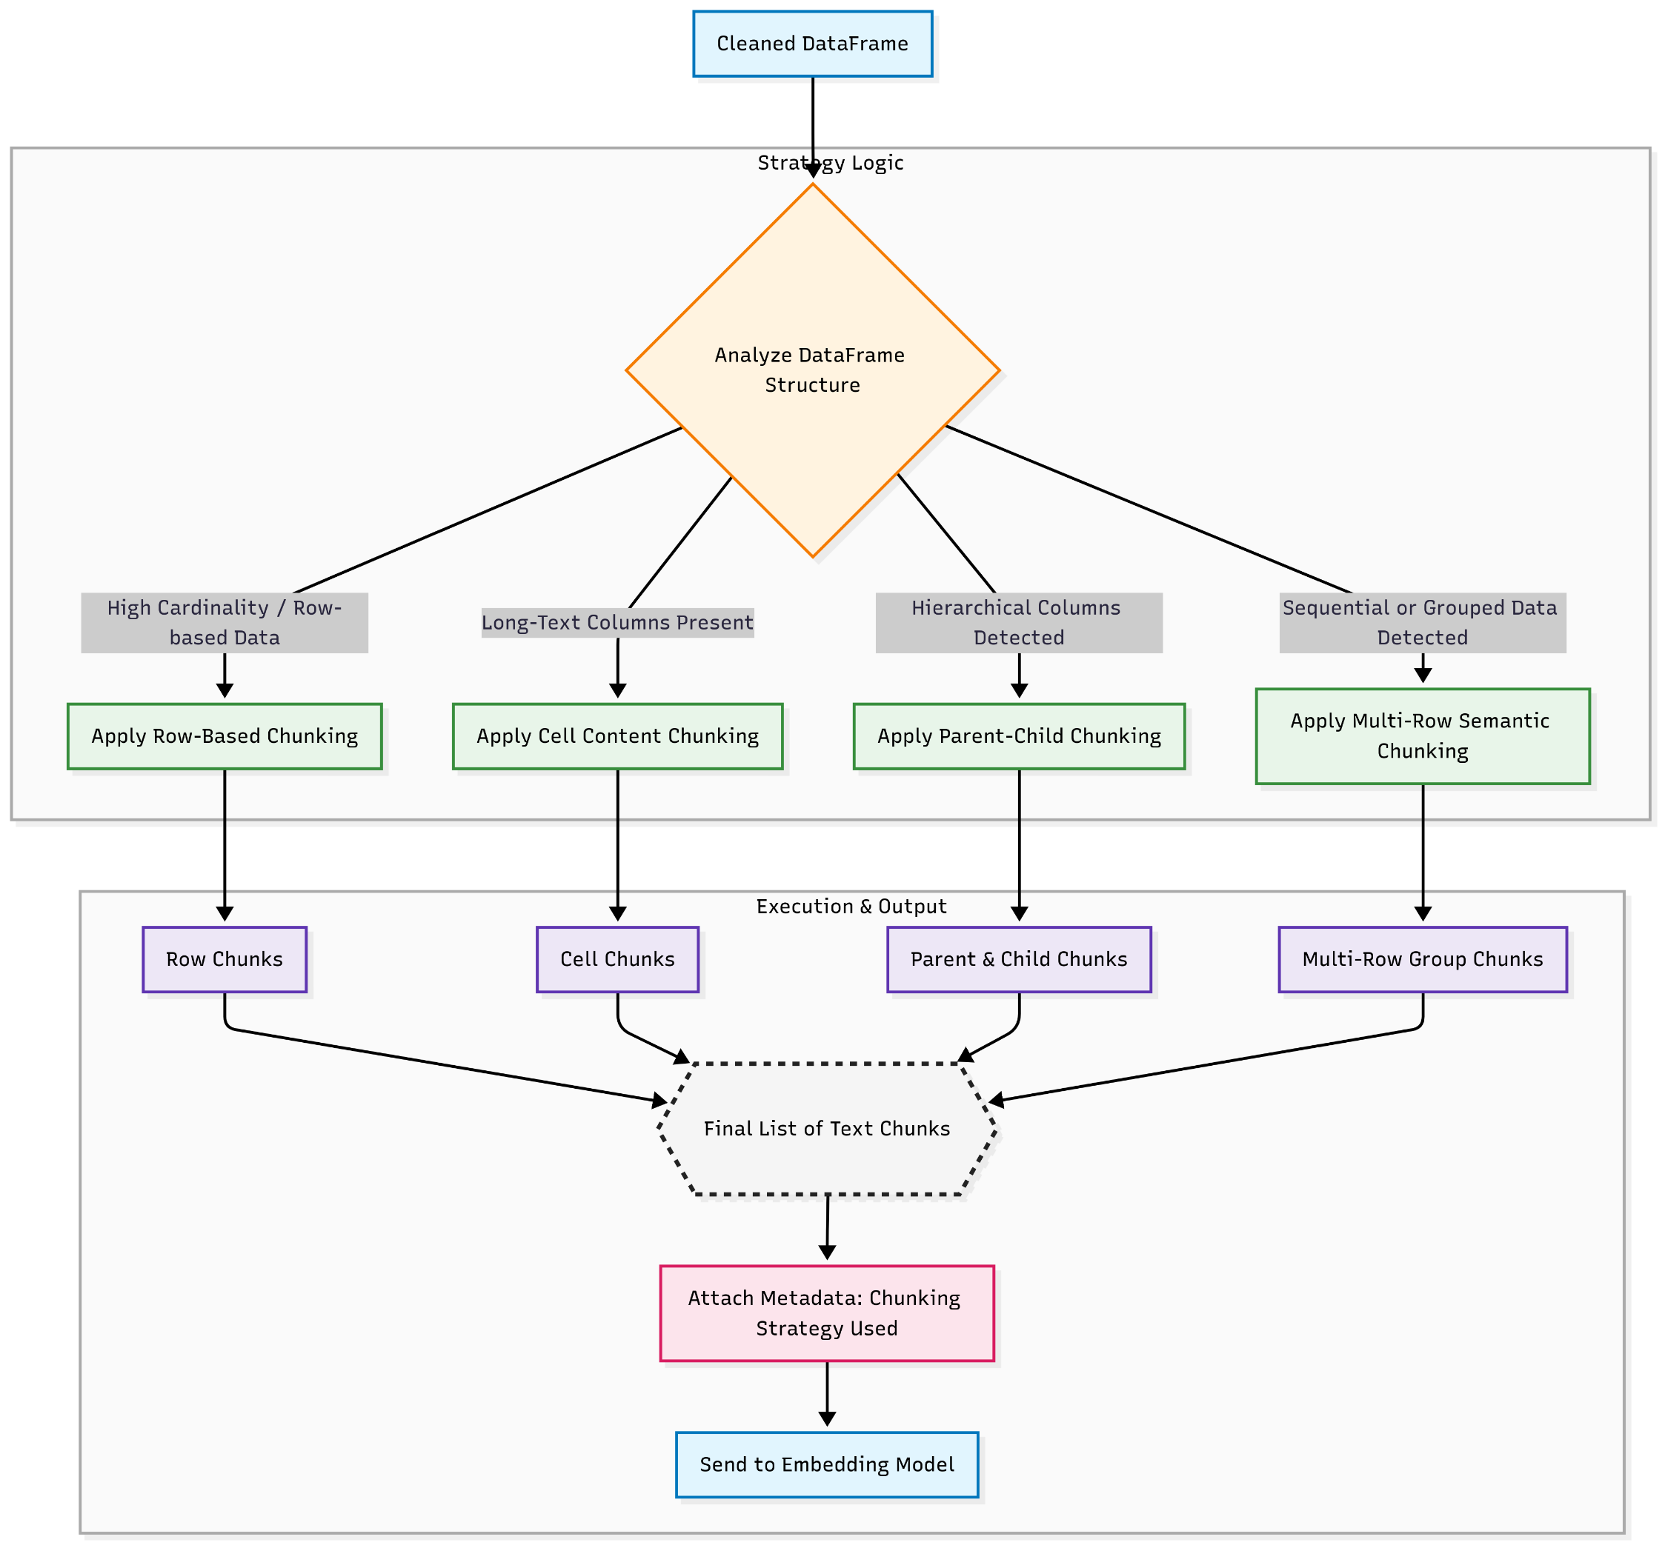
Architecture Layer 2: Optimized Chunking Strategies
Purpose: Breaking Text into Optimal Chunks for AI Retrieval
Adaptive Strategies: Applies four chunking methods based on data characteristics:
Row-based
Cell-content
Multi-row
Parent-Child relationships
Applies multiple chunking strategies in parallel, combining their outputs to form a richer, interconnected set of retrievable data.
Metadata Preservation: Each chunk is tagged with source and attributes for traceability & accurate filtering
This layer balances chunk size and context to maximize search relevance.
Notes:
6

Slide 7
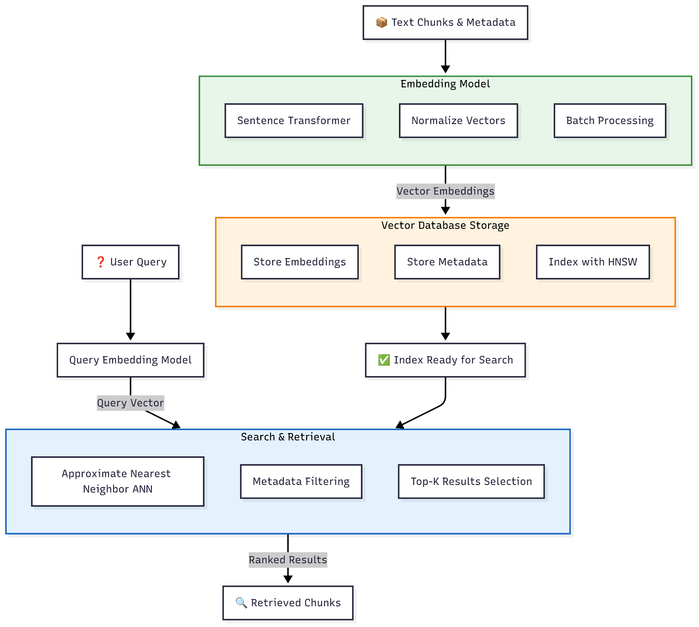
Architecture Layer 3: Intelligence & Storage
Purpose: Semantic Understanding and Efficient Storage for Search
Semantic Embedding: Uses Sentence Transformer models to encode text into vector representations capturing semantic meaning.
Vector Database: Stores embeddings and metadata in ChromaDB with HNSW indexing for Approximate Nearest Neighbor (ANN) search.
Hybrid Search: Combines semantic vector search with metadata filters (e.g., "positive reviews for products under $100") for fine-grained querying.
This layer enables context-aware retrieval to meet complex search demands.
Notes:
7

Slide 8
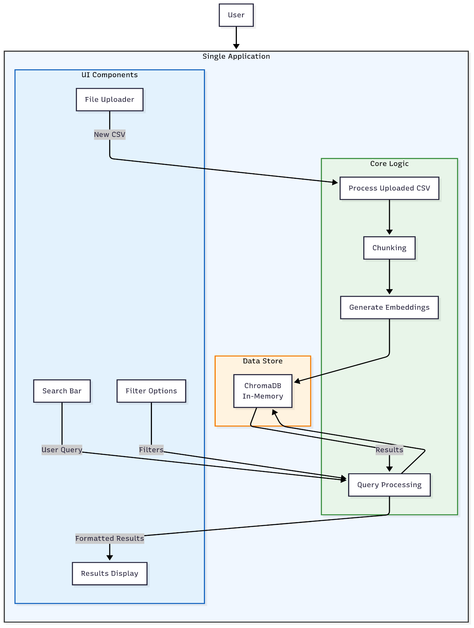
Architecture Layer 4: User Interface
Purpose: Simple, Powerful User Interaction
Streamlit Web App: Clean UI for CSV upload and question entry.
Real-Time Processing: Executes the full pipeline live within the app, from ingestion to embedding.
Filtered Results: Presents ranked, semantically relevant answers with source context and filter options for enhanced user control.
This interface layer bridges technical complexity and user accessibility.
Notes:
8

Slide 9
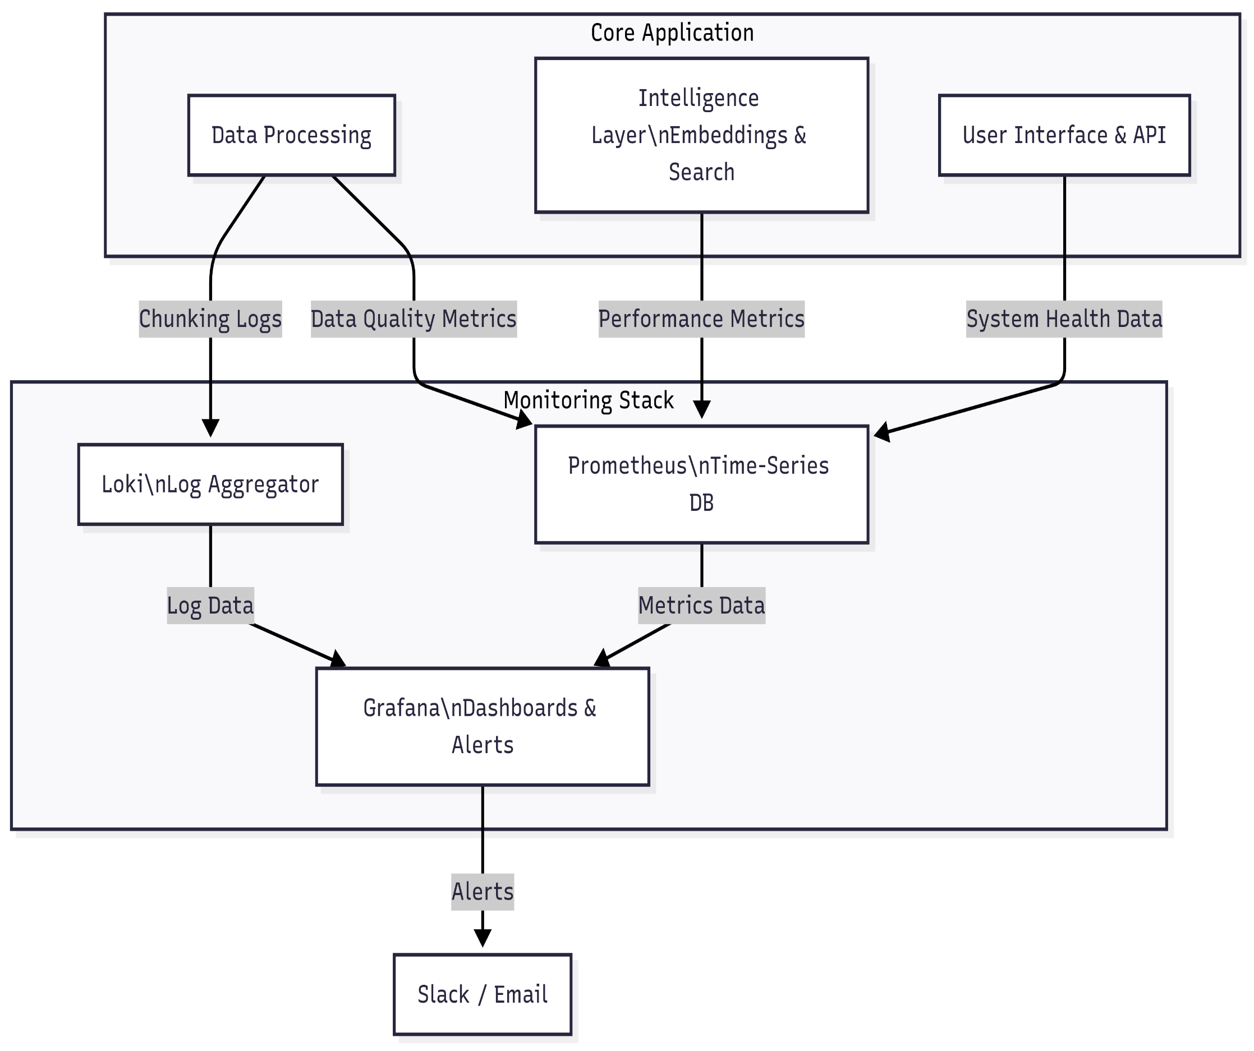
Architecture Layer 5: Monitoring & Observability
Purpose: Maintain System Health, Performance, and Quality
Proactive Tracking: Uses Prometheus to monitor data quality, chunk sizes, query latency, and overall system health.
Centralized Logging: Loki aggregates logs for debugging and auditing all pipeline stages.
Actionable Alerts: Grafana dashboards visualize metrics and trigger alerts for anomalies such as slow queries or oversized chunks.
This ensures reliability and maintainability in production environments.
Notes:
9

Slide 10
Sprint Goal – Week 1 – Foundation & Core Processing
Day | Task | Description | Deliverable
Day 1 | Project Setup & Core Dependencies | Initialize project repository (e.g., Git). Create requirements.txt with libraries (LangChain, Pandas, Sentence-Transformers, ChromaDB, Streamlit). Set up virtual environment and install packages. | Working Python environment with dependencies installed. GitHub/GitLab repository.
Day 2 | Robust CSV Reader & Validation | Implement CSV reading using Pandas. Add validation: auto-detect encoding, delimiter, validate headers. Handle errors gracefully. | Python function that returns cleaned DataFrame or useful error message.
Day 3 | Text Preprocessing Pipeline | Build text cleaning functions: lowercase, strip whitespace, remove HTML tags. Separate text columns (to be cleaned) from numeric/categorical (stored as metadata). | Module with preprocessing functions returning cleaned DataFrame.
Day 4 | Implement Row-Based Chunking | Develop chunking strategy: convert each row into formatted text (e.g., "ColumnName: Value, OtherColumn: Value"). | Function that outputs list of text chunks from DataFrame.
Day 5 | Implement Cell-Based Chunking | Use LangChain’s RecursiveCharacterTextSplitter for long text columns (e.g., descriptions). Preserve row metadata for each new chunk. | Function to generate chunks from specific long-text columns.

Slide 11
Week 2 – Intelligence, Search & Interface
Day | Task | Description | Deliverable
Day 6 | Embedding Generation & Storage | Initialize Sentence Transformer model. Create function to take list of text chunks, generate embeddings in batches, and store them in ChromaDB collection with metadata. | Script that processes chunks and populates ChromaDB vector store.
Day 7 | Search & Retrieval Logic | Build core search function: (1) take user query, (2) generate embedding, (3) query ChromaDB for similar vectors, (4) return top-K results with text + metadata. | Function search_query(query: str, filters: dict) returning ranked results.
Day 8 | Streamlit UI – Data Ingestion | Build UI components: file uploader + processing button. Trigger backend pipeline (Days 2–5) and store resulting vectors in ChromaDB (Day 6). | Web app where user uploads CSV and sees “Processing Successful” message.
Day 9 | Streamlit UI – Search Interface | Build search bar + results display in Streamlit. Connect UI to search function (Day 7). Display results neatly, showing source text and metadata. | Web app where user asks a question and gets semantic search results.
Day 10 | Debugging, Polish & Stretch Goals | Test pipeline with multiple CSVs. Fix bugs. Add loading indicators. Stretch goals: filter sidebar, better error messages, basic README for project. | Robust functional MVP + plan for future improvements.

Slide 12
Expected Outcome & Benefits
Delivering High-Impact Results
High-Quality Search: Drasatically improved accuracy and relevance through semantic understanding.
Adaptive Processing: Automatic selection of optimal strategies for diverse CSV data.
Powerful Hybrid Queries: Complex user queries with precise metadata-based filtering.
Production-Ready: Robust, observable, and maintainable system suitable for real-world deployment.
Notes:
12

Slide 13
Thank you for your attention. Questions?

