Slide 1
BASIC COMPUTER CONCEPTS
Updated 8/27/04
Notes:
1
1

Slide 2
HARDWARE VS. SOFTWARE
Hardware
  The computer equipment
  Includes printers, monitors, disk drives, etc.
Software
  Programs which tell the computer what to do
  Examples - word processing, gradebook, tutorials, games, etc.
Notes:
3
3

Slide 3

Notes:
4
4

Slide 4
HISTORY OF COMPUTERS
Charles Babbage - father of computer
  1800’s planned analytical engine
ENIAC - developed at end of WW II
1951 - 1963 1st and 2nd generation
  very large, used unreliable vacuum tubes
1963 - present - 3rd and 4th generation
  smaller, faster - use transistors and integrated circuits

Slide 5
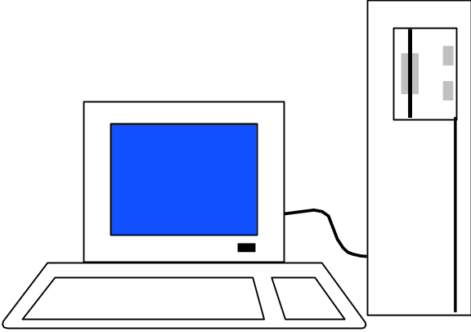
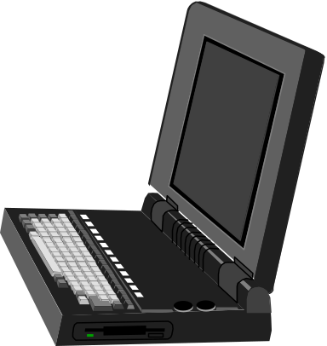
TYPES OF COMPUTERS – PERSONAL COMPUTERS (PC)
Also called Microcomputers
Available in desktop size, notebook size and handheld
Can be IBM, IBM Compatible or Apple
Notes:
8
8

Slide 6
COMPUTER OPERATIONS
Input
Processing
Output
External Storage
Notes:
9
9

Slide 7
INPUT DEVICES - KEYBOARD
Most commonly used input device
Ergonomic - fit natural hand placement
Special keys
  Enter, Function, Ctrl, Alt, Num Lock, Esc
Notes:
10
10

Slide 8
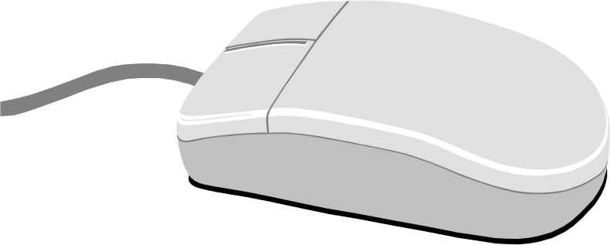
INPUT DEVICES - MOUSE
Controls cursor on screen
May be mechanical or optical
Most models have a “wheel” for scrolling
Notes:
11
11

Slide 9
INPUT DEVICES - OTHER
Pointers (replaces mouse on notepads)
  Track point, track ball, touch pad
Scanner
Digital camera
Touch screen
Voice
Notes:
12
12

Slide 10
OUTPUT DEVICES
Monitor
Printer
Disk Drive
  Can also be input device
Modem
  Can also be input device
Notes:
24
24

Slide 11
MONITORS
Made up of tiny elements called pixels
Each row of pixels is called a scan line
Picture is displayed by an electronic beam lighting up certain pixels
Notes:
25
25

Slide 12
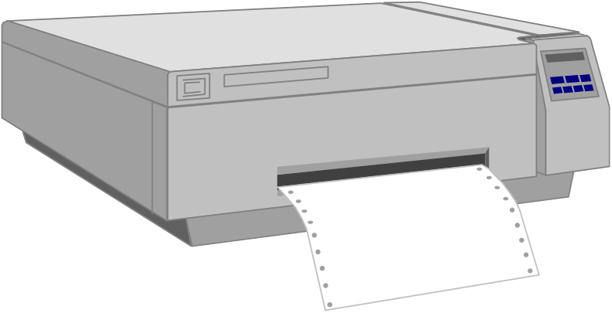
PRINTERS
Laser
Ink Jet
Dot Matrix
Notes:
32
32

Slide 13
BASIC PROCESSING CYCLE
Central
Processing
Unit
Internal
Memory
Data Bus
Notes:
13
13

Slide 14
HOW INFORMATION IS STORED
Memory consist of switches which can be either on or off - Off=0 On=1
Each on/off switch is called a bit
Eight bits make up a byte
It takes one byte to store a character
  Character can be letter, space, punctuation, etc.
  ASCII code used
Notes:
20
20

Slide 15
OTHER MEMORY TERMS
Byte is eight bits
Kilobyte (KB) is approx. 1,000 bytes
Megabyte (MB) is approx. 1million bytes
Gigabyte (GB) is approx. 1 billion bytes
Notes:
21
21

Slide 16
CENTRAL PROCESSING UNIT
Also called CPU, processor or microprocessor
Is the “brains” of the computer
Performs all computer operations
Notes:
14
14

Slide 17
INTERNAL MEMORY - RAM
RAM - Random Access Memory
  CPU can access any location as quickly as any other
Can not only read current info but also write new info
Very important in determining capabilities of the computer system
Computer should have at least 256 megs - 512 preferred (can add to later)
Notes:
23
23

Slide 18
INTERNAL MEMORY - ROM
ROM - Read Only Memory
  Can read info Stored in ROM
  Can not write new info into ROM
Used for “internal workings” of computer
Buyer is not very concerned with ROM
Notes:
22
22

Slide 19
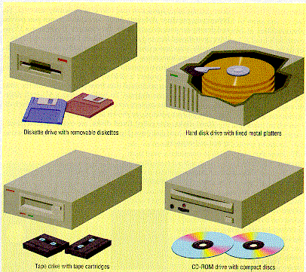
EXTERNAL MEMORY
Notes:
36
36

Slide 20
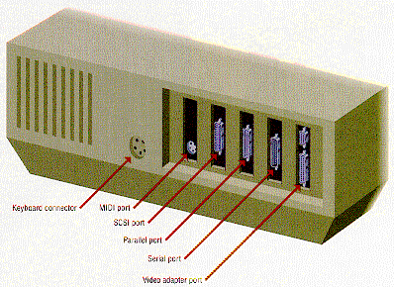
PORTS
Connects computer to another device
Parallel port
  Used primarily by printers
Serial ports
  Modem, mouse, etc.
SCSI - chain devices
USB –may be needed for
  Digital Cameras
  Mp3 players
  Other devices
Notes:
46
44

Slide 21
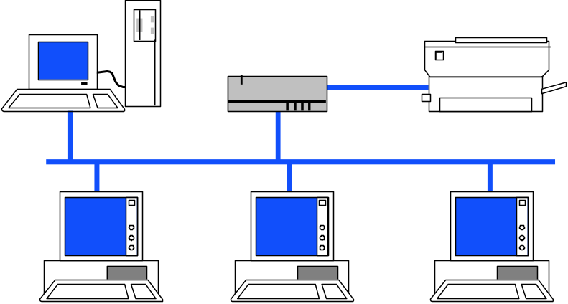
NETWORKS
Connects computers
LAN - Local Area
WAN - Wide Area
Wireless
Allows sharing of programs, files, printers, etc.
Server is “main” computer
Notes:
44
43

Slide 22
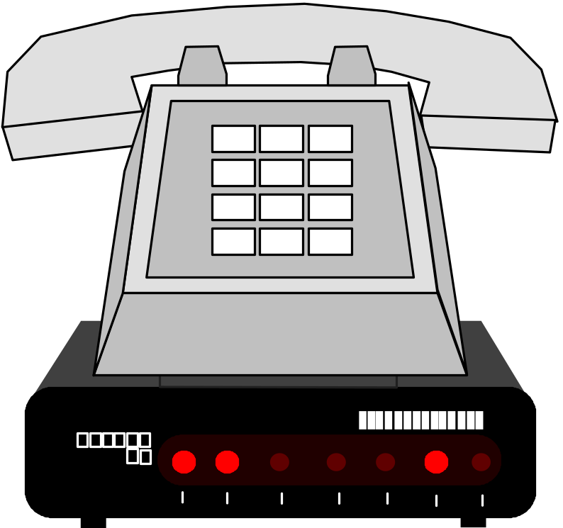
MODEMS - GENERAL
Allows 2 computers to communicate over phone lines
Can be internal or external
Can also have fax capabilities
Notes:
42
41

Slide 23
MODEMS
Bits per second(bps) indicates speed
  Old modems - 9,600, 14,400, 28,800, 33,600
  56,000 (56K) has becoming standard
Ways of connecting to the Internet
  Dial-up modem – used in most homes
  Cable modem – uses TV cable lines
  DSL – modified phone line
  T1 line – used by schools, businesses, etc.
Notes:
43
42

Slide 24

Notes:
48
47

Slide 25
PROGRAMS
Set of instructions to the computer
Programming languages
  Machine language
  Assembly language
  Procedural languages
    Basic, Fortran, Cobol
  Object oriented languages
    Visual Basic, C++, C#, Java

Slide 26
SYSTEMS SOFTWARE
Run fundamental operations
  Loading and running programs
  Saving and retrieving data
  Communicating with printers, modems, etc.
Examples of systems software
  DOS
  Windows 3.1, 95, 98, Me, 2000, and XP
  Unix
  Linux
Notes:
49
48

Slide 27
APPLICATIONS SOFTWARE
Helps you to accomplish a certain task
Examples
  Word processing - memos, reports, etc.
  Spreadsheets - budgets, etc.
  Database - search, sort, select data
  Educational - simulations, practice
  Graphics - charts, diagrams
  Desktop publishing - pamphlets, etc.
Notes:
50
49

Slide 28
SOFTWARE VIRUSES
Illegal code added to a program
May spread to many computers
  Copy files from one computer to another
  Download files by modem
  E-mail attachments
Virus may be relatively harmless
  Writes “You’ve been stoned” on screen
Virus may also be very damaging
  Erases everything on hard drive
Virus may activate on a certain date
Notes:
52
51

Slide 29
VIRUS PROTECTION
Be careful where you copy files from
Do not open e-mail attachments unless you are sure that it is safe
Use virus protection program
  Detects and removes illegal code
  Should be updated often
Notes:
53
52

Slide 30
BASIC COMPUTER CONCEPTS
End of Slide Show

Slide 31
ASCII –
  American Standard Code for information Interchange.
  Hi → H = 72 i =104

