Slide 1
IMAGE CLASSIFICATION
SUBMITTED BY: SHANTY EMERSON

Slide 2
CONTENT
INTRODUCTION
DATA COLLECTION
TRAINING MODEL
DATA VISUALIZATION
MODEL CREATION
CONCLUSION
THANKYOU

Slide 3
INTRODUCTION
Business Problem Framing
We have scraped total 1795 data from each Sarees, Trousers and Jeans from Amazon website and train model using Deep Learning to predict the category of the image
Conceptual Background of the Domain Problem
Images are one of the major sources of data in the field of data science and AI. This field is making appropriate use of information that can be gathered through images by examining its features and details. We are trying to give you an exposure of how an end to end project is developed in this field. The idea behind this project is to build a deep learning-based Image Classification model on images that will be scraped from e-commerce portal. This is done to make the model more and more robust. This task is divided into two phases: Data Collection and Model Building. Data Collection Phase: In this section, you need to scrape images from e-commerce portal, Amazon.com
The clothing categories used for scraping will be:
Sarees (women)
Trousers (men)
Jeans (men)

Slide 4
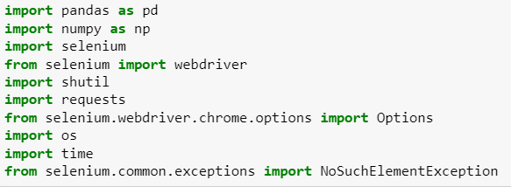
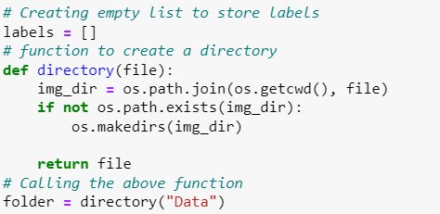
DATA COLLECTION
Web Scrapping also called “Crawling” or “Spidering” is the technique to gather data automatically from an online source usually from a website. While Web Scrapping is an easy way to get a large volume of data in a relatively short time frame, it adds stress to the server where the source is hosted.
One can utilize the data collected from a website such as e-commerce portal, Job portals, social media channels to understand customer’s buying patterns, employee attrition behavior, and customer’s sentiments and the list goes on.
Most popular libraries or frameworks that are used in Python for Web – Scrapping are Beautiful Soup, Scrappy & Selenium.
Selenium is an open-source web-based automation tool. Selenium primarily used for testing in the industry but It can also be used for web scraping. We’ll use the Chrome browser but you can try on any browser, It’s almost the same.

Slide 5
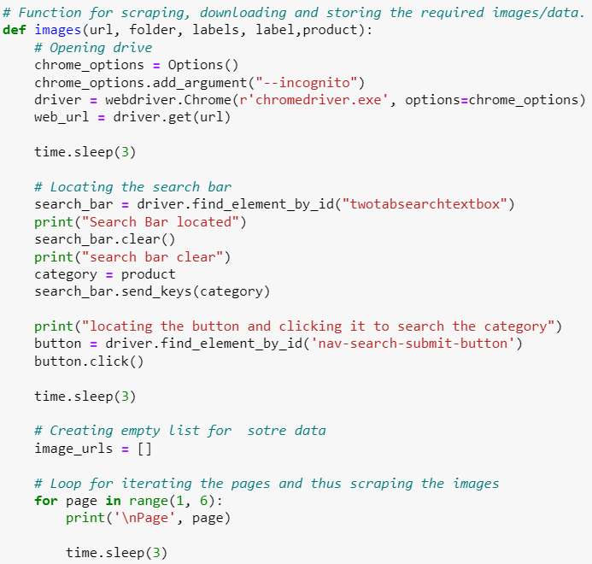
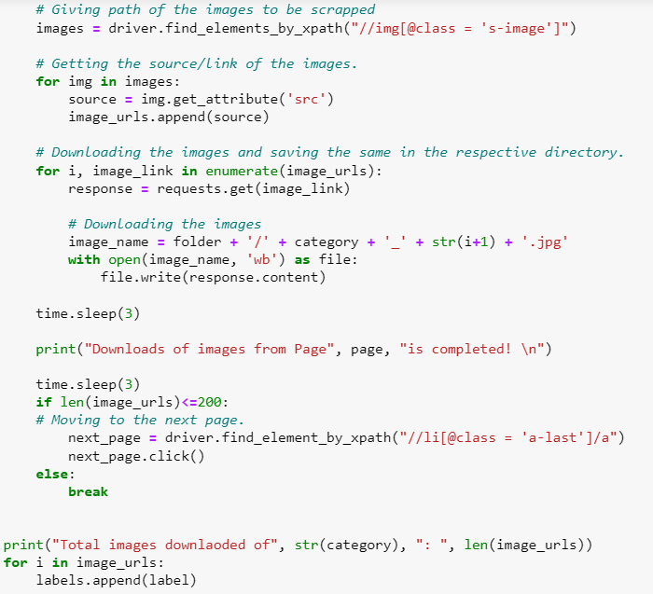
DATA COLLECTION

Slide 6
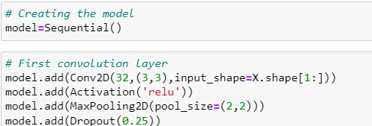
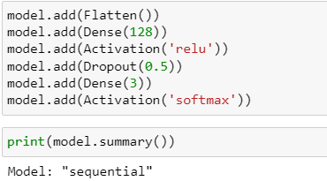
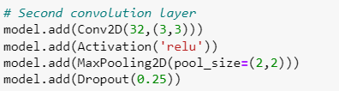
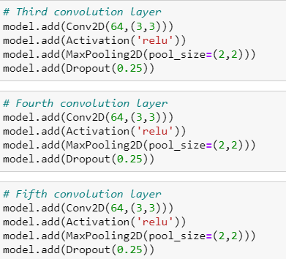
Training Model for Classification
OPTIMISER

Slide 7
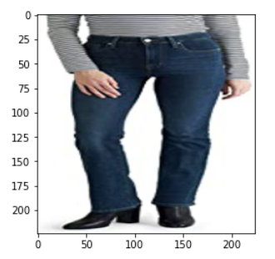
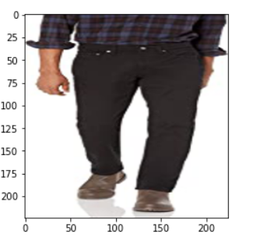
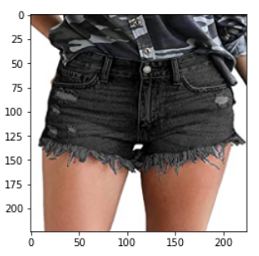
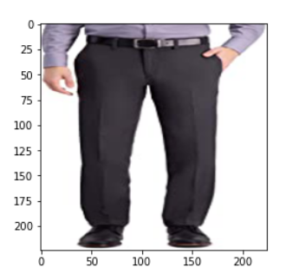
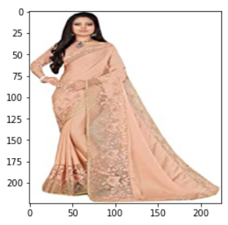
DATA VISUALIZATION

Slide 8
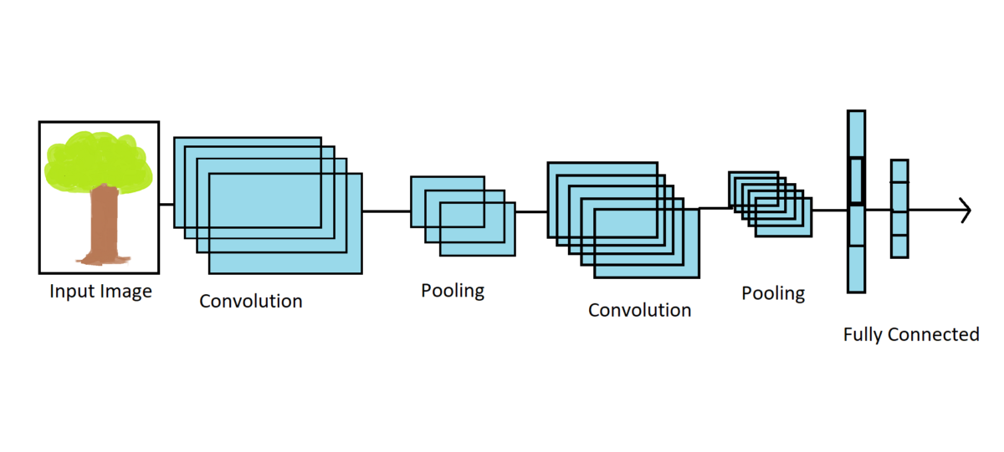
MODEL CREATION
The model type that we will be using is Sequential. Sequential is the easiest way to build a model in Keras. It allows you to build a model layer by layer.
We use the ‘add()’ function to add layers to our model. Our first 2 layers are Conv2D layers. These are convolution layers that will deal with our input images, which are seen as 2-dimensional matrices.
In between the Conv2D layers and the dense layer, there is a ‘Flatten’ layer. Flatten serves as a connection between the convolution and dense layers.

Slide 9
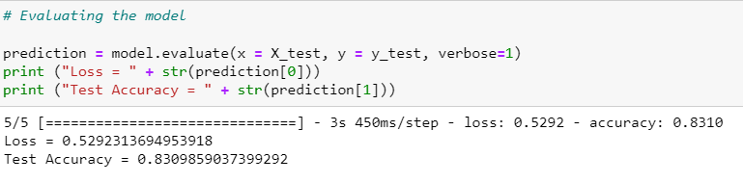
CONCLUSION
The Test Accuracy 83%.
We have got a good accuracy because we have collected more than 200 data if we collect more than 1000 data, we would be able to train the dataset with better accuracy.

Slide 10
Thank You

