Slide 1

MALIGNANT COMMENTS CLASSIFIER
Submitted by: SHANTY EMERSON

Slide 2
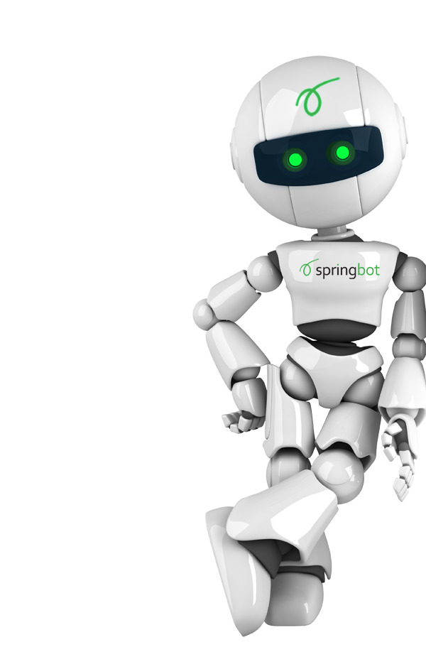
CONTENT
Introduction
Database Description
Data Preprocessing
Data Visualization
Data Modelling
Evaluation Metrics
Final Model
Conclusion

Slide 3

INTRODUCTION
The proliferation of social media enables people to express their opinions widely online. However, at the same time, this has resulted in the emergence of conflict and hate, making online environments uninviting for users. Although researchers have found that hate is a problem across multiple platforms, there is a lack of models for online hate detection.
Online hate, described as abusive language, aggression, cyberbullying, hatefulness and many others has been identified as a major threat on online social media platforms. Social media platforms are the most prominent grounds for such toxic behaviour. Engage your Audience
There has been a remarkable increase in the cases of cyberbullying and trolls on various social media platforms. Many celebrities and influences are facing backlashes from people and have to come across hateful and offensive comments. This can take a toll on anyone and affect them mentally leading to depression, mental illness, self-hatred and suicidal thoughts

Slide 4

DATABASE DESCRIPTION
The data set contains the training set, which has approximately 1,59,000 samples and the test set which contains nearly 1,53,000 samples. All the data samples contain 8 fields which includes ‘Id’, ‘Comments’, ‘Malignant’, ‘Highly malignant’, ‘Rude’, ‘Threat’, ‘Abuse’ and ‘Loathe’.
The label can be either 0 or 1, where 0 denotes a NO while 1 denotes a YES. There are various comments which have multiple labels. The first attribute is a unique ID associated with each comment.
The dataset shape is Train.csv (159571, 8) Test.csv (153164, 2)
The data set includes attributes:
1.Malignant
2.Highly Malignant
3.Rude
4.Threat
5.Abuse
6.Loathe
7.ID
8.Comment text

Slide 5
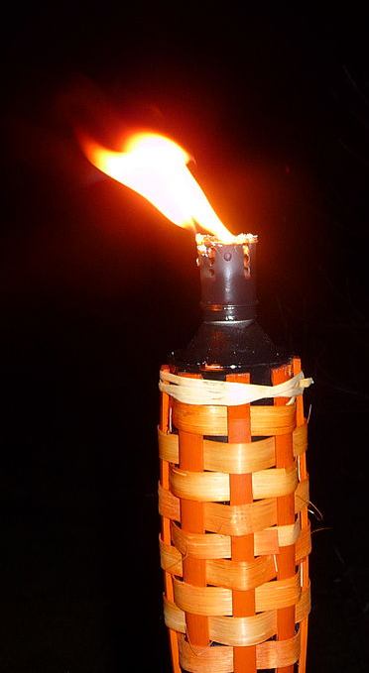
DATA PREPROCESSING
Import necessary libraries
Read the train.csv and test.csv file(parallelly pre-processing is done for both train and test datasets).
Making of corpus by GENERIC NLP FILTER CODE
a) Convert all cases to lower
b) Remove punctuations
c) Remove Stop words
d) Stemming and Lemmatising
Applying embedding technique.
(TF-IDF Encoding)
Train_test_split: Training data in a different way as our target feature('labels') contains 6 classes.
Data is now ready for model building process input i.e vectors(numerical format

Slide 6
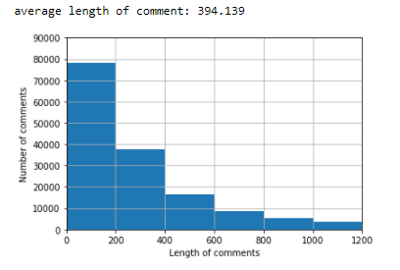
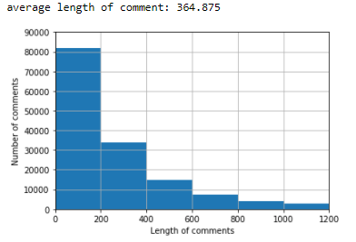
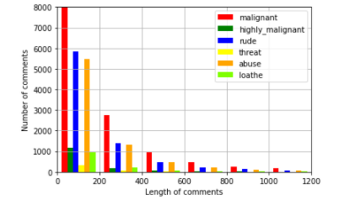
DATA VISUALIZATION
Analyzing No. of comments having lengths varying from 0 to 1200
Number of comments classified as: malignant,highly_malignant,rude. Depending on their lengths for train data.
Inference from Data-→Data with low sentence lengths( <200) are malignant,highly_malignant & rude.

Slide 7
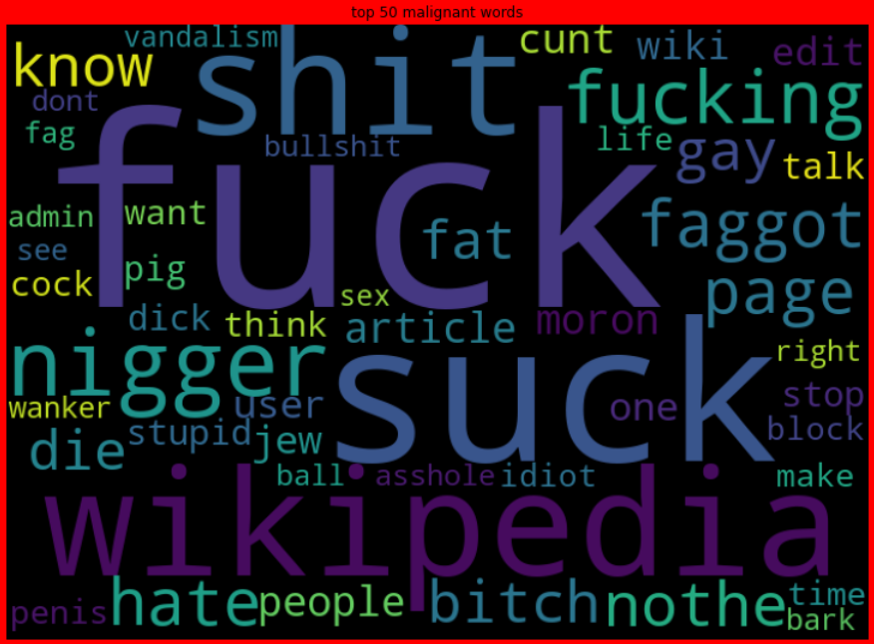
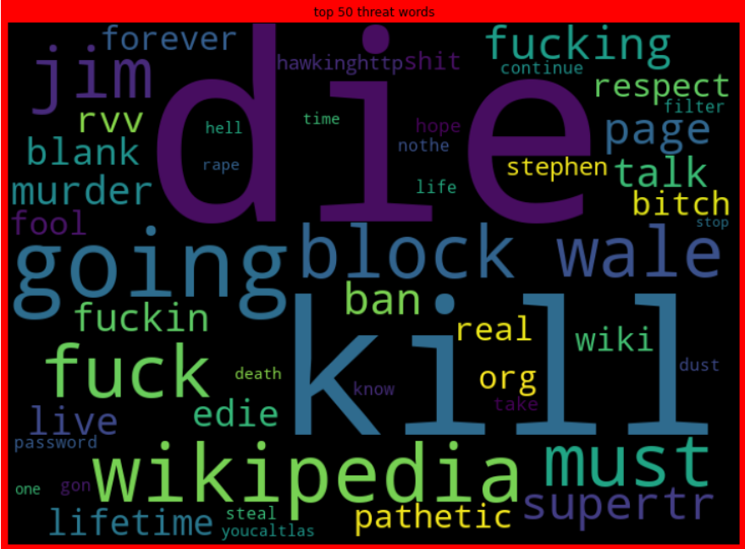
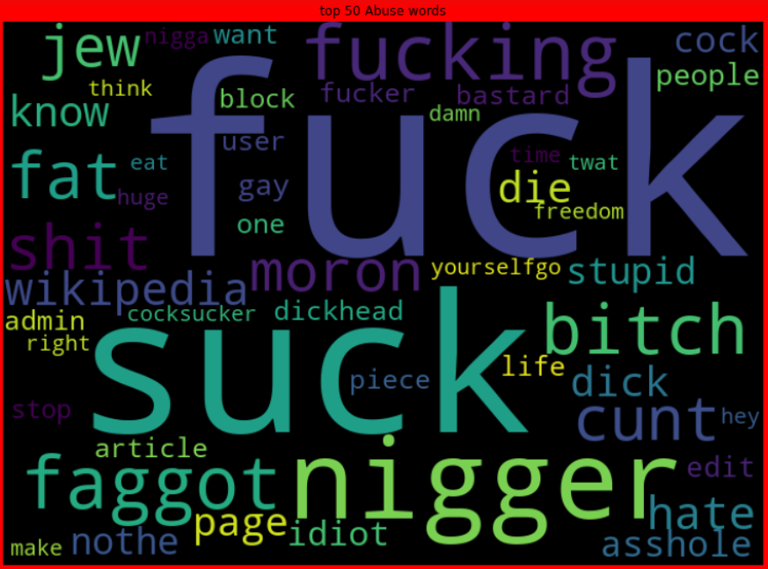
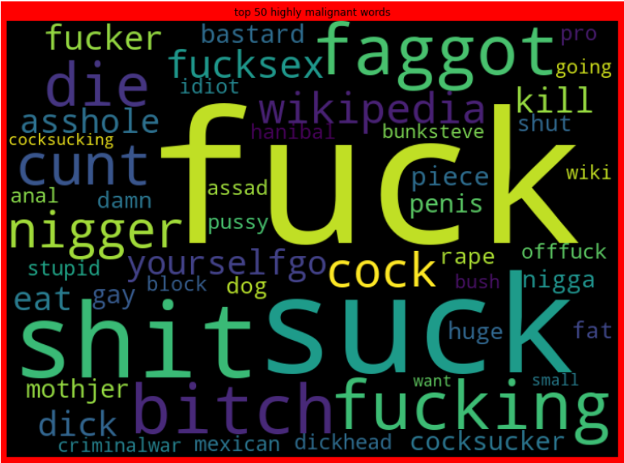
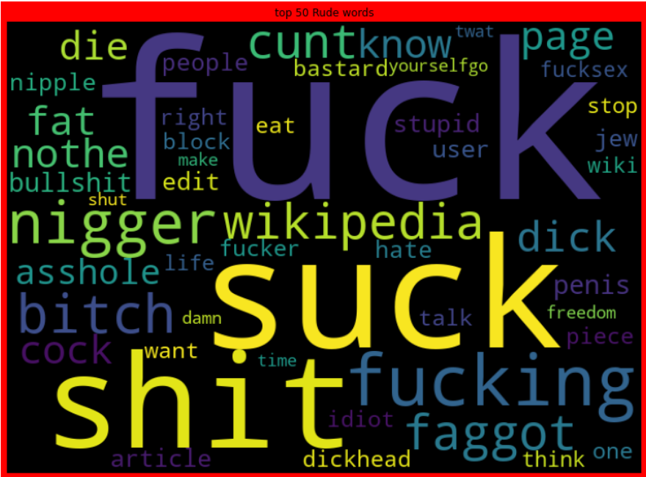
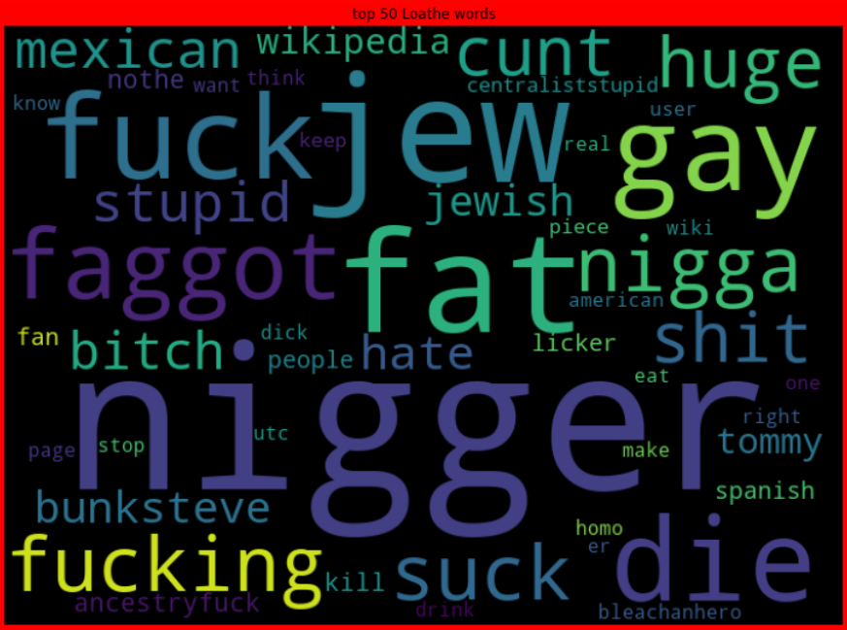
DATA VISUALIZATION cotd..
Malignant
Highly Malignant
Rude
Threat
Abuse
Loathe

Slide 8

DATA MODELLING
Machine Learning Algorithms Used:
Multinomial Naive Bayes Classifier
The multinomial Naive Bayes classifier is suitable for classification with discrete features (e.g., word counts for text classification
Complement Naive Bayes Classifier
This approach is almost the same as the Multinomial, though now we count the occurrences of a word in the complement to the class. For example, for the spam message we will count the repetitions of each word in all the non-spam messages.
AdaBoost Classifier
This Photo by Unknown Author is licensed under CC BY

Slide 9
EVALUATION METRICS
Accuracy
Log Loss
Hamington Loss
This is a classification problem I have chosen.
Key Metrics are:

Slide 10
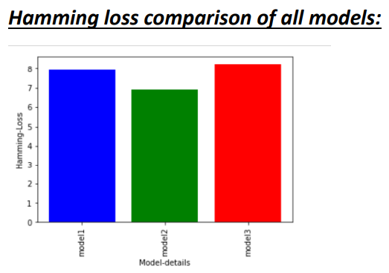
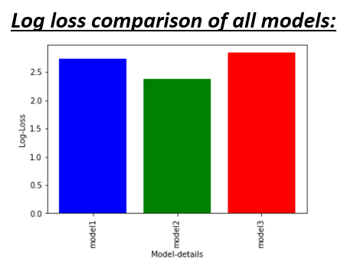
FINAL MODEL
If we compare all the models on basis of hamming-loss :
The best model would be Complement Naive Bias Classifier model. It has a hamming-loss of 6.90 % only.
If we compare all the models on basis of Log-loss :
The best model will be the Complement Naive Bias Classifier model. It has a Log-loss of 2.38% only.

Slide 11
CONCLUSION
Data with low sentence lengths (<200) are malignant, rude, abuse.
Some very large length comments can be seen, in our dataset. These pose serious problems like adding excessively more words to the training dataset, causing training time to increase and accuracy to decrease.
Complimentary Naïve Bias Classification Model is the recommended one.

Slide 12
Thank YOU

