Slide 1
NLP
https://www.youtube.com/watch?v=R-AG4-qZs1A&list=PLeo1K3hjS3uuvuAXhYjV2lMEShq2UYSwX&index=1&t=1s

Slide 2
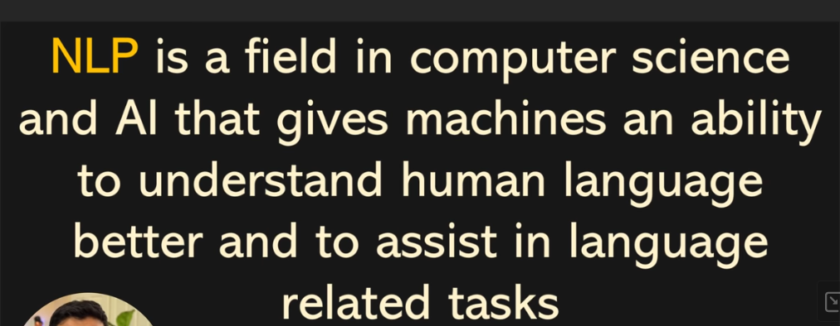

Slide 3
Large Language Model (LLM): "LLM" could refer to a large language model like GPT-3.5, which is capable of generating human-like text based on the input it receives.

Slide 4
"GPT" stands for "Generative Pre-trained Transformer." It is a type of artificial intelligence model designed for natural language understanding and generation. The "Generative" part means it can generate text or content, "Pre-trained" indicates that it is trained on a large dataset before being fine-tuned for specific tasks, and "Transformer" refers to the underlying neural network architecture.
GPT models, like GPT-3, are capable of a wide range of natural language processing tasks, including text generation, text completion, text summarization, language translation, question-answering, and more. These models have been influential in various applications, such as chatbots, language translation services, content generation, and even scientific research.

Slide 5
Word Embedding
Word embedding is a technique used in natural language processing (NLP) and machine learning to represent words as vectors in a continuous vector space.
The primary goal of word embeddings is to capture the semantic relationships and contextual meanings of words based on their usage in large text corpora.
Word embeddings are learned from a large corpus of text, such as a collection of books, articles, or websites. The model analyzes the co-occurrence patterns of words within sentences or documents to adjust the word vectors accordingly.

Slide 6
Word Embedding
Word embeddings are often generated using neural network-based models like Word2Vec, GloVe (Global Vectors for Word Representation), or contextual embeddings like BERT (Bidirectional Encoder Representations from Transformers).
Overall, word embeddings play a pivotal role in making machine learning models understand and work with human language effectively, bridging the gap between the symbolic nature of language and the numerical processing capabilities of machine learning algorithms.

Slide 7
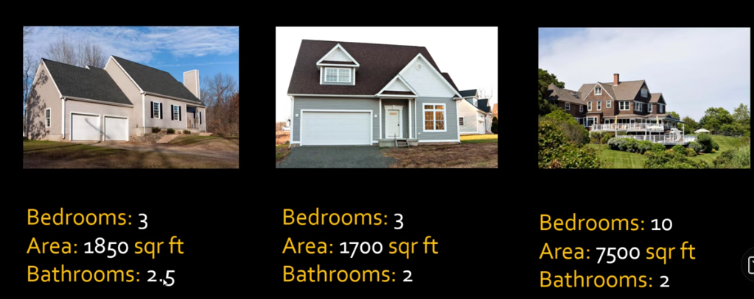

Slide 8
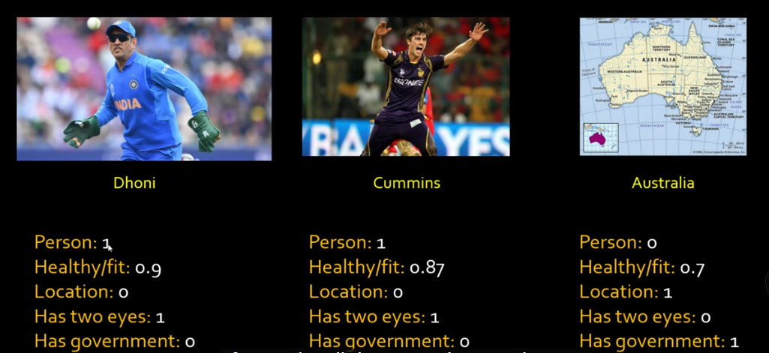

Slide 9
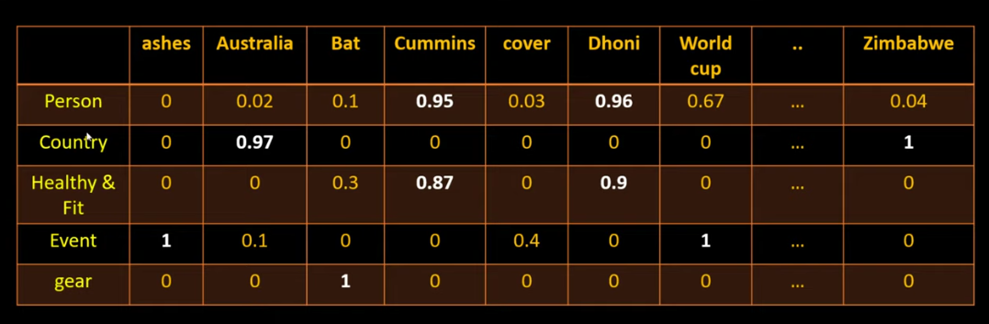

Slide 10
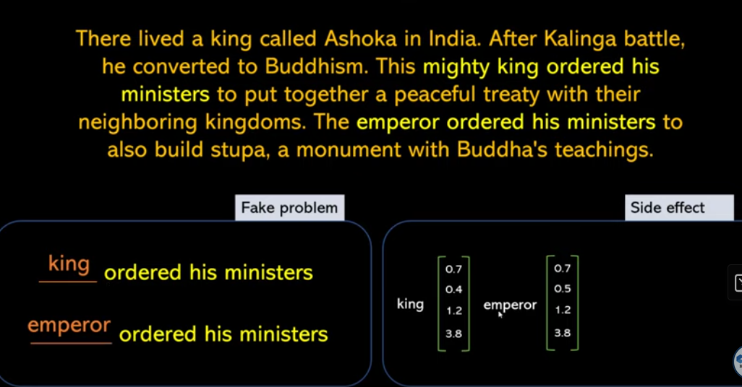
Take a fake problem, Solve it using neural network
You get word embeddings as a side effect
Fake problem : fill in missing word in a sentence

Slide 11
Meaning of the word can be derived from the surrounding words, the surrounding words are called sentence.
Auto complete the missing words using the window of 3 words, 4 words
This type of problem also called self supervised because all you have is paragraph
Using the backprogations weights are adjusted.

Slide 12
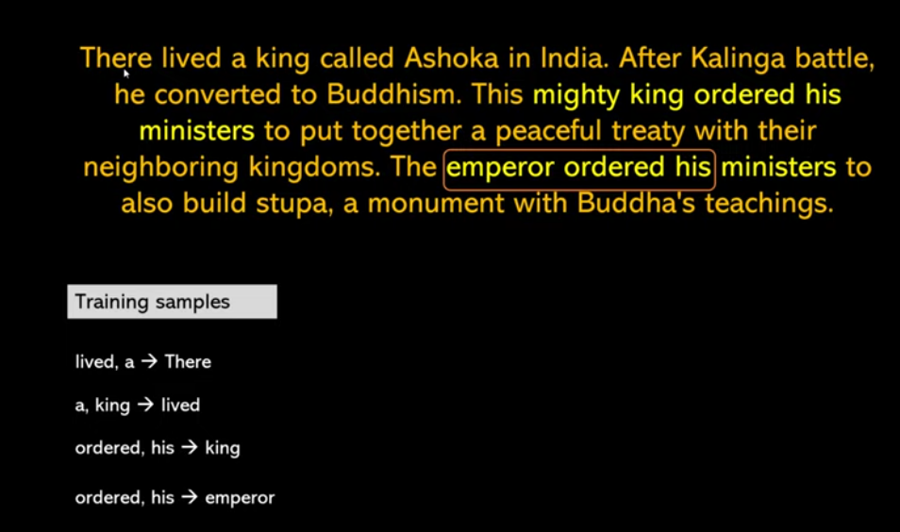

Slide 13
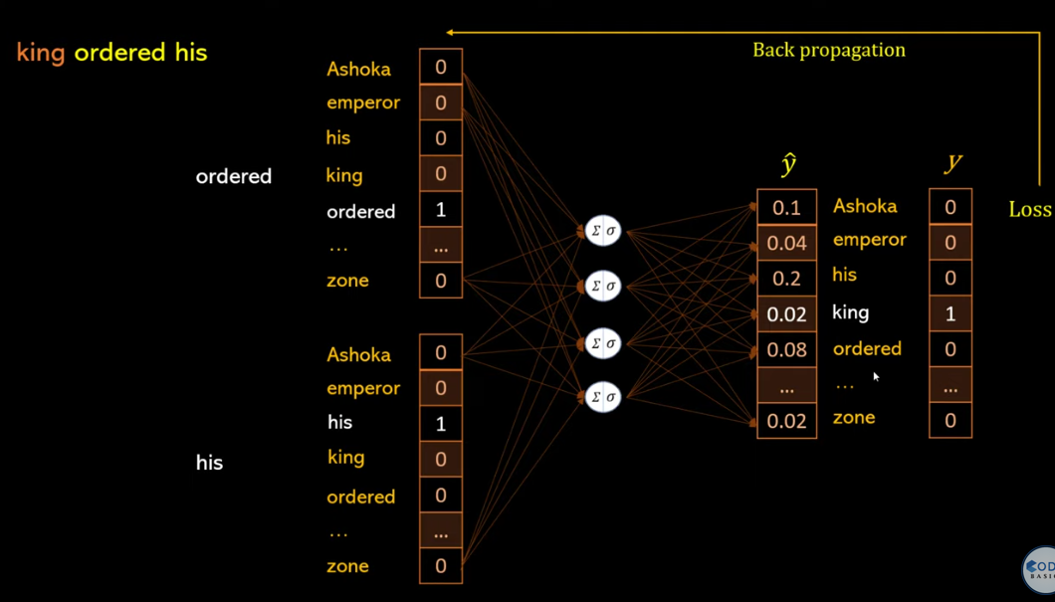

Slide 14
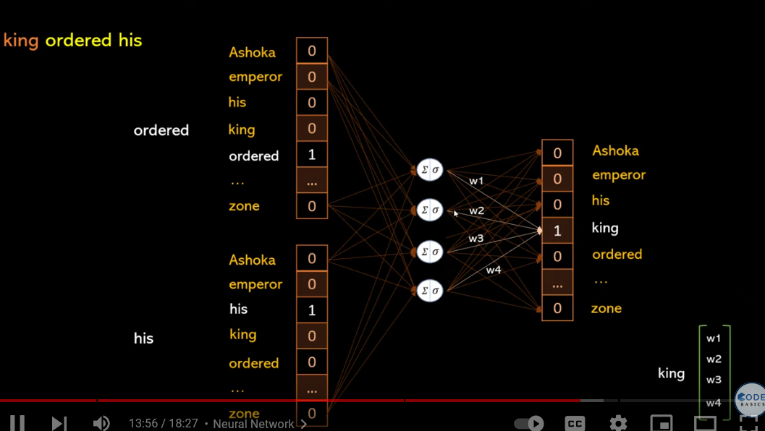

Slide 15
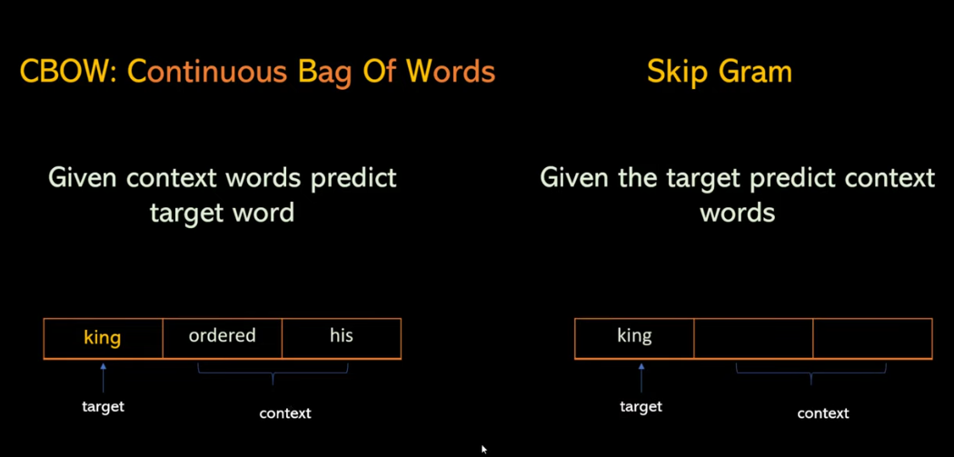
This techniques convert word to vectors which allow computer to do lot of mathematics with it

Slide 16
