Slide 1
Regression

Slide 2

Linear Regression
Supervised Approach for predicting a quantitative response Y on the basis of predictor variables X.
It assumes that there is approximately a linear relationship between X and Y .
Mathematically, we can write this linear relationship as
It is parametric in nature because it makes certain assumptions based on the data set.
If the data set follows those assumptions, regression gives incredible results. Otherwise, it struggles to provide convincing accuracy.

Slide 3
Example: Retail sales and floor space
It is customary in retail operations to asses the performance of stores partly in terms of their annual sales relative to their floor area (square feet).
We might expect sales to increase linearly as stores get larger, with of course individual variation among stores of the same size. The regression model for a population of stores says that
SALES = β₀ + β₁× AREA + ε

Slide 4
Example: Do wages rise with experience?
Many factors affect the wages of workers: the industry they work in, their type of job, their education and their experience, and changes in general levels of wages.

Slide 5
Example Use case
Problem : To provide advice to client on how to improve sales of a particular product.
Data : The Advertising data set consists of the sales of that product in 200 different markets, along with advertising budgets for the product in each of those markets for three different media: TV, radio, and newspaper.
Understanding:
Advertising budgets are input variables while sales input is an output variable.
on the basis of this data, a marketing plan for next year that will result in high product sales.
Notes:
In other words, our goal is to develop an accurate model that can be used to predict sales on the basis of the three media budgets. Advertising budgets are input variables while sales input is an output variable.

Slide 6
Questions
Is there a relationship between advertising budget and sales?
How strong is the relationship between advertising budget and sales?
Which media contribute to sales? Do all three media—TV, radio, and newspaper—contribute to sales, or do just one or two of the media contribute?
How accurately can we estimate the effect of each medium on sales?
For every dollar spent on advertising in a particular medium, by what amount will sales increase?
How accurately can we predict future sales?
For any given level of television, radio, or newspaper advertising, what is our prediction for sales, and what is the accuracy of this prediction?

Slide 7
Questions
Is the relationship linear?
If there is approximately a straight-line relationship between advertising expenditure in the various media and sales, then linear regression is an appropriate tool.
If not, then it may still be possible to transform the predictor or the response so that linear regression can be used.
Is there synergy among the advertising media?
Perhaps spending $50,000 on television advertising and $50,000 on radio advertising results in more sales than allocating $100,000 to either television or radio individually.
In marketing, this is known as a synergy effect, while in statistics it is called an interaction effect.
We can use linear regression to answer each of these questions.

Slide 8
Linear Regression
Supervised Approach for predicting a quantitative response Y on the basis of predictor variables X.
It assumes that there is approximately a linear relationship between X and Y .
Mathematically, we can write this linear relationship as
It is parametric in nature because it makes certain assumptions based on the data set.
If the data set follows those assumptions, regression gives incredible results. Otherwise, it struggles to provide convincing accuracy.

Slide 9
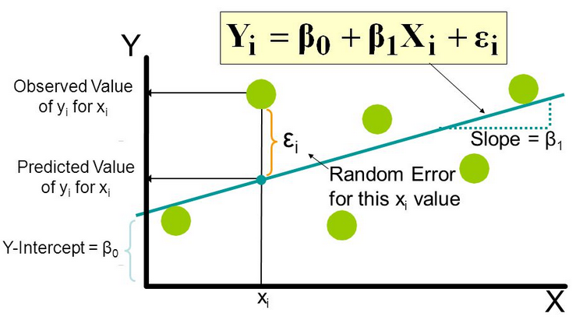
Explanation : Y = βo + β1X + ∈
Y - This is the variable we predict
X - This is the variable we use to make a prediction
βo - This is the intercept term. It is the prediction value you get when X = 0
β1 - This is the slope term. It explains the change in Y when X changes by 1 unit.
∈ - This represents the residual value, i.e. the difference between actual and predicted values.

Slide 10
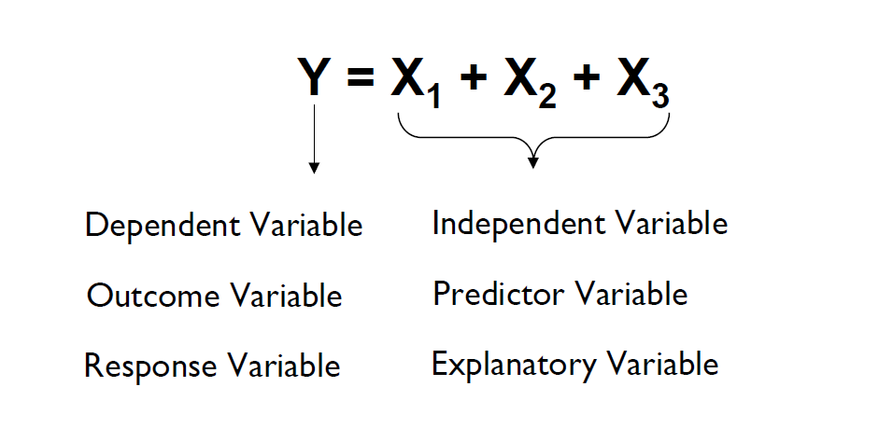

Slide 11

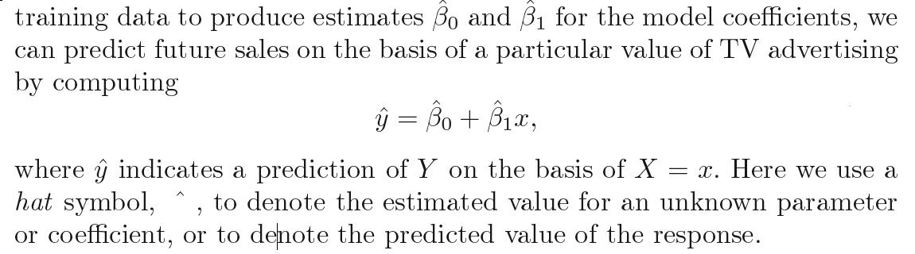
For example X may represent TV advertising and Y may represent sales. Then we can regress sales onto TV by fitting the model

Slide 12
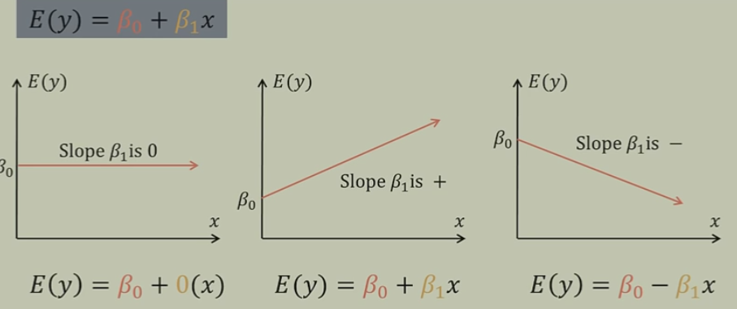

Slide 13

Estimating the Coefficients
In practice, β0 and β1 are unknown. We must use data to estimate the coefficients.
n observation pairs, each of which consists of a measurement of X and a measurement of Y .
In the Advertising example, this data set consists of the TV advertising budget and product sales in n = 200 different markets.
Want to find coefficients such that the resulting line is as close as possible to the n = 200 data points.
Most common approach involves minimizing the least squares criterion.

Slide 14
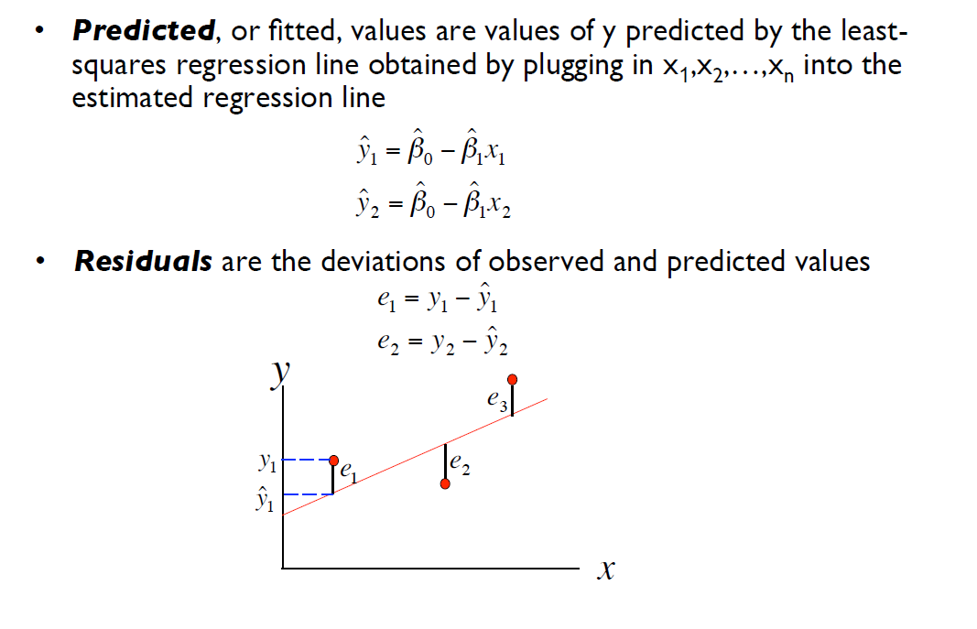
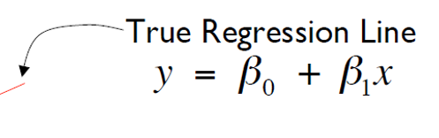

Slide 15
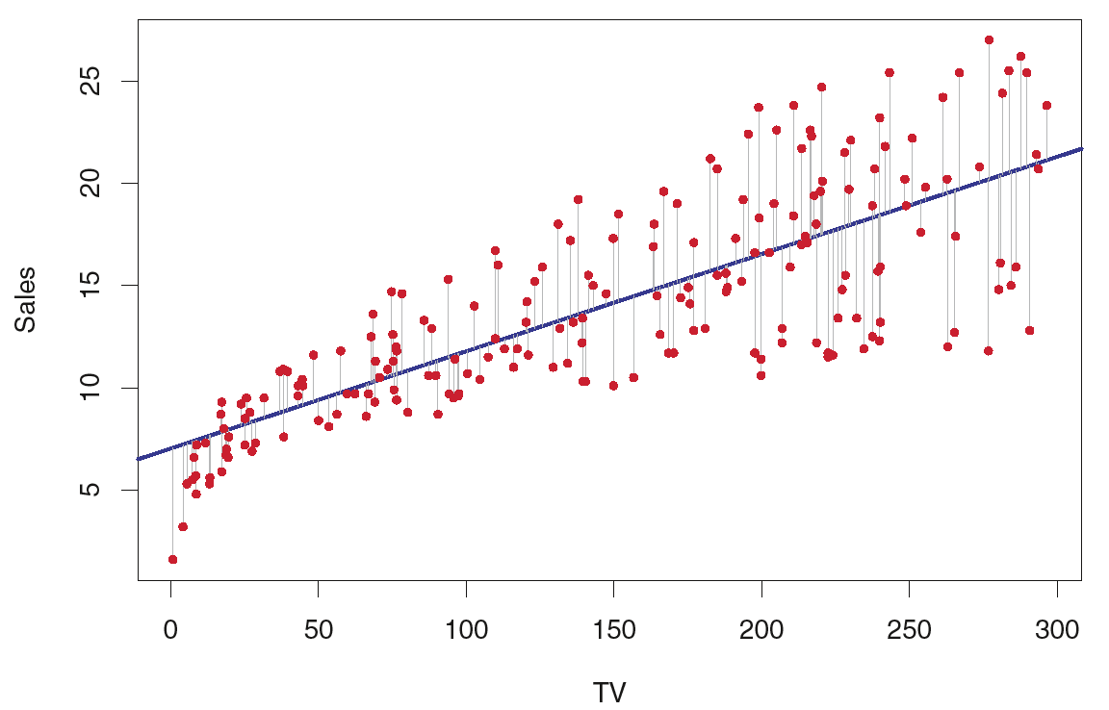
For the Advertising data, the least squares fit for the regression of sales onto TV is shown. The fit is found by minimizing the sum of squared errors. Each grey line segment represents an error.
Notes:
In this case a linear fit captures the essence of the relationship, although it is somewhat deficient in the left of the plot.

Slide 16


Estimating the Coefficients
Error
We define the residual sum of squares (RSS) as
The least squares approach chooses coefficients minimize the RSS. Using some calculus, one can show that the minimizers are

Slide 17
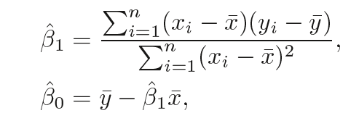



Slide 18

Simple linear regression fit to the Advertising data, gives
An additional $1,000 spent on TV advertising is associated with selling approximately 47.5 additional units of the product.

Slide 19

Assessing the Accuracy of the Coefficient Estimates
We assume that the true relationship between X and Y takes the form Y = f(X) + e for some unknown function f, where e is a mean-zero random error term.
If f is to be approximated by a linear function, then we can write this relationship as
Here β0 is the intercept term—that is, the expected value of Y when X = 0, and β1 is the slope—the average increase in Y associated with a one-unit increase in X.
The error term is a catch-all for what we miss with this simple model: the true relationship is probably not linear, there may be other variables that cause variation in Y , and there may be measurement error.
We typically assume that the error term is independent of X.

Slide 20
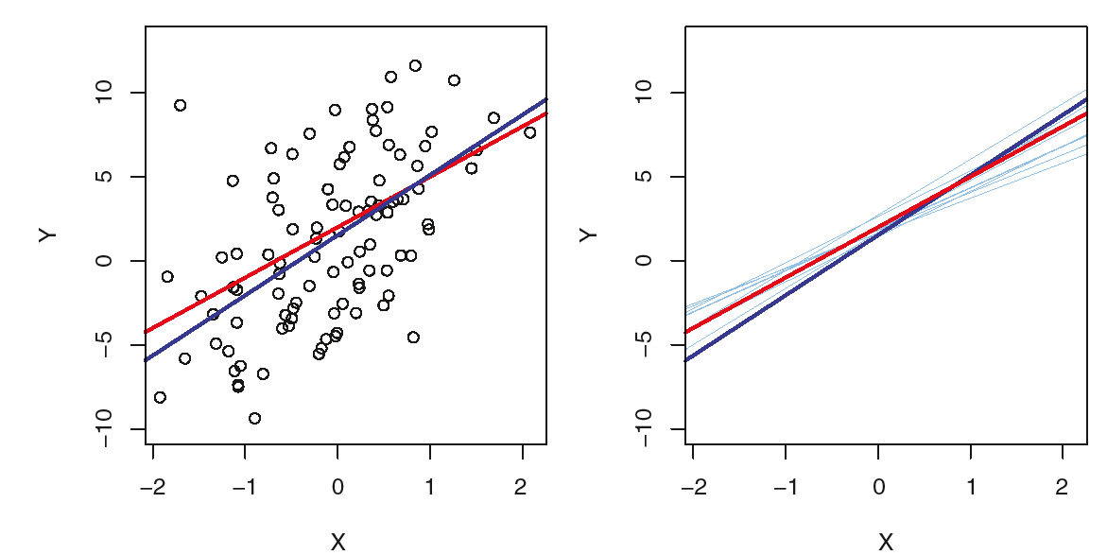
Population regression line, is the best linear approximation to the true relationship between X and Y
A simulated data set. Left: The red line represents the true relationship, f(X) = 2+3X, which is known as the population regression line. The blue line is the least squares line; it is the least squares estimate for f(X) based on the observed data, shown in black.
Right: The population regression line is again shown in red, and the least squares line in dark blue. In light blue, ten least squares lines are shown, each computed on the basis of a separate random 100 set of observations. Each least squares line is different, but on average, the least squares lines are quite close to the population regression line.

Slide 21

In real applications, we have access to a set of observations from which we can compute the least squares line; however, the population regression line is unobserved.
The unknown coefficients β0 and β1 in linear regression define the population regression line.
We seek to estimate these unknown coefficients using above equation. These coefficient estimates defined by the least squares line.

Slide 22
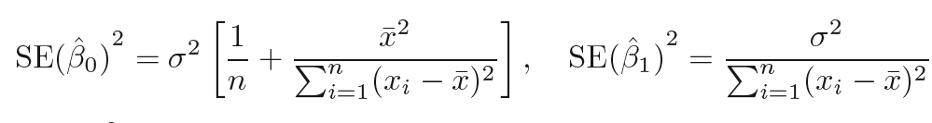
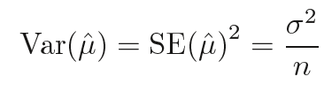
As regression coefficients calculated from sample data, there might be some error from actual coefficient, it is represented by
Similar to standard error in sample mean

Slide 23


Standard errors can be used to compute confidence intervals.
For linear regression, the 95% confidence interval for β1 approximately takes the form
Similarly, a confidence interval for β0 approximately takes the form

Slide 24
In the case of the advertising data, the 95% confidence interval for β0 is [6.130, 7.935] and the 95% confidence interval for β1 is [0.042, 0.053].
Therefore, we can conclude that in the absence of any advertising, sales will, on average, fall somewhere between 6,130 and 7,940 units.
Furthermore, for each $1,000 increase in television advertising, there will be an average increase in sales of between 42 and 53 units.

Slide 25


Hypothesis Testing in Regression
Standard errors can also be used to perform hypothesis tests on the hypothesis coefficients.
Null hypothesis
H0 : There is no relationship between X and Y
Versus the alternative hypothesis
Ha : There is some relationship between X and Y .

Slide 26
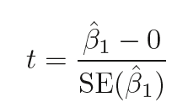
t-statistic
It measures the number of standard deviations that ˆ β1 is away from 0.
We reject the null hypothesis—that is, we declare a relationship to exist between X and Y —if the p-value is small enough.
Typical p-value cutoffs for rejecting the null hypothesis are 5 or 1%. When n = 30, these correspond to t-statistics of around 2 and 2.75

Slide 27
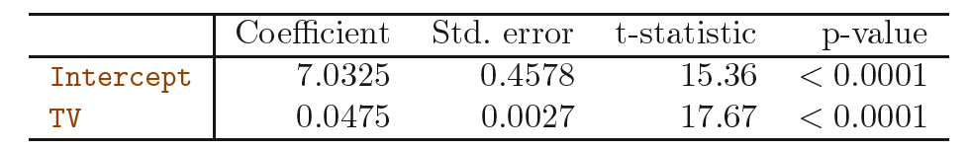

For the Advertising data, coefficients of the least squares model for the regression of number of units sold on TV advertising budget.
Notice that the coefficients for ˆβ0 and ˆ β1 are very large relative to their standard errors, so the t-statistics are also large;
The probabilities of seeing such values if H0 is true are virtually zero. Hence we can conclude that

Slide 28
Assessing the Accuracy of the Model
The quality of a linear regression fit is typically assessed using two related quantities: the residual standard error (RSE) and the R2 statistic.

Slide 29
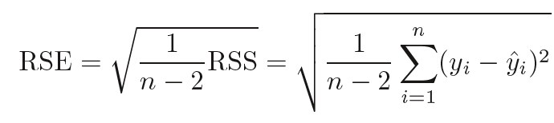
RSE (Residual Sum of Square Error)
The RSE is an estimate of the standard deviation of error .
Roughly speaking, it is the average amount that the response will deviate from the true regression line.
It is computed using the formula

Slide 30
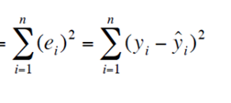

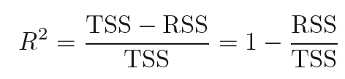
R2 Statistic
The R2 statistic provides an alternative measure of fit.
It always takes on a value between 0 and 1, and is independent of the scale of Y .
To calculate R2, we use the formula

Slide 31
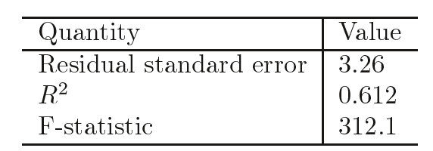
In the case of the advertising data
RSE is 3.26. In other words, actual sales in each market deviate from the true regression line by approximately 3,260 units, on average. (sales variable is in thousands of units, and the TV variable is in thousands of dollars).

Slide 32
R2 measures the proportion of variability in Y that can be explained using X.
An R2 statistic that is close to 1 indicates that a large proportion of the variability in the response has been explained by the regression.
A number near 0 indicates that the regression did not explain much of the variability in the response
The R2 was 0.61, and so just under two-thirds of the variability in sales is explained by a linear regression on TV.

Slide 33
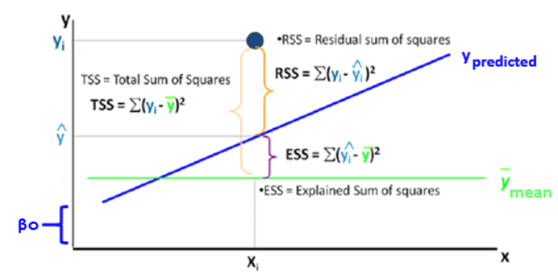
Performance Measure
Rsquare = ESS/ TSS

Slide 34
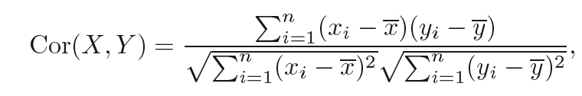

The R2 statistic is a measure of the linear relationship between X and Y . Recall that correlation, defined as
is also a measure of the linear relationship between X and Y .
This suggests that we might be able to use r = Cor(X, Y ) instead of R2 in order to assess the fit of the linear model.

Slide 35
Multiple linear Regression
Simple linear regression is a useful approach for predicting a response on the basis of a single predictor variable.
However, in practice we often have more than one predictor. For example, in the Advertising data, we have examined the relationship between sales and TV advertising.
How can we extend our analysis of the advertising data in order to accommodate these two additional predictors?

Slide 36
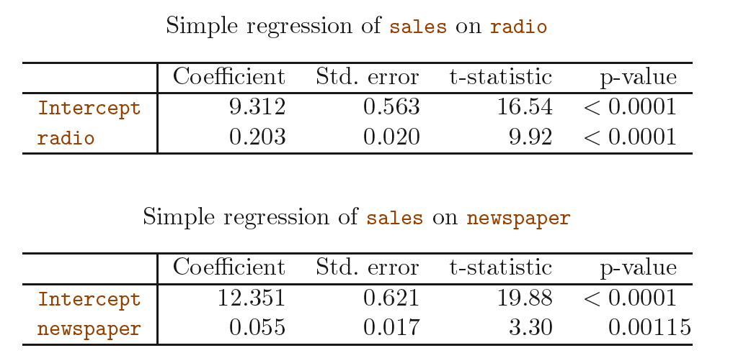

Slide 37
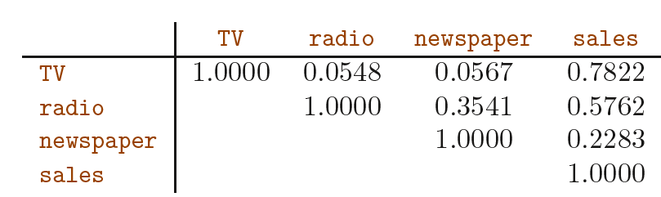
One option is to run three separate simple linear regressions, each of which uses a different advertising medium as a predictor.
However, the approach of fitting a separate simple linear regression model for each predictor is not entirely satisfactory.
It is unclear how to make a single prediction of sales given levels of the three advertising media budgets, since each of the budgets is associated with a separate regression equation.
Each of the three regression equations ignores the other two media in forming estimates for the regression coefficients. (important when variables are correlated)

Slide 38
We can accommodate multiple predictors by giving each predictor a separate slope coefficient in a single model.
In general, suppose that we have p distinct predictors. Then the multiple linear regression model takes the form

Slide 39
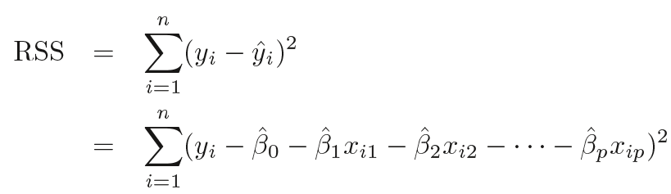
Estimating the Regression Coefficients
The parameters are estimated using the same least squares approach that we saw in the context of simple linear regression.
We choose β0, β1, . . . , βp to minimize the sum of squared residuals

Slide 40
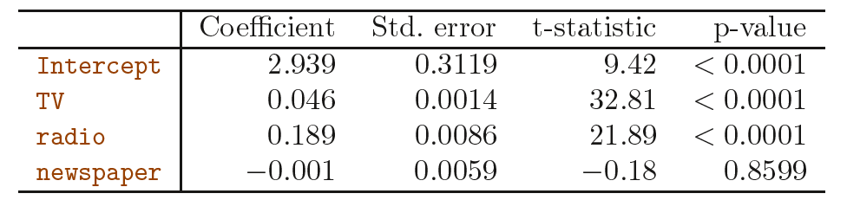
Displays the multiple regression coefficient estimates when TV, radio, and newspaper advertising budgets are used to predict product sales using the Advertising data.
Spending an additional $1,000 on radio advertising leads to an increase in sales by approximately 189 units.
The coefficient for radio represents the average effect of increasing radio spending by $1,000 while holding TV and newspaper fixed.

Slide 41
Does it make sense for the multiple regression to suggest no relationship between sales and newspaper while the simple linear regression implies the opposite?
Remember the correlation between radio and newspaper was 0.35. This reveals a tendency to spend more on newspaper advertising where more is spent on radio advertising.
In a simple linear regression, only examines sales versus newspaper, we will observe that higher values of newspaper tend to be associated with higher values of sales, even though newspaper advertising does not actually affect sales.
So newspaper sales are a surrogate for radio advertising; newspaper gets “credit” for the effect of radio on sales.

Slide 42
Running a regression of shark attacks versus ice cream sales for data collected at a given beach community over a period of time would show a positive relationship, similar to that seen between sales and newspaper.
Of course no one (yet) has suggested that ice creams should be banned at beaches to reduce shark attacks.
In reality, higher temperatures cause more people to visit the beach, which in turn results in more ice cream sales and more shark attacks.
A multiple regression of attacks versus ice cream sales and temperature reveals that, as intuition implies, the former predictor is no longer significant after adjusting for temperature.

Slide 43
Some Important Questions
When we perform multiple linear regression, we usually are interested in answering a few important questions.
Is at least one of the predictors X1,X2, . . . , Xp useful in predicting the response?
Do all the predictors help to explain Y , or is only a subset of the predictors useful?
How well does the model fit the data?
Given a set of predictor values, what response value should we predict, and how accurate is our prediction?

Slide 44


Is There a Relationship Between the Response and Predictors?
In the simple linear regression setting, in order to determine whether there is a relationship between the response and the predictor we can simply check whether β1 = 0.
In multiple linear regression, We test the null hypothesis

Slide 45



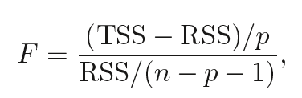
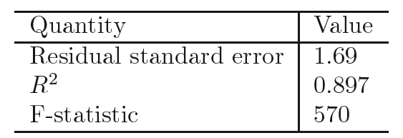
This hypothesis test is performed by computing the F-statistic
Since this is F statistic:570 far larger than 1, it provides compelling evidence against the null hypothesis H0.
In other words, the large F-statistic suggests that at least one of the advertising media must be related to sales.

Slide 46
What are the assumptions made in regression ?
As we discussed, regression is a parametric technique, so it makes assumptions.
There exists a linear and additive relationship between dependent (DV) and independent variables (IV).
By linear, it means that the change in DV by 1 unit change in IV is constant.
By additive, it refers to the effect of X on Y is independent of other variables.
There must be no correlation among independent variables. Presence of correlation in independent variables lead to Multicollinearity. If variables are correlated, it becomes extremely difficult for the model to determine the true effect of IVs on DV.
The error terms must possess constant variance. Absence of constant variance leads to heteroskedestacity.
The error terms must be uncorrelated i.e. error at ∈t must not indicate the at error at ∈t+1.
The dependent variable and the error terms must possess a normal distribution.

Slide 47
Additional Study
http://www.sthda.com/english/articles/40-regression-analysis/168-multiple-linear-regression-in-r/

Slide 48
Model Fit

Slide 49


R Square
In simple regression, R2 is the square of the correlation of the response and the variable.
In multiple linear regression, it turns out that it equals , the square of the correlation between the response and predicted response from model.
It turns out that R2 will always increase when more variables are added to the model, even if those variables are only weakly associated with the response.
This is due to the fact that adding another variable to the least squares equations must allow us to fit the training data (though not necessarily the testing data) more accurately. Adjusted R square

Slide 50
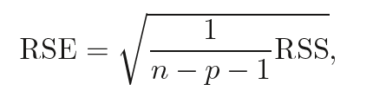

Relative Standard Error (RSE)
Similar to R-square , adding another variable to the least squares equations reduces training error. Need to be adjusted for increase number of parameters.

Slide 51
Analysis of Residual
To examine whether the regression model is appropriate for the data being analyzed, we can check the residual plots.
Residual plots are:
Plot a histogram of the residuals
Plot residuals against the fitted values.
Plot residuals against the independent variable.
Plot residuals over time if the data are chronological.

Slide 52
Residual plots
The residuals should have no systematic pattern.
The residual plot to right shows a scatter of the points with no individual observations or systematic change as x increases.

Slide 53
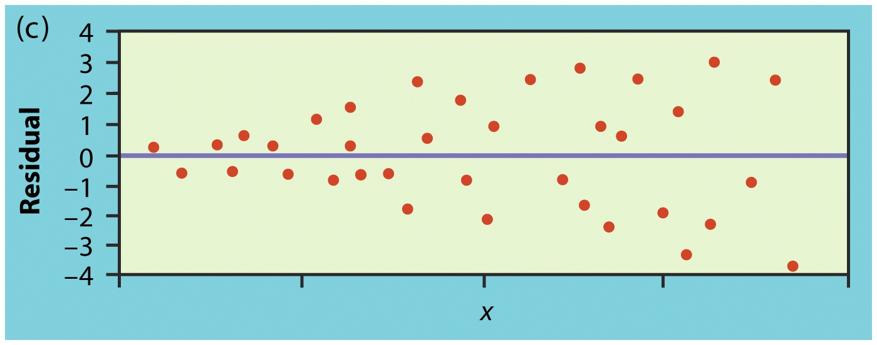
Residual plots
The points in this plot show more spread for larger values of the explanatory variable x, so prediction will be less accurate when x is large.

Slide 54
Variable transformations
If the residual plot suggests that the variance is not constant, a transformation can be used to stabilize the variance.
If the residual plot suggests a non linear relationship between x and y, a transformation may reduce it to one that is approximately linear.
Common linearizing transformations are:
Variance stabilizing transformations are:

Slide 55
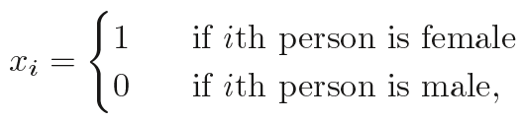
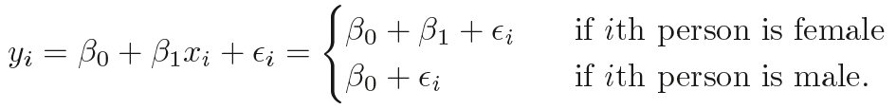
Qualitative Predictors
For example, credit card balance based on the gender variable, we can create dummy variable a new variable that takes the form
and use this variable as a predictor in the regression equation.
This results in the model
Now β0 can be interpreted as the average credit card balance among males, β0 + β1 as the average credit card balance among females, and β1 as the average difference in credit card balance between females and males.

Slide 56
The decision to code females as 1 and males as 0 is arbitrary, and has no effect on the regression fit, but does alter the interpretation of the coefficients

Slide 57
Potential Problems in linear Regression
When we fit a linear regression model to a particular data set, many problems may occur. Most common among these are the following:
Non-linearity of the response-predictor relationships
Correlation of error terms
Non-constant variance of error terms (heteroscedasticity)
Outliers
5. Collinearity (VIF)

Slide 58
Deciding on Important Variables

Slide 59


Variance Inflation Factors (VIFs)
Quantifies the extent of correlation between one predictor and the other predictors in a model.
It is used for diagnosing collinearity/multicollinearity.
The extent to which a predictor is correlated with the other predictor variables in a linear regression can be quantified as the R-squared statistic of the regressionwhere the predictor of interest is predicted by all the other predictor variables. The variance inflation for a variable is then computed as
Higher values signify that it is difficult to impossible to assess accurately the contribution of predictors to a model
tolerance
Notes:
https://www.displayr.com/variance-inflation-factors-vifs/

Slide 60
How to interpret the VIF
A VIF can be computed for each predictor in a predictive model.
A value of 1 means that the predictor is not correlated with other variables.
The higher the value, the greater the correlation of the variable with other variables.
Values of more than 4 or 5 are sometimes regarded as being moderate to high, with values of 10 or more being regarded as very high.
When two variables are highly correlated, each will have the same high VIF.

Slide 61
How to use VIF
Using the full set of explanatory variables, calculate a VIF for each variable.
Remove the variable with the single highest value
Recalculate all VIF values with the new set of variables, remove the variable with the next highest value, and so on, until all values are below the threshold.
The VIF values will change after each variable is removed.
Notes:
https://beckmw.wordpress.com/2013/02/05/collinearity-and-stepwise-vif-selection/

Slide 62
Stepwise Regression
Forward selection.
Begin with the null model—a model that contains an intercept but no predictors.
Then fit p simple linear regressions and add to the null model the variable that results in the lowest RSS.
We then add to that model the variable that in the lowest RSS for the new two-variable model.
This approach is continued until some stopping rule is satisfied.
Backward selection
Start with all variables in the model, and backward remove the variable with the largest p-value—that is, the variable selection that is the least statistically significant.
The new (p − 1)-variable model is fit, and the variable with the largest p-value is removed.
This procedure continues until a stopping rule is reached. For instance, we may stop when all remaining variables have a p-value below some threshold.

Slide 63
Stepwise Regression
Mixed selection (Combination of forward and backward selection)
Start with no variables in the model, and as with forward selection, we add the variable that provides the best fit. Continue to add variables one-by-one.
As we noted with the Advertising example, the p-values for variables can become larger as new predictors are added to the model.
Hence, if at any point the p-value for one of the variables in the model rises above a certain threshold, then we remove that variable from the model.
We continue to perform these forward and backward steps until all variables in the model have a sufficiently low p-value.
Backward selection cannot be used if p > n, while forward selection can always be used.
Forward selection is a greedy approach, and might include variables early that later become redundant. Mixed selection can remedy this.

Slide 64
Why OLS? Why not Least absolute deviation
It uses squared error which has nice mathematical properties, thereby making it easier to differentiate and compute gradient descent.
OLS is easy to analyze and computationally faster, i.e. it can be quickly applied to data sets having 1000s of features.
Interpretation of OLS is much easier than other regression techniques.

