Slide 1

Forecasting Knowledge Transfer

Slide 2
Agenda
Time Series Data
General Steps for Time Series Forecasting
Basic Analysis
Forecast Models
Model Selection
Combination Model
Visualizations
2
RBEI/EDS1 | 2018-04-13
© Robert Bosch Engineering and Business Solutions Private Limited 2018. All rights reserved, also regarding any disposal, exploitation, reproduction, editing, distribution, as well as in the event of applications for industrial property rights.

Slide 3
Introduction
Forecasting
In the early stages of a forecasting project, decisions need to be made about what should be forecast. For example, if forecasts are required for items in a manufacturing environment, it is necessary to ask whether forecasts are needed for:
every product line, or for groups of products?
every sales outlet, or for outlets grouped by region, or only for total sales?
weekly data, monthly data or annual data?
3
RBEI/EDS1 | 2018-04-13
© Robert Bosch Engineering and Business Solutions Private Limited 2018. All rights reserved, also regarding any disposal, exploitation, reproduction, editing, distribution, as well as in the event of applications for industrial property rights.

Slide 4
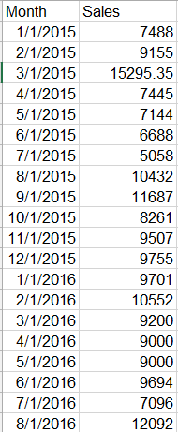
Time Series Data
Introduction
Time series data occurs wherever the same measurements are recorded on a regular basis
such as a month, quarter, or year….
Example:
Monthly Sales in Restaurant
4
RBEI/EDS1 | 2018-04-13
© Robert Bosch Engineering and Business Solutions Private Limited 2018. All rights reserved, also regarding any disposal, exploitation, reproduction, editing, distribution, as well as in the event of applications for industrial property rights.

Slide 5
General Steps for Time series Forecasting
Introduction
Setting Goals for Forecasting & Gathering Data
Data Preparation, Basic Analysis of Data like Decomposition, outlier correction
Choosing the forecasting like ARIMA, ETS, Naïve, Snaive, Neural network, state space model, MAPA, Theta, BSTS,
Forecasting from Best Model/ Combined model
Visualization for Actual and Forecast value Comparison
5
RBEI/EDS1 | 2018-04-13
© Robert Bosch Engineering and Business Solutions Private Limited 2018. All rights reserved, also regarding any disposal, exploitation, reproduction, editing, distribution, as well as in the event of applications for industrial property rights.

Slide 6

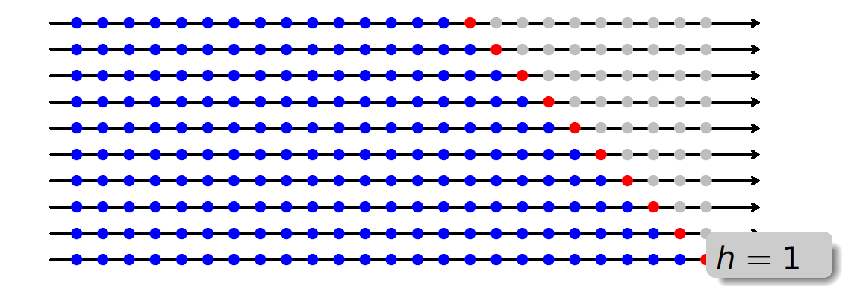
How we forecast
Forecasting
Sales Data
Data Preparation
Weighting factor 1
ARIMA
Forecast 1
*
Weighting factor 2
Total
Forecast
Neural Net
Forecast 2
*
+
Weighting factor 3
ETS, Naïve..
…
*
Validation using rolling forecast & Comparison
MAE
6
RBEI/EDS1-PJ-AI-S2 | 2018-04-13
© Robert Bosch Engineering and Business Solutions Private Limited 2018. All rights reserved, also regarding any disposal, exploitation, reproduction, editing, distribution, as well as in the event of applications for industrial property rights.

Slide 7
Error Calculation
Forecasting
7
RBEI/EDS1 | 2018-04-13
© Robert Bosch Engineering and Business Solutions Private Limited 2018. All rights reserved, also regarding any disposal, exploitation, reproduction, editing, distribution, as well as in the event of applications for industrial property rights.

Slide 8
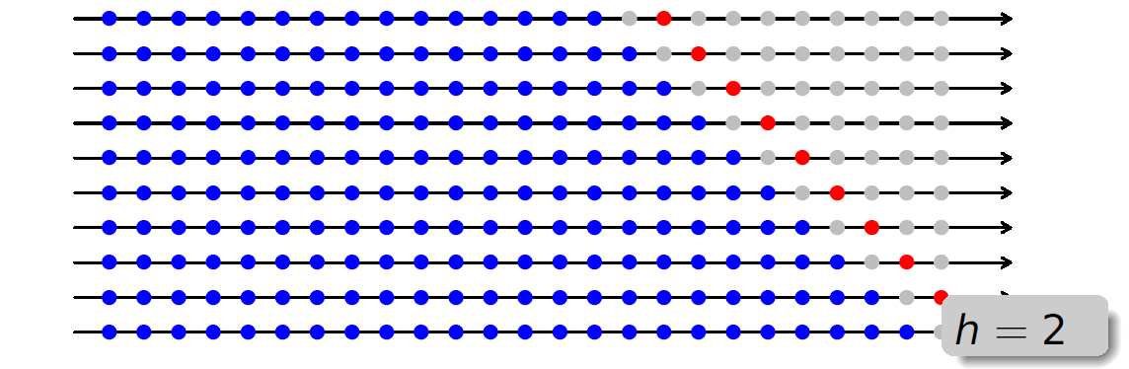
Error Calculation
Forecasting
8
RBEI/EDS1 | 2018-04-13
© Robert Bosch Engineering and Business Solutions Private Limited 2018. All rights reserved, also regarding any disposal, exploitation, reproduction, editing, distribution, as well as in the event of applications for industrial property rights.

Slide 9
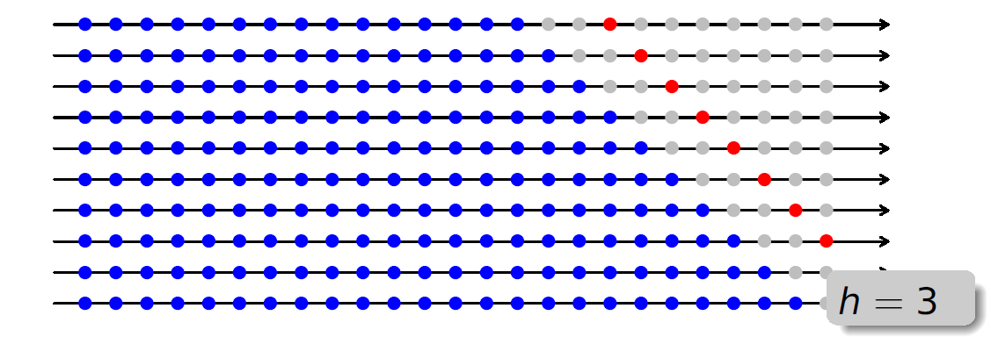
Error Calculation
Forecasting
9
RBEI/EDS1 | 2018-04-13
© Robert Bosch Engineering and Business Solutions Private Limited 2018. All rights reserved, also regarding any disposal, exploitation, reproduction, editing, distribution, as well as in the event of applications for industrial property rights.

Slide 10
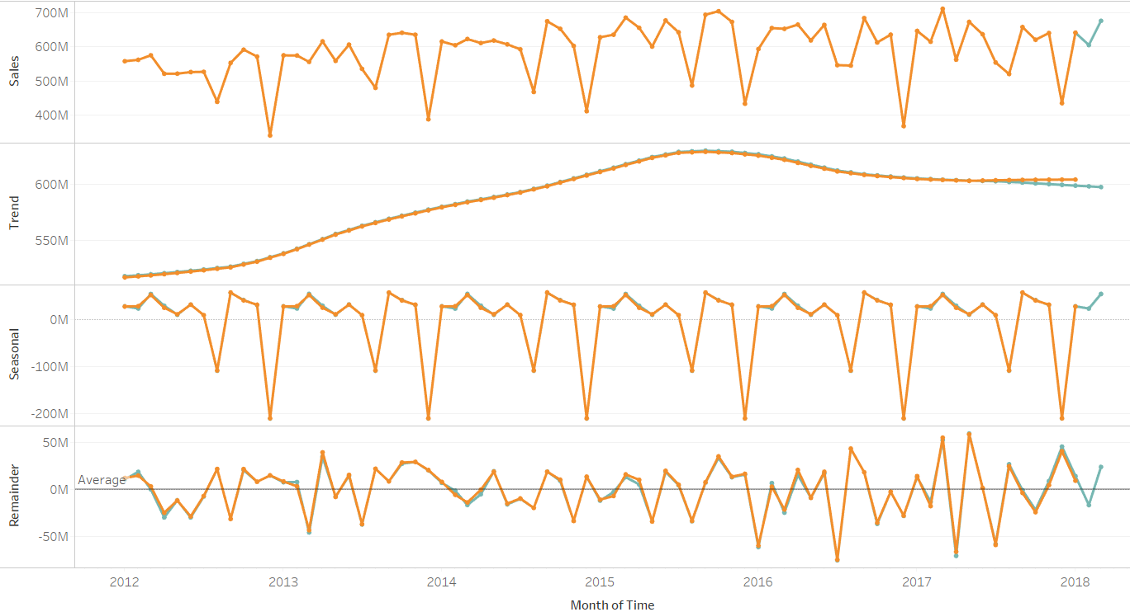
Decomposition
Basic Analysis
Trend pattern exists when there is a long-term increase or decrease in the data.
Seasonal pattern exists when a series is influenced by seasonal factors (e.g., the quarter of the year, the month, or day of the week).
STL :
“Seasonal and Trend decomposition using Loess”
Convert the data to time series
input_data<-ts(raw_data$Sales, frequency = 12)
m <- stl( input_data, s.window = "periodic", robust = TRUE)
input_data$Seasonal<-as.numeric(m$time.series[,1])
input_data$Trend<-as.numeric(m$time.series[,2])
input_data$Remainder<- as.numeric(m$time.series[,3])
How it is helpful for planners?
10
RBEI/EDS1 | 2018-04-13
© Robert Bosch Engineering and Business Solutions Private Limited 2018. All rights reserved, also regarding any disposal, exploitation, reproduction, editing, distribution, as well as in the event of applications for industrial property rights.
Notes:
Remove the seasonality from series:
Calculate average for each month (Jan 14, Jan 15…) and then subtract from corresponding month observations
Loess method
Calculate moving average (12 period)
and then calculate ratio of actual sales and moving average
Calculate average of ratios for each period
Divide Original sales with average ratio
Remove Trend using regression equation with Time
Subtract Trend and seasonality to get the Remainder

Slide 11
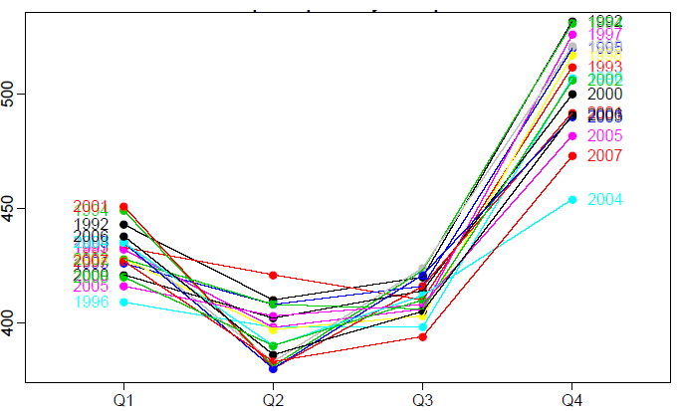
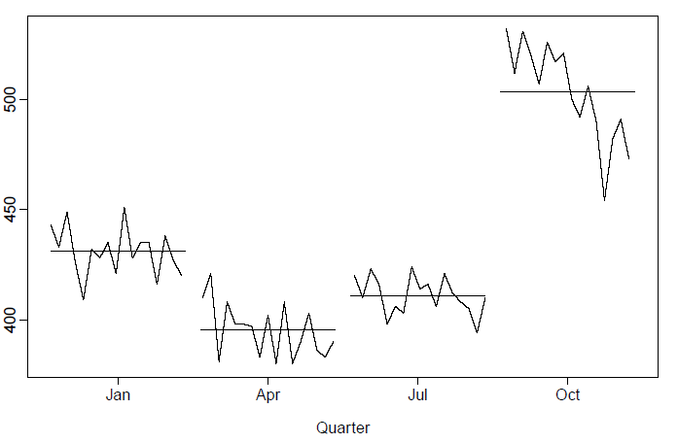
Seasonality Detection
Basic Analysis
seasonplot(input_data, year.labels=TRUE)
monthplot(input_data)
findfrequency(x)
11
RBEI/EDS1 | 2018-04-13
© Robert Bosch Engineering and Business Solutions Private Limited 2018. All rights reserved, also regarding any disposal, exploitation, reproduction, editing, distribution, as well as in the event of applications for industrial property rights.

Slide 12
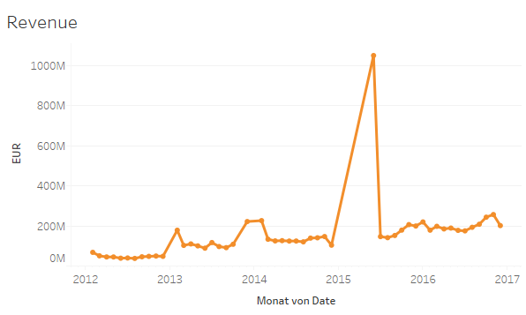
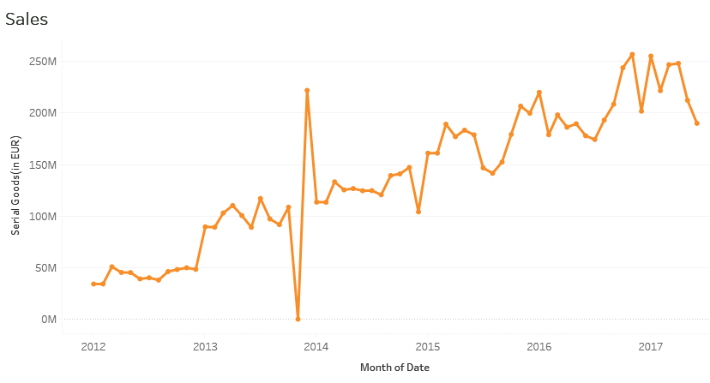
Outlier Correction
Basic Analysis
Monthly sales are booked with delay at the start of the year
Unusual sales pattern present due to booking error
tsoutlier package in R
In case of multiple series, if not starting from same point might want to remove initial zeros
Sometime need to take transformation like : log, exponential
12
RBEI/EDS1 | 2018-04-13
© Robert Bosch Engineering and Business Solutions Private Limited 2018. All rights reserved, also regarding any disposal, exploitation, reproduction, editing, distribution, as well as in the event of applications for industrial property rights.

Slide 13
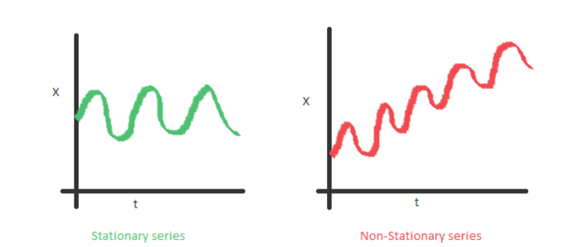
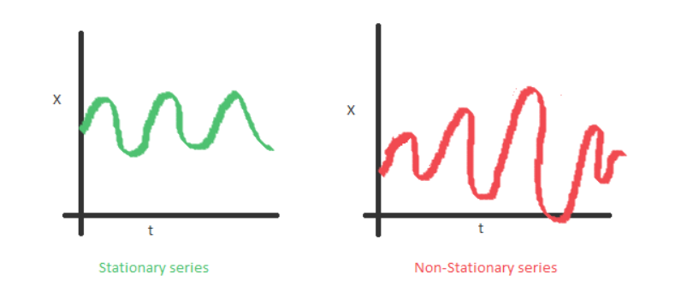
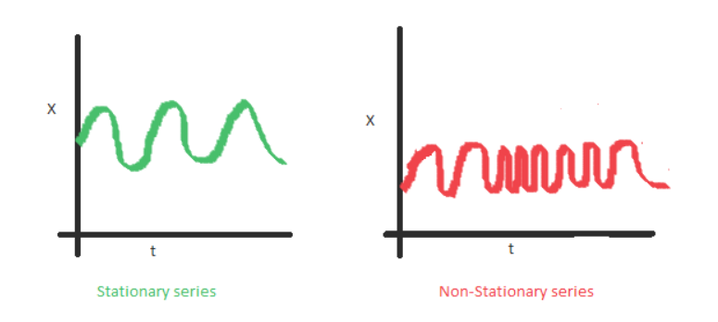
Stationary Time Series data
Forecasting
13
RBEI/EDS1 | 2018-04-13
© Robert Bosch Engineering and Business Solutions Private Limited 2018. All rights reserved, also regarding any disposal, exploitation, reproduction, editing, distribution, as well as in the event of applications for industrial property rights.
Notes:
The mean of the series should not be a function of time rather should be a constant.
The variance of the series should not a be a function of time.
The covariance of the i th term and the (i + m) th term should not be a function of time.

Slide 14
Forecast Models
Forecasting
ETS (Exponential Smoothing)
STLF ( Seasonality Trend Level forecast )
ARIMA (Autoregressive Integrated Moving Average)
Theta
Average Model
Moving Average
Naïve
Seasonal naïve
Drift Method
BSTS (Baysian Structural Time Series )
BATS/ TBATS: Trigonometric form of state space model
State Space Model (Missing Values)
ARCH/GARCH
forecastxgb (forecasting using extreme gradient boosting)
Neural Network
LSTM
Combined Model
14
RBEI/EDS1 | 2018-04-13
© Robert Bosch Engineering and Business Solutions Private Limited 2018. All rights reserved, also regarding any disposal, exploitation, reproduction, editing, distribution, as well as in the event of applications for industrial property rights.

Slide 15
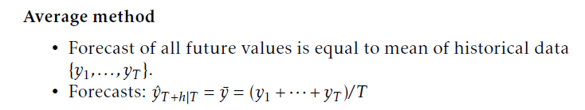
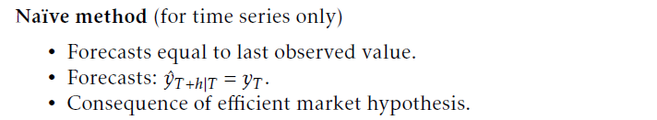
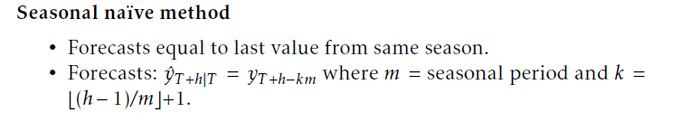
Model Explanations
Forecasting
15
RBEI/EDS1 | 2018-04-13
© Robert Bosch Engineering and Business Solutions Private Limited 2018. All rights reserved, also regarding any disposal, exploitation, reproduction, editing, distribution, as well as in the event of applications for industrial property rights.

Slide 16
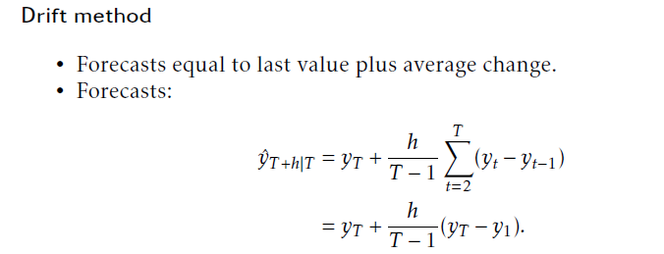
Model Explanations
Forecasting
16
RBEI/EDS1 | 2018-04-13
© Robert Bosch Engineering and Business Solutions Private Limited 2018. All rights reserved, also regarding any disposal, exploitation, reproduction, editing, distribution, as well as in the event of applications for industrial property rights.

Slide 17
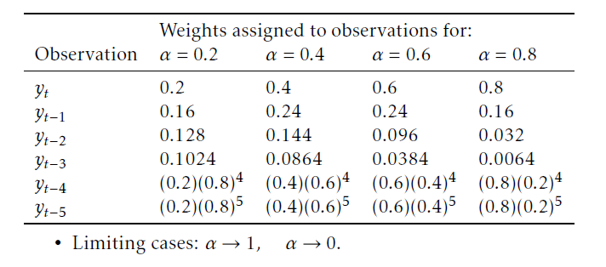
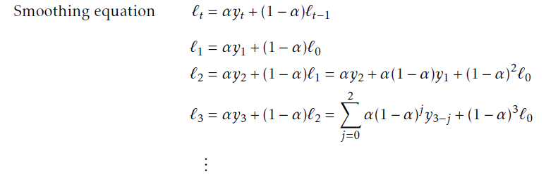
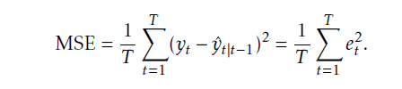
Exponential Smoothing Model
Forecasting
Exponentially decreasing weights from current value to past
If trend and seasonality exist, separate equation build.
At end, depend on relationship added, multiplied or both depends how series is decomposed
17
RBEI/EDS1 | 2018-04-13
© Robert Bosch Engineering and Business Solutions Private Limited 2018. All rights reserved, also regarding any disposal, exploitation, reproduction, editing, distribution, as well as in the event of applications for industrial property rights.

Slide 18
ARIMA Model
Forecasting
Initially, makes series stationary using differencing
Differences between consecutive observations known as differencing.
1, 2, 3, 4, 5, 6, 7, 8, 9, 10……….
1, 1, 1, 1, 1, 1, 1, 1, 1………
After removing seasonality and trend build regression models using past values and regression errors
18
RBEI/EDS1 | 2018-04-13
© Robert Bosch Engineering and Business Solutions Private Limited 2018. All rights reserved, also regarding any disposal, exploitation, reproduction, editing, distribution, as well as in the event of applications for industrial property rights.

Slide 19
Sample forecast function
Forecasting
Arima_Model<- function(Training_data, season_parameter, Forecast_horizon)
{
trial<-try({
Training_data<-ts(Training_data[,2], frequency = season_parameter)
fit_arima<-auto.arima(Training_data)
#prediction
sales_pred <- forecast(fit_arima, h=Forecast_horizon)
forecast_results<-as.numeric(sales_pred$mean)
forecast_results[forecast_results < 0] <- 0
})
if(class(trial)=="try-error") forecast_results<-rep(0,Forecast_horizon)
return(forecast_results)
}
19
RBEI/EDS1 | 2018-04-13
© Robert Bosch Engineering and Business Solutions Private Limited 2018. All rights reserved, also regarding any disposal, exploitation, reproduction, editing, distribution, as well as in the event of applications for industrial property rights.

Slide 20
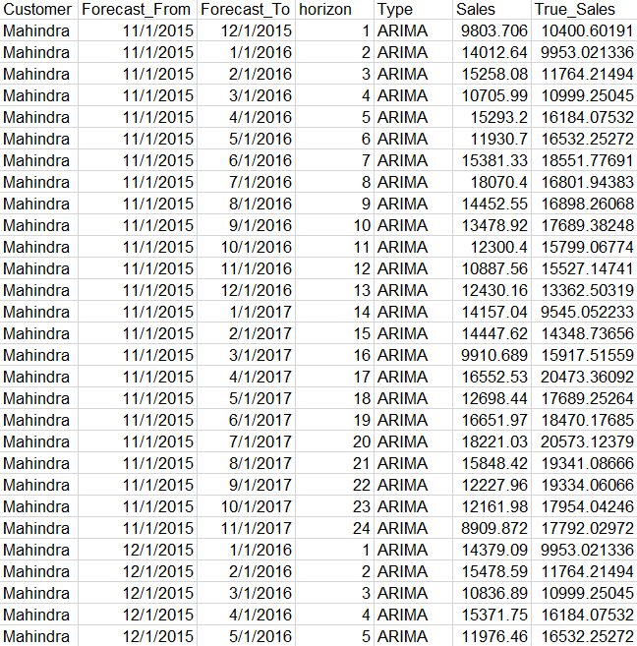
Store Forecast Results
Forecasting
arima_forecast <-
data.frame(Customer=j,
Forecast_From=last_month, Forecast_To,
horizon=1:forecast_horizon,
Type="ARIMA",
Sales=Arima_Model(train_data,12,forecast_horizon)
)
20
RBEI/EDS1 | 2018-04-13
© Robert Bosch Engineering and Business Solutions Private Limited 2018. All rights reserved, also regarding any disposal, exploitation, reproduction, editing, distribution, as well as in the event of applications for industrial property rights.

Slide 21

Best way to Choose model
Forecasting
Divide the data in two parts Training Data and Test Data according to horizon. Suppose we have data from Jan 2008 to Dec 2016 and want to forecast 12 period ahead.
Choose model has lowest average MAPE Error for each horizon and overall
Training Data Jan08 to Dec13
Forecast Jan14 to Dec14
Training Data Jan08 to Jan14
Forecast Feb14 to Jan15
Training Data Jan08 to Feb14
Forecast Mar14 to Feb15
…………..
…………….
Training Data Jan08 to Dec16
Forecast Jan17 to Dec17
21
RBEI/EDS1 | 2018-04-13
© Robert Bosch Engineering and Business Solutions Private Limited 2018. All rights reserved, also regarding any disposal, exploitation, reproduction, editing, distribution, as well as in the event of applications for industrial property rights.

Slide 22
How we forecast
Forecasting
Sales Data
FERI External Indicators
Weighting factor 1
Data Preparation
ARIMA
Forecast 1
*
Weighting factor 2
Total
Forecast
Neural Net
Forecast 2
*
+
Weighting factor 3
ETS, Naïve..
…
*
Validation using rolling forecast & Comparison
MAE
22
RBEI/EDS1-PJ-AI-S2 | 2018-04-13
© Robert Bosch Engineering and Business Solutions Private Limited 2018. All rights reserved, also regarding any disposal, exploitation, reproduction, editing, distribution, as well as in the event of applications for industrial property rights.

Slide 23
Error Calculation
Forecasting
23
RBEI/EDS1 | 2018-04-13
© Robert Bosch Engineering and Business Solutions Private Limited 2018. All rights reserved, also regarding any disposal, exploitation, reproduction, editing, distribution, as well as in the event of applications for industrial property rights.

Slide 24
Error Calculation
Forecasting
24
RBEI/EDS1 | 2018-04-13
© Robert Bosch Engineering and Business Solutions Private Limited 2018. All rights reserved, also regarding any disposal, exploitation, reproduction, editing, distribution, as well as in the event of applications for industrial property rights.

Slide 25
Error Calculation
Forecasting
25
RBEI/EDS1 | 2018-04-13
© Robert Bosch Engineering and Business Solutions Private Limited 2018. All rights reserved, also regarding any disposal, exploitation, reproduction, editing, distribution, as well as in the event of applications for industrial property rights.

Slide 26
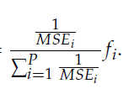
Combination Model
Forecasting
Variance-based, or Inverse Mean Squared Error : more accurate forecasting methods (lower MSE) are weighted more heavily
Procedure:
Need to divide data in three sets: Training Data, Validation Data (2015), Test Data (2016 onwards)
Training Data for fitting the model
Validation set to predict from each model and use calculated weights to generate forecast for test data, it will be updated after every iteration(Rolling forecast)
All steps will be repeated for each horizon
If sufficient history not available we can median also
26
RBEI/EDS1 | 2018-04-13
© Robert Bosch Engineering and Business Solutions Private Limited 2018. All rights reserved, also regarding any disposal, exploitation, reproduction, editing, distribution, as well as in the event of applications for industrial property rights.

Slide 27
Combined Model Code
Forecasting
combine_forecast<- function(series,training_data,all_forecast_previous,Forecast_horizon,target_var)
{
previous_forecast<- subset(all_forecast_previous,Series==series & Forecast_From< max(training_data$Date))
current_forecast<- subset(all_forecast_previous,Series==series & Forecast_From== max(training_data$Date))
last_month<-max(training_data$Date)
Forecast_To<-seq(from=last_month,length= Forecast_horizon+1,by="month")[2:( Forecast_horizon+1)]
comb_forecast<-NULL
for(h in 1:Forecast_horizon)
{
#calculate weight
temp_forecast= subset(previous_forecast,horizon==h)
temp_forecast_new= subset(current_forecast,horizon==h)
temp_forecast<-subset(temp_forecast,Type %in% temp_forecast_new$Type)
forecast_single_horizon<-cast(temp_forecast, Forecast_From+Forecast_To+horizon+Series~Type, sum, value = 'Sales')
test_actual_data<- merge(training_data, forecast_single_horizon, by.y=c('Forecast_To'), by.x=c('Date'))
27
RBEI/EDS1 | 2018-04-13
© Robert Bosch Engineering and Business Solutions Private Limited 2018. All rights reserved, also regarding any disposal, exploitation, reproduction, editing, distribution, as well as in the event of applications for industrial property rights.

Slide 28
Combined Model Code
Forecasting
trial<- try({
combined_weights<-Forecast_comb(test_actual_data[,target_var],as.matrix( test_actual_data[,6:ncol( test_actual_data)]),
Averaging_scheme= c("variance based"))
forecast_single_horizon_new<-cast( temp_forecast_new, Forecast_From+Forecast_To+horizon+Customer~Type,sum, value = 'Sales')
comb_fore<-as.matrix(forecast_single_horizon_new[,5:ncol(forecast_single_horizon)]) %*% as.matrix(combined_weights$weights)
})
if(class(trial)=="try-error") {
trial1<- try({ comb_fore<- median(temp_forecast_new$Sales[temp_forecast_new$Sales>0]) })
if(class(trial1)=="try-error") comb_fore<-median(temp_forecast_new$Sales)
}
#Combined Forecast
comb_forecast<-rbind(comb_forecast, data.frame(Series=series, Forecast_From=last_month,Forecast_To=Forecast_To[h],horizon=h,
Type="Combined", Sales=as.numeric(comb_fore)))
}
return(comb_forecast)
}
28
RBEI/EDS1 | 2018-04-13
© Robert Bosch Engineering and Business Solutions Private Limited 2018. All rights reserved, also regarding any disposal, exploitation, reproduction, editing, distribution, as well as in the event of applications for industrial property rights.

Slide 29

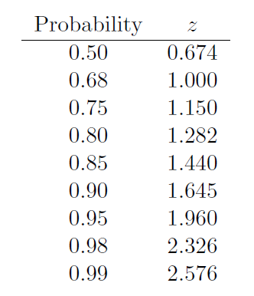
Calculation for confidence interval
Forecasting
Upper and lower confidence intervals for our forecasts
The value of z to be used depends on the degree of confidence desired
A 95 % confidence interval requires z = 1.96
29
RBEI/EDS1 | 2018-04-13
© Robert Bosch Engineering and Business Solutions Private Limited 2018. All rights reserved, also regarding any disposal, exploitation, reproduction, editing, distribution, as well as in the event of applications for industrial property rights.

Slide 30
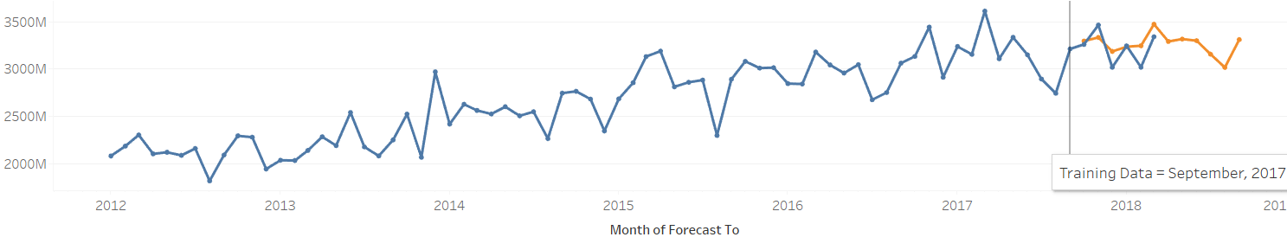
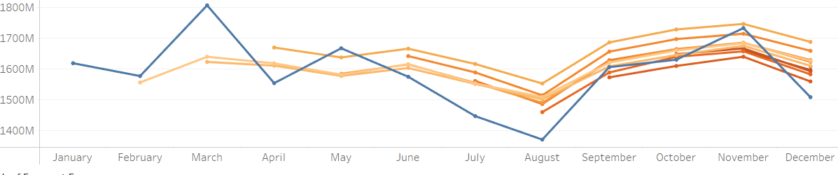
Monthly Forecast/ CFM Forecast
Visualizations
30
RBEI/EDS1 | 2018-04-13
© Robert Bosch Engineering and Business Solutions Private Limited 2018. All rights reserved, also regarding any disposal, exploitation, reproduction, editing, distribution, as well as in the event of applications for industrial property rights.

Slide 31
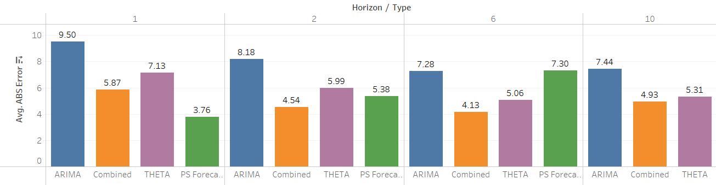
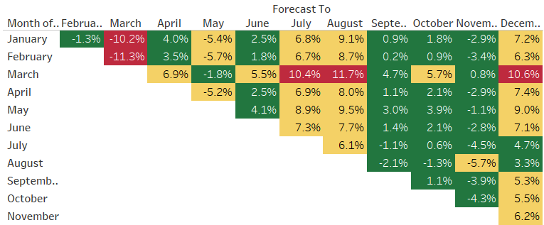
Monthly Error Table
Visualizations
31
RBEI/EDS1 | 2018-04-13
© Robert Bosch Engineering and Business Solutions Private Limited 2018. All rights reserved, also regarding any disposal, exploitation, reproduction, editing, distribution, as well as in the event of applications for industrial property rights.

Slide 32
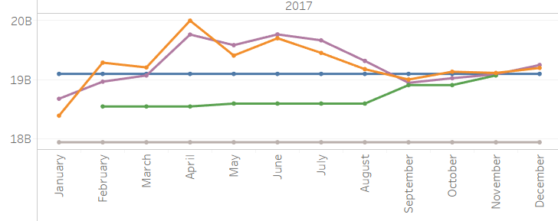

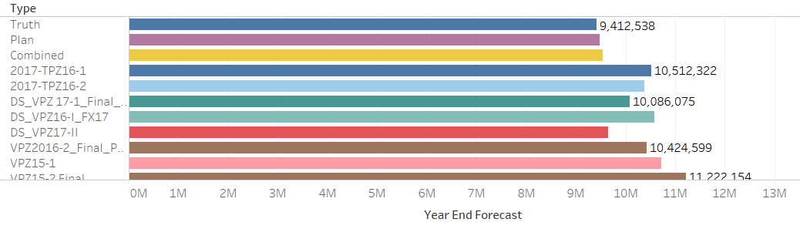
Total Year Forecast/ CF forecast
Visualizations
For Jan 2017 , Forecast(Jan +Feb+….+Dec)
For Feb 2017, Actual(Jan)+ Forecast(Feb + Mar+… +Dec)
… ……For Dec 2017 , Actual(Jan + Feb+…+Nov)+Forecast(Dec)
32
RBEI/EDS1 | 2018-04-13
© Robert Bosch Engineering and Business Solutions Private Limited 2018. All rights reserved, also regarding any disposal, exploitation, reproduction, editing, distribution, as well as in the event of applications for industrial property rights.

Slide 33
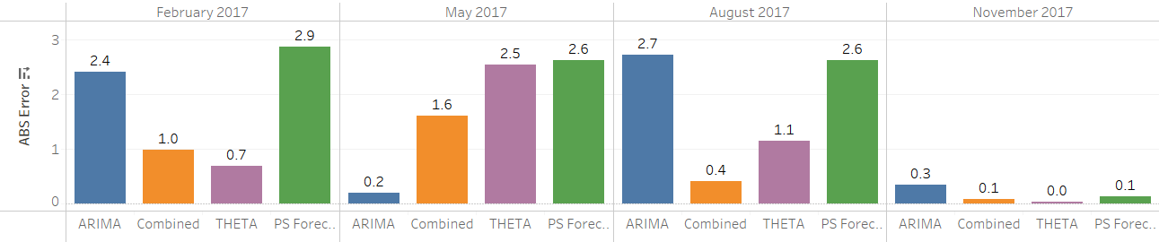
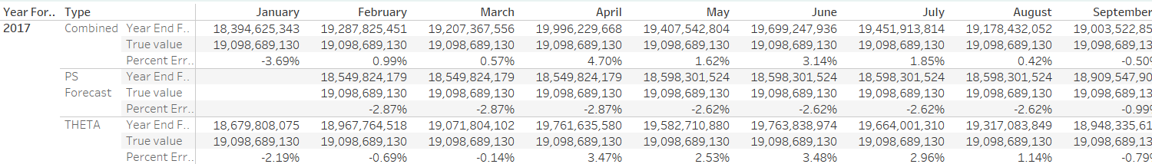
Total Year Error
Visualizations
33
RBEI/EDS1 | 2018-04-13
© Robert Bosch Engineering and Business Solutions Private Limited 2018. All rights reserved, also regarding any disposal, exploitation, reproduction, editing, distribution, as well as in the event of applications for industrial property rights.

Slide 34
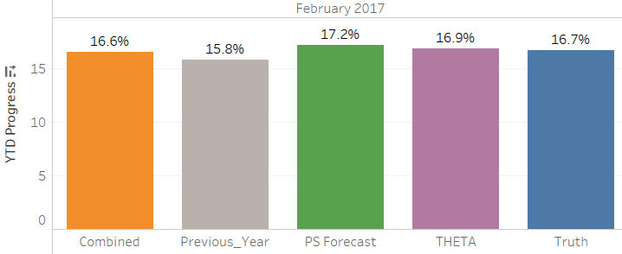
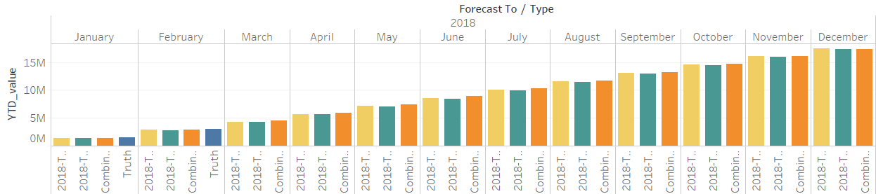
YTD Progress
Visualizations
Cumulative Actual Sales till date/CF forecast
34
RBEI/EDS1 | 2018-04-13
© Robert Bosch Engineering and Business Solutions Private Limited 2018. All rights reserved, also regarding any disposal, exploitation, reproduction, editing, distribution, as well as in the event of applications for industrial property rights.

Slide 35
Thank You
35
RBEI/EDS1 | 2018-04-13
© Robert Bosch Engineering and Business Solutions Private Limited 2018. All rights reserved, also regarding any disposal, exploitation, reproduction, editing, distribution, as well as in the event of applications for industrial property rights.

Slide 36
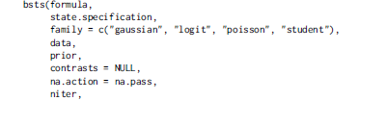
Basic difference in Forecast Models
Header of section
Forecast Model | Difference
ETS | Useful when importance are decreasing from recent to past
ARIMA | When effect of lag2 is more than effect of lag1 on lag0
BSTS | When is non stationary (after removing trend and seasonality i.e. auto covariance is not constant), it is useful as it considers standard deviation in the model BSTS models approximate model uncertainty by allowing all components to be nonstationary The bsts package allows for non-Gaussian error families in the observation equation (as well as some state compo
36
RBEI/EDS1 | 2018-04-13
© Robert Bosch Engineering and Business Solutions Private Limited 2018. All rights reserved, also regarding any disposal, exploitation, reproduction, editing, distribution, as well as in the event of applications for industrial property rights.

Slide 37
Model Explanations
Forecasting
37
RBEI/EDS1 | 2018-04-13
© Robert Bosch Engineering and Business Solutions Private Limited 2018. All rights reserved, also regarding any disposal, exploitation, reproduction, editing, distribution, as well as in the event of applications for industrial property rights.

Slide 38
Discussion on ETS Time Series Model

Slide 39


Simple Exponential Smoothing
ETS Model
In naïve model the most current observation is the only important one and all previous observations provide no information for the future.
In average method, we assigned equal weights to all previous observations
It may be sensible to attach larger weights to more recent observations than to observations from the distant past. This is exactly the concept behind simple exponential smoothing.
Suitable for forecasting data with no trend or seasonal pattern.
39
RBEI/EDS1 | 2018-04-13
© Robert Bosch Engineering and Business Solutions Private Limited 2018. All rights reserved, also regarding any disposal, exploitation, reproduction, editing, distribution, as well as in the event of applications for industrial property rights.
Notes:
Naïve :This can be thought of as a weighted average where all the weight is given to the last observation.
Average :Hence, the average method assumes that all observations are of equal importance and they are given equal weight when generating forecasts.

Slide 40
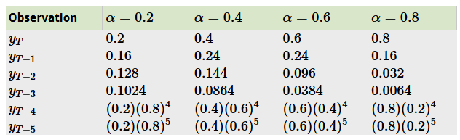
Why name is Exponential Smoothing?
ETS Model
The weights attached to the observations decrease exponentially as we go back in time
If α is small (i.e., close to 0), more weight is given to observations from the more distant past.
If α is large (i.e., close to 1), more weight is given to the more recent observations.
If alpha=1 , It will be equivalent to Naïve model
40
RBEI/EDS1 | 2018-04-13
© Robert Bosch Engineering and Business Solutions Private Limited 2018. All rights reserved, also regarding any disposal, exploitation, reproduction, editing, distribution, as well as in the event of applications for industrial property rights.

Slide 41


Different Forms of Exponential Smoothing
ETS Model
Weighted Average form
The forecast at time t+1 is equal to a weighted average between the most recent observation and the most recent forecast
Component form
comprise a forecast equation and a smoothing equation for each of the components
where is the level (or the smoothed value) of the series at time t. The forecast equation shows that the forecasted value at time t+1 is the estimated level at time t.
41
RBEI/EDS1 | 2018-04-13
© Robert Bosch Engineering and Business Solutions Private Limited 2018. All rights reserved, also regarding any disposal, exploitation, reproduction, editing, distribution, as well as in the event of applications for industrial property rights.

Slide 42

Different Forms of Exponential Smoothing
ETS Model
Error Correction Form
Obtained by re-arranging the level equation in the component form
Large alpha is to one the “rougher” the estimate of the level (large adjustments take place).
Smaller the alpha the “smoother” the level (small adjustments take place).
42
RBEI/EDS1 | 2018-04-13
© Robert Bosch Engineering and Business Solutions Private Limited 2018. All rights reserved, also regarding any disposal, exploitation, reproduction, editing, distribution, as well as in the event of applications for industrial property rights.

Slide 43

Estimation of Smoothing parameter
ETS Model
We estimate the parameter by minimizing the sum of the squared errors (SSE)
Multi-horizon forecast : Simple exponential smoothing has flat forecast
Example in Excel
R code
fit1 <- ses(oildata, h=3)
43
RBEI/EDS1 | 2018-04-13
© Robert Bosch Engineering and Business Solutions Private Limited 2018. All rights reserved, also regarding any disposal, exploitation, reproduction, editing, distribution, as well as in the event of applications for industrial property rights.

Slide 44
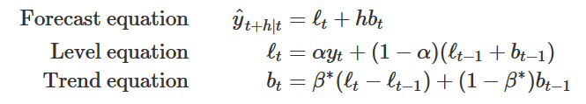



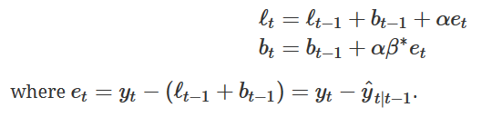
Holt’s Linear Trend Method (Double ETS)
ETS Model
Holt (1957) extended simple exponential smoothing to allow forecasting of data with a trend.
This method involves a forecast equation and two smoothing equations (one for the level and one for the trend):
Error Correction form
fit1 <- holt(air, alpha=0.8,beta=0.2,h=5)
44
RBEI/EDS1 | 2018-04-13
© Robert Bosch Engineering and Business Solutions Private Limited 2018. All rights reserved, also regarding any disposal, exploitation, reproduction, editing, distribution, as well as in the event of applications for industrial property rights.

Slide 45
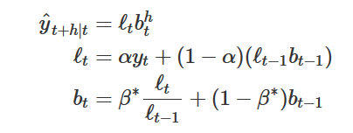

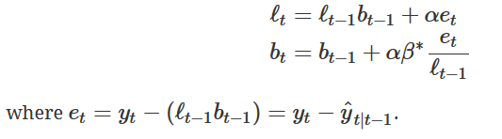
Exponential Trend Model
ETS Model
A variation from previous method is achieved by allowing the level and the slope to be multiplied rather than added
now represents an estimated growth rate (in relative terms rather than absolute)
Error Correction form
fit2 <- holt(air, alpha=0.8, beta=0.2, exponential=TRUE, h=5)
45
RBEI/EDS1 | 2018-04-13
© Robert Bosch Engineering and Business Solutions Private Limited 2018. All rights reserved, also regarding any disposal, exploitation, reproduction, editing, distribution, as well as in the event of applications for industrial property rights.

Slide 46
Damped Trend Model
ETS Model
The forecasts generated by Holt’s linear method display a constant trend (increasing or decreasing) indefinitely into the future.
Even more extreme are the forecasts generated by the exponential trend method which include exponential growth or decline.
Empirical evidence indicates that these methods tend to over-forecast, especially for longer forecast horizons.
Motivated by this observation, Gardner and McKenzie (1985) introduced a parameter that “dampens” the trend to a flat line some time in the future.
Methods that include a damped trend have proven to be very successful and are arguably the most popular individual methods when forecasts are required automatically for many series.
46
RBEI/EDS1 | 2018-04-13
© Robert Bosch Engineering and Business Solutions Private Limited 2018. All rights reserved, also regarding any disposal, exploitation, reproduction, editing, distribution, as well as in the event of applications for industrial property rights.

Slide 47
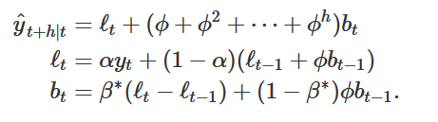

Damped Trend Model
ETS Model
Additive damped trend
Φ dampens the trend so that it approaches a constant some time in the future.
The effect of this is that short-run forecasts are trended while long-run forecasts are constant.
Error Correction form
fit4 <- holt(livestock2,damped=TRUE)
47
RBEI/EDS1 | 2018-04-13
© Robert Bosch Engineering and Business Solutions Private Limited 2018. All rights reserved, also regarding any disposal, exploitation, reproduction, editing, distribution, as well as in the event of applications for industrial property rights.

Slide 48
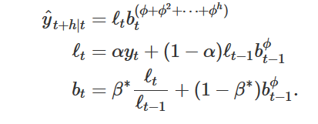
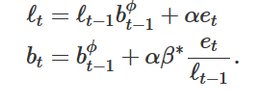
Damped Trend Model
ETS Model
Multiplicative damped trend
This method will produce less conservative forecasts than the additive damped trend method when compared to Holt’s linear method.
Error Correction form
fit5 <- holt(livestock2,exponential=TRUE,damped=TRUE)
48
RBEI/EDS1 | 2018-04-13
© Robert Bosch Engineering and Business Solutions Private Limited 2018. All rights reserved, also regarding any disposal, exploitation, reproduction, editing, distribution, as well as in the event of applications for industrial property rights.

Slide 49
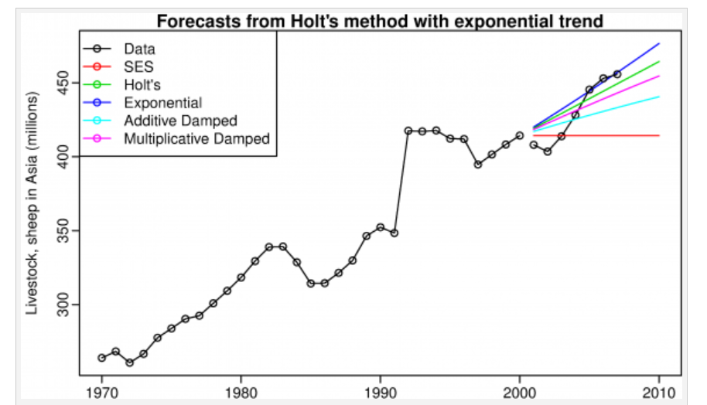
Double Exponential Smoothing Models
ETS Model
49
RBEI/EDS1 | 2018-04-13
© Robert Bosch Engineering and Business Solutions Private Limited 2018. All rights reserved, also regarding any disposal, exploitation, reproduction, editing, distribution, as well as in the event of applications for industrial property rights.

Slide 50
Holt-Winters Seasonal Method (Triple ETS)
ETS Model
Holt (1957) and Winters (1960) extended Holt’s method to capture seasonality.
The Holt-Winters seasonal method comprises the forecast equation and three smoothing equations — one for the level, one for trend, and one for the seasonal component
There are two variations to this method that differ in the nature of the seasonal component.
The additive method is preferred when the seasonal variations are roughly constant through the series,(seasonal component is expressed in absolute terms in the scale of the observed series)
while the multiplicative method is preferred when the seasonal variations are changing proportional to the level of the series. (seasonal component is expressed in relative terms (percentages) )
50
RBEI/EDS1 | 2018-04-13
© Robert Bosch Engineering and Business Solutions Private Limited 2018. All rights reserved, also regarding any disposal, exploitation, reproduction, editing, distribution, as well as in the event of applications for industrial property rights.

Slide 51
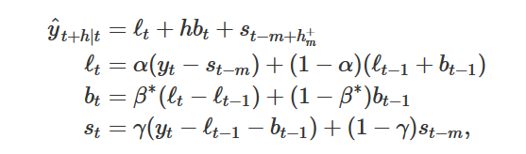
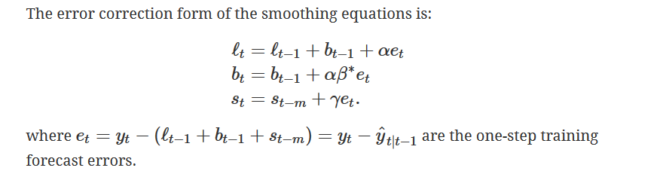
Holt-Winters Seasonal Method
ETS Model
Holt-Winters additive method
fit1 <- hw(aust,seasonal="additive")
51
RBEI/EDS1 | 2018-04-13
© Robert Bosch Engineering and Business Solutions Private Limited 2018. All rights reserved, also regarding any disposal, exploitation, reproduction, editing, distribution, as well as in the event of applications for industrial property rights.

Slide 52
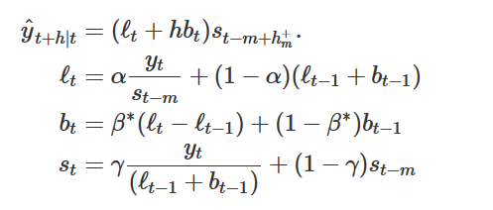
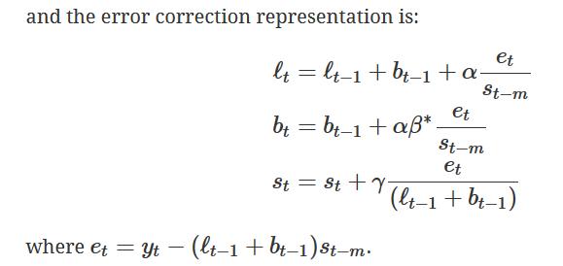
Holt-Winters Seasonal Method
ETS Model
Holt-Winters Multiplicative method
fit2 <- hw(aust, seasonal="multiplicative")
52
RBEI/EDS1 | 2018-04-13
© Robert Bosch Engineering and Business Solutions Private Limited 2018. All rights reserved, also regarding any disposal, exploitation, reproduction, editing, distribution, as well as in the event of applications for industrial property rights.

Slide 53
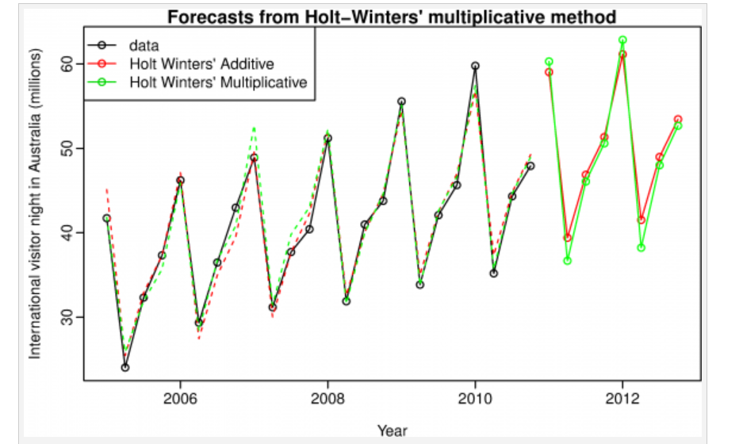
Holt Winter Model
ETS Model
53
RBEI/EDS1 | 2018-04-13
© Robert Bosch Engineering and Business Solutions Private Limited 2018. All rights reserved, also regarding any disposal, exploitation, reproduction, editing, distribution, as well as in the event of applications for industrial property rights.

Slide 54
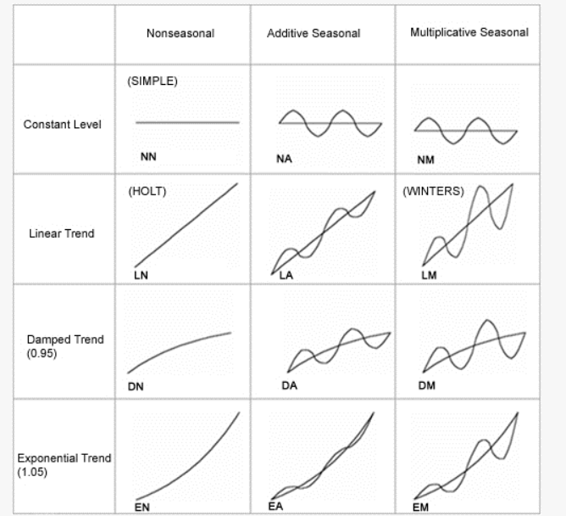

Header of section
54
RBEI/EDS1 | 2018-04-13
© Robert Bosch Engineering and Business Solutions Private Limited 2018. All rights reserved, also regarding any disposal, exploitation, reproduction, editing, distribution, as well as in the event of applications for industrial property rights.

Slide 55
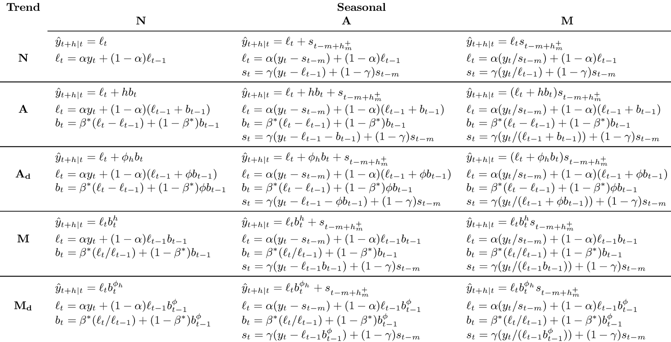
Header of section
55
RBEI/EDS1 | 2018-04-13
© Robert Bosch Engineering and Business Solutions Private Limited 2018. All rights reserved, also regarding any disposal, exploitation, reproduction, editing, distribution, as well as in the event of applications for industrial property rights.

Slide 56
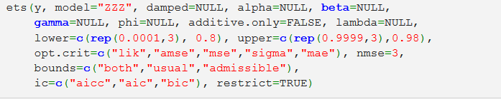
Header of section
56
RBEI/EDS1 | 2018-04-13
© Robert Bosch Engineering and Business Solutions Private Limited 2018. All rights reserved, also regarding any disposal, exploitation, reproduction, editing, distribution, as well as in the event of applications for industrial property rights.

Slide 57

Initialization
ETS Model
57
RBEI/EDS1 | 2018-04-13
© Robert Bosch Engineering and Business Solutions Private Limited 2018. All rights reserved, also regarding any disposal, exploitation, reproduction, editing, distribution, as well as in the event of applications for industrial property rights.

Slide 58
Reference
ETS Model
Calculation example :
https://www.otexts.org/fpp/7/6
https://www.itl.nist.gov/div898/handbook/pmc/section4/pmc435.htm
58
RBEI/EDS1 | 2018-04-13
© Robert Bosch Engineering and Business Solutions Private Limited 2018. All rights reserved, also regarding any disposal, exploitation, reproduction, editing, distribution, as well as in the event of applications for industrial property rights.

Slide 59
Thank You
59
RBEI/EDS1 | 2018-04-13
© Robert Bosch Engineering and Business Solutions Private Limited 2018. All rights reserved, also regarding any disposal, exploitation, reproduction, editing, distribution, as well as in the event of applications for industrial property rights.

