Slide 1
Introduction To Python
Shanu Agrawal

Slide 2
What is Python?
Python is a general-purpose, versatile and popular programming language.
It was created by Guido van Rossum, and released in 1991.
It can be used for everything from web development to software development and scientific applications.

Slide 3
Why Python?
Easy to Learn, prototype, deploy
Open Source programming
Code syntax is compact
Lot of inbuilt packages available
Good for data science
Object Oriented Programming
Python works on different platforms (Windows, Mac, Linux, Raspberry Pi, etc).

Slide 4
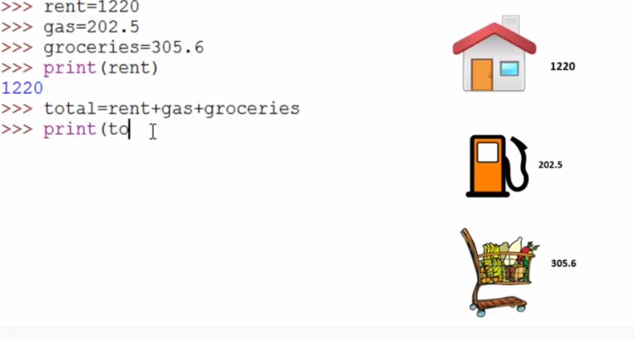
Variables
Are containers to hold any data, numeric, text.. etc.
We can the change the value in variable
Suppose rent went up can change the rent
We cannot use python keywords as variable name.
Cannot use special characters in variables like +,-

Slide 5
Numbers
Two types of number : integer(whole number), float (number with fraction)
Using round function we can limit the decimals

Slide 6
Numbers
All addition(+), subtraction(-), division(/) and multiplication(*) is possible in python
For remainder we use % sign
11%2
1
For power 3**2=9
Number calculation prioritization

Slide 7
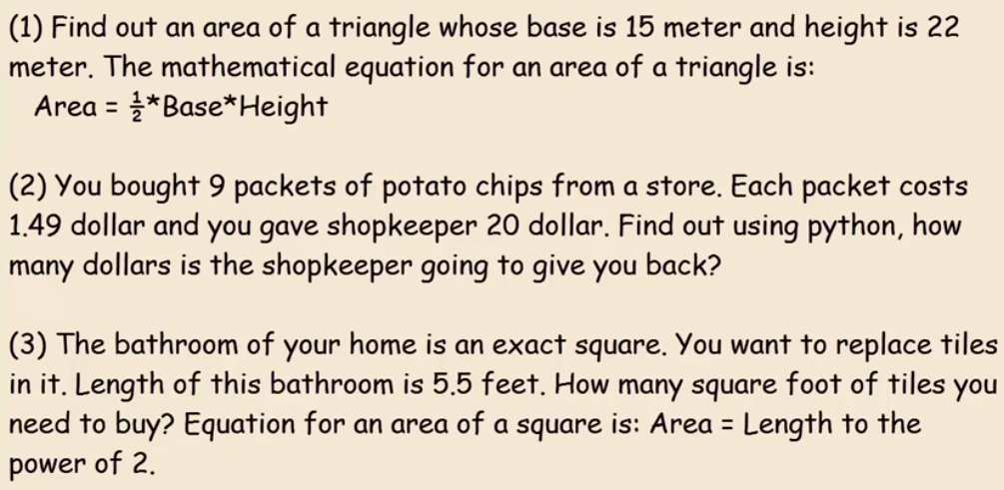

Slide 8
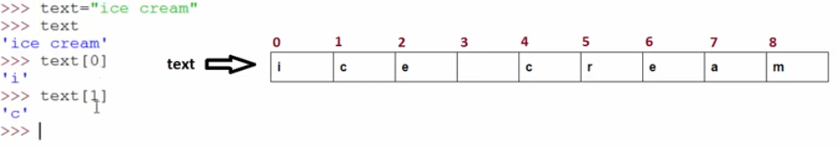
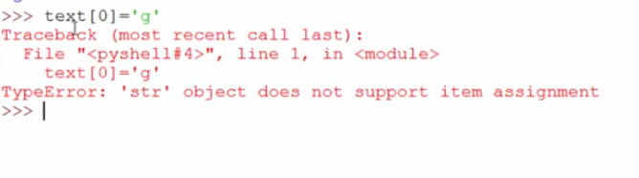
Strings
Used to store text information
Strings are immutable. we cannot change specific memory value.
When we reassign will create different memory location

Slide 9
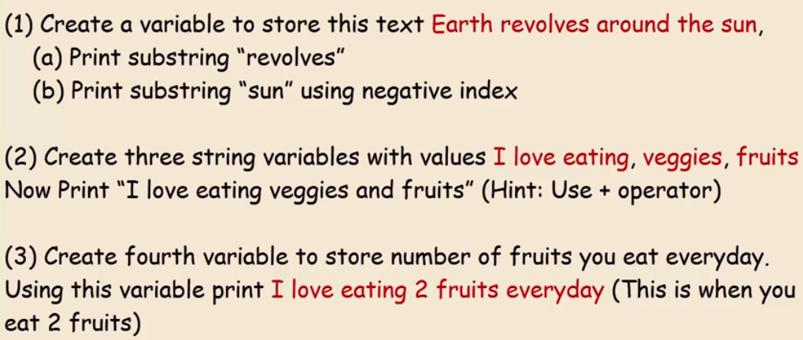

Slide 10
Data Types
Data Type | Description | Also Known as | Examples
Logical | Binary | Simple Built-in | True/ False
Float | Numbers with decimal | Simple Built-in | 5.908, 4.7,..
Integer | Without decimal | Simple Built-in | -4, 1, 2, …
String | Character String (Immutable) | Simple Built-in , sequence | “I Love India”
List | Mutable ordered collection of values | Sequence, Collections | [[1,2,5], [“I”, 1, 6]]
Tuple | Immutable ordered collection of values | Sequence, Collections | (4, 6,8) , (“A”, “B”)
Dictionary | Key-value pairs, no duplicate key | Collections | {“A”:1, “B”: 12}
Data Frame | Row column structure | Collections | Excel structure

Slide 11
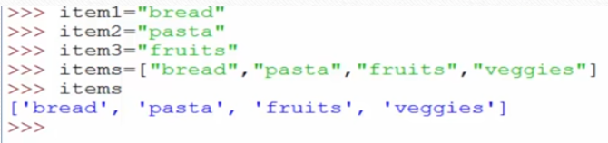
List
A list is a collection which is ordered and changeable. In Python lists are written with square brackets.
Suppose you want to go to grocery store, before going you are deciding on items to buy
#bread, butter, fruits, vegetables

Slide 12
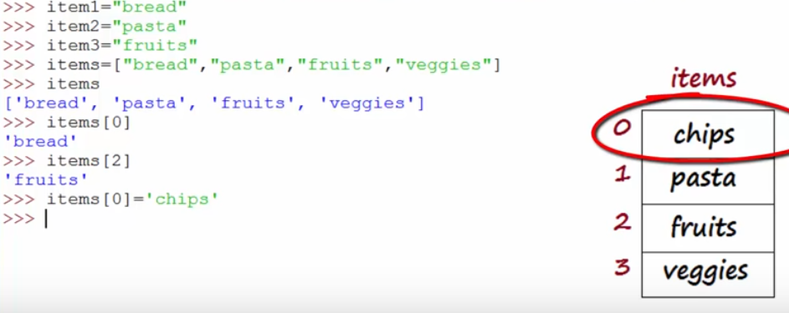

Slide 13
Accessing Single value
T= [1, 4, 7, 9,11]
Positive index: counting starts from 0 left to right
T[2]
7
Negative index : counting starts from -1 right to left
T[-2]
9

Slide 14
Accessing Range of values
T= [1, 4, 7, 9,11]
Syntax | Output | Comment
T[0:3] | [1, 4, 7] | Starts from first index till one less of second index
T[-4:-2] | [4, 7] | Starts from first index till one less of second index
T[1:-2] | [4, 7] | Starts from first index till one less of second index
T[ :3] | [1, 4, 7] | When omit the first index, start from 0 index till one less of second index
T[2: ] | [7, 9, 11] | When omit the second index, start from first index till end

Slide 15
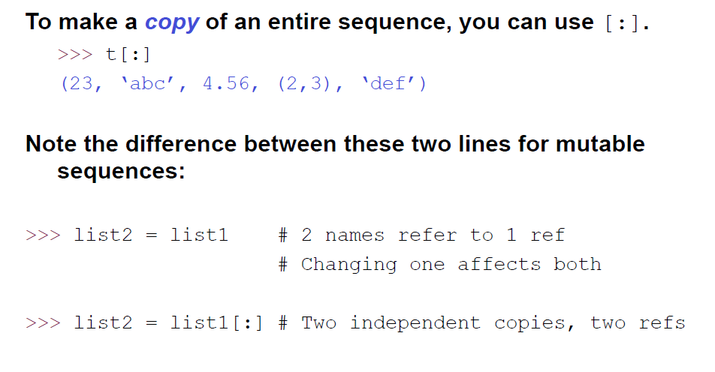
Copying the Whole Sequence

Slide 16
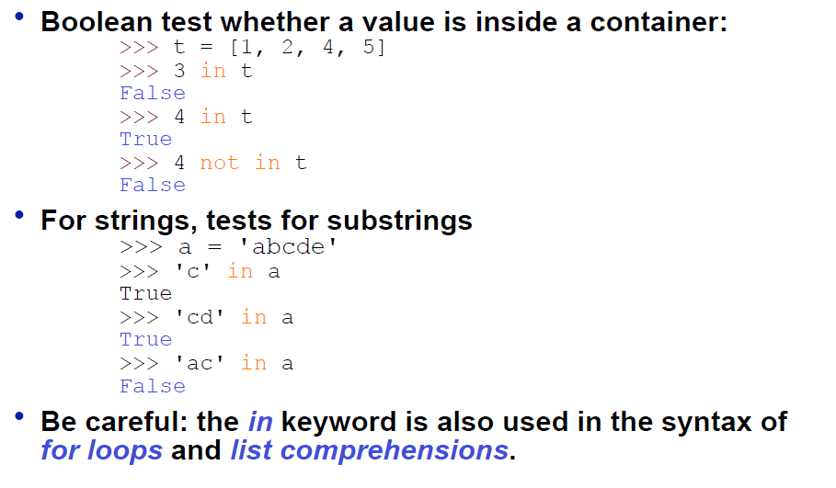
The ‘in’ Operator

Slide 17
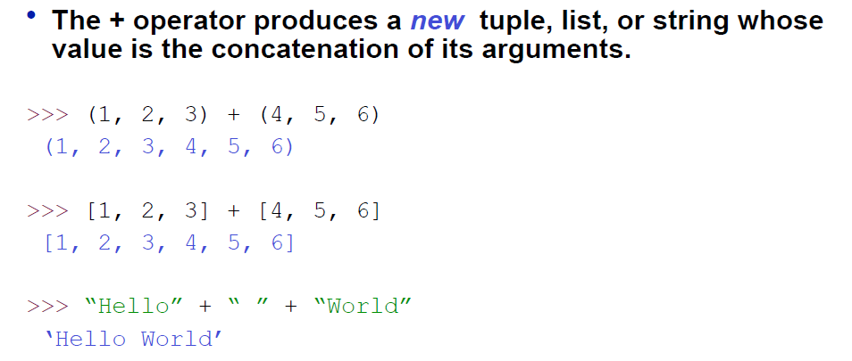
The + Operator

Slide 18
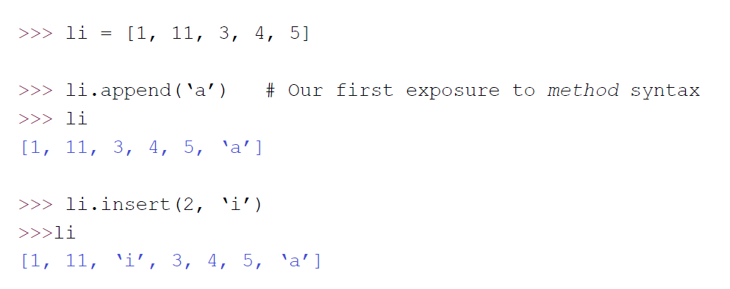
Operations on Lists Only 1

Slide 19
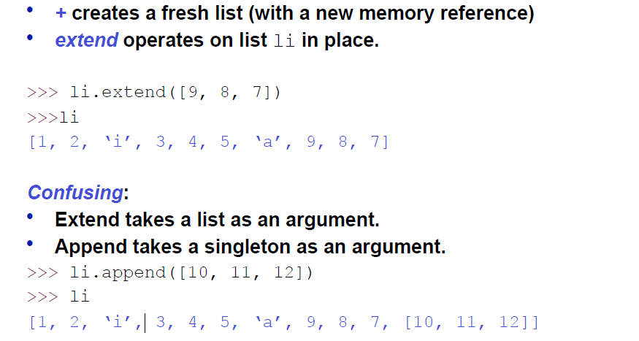
The extend method vs the + operator

Slide 20
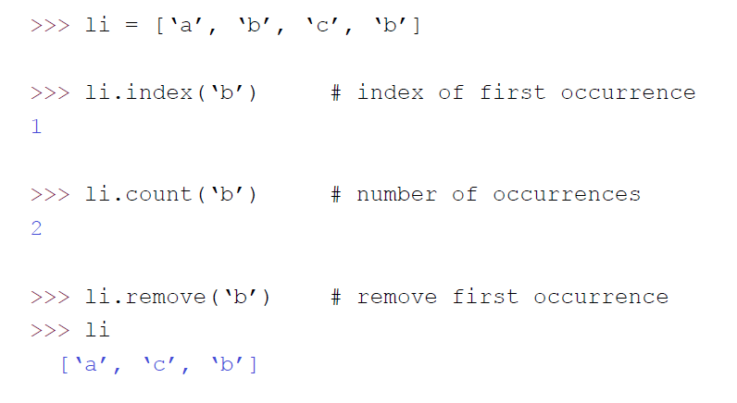
Operations on Lists

Slide 21
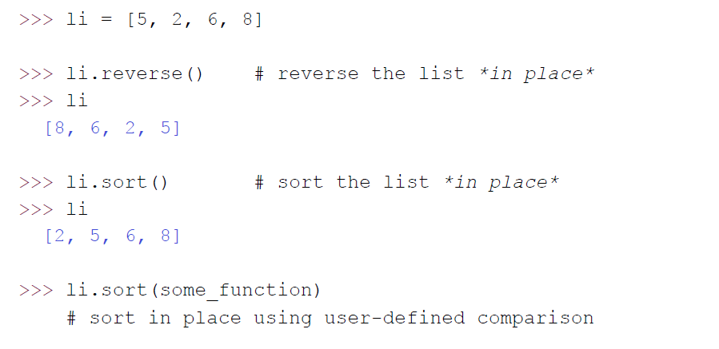
Operations on Lists

Slide 22
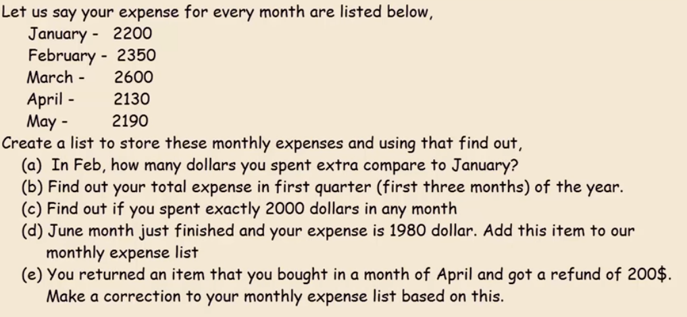

Slide 23
Tuples
A tuple is a collection of values which is ordered and unchangeable. In Python tuples are written with round brackets.
Tuples are immutable, we can not modify specific index value, delete value
(9, 10, 34)
Accessing values same as strings and list

Slide 24
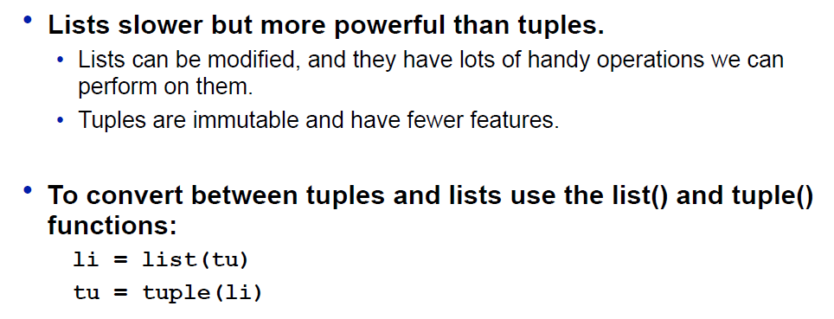
Tuples vs. Lists

Slide 25
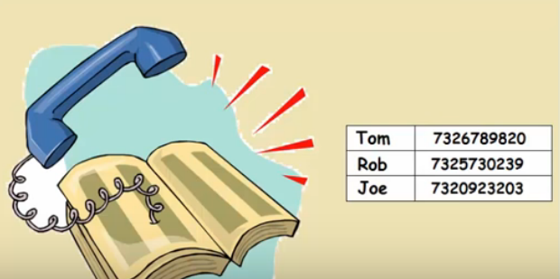
Dictionaries
Allows to store key value pairs
Also known as maps, hash tables, associate arrays
Order does not matter
Classical example : telephone Directory

Slide 26
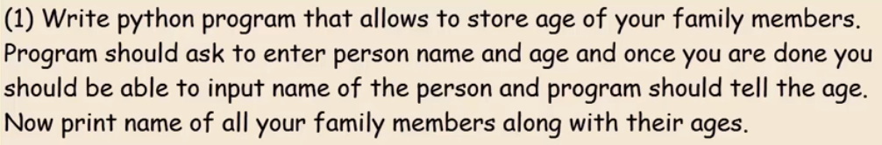

Slide 27
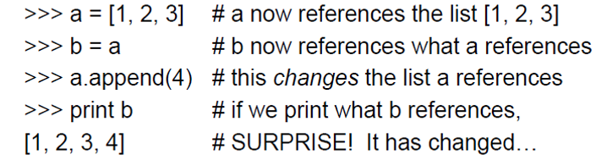
Semantic Reference
X=Y does not make a copy of Y object, X will refer to same memory address as Y
Any change in X will cause change in Y

Slide 28
Semantic Reference
X=Y does not make a copy of Y object, X will refer to same memory address as Y
To avoid any change in X will cause change in Y
X= Y.copy( )
To check if referring to same address
X is Y

Slide 29
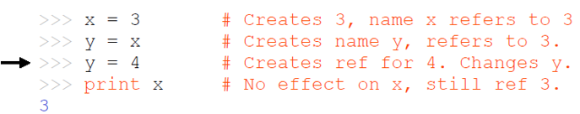
Semantic Reference
X=Y does not make a copy of Y object, X will refer to same memory address as Y
If it is simple built-in datatype (float, integer, string), after modifying one will start acting as two object

Slide 30
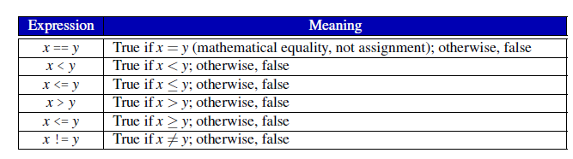
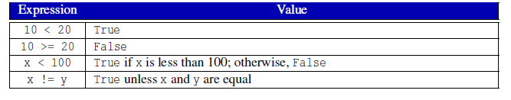
Conditional Execution

