Slide 1
Pandas Data Frame

Slide 2
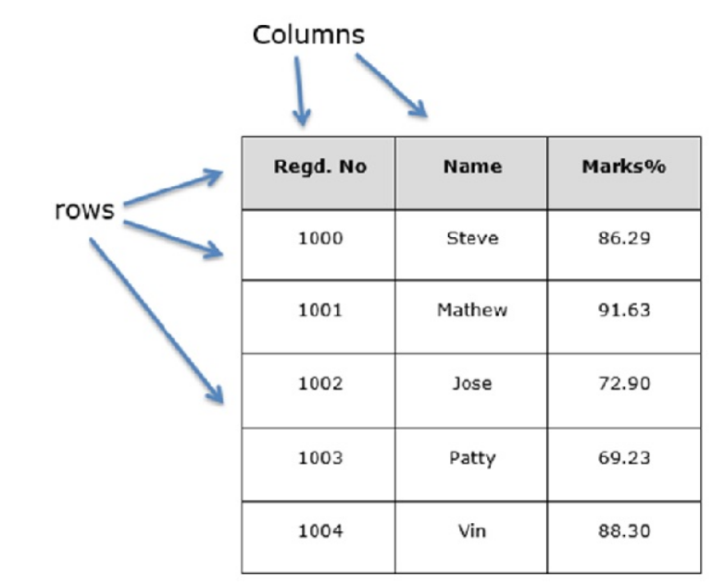
Introduction
A Data frame is a two-dimensional data structure, i.e., data is aligned in a tabular fashion in rows and columns.
Features of DataFrame
Potentially columns are of different types
Size – Mutable
Labeled axes (rows and columns)
Can Perform Arithmetic operations on rows and columns

Slide 3
In the real world, a Pandas DataFrame will be created by loading the datasets from SQL Database, CSV file, and Excel file.
Pandas DataFrame can be created from the lists, dictionary, and from a list of dictionary etc.
pandas.DataFrame( data, index, columns, dtype, copy)
data : lists, dict
index : For the row labels, the Index to be used for the resulting frame is Optional Default np.arange(n) if no index is passed.

Slide 4
pandas.DataFrame (data, index, columns, dtype)
data : lists, dict
index : For the row labels, the Index to be used for the resulting frame is Optional Default np.arange(n) if no index is passed.
Columns: For column labels, the optional default syntax is - np.arange(n). This is only true if no index is passed.
Dtype: Data type of each column

