Slide 2
Qualitative Data
Common examples include student letter grade (A, B, C, D or F), commercial bond rating (AAA, AAB, ...) and consumer clothing shoe sizes (1, 2, 3, ...)
data("painters")
View(painters)
help(painters)
Problem
Find the frequency distribution of the painter schools in the data set painters.
> school = painters$School # the painter schools > school.freq = table(school) # apply the table function
> school.freq school A B C D E F G H 10 6 6 10 7 4 7 4

Slide 3
Exercise
Find the frequency distribution of the composition scores in painters.
Find programmatically the school that has the most painters.
Find the relative frequency distribution of the painter schools in the data set painters.
Find the relative frequency distribution of the painter schools in the data set painters.

Slide 4
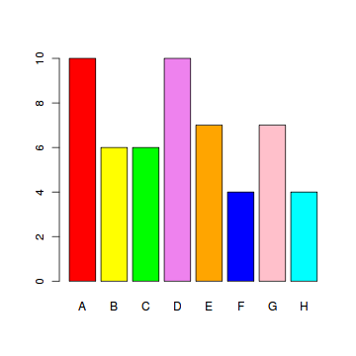
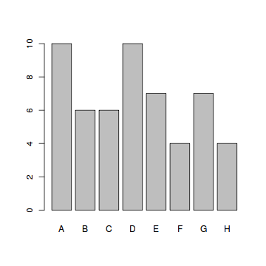
Bar Plot
we apply the barplot function to produce its bar graph.
> barplot(school.freq) # apply the barplot function
> colors = c("red", "yellow", "green", "violet", + "orange", "blue", "pink", "cyan")
> barplot(school.freq, # apply the barplot function + col=colors) # set the color palette

Slide 5
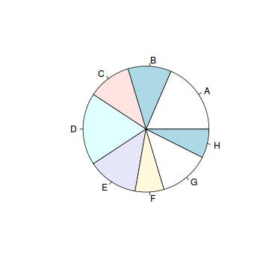
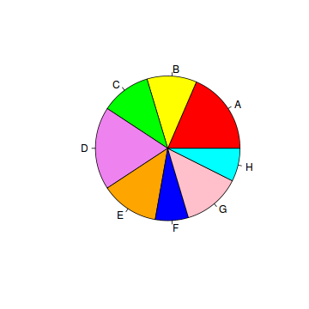
Pie Chart
we apply the pie function to produce its pie chart.
> pie(school.freq) # apply the pie function
> colors = c("red", "yellow", "green", "violet", + "orange", "blue", "pink", "cyan") > pie(school.freq, # apply the pie function + col=colors) # set the color palette

Slide 6
Exercise
Find the bar graph of the composition scores in painters.
Find the pie chart of the composition scores in painters.

