Slide 1
Probability Distribution

Slide 2
By examining the chest X ray, the probability that TB is detected when a person is actually suffering is 0.99. The probability of an healthy person diagnosed to have TB is 0.001. In a certain city, 1 in 1000 people suffers from TB. A person is selected at random and is diagnosed to have TB. What is the probability that he actually has TB?
TB detected
0.99
P(A person is selected at random and is diagnosed to have TB)=
(1/1000)*0.99+(999/1000)*0.001
P(actually has TB)=
P(Suffering and TB detected)/P(A person is selected at random and is diagnosed to have TB)
0.99*(1/1000)
((1/1000)*0.99+(999/1000)*0.001)
1/1000
Suffering
TB not detected
0.01
TB detected
0.001
Not Suffering
999/1000
TB not detected
0.999

Slide 3
Event Types
Independent (each event is not affected by other events),
Dependent (also called "Conditional", where an event is affected by other events)
Mutually Exclusive (events can't happen at the same time)
Equally Likely: probability is equal

Slide 4
Random Variables

Slide 5
Random Variables
Something is random when it varies by chance
a numerical characteristic that takes on different values due to chance
Example: Rolling a die there are six equally possible outcomes, the observed outcome on any one roll is random.

Slide 6
Types
A discrete random variable has a countable set of distinct possible values.
Number of classes missed last week (possible outcomes are 0, 1, 2, 3, ..., up to the maximum number of classes)
A continuous random variable is such that any value (to any number of decimal places) within some interval is a possible value.
Heights of individuals
Time to finish a test
Hours spent exercising last week

Slide 7
Probability distribution
A table, graph, or formula that gives the probability of a given outcome's occurrence

Slide 8
Probability distribution
For a discrete random variable, its probability distribution (also called the probability distribution function) is any table, graph, or formula that gives each possible value and the probability of that value.
Note: The total of all probabilities across the distribution must be 1, and each individual probability must be between 0 and 1, inclusive.

Slide 9
A census was conducted at a university. All students were asked how many tattoos they had.
Tattoos | 0 | 1 | 2 | 3 | 4
Probability | .850 | .120 | .015 | .010 | .005

Slide 10
Expected Value of a Discrete Random Variable
Tattoos | 0 | 1 | 2 | 3 | 4
Probability | .850 | .120 | .015 | .010 | .005
E(X)=0(.85)+1(.12)+2(.015)+3(.010)+4(.005)=.20
The mean number of tattoos per student is .20.

Slide 11
A fair six-sided die is tossed. You win $2 if the result is a “1,” you win $1 if the result is a “6,” otherwise you lose $1.
The Probability Distribution for X = Amount Won or Lost

Slide 12
The Probability Distribution for X = Amount Won or Lost
X | +$2 | +$1 | -$1
Probability | 1/6 | 1/6 | 4/6
E(X)

Slide 13

The Probability Distribution for X = Amount Won or Lost
X | +$2 | +$1 | -$1
Probability | 1/6 | 1/6 | 4/6
E(X)=$2(1/6)+$1(1/6)+(−$1)(4/6)
=$−1/6
=−$0.17
if you play many times, the average outcome is losing 17 cents per play.
Thus, over time you should expect to lose money.

Slide 14
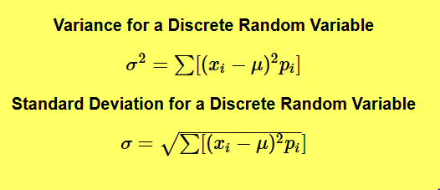
Standard Deviation
For instance, you may "expect" to win $20 when playing a particular game (which appears good!), but the spread for this might be from losing $20 to winning $60. Knowing such information can influence you decision on whether to play.

Slide 15
probability you get 2 right when you guess as 3 True-False questions
True
TTT
TTF
TFT
TFF
FTT
FTF
FFT
FFF
0.5
True
0.5
False
0.5
True
0.5
=3/8
True
0.5
False
0.5
False
0.5
True
True
0.5
0.5
False
0.5
0.5
False
False
0.5
True
0.5
False
0.5

Slide 16
probability you get 20 right when you guess as 30 True-False questions

Slide 17
Binomial Random Variable
A specific type of discrete random variable that counts how often a particular event occurs in a fixed number of trials
Examples
Number of correct guesses at 30 true-false questions when you randomly guess all answers.
Number of winning lottery tickets when you buy 10 tickets of the same kind
Number of left-handers in a randomly selected sample of 100 unrelated people
Number of tails when flipping a coin 10 times

Slide 18
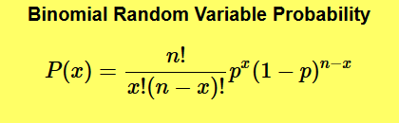
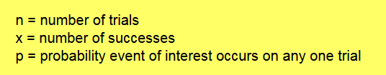
probability you get 20 right when you guess as 30 True-False questions

Slide 19
#exactly 4 correct answers by random attempts
dbinom(4, size=30, prob=0.5)
#having four or less correct answers by random attempts
pbinom(4, size=30, prob=0.5)

Slide 20
Cross-fertilizing a red and a white flower produces red flowers 25% of the time. Now we cross-fertilize five pairs of red and white flowers and produce five offspring.
Find the probability that there will be no red flowered plants in the five offspring.
P(X=0)
dbinom(0, size=5, prob=0.25)
probability that there would be one or fewer red flowered plants?
P(X<=1)
dbinom(0, size=5, prob=0.25) +dbinom(1, size=5, prob=0.25)
pbinom(1, size=5, prob=0.25)

Slide 21
For a variable to be a binomial random variable, ALL of the following conditions must be met:
There are a fixed number of trials (a fixed sample size)
On each trial, the event of interest either occurs or does not
The probability of occurrence (or not) is the same on each trial
Trials are independent of one another

Slide 22
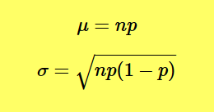
Expected Value and Standard Deviation
For instance, the “expected” number of correct (random) guesses at 30 True-False questions is np = (30)(.5) = 15 (half of the questions).

Slide 23
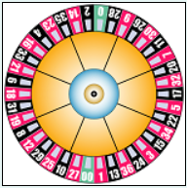
A roulette wheel has 38 slots, 18 are red, 18 are black, and 2 are green. You play five games and always bet on red.
What is the probability that you will win all five games?
P(X=5)= dbinom(5,size=5, prob=18/38)

Slide 24
A roulette wheel has 38 slots, 18 are red, 18 are black, and 2 are green. You play five games and always bet on red.
What is the probability that you will win no more than two games?
P(X<=2)= pbinom(2,size=5, prob=18/38)

Slide 25
A roulette wheel has 38 slots, 18 are red, 18 are black, and 2 are green. You play five games and always bet on red.
How many games can you expect to win?

Slide 26
You sell sandwiches. 70% of people choose veg, the rest choose non-veg.
What is the probability of selling 2 veg sandwiches to the next 3 customers?

Slide 27
Your company makes sports bikes. 90% pass final inspection (and 10% fail and need to be fixed).
What is the expected mean and variance of the 4 next inspections?

Slide 28
There are twelve multiple choice questions in an English class quiz. Each question has five possible answers, and only one of them is correct.
Find the probability of having four or less correct answers if a student attempts to answer every question at random.

Slide 29
Continuous Random Variable
A continuous random variable is such that any value (to any number of decimal places) within some interval is a possible value.
Heights of individuals
Time to finish a test
Hours spent exercising last week

Slide 30
Natural: human height, temperature, blood pressure
Man Made: machined products
For these measure, the average tends to be more frequent while values away from the mean are less frequent

Slide 31
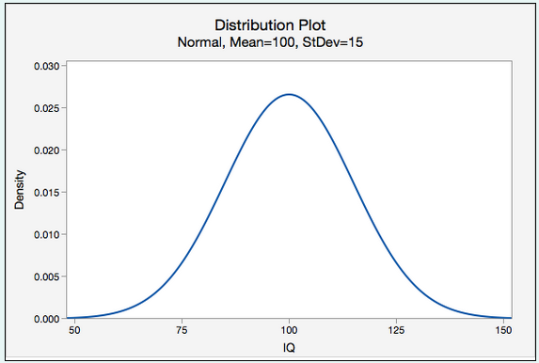
Normal Random Variables
A symmetric bell-shaped density function.
The distribution of IQ scores is normal
The total area under the curve is 1.00, or 100%.
In other words, 100% of observations fall under the curve.

Slide 32
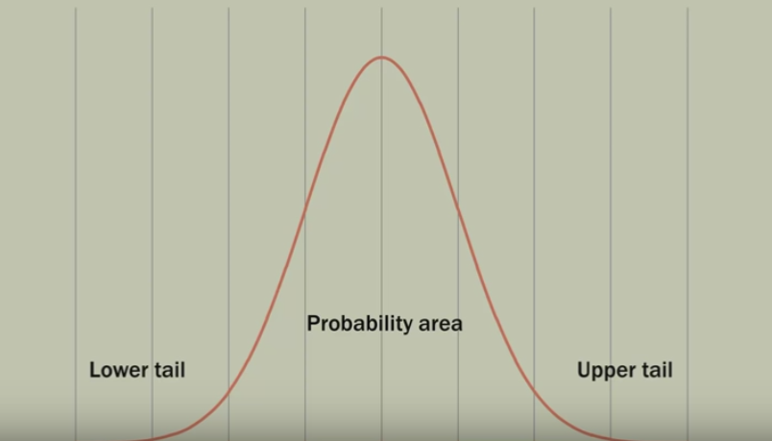

Slide 33
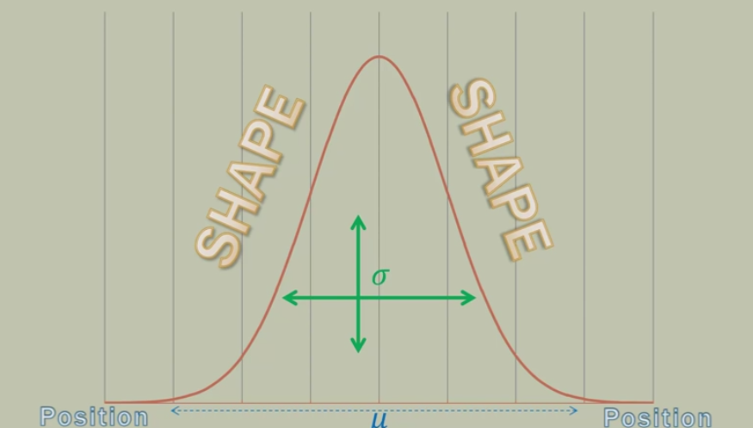

Slide 34
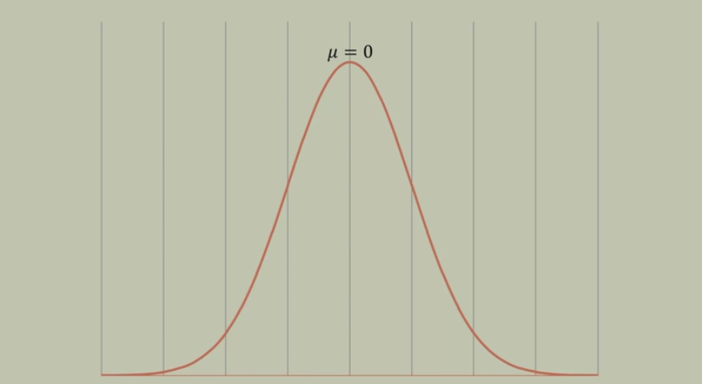
µ can be any numerical value
Slides distribution side to side

Slide 35
This becomes very very important when you are trying to determine the two population/sample are statistically different or not.

Slide 36
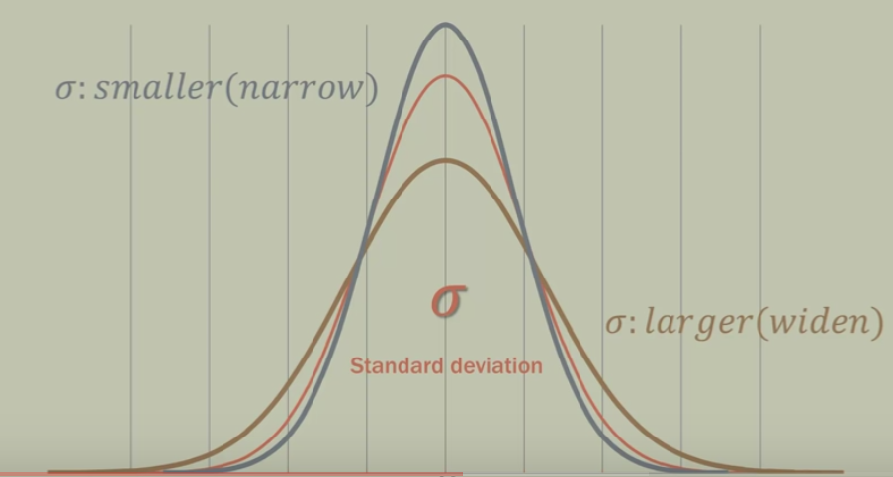

Slide 37
probability that the IQ of a randomly selected individual will be less than 115

Slide 38
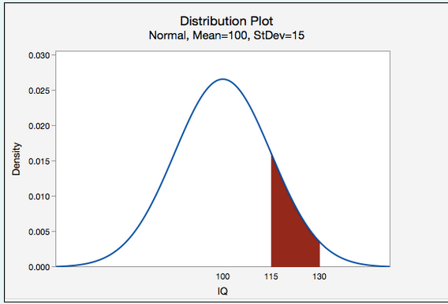
probability that the IQ of a randomly selected individual will be between 115 and 130

Slide 39
Scenario: Vehicle speeds at a highway location have a normal distribution with a mean of 65 mph and a standard deviation of 5 mph.
Question: What is the probability that a randomly selected vehicle will be going 73 mph or slower?

Slide 40
probability that a randomly selected vehicle speed is greater than 73

Slide 41
Suppose pulse rates of adult females have a normal curve distribution with mean of 75 and a standard deviation of 8. What is the probability that a randomly selected female has a pulse rate greater than 85?

Slide 42
The lifetime of a battery is normally distributed with a mean life of 40 hours and a standard deviation of 1.2 hours. Find the probability that a randomly selected battery lasts longer than 42 hours.

Slide 43

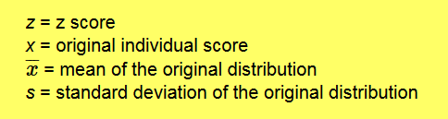
Standard Normal distribution

Slide 44
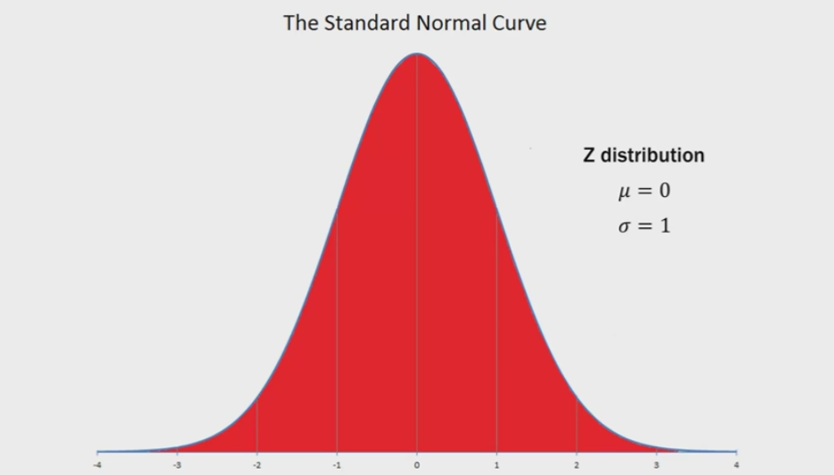

Slide 45
Area under the curve is 1

Slide 46
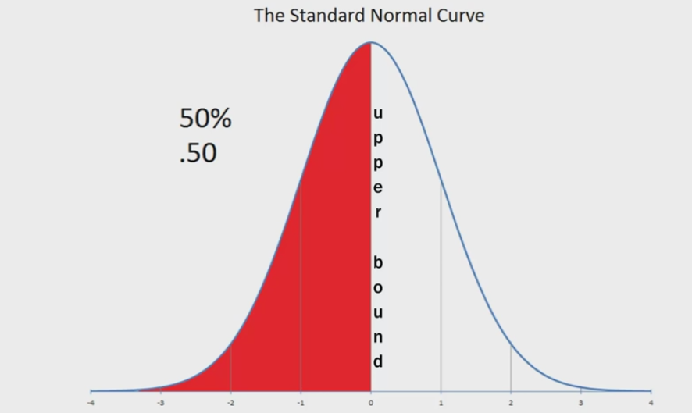

Slide 47
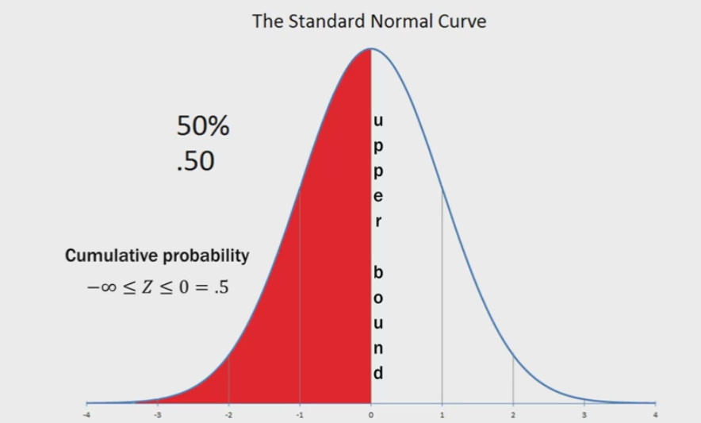

Slide 48
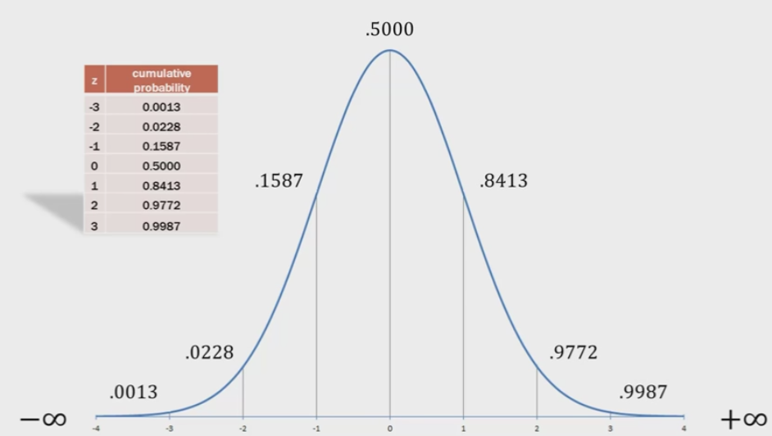

Slide 49
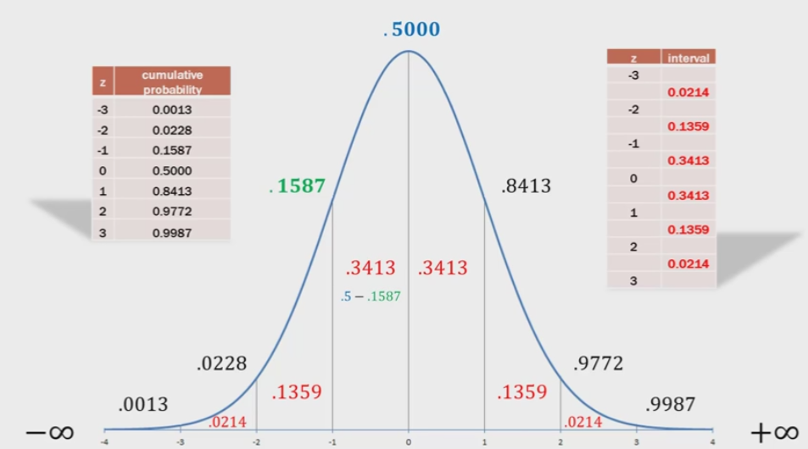

Slide 50
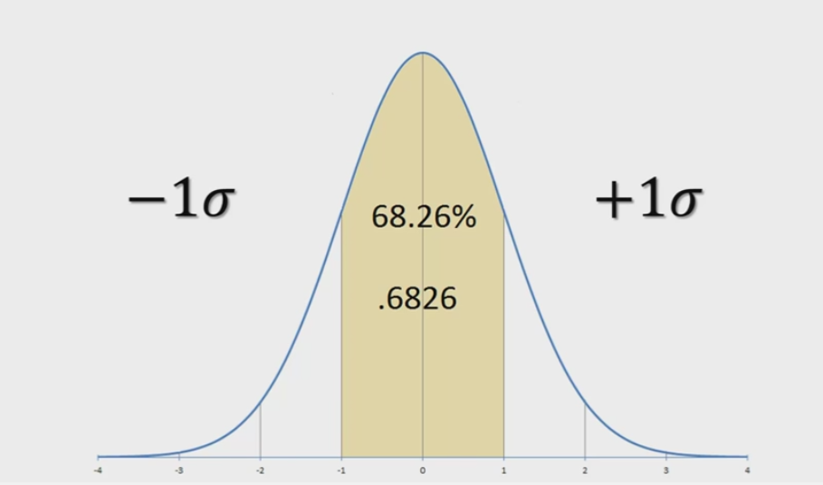

Slide 51
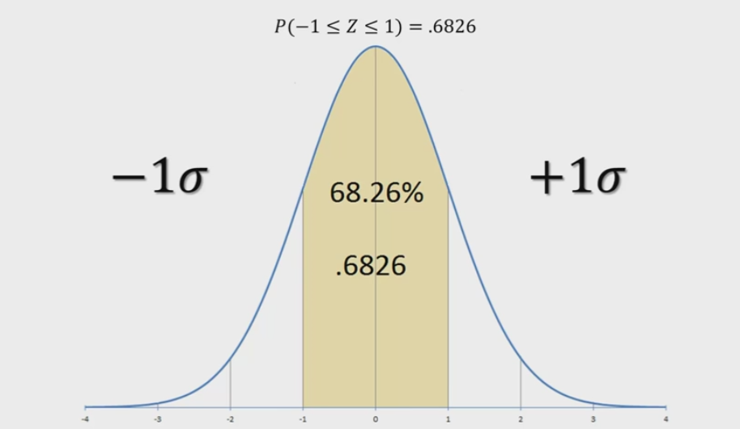

Slide 52
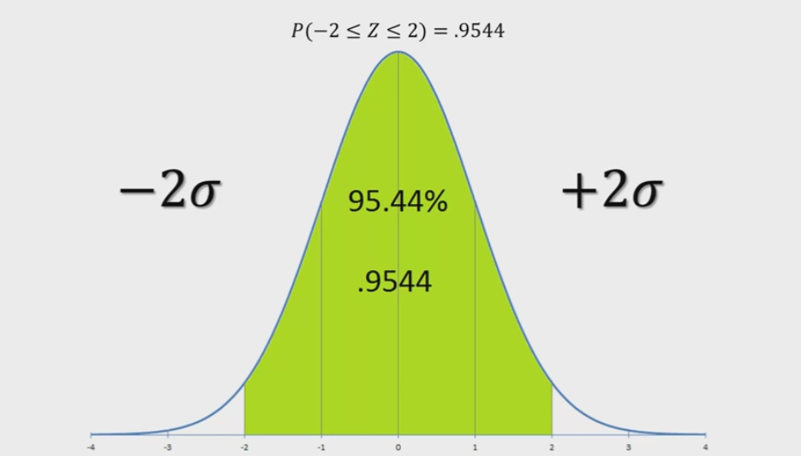

Slide 53
In statistics we use 95% confidence interval that is exactly -1.96 to +1.96.

Slide 54
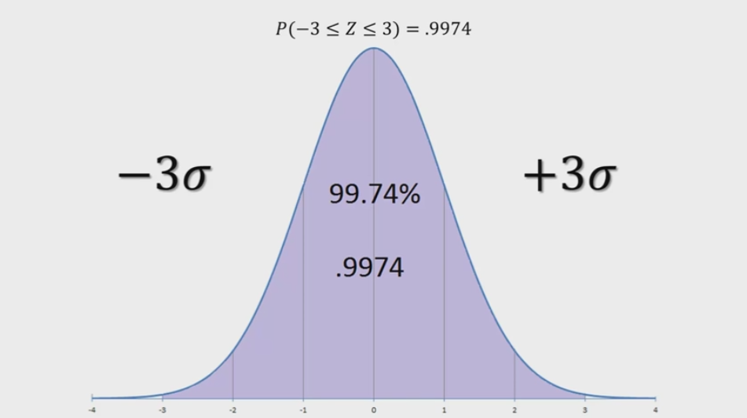

Slide 55
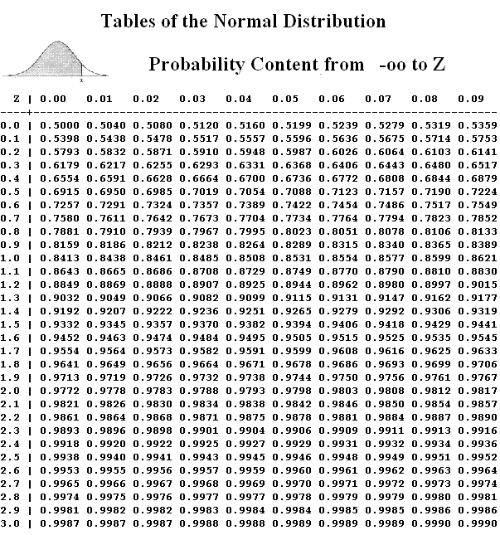

Slide 56
Consider taking two random samples, each sample consisting of 5 students,
from a class and calculating the mean height in each sample. Would you expect both sample means to be exactly the same?

Slide 57
No, the two sample means would be different because of random sampling error.
If you were to repeatedly pull samples of 5 students from the population of all students and compute the mean of each sample, you could construct a distribution of sample means.

Slide 58
Sampling Distribution
The distribution of the values of sample statistic computed for each possible sample drawn from target population.

Slide 59
Sampling Distribution
The distribution of the values of sample statistic computed for each possible sample drawn from target population.

Slide 60
Sampling Distribution
The distribution of the values of sample statistic computed for each possible sample drawn from target population.
It is used estimate the population parameter

Slide 61
Statistics
Mean of mean of sampling distribution
Standard deviation of mean of sampling distribution

Slide 62
Central Limit Theorem
With a sample size of at least 30, the distribution of sample means will be approximately normally distributed regardless of the shape of the population with a mean of μ and a standard deviation sigma/root(n) of This is known as the Central Limit Theorem.

Slide 63
In the population, IQ scores are normally distributed with a mean of 100 and standard deviation of 15. If we repeatedly pulled random samples of 25 individuals from the population and measured their IQ, what proportion of those samples would we expect to have a sample mean between 95 and 105?

Slide 64
The height of women in the United States is normally distributed with a mean of 163cm and standard deviation of 6cm. What is the probability that you would randomly select one woman in the United States and she is taller than 169cm?
The height of women in the United States is normally distributed with a mean of 163cm and standard deviation of 6cm. What is the probability that you would randomly select a sample of n=50 women in the United States and their average height is greater than 169cm?

Slide 65
According to one source, newborn baby weights have a mean of 7.5 pounds with a standard deviation of 1.1 pounds.
If these numbers are accurate, what proportion of samples of n=50 would have a sample mean greater than 8 pounds?

Slide 66
In Article published, the population of all World Campus students 49.2% were female.
Wanted to check whether it is actually true.
He obtains a random sample of 50 students. In his random sample there were 28 females and 22 males.
If the population from which her sample was drawn really is 49.2% female, what is the probability that she would take a random sample of 50 students and find that 28 or more are females?

