Slide 1

Basics of Neural Network Programming
Gradient Descent
deeplearning.ai

Slide 2
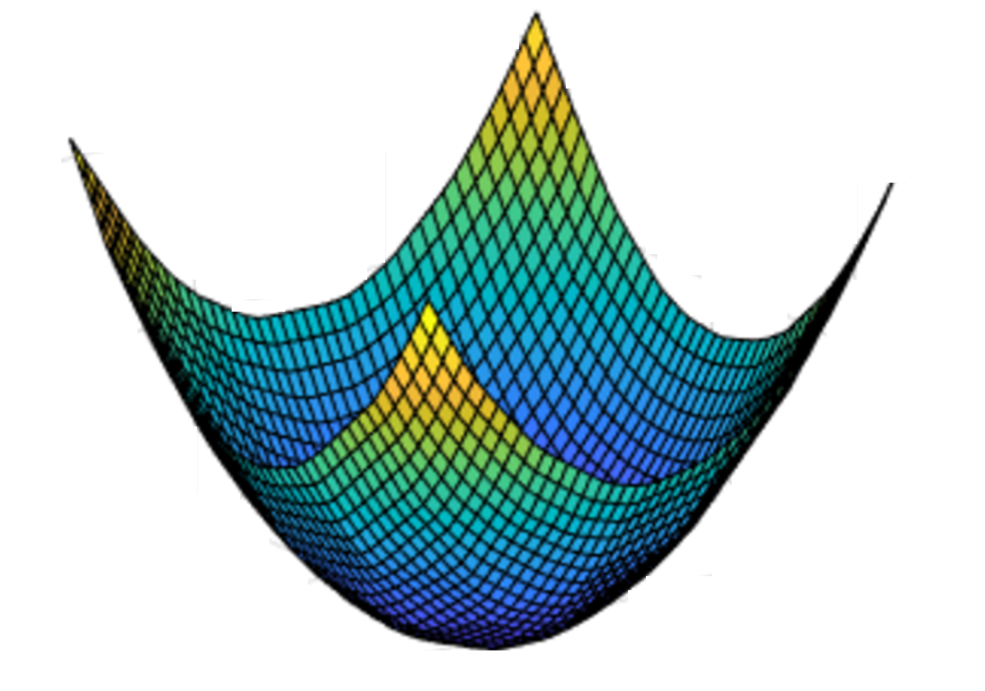
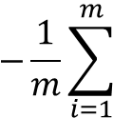


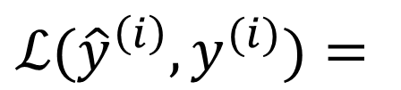

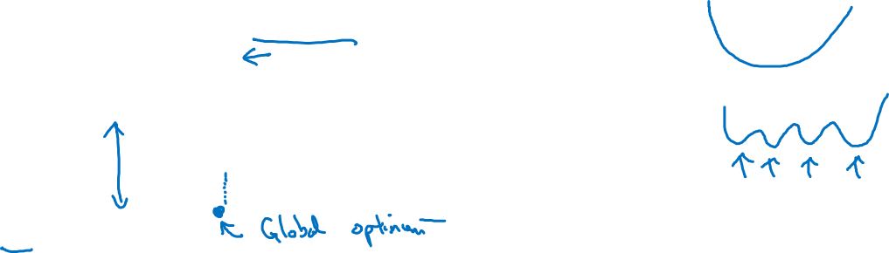
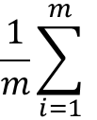



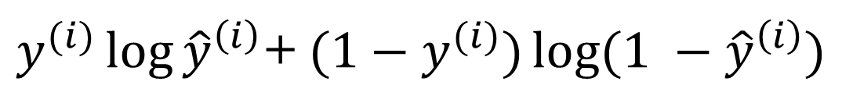

Gradient Descent
Recap: $\hat{y}= σ\left(w^{T}x+b\right)$, $σ\left(z\right)=\frac{1}{1+e^{−z}}$
$$\frac{1}{m}\sum_{i=1}^{m}{ }$$
$ℒ({\hat{y}}^{\left(i\right)},y^{(i)})$ $=$
$$−\frac{1}{m}\sum_{i=1}^{m}{ }$$
$$J\left(w,b\right)=$$
$y^{(i)}\log{{\hat{y}}^{\left(i\right)}}$+ $({1−y}^{(i)})\log{(1 −{\hat{y}}^{\left(i\right)})}$
Want to find $w,b$ that minimize $J\left(w,b\right)$
$$J\left(w,b\right)$$
$$b$$
$$w$$

Slide 3

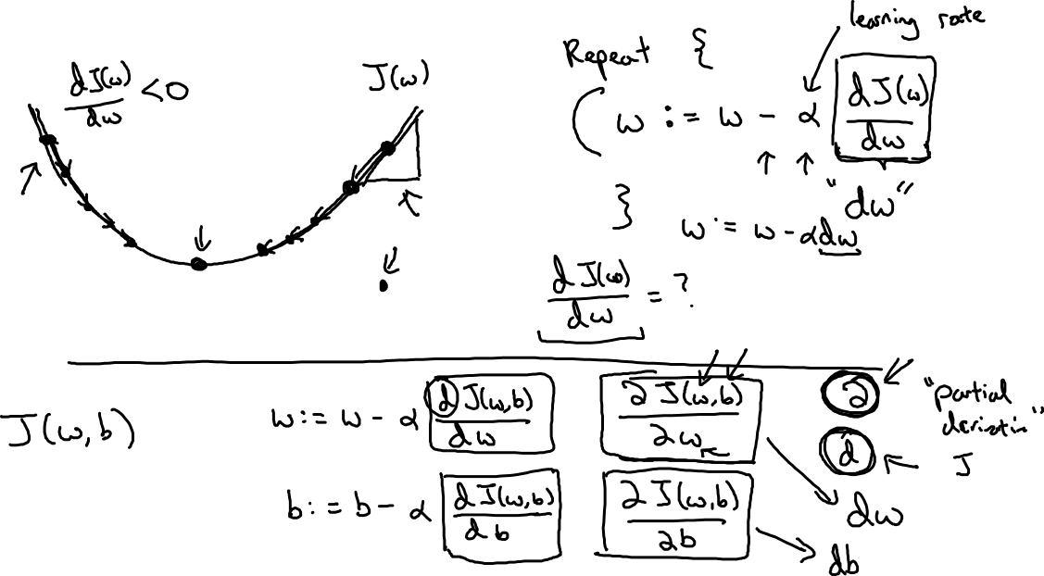
Gradient Descent
$$w$$

Slide 4
Basics of Neural Network Programming
Derivatives
deeplearning.ai

Slide 5


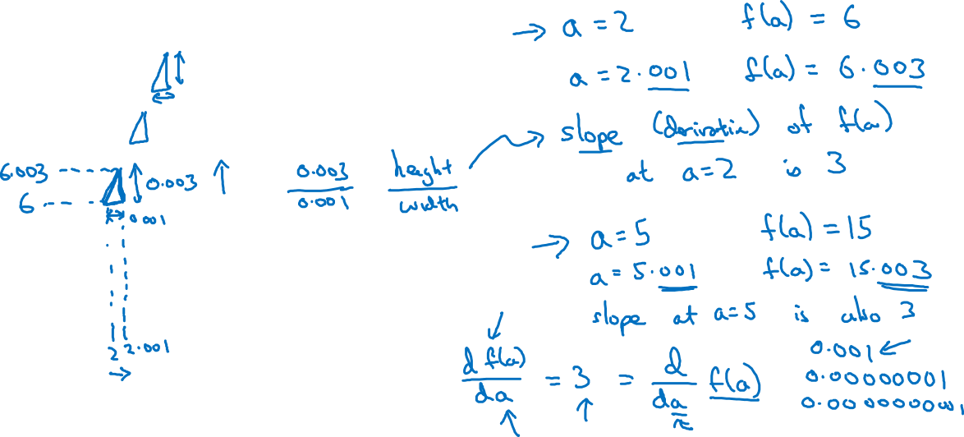
Intuition about derivatives
$$f\left(a\right)=3a$$
$$a$$

Slide 6
Basics of Neural Network Programming
More derivatives examples
deeplearning.ai

Slide 7


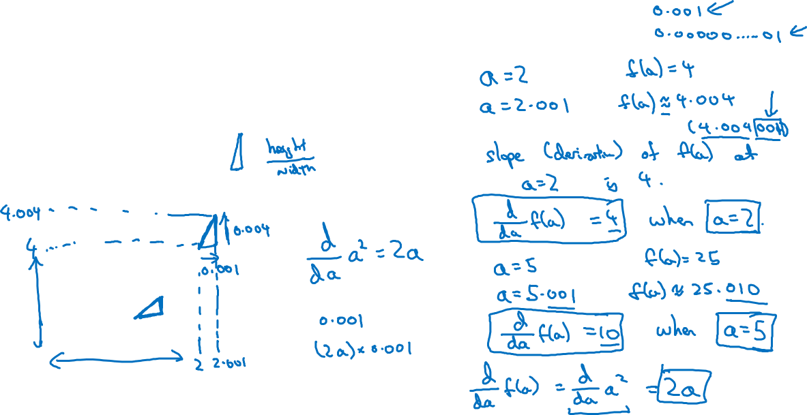
Intuition about derivatives
$$f\left(a\right)=a^{2}$$
$$a$$

Slide 8
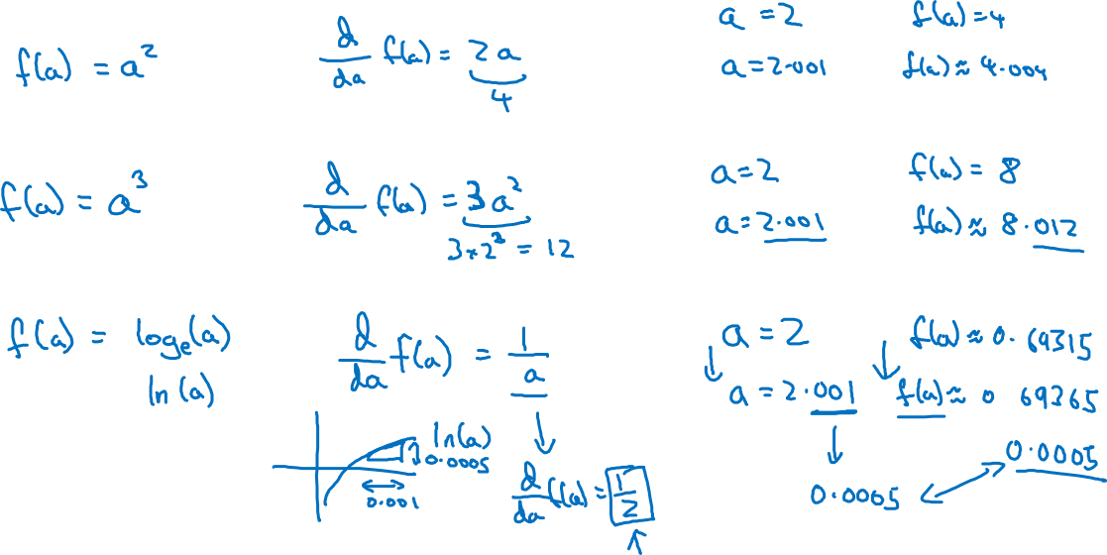
More derivative examples

Slide 9
Basics of Neural Network Programming
Computation Graph
deeplearning.ai

Slide 10
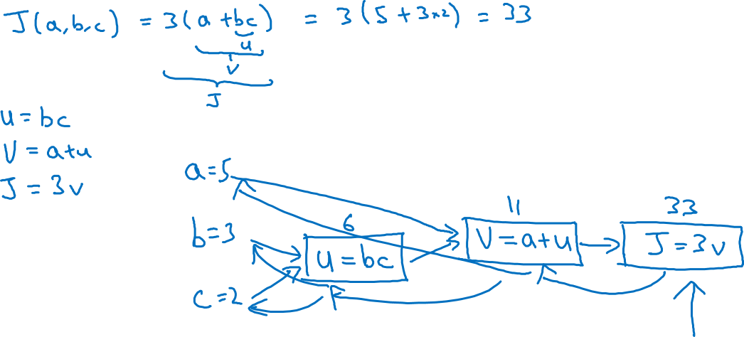
Computation Graph

Slide 11
Basics of Neural Network Programming
Derivatives with a Computation Graph
deeplearning.ai

Slide 12
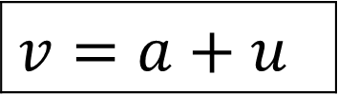

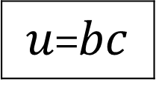



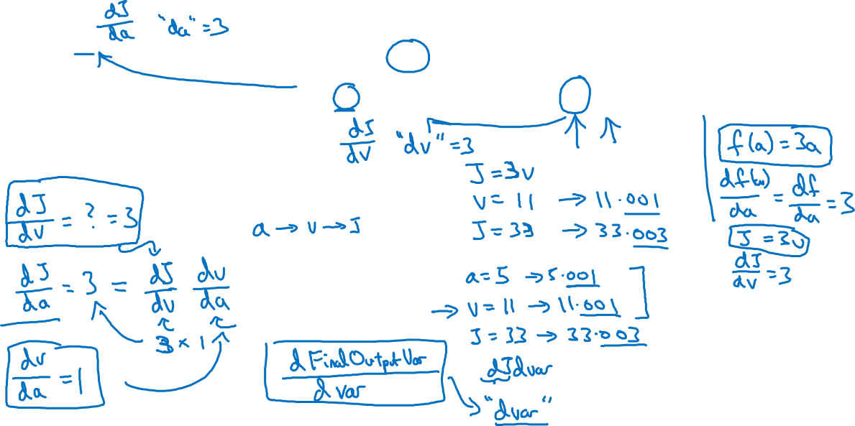
Computing derivatives
$$a=5$$
11
33
$$b=3$$
6
$$v=a+u$$
$J=3v$
$u$=$bc$
$$c=2$$

Slide 13
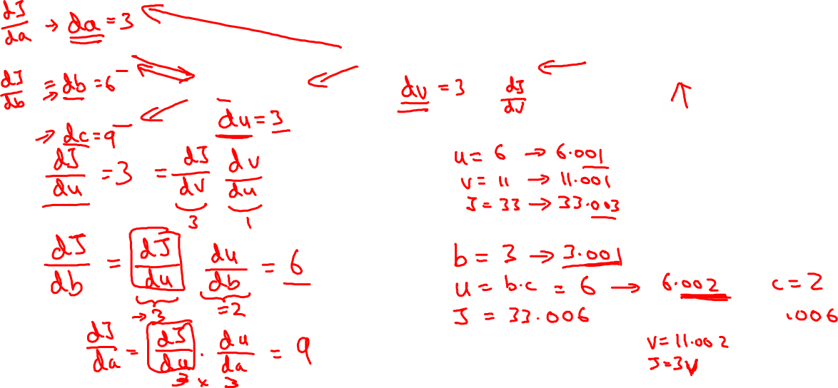
Computing derivatives
$$a=5$$
11
33
$$b=3$$
6
$$v=a+u$$
$J=3v$
$u$=$bc$
$$c=2$$

Slide 14
Basics of Neural Network Programming
Logistic Regression
Gradient descent
deeplearning.ai

Slide 15


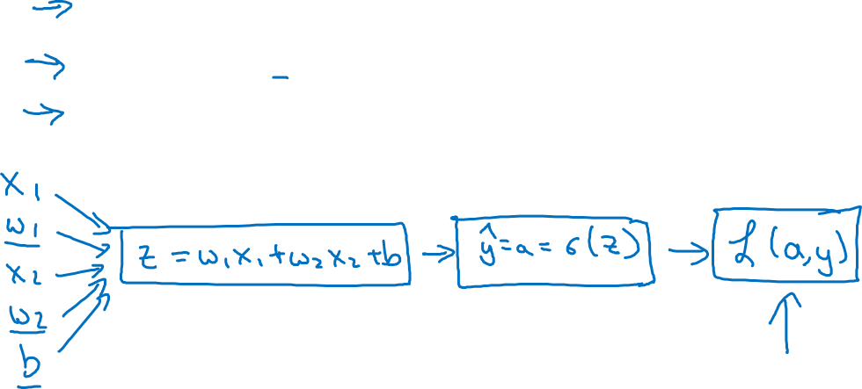
Logistic regression recap
$$z= w^{T}x+b$$
$$\hat{y}=a= σ(z)$$
$$ℒ\left(a,y\right)=−(y\log{(a)+(1−y)\log{(1−a))}}$$

Slide 16






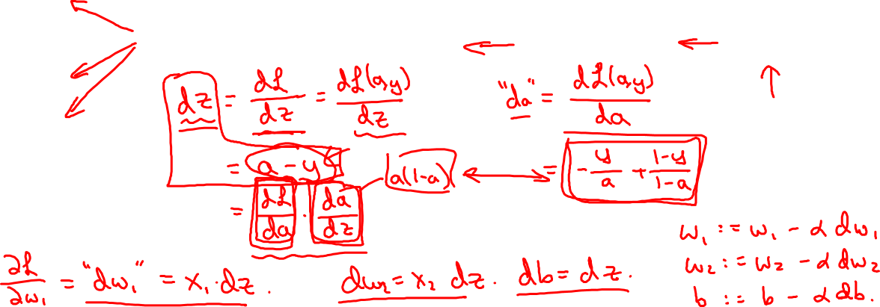

Logistic regression derivatives
$$x_{1}$$
$$w_{1}$$
$$x_{2}$$
$$z= w_{1}x_{1}+w_{2}x_{2}+b$$
$$a= σ(z)$$
$$ℒ(a,y)$$
$$w_{2}$$
b

Slide 17
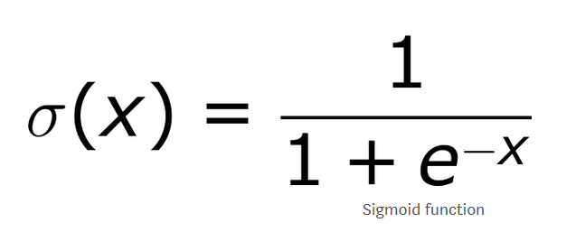
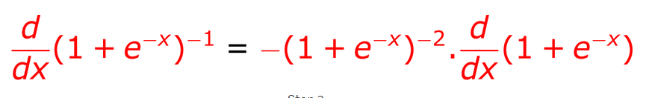
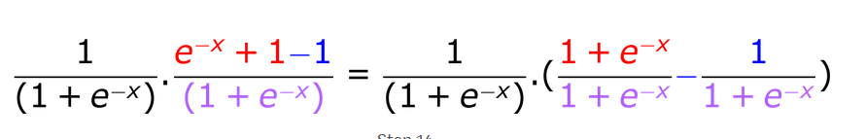
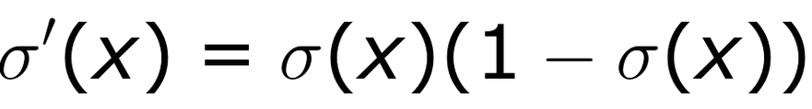
Derivative of sigmoid function
Notes:
https://towardsdatascience.com/derivative-of-the-sigmoid-function-536880cf918e

Slide 18
Basics of Neural Network Programming
Gradient descent
on m examples
deeplearning.ai

Slide 19
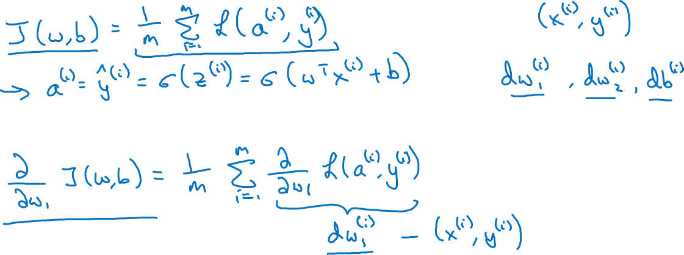
Logistic regression on m examples

Slide 20
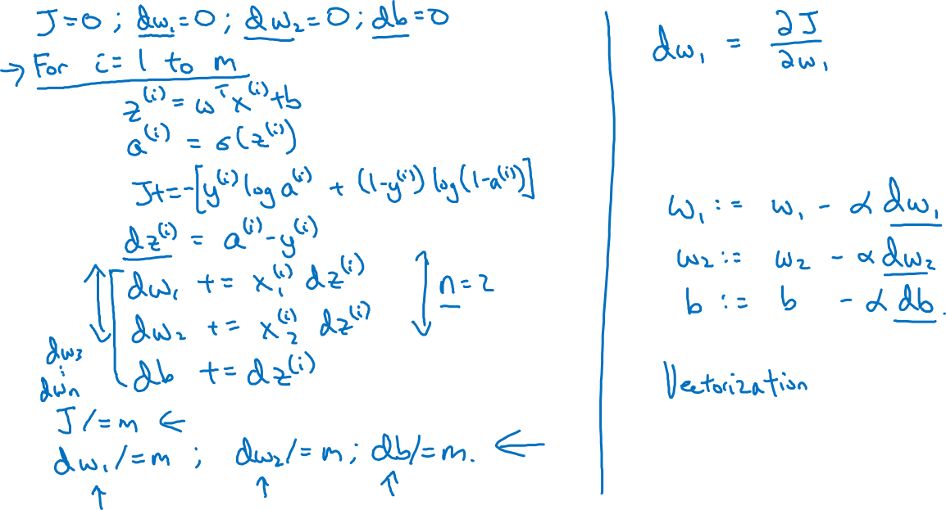
Logistic regression on m examples

Slide 21
Basics of Neural Network Programming
Vectorization
deeplearning.ai

Slide 22
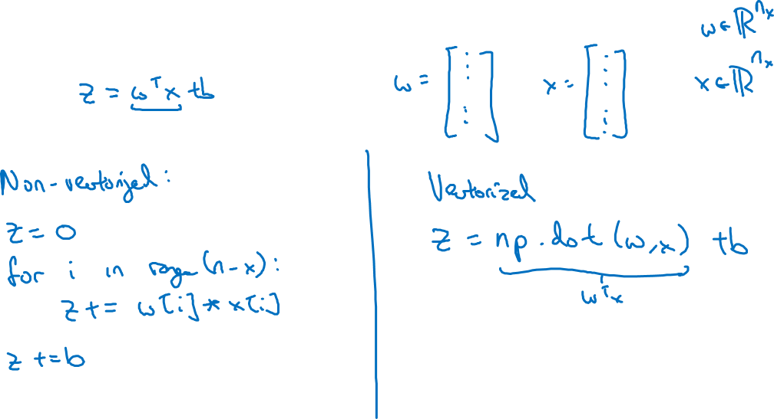
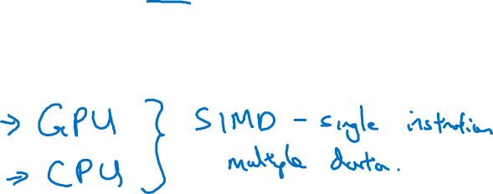
What is vectorization?

Slide 23
Basics of Neural Network Programming
More vectorization
examples
deeplearning.ai

Slide 24
Neural network programming guideline
Whenever possible, avoid explicit for-loops.

Slide 25
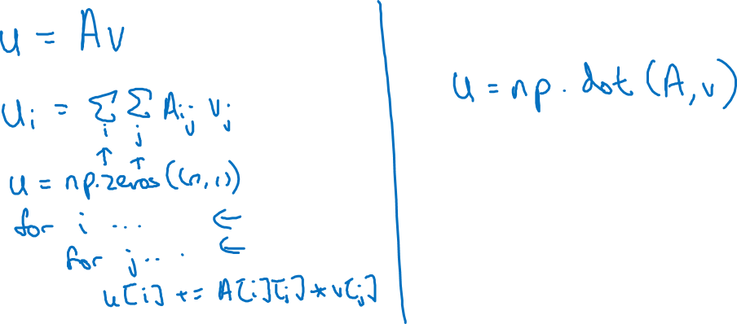
Neural network programming guideline
Whenever possible, avoid explicit for-loops.

Slide 26
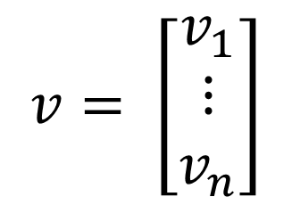
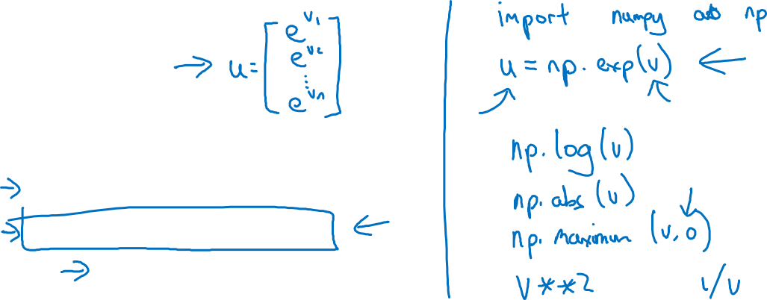
Vectors and matrix valued functions
Say you need to apply the exponential operation on every element of a matrix/vector.
$$v= \left[\begin{matrix}v_{1} \\ ⋮ \\ v_{n}\end{matrix}\right]$$
u = np.zeros((n,1))
for i in range(n):
u[i]=math.exp(v[i])

Slide 27

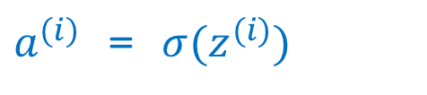
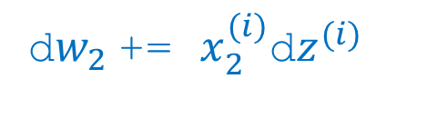
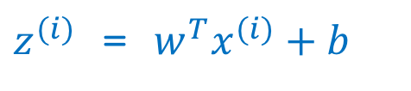
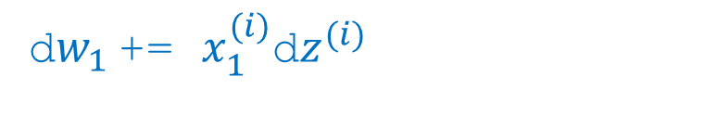
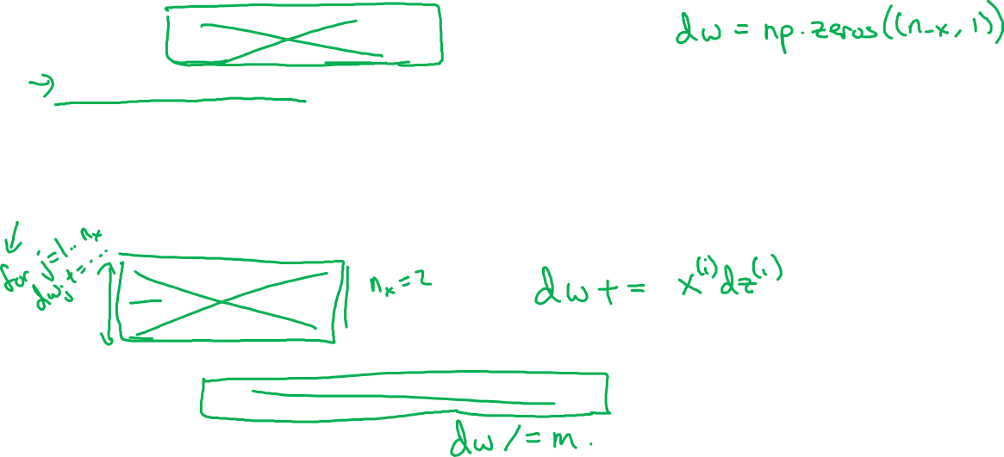
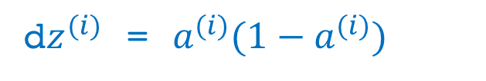
Logistic regression derivatives
J = 0, dw1 = 0, dw2 = 0, db = 0
for i = 1 to n:
$z^{(i)}$ = $w^{T}x^{(i)}+b$
$a^{(i)}$ = $σ{(z}^{(i)})$
$J$+= $−\left[y^{(i)} \log{{\hat{y}}^{\left(i\right)}+({1−y}^{\left(i\right)})\log{(1 −{\hat{y}}^{\left(i\right)})}}\right]$
d$z^{(i)}$ = $a^{(i)}{(1−a}^{(i)})$
d${w_{1}}^{ }$+= $x_{1}^{(i)}\text{d}z^{(i)}$
d${w_{2}}^{ }$+= $x_{2}^{(i)}\text{d}z^{(i)}$
db += d$z^{(i)}$
J = J/m, d$w_{1}$ = d$w_{1}$/m, d$w_{2}$ = d$w_{2}$/m, db = db/m

Slide 28
Basics of Neural Network Programming
Vectorizing Logistic
Regression
deeplearning.ai

Slide 29


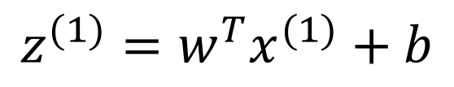
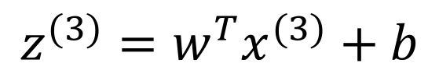
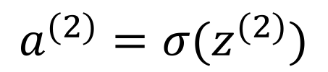
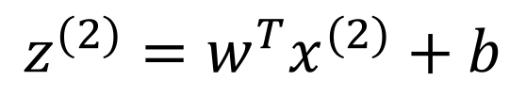
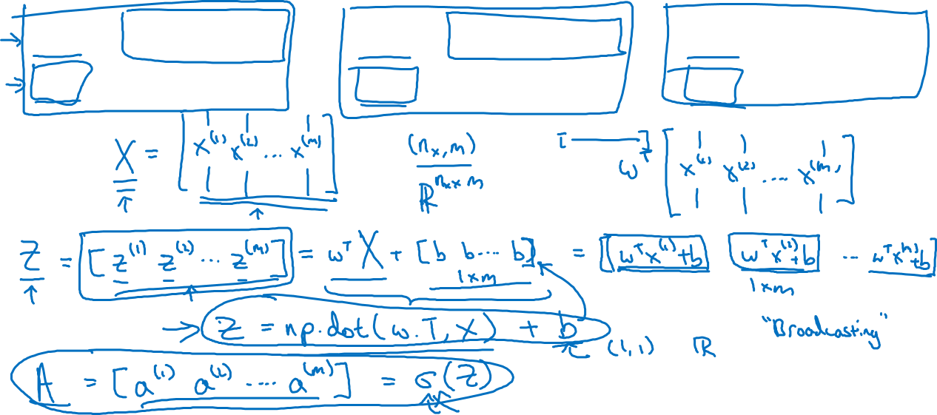
Vectorizing Logistic Regression
$$z^{(1)}=w^{T}x^{(1)}+b$$
$$z^{(2)}=w^{T}x^{(2)}+b$$
$$z^{(3)}=w^{T}x^{(3)}+b$$
$$a^{(1)}={σ(z}^{(1)})$$
$$a^{(2)}={σ(z}^{(2)})$$
$$a^{(3)}={σ(z}^{(3)})$$

Slide 30
Basics of Neural Network Programming
Vectorizing Logistic
Regression’s Gradient
Computation
deeplearning.ai

Slide 31
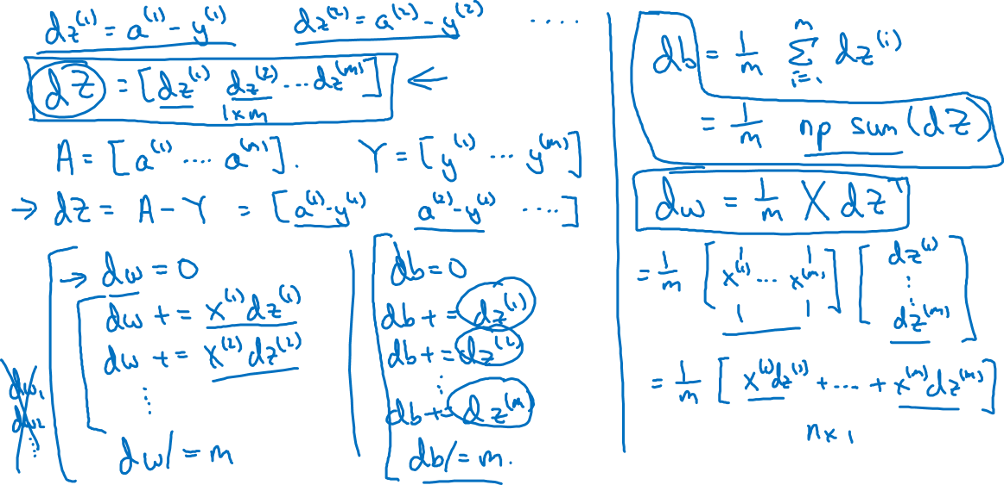
Vectorizing Logistic Regression

Slide 32
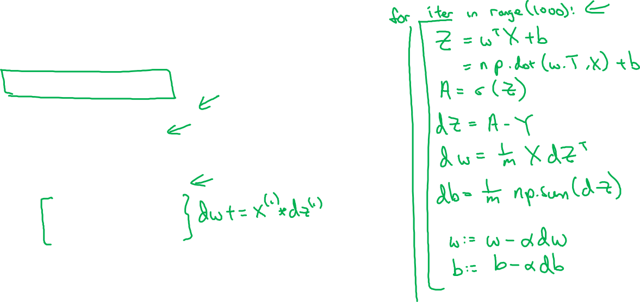
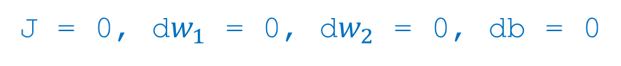
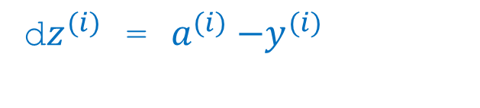
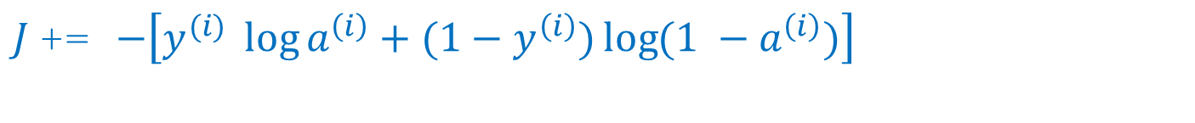
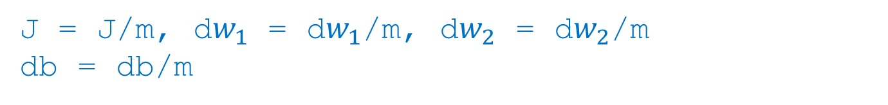
Implementing Logistic Regression
J = 0, d$w_{1}$ = 0, d$w_{2}$ = 0, db = 0
for i = 1 to m:
$z^{(i)}$ = $w^{T}x^{(i)}+b$
$a^{(i)}$ = $σ{(z}^{(i)})$
$J$+= $−\left[y^{(i)} \log{a^{\left(i\right)}+({1−y}^{\left(i\right)})\log{(1 −a^{\left(i\right)})}}\right]$
d$z^{(i)}$ = $a^{(i)}{−y}^{(i)}$
d${w_{1}}^{ }$+= $x_{1}^{(i)}\text{d}z^{(i)}$
d${w_{2}}^{ }$+= $x_{2}^{(i)}\text{d}z^{(i)}$
db += d$z^{(i)}$
J = J/m, d$w_{1}$ = d$w_{1}$/m, d$w_{2}$ = d$w_{2}$/m
db = db/m

Slide 33
Basics of Neural Network Programming
Broadcasting in
Python
deeplearning.ai

Slide 34
Broadcasting example
Calories from Carbs, Proteins, Fats in 100g of different foods:
Apples
Beef
Eggs
Potatoes
Carb
$$\left[\begin{matrix}56.0 & 0.0 & \begin{matrix}4.4 & 68.0\end{matrix} \\ 1.2 & 104.0 & \begin{matrix}52.0 & 8.0\end{matrix} \\ 1.8 & 135.0 & \begin{matrix}99.0 & 0.9\end{matrix}\end{matrix}\right]$$
Protein
Fat
cal = A.sum(axis = 0)
percentage = 100*A/(cal.reshape(1,4))

Slide 35
Broadcasting example
$$\left[\begin{matrix}1 \\ \begin{aligned}\begin{matrix}2 \\ 3\end{matrix} \\ 4\end{aligned}\end{matrix}\right]$$
$$\left[\begin{matrix}101 \\ \begin{aligned}\begin{matrix}102 \\ 103\end{matrix} \\ 104\end{aligned}\end{matrix}\right]$$
$$100$$
=
+
$\left[\begin{matrix}1 & 2 & 3 \\ 4 & 5 & 6\end{matrix}\right]$
$$\left[\begin{matrix}100 & 200 & 300\end{matrix}\right]$$
$$\left[\begin{matrix}101 & 202 & 303 \\ 104 & 205 & 306\end{matrix}\right]$$
+
=
$\left[\begin{matrix}1 & 2 & 3 \\ 4 & 5 & 6\end{matrix}\right]$
$$\left[\begin{matrix}100 \\ 200\end{matrix}\right]$$
$$\left[\begin{matrix}101 & 102 & 103 \\ 204 & 205 & 206\end{matrix}\right]$$
+
=

Slide 36
General Principle

Slide 37
Python / numpy vectors
import numpy as np
a = np.random.randn(5)
a = np.random.randn((5,1))
a = np.random.randn((1,5))
assert(a.shape = (5,1))

Slide 38
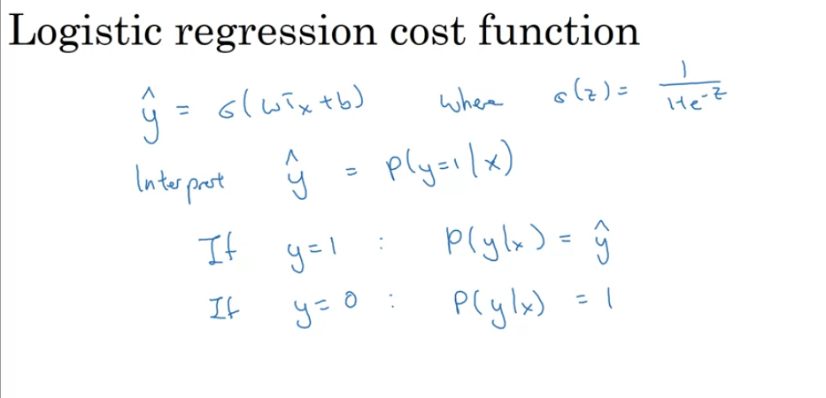

Slide 39
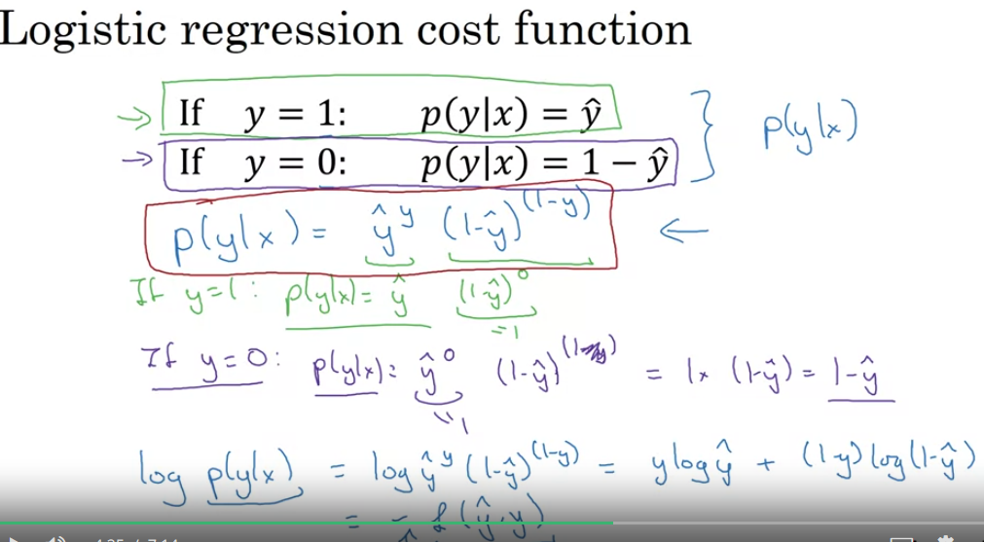

Slide 40
