Slide 1
One hidden layer
Neural Network
Neural Networks
Overview

Slide 2







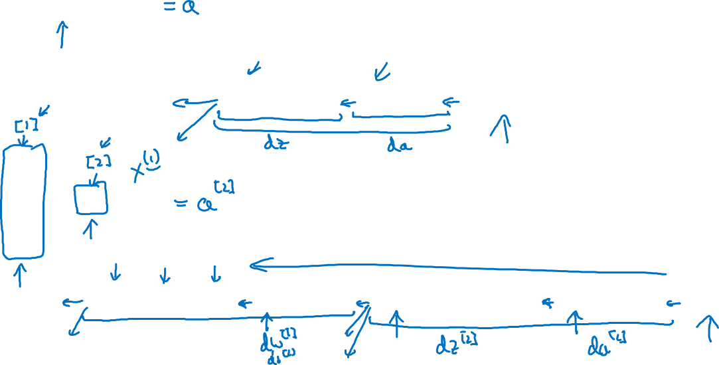





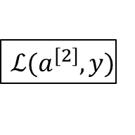







What is a Neural Network?
$$x_{1}$$
$$x_{2}$$
$$\hat{y}$$
$$x_{3}$$
x
w
$$z=w^{T}x+b$$
$$a=σ(z)$$
$$ℒ(a,y)$$
b
$$x_{1}$$
$$x_{2}$$
$$\hat{y}$$
$$x_{3}$$
x
$$W^{[1]}$$
$$z^{[1]}=W^{[1]}x+b^{[1]}$$
$$a^{[1]}=σ(z^{[1]})$$
$$z^{[2]}=W^{[2]}a_{ }^{[1]}+b^{[2]}$$
$$a^{[2]}=σ(z^{[2]})$$
$$ℒ(a^{[2]},y)$$
$$b^{[1]}$$
$$W^{[2]}$$
$$b^{[2]}$$

Slide 3
In logistic regression we had one node for sigmoid function, but in neural network several sigmoid functions are stacked together and can have multiple layers for sigmoid functions.
The adjustment of weights and intercept for neural network is exact same as logistic regression. We adjust weights using gradient change using backward calculation.
Square bracket represents layer number and round bracket represents input number in superscript.

Slide 4
One hidden layer
Neural Network
Neural Network
Representation

Slide 5


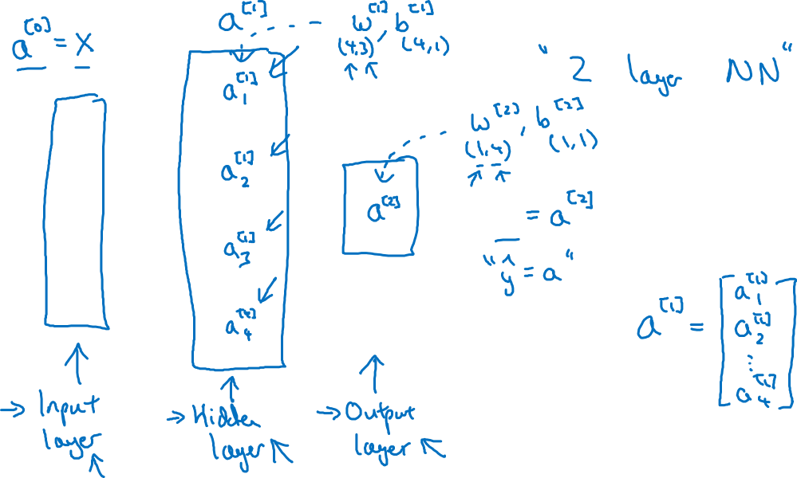


Neural Network Representation
$$x_{1}$$
$$x_{2}$$
$$\hat{y}$$
$$x_{3}$$

Slide 6
In all neural network there are 3 layers: input, hidden and output layer.
A is activation function, for input layer we represent using a[0], hidden a[2] and output a[3] in above example
When we count number of layers in neural network we don’t count input layer.
For any dimension of w= (# of Neuron in current layer, # of Neuron in previous layer)
B= (# of Neuron in current layer, 1)

Slide 7
One hidden layer
Neural Network
Computing a
Neural Network’s
Output

Slide 8











Neural Network Representation
$$x_{1}$$
$$x_{1}$$
$$x_{2}$$
$$σ(z)$$
$$a=\hat{y}$$
$$x_{2}$$
$$\hat{y}$$
$$w^{T}x+b$$
$$z$$
$$a$$
$$x_{3}$$
$$x_{3}$$
$$z=w^{T}x+b$$
In logistic regression, two step calculations happen, first on Z then computes activation function for predicted Y PBMJUN200NKWU
The exact same calculations happen for each node of neural n/w.
$$a=σ(z)$$

Slide 9

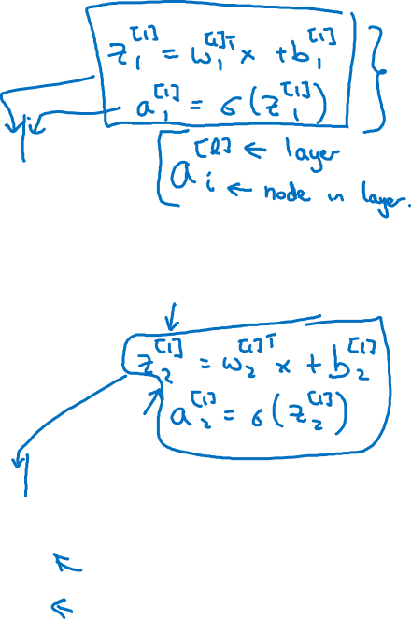





Neural Network Representation
$$x_{1}$$
$$x_{1}$$
$$x_{2}$$
$$σ(z)$$
$$a=\hat{y}$$
$$x_{2}$$
$$\hat{y}$$
$$w^{T}x+b$$
$$z$$
$$a$$
$$x_{3}$$
$$x_{3}$$
$$z=w^{T}x+b$$
$$x_{1}$$
$$a=σ(z)$$
$$x_{2}$$
$$\hat{y}$$
$$x_{3}$$

Slide 10

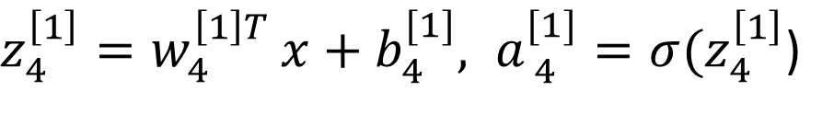


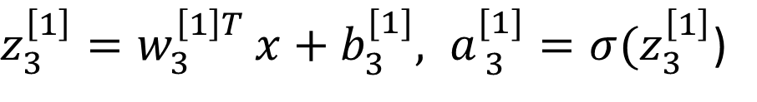


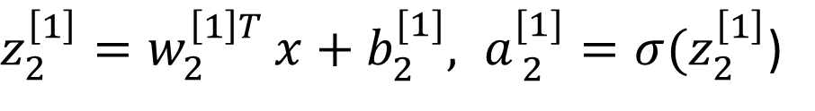

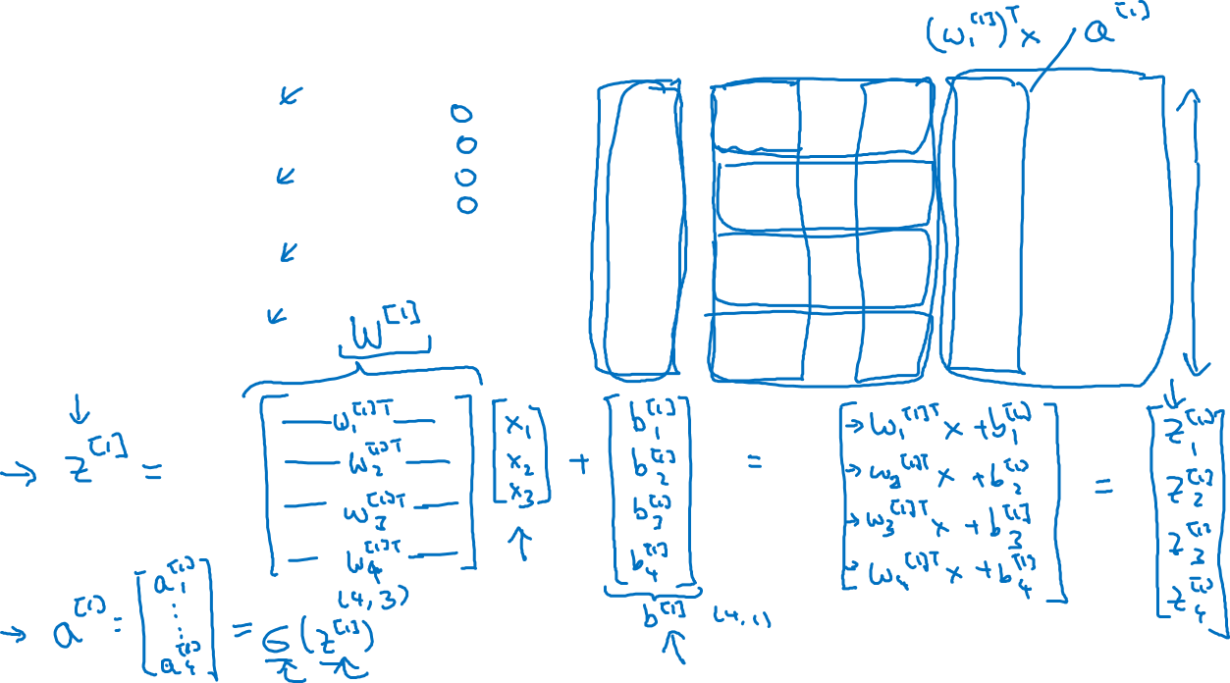
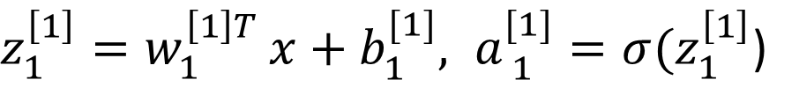


Neural Network Representation
$$a_{1}^{\left[1\right]}$$
$z_{1}^{\left[1\right]}=w_{1}^{{\left[1\right]T}^{ }}x+b_{1}^{[1]}, a_{ 1}^{[1]}=σ(z_{1}^{\left[1\right]}$)
$$x_{1}$$
$$a_{2}^{\left[1\right]}$$
$z_{2}^{\left[1\right]}=w_{2}^{{\left[1\right]T}^{ }}x+b_{2}^{[1]}, a_{ 2}^{[1]}=σ(z_{2}^{\left[1\right]}$)
$$x_{2}$$
$$\hat{y}$$
$$a_{3}^{\left[1\right]}$$
$z_{3}^{\left[1\right]}=w_{3}^{{\left[1\right]T}^{ }}x+b_{3}^{[1]}, a_{ 3}^{[1]}=σ(z_{3}^{\left[1\right]}$)
$$x_{3}$$
$$a_{4}^{\left[1\right]}$$
$z_{4}^{\left[1\right]}=w_{4}^{{\left[1\right]T}^{ }}x+b_{4}^{[1]}, a_{ 4}^{[1]}=σ(z_{4}^{\left[1\right]}$)

Slide 11



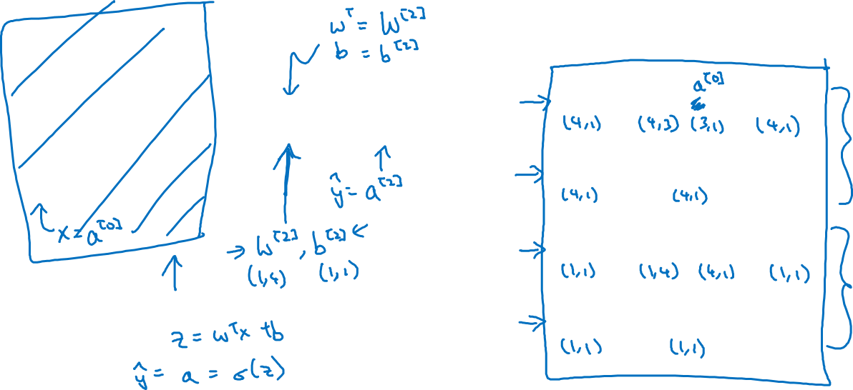

Neural Network Representation learning
$$a_{1}^{\left[1\right]}$$
Given input x:
$$x_{1}$$
$$a_{2}^{\left[1\right]}$$
$$z^{\left[1\right]}=W^{\left[1\right]}x+b^{\left[1\right]}$$
$$x_{2}$$
$$\hat{y}$$
$$a_{3}^{\left[1\right]}$$
$$x_{3}$$
$$a^{\left[1\right]}=σ(z^{\left[1\right]})$$
$$a_{4}^{\left[1\right]}$$
$$z^{\left[2\right]}=W^{\left[2\right]}a^{\left[1\right]}+b^{\left[2\right]}$$
$$a^{\left[2\right]}=σ(z^{\left[2\right]})$$

Slide 12
One hidden layer
Neural Network
Vectorizing across
multiple examples

Slide 13




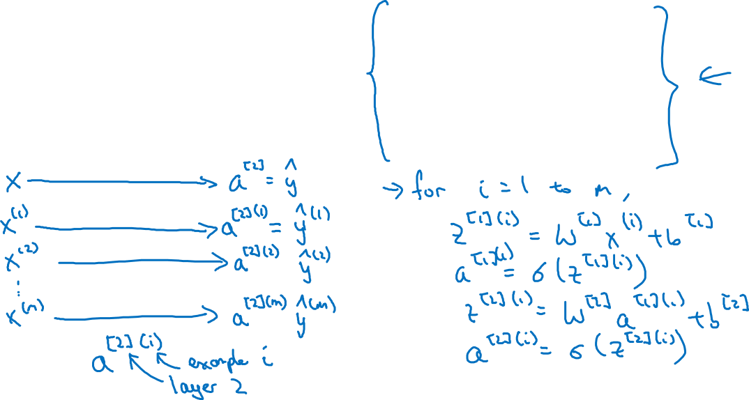

Vectorizing across multiple examples
$$z^{\left[1\right]}=W^{\left[1\right]}x+b^{\left[1\right]}$$
$$x_{1}$$
$$a^{\left[1\right]}=σ(z^{\left[1\right]})$$
$$x_{2}$$
$$\hat{y}$$
$$z^{\left[2\right]}=W^{\left[2\right]}a^{\left[1\right]}+b^{\left[2\right]}$$
$$x_{3}$$
$$a^{\left[2\right]}=σ(z^{\left[2\right]})$$

Slide 14
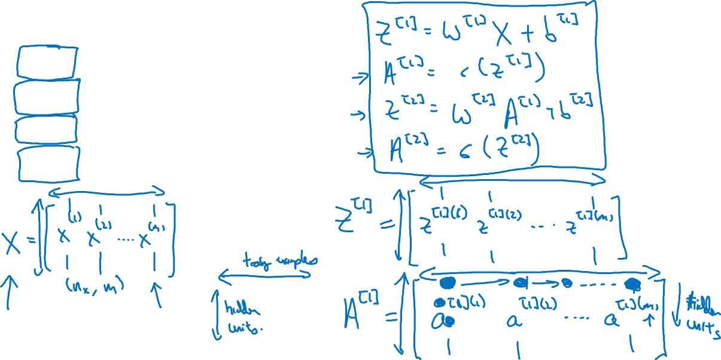




Vectorizing across multiple examples
for i = 1 to m:
$$z^{\left[1\right](i)}=W^{\left[1\right]}x^{(i)}+b^{\left[1\right]}$$
$$a^{\left[1\right](i)}=σ(z^{\left[1\right]\left(i\right)})$$
$$z^{\left[2\right](i)}=W^{\left[2\right]}a^{\left[1\right](i)}+b^{\left[2\right]}$$
$$a^{\left[2\right](i)}=σ(z^{\left[2\right]\left(i\right)})$$

Slide 15
Horizontally represents the hidden units in particular layer.
Vertically represents then number of training examples

Slide 16
One hidden layer
Neural Network
Explanation
for vectorized
implementation

Slide 17
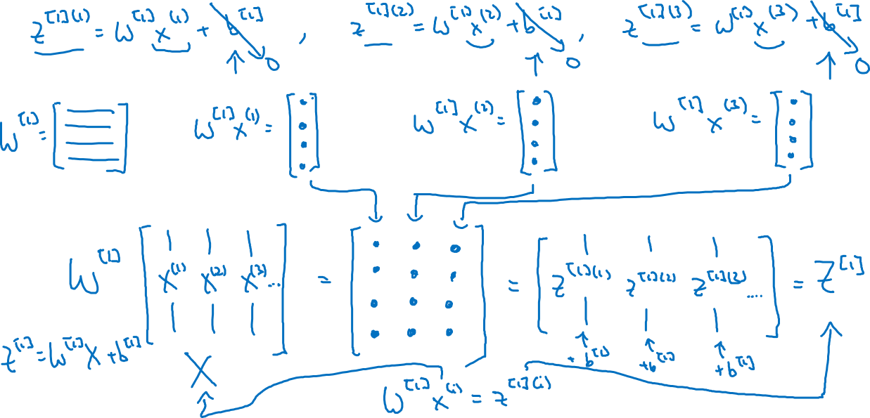
Justification for vectorized implementation

Slide 18











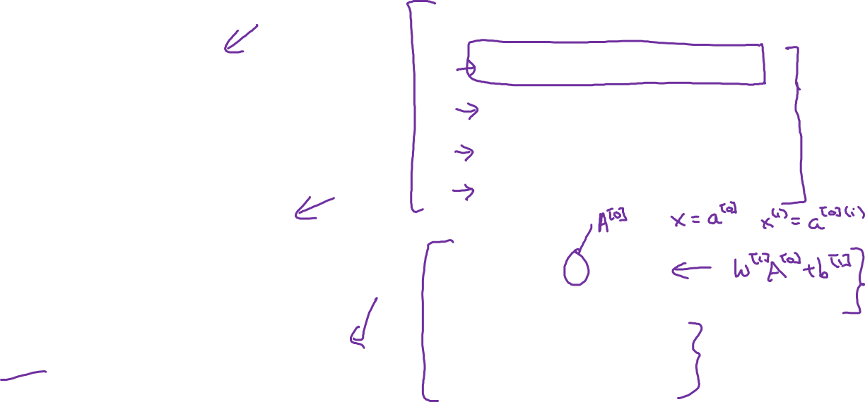





Recap of vectorizing across multiple examples
for i = 1 to m
$$x_{1}$$
$$z^{\left[1\right](i)}=W^{\left[1\right]}x^{(i)}+b^{\left[1\right]}$$
$$x_{2}$$
$$\hat{y}$$
$$x_{3}$$
$$a^{\left[1\right](i)}=σ(z^{\left[1\right]\left(i\right)})$$
$$z^{\left[2\right](i)}=W^{\left[2\right]}a^{\left[1\right](i)}+b^{\left[2\right]}$$
$$a^{\left[2\right](i)}=σ(z^{\left[2\right]\left(i\right)})$$
$$X=$$
$$x^{(1)}$$
$$x^{(2)}$$
…
$$x^{(m)}$$
$$Z^{\left[1\right]}=W^{\left[1\right]}X+b^{\left[1\right]}$$
$$A^{\left[1\right]}=σ(Z^{\left[1\right]})$$
$$Z^{\left[2\right]}=W^{\left[2\right]}A^{\left[1\right]}+b^{\left[2\right]}$$
$A^{[1]}=$
$$a^{[1](1)}$$
$$a^{[1](2)}$$
$$a^{[1](m)}$$
…
$$A^{\left[2\right]}=σ(Z^{\left[2\right]})$$

Slide 19
One hidden layer
Neural Network
Activation functions

Slide 20




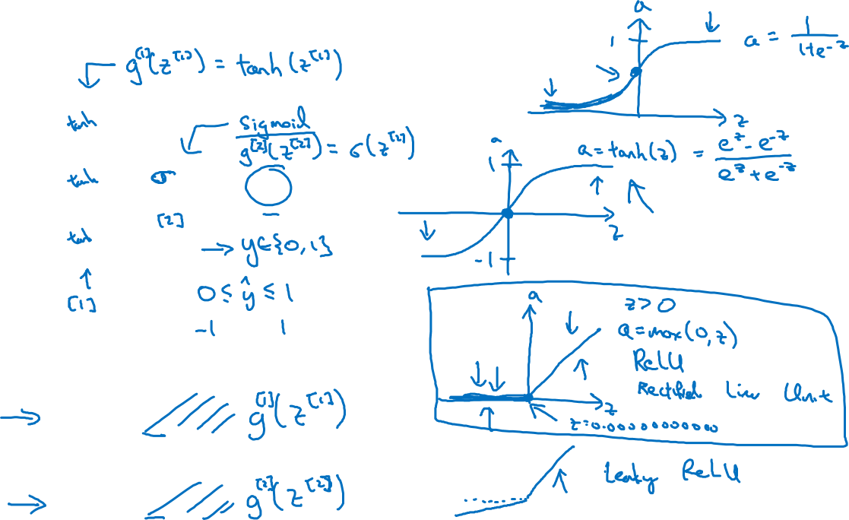


Activation functions
$$x_{1}$$
$$x_{2}$$
$$\hat{y}$$
$$x_{3}$$
Given x:
$$z^{\left[1\right]}=W^{\left[1\right]}x+b^{\left[1\right]}$$
$$a^{\left[1\right]}=σ(z^{\left[1\right]})$$
$$z^{\left[2\right]}=W^{\left[2\right]}a^{\left[1\right]}+b^{\left[2\right]}$$
$$a^{\left[2\right]}=σ(z^{\left[2\right]})$$

Slide 21
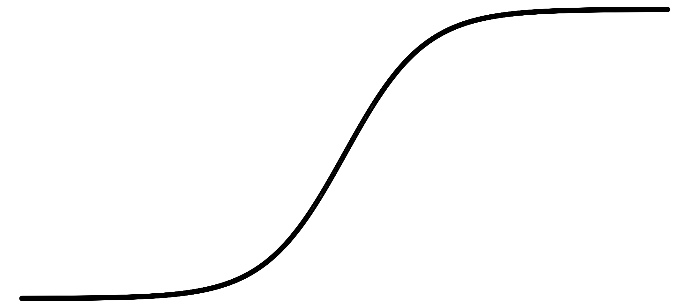
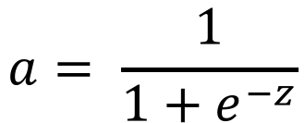
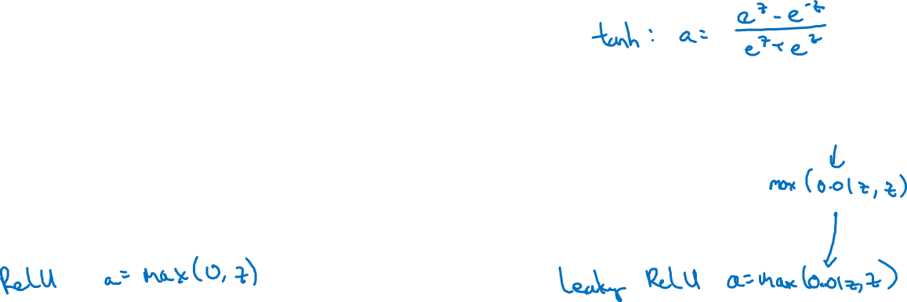
Pros and cons of activation functions
a
a
x
z
$$a= \frac{1}{1+e^{−z}}$$
sigmoid:
a
a
z
z

Slide 22
Sigmoid activation function becomes slow in learning when z value is high.
Better function than Sigmoid is tanh function, as it makes mean 0, but still slow in learning for large values of Z
To learn faster, Relu(rectified linear n/w) and leaky relu is used.
We can use combination of activation function, in hidden layer relu and output layer Sigmoid because of 0/1 output.
Leaky Relu is rarly used in practice, but works similar to Relu

Slide 23
One hidden layer
Neural Network
Why do you
need non-linear
activation functions?

Slide 24



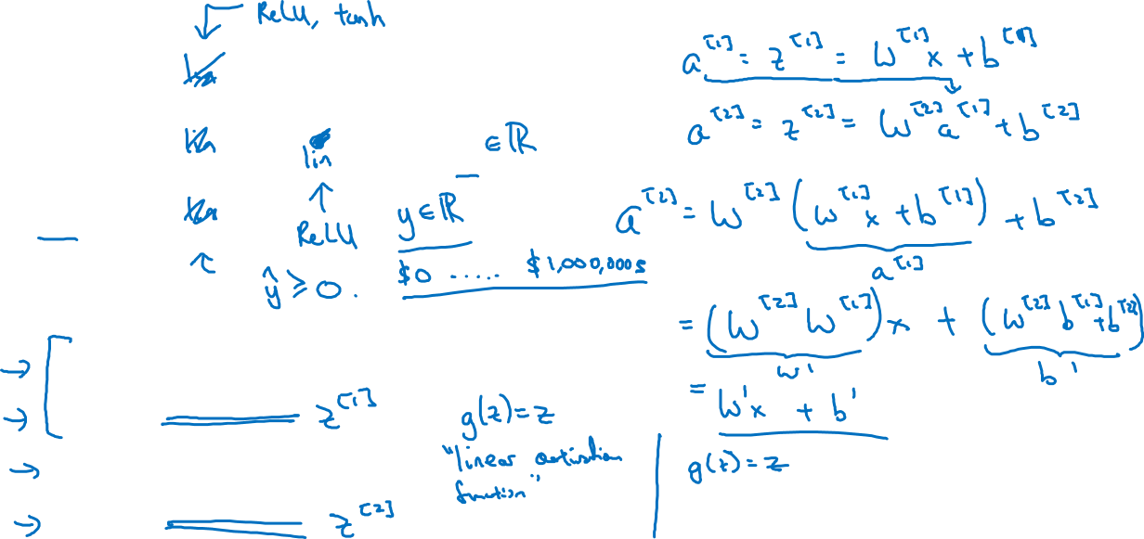



Activation function
$$x_{1}$$
$$x_{2}$$
$$\hat{y}$$
$$x_{3}$$
Given x:
$$z^{\left[1\right]}=W^{\left[1\right]}x+b^{\left[1\right]}$$
$$a^{\left[1\right]}=g^{[1]}(z^{\left[1\right]})$$
$$z^{\left[2\right]}=W^{\left[2\right]}a^{\left[1\right]}+b^{\left[2\right]}$$
$$a^{\left[2\right]}=g^{[2]}(z^{\left[2\right]})$$

Slide 25
Using Linear activation function does not make sense, it is same as linear regression. Composition of two linear function is linear function.
We can use linear function in output layer when we have regression problem. It will have different activation function in hidden layer. If output is always greater than zero then use Relu activation function.
It is useless to have linear activation function in hidden layer, no matter how many hidden units and layer we have at end it will e linear activation function only.

Slide 26
One hidden layer
Neural Network
Derivatives of
activation functions

Slide 27
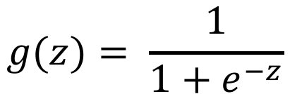
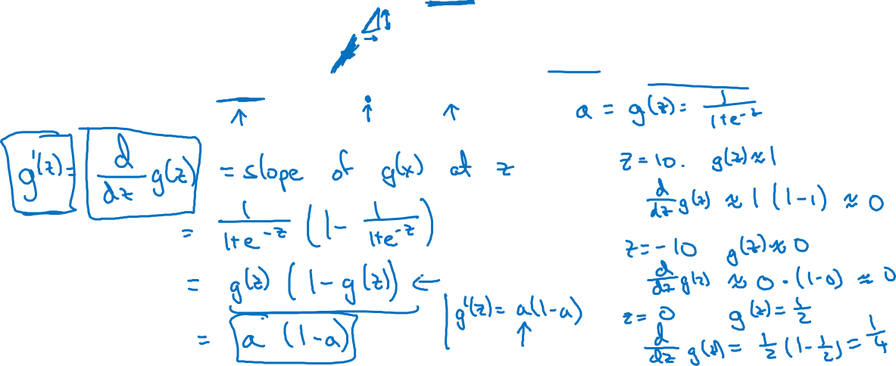
Sigmoid activation function
a
$$g(z)= \frac{1}{1+e^{−z}}$$
z

Slide 28

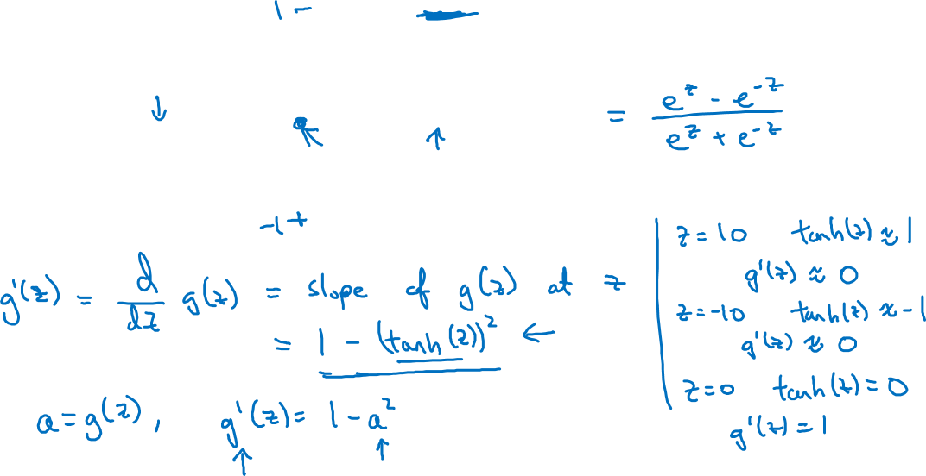
Tanh activation function
a
$$g(z)=tanh(z){ }$$
z

Slide 29
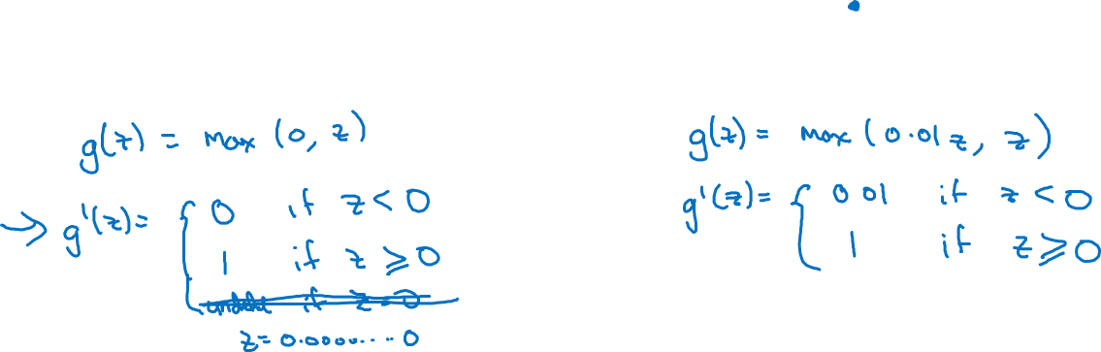
ReLU and Leaky ReLU
a
a
z
z
ReLU
Leaky ReLU

Slide 30
One hidden layer
Neural Network
Gradient descent for
neural networks

Slide 31
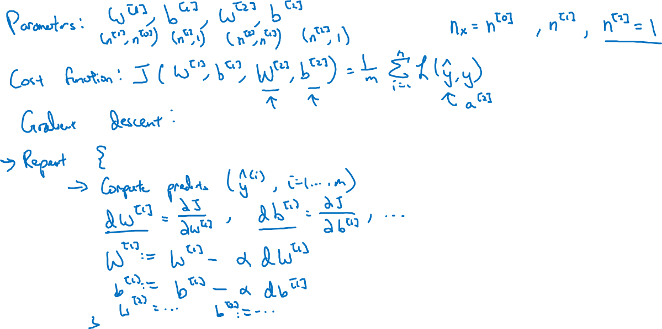
Gradient descent for neural networks

Slide 32
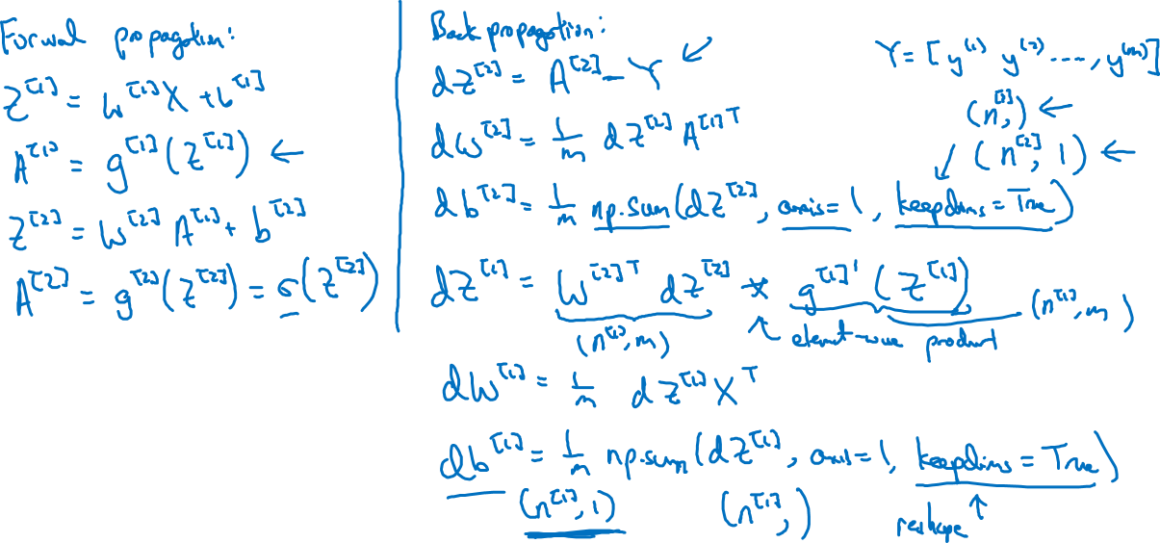
Formulas for computing derivatives

Slide 33
One hidden layer
Neural Network
Backpropagation
intuition (Optional)

Slide 34






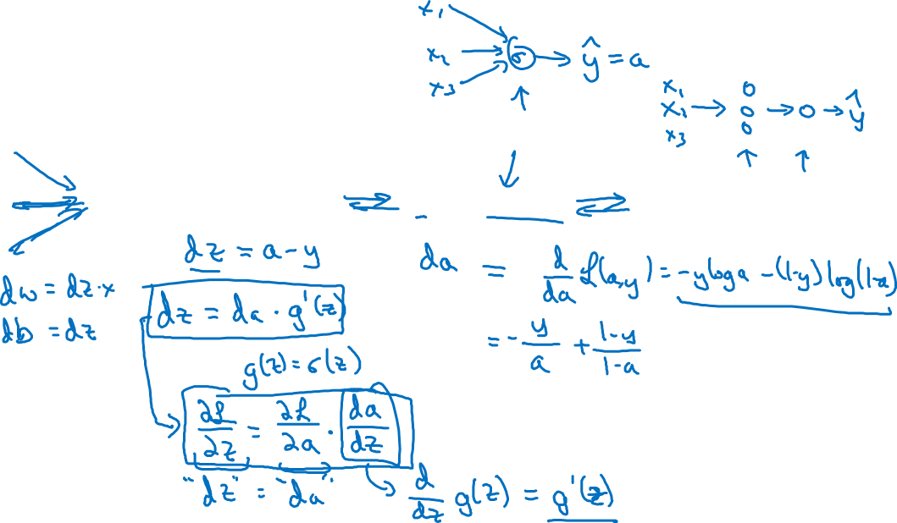
Computing gradients
Logistic regression
$$x$$
$$w$$
$$z=w^{T}x+b$$
$$a= σ(z)$$
$$ℒ(a,y)$$
$$b$$

Slide 35

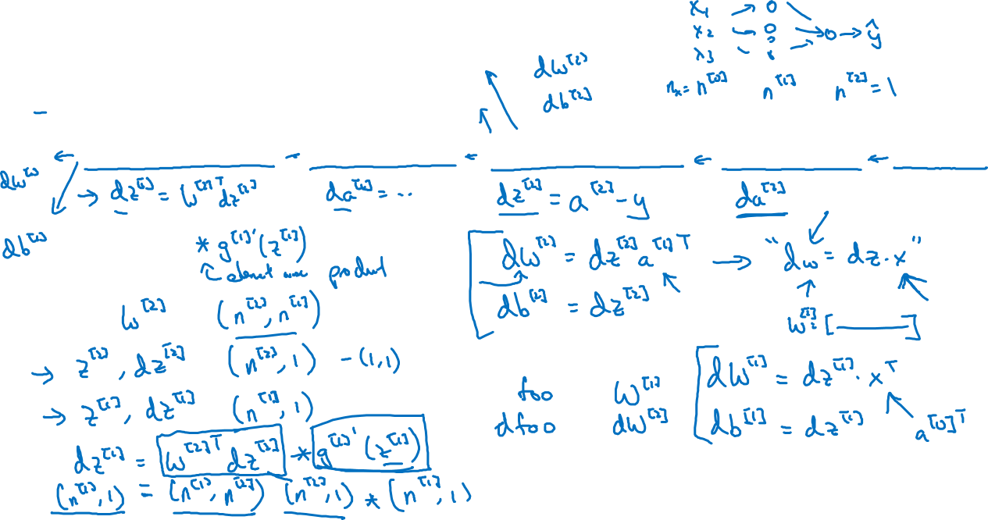



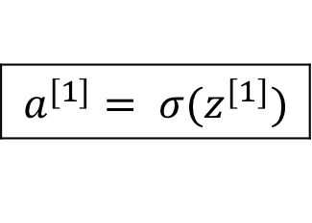





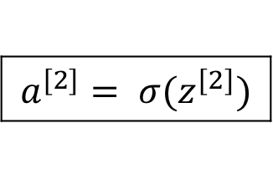
Neural network gradients
$$W^{[2]}$$
$$x$$
$$b^{[2]}$$
$$W^{[1]}$$
$$z^{[1]}=W^{[1]}x+b^{[1]}$$
$$a^{[1]}= σ(z^{[1]})$$
$$z^{[2]}=W^{[2]}x+b^{[2]}$$
$$a^{[2]}= σ(z^{[2]})$$
$$ℒ(a^{[2]},y)$$
$$b^{[1]}$$

Slide 36





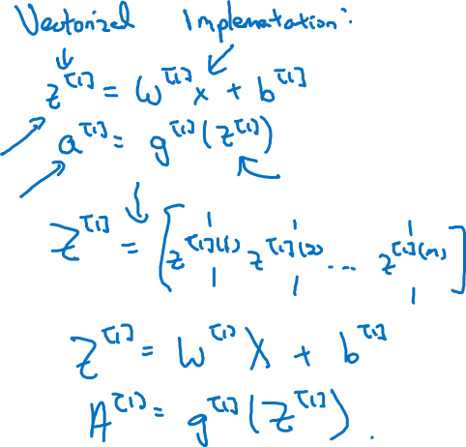
Summary of gradient descent
$$dz^{[2]}=a^{[2]}−y$$
$$dW^{[2]}=dz^{[2]}a^{{\left[1\right]}^{T}}$$
$$db^{[2]}=dz^{[2]}$$
$$dz^{[1]}=W^{\left[2\right]T}dz^{[2]}∗g^{[1]}′(z^{\left[1\right]})$$
$$dW^{[1]}=dz^{[1]}x^{T}$$
$$db^{[1]}=dz^{[1]}$$

Slide 37

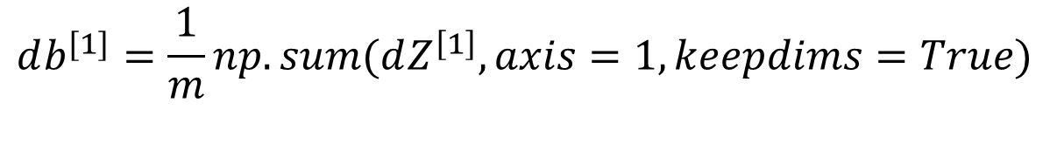
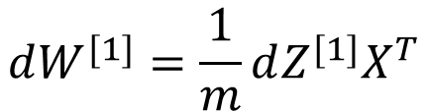
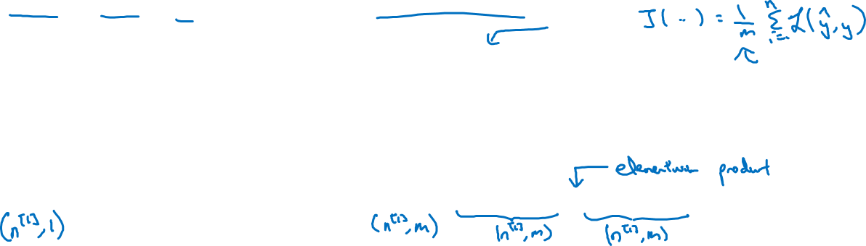
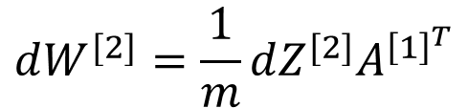
Summary of gradient descent
$$dz^{[2]}=a^{[2]}−y$$
$$dZ^{[2]}=A^{[2]}−Y$$
$$dW^{[2]}=dz^{[2]}a^{{\left[1\right]}^{T}}$$
$$dW^{[2]}=\frac{1}{m}dZ^{[2]}A^{{\left[1\right]}^{T}}$$
$$db^{[2]}=dz^{[2]}$$
$$db^{[2]}=\frac{1}{m}np.sum(dZ^{\left[2\right]},axis=1, keepdims=True)$$
$$dz^{[1]}=W^{\left[2\right]T}dz^{[2]}∗g^{[1]}′(z^{\left[1\right]})$$
$$dZ^{[1]}=W^{\left[2\right]T}dZ^{[2]}∗g^{[1]}′(Z^{\left[1\right]})$$
$$dW^{[1]}=dz^{[1]}x^{T}$$
$$dW^{[1]}=\frac{1}{m}dZ^{[1]}X^{T}$$
$$db^{[1]}=dz^{[1]}$$
$$db^{[1]}=\frac{1}{m}np.sum(dZ^{\left[1\right]},axis=1, keepdims=True)$$

