Slide 1
https://www.cloudskillsboost.google/course_sessions/5018315/video/384243

Slide 2
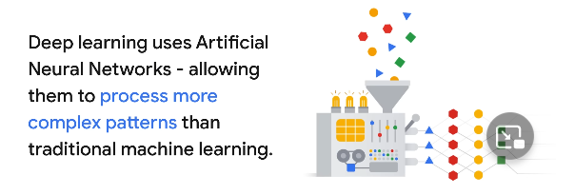
Deep Learning
Artificial neural network are inspired by human brains made of many interconnected nodes layers of neurons allows to learn more complex pattern than traditional machine learning models. It can use

Slide 3
Generative AI
Generative is a type of AI can produce various types of content : audio , text..
GenAI is subset of Deep learning. It uses articifical neural network.
LLM is also subset of data

Slide 4
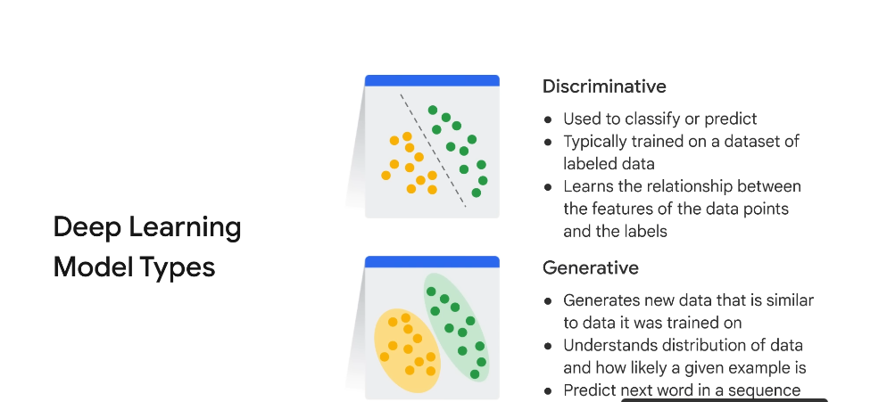

Slide 5
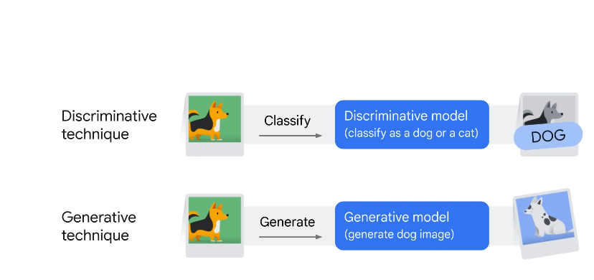

Slide 6
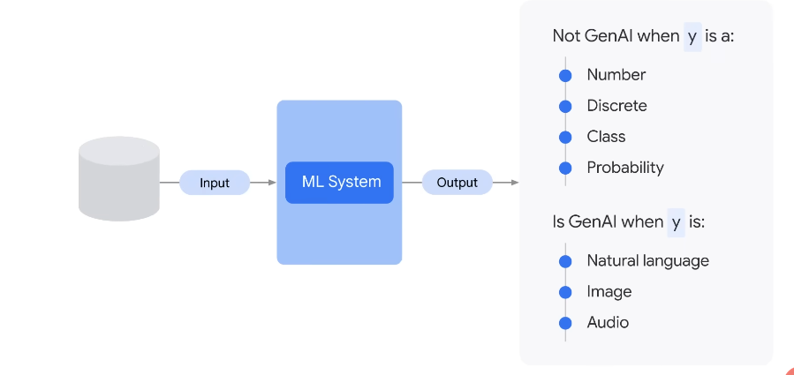
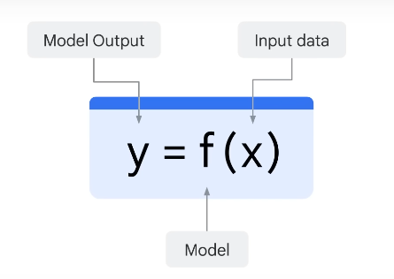

Slide 7
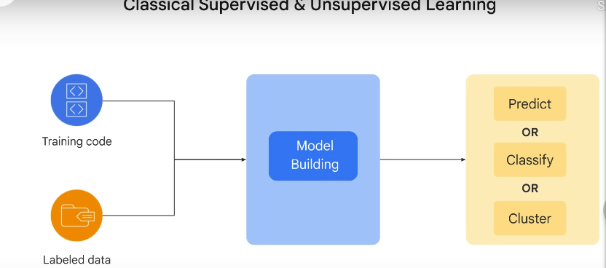

Slide 8
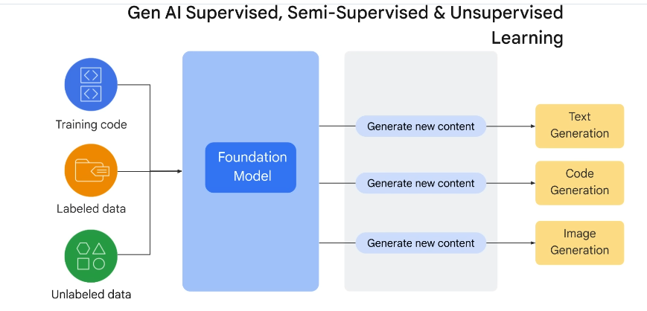

Slide 9
Foundational Model in Machine Learning
In the context of machine learning, a foundational model could be a basic algorithm or approach upon which more advanced techniques are built. Linear regression and decision trees are foundational models in supervised learning, for instance.
These foundational models are often relatively simple but are crucial in understanding the core concepts of machine learning. They are used as starting points for many machine learning tasks and provide a basis for further exploration and development. Here are a few foundational models in machine learning:

Slide 10
Linear Regression:
Linear regression is one of the simplest and most foundational models in machine learning. It deals with modeling the relationship between a dependent variable (target) and one or more independent variables (features) by fitting a linear equation to the observed data.
Logistic Regression:
Logistic regression is used for binary classification tasks. It models the probability that a given input belongs to one of two classes. Despite the name "regression," it's commonly used in classification problems.

Slide 11
Decision Trees:
Decision trees are versatile and interpretable models used for both classification and regression tasks. They partition the feature space into regions and assign labels or values based on the majority class or average within each region.
k-Nearest Neighbors (k-NN):
k-NN is a simple instance-based learning algorithm used for both classification and regression. It predicts the class or value of a new data point based on the majority class or average of its k nearest neighbors in the training data.

Slide 12
Naive Bayes:
Naive Bayes is a probabilistic model that's particularly useful for text classification tasks, such as spam detection and sentiment analysis. It's based on Bayes' theorem and assumes that features are conditionally independent, which simplifies calculations.
Principal Component Analysis (PCA):
PCA is a dimensionality reduction technique rather than a predictive model. It's foundational for feature extraction and data visualization. PCA identifies the most significant dimensions (principal components) in high-dimensional data.

Slide 13
SVM (Support Vector Machines):
SVM is a foundational model for both classification and regression. It aims to find a hyperplane that best separates data points of different classes with a maximal margin.
Perceptron:
The perceptron is one of the earliest models for binary classification. It's a single-layer neural network that can learn linear decision boundaries.

Slide 14
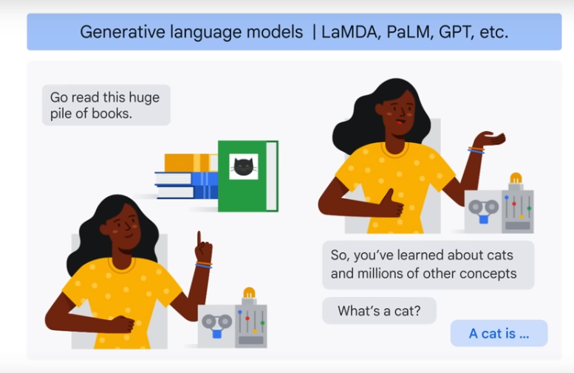

Slide 15
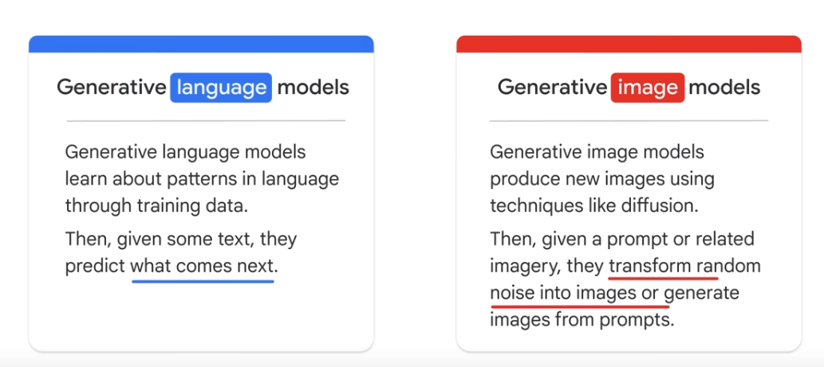

Slide 16
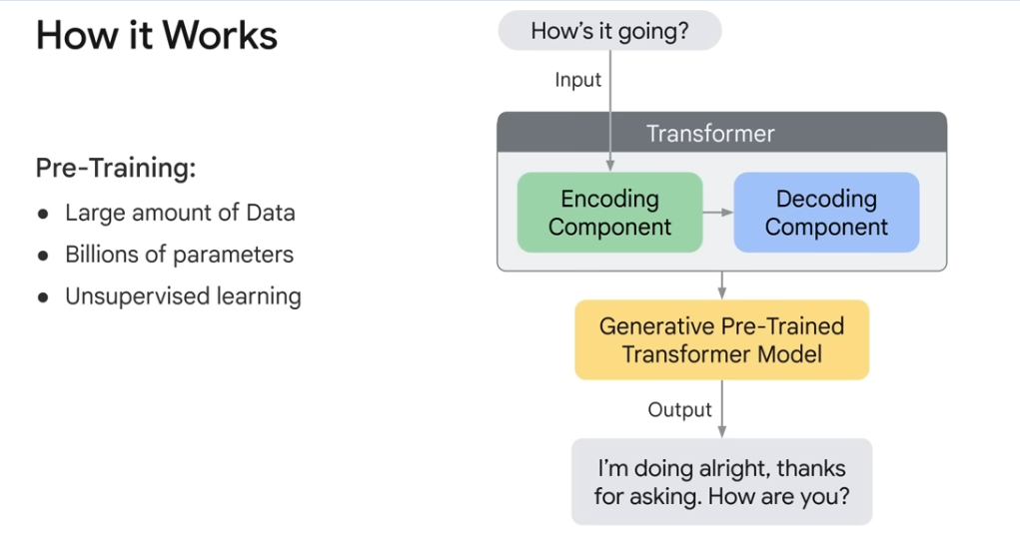

Slide 17
A Foundation model is a large AI model pretrained on vast quantity of data designed to be adapted or fine tuned to wide range of downstream tasks such as sentiment analysis, imae captioning and object recognition.
Vertex AI
PALM API
BERT
BARD

Slide 18
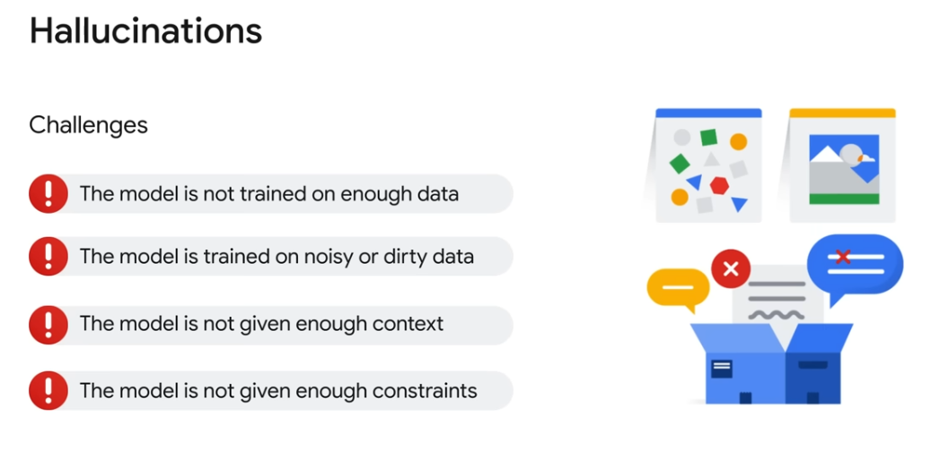

Slide 19
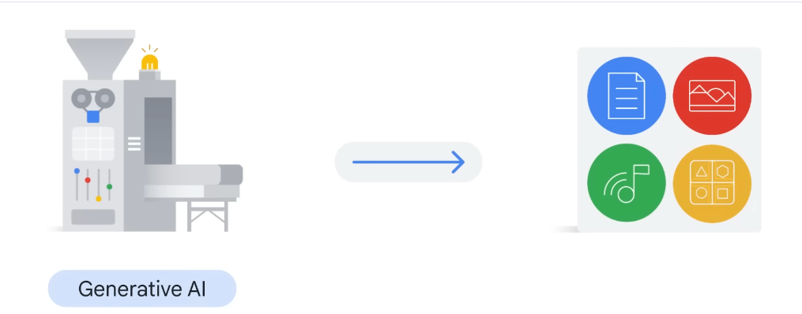
Generative AI and LLM model are intersect and part of deep learning models

Slide 20
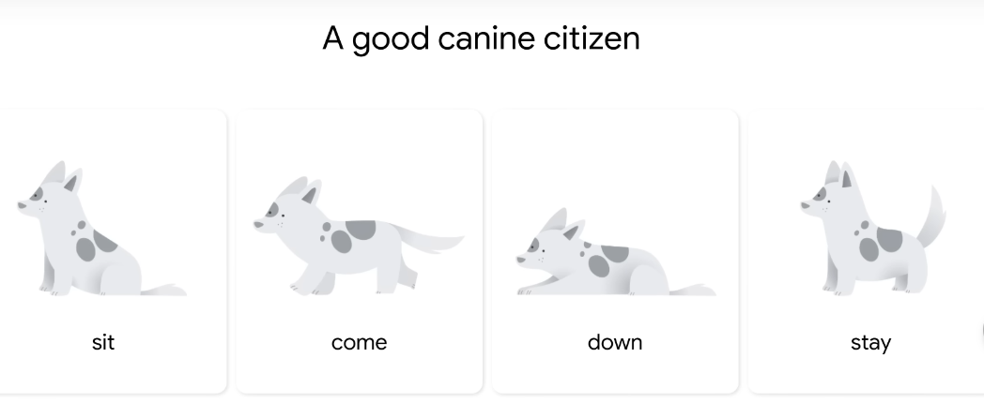
Large, general-purpose language models can be pre trained and then fine-tuned for specific purposes

Slide 21
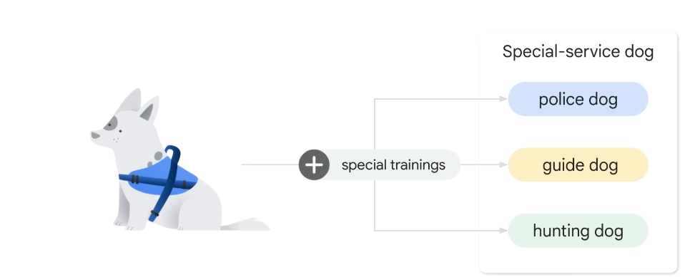

Slide 22
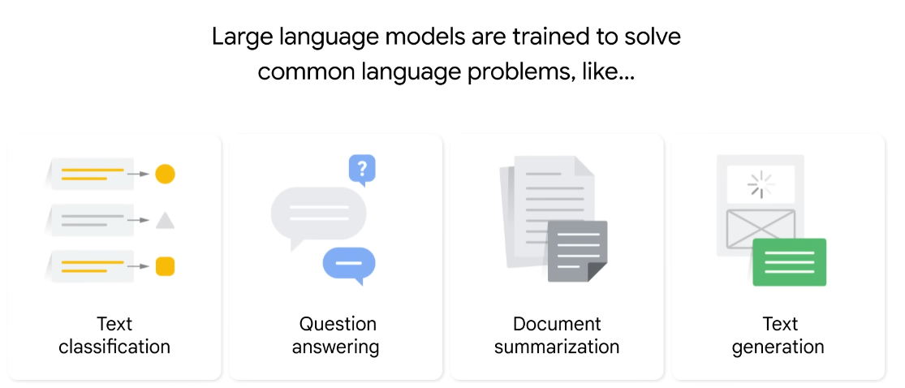

Slide 23
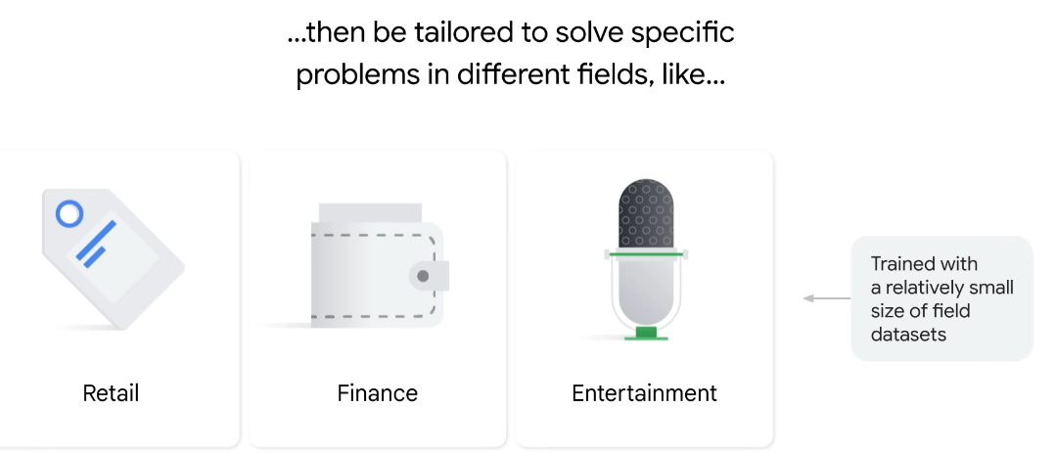

Slide 24
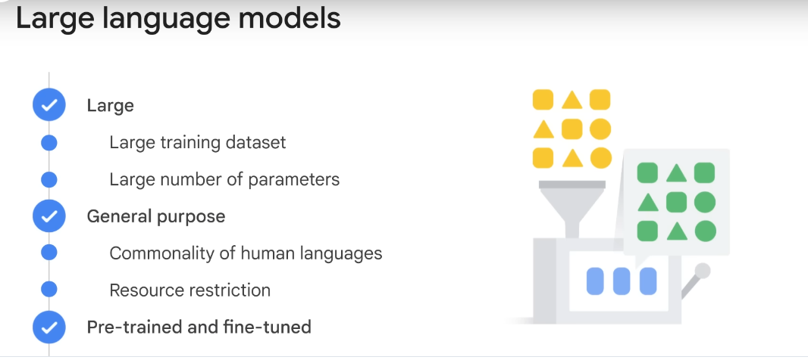

Slide 25
Parameters define the skill of model in solving a problem such as predicting text.
General purposes: models are sufficient to solve common problems. Commanity in human language regardless of the specific tasks domain, resource restriction, very few companies have resources to train such large language model with huge data sets and tremendous number of parameters. How about creating fundamental language models and allows others to use
Pretrained LLM model and then fine tune according to task with less data.

Slide 26
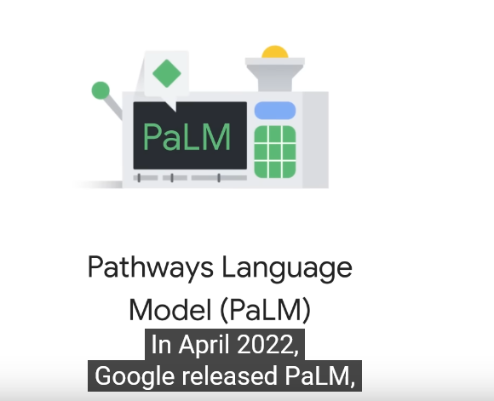

Slide 27
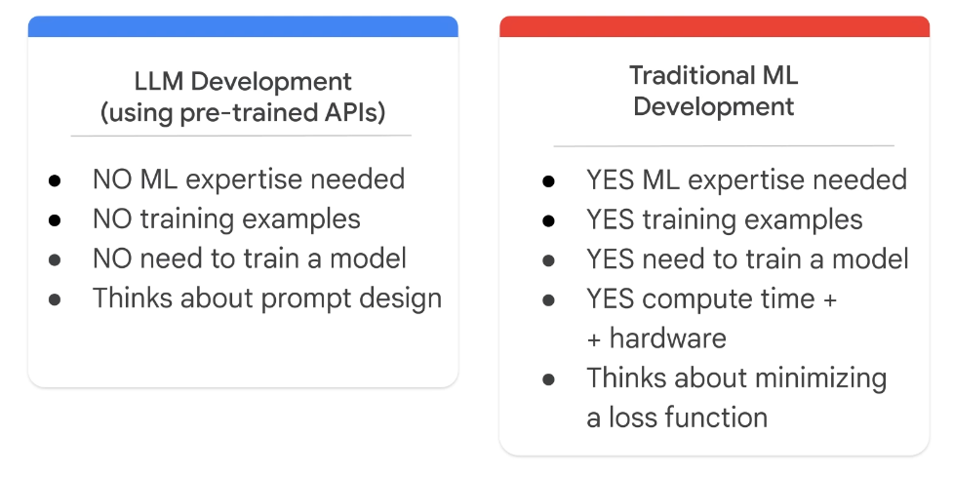

Slide 28
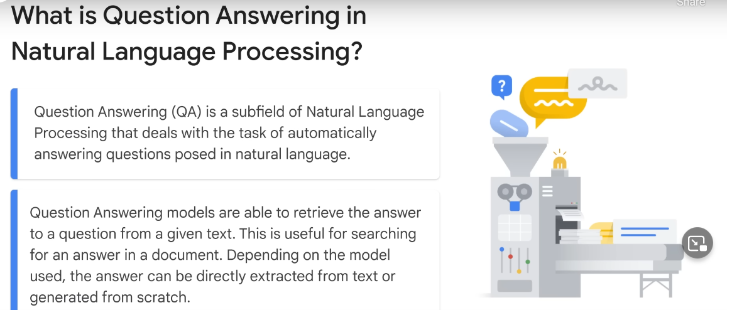

Slide 29
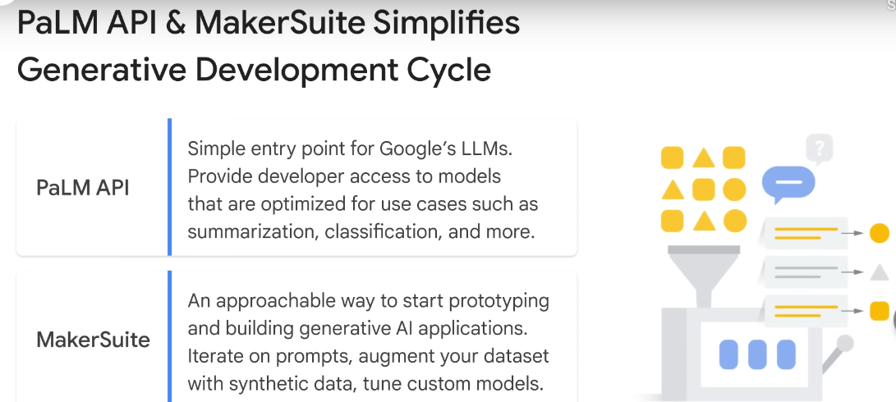
Vertex AI provides task specific foundation models

