Slide 1
Model Explainability

Slide 2
Introduction
Model Explainability
Lot of times from machine learning model we can make good predictions but find difficult to understand the logic behind those predictions / explain to customer except linear models.
To understand model the most important insights :
What are the most important features?
Change in Y variable with unit change in X variable?
Which features caused increase/decrease in prediction for individual prediction?
A model says a bank shouldn't loan someone money, and the bank is legally required to explain the basis for each loan rejection
A healthcare provider wants to identify what factors are driving each patient's risk of some disease so they can directly address those risk factors with targeted health interventions

Slide 3
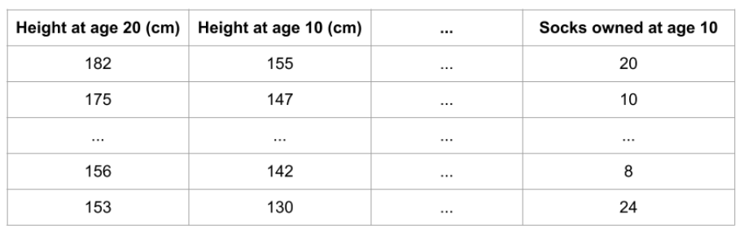
Feature Importance : Permutation Importance
Model Explainability
Permutation importance is calculated after a model has been fitted. So we won't change the model
We will ask the question: If randomly shuffle a single column in the validation data, leaving the target and all other columns in place, how would that affect the accuracy of predictions in that now-shuffled data?
Randomly re-ordering a single column should cause less accurate predictions, since the resulting data no longer corresponds to anything observed in the real world.
We want to predict a person's height when they become 20 years old, using the below data
Useful features : height at age 10,
little predictive power: socks owned
If Height at age 10 randomly shuffled should cause less accurate predictions.
But if socks owned randomly shuffled predictions wouldn't suffer as it not important

Slide 4
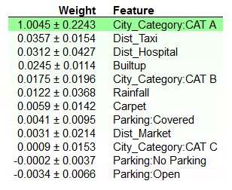
Feature Importance: Permutation Importance
Model Explainability
Output example for house price prediction
Will tell about important features , but will not give the direction of importance
The first number in each row shows how much model performance decreased with a random shuffling.
Second number : amount of randomness in our permutation importance calculation by repeating the process with multiple shuffles. Basically measures how performance varied from one-reshuffling to the next.
Negative values for permutation importances, the predictions on the shuffled (or noisy) data happened to be more accurate than the real data.

Slide 5
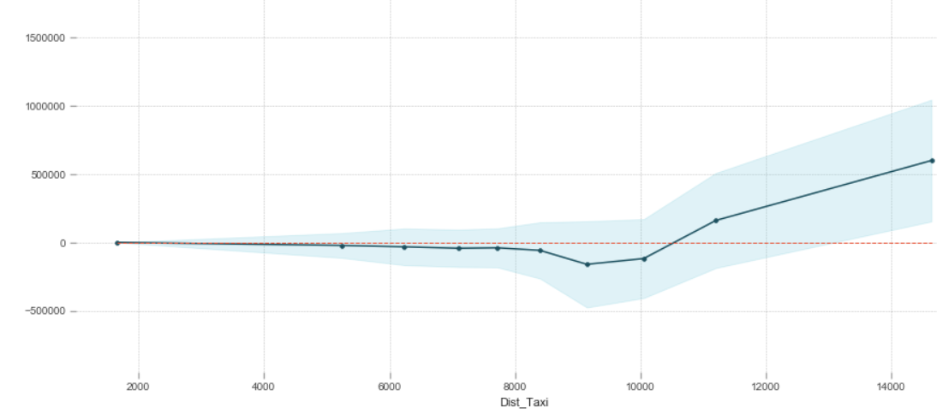
Feature Direction: Partial Plots
Model Explainability
While feature importance shows what variables most affect predictions, partial dependence plots show how a feature affects predictions.
Partial dependence plots are calculated after a model has been fit.
Here we repeatedly alter the value for one variable for full range keeping the other column values fixed and calculate the prediction in validation data. And we plot the average predicted outcome on the versus the variable values.
The y axis is interpreted as change in the prediction from what it would be predicted at the baseline value.
A blue shaded area indicates level of confidence

Slide 6
Impact on Prediction: Shapley value
Model Explainability
SHAP Values (an acronym from SHapley Additive exPlanations) break down a prediction to show the impact of each feature.
Interpret the impact of having a certain value for a given feature in comparison to the prediction we'd make if that feature took some baseline value.
The concept came from Game Theory
1. Bangalore-Pune (Round Trip): 4000
2. Bangalore-Mumbai (Round Trip): 5000
3. Bangalore- Pune-Mumbai-Bang: 6000
Pune (Shashank)
How to divide cost?
Shashank (PU): 4000 Manish(PU): 5000
Manish(IU): 2000 Shashank (IU): 1000
Avg Shashank : 2500 , Manish : 3500
Bangalore
(Vivek)
Mumbai
(Manish)

Slide 7
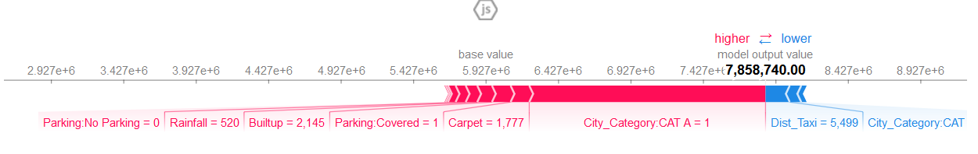
Impact on Prediction: Shapley value
Model Explainability
We calculate the impact of each feature for individual prediction
That is, the SHAP values of all features sum up to explain why my prediction was different from the base value.
Red: Support to Increase the House price
Blue : Support to Decrease the House Price

Slide 8
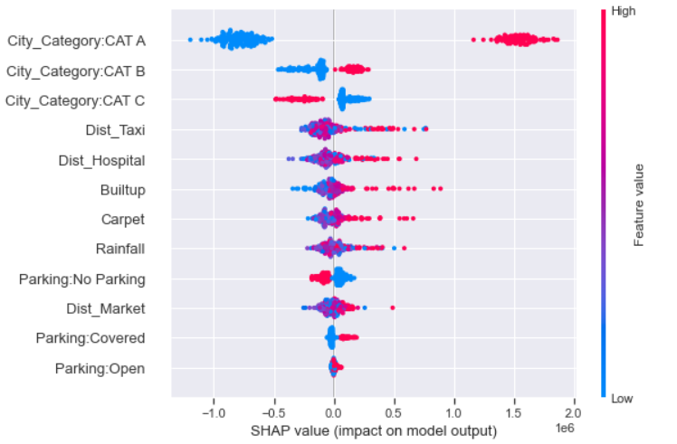
Impact on Prediction: SHAP summary plots
Model Explainability
Calculate shap_values for all of row in validation rather than a single row, (Bird Eye View)
Each dot has three characteristics:
Vertical location shows what feature it is depicting
Color shows whether that feature was high or low for that row of the dataset
Horizontal location shows whether the effect of that value caused a higher or lower prediction.

Slide 9
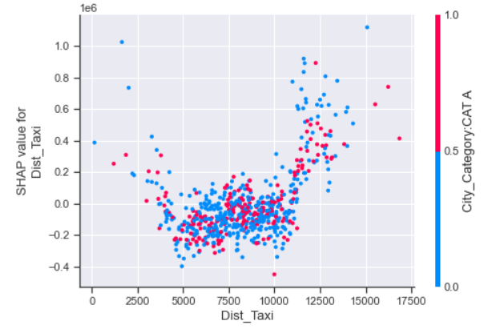
Impact on Prediction: SHAP Dependence Contribution Plots
Model Explainability
Similar to Partial Dependence Plots to show how a single feature impacts predictions, plot with interaction variable also
Ignore colour
When Dist_Taxi increases, it decreases the house price initially and then drastically increases
Colour shows the interactition with city category:CAT A, if in other category causes more increases in house price later.

Slide 10
Links
Model Explainability
https://www.kaggle.com/learn/machine-learning-explainability

Slide 11
Model Explainability
Thank You

