Slide 1

LLMs

Slide 2
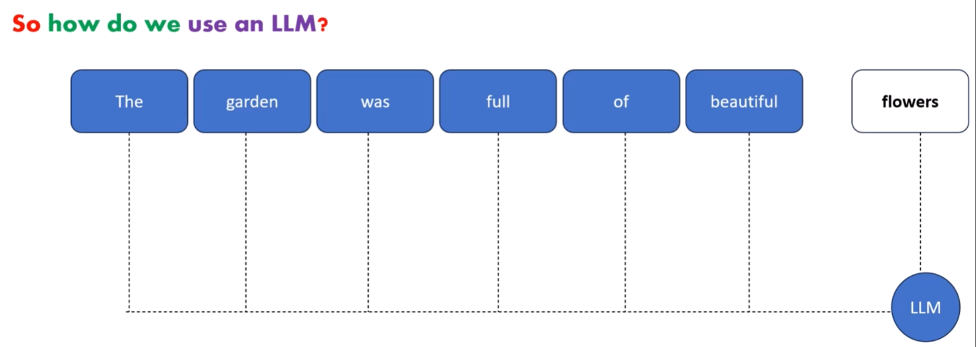
What is LLMs?
A large Language model is a trained deep learning model that understands and generate text in a human like fashion.
LLMs are good at Understanding and generating human language

Slide 3
Why we call it Large Language Model?
Because of the size and complexity of the Neural Network as well as the size of the dataset that it was trained on.
Researchers started to make these models large and trained on huge datasets
That they started showing impressive results like understanding complex Natural Language and generating language more eloquently than ever.

Slide 4
What makes LLM so Powerful?
In case of LLM, one model can be used for a whole variety of tasks like:-
Text generation, Chatbot, summarizer, translation, code generation
& so on …
So, LLM is subset of Deep Learning & it has some properties merge with
Generative AI

Slide 5
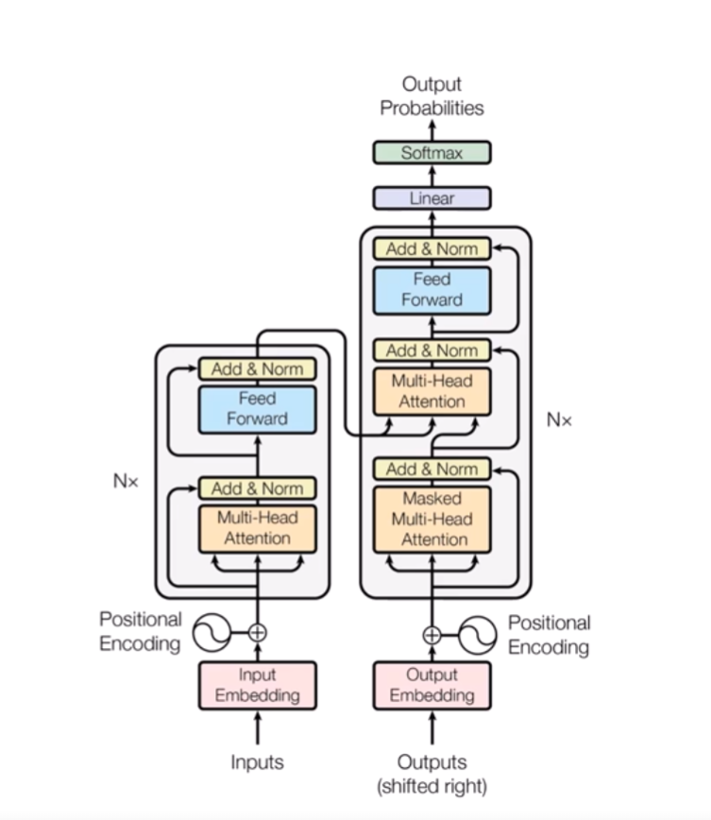
LLMs Model Architecture
Large Language models are based on transformer a type of Neural Network
Architecture invented by Google.

Slide 6
Few milestone in large language model
BERT: Bidirectional Encoder Representations from Transformers (BERT) was developed by Google
GPT: GPT stands for "Generative Pre-trained Transformer".The model was developed by OpenAI
XLM: Cross-lingual Language Model Pretraining by Guillaume Lample, Alexis Conneau.
T5: The Text-to-Text Transfer Transformer It was created by Google AI
Megatron: Megatron is a large, powerful transformer developed by the Applied Deep Learning Research team at NVIDIA
M2M-100: multilingual encoder-decoder (seq-to-seq) model researchers at Facebook

Slide 7
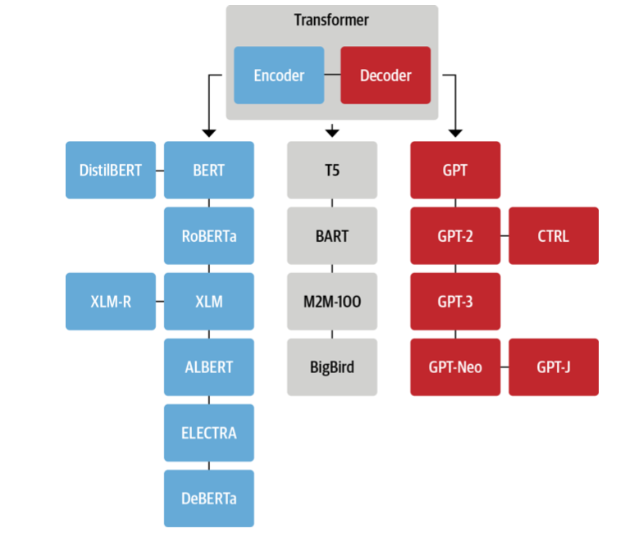
Transformer Tree

Slide 8
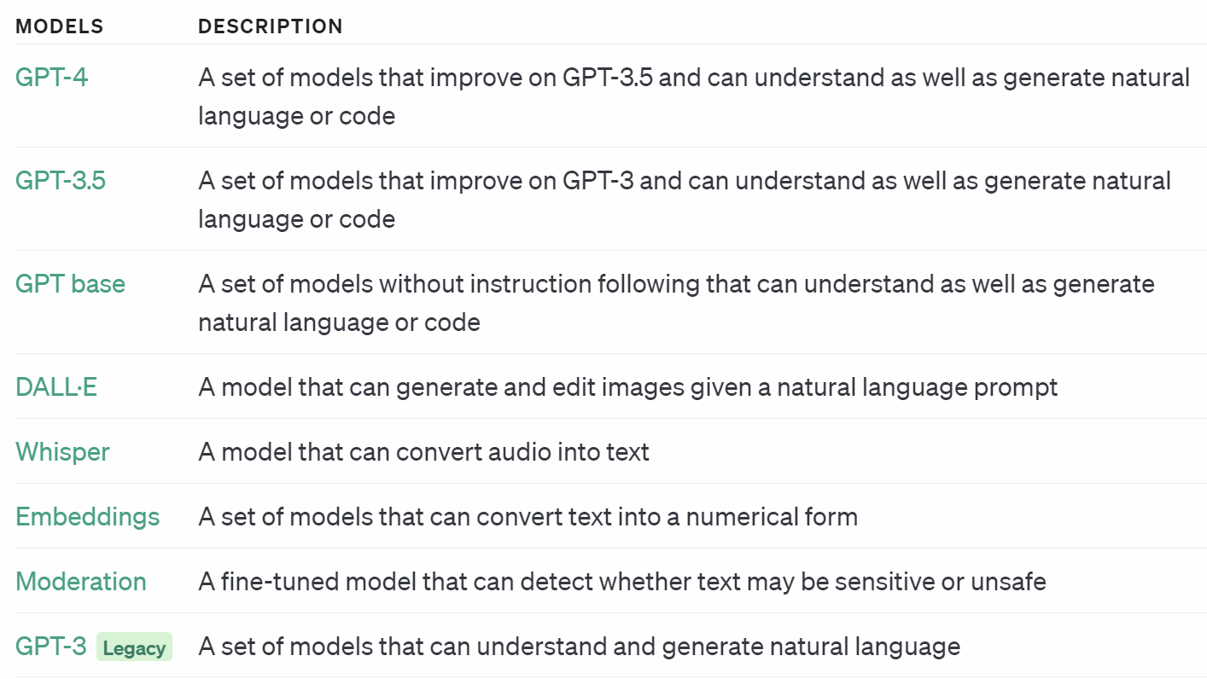
OpenAI Based LLM models

Slide 9
Other Open Source Models
BLOOM
Llama 2
PaLM
Falcon
Claude
MPT-30B
Stablelm
So on ….

Slide 10
What can LLMs be used for?
Text Classification
Text Generation
Text Summarization
Conversation AI like chatbot, Question Answering
Speech recognition and Speech identification
Spelling Corrector
So on……

Slide 11
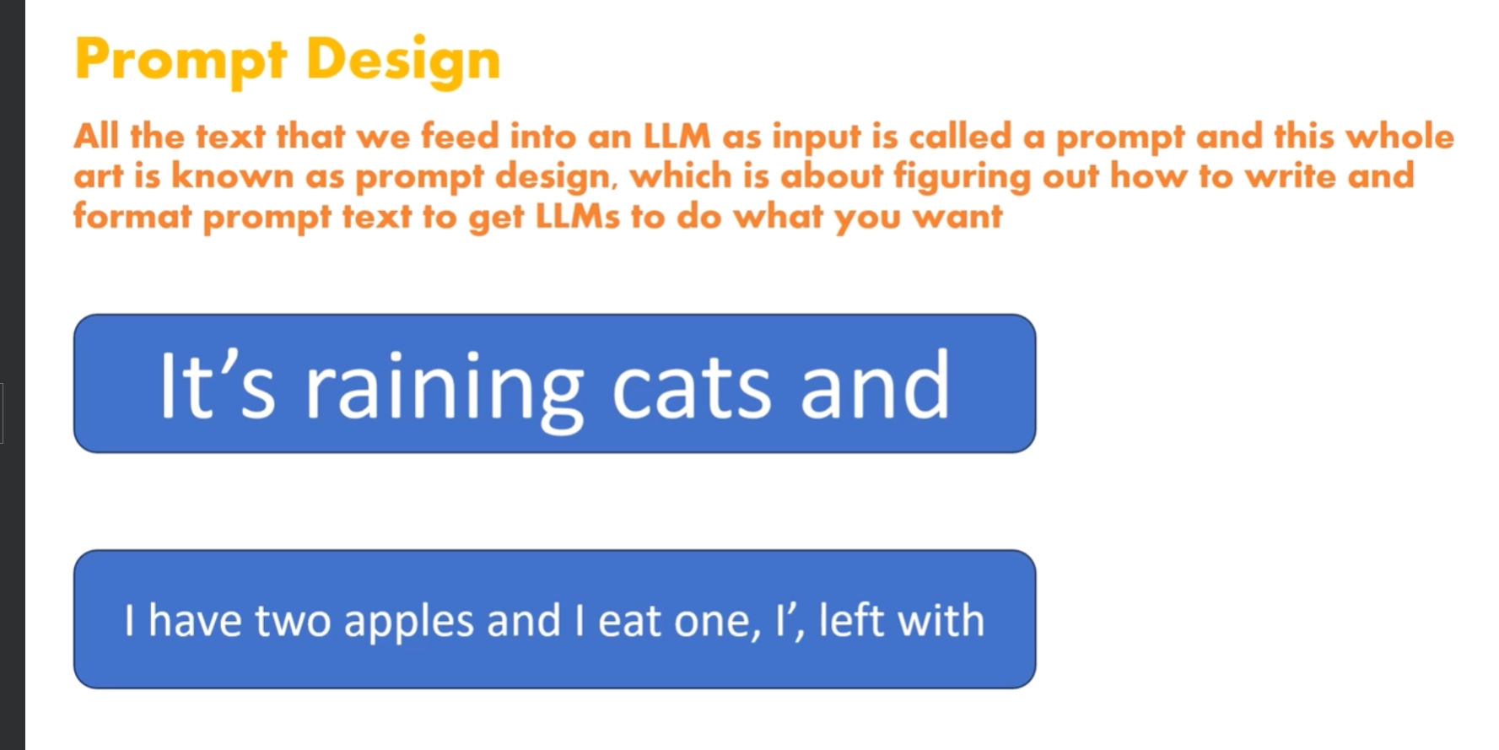
Prompt Designing

Slide 12
How ChatGPT was trained?
Internally using a LLM which is gpt-3.5 or gpt-4
It has trained on a large amount of data which is available all over the internet.
Generative pre-training
Supervised fine-tuning
Reinforcement learning

Slide 13
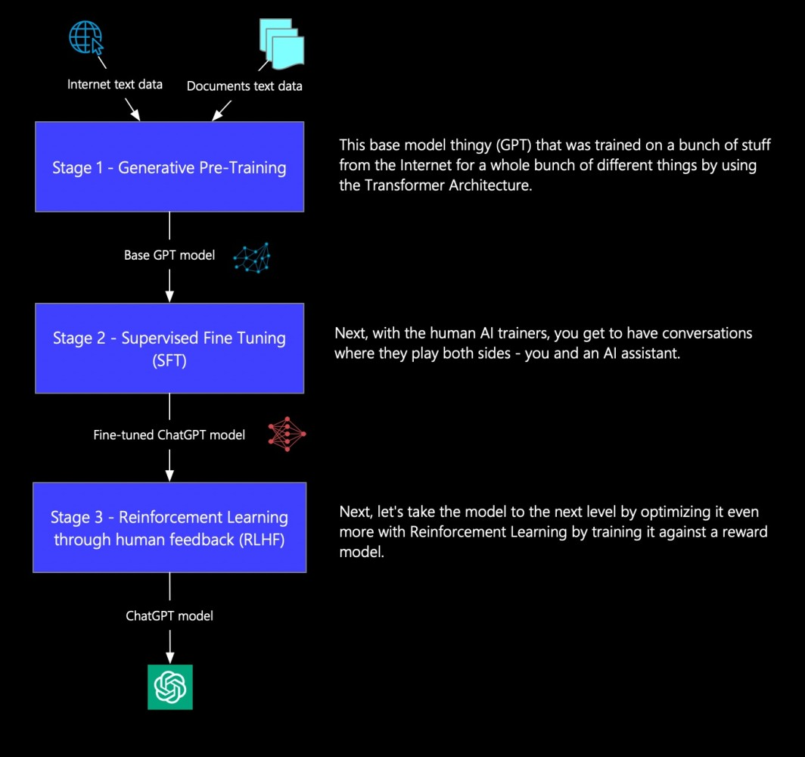

Slide 14
Thank You!

Slide 15
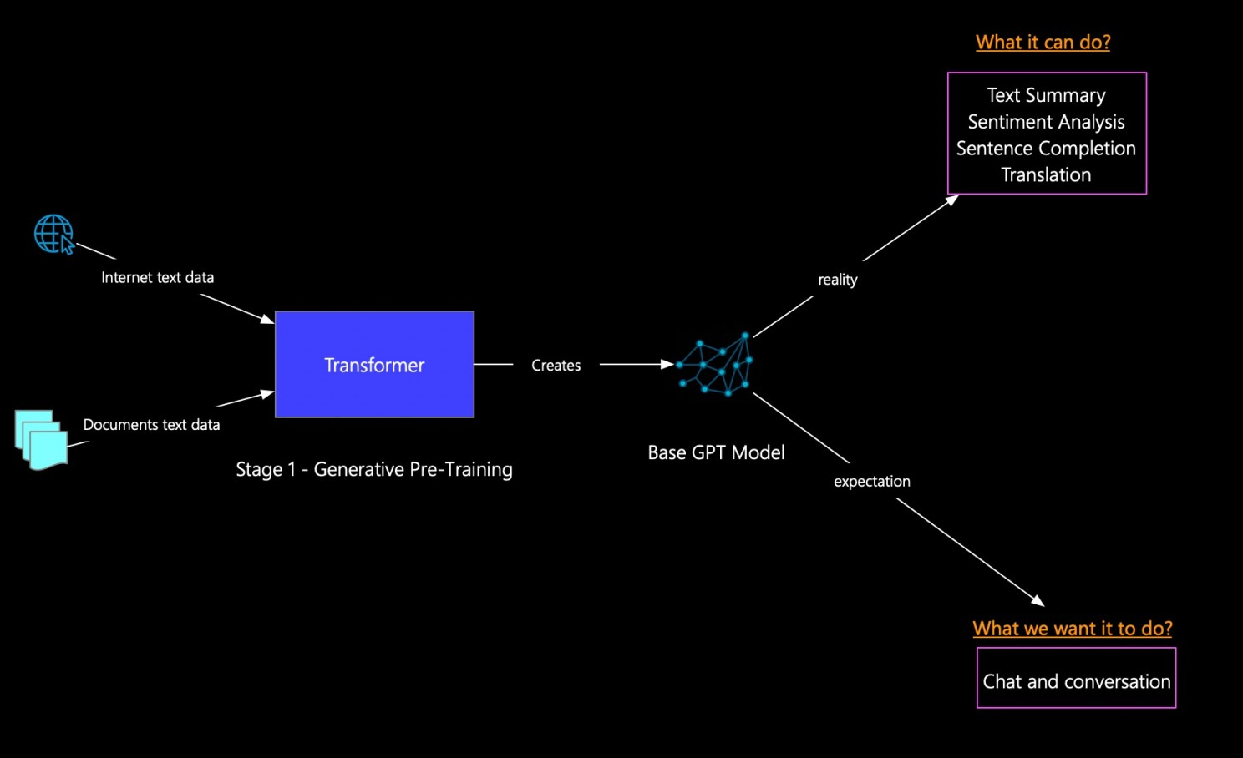
Generative Pre-Training

Slide 16
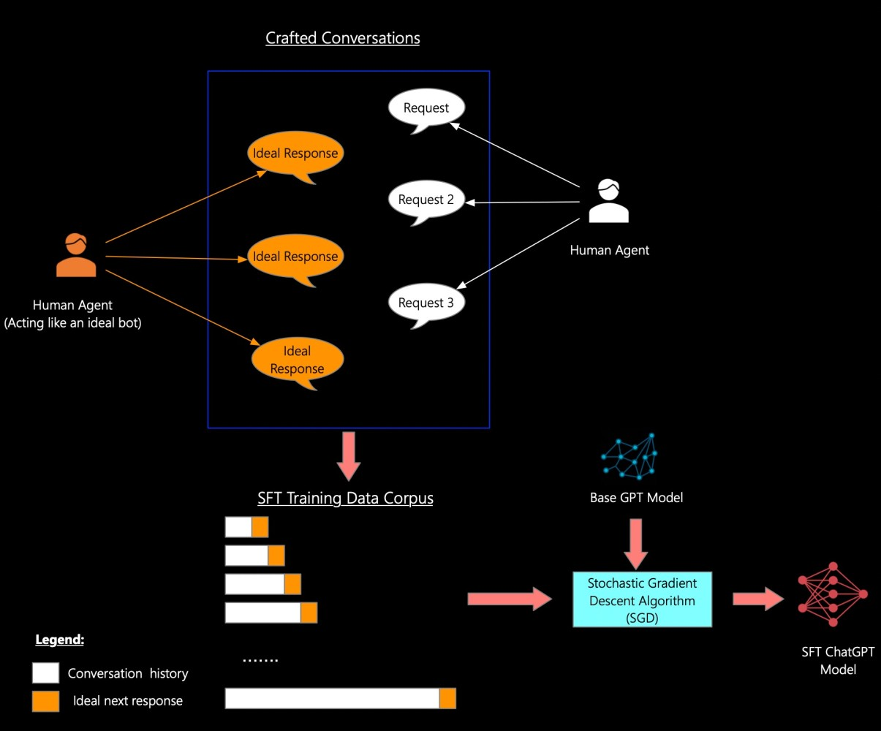
Supervised Fine-Tuning (SFT)

Slide 17
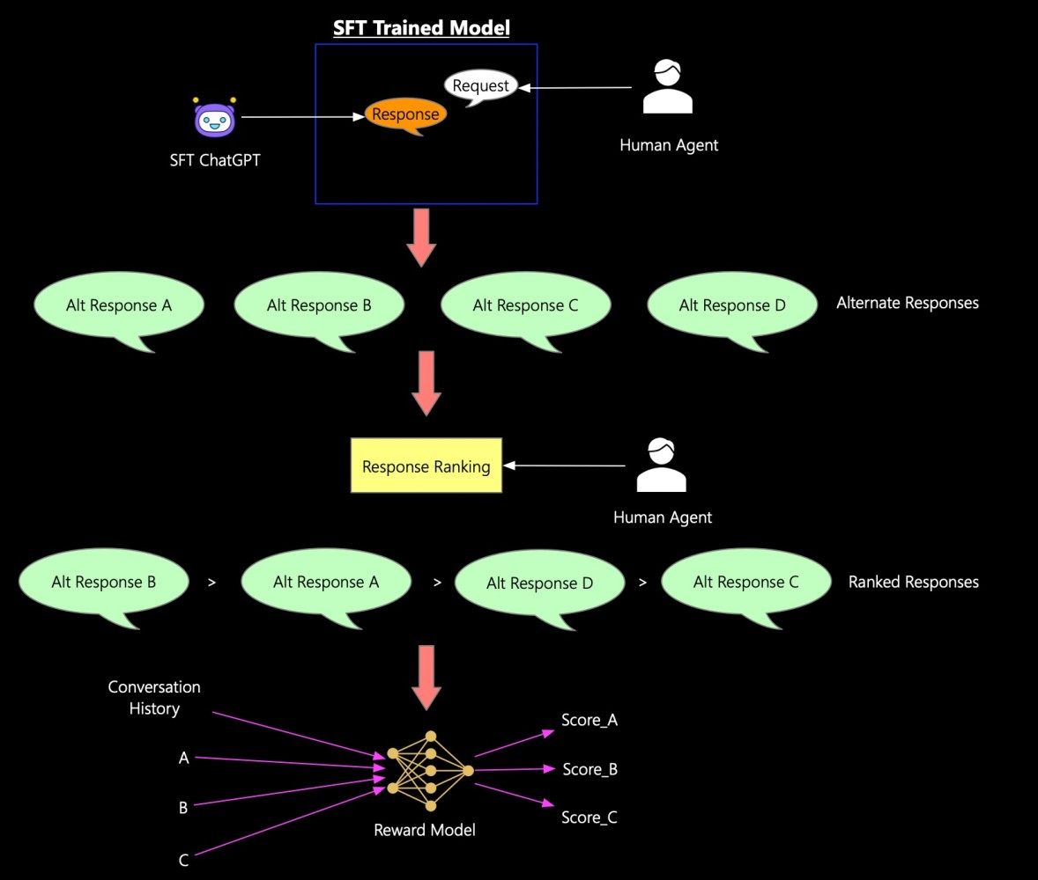
Reinforcement Learning through Human Feedback (RLHF)

Slide 18
Reference i used: https://www.linkedin.com/pulse/discover-how-chatgpt-istrained-pradeep-menon/

