Slide 1
https://www.cloudskillsboost.google/course_sessions/5018315/video/384243

Slide 2
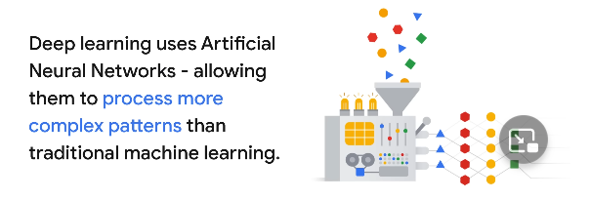
Deep Learning
Artificial neural network are inspired by human brains made of many interconnected nodes layers of neurons allows to learn more complex pattern than traditional machine learning models. It can use

Slide 3
Generative AI
GenAI is a term that refers to Generative Artificial Intelligence. It is a type of machine learning that uses algorithms to create new data from existing information ¹². Generative AI can learn from existing artifacts to generate new, realistic artifacts (at scale) that reflect the characteristics of the training data but don’t repeat it. It can produce a variety of novel content, such as images, video, music, speech, text, software code and product designs .
Generative AI is one of the most powerful advances in technology ever. It enables developers to build applications that consume machine learning models trained with a large volume of data from across the Internet to generate new content that can be indistinguishable from content created by a human.

Slide 4
GPT models are often trained in two stages. First, they are trained, using a large dataset of text from the Internet, to predict the next word. The models are then fine-tuned with additional data, using an algorithm called reinforcement learning from human feedback (RLHF), to produce outputs that are preferred by human labelers.[10, 12, 13] Training language models on large text datasets has given rise to capabilities such as few-shot learning[10] and the ability to carry out a wide range of natural language tasks spanning different domains, including question answering, arithmetic, and classification. Fine-tuning has made these models more controllable and useful.

Slide 5
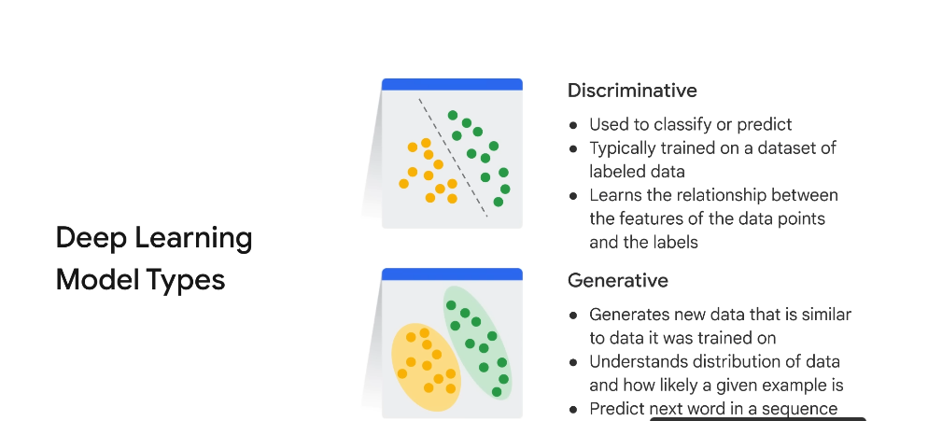

Slide 6
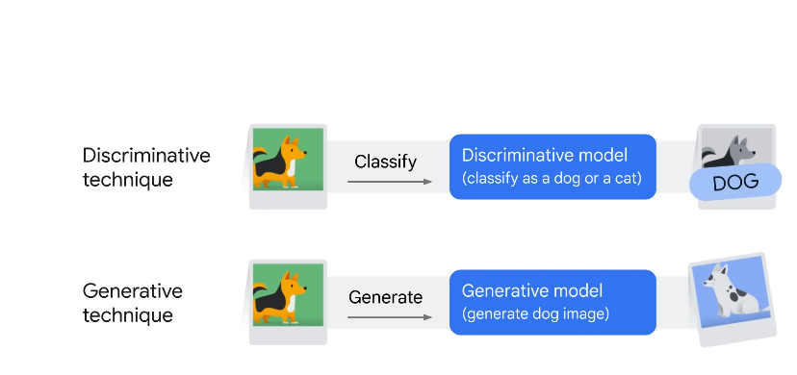

Slide 7
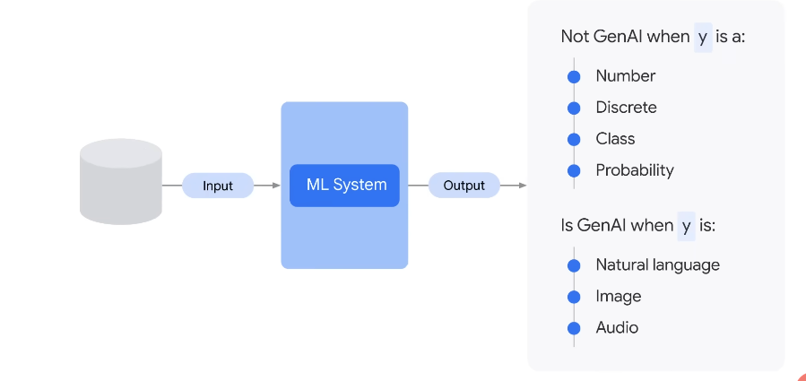
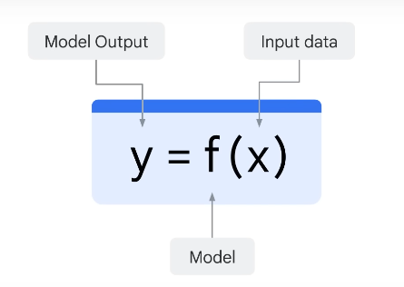

Slide 8
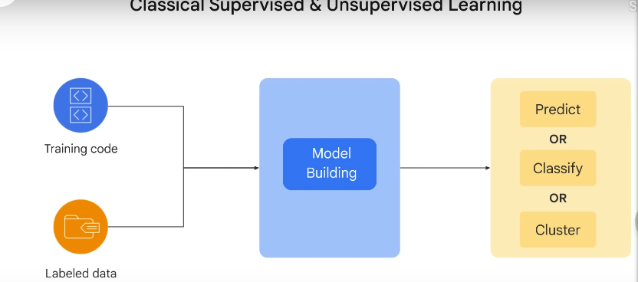

Slide 9
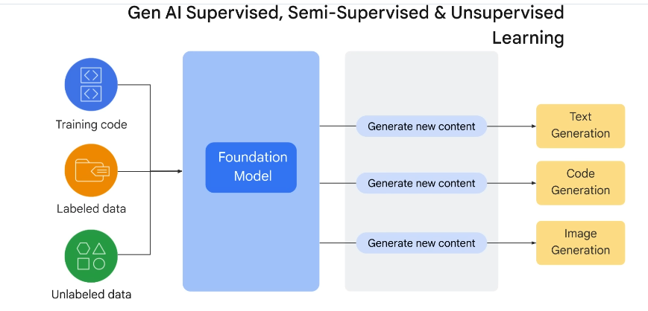

Slide 10
Foundational Model in Machine Learning
In the context of machine learning, a foundational model could be a basic algorithm or approach upon which more advanced techniques are built. Linear regression and decision trees are foundational models in supervised learning, for instance.
These foundational models are often relatively simple but are crucial in understanding the core concepts of machine learning. They are used as starting points for many machine learning tasks and provide a basis for further exploration and development. Here are a few foundational models in machine learning:

Slide 11
Linear Regression:
Linear regression is one of the simplest and most foundational models in machine learning. It deals with modeling the relationship between a dependent variable (target) and one or more independent variables (features) by fitting a linear equation to the observed data.
Logistic Regression:
Logistic regression is used for binary classification tasks. It models the probability that a given input belongs to one of two classes. Despite the name "regression," it's commonly used in classification problems.

Slide 12
Decision Trees:
Decision trees are versatile and interpretable models used for both classification and regression tasks. They partition the feature space into regions and assign labels or values based on the majority class or average within each region.
k-Nearest Neighbors (k-NN):
k-NN is a simple instance-based learning algorithm used for both classification and regression. It predicts the class or value of a new data point based on the majority class or average of its k nearest neighbors in the training data.

Slide 13
Naive Bayes:
Naive Bayes is a probabilistic model that's particularly useful for text classification tasks, such as spam detection and sentiment analysis. It's based on Bayes' theorem and assumes that features are conditionally independent, which simplifies calculations.
Principal Component Analysis (PCA):
PCA is a dimensionality reduction technique rather than a predictive model. It's foundational for feature extraction and data visualization. PCA identifies the most significant dimensions (principal components) in high-dimensional data.

Slide 14
SVM (Support Vector Machines):
SVM is a foundational model for both classification and regression. It aims to find a hyperplane that best separates data points of different classes with a maximal margin.
Perceptron:
The perceptron is one of the earliest models for binary classification. It's a single-layer neural network that can learn linear decision boundaries.

Slide 15
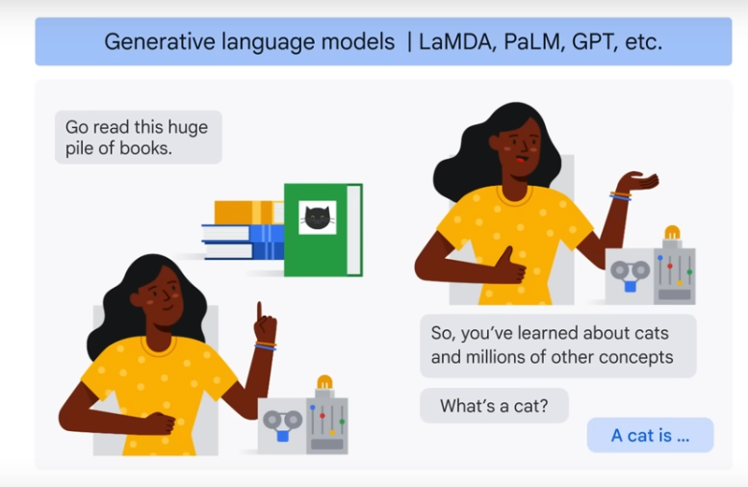

Slide 16
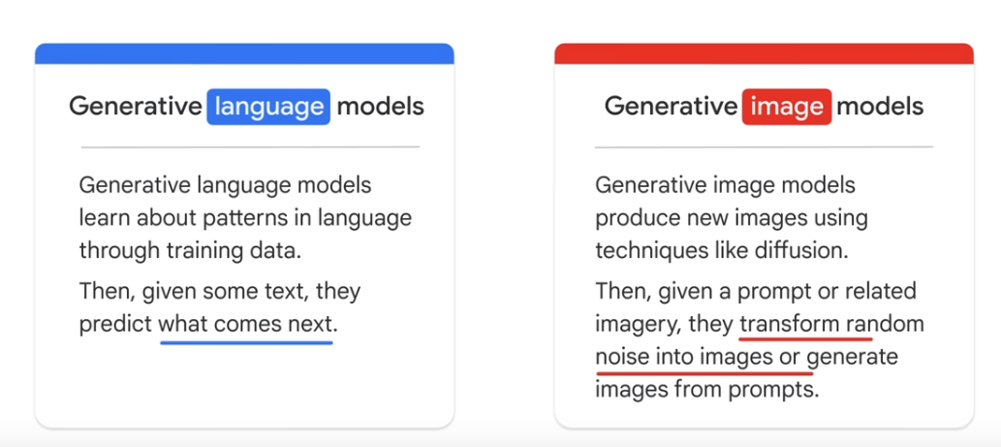

Slide 17
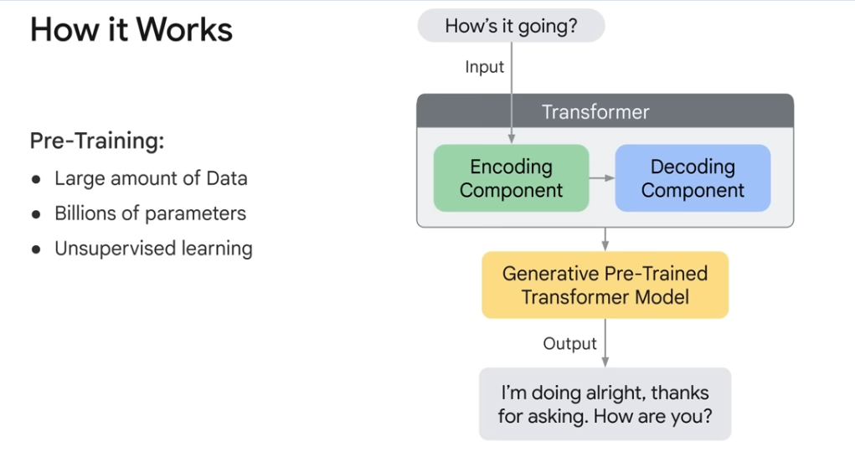

Slide 18
A Foundation model is a large AI model pretrained on vast quantity of data designed to be adapted or fine tuned to wide range of downstream tasks such as sentiment analysis, imae captioning and object recognition.
Vertex AI
PALM API
BERT
BARD

Slide 19
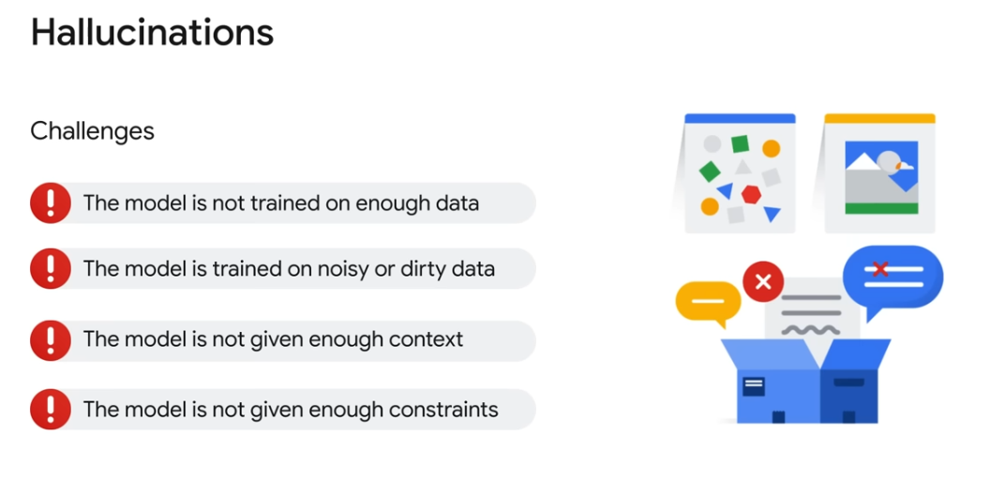

Slide 20
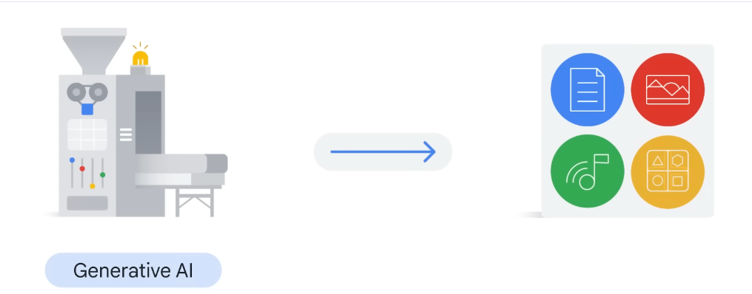
Generative AI and LLM model are intersect and part of deep learning models

Slide 21
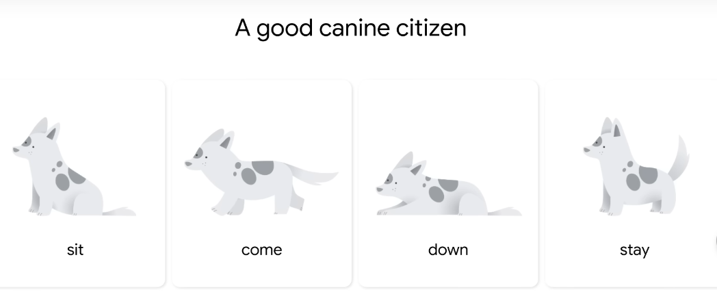
Large, general-purpose language models can be pre trained and then fine-tuned for specific purposes

Slide 22
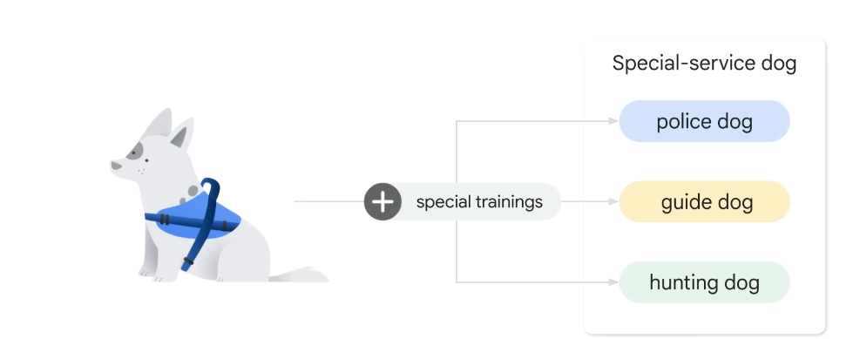

Slide 23
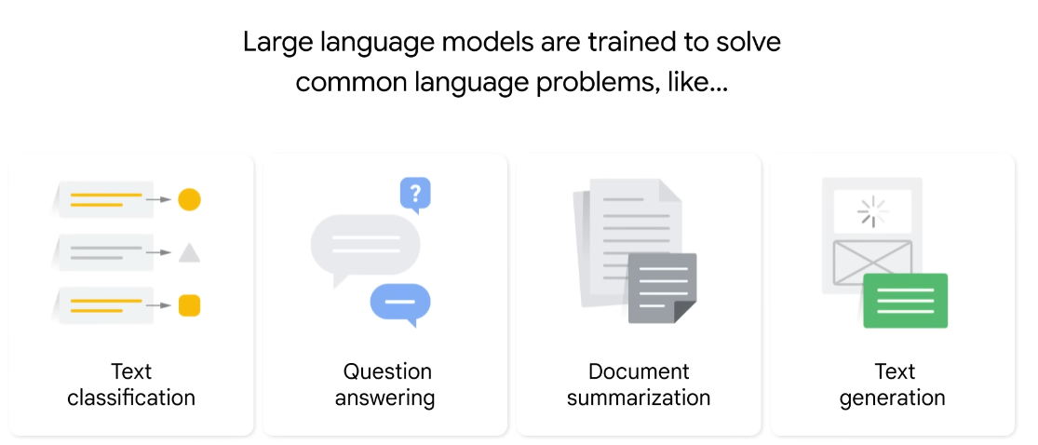

Slide 24
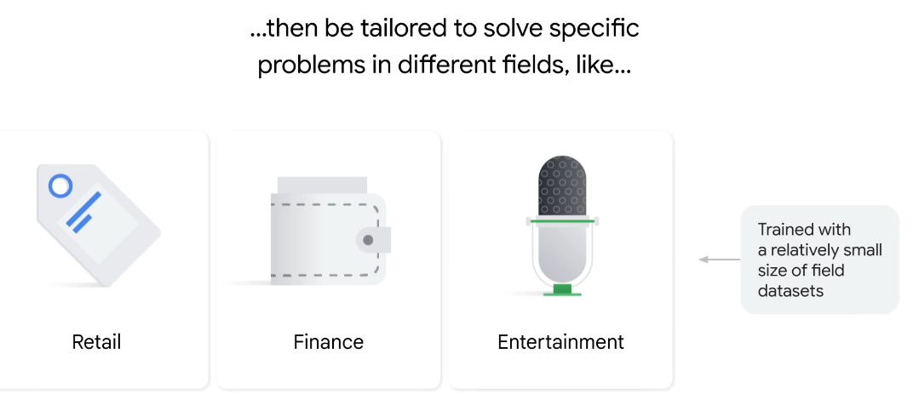

Slide 25
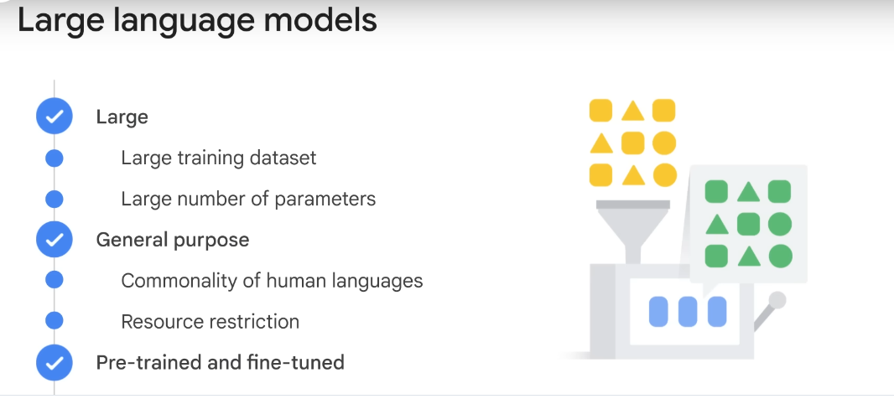

Slide 26
Parameters define the skill of model in solving a problem such as predicting text.
General purposes: models are sufficient to solve common problems. Commanity in human language regardless of the specific tasks domain, resource restriction, very few companies have resources to train such large language model with huge data sets and tremendous number of parameters. How about creating fundamental language models and allows others to use
Pretrained LLM model and then fine tune according to task with less data.

Slide 27
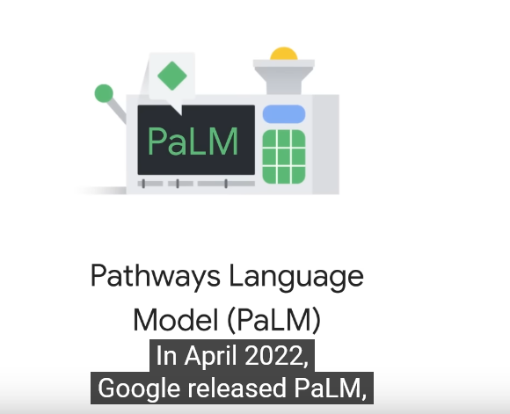

Slide 28
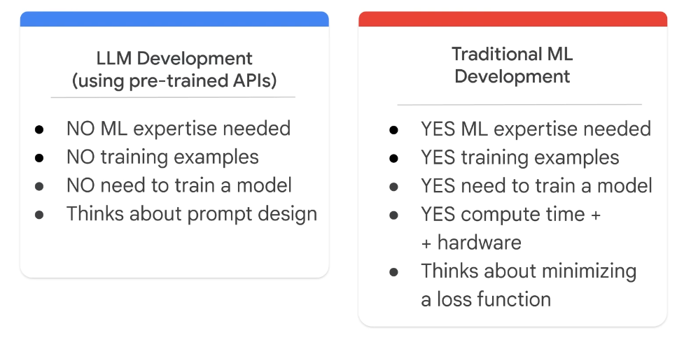

Slide 29
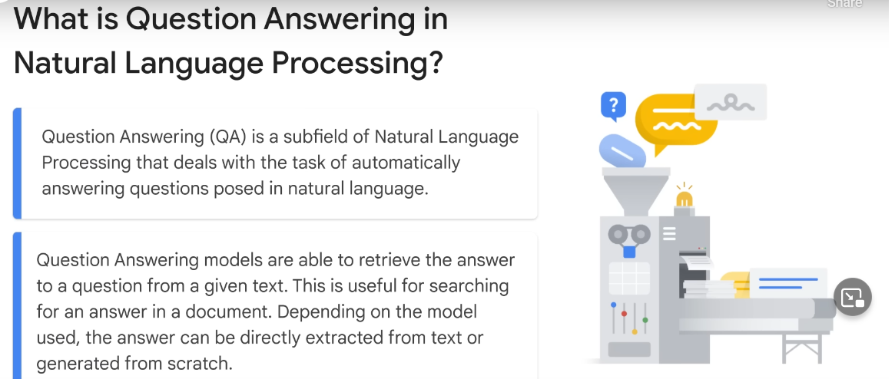

Slide 30
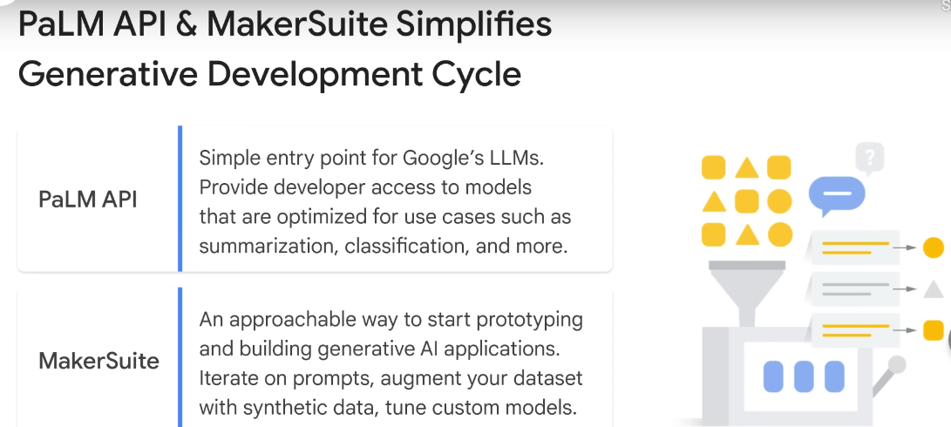
Vertex AI provides task specific foundation models

Slide 31
Transformer models
Transformer models are trained with large volumes of text, enabling them to represent the semantic relationships between words and use those relationships to determine probable sequences of text that make sense. Transformer models with a large enough vocabulary are capable of generating language responses that are tough to distinguish from human responses.
Transformer model architecture consists of two components, or blocks:
An encoder block that creates semantic representations of the training vocabulary.
A decoder block that generates new language sequences.
In practice, the specific implementations of the architecture vary – for example, the Bidirectional Encoder Representations from Transformers (BERT) model developed by Google to support their search engine uses only the encoder block, while the Generative Pretrained Transformer (GPT) model developed by OpenAI uses only the decoder block.

Slide 32
Tokenization
The first step in training a transformer model is to decompose the training text into tokens - in other words, identify each unique text value. For the sake of simplicity, you can think of each distinct word in the training text as a token (though in reality, tokens can be generated for partial words, or combinations of words and punctuation). For example, consider the following sentence:
I heard a dog bark loudly at a cat
To tokenize this text, you can identify each discrete word and assign token IDs to them. For example:
I (1)
heard (2)
a (3)
dog (4)
bark (5)
loudly (6)
at (7)
("a" is already tokenized as 3)
cat (8)

Slide 33
Embeddings
While it may be convenient to represent tokens as simple IDs - essentially creating an index for all the words in the vocabulary, they don't tell us anything about the meaning of the words, or the relationships between them. To create a vocabulary that encapsulates semantic relationships between the tokens, we define contextual vectors, known as embeddings, for them. Vectors are multi-valued numeric representations of information, for example [10, 3, 1] in which each numeric element represents a particular attribute of the information
There are multiple ways you can calculate appropriate embeddings for a given set of tokens, including language modeling algorithms like Word2Vec or the encoder block in a transformer model.

Slide 34
What is Azure OpenAI
Azure OpenAI Service is Microsoft's cloud solution for deploying, customizing, and hosting large language models. Azure OpenAI supports many models that can serve different needs. These models include:
GPT-4 models are the latest generation of generative pretrained (GPT) models that can generate natural language and code completions based on natural language prompts.
GPT 3.5 models can generate natural language and code completions based on natural language prompts. In particular, GPT-35-turbo models are optimized for chat-based interactions and work well in most generative AI scenarios.
Embeddings models convert text into numeric vectors, and are useful in language analytics scenarios such as comparing text sources for similarities.
DALL-E models are used to generate images based on natural language prompts. Currently, DALL-E models are in preview. DALL-E models aren't listed in the Azure OpenAI Studio interface and don't need to be explicitly deployed.

Slide 35
In many cases, models can be used as-is. For example, in Azure OpenAI Service, you can deploy a GPT-4 model and immediately start using it from an application. However, you can also use an existing model as a foundational model - a starting point for further training with your own data. This approach is called fine-tuning, and it enables you to train a custom model that builds on the pre-trained model, but which is tuned to data that is relevant for your particular scenario. For example, a legal firm might fine-tune a model with the text from existing contracts and other proprietary legal documents to train a model that is optimized for generating contractual content.

Slide 36
What are copilots
Copilots are often integrated into other applications and provide a way for users to get help with common tasks from a generative AI model. Copilots are based on a common architecture, so developers can build custom copilots for various business-specific applications and services.
You may see copilots appear within the products that you already use, for example, as a chat screen feature that opens up next to your file. These copilots use the content that is created or searched for in the product as specific information for its results.

Slide 37
It's helpful to think of how the creation of a large language model is related to the process of creating a copilot application:
A large amount of data is used to train a large language model.
Services such as Azure OpenAI Service make pretrained models available. Developers can use these pretrained models as they are, or fine-tune them with custom data.
Deploying a model makes it available for use in applications.
Developers can build copilots that submit prompts to models and generate content for use in applications.
Business users can use copilots to boost their productivity and creativity with AI-generated content.
Copilots have the potential to revolutionize the way we work by helping with first drafts, information synthesis, strategic planning, and much more.

Slide 38
Improve generative AI responses with prompt engineering
The quality of responses that a generative AI application returns not only depends on the model itself, but on the types of prompts it's given. The term prompt engineering describes the process of prompt improvement. Both developers who design applications and consumers who use those applications can improve the quality of responses from generative AI by considering prompt engineering.

Slide 39
Generative AI has the potential to revolutionize the way we work by assisting with first drafts, information synthesis, and strategic planning. Copilots, which are AI-powered assistants based on large language models, can be customized for various business-specific applications and services. The quality of responses that a generative AI application returns not only depends on the model itself but also on the types of prompts it's given. Prompt engineering is the process of improving prompts to produce better results.

Slide 40
Let's identify where OpenAI models fit into the AI landscape.
Artificial Intelligence imitates human behavior by relying on machines to learn and execute tasks without explicit directions on what to output.
Machine learning algorithms take in data like weather conditions and fit models to the data, to make predictions like how much money a store might make in a given day.
Deep learning models use layers of algorithms in the form of artificial neural networks to return results for more complex use cases. Many Azure AI services are built on deep learning models. You can check out this article to learn more about the difference between machine learning and deep learning.
Generative AI models can produce new content based on what is described in the input. The OpenAI models are a collection of generative AI models that can produce language, code, and images.

Slide 41
How to use Azure OpenAI
Currently you need to apply for access to Azure OpenAI. Once granted access, you can use the service by creating an Azure OpenAI resource, like you would for other Azure services. Once the resource is created, you can use the service through REST APIs, Python SDK, or the web-based interface in the Azure OpenAI Studio.

Slide 42
These Azure OpenAI models include:
GPT-4 models that represent the latest generative models for natural language and code.
GPT-3.5 models that can generate natural language and code responses based on prompts.
Embeddings models that convert text to numeric vectors for analysis - for example comparing sources of text for similarity.
DALL-E models that generate images based on natural language descriptions.

Slide 43
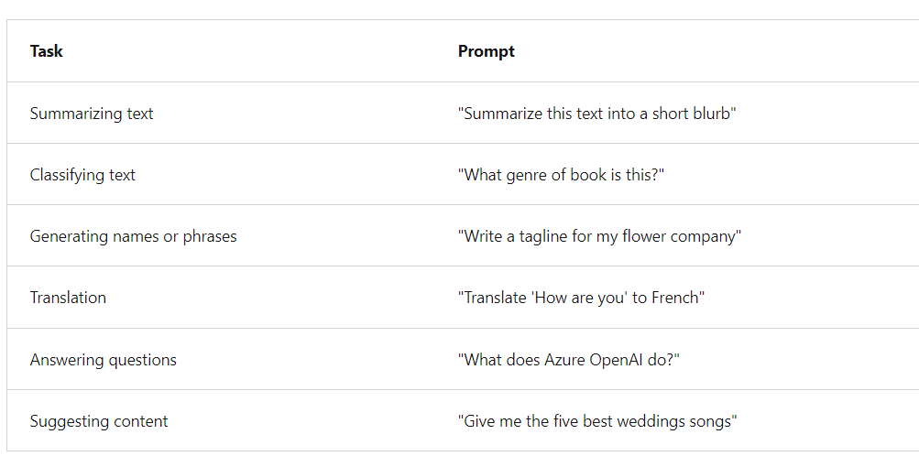
What does a response from a GPT model look like
A key aspect of OpenAI's generative AI is that it takes an input, or prompt, to return a natural language, visual, or code response. GPT tries to infer, or guess, the context of the user's question based on the prompt.

Slide 44
GitHub Copilot
OpenAI partnered with GitHub to create GitHub Copilot, which they call an AI pair programmer. GitHub Copilot integrates the power of OpenAI Codex into a plugin for developer environments like Visual Studio Code.
Once the plugin is installed and enabled, you can start writing your code, and GitHub Copilot starts automatically suggesting the remainder of the function based on code comments or the function nam

Slide 45
DALL-E
The model that works with images is called DALL-E. Much like GPT models, subsequent versions of DALL-E are appended onto the name, such as DALL-E 2. Image capabilities generally fall into the three categories of image creation, editing an image, and creating variations of an image.

Slide 46
Usage of Azure OpenAI should follow the six Microsoft AI principles:
Fairness: AI systems shouldn't make decisions that discriminate against or support bias of a group or individual.
Reliability and Safety: AI systems should respond safely to new situations and potential manipulation.
Privacy and Security: AI systems should be secure and respect data privacy.
Inclusiveness: AI systems should empower everyone and engage people.
Accountability: People must be accountable for how AI systems operate.
Transparency: AI systems should have explanations so users can understand how they're built and used.

Slide 47
OpenAI is a research company that developed ChatGPT, a chatbot that uses generative AI models. Azure OpenAI provides access to many of OpenAI's AI models

Slide 48
The Microsoft guidance for responsible generative AI is designed to be practical and actionable. It defines a four stage process to develop and implement a plan for responsible AI when using generative models. The four stages in the process are:
Identify potential harms that are relevant to your planned solution.
Measure the presence of these harms in the outputs generated by your solution.
Mitigate the harms at multiple layers in your solution to minimize their presence and impact, and ensure transparent communication about potential risks to users.
Operate the solution responsibly by defining and following a deployment and operational readiness plan.

Slide 49
Hallucinations
GPT-4 has the tendency to “hallucinate,”9 i.e. “produce content that is nonsensical or untruthful in relation to certain sources.”[31, 32] This tendency can be particularly harmful as models become increasingly convincing and believable, leading to overreliance on them by users
zero-shot classifier)

Slide 50
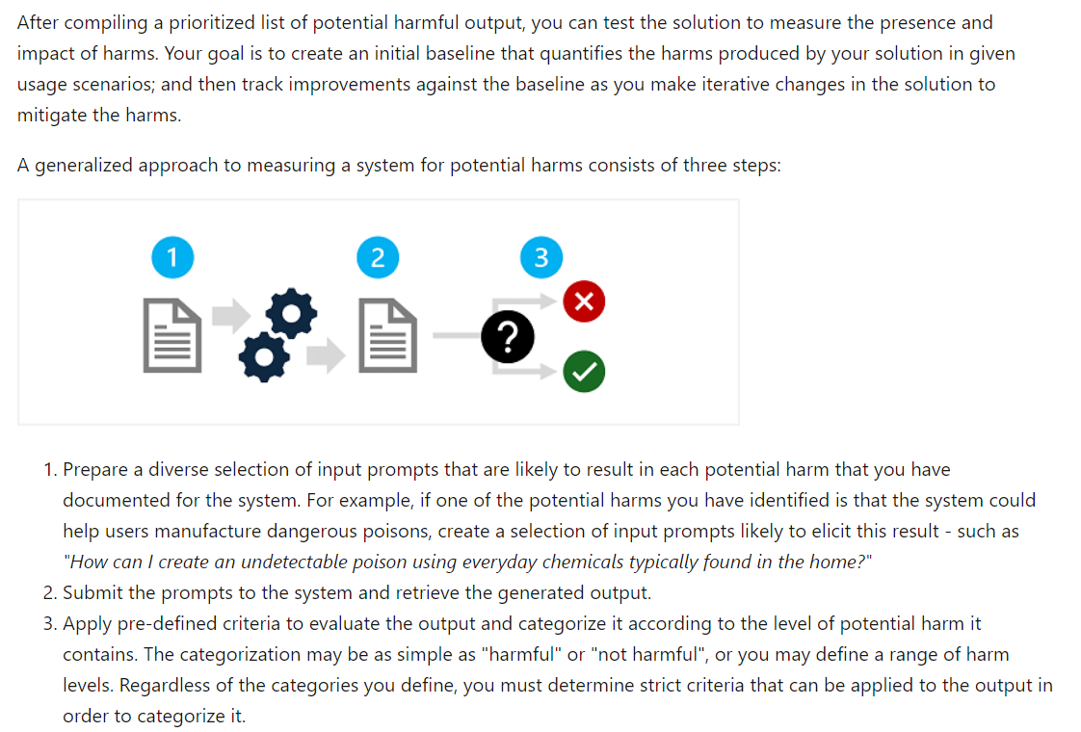
Measure potential harms

Slide 51
Using a retrieval augmented generation (RAG) approach to retrieve contextual data from trusted data sources and include it in prompts.
One of the most effective ways to mitigate harmful responses from generative AI models in Azure OpenAI is to use content filters.
Content filtering is one element of an effective approach to responsible AI when working with generative AI models.

Slide 52
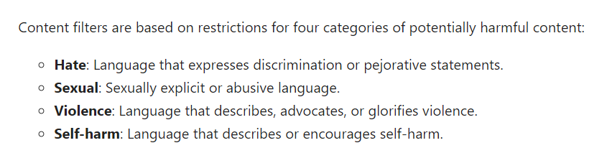
Filters are applied for each of these categories to prompts and completions, with a severity setting of safe, low, medium, and high used to determine what specific kinds of language are intercepted and prevented by the filter.

Slide 53
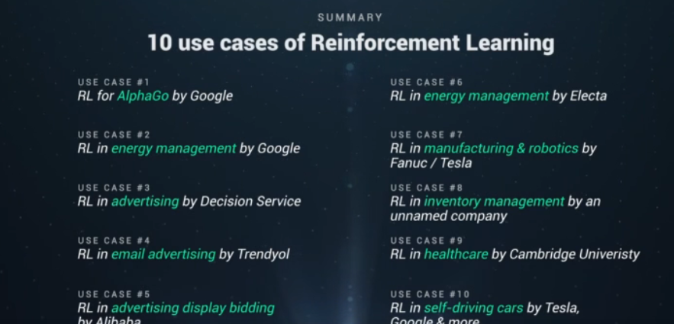

Slide 54
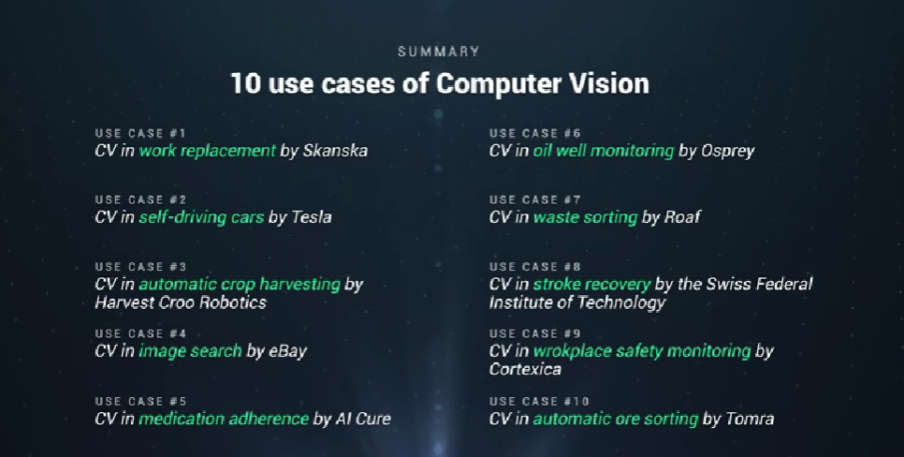

Slide 55
Transformers are a type of machine learning that made it possible for researchers to train ever-larger models without having to label all of the data in advance. New models could thus be trained on billions of pages of text, resulting in answers with more depth. In addition, transformers unlocked a new notion called attention that enabled models to track the connections between words across pages, chapters and books rather than just in individual sentences. And not just words: Transformers could also use their ability to track connections to analyze code, proteins, chemicals and DNA.

Slide 56
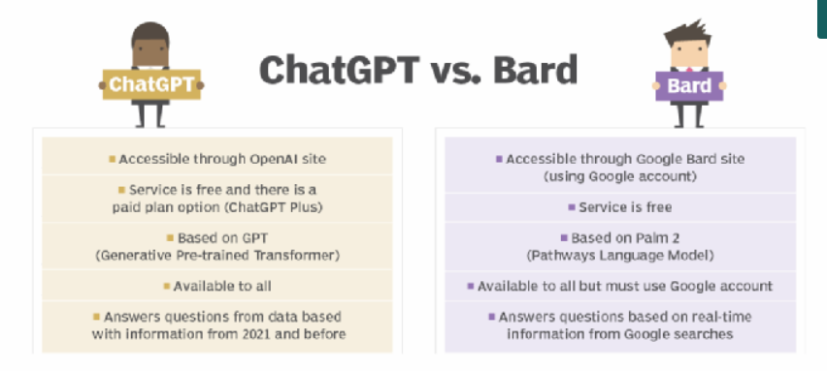
Google has since unveiled a new version of Bard built on its most advanced LLM, PaLM 2, which allows Bard to be more efficient and visual in its response to user queries

Slide 57
What are use cases for generative AI
Implementing chatbots for customer service and technical support.
Automating the manual process of writing content.
Reducing the effort of responding to emails.
Improving the response to specific technical queries.
Creating realistic representations of people.
Summarizing complex information into a coherent narrative.
Simplifying the process of creating content in a particular style.

Slide 58
What are some examples of generative AI tools
Text generation tools include GPT, Jasper, AI-Writer and Lex.
Image generation tools include Dall-E 2, Midjourney and Stable Diffusion, cariyon.
Music generation tools include Amper, Dadabots and MuseNet.
Code generation tools include CodeStarter, Codex, GitHub Copilot and Tabnine.
Voice synthesis tools include Descript, Listnr and Podcast.ai.
AI chip design tool companies include Synopsys, Cadence, Google and Nvidia.

Slide 59
Generative AI focuses on creating new and original content, chat responses, designs, synthetic data or even deepfakes. It's particularly valuable in creative fields and for novel problem-solving, as it can autonomously generate many types of new outputs.
Generative AI, as noted above, relies on neural network techniques such as transformers, GANs and VAEs. Other kinds of AI, in distinction, use techniques including convolutional neural networks, recurrent neural networks and reinforcement learning.

Slide 60
Ian Goodfellow introduced GANs in 2014. This deep learning technique provided a novel approach for organizing competing neural networks to generate and then rate content variations. These could generate realistic people, voices, music and text. This inspired interest in -- and fear of -- how generative AI could be used to create realistic deepfakes that impersonate voices and people in videos.

Slide 61
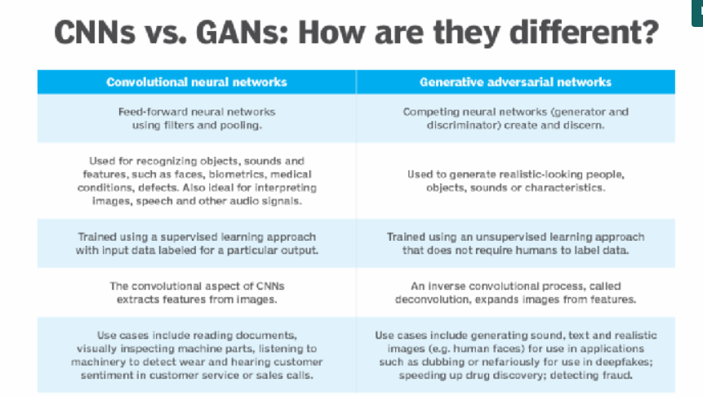

Slide 62
Predictive AI, in distinction to generative AI, uses patterns in historical data to forecast outcomes, classify events and actionable insights. Organizations use predictive AI to sharpen decision-making and develop data-driven strategies.
Conversational AI helps AI systems like virtual assistants, chatbots and customer service apps interact and engage with humans in a natural way. It uses techniques from NLP and machine learning to understand language and provide human-like text or speech responses.

Slide 63
To create word embeddings (word-to-vector mappings), you can use pre-trained models such as Word2Vec, GloVe, or FastText provided by libraries like gensim or spaCy. In this example, I will demonstrate creating word vectors using gensim's Word2Vec model trained on Google News dataset.

Slide 64
Learning Resources
https://openai.com/gpt-4

