Slide 1
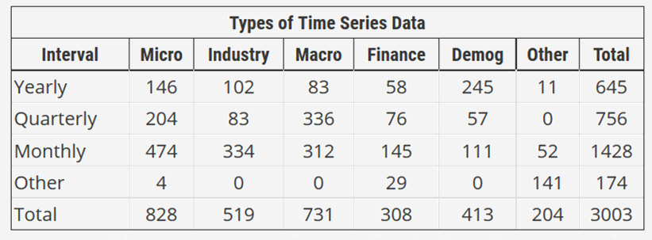
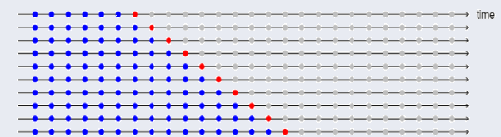
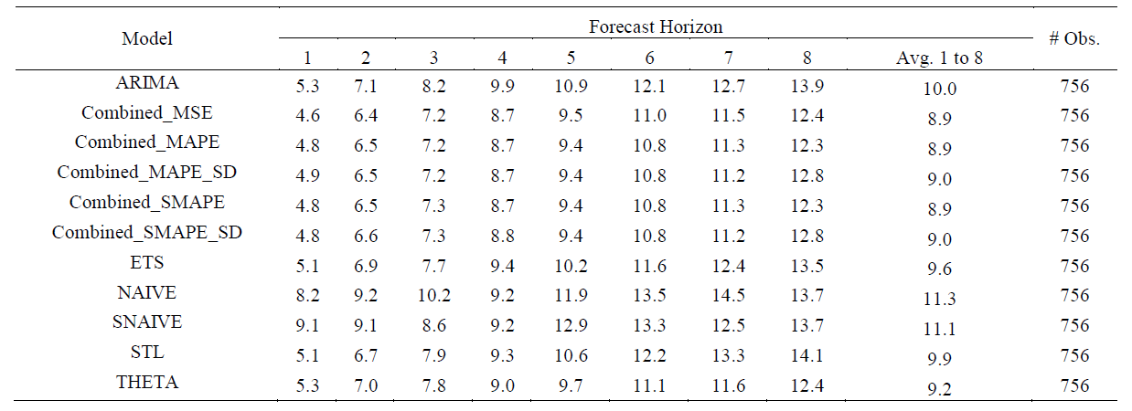
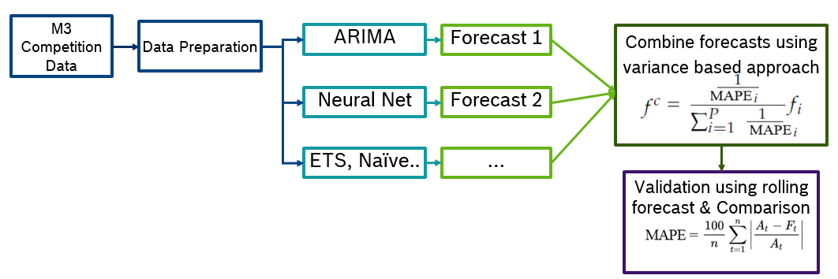
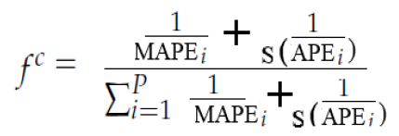
Ensemble of Time Series forecasting in Complex Structure
Balasubramanyam Pisupati, Shanu Agrawal
Project Overview
Results
Find a forecast model that performs best for all scenarios and in all forecast horizons.
Ensembling of forecasts using SMAPE & MAPE error calculated from rolling forecast approach.
As mentioned in methodology, variance based approach is used with MSE, SMAPE, MAPE with and without standard deviation to combine forecast.
To assign weight to each forecast model, errors are computed based on past six forecast of test data according to rolling forecast approach for monthly forecast.
This process is repeated for each horizon. We created 25 rolling forecast, to get equal number of test forecast for all horizons.
Once we get weight for each model, current training data forecast will be multiplied with weight to get combined forecast.
Combined forecast is calculated for Monthly, Quarterly and yearly data of M3-Competition.
Average SMAPE: M3 Competition Quarterly Data All Categories
Data
M3 Competition Data organized by International Institute of forecasters.
Solution Approach
In this paper for forecasting time series model like ARIMA, ETS, Naïve, Snaïve, Theta, STL are used as base models.
To check the efficiency of forecast model, the rolling forecast approach is used.
Then ensemble the rolling forecast from all models for each horizon better forecast on an overall using different approaches.
When forecast models have wide error variance above formula might not work, assign weight according to preciseness and reliability.
Conclusion
Ensembling of different forecast using SMAPE & and MAPE with or without SD is helpful to produce forecast that performs well for all scenarios/horizon.
Combined model adopts to the new forecast model as and when it observes the changes in behavior of time series.
People
Balasubramanyam Pisupati: Senior Manager, Bosch Centre for Artificial Intelligence
Shanu Agrawal : Data Scientist, Bosch Centre for Artificial Intelligence
Notes:
Able to change dynamically

