Slide 1
Base Statistics

Slide 2
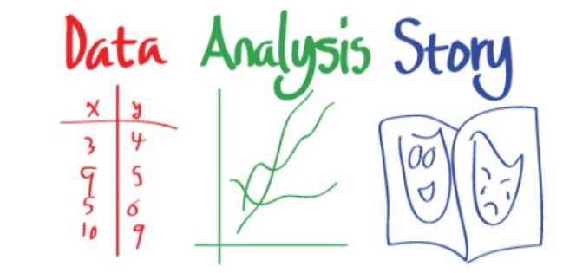
What is Analytics?
Obtain Good Data
Analyze
Turn into Human Readable format/insights

Slide 3
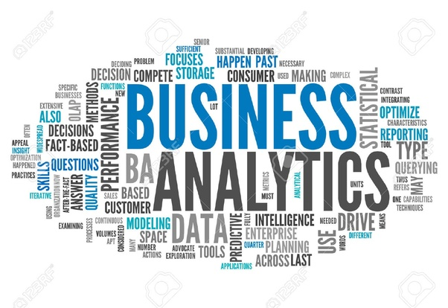
Applications
Health Care
Predict how long a patient will stay as soon as they are admitted
Predict what a patient has based on symptoms and past medical history
Manufacturing
Predict when a machine will need maintenance before it breaks down
Determine the reason behind failure
Banking
Loan default prediction from credit history
Location(Identifying best location for bank branch ATM)
Consumer
Pricing(Setting price for consumer and industrial goods)
Customer Segmentation(Identifying key customer groups in retail, insurance)
Notes:
Retailers, do in fact, routinely analyze their customers' transaction data. If you've ever used a shopper's loyalty card at your grocer, coffee shop, or another retailer, it is likely that your purchase data is being used for machine learning. Retailers use machine learning methods for advertising, targeted promotions, inventory management, or the layout of the items in the store.

Slide 4
Applications
Predict whether someone will have a heart attack on the basis of demographic, diet and clinical measurements.
Customize an email spam detection system.
Identify the numbers in a handwritten zip code.
Establish the relationship between salary and demographic variables in population survey data.
Automate traffic signals according to road conditions
Target advertising to specific types of consumers

Slide 5
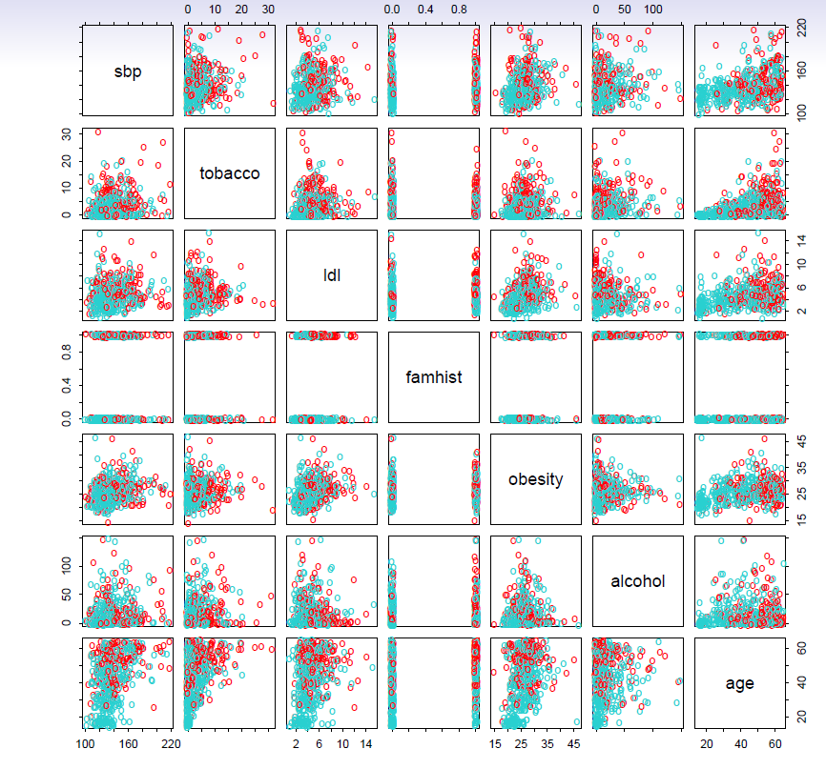

Slide 6
Applications
Predict whether someone will have a heart attack on the basis of demographic, diet and clinical measurements.
Establish the relationship between salary and demographic variables in population survey data.
Customize an email spam detection system.
Identify the numbers in a handwritten zip code.
Automate traffic signals according to road conditions
Target advertising to specific types of consumers

Slide 7
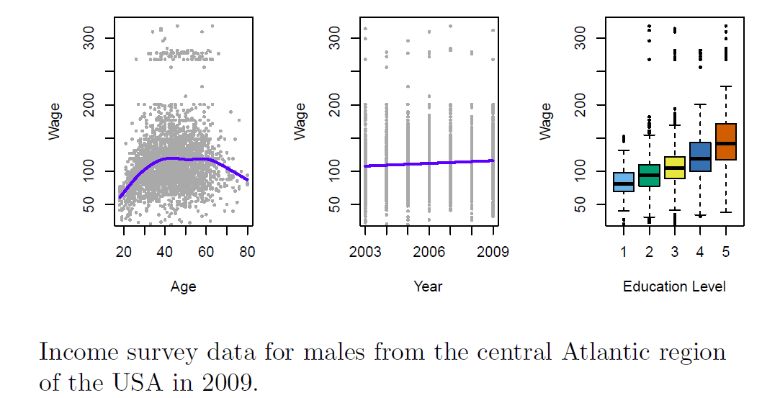

Slide 8
Applications
Predict whether someone will have a heart attack on the basis of demographic, diet and clinical measurements.
Establish the relationship between salary and demographic variables in population survey data.
Customize an email spam detection system.
Identify the numbers in a handwritten zip code.
Automate traffic signals according to road conditions
Target advertising to specific types of consumers

Slide 9
Problem
Imagine that you are interested in measuring the level of anxiety of college students during finals week in one of your courses.
You have 11 study participants rate their level of anxiety on a scale from 1 to 10, with 1 being 'no anxiety' and 10 being 'extremely anxious. You collect the ratings and review them.
The ratings are 8, 4, 9, 3, 5, 8, 6, 6, 7, 8, and 10. Your teacher asks you for a summary of your findings.
How do you summarize this data?

Slide 10
Descriptive Statistics
Summarize data into meaningful charts and reports
E.g. To analysis business performance, create charts related to budget, Sales, revenue or cost.
This will help managers to drill down and make queries like
How much did we sell in each region?
Which factory has the lowest productivity?
What was our revenue and profit last quarter?
How many and what kind of complaints we resolve?
Profit and loss trends
Notes:
Retailers, do in fact, routinely analyze their customers' transaction data. If you've ever used a shopper's loyalty card at your grocer, coffee shop, or another retailer, it is likely that your purchase data is being used for machine learning. Retailers use machine learning methods for advertising, targeted promotions, inventory management, or the layout of the items in the store.
Retailers, do in fact, routinely analyze their customers' transaction data. If you've ever used a shopper's loyalty card at your grocer, coffee shop, or another retailer, it is likely that your purchase data is being used for machine learning. Retailers use machine learning methods for advertising, targeted promotions, inventory management, or the layout of the items in the store.

Slide 11
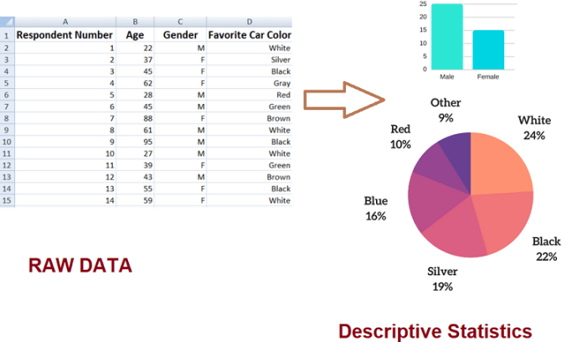
Measure of Central Tendency : Mean, Median, Mode
Measure of Spread : Variance, standard deviation
Clustering: customer Segments

Slide 12
How do they arrive at this conclusion?
Doctors believes that the average teen sleeps on average no longer than 10 hours per day
A company has started that their straw machine makes straws that are 4 mm diameter. A worker believes that the machine no longer makes straw of 4 mm diameter
The school board claims that at least 60% of students bring a phone to school

Slide 13
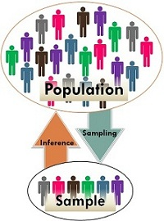
Inferential Statistics
It allows you to make inferences from that data. With inferential statistics, you take data from sample and make generalizations about a population.
For example, you might stand in a mall and ask a sample of 100 people if they like shopping at Levis.
You could make a bar chart of yes or no answers (that would be descriptive statistics) of the population (all shoppers in all malls)
Or you could use inferential statistics to reason that around 75-80% of the population like shopping at Levis taking multiple samples.
Hypothesis Testing

Slide 14
How to predict?
Find out whether someone will have a heart attack on the basis of demographic, diet and clinical measurements.
Establish the relationship between salary and demographic variables in population survey data.
Customize an email spam detection system.
Identify the numbers in a handwritten zip code.
Automate traffic signals according to road conditions

Slide 15
Predictive Statistics
Predict the future by examining historical data, detecting patterns and relationships, and extrapolating the relationships future in time.
Regression, Classification, forecasting
Predict apple sales on daily level for fruit shop
Predict the tree stress using leaf pressure and temperature sensor
Predict probability of loan default using loan amount, profession, education, gender

Slide 16
How to recommend?
Best price for Idly Sales in Restaurant?
Amount of cash to be stored in ATM
The optimal budget allocation for advertising combinations: TV, radio, and newspaper to maximize sales
Best route for fastest delivery
Influencing factors for product sales
Employee scheduling and supply chain designs
Optimization Problems
Prescriptive Statistics

Slide 17
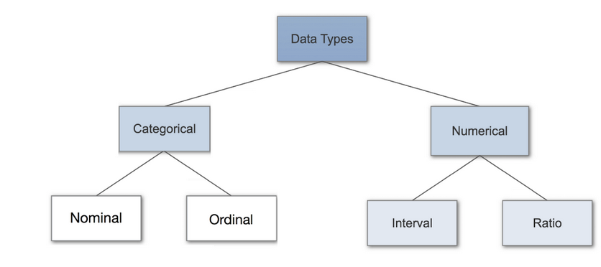
Data Types(measurement scales)
An important concept of statistics, which needs to be understood, to correctly apply statistical measurements to your data and therefore to correctly conclude certain assumptions about it.

Slide 18
Categorical Data
Categorical data represents characteristics, represent things like gender, language etc.
Categorical data can also take on numerical values (Example: 1 for female and 0 for male). Note that those numbers don’t have mathematical meaning.
Nominal Data

Slide 19
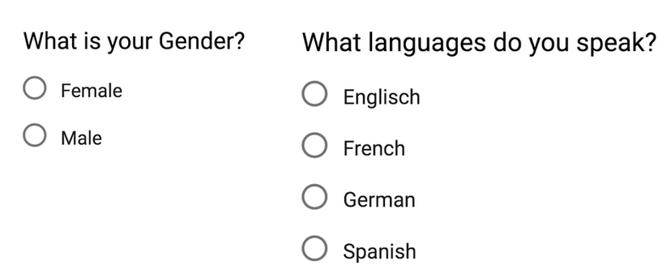
Nominal Data
Nominal values represent discrete units and are used to label variables, that have no quantitative value.
Just think of them as “labels”, data that has no order. Therefore if you would change the order of its values, the meaning would not change.
dichotomous

Slide 20
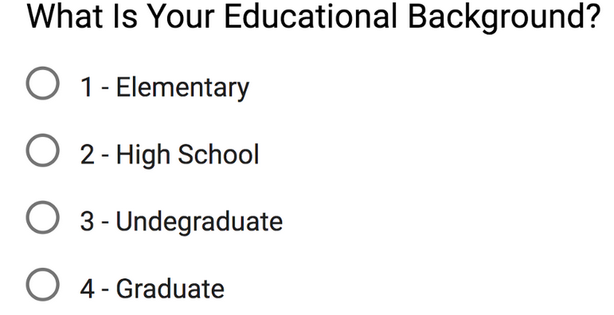
Ordinal Data
Ordinal values represent discrete and ordered units.
It is therefore nearly the same as nominal data, except that it’s ordering matters.

Slide 21
Numerical Data
Discrete Data
Values are distinct and separate, data can only take on certain values.
This type of data can’t be measured but it can be counted.
An example is the number of heads in 100 coin flips.
2. Continuous Data
Continuous Data represents measurements, values can’t be counted but they can be measured.
An example would be the height of a person, which you can describe by using intervals on the real number line.

Slide 22
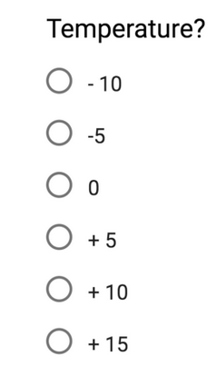
Interval Data
Interval values represent ordered units that have the same difference.
A variable contains numeric values that are ordered and where we know the exact differences between the values.
Problems:
Don’t have a “true zero”. to our example, that there is no such thing as no temperature.
We can add and subtract, but we cannot multiply, divide or calculate ratios. Because there is no true zero, a lot of descriptive and inferential statistics can’t be applied.

Slide 23
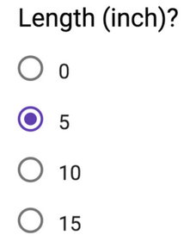
Ratio Data
Ratio values are also ordered units that have the same difference.
Ratio values are the same as interval values, with the difference that they do have an absolute zero.
Good examples are height, weight, length etc.
We can add and subtract, multiply, divide or calculate ratios.
Because there is true zero.
Notes:
https://towardsdatascience.com/data-types-in-statistics-347e152e8bee

Slide 24
A small Quiz!! – You get nothing if you win..
Example | Type of data
Classification of Departments- Eg – Marketing, Finance, HR, Operations | Nominal Data
Different suppliers | Nominal Data
Highest Educational Qualification | Ordinal Data
Cost incurred in Auto to travel from Silk board to Koramangala | Ratio Data
Time when to say Good morning/Afternoon or evening | Interval Data
Item Description | Nominal Data
Item Cost | Ratio Data
Order Date | Interval Data
Arrival Date | Interval Data
Quantity Ordered | Ratio Scale
The production quality rated from 1 to 5 | Ordinal Data
The ranking of top 10 students in a class | Ordinal Data
Vehicles classified as 2 wheeler, 4 wheeler, 8 wheeler | Nominal Data
No of wheels in a 2 wheeler, 4 wheeler, 8 wheeler | Ordinal Data

Slide 25
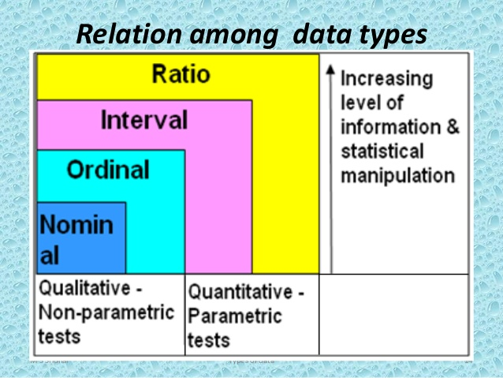
Why Data Types are important?
Datatypes are an important concept because statistical methods can only be used with certain data types.
You have to analyze continuous data differently than categorical data otherwise it would result in a wrong analysis.

Slide 26
Questions
Average weight of students in class
Average salary for data scientist
Average living cost in Bangalore
Average age group in party
Frequently used travel mode in Bangalore
Most popular laptop
Is there difference in color preference Pink/Blue between Male/Female

Slide 27
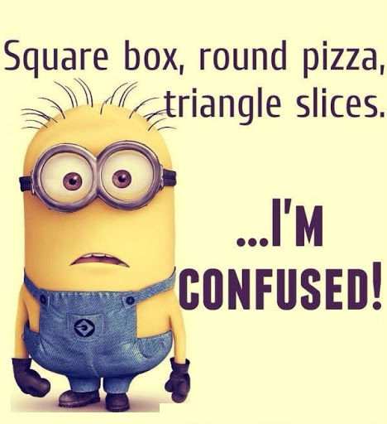
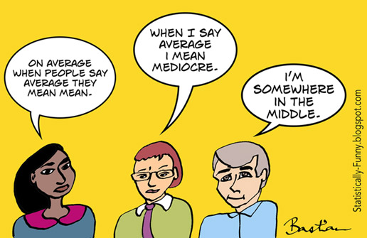
Where to start??
Categorical Data
Counts/frequency
Percentages
Crosstabs – Rows and Columns
Mode
Numerical Data- Most common way to summarize a numerical data is to describe where the center is:
Max, Min
Mean
Median, Quartile
Outliers – Numbers in a dataset that are
extremely high or low compared to the rest

Slide 28
Measures of Central Tendency
A measure of central tendency is a single value that attempts to describe a set of data by identifying the central position within that set of data
Mean: Add up the numbers and divide by how many numbers.
Example: The mean of 4, 1, and 7 is (4+1+7)/3 = 12/3 = 4
Median: The middle number; found by ordering all data points and picking out the one in the middle (or if there are two middle numbers, taking the mean of those two numbers).
Example: The median of 4, 1, and 7 is 4 because when the numbers are put in order (1, 4, 7) , the number 4 is in the middle.
Mode: The most frequent number—that is, the number that occurs the highest number of times.
Example: The mode of {Bus,Car, Car, Bike, Bike, Car} is Car because it occurs three times, which is more than any other transport.

Slide 29
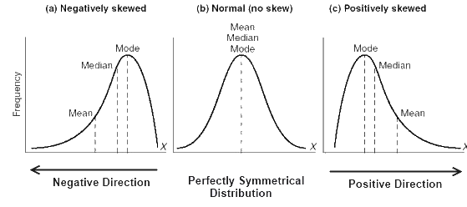
Empirical Relation Between Mean, Median And Mode
A distribution in which the values of mean, median and mode coincide (i.e. mean = median = mode) is known as a symmetrical distribution.
When values of mean, median and mode are not equal the distribution is known as asymmetrical or skewed distribution

Slide 30
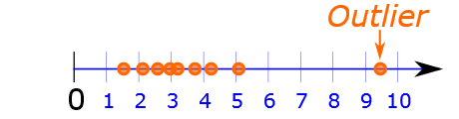
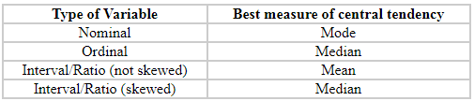
When to use what?
Mean:
An important property of the mean is that it includes every value in your data set as part of the calculation.
The mean is the only measure of central tendency where the sum of the deviations of each value from the mean is always zero.
The mean has one main disadvantage: it is particularly susceptible to the influence of outliers.
Median:
Not as strongly influenced by the outliers.
Time when we usually prefer the median over the mean (or mode) is when our data is skewed.
Mode:
Sometimes the mode is considered as being the most popular option.
Normally, the mode is used for categorical data where we wish to know which is the most common category
Problem with the mode is that it will not provide us with a very good measure of central tendency when the most common mark is far away from the rest of the data in the data set

Slide 31
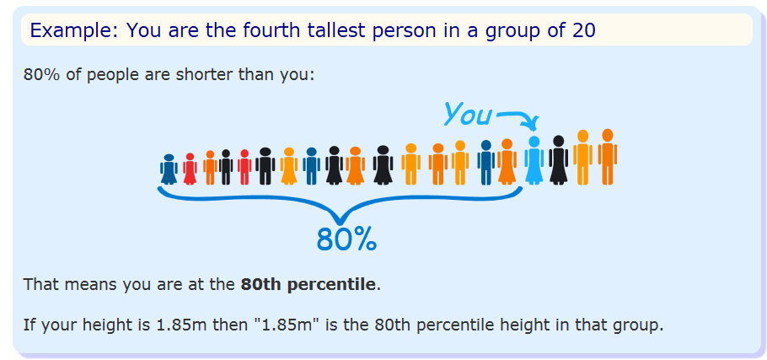
Percentile
Percentile: the value below which a percentage of data falls.
Example: Suppose the test scores were
22, 34, 68, 75, 79, 79, 81, 83, 84, 87, 90, 92 (12)
If your score was the 75, in what percentile did you score? – Ans 25 percentile
Which score will result in 60 percentile – Ans 83

Slide 32
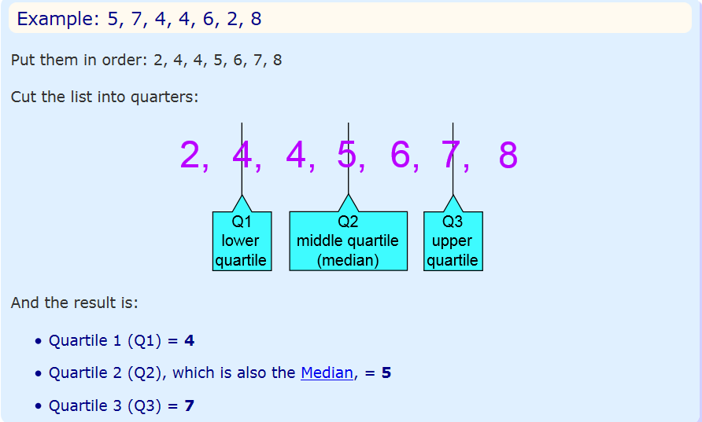
Quartile
Quartiles are the values that divide a list of numbers into quarters:
Put the list of numbers in order
Then cut the list into four equal parts
The Quartiles are at the "cuts"

Slide 33
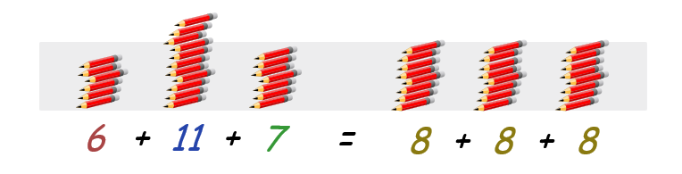
Problem
Two workers, on an average produce 8 pencils per day. And number of pencils produced the last 3 days given.
Which worker will you hire?

Slide 34
Problem
The scores of three batsman in the three matches played are as given below:
The average runs scored by all three is 100 runs.
If you have to pick only one batsman for the next match, which one will you pick and why??
 | Rohit Sharma | Virat Kohli | MS Dhoni
Match 1 | 5 | 95 | 50
Match 2 | 280 | 100 | 100
Match 3 | 15 | 105 | 150

Slide 35
Measure of Variability
Variability refers to amount of spread or variability within your data
There are four frequently used measures of variability:
Range,
Interquartile range
Variance
Standard deviation

Slide 36
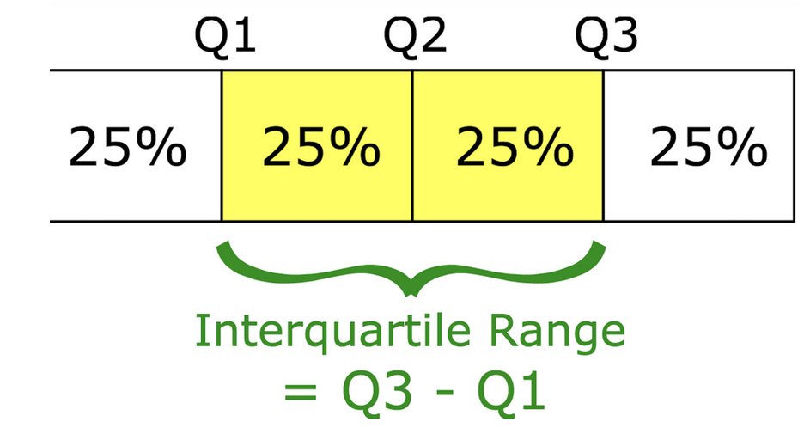
Measure of Variability
Range
Simplest measure of variability
Difference b/w highest score and lowest score
Lower the range, lower the variability in the data
Interquartile Range
Measure of statistical dispersion between upper (75th) and lower (25th) quartiles.

Slide 37
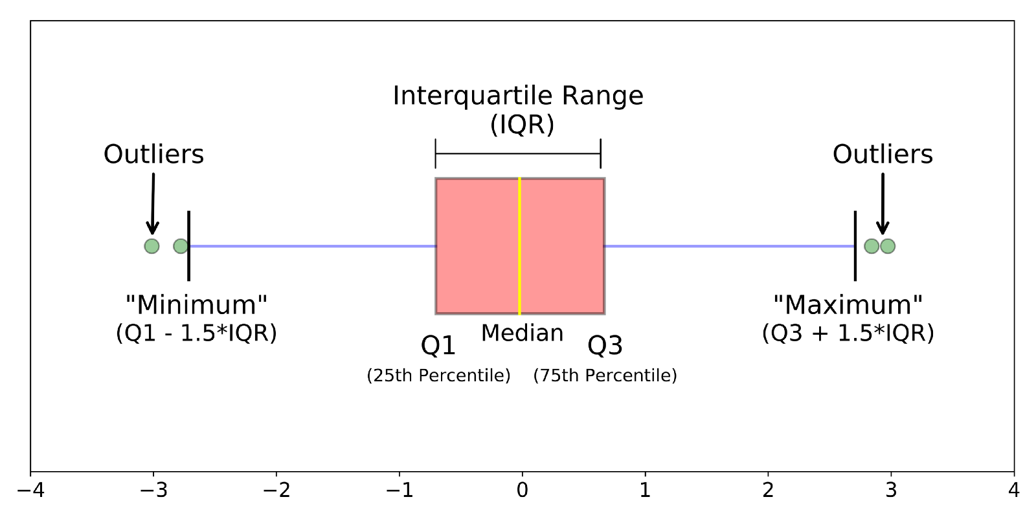
Boxplots are a standardized way of displaying the distribution of data based on a five number summary (“minimum”, first quartile (Q1), median, third quartile (Q3), and “maximum”).

Slide 38
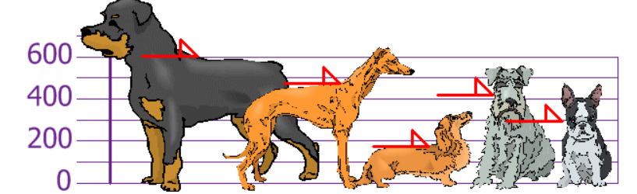
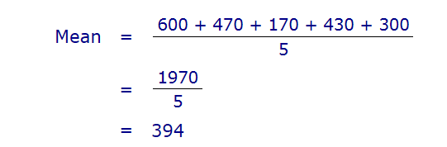
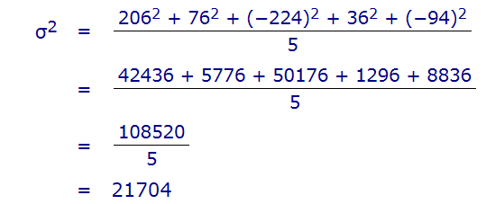
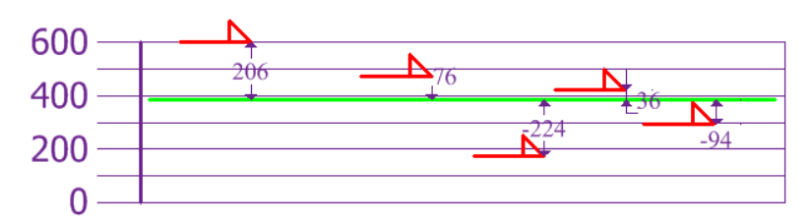
Variance
The average of the squared differences from the Mean
You and your friends have just measured the heights of your dogs (in millimeters):
The heights (at the shoulders) are: 600mm, 470mm, 170mm, 430mm, 300mm.
Notes:
https://www.mathsisfun.com/data/standard-deviation.html, The squares are used during the calculation because they weight outliers more heavily than points that are near to the mean.

Slide 39
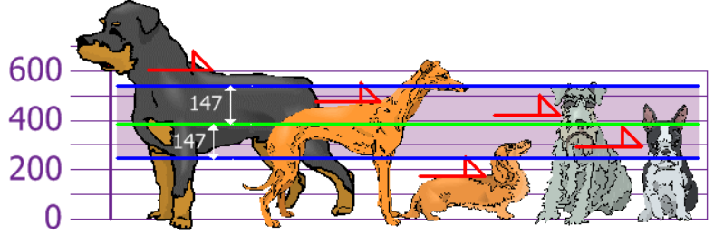
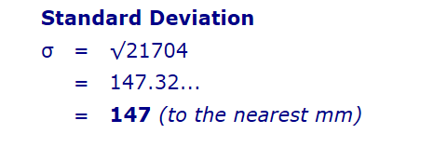
Standard deviation
The problem with Variance is that because of the squaring, it is not in the same unit of measurement as the original data.
Resolve using standard deviation the square root of Variance
So, using the Standard Deviation we have a "standard" way of knowing what is normal, and what is extra large or extra small.

Slide 40
Standard Deviation
Useful measure of variability when the distribution is normal or approximately normal
Standard deviation is also useful when comparing the spread of two separate data sets that have approximately the same mean
The data set with the smaller standard deviation has a narrower spread of measurements around the mean and therefore usually has comparatively fewer high or low values
An item selected at random from a data set whose standard deviation is low has a better chance of being close to the mean than an item from a data set whose standard deviation is higher.
Standard deviation is never negative.
Standard deviation is sensitive to outliers
If all values of a data set are the same, the standard deviation is zero
The standard deviation is expressed in the same units as the mean is, whereas the variance is expressed in squared units

Slide 41
In everyday life, we come across statements such as
It will probably rain today.
I doubt that he will pass the test.
Chances are high that the prices of diesel will go up.
There is a 50-50 chance of India winning a toss in today’s match.

Slide 42
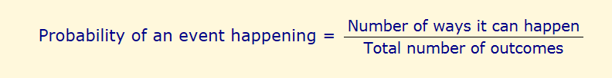
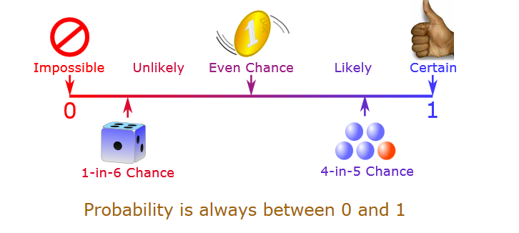
Probability
Many events can't be predicted with total certainty. The best we can say is how likely they are to happen, using the idea of probability.
Notes:
https://www.mathsisfun.com/data/probability.html
https://www.analyticsvidhya.com/blog/2017/09/6-probability-distributions-data-science/

Slide 43
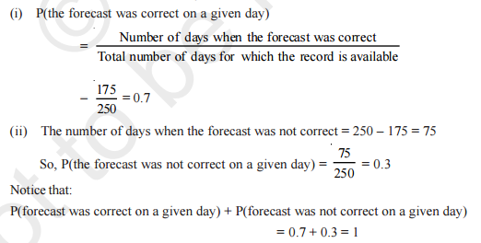
Example 1
The record of a weather station shows that out of the past 250 consecutive days, its weather forecasts were correct 175 times.
(i) What is the probability that on a given day it was correct?
(ii) What is the probability that it was not correct on a given day?

Slide 44

Example 2
A tyre manufacturing company kept a record of the distance covered before a tyre needed to be replaced. The table shows the results of 1000 cases
If you buy a tyre of this company, what is the probability that :
it will need to be replaced before it has covered 4000 km?
it will last more than 9000 km?
it will need to be replaced after it has covered somewhere between 4000 km and 14000 km?

Slide 45
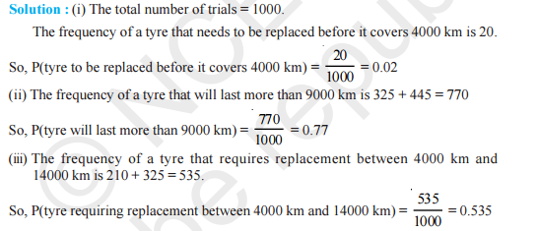
Example 2

Slide 46

Example 3
The percentage of marks obtained by a student in the monthly unit tests are given below
find the probability that the student gets more than 70% marks in a unit test.

Slide 47

Example 3

Slide 48
Example 4
An insurance company selected 2000 drivers at random (i.e., without any preference of one driver over another) in a particular city to find a relationship between age and accidents.
Age of Drivers (in Years) | Accidents in One year
 | 0 | 1 | 2 | 3 | Over 3
18-29 | 440 | 160 | 110 | 61 | 35
30-50 | 505 | 125 | 60 | 22 | 18
above 50 | 360 | 45 | 35 | 15 | 9
Find the probabilities of the following events for a driver chosen at random from the city
(i)being 18-29 years of age and having exactly 3 accidents in one year.
(ii) being 30-50 years of age and having one or more accidents in a year.
(iii) Having no accident in one year.

Slide 49
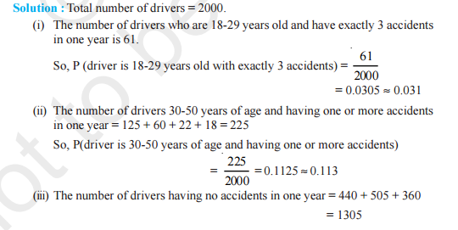

Example 4

Slide 50

Example 5
Fifty seeds were selected at random from each of 5 bags of seeds, and were kept under standardised conditions favourable to germination. After 20 days, the number of seeds which had germinated in each collection were counted and recorded
What is the probability of germination of
(i) more than 40 seeds in a bag?
(ii) 49 seeds in a bag?
(iii) more that 35 seeds in a bag?

Slide 51

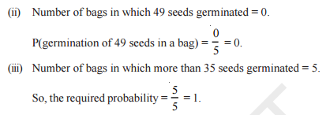
Example 5

Slide 52
Normal

Slide 53
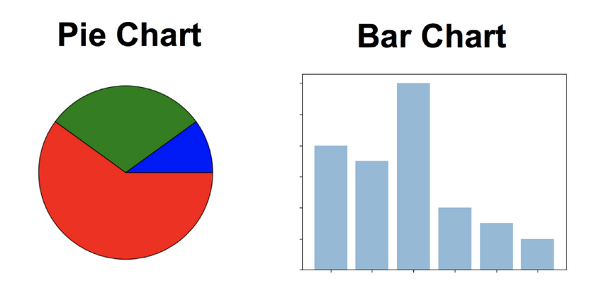
Nominal Data
Frequencies: The Frequency is the rate at which something occurs over a period of time or within a dataset.
Proportion/Percentage: You can easily calculate the proportion by dividing the frequency by the total number of events. (how often something happened divided by how often it could happen)

Slide 55
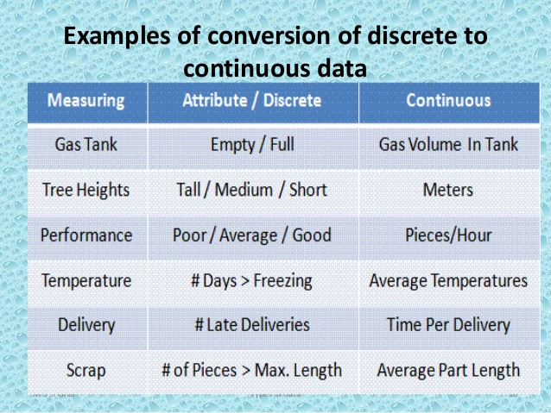
Types of Data
Numerical Data:
These data have meaning as a measurement, such as a person’s height, weight, IQ, or blood pressure
Or they’re a count, such as the number of stock shares a person owns
Can further be classified as:
Discrete Data
One that is derived from counting something
Continuous Data
Their possible values cannot be counted and can only be described using intervals on the real number line
Can be finite(Eg. No of heads in 100 coin flips)
Or infinite(No of flips to get 100 heads)
Eg. - lifetime of a battery, Time to come to class

Slide 56
2. Categorical Data:
Categorical data represent characteristics such as a person’s gender, marital status, hometown, or the types of movies they like.
Can have meaningless numerical values – Eg 1 for Pass, 0 for Fail
Could not perform mathematical operations

Slide 57
Based on type of measurement scale
Nominal Data
Categorized based on certain characteristics
E.g.- Gender, Geographical regions, Type of employees
Ordinal Data
Can be ordered or ranked based on relationship
Allows comparison
Interval Data
Are ordinal with a constant difference
Have arbitrary zero points
Ratio Data
Continuous
No quantitative relationship with one another
Can have meaningless numerical value
More meaningful than nominal
Does not quantify magnitude of difference
Eg – Quality rating to a restaurant, teams ranking
Eg. Temperature(cannot say 25 degree is twice as hot as 50 degree)
Allows meaningful comparison of ranges, avg and other stats
Have Natural zero
Eg- Rupees, Dist,

Slide 58
Scope of Business Analytics
Predictive Analytics
Seeks to predict the future by examining historical data
Detect patterns and relationships
Prescriptive Analytics
Descriptive Analytics
Uses data to understand past and current business trends
Categorize, Characterize, consolidate and classify data
Summarizes data to meaningful charts and reports
Eg – Revenue and profit charts of last year
Extrapolates
Answers questions like: What will happen if.. , What do we expect to pay… etc
Uses optimization to identify best alternatives
Eg- Predict sales of blue colored umbrella
Answers questions like: How much to produce to maximize profit.., Best route for delivery with minimum cost… etc
Helps to select the best option among many choices

Slide 59
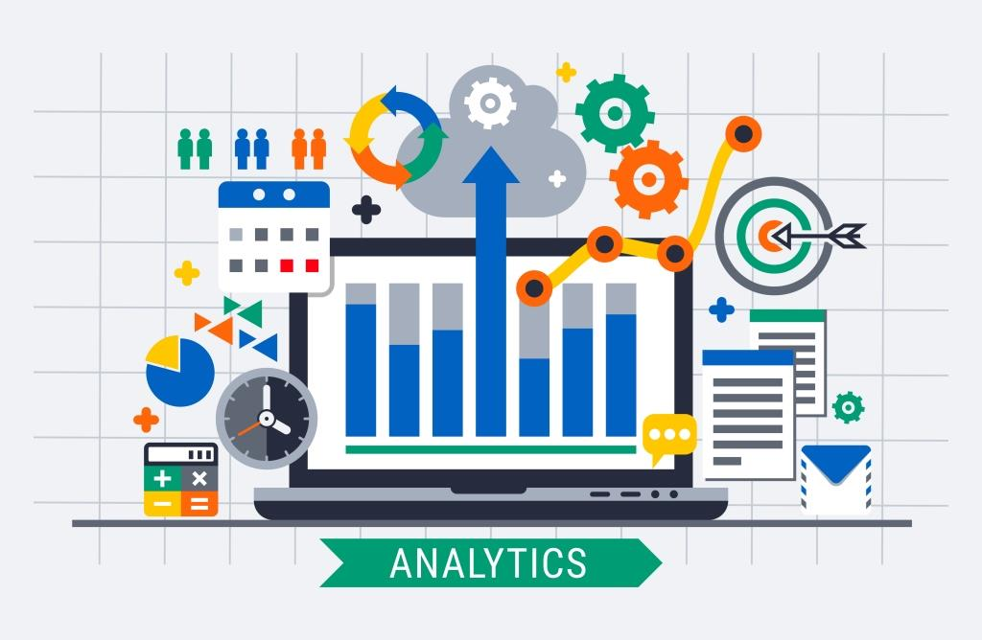
What is Analytics?
Analytics makes use of following to make decisions:
Data
Statistical analysis, quantitative methods
Mathematical or computer based models
Business Analytics is a process of transforming data into actions through analysis using various tools like MSexcel,SAS,Minitab.
Applications:
Pricing(Setting price for consumer and industrial goods)
Customer Segmentation(Identifying key customer groups in retail, insurance)
Location(Identifying best location for bank branch ATM)
Merchandising(Determining brands to buy, quantities)

Slide 60
Evolution of Business Analytics
Business Intelligence
Information Systems
Statistics
Comes into place due to massive data
Include basic tools of description, exploration, estimation and inference
Advanced techniques – Regression, Forecasting, Data Mining
Decision Support Systems:
Data Management
Model Management
Communication System

Slide 61
• Predict the outcomes of elections
• Identify and filter spam messages from e-mail
• Foresee criminal activity
• Automate traffic signals according to road conditions
• Produce financial estimates of storms and natural disasters
• Examine customer churn
• Create auto-piloting planes and auto-driving cars
• Identify individuals with the capacity to donate
• Target advertising to specific types of consumers
Retailers, do in fact, routinely analyze their customers' transaction data. If you've ever used a shopper's loyalty card at your grocer, coffee shop, or another retailer, it is likely that your purchase data is being used for machine learning. Retailers use machine learning methods for advertising, targeted promotions, inventory management, or the layout of the items in the store.

Slide 62
Dependent, Independent Variables
Independent variable
An independent variable is a variable that represents a quantity that is being manipulated in an experiment.
Dependent variables
A dependent variable represents a quantity whose value depends on how the independent variable is manipulated.
Work and salary
Height and Weight
No of hrs AC is switched on and electricity bill
For every mile you run, you burn 100 calories.

Slide 63
Cost Function
It is used to predict O/P at different levels of I/P
Eg 1:
A sunglass manufacturer is planning production of new varieties of sunglasses. For the first year, the fixed costs for setting up a new production line is 1.25 Lakhs. Variable cost for producing each piece of sunglasses are Rs 35. They plan to sell each @ 160 Rs.
Find the profit if 1100 pcs are sold
Find the break even point
Eg 2:
The management of Duralex Companies, a manufacturer of toys, has asked for a new cost study to improve next year’s budget forecasts. They pay rent of $300 a month and they pay an average of $30 a month for electricity. Each toy requires $5 in plastic and $2 in cloth.
How much will it cost them to manufacture 1200 toys annually?
How much will it cost them to manufacture 1500 toys annually?

Slide 64
Problem Solving with Analytics
Recognizing a problem
Structuring the problem
Analyzing the problem
Implementing results and making a decision
Implementing the solution
Defining the problem

Slide 65
Caution should be exercised when obtaining or analyzing data in order to avoid breaking laws, violating terms of service or data use agreements, abusing the trust, or violating privacy of the customers or the public.
Apart from the legal consequences, using data inappropriately may hurt your bottom line. Customers may feel uncomfortable or become spooked if aspects of their lives they consider private are made public. Recently, several high-profile web applications have experienced a mass exodus of users who felt exploited when the applications' terms of service agreements changed and their data was used for purposes beyond what the users had originally agreed upon.

