Slide 1
Base Analytics
Sampling
Shanu Agrawal

Slide 2
Example
Newspaper agency want to know the true approval rating of Narendra Modi?
Imagine if they have to ask every single Indian opinion.
It is impractical in this case, and in most situations.
Extremely expensive for the polling organization.
Need extremely large workforce to try and collect the opinions of every Indian.
Take many workers and many hours to organize, interpret, and display this information.
Even if it could be done in several months, by the time the results were published, it would be very probable that recent events had changed peoples’ opinions and that the results would be obsolete.

Slide 3
Example
Many manufacturing companies test their products for quality control.
A tyre manufacturer might use a machine to see how much air it can apply to the tyre before it brust.
If they did this with every tyre, they would have none left to sell!

Slide 4
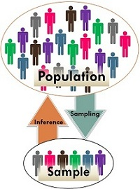
Comparison Chart
BASIS FOR COMPARISON | POPULATION (Census) | SAMPLE
Meaning | Population refers to the collection of all elements possessing common characteristics, that comprises universe. | Sample means a subgroup of the members of population chosen for participation in the study.
Includes | Each and every unit of the group. | Only a handful of units of population.
Characteristic | Parameter | Statistic
Data collection | Complete enumeration or census | Sample survey or sampling
Focus on | Identifying the characteristics. | Making inferences about population.
Mean | μ | x̅
Standard Deviation | σ | s
Notes:
https://keydifferences.com/difference-between-population-and-sample.html

Slide 5
Sampling Methods
Sampling Methods
Subjective Sampling
Probabilistic Sampling
Simple Random Sampling
Stratified Sampling
Systematic or Periodic Sampling
Cluster Sampling
Judgment Sampling
Convenience Sampling
Referral /Snowball Sampling
Sampling Methods can be either of the following:
Subjective Sampling:
Judgment Sampling – Expert judgment is used. - Selecting “best” customers
Convenience Sampling – Samples are selected based on ease with which data can be collected.
– All customers who visit this month
Notes:
Suppose your statistics teacher gave you an assignment to perform a survey of 20 individuals.
You would most likely tend to ask your friends and family to participate, because it would be easy and quick.
This is an example of convenience sampling, or convenience bias.
While it is not always true, your friends are usually people who share common values, interests, and opinions.

Slide 6
Probabilistic Sampling:
Simple Random Sampling - Every subset of a given size has an equal chance of being selected.
Systematic/Periodic Sampling – Selects every n^{th} item from population. Eg – Sampling orders received on every Sunday
Stratified Sampling – Population is divided into subsets(strata) and proportion of sample is selected from each strata. Eg – Sampling based on student Qualification
Cluster Sampling - Population is divided into subgroups(clusters), random sample of cluster and taking all data in that cluster
Snowball sampling: This technique is used in the situations where the population is completely unknown and rare. Therefore we will take the help from the first element which we select for the population and ask him to recommend other elements who will fit the description of the sample needed.
Sampling Methods
Subjective Sampling
Probabilistic Sampling
Simple Random Sampling
Stratified Sampling
Systematic or Periodic Sampling
Cluster Sampling
Judgment Sampling
Convenience Sampling
Referral /Snowball Sampling
Notes:
In continuous process can pick one or x items/samples at random times, or picking random number of items at frequent interval.

Slide 7
Risks in Sampling
Sampling Bias: Sample is called biased if it systematically favors some outcomes over others
Incorrect sampling frame (undercoverage):
The sampling frame is the term we use to refer to the group or listing from which the sample is to be chosen.
A sampling frame error occurs when some group from the population does not have the opportunity to be represented in the sample.
surveys are often done over the telephone.

Slide 8
Risks in Sampling
Size Bias:
One particular subgroup in a population is likely to be over-represented or under-represented due to its size
If we chose a state at random from a map by closing our eyes and pointing to a particular place, larger states would have a greater chance of being chosen than smaller ones.
Incorrect Response Bias
A major problem with surveys is that you can never be sure that the person is actually responding truthfully.
Might occur when asking questions about extremely sensitive or personal issues.
For example, a survey conducted about illegal drinking among teens
Even if guaranteed their responses are confidential, some teenagers may not want to admit to engaging in such behavior at all.
Notes:
A major problem with surveys is that you can never be sure that the person is actually responding truthfully. When an
individual intentionally responds to a survey with an untruthful answer, this is called incorrect response bias. This
can occur when asking questions about extremely sensitive or personal issues. For example, a survey conducted
about illegal drinking among teens might be prone to this type of bias. Even if guaranteed their responses are
confidential, some teenagers may not want to admit to engaging in such behavior at all. Others may want to appear
more rebellious than they really are, but in either case, we cannot be sure of the truthfulness of the responses.

Slide 9
Risks in Sampling
Non-Response Bias
One of the biggest problems in survey is that most people just don’t want to be bothered taking the time to respond to a poll of any kind.
They hang up on a telephone survey, put a mail-in survey in the recycling bin, or walk quickly past an interviewer on the street.
We just don’t know how much these individuals’ beliefs and opinions reflect those of the general population, and, therefore, almost all surveys could be prone to non-response bias.

Slide 10
Lesson Learnt
Because a census is so difficult to do, take a representative subset of the population, called a sample, to try and make conclusions about the entire population.
The downside to sampling is that we can never be completely sure that we have captured the truth about the entire population, due to random variation in our sample that is called sampling error.
Poor technique in surveying or choosing a sample can also lead to incorrect conclusions about the population that are generally referred to as bias.

Slide 11
Rupali wanted to know which brand of soccer shoe high school soccer players prefer. She decided to ask the girls on her team which brand they liked.
What is the population in this example?
Which group(s) from the population is/are going to be under-represented?
What type of bias best describes the error in her sample? Why?
If she asked all high school soccer players this question, what is the statistical term we would use to describe the situation?

Slide 12
Sampling Distribution
Suppose that we draw all possible samples of size n from a given population. Suppose further that we compute a statistic (e.g., a mean, proportion, standard deviation) for each sample.
The frequency/ probability distribution of this statistic is called a sampling distribution.

Slide 13
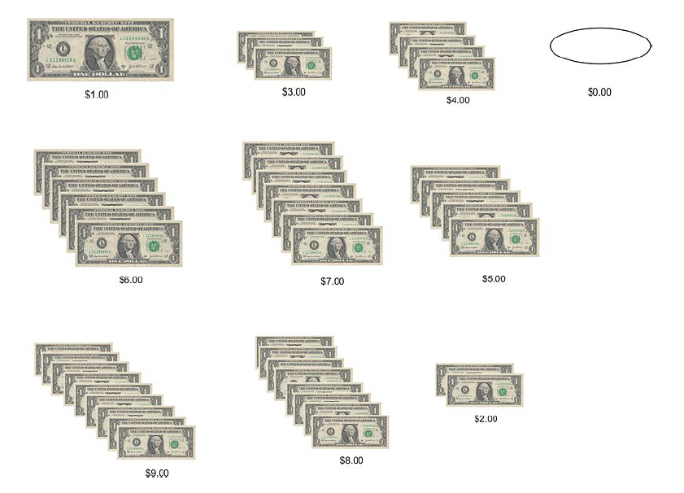
Example
We want to know how much cash people carry on average, in a very small population of people: 20 people on a busy street corner.
Suppose have from 0 dollar to 19 dollar
mean of $9.50.
Now lets take all possible combination of sample of size 2 from this population and calculate mean for each sample

Slide 14
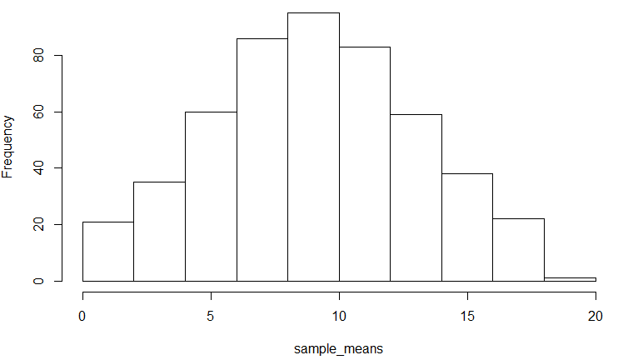
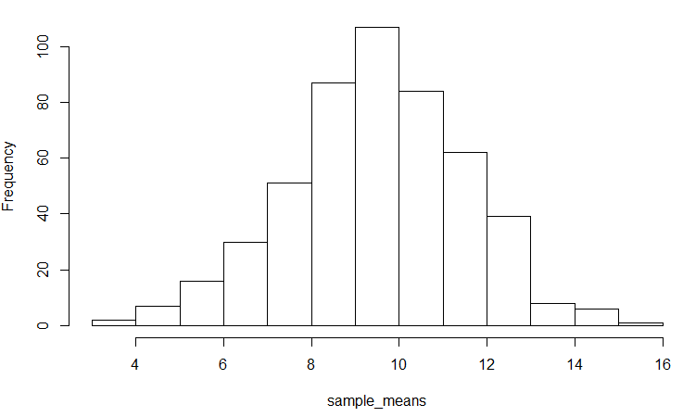
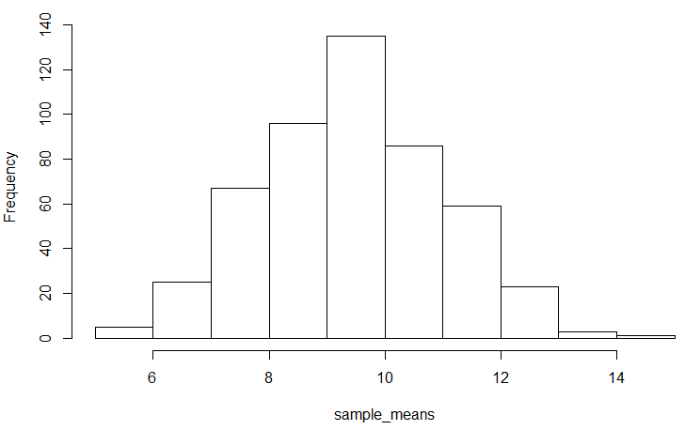
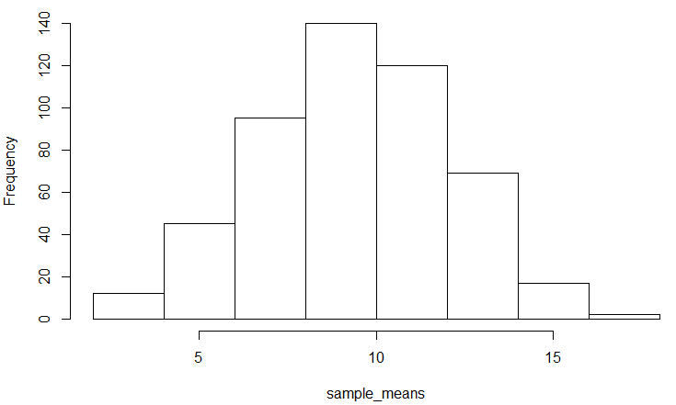
sample size =2 , #samples= 500
sample size =4 , #samples= 500
sample size =8 , #samples= 500
sample size =6 , #samples= 500

Slide 15
Sampling Distribution
The distribution of the dots on the graph is an example of a sampling distribution.
As can be seen, selecting a sample of one is not very good, since the range of sample means is anywhere from $0.00 to $19.00.
The true mean of $9.50 could be missed by quite a bit with any one given sample.

Slide 16
Impact of Sample Size
From the graphs above, it is obvious that increasing the sample size resulted in a sampling distribution of means that were more closely clustered around the true mean.
Also, the sampling distribution of the sample means is approximately normal, as can be seen by the bell shape in each of the graphs.
If a sample of size n=20 were selected, there would be only one possible sample, and it would yield the true mean of $9.50.
Variability of the sample means decreases as sample size increases.
This variability of sample means is called the standard error, s.

Slide 17
Sampling is an important tool for determining the characteristic of a population.
When we constructed a distribution of sample means, we saw that the sample means clustered around the true mean.
As the sample size increased, the shape of that distribution became more and more Normal.
Although the true mean of the population was unknown, random sampling yielded a reliable estimate.
Now learn, most remarkable theorems in statistics will allow us to estimate what is true in a population without having to repeatedly sample!

Slide 18
Central Limit Theorem
If you increase the sample size for a random variable, the distribution of the sample means approximates a normal distribution.
Here is what this theorem allows us to do:
If we select a single sample of a known size from our population and calculate its mean, we can use this sample mean to predict the true population mean with a defined degree of confidence.
This holds true no matter what the shape of the original distribution.

Slide 19
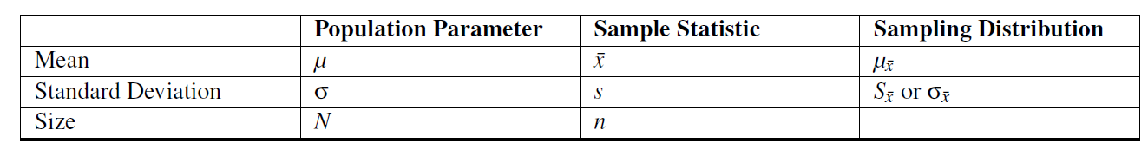
If you collect many samples from an ordinary random variable, and calculate the mean of each sample, then the means will be distributed in an approximate bell-curve, and the “mean of means” will be the same as the mean of the population.
The larger the size of the samples you collect, the more closely the distribution of their means will approximate a normal distribution.

Slide 20


Shape of the sampling distribution:
As long as your sample size is 30 or greater, you may assume the distribution of the sample means to be approximately normal. This is true regardless of the original distribution of the random variable.
The mean of the distribution:
The mean of a sampling distribution, is the mean of the population.
The standard error of the distribution:
The standard deviation of the sample means can be estimated by dividing the standard deviation of the population by the square root of the sample size.

Slide 21
Evan checked 123 online auction sellers to record their average asking price for his favorite game. According to a major nation price-checking site, the national average online auction cost for the game is $35.00 with a standard deviation of $3.00. Evan found the prices less than $34.86 on average. How likely is this result?

Slide 22
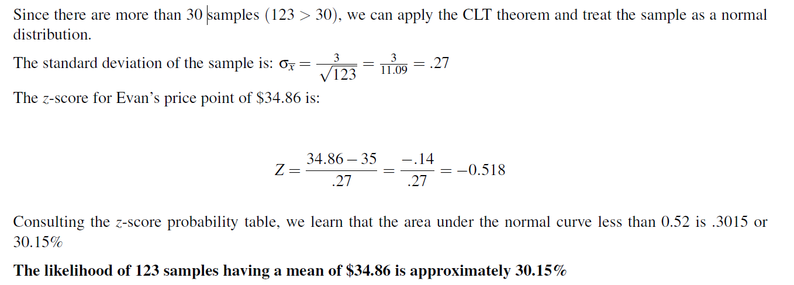

Slide 23
Porportion
The population proportion, p, is the proportion of individuals in the population that have a certain characteristic of interest based on a binomial random variable
The sample proportion is the number of individuals in the sample who have that characteristic of interest divided by the total sample size (n).
If you take a sample of 100 students and find 60 freshman, the sample proportion for freshman is 60/100 = 0.60.

Slide 24
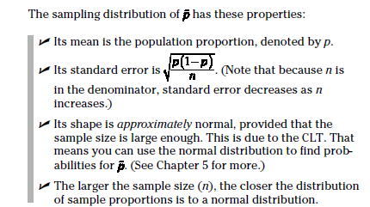

Slide 25
What is the average SAT was for students at a particular college. You asked a few students while visiting, and the sample mean was 1280.
Would you feel comfortable saying, "The average SAT at this school is 1280.“
There might be some sampling error involved.
The true average SAT may be somewhat higher or somewhat less.

Slide 26
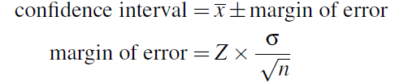
A confidence interval is the interval within which you expect to capture a specific value. The confidence interval width is dependent on the confidence level.
A confidence is the probability value associated with a confidence interval.
The margin of error is found by multiplying the standard error of the mean by the z-score of the percent confidence level

Slide 27
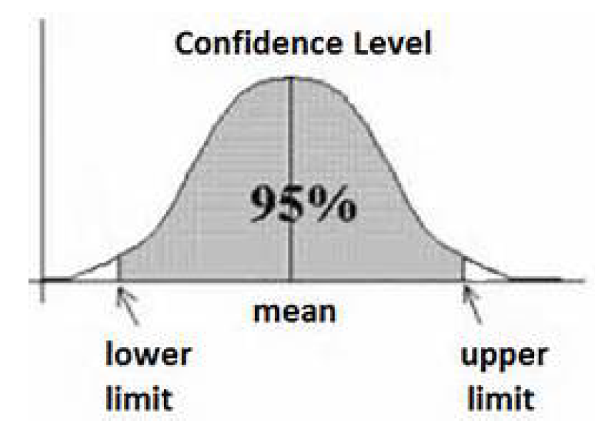
Common choices for the confidence level are 90%, 95%, and 99%.
The selection of a confidence level determines the probability that the confidence interval produced will contain the true parameter value.
The interval constructed with 99% confidence will have a higher chance of containing the true mean than an interval constructed with 95% confidence.
The more confidence in the interval, the wider it becomes.
This means that you’ve lost precision and this could be a problem.

Slide 28
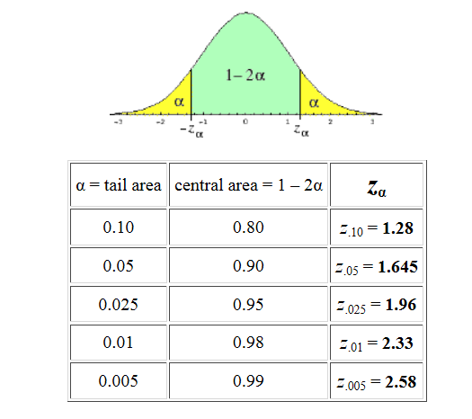
qnorm(0.90)
qnorm(0.10)

Slide 29
Suppose the average height of a sample of 100 women is 5’5’’, in other words, X =5’5’’. Within what range of heights can we expect the population mean to be, with 95% confidence? Assume a standard deviation for the population of 1.5’’.

Slide 30
A machine produces electrical components. 99.7% of the components have lengths between 1.176 cm and 1.224 cm. Assuming this data is normally distributed, what are the mean and standard deviation?
mean- 3SD= 1.176
Mean+3SD=1.224
Mean= (1.176+1.224)/2= 1.2 , SD= (1.224-1.176)/6= 0.008

Slide 31
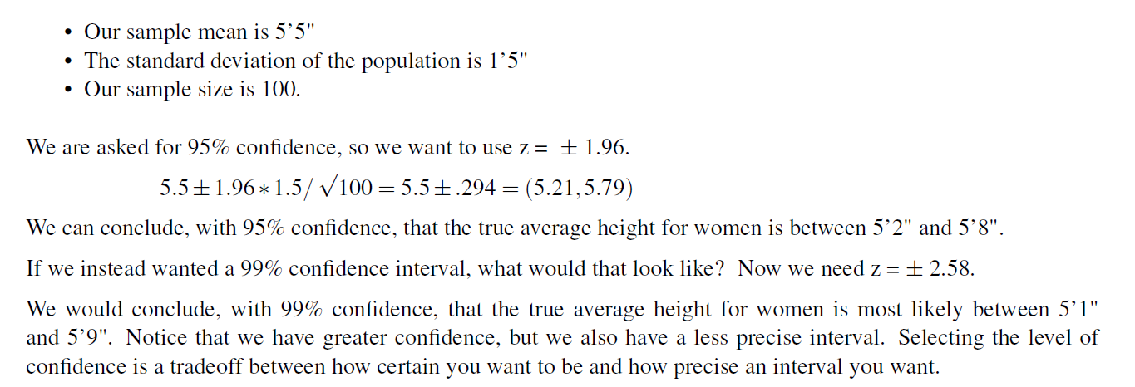

Slide 32
Suppose you had 40 samples of bags of candy, each of which contains some number of pieces. The number of pieces in each bag is said to be normally distributed. The mean number of candies in your sample is 38 pieces. The standard deviation for bags in the population is 2 pieces.
What is the average number of candies in each bag in the population?
To answer this question, you need to create a confidence interval. Let’s assume that you have been asked to report a confidence interval with 99% certainty.

Slide 33
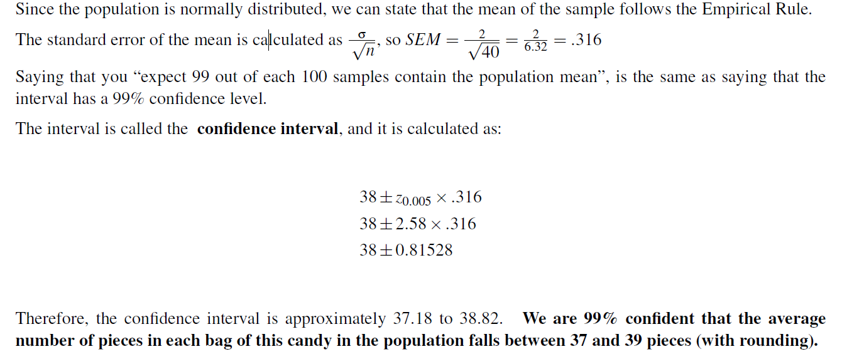

Slide 34
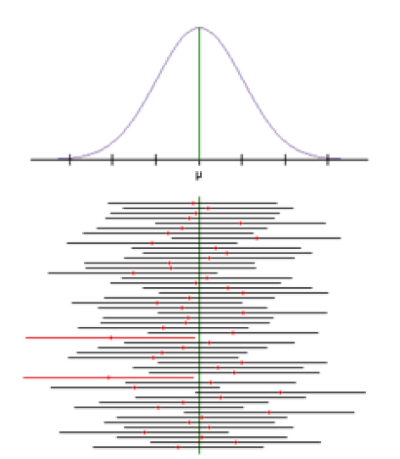
Interpretation of a Confidence Interval
Mistake made by persons interpreting a confidence interval is claiming that
a confidence level indicates the probability that the mean of the population will occur within your interval! This is not true.
Your interval either does - or does not - contain the true population mean.
A 95% confidence interval means is that if you took 100 samples, all of the same size, and formed 100 confidence intervals, 95 of these intervals would capture the population mean.
The probability is attributed to the method, not to any particular confidence interval. This means if you repeated this sampling procedure 100 times, 95 of the intervals produced would contain the population mean.
The confidence level indicates the number of times out of 100 that the mean of the population will be within the given interval of the sample mean.

