Slide 1
Hypothesis Testing

Slide 2
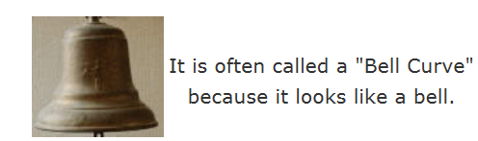
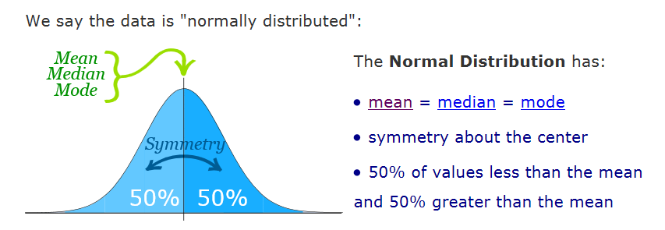
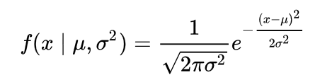
skewness is zero

Slide 3
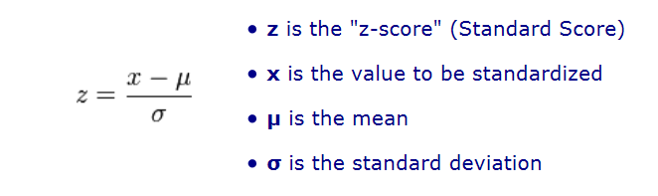
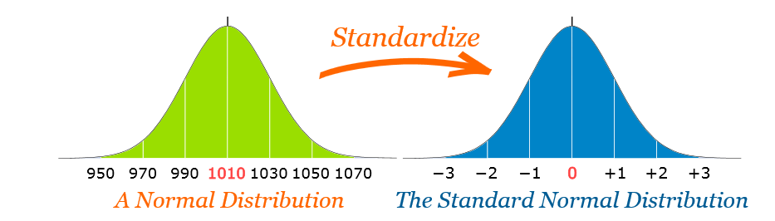
Standard Normal Distribution
Standard normal distribution is a special case of normal distribution where mean = 0 and S.D = 1
Convert a value to a Standard Score ("z-score"):
first subtract the mean, then divide by the Standard Deviation

Slide 4
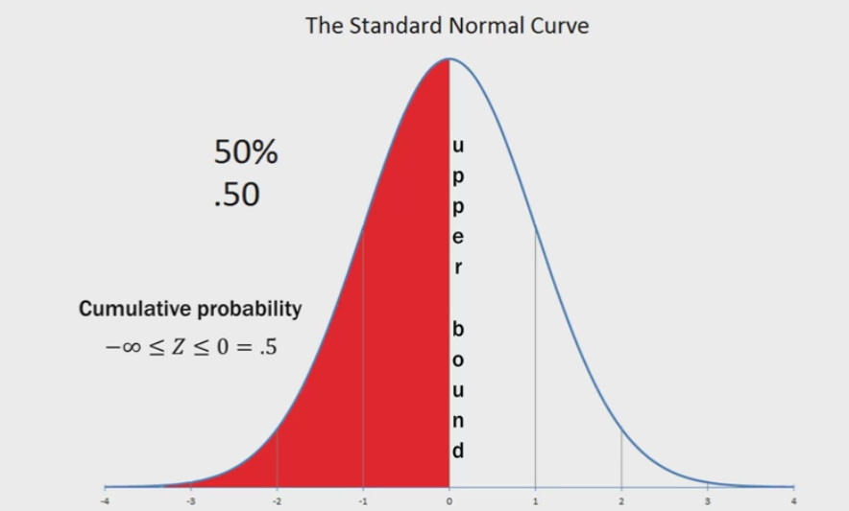
Points to Note
Area/cumulative for probability distribution is always 1.
A census was conducted at a university. All students were asked how many tattoos they had.
Tattoos | 0 | 1 | 2 | 3 | 4
Probability | .850 | .120 | .015 | .010 | .005

Slide 5
Calculate probability between P(-1.65 < Z ≤ 1.93)
P(1.93)= 0.9732
P(-1.65)= 1- P(1.65) = 1- 0.9505 =0.05
P(1.93)- P(-1.65)= 0.9732- 0.05 = 0.93
-1.65
1.93

Slide 6
Use the Standard Normal Distribution table to find
P(0 < Z ≤ 1)
P(-1.65 < Z ≤ 1.93)
P(0.85 < Z ≤ 2.23)
P(Z > 1.75)
P(Z ≤ -0.69)
P(-1.27 < Z ≤ 0).
P(Z > -2.64)
P(Z ≤ 0.96).

Slide 7
pnorm(x,mean,sd, lower.tail)
logical; if TRUE (default), probabilities are P[X ≤ x] otherwise, P[X > x].
This function gives the probability of a normally distributed random number to be less that the value of a given number. It is also called "Cumulative Distribution Function".
qnorm() : opposite of pnorm
This function takes the probability value and gives a number whose cumulative value matches the probability value.

Slide 8
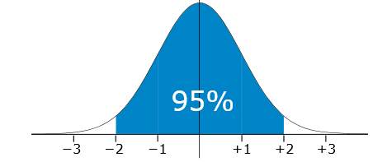
The Fresha Tea Company pack tea in bags marked as 250 g A large number of packs of tea were weighed and the mean and standard deviation were calculated as 255 g and 2.5 g respectively. Assuming this data is normally distributed, what percentage of packs are underweight?
P(X<250g)
Z= (250-255)/2.5 = -2
P(-2)= 2.5%
pnorm(x=250,mean=255,sd=2.5)

Slide 9
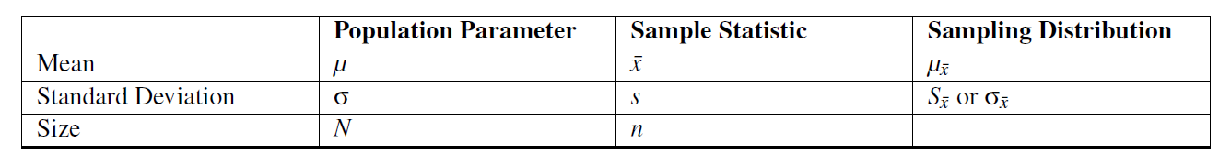
Sampling Distribution
It is a probability distribution of a statistic obtained through a large number of samples drawn from a specific population.
If you collect many samples from an ordinary random variable, and calculate the mean of each sample, then the means will be distributed in an approximate bell-curve, and the “mean of means” will be the same as the mean of the population.
The larger the size of the samples you collect, the more closely the distribution of their means will approximate a normal distribution.

Slide 10


Sampling Distribution
Shape of the sampling distribution:
As long as your sample size is 30 or greater, you may assume the distribution of the sample means to be approximately normal. This is true regardless of the original distribution of the random variable.
The mean of the distribution:
The mean of a sampling distribution, is the mean of the population.
The standard error of the distribution:
The standard deviation of the sample means can be estimated by dividing the standard deviation of the population by the square root of the sample size.
Notes:
https://www.spss-tutorials.com/sampling-distribution-what-is-it/

Slide 11
Central Limit Theorem
If you increase the sample size for a random variable, the distribution of the sample means/statistic approximates to a normal distribution.
And, more importantly, this holds true no matter what the shape of the original distribution. That’s pretty amazing.

Slide 12
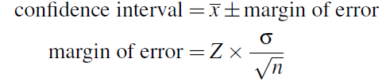
A confidence interval is the interval within which you expect to capture a specific value. The confidence interval width is dependent on the confidence level.
A confidence level is the probability value associated with a confidence interval.
A 95% confidence interval means is that if you took 100 samples, all of the same size, and formed 100 confidence intervals, 95 of these intervals would capture the population mean.

Slide 13
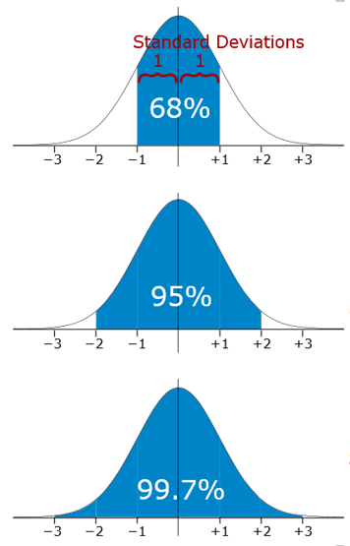
Empirical Rule
The empirical rule tells you what percentage of your data falls within a certain number of standard deviations from the mean:
likely to be within ~1 standard deviation (68 out of 100 should be)
very likely to be within ~2 standard deviations (95 out of 100 should be)
Z- Value= -1.96 to +1.96
almost certainly within ~3 standard deviations (997 out of 1000 should be)

Slide 14
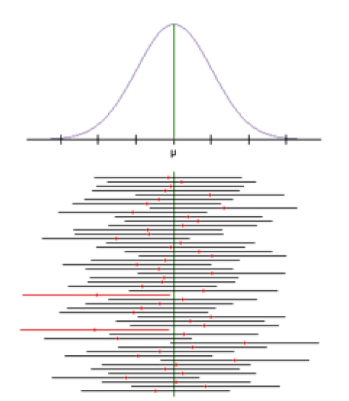
Interpretation of a Confidence Interval
Mistake made by persons interpreting a confidence interval is claiming that
a confidence level indicates the probability that the mean of the population will occur within your interval! This is not true.
Your interval either does - or does not - contain the true population mean.
A 95% confidence interval means is that if you took 100 samples, all of the same size, and formed 100 confidence intervals, 95 of these intervals would capture the population mean.

Slide 15
Hypothesis testing is an act in statistics whereby an analyst tests an assumption regarding a population parameter.
The methodology employed by the analyst depends on the nature of the data used and the reason for the analysis.
It performed on sample data from a larger population.

Slide 16

Hypothesis Testing Procedure
1. State the null and alternative hypotheses.
2. Select the appropriate significance level, find the critical value and check the test assumptions.
3. Analyze the data and compute the test statistic /p-value
4. Examine your test value /p value and make our decision
Do you remember me???

Slide 17
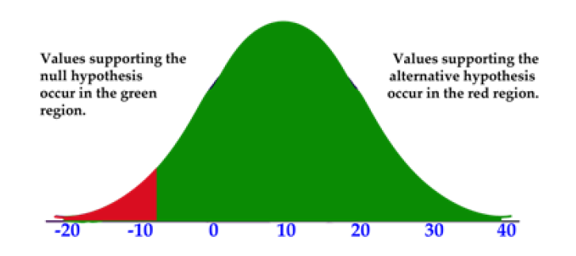
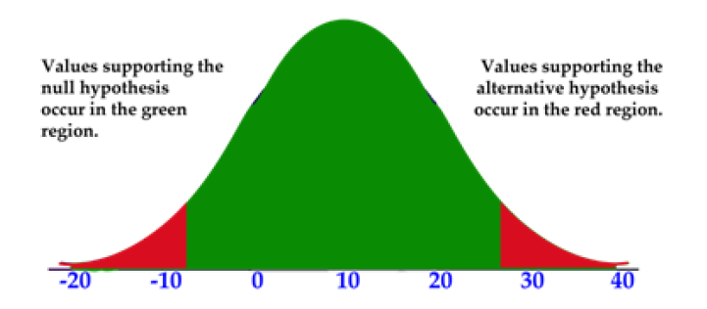
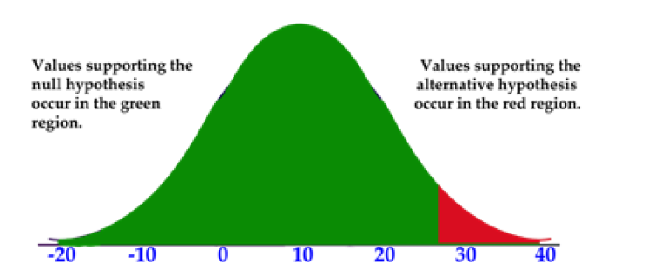
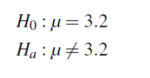
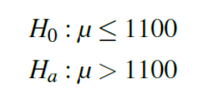

Hypothesis Tests and Their Tails
Lower/left tailed
two tailed
upper/right tailed

Slide 18
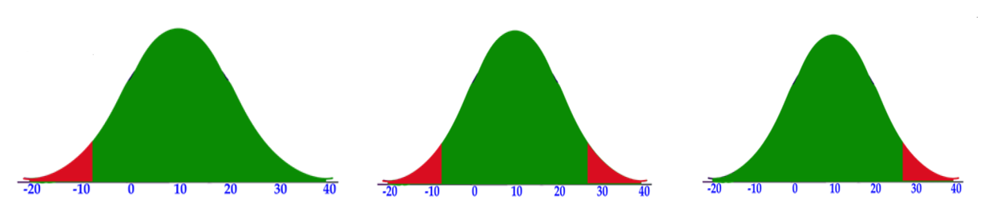
How to calculate critical value?
For 0.05 level of significance
0.05
0.025
0.05
0.025
t.test(my_data$weight, mu = 25, alternative = "less")
t.test(my_data$weight, mu = 25, alternative = “two.sided")
t.test(my_data$weight, mu = 25, alternative = “greater")

Slide 19
P-Values
“What is the probability of obtaining the value of the test statistic we did if the null hypothesis is true?”
This is called the p− value.
Probability that it will lie in null hypothesis interval.

Slide 20
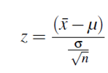

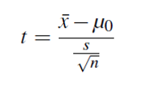
How to decide on test?
When the population standard deviation is known use z test
If unknown use t-test
T- test , we calculate degree of freedom (sample size-1)
T-test becomes similar to z-test if sample size increases
Notes:
https://stattrek.com/sampling/sampling-distribution.aspx

Slide 21
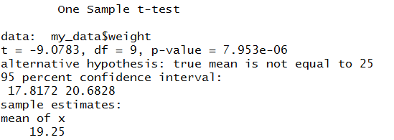
Data set containing the weight of 10 mice.
We want to know, if the average weight of the mice differs from 25g?
set.seed(1234)
my_data <- data.frame( name = paste0(rep("M_", 10), 1:10), weight = round(rnorm(10, 20, 2), 1))
#We want to know, if the average weight of the mice differs from 25g (two-tailed test)?
# One-sample t-test
t.test(my_data$weight, mu = 25, alternative = “two-sided")
In R the p-value is addition of both the tails/ critical region

Slide 22
#if you want to test whether the mean weight of mice is less than 25g (one-tailed test), type this:
t.test(my_data$weight, mu = 25, alternative = "less")
#Or, if you want to test whether the mean weight of mice is greater than 25g (one-tailed test), type this:
t.test(my_data$weight, mu = 25, alternative = "greater")

Slide 23
We wanted to test a hypothesis about the effect of two medications on curing an illness.
We may want to test the difference between the means of males and females on the spending in shopping

Slide 24
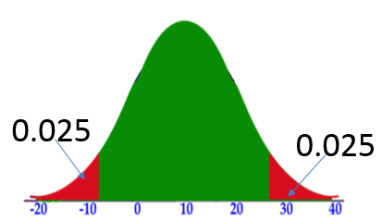
We may want to test the difference between the means of males and females on the spending in shopping
HA: Spending(men) != spending(women)
H0: Spending(men) == spending(women)
Two-sided

Slide 25
We may want to test the whether the means spending of males is greater than females on the spending in shopping
HA: spending(men)> spending(women)
H0: spending(men)<= spending(women)
One tail

Slide 26
Independent Samples
We assume that the scores of one sample do not affect the other
For example, suppose quality inspectors want to compare two laboratories to determine whether their blood tests give similar results.
They send blood samples drawn from the same 10 children to both labs for analysis.
Notes:
https://support.minitab.com/en-us/minitab/18/help-and-how-to/statistics/basic-statistics/supporting-topics/tests-of-means/what-are-independent-samples/

Slide 27
Dependent Samples
These types of samples are related to each other
In one, a group may be measured twice such as in a pretest-posttest situation (scores on a test before and after the lesson)
For example, you might have tested participants' eyesight when wearing two different types of spectacle.

Slide 28


Testing Hypotheses with Independent Samples
The set up for the independent sample t-test is very similar to the single sample t-test.
hypotheses for the t-test, whether the means of two separate populations are equal
Similarly we can check whether one sample is greater and less than other sample/population.

Slide 29
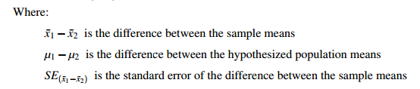

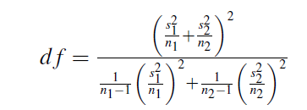


t-statistic formula

Slide 30
The Assumptions of the Independent Samples t-test
A random sample of each population is used.
The random samples are each made up of independent observations
Each sample is independent of one another
The population distribution of each population must be nearly normal, or the size of the sample is large.

Slide 31
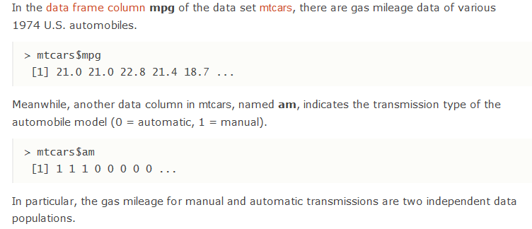

Slide 32
Assuming that the data in mtcars follows the normal distribution, With the 95% confidence interval estimate, is there difference between the mean gas mileage of manual and automatic transmissions.

Slide 33
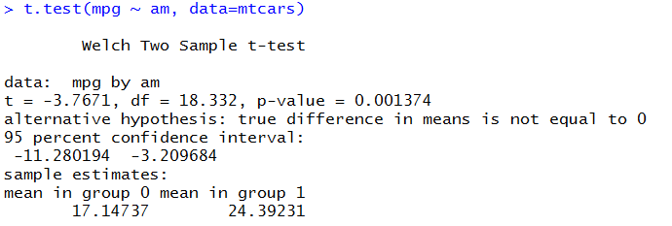
t.test(mpg ~ am, data=mtcars)
t.test(mtcars[mtcars$am==1,'mpg'],mtcars[mtcars$am==0,'mpg'], data=mtcars, alternative="two.sided")

Slide 34
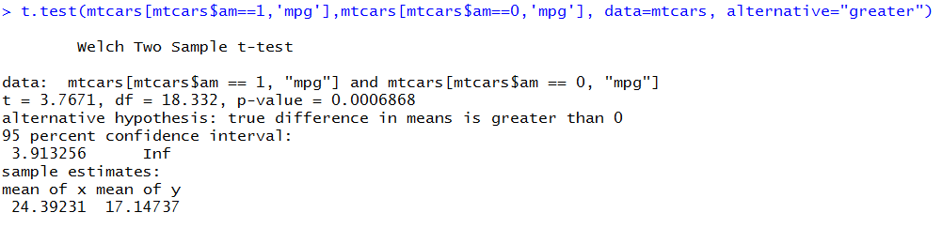
Assuming that the data in mtcars follows the normal distribution, With the 95% confidence interval estimate, is the mean gas mileage of manual is greater than automatic transmissions.
H0: mean(manual) <= mean(automatic)
HA: mean(manual)>mean(automatic)

Slide 35
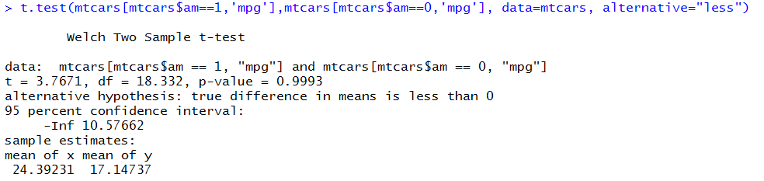
Assuming that the data in mtcars follows the normal distribution, With the 95% confidence interval estimate, is the mean gas mileage of manual is less than automatic transmissions.

Slide 36
The head of the English department is interested in the difference in writing scores between freshman English students who are taught by different teachers. The incoming freshmen are randomly assigned to one of two English teachers and are given a standardized writing test after the first semester. We take a sample of eight students from one class and nine from the other. Is there a difference in achievement on the writing test between the two classes?

Slide 37
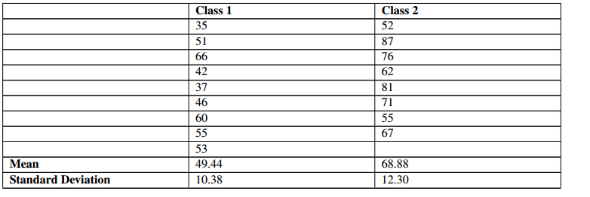

Slide 38
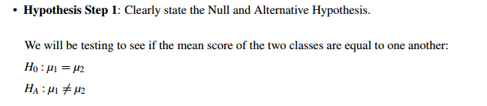

Slide 39


Slide 40
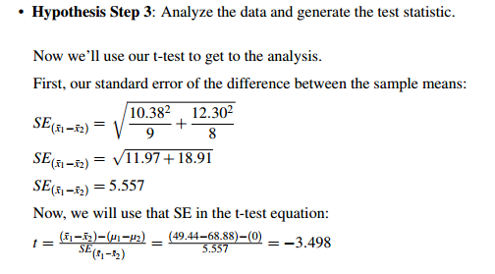

Slide 41
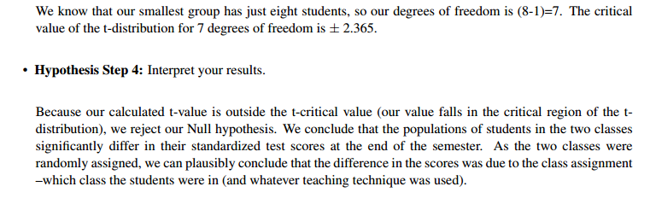

Slide 42
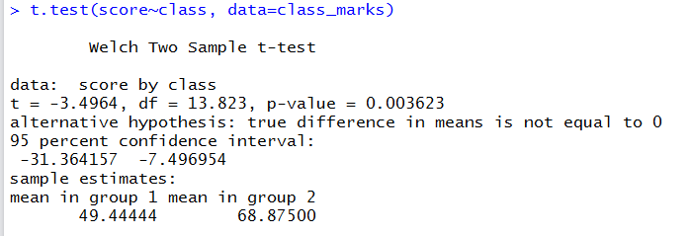
class_marks<-data.frame(score=c(35,51,66,42,37,46,60,55,53,c(52,87,76,62,81,71,55,67)),
class= c(rep(1,9),rep(2,8)))
t.test(score~class, data=class_marks)

Slide 43

Hypotheses with Dependent(Matched) Samples
Another name for the dependent samples t-test is the paired samples t-test.
In some way, the two variables we will be testing will be paired –or related –to one another.
It is used to compare the means between two related groups of samples. In this case, you have two values (i.e., pair of values) for the same samples.

Slide 44
As an example of data, 20 mice received a treatment X during 3 months. We want to know whether the treatment X has an impact on the weight of the mice.
To answer to this question, the weight of the 20 mice has been measured before and after the treatment. This gives us 20 sets of values before treatment and 20 sets of values after treatment from measuring twice the weight of the same mice.

Slide 45
# Weight of the mice before treatment
before <-c(200.1, 190.9, 192.7, 213, 241.4, 196.9, 172.2, 185.5, 205.2, 193.7)
# Weight of the mice after treatment
after <-c(392.9, 393.2, 345.1, 393, 434, 427.9, 422, 383.9, 392.3, 352.2)
# Create a data frame
my_data <- data.frame(
group = rep(c("before", "after"), each = 10),
weight = c(before, after)
)

Slide 46
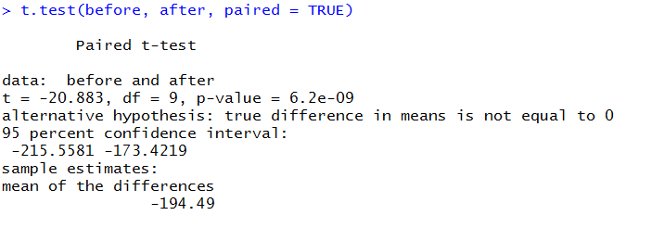
#We want to know, if there is any significant difference in the mean weights after treatment?
t.test(before, after, paired = TRUE)

Slide 47
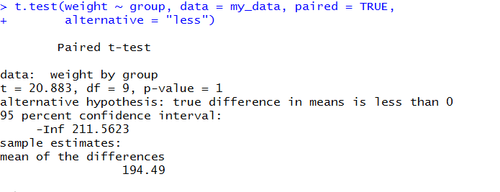
#if you want to test whether the average weight before treatment is less than the average weight after treatment, type this:
t.test(weight ~ group, data = my_data, paired = TRUE,
alternative = "less")

Slide 48
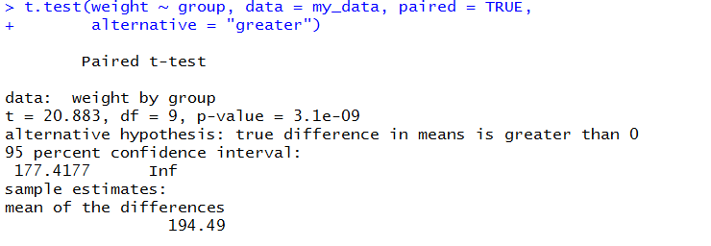
#Or, if you want to test whether the average weight before treatment is greater than the average weight after treatment, type this
t.test(weight ~ group, data = my_data, paired = TRUE,
alternative = "greater")

Slide 49
Paired t-test analysis is performed as follow:
Calculate the difference (d) between each pair of value
Compute the mean (m) and the standard deviation (s) of d
Compare the average difference to 0. If there is any significant difference between the two pairs of samples, then the mean of d (m) is expected to be far from 0.
Paired t-test can be used only when the difference d is normally distributed.

Slide 50



Degree of freedom =n-1

Slide 51
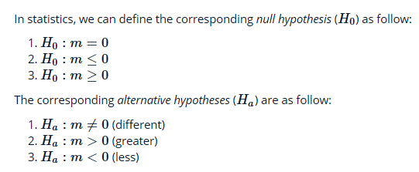

whether the mean difference (m ) is equal to 0?
whether the mean difference (m) is less than 0?
whether the mean difference (m) is greater than 0?

Slide 52
A math teacher wants to determine the effectiveness of her statistics lesson. She gives a simple skills test to nine students before the start of class (a pre-test) and the same skills test to the same students at the end of class (a post-test).

Slide 53
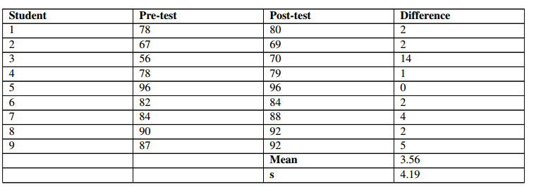

Slide 54
Hypothesis Step 1:
Clearly state the Null and Alternative Hypothesis.

Slide 55
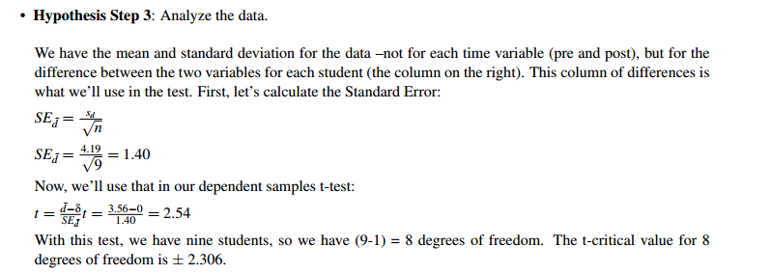

Slide 56
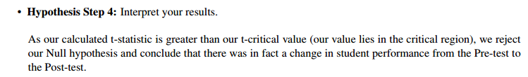

Slide 57
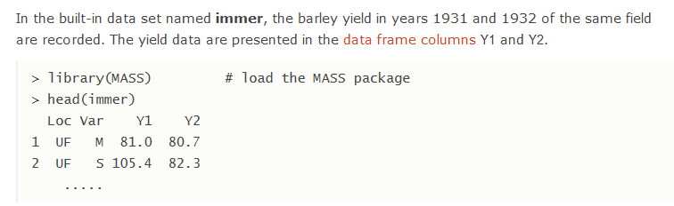
The immer data frame has 30 rows and 4 columns. Five varieties of barley were grown in six locations in each of 1931 and 1932.
This data frame contains the following columns:
Loc :The location.
Var :The variety of barley ("manchuria", "svansota", "velvet", "trebi" and "peatland").
Y1 :Yield in 1931.
Y2:Yield in 1932.

Slide 58
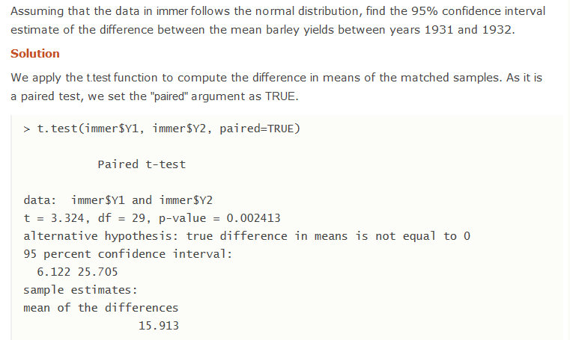

Slide 59

Notes:
http://www.r-tutor.com/elementary-statistics/inference-about-two-populations/population-mean-between-two-matched-samples

