Slide 1
Evan price-checked 123 online auction sellers to record their average asking price for his favorite game. According to a major nation price-checking site, the national average online auction cost for the game is $35.00 with a standard deviation of $3.00. Evan found the prices less than $34.86 on average. How likely is this result?

Slide 2
Evan price-checked 123 online auction sellers to record their average asking price for his favorite game. According to a major nation price-checking site, the national average online auction cost for the game is $35.00 with a standard deviation of $3.00. Evan found the prices less than $34.86 on average. How likely is this result?
The likelihood of 123 samples having a mean of $34.86 is approximately 30.15%

Slide 3
A receipe website has calculated that the time it takes to cook Sunday dinner has a µ of 1 hr with σ of 25 mins. Over the course of a month, 172 users report their time spent cooking Sunday dinner, what is the probability that the average user reports spending less than 45 mins cooking dinner?

Slide 4
Hypothesis Testing

Slide 5
Hypothesis
A premise or claim that we want to test/investigate.

Slide 6
Null Hypothesis: Ho currently accepted value for a parameter. Every one used to think it is correct based on past studies.
Alternative Hypothesis: Ha/ Research hypothesis. Involves the claim to be tested.
Eg: median Income of country higher than previous

Slide 7


Slide 8
Ho : µ = 5g
Ha: µ = 5g
Ho and Ha are mathematically opposites.

Slide 9
Possible Outcomes of Test
Reject Null Hypothesis: data says this is no longer true.
Fail to reject Null Hyp Ho.
It is difficult to prove true.

Slide 10
Test Statistic
Calculated from sample data and used to decide.
Ex. Sample 50 bars
get Avg val
Calculate test statistic (significantly enough to reject null Ho or not)

Slide 11
Statistically Significant
Where do we draw the line to make a decision.
Ex. Avg. of 50 bars: 5.12g
Avg. of 50 bars: 5.72g
Avg. of 50 bars: 7.23g
Need concrete way of decide…

Slide 12
Level of Confidence
C- 95%, 99%
How confident are we in our decision.

Slide 13
confidence interval = x ± margin of error
margin of error = Z × σ √ n

Slide 14
Assume the standard deviation chocolate bar is 1g. Within what range of weight can we expect the population mean to be, with 95% confidence?

Slide 15
Assume the standard deviation chocolate bar is 1g. Within what range of weight can we expect the population mean to be, with 95% confidence?
We are asked for 95% confidence, so we want to use z = ± 1.96.
5±1.96 ∗ 1/ √ 50= 5±.2771 =(4.722, 5.277)

Slide 16
Suppose the average height of a sample of 100 women is 5’5’’ , in other words, X = 5’5’’. Within what range of heights can we expect the population mean to be, with 95% confidence? Assume a standard deviation for the population of 1’5’’ .

Slide 17
Level of Significance
α= 1-c
How sure are we making right decision.
Error

Slide 18
Type 1 and Type 2 Error

Slide 19


Slide 20
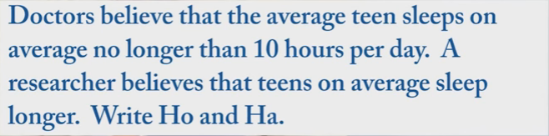

Slide 21
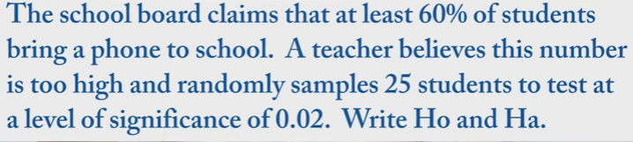

Slide 22
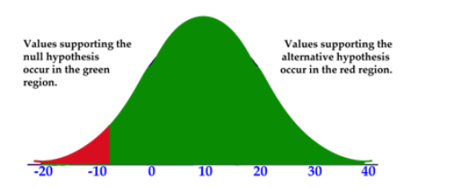
One and Two-Tailed Hypothesis Tests

Slide 23
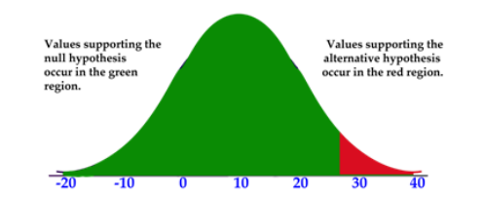

Slide 24
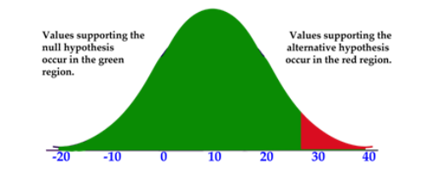

Slide 25
Critical Values
For two tail test

Slide 26
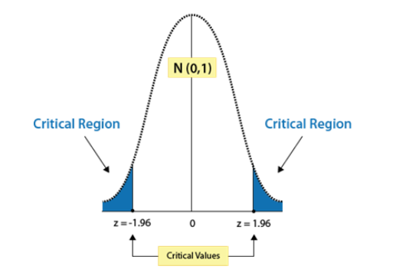
What is the critical value z for a 95% confidence level, assuming a two-tailed test?

Slide 27
What would be the critical value for a right-tailed test with α = 0.01?

Slide 28
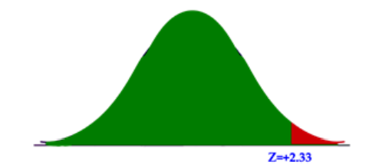
What would be the critical value for a right-tailed test with α = 0.01?

Slide 29
C | α | One-Tail Test | Two tail test
0.90 | 0.10 | 1.28 | 1.645
0.95 | 0.05 | 1.645 | 1.96
0.98 | 0.02 | 2.05 | 2.33
0.99 | 0.01 | 2.33 | 2.575

Slide 30
What would be the critical value for a left-tailed test with α = 0.01?
What would be the critical region for a two-tailed test with α = 0.08?
What would be the α for a right-tailed test with a critical value of Z = 1.76?

Slide 31
Steps of Hypothesis Testing
State the null and alternative hypotheses.
Select the appropriate significance level and check the test assumptions.
Analyze the data and compute the test statistic.
Interpret the result

Slide 32
The school nurse thinks the average height of 7th graders has increased. The average height of a 7th grader five years ago was 145 cm with a standard deviation of 20 cm. She takes a random sample of 200 students and finds that the average height of her sample is 147 cm. Are 7th graders now taller than they were before? (95%)

Slide 33
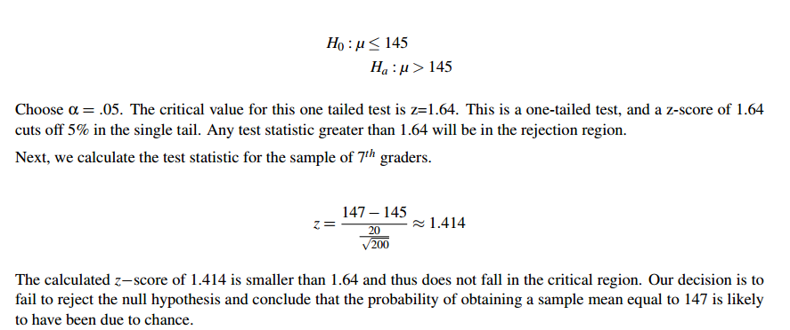

Slide 34
Blood glucose levels for obese patients have a mean of 100 with a standard deviation of 15. A researcher thinks that a diet high in raw cornstarch will have a positive or negative effect on blood glucose levels. A sample of 30 patients who have tried the raw cornstarch diet have a mean glucose level of 140. Test the hypothesis that the raw cornstarch had an effect.(0.95)

Slide 35
A herd of 1,500 steer was fed a special high‐protein grain for a month. A random sample of 29 were weighed and had gained an average of 6.7 pounds. If the standard deviation of weight gain for the entire herd is 7.1, test the hypothesis that the average weight gain per steer for the month was more than 5 pounds.(0.90)

Slide 36
Hypothesis Tests When You Don’t Know Your Population Parameters
We don’t know the true population mean, and we certainly don’t know the true population standard deviation.
Instead, we want to conduct a hypothesis test using only our sample and the information it can provide us. How can we do this?

Slide 37
when he was working with very small samples, the distributions of the mean differed significantly from the normal distribution. He noticed that as his sample sizes changed, the shape of the distribution changed as well.

Slide 38
The Student’s t-distribution is similar to the normal distribution, except it is more spread out and wider in appearance, and has thicker tails.
As the number of observations gets larger, the t-distribution shape becomes more and more like the shape of the normal distribution.
In fact, if we had an infinite number of observations, the t distribution would perfectly match the normal distribution.
It is the distribution that allows us to test hypotheses when we don’t know the true population standard deviation

Slide 39
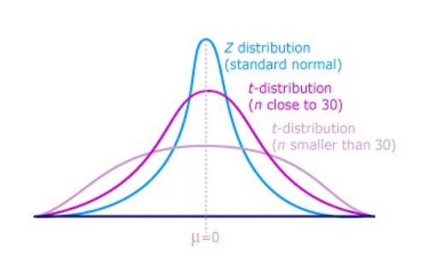

Slide 40
The differences between the t-distribution and the normal distribution are more exaggerated when there are fewer data points, and therefore fewer degrees of freedom.
Degrees of freedom are essentially the number of samples that have the ’freedom’ to change without affecting the sample mean.

Slide 41
The reason you need to know how to find the number of degrees of freedom is quite simple:
when you use a t distribution for a hypothesis test, there is a different critical value for each number of degrees of freedom. The larger your sample, the closer the critical value gets to the z-score for your alpha level.

Slide 42
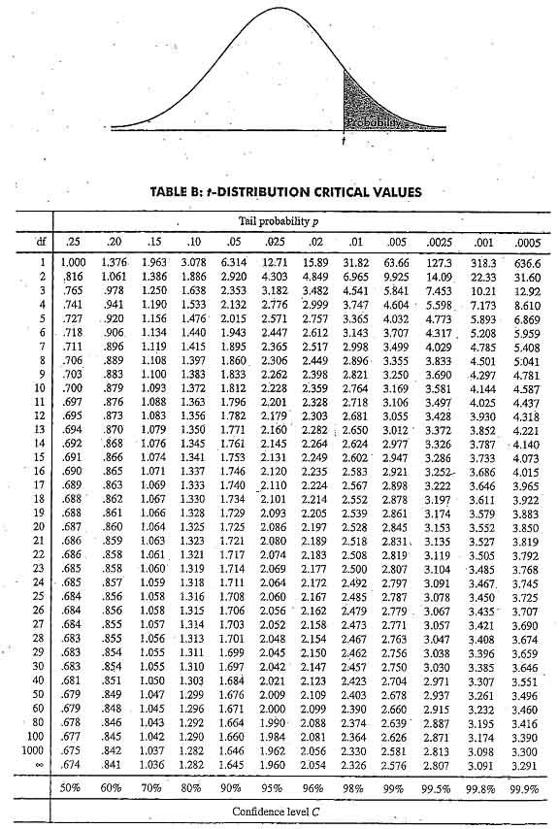

Slide 43
T-Test for One Sample Mean
So when do we use the t-distribution and when do we use the normal distribution?
It’s simple: When we know the population standard deviation we use the normal distribution. When we don’t know the population standard deviation (so we need to use our sample standard deviation), we use the t-distribution.

Slide 44

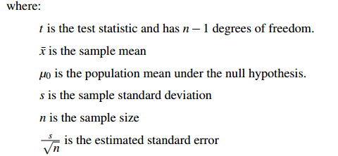

Slide 45
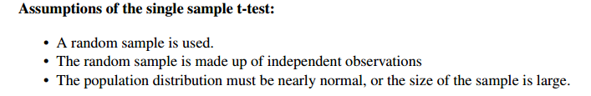

Slide 46
The high school athletic director is asked if football players are doing as well academically as the other student athletes. We know from a previous study that the average GPA for the student athletes is 3.10. After an initiative to help improve the GPA of student athletes, the athletic director randomly samples 20 football players and finds that the average GPA of the sample is 3.18 with a sample standard deviation of 0.54. Is there a significant improvement? Use a 0.05 significance level.

Slide 47
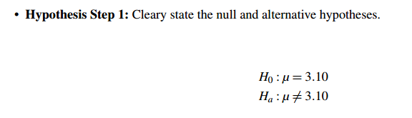

Slide 49
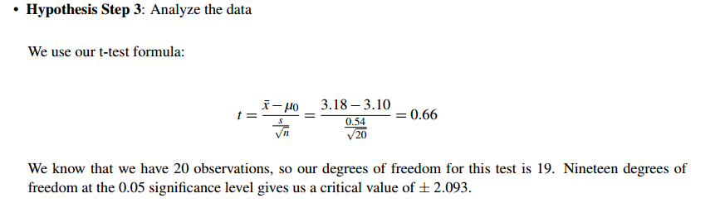

Slide 50
Hypothesis Step 4: Interpret your results

Slide 51
Suppose you have a new oil additive that may extend the life of an engine. You give it to 25 random motors and find that the average lifespan is 78 months, and the standard deviation in their lifespan is 12. You know that with unmodified oil, the mean lifespan is 72 months, and hope to show that your additive improves that.

Slide 52
A research study measured the pulse rates of 57 college men and found a mean pulse rate of 70.4211 beats per minute with a standard deviation of 9.9480 beats per minute. Researchers want to know if the mean pulse rate for all college men is different from the current standard of 72 beats per minute.

Slide 53
in 2011, the average American spent $16,803 on housing. A suburban community wants to know if their residents spent less than this national average. In a survey of 30 residents, they found that they spent an annual average of $15,800 with a standard deviation of $2,600.
Notes:
https://onlinecourses.science.psu.edu/stat200/print/book/export/html/54

Slide 54
qt(0.25, 40)
abs(qt(0.25, 40)) # 75% confidence, 1 sided (same as qt(0.75, 40))
abs(qt(0.01, 40)) # 99% confidence, 1 sided (same as qt(0.99, 40))
abs(qt(0.01/2, 40)) # 99% confidence, 2 sided

