Slide 1
Probability

Slide 2
In everyday life, we come across statements such as
It will probably rain today.
I doubt that he will pass the test.
Chances are high that the prices of diesel will go up.
There is a 50-50 chance of India winning a toss in today’s match.

Slide 3
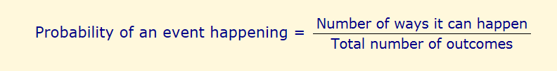
Probability
Many events can't be predicted with total certainty. The best we can say is how likely they are to happen, using the idea of probability.

Slide 4
The record of a weather station shows that out of the past 250 consecutive days, its weather forecasts were correct 175 times.
(i) What is the probability that on a given day it was correct?
(ii) What is the probability that it was not correct on a given day?

Slide 5
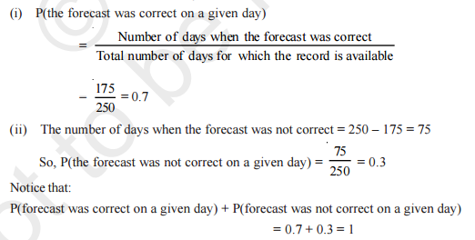

Slide 6

A tyre manufacturing company kept a record of the distance covered before a tyre needed to be replaced. The table shows the results of 1000 cases
If you buy a tyre of this company, what is the probability that :
it will need to be replaced before it has covered 4000 km?
it will last more than 9000 km?
it will need to be replaced after it has covered somewhere between 4000 km and 14000 km?

Slide 7
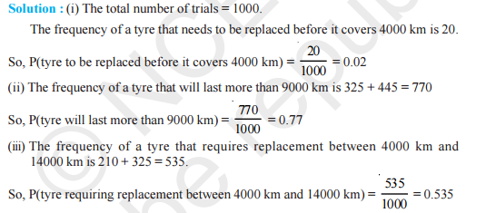

Slide 8

The percentage of marks obtained by a student in the monthly unit tests are given below
find the probability that the student gets more than 70% marks in a unit test.

Slide 9


Slide 10
An insurance company selected 2000 drivers at random (i.e., without any preference of one driver over another) in a particular city to find a relationship between age and accidents.
Age of Drivers (in Years) | Accidents in One year
 | 0 | 1 | 2 | 3 | Over 3
18-29 | 440 | 160 | 110 | 61 | 35
30-50 | 505 | 125 | 60 | 22 | 18
above 50 | 360 | 45 | 35 | 15 | 9
Find the probabilities of the following events for a driver chosen at random from the city
(i)being 18-29 years of age and having exactly 3 accidents in one year.
(ii) being 30-50 years of age and having one or more accidents in a year.
(iii) Having no accident in one year.

Slide 11
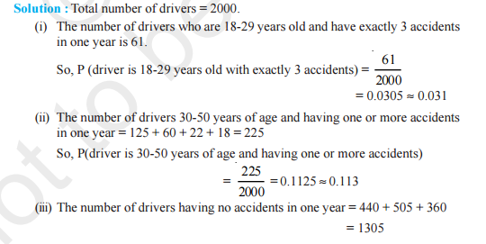


Slide 12

Fifty seeds were selected at random from each of 5 bags of seeds, and were kept under standardised conditions favourable to germination. After 20 days, the number of seeds which had germinated in each collection were counted and recorded
What is the probability of germination of
(i) more than 40 seeds in a bag?
(ii) 49 seeds in a bag?
(iii) more that 35 seeds in a bag?

Slide 13

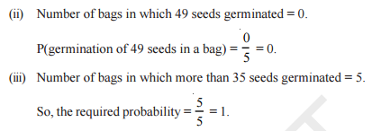

Slide 14
df$value.cut = cut(df$value, breaks=c(0, 25, 100))

Slide 15
Missing Value handling
sum(loan$Loan_Amount)
#It give NA when observations are not present for some
#We can correct by na.rm=TRUE
sum(loan$Loan_Amount, na.rm=TRUE)
A<- c(1,2,NA,3)
sum(A)
NA
sum(A, na.rm=TRUE)
6
A<-c(1,2,NULL, 3)
sum(A)
6

Slide 16
#remove row if any particular variable values are missing
My_data<-My_data[!is.na(My_data$Variable), ]
#clean complete data
My_data<-My_data[complete.cases(My_data), ]

Slide 17
10% of the bulbs produced in a factory are of red colour and 2% are red and defective. If one bulb is picked up at random, determine the probability of its being defective if it is red
?????
Defective
10%
2% are red and Defective out of Total (100%)
P(Red)*P(Defective)= 2%
It is not from Red
So Answer is not 2%
Red
Non Defective
Not Red
Defective
90%
Non Defective
Note: In Class we solve Incorrectly

Slide 18
10% of the bulbs produced in a factory are of red colour and 2% are red and defective. If one bulb is picked up at random, determine the probability of its being defective if it is red
?????
Defective
10%
2% are red and Defective out of Total (100%)
P(Red)*P(Defective)= 2%
P(Defective if it Red)= 2% / 10%
= 0.2%
Sample: Red Bulbs
Event: Defective in Red
Red
Non Defective
Not Red
Defective
90%
Non Defective

Slide 19
Three machines E1 , E2 , E3 in a certain factory produce 50%, 25% and 25%, respectively, of the total daily output of electric tubes.
It is known that 4% of the tubes produced one each of machines E1 and E2 are defective, and that 5% of those produced on E3 are defective.
If one tube is picked up at random from a day’s production, calculate the probability that it is defective.

Slide 20
D
4%
50%
ND
E1
D
4%
E2
Sample: 100%, all electric tubes
Event: tubes which are defective
50%*4% + 25%*4% + 25%*5%
25%
ND
E3
D
5%
25%
ND

Slide 21
A car manufacturing factory has two plants, X and Y. Plant X manufactures 70% of cars and plant Y manufactures 30%. 80% of the cars at plant X and 90% of the cars at plant Y are rated of standard quality. A car is chosen at random and is found to be of standard quality. What is the probability that it has come from plant X?

Slide 22
Standard
80%
Sample: standard quality cars
Event: standard alit of plant X
70%
X
70%*80%
Non Standard
70%*80%+30%*90%
Standard
90%
Y
30%
Non Standard

Slide 23
Suppose 10,000 tickets are sold in a lottery each for Re 1. First prize is of Rs 3000 and the second prize is of Rs. 2000. There are three third prizes of Rs. 500 each. If you buy one ticket, what is your expectation.

Slide 24
Suppose that 6% of the people with blood group O are left handed and 10% of those with other blood groups are left handed 30% of the people have blood group O. If a left handed person is selected at random, what is the probability that he/she will have blood group O?

