Slide 1
BASIC STATISTICS

Slide 2
Many of statistical tests including correlation, regression, t-test, and analysis of variance (ANOVA) assume some certain characteristics about the data.
They require the data to follow a normal distribution or Gaussian distribution. These tests are called parametric tests, because their validity depends on the distribution of the data.

Slide 3
Parametric Test
Samples have normal distribution
Non-Parametric test
Samples does not follow Normal Distribution
Wilcoxon test
http://sphweb.bumc.bu.edu/otlt/MPH-Modules/BS/BS704_Nonparametric/BS704_Nonparametric_print.html

Slide 4
Test For Normality
Density plot
Kolmogorov-Smirnov (K-S) normality test and Shapiro-Wilk’s test
Shapiro-Wilk’s method is widely recommended for normality test and it provides better power than K-S. It is based on the correlation between the data and the corresponding normal scores.

Slide 5

The null hypothesis of these tests is that “sample distribution is normal”. If the test is significant, the distribution is non-normal.
shapiro.test(my_data$len)
From the output, the p-value > 0.05 implying that the distribution of the data are not significantly different from normal distribution. In other words, we can assume the normality.

Slide 6
Supervised Learning
Supervised statistical learning involves building a statistical model for predicting, or estimating, an output based on one or more inputs.
To understand the association between an employee’s age and education, as well as the calendar year, on his wage.
The Wage data involves predicting a continuous or quantitative output value. This is often referred to as a regression problem.
However, in certain cases we may instead wish to predict a non-numerical value—that is, a categorical.
Predicting whether a given day’s stock market performance will fall into the Up bucket or the Down bucket. This is known as a classification problem.

Slide 7
Unsupervised Learning
With unsupervised statistical learning, there are inputs but no supervising output; nevertheless we can learn relationships and structure from such data.
We only observe input variables, with no corresponding output.
For example, in a marketing setting, we might have demographic information for a number of customers. We may wish to understand which types of customers are similar to each other by grouping individuals according to their observed characteristics. This is known as a clustering problem.
Unlike in the previous examples, here we are not trying to predict an output variable.

Slide 8
Statistical Learning ?
Problem : To provide advice to client on how to improve sales of a particular product.
Data : The Advertising data set consists of the sales of that product in 200 different markets, along with advertising budgets for the product in each of those markets for three different media: TV, radio, and newspaper.
Understanding:
It is not possible for our client to directly increase sales of the product. On the other hand, they can control the advertising expenditure in each of the three media.
Therefore, if we determine that there is an association between advertising and sales, then we can instruct our client to adjust advertising budgets, thereby indirectly increasing sales.
In other words, our goal is to develop an accurate model that can be used to predict sales on the basis of the three media budgets. Advertising budgets are input variables while sales input is an output variable.

Slide 9
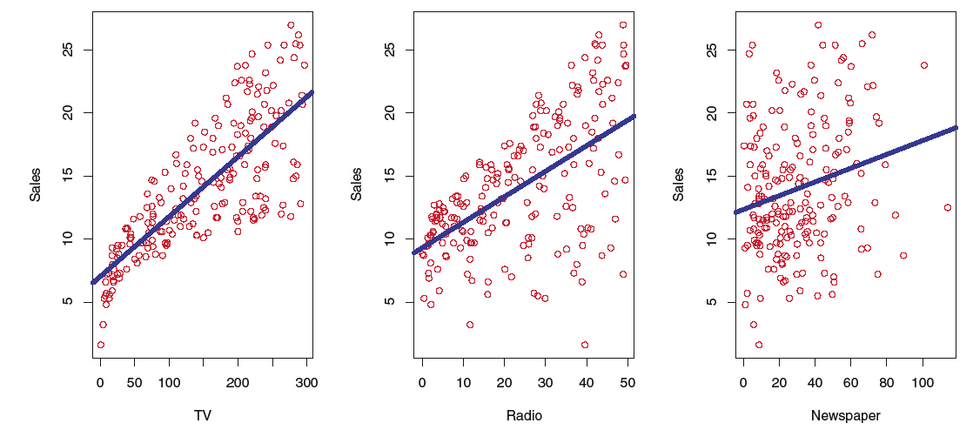
The Advertising data set. The plot displays sales, in thousands of units, as a function of TV, radio, and newspaper budgets, in thousands of dollars, for 200 different markets. In each plot we show the simple least squares fit of sales to that variable

Slide 10

The inputs go by different names, such as predictors, independent variables, features, or sometimes just variables.
The output variable in previous example, sales is variable often called the response or dependent variable.
More generally, suppose that we observe a quantitative response Y and p different predictors, X1,X2, . . .,Xp. We assume that there is some relationship between Y and X = (X1,X2, . . .,Xp), which can be written in the very general form
In essence, statistical learning refers to a set of approaches for estimating f. There are two main reasons that we may wish to estimate f: prediction and inference.

Slide 11
Inference
In this situation we wish to estimate f(X), but our goal is not necessarily to make predictions for Y .
We instead want to understand the relationship between X and Y , or more specifically, to understand how Y changes as a function of X1, . . .,Xp.
F(X) cannot be treated as a black box, because we need to know its exact form.
Which predictors are associated with the response?
What is the relationship between the response and each predictor?
Can the relationship between Y and each predictor be adequately summarized using a linear equation, or is the relationship more complicated?

Slide 12
Inference
Consider the Advertising data, One may be interested in answering questions such as:
– Which media contribute to sales?
– Which media generate the biggest boost in sales? or
– How much increase in sales is associated with a given increase in TV advertising?
The brand of a product that a customer might purchase based on variables such as price, store location, discount levels, competition price, and so forth.
– In this situation one is interested in how each of the individual variables affects the probability of purchase.
– For instance, what effect will changing the price of a product have on sales?

Slide 13
prediction
For instance, consider a company that is interested in conducting a direct-marketing campaign.
The goal is to identify individuals who will respond positively to a mailing, based on observations of demographic variables measured on each individual.
In this case, the demographic variables serve as predictors, and response to the marketing campaign (either positive or negative) serves as the outcome.
The company is not interested in obtaining a deep understanding of the relationships between each individual predictor and the response; instead, the company simply wants an accurate model to predict the response using the predictors. This is an example of modeling for prediction.

Slide 14
Finally, some modeling could be conducted both for prediction and inference.
For example, in a real estate setting, one may seek to relate values of homes to inputs such as crime rate, zoning, distance from a river, air quality, schools, income level of community, size of houses, and so forth.
In this case one might be interested in how the individual input variables affect the prices—that is, how much extra will a house be worth if it has a view of the river? This is an inference problem.
Alternatively, one may simply be interested in predicting the value of a home given its characteristics: is this house under- or over-valued? This is a prediction problem.

Slide 15
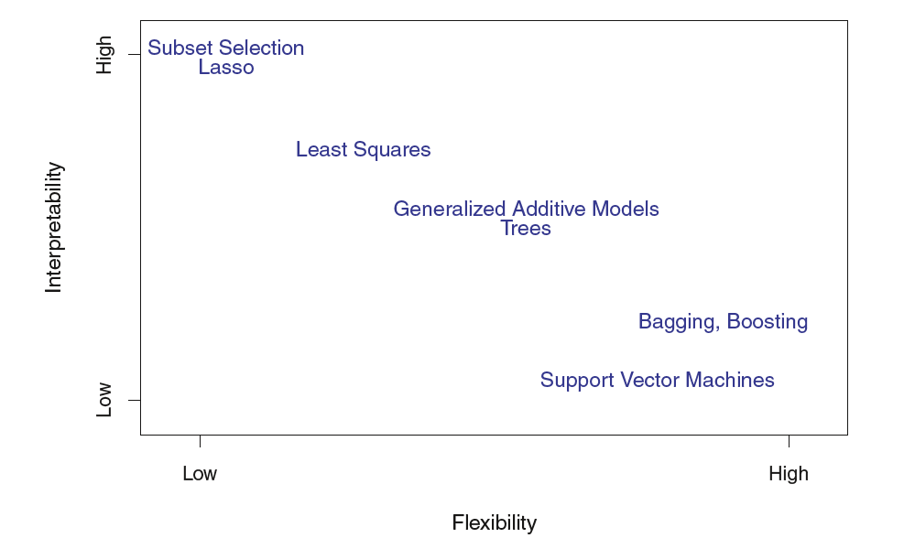
The Trade-Off Between Prediction Accuracy and Model Interpretability
A representation of the tradeoff between flexibility and interpretability, using different statistical learning methods.
In general, as the flexibility of a method increases, its interpretability decreases.
when inference is the goal, there are clear advantages to using simple and relatively inflexible statistical learning methods.
When interested in prediction, and the interpretability of the predictive model is simply not of interest.

Slide 16
Our goal is to apply a statistical learning method to the training data in order to estimate the unknown function f.
In other words, we want to find a function ˆ f such that Y ≈ ˆ f(X) for any observation (X, Y ).
Broadly speaking, most statistical learning methods for this task can be characterized as either parametric or non-parametric.

Slide 17
Parametric Methods
We make an assumption about the functional form, or shape, of f.
– For example, one very simple assumption is that f is linear in X
We need a procedure that uses the training data to fit or train the model.
– In the case of the linear model, we need to estimate the parameters β0, β1, . . . , βp. That is, we want to find values of these parameters such that
Y ≈ β0 + β1X1 + β2X2 + . . . + βpXp.
It reduces the problem of estimating f down to one of estimating a set of parameters
The potential disadvantage of a parametric approach is that the model we choose will usually not match the true unknown form of f.
More complex models can lead to a phenomenon known as overfitting the data, which essentially means they overfitting follow the errors, or noise, too closely.

Slide 18
Non-parametric Methods
Non-parametric methods do not make explicit assumptions about the functional form of f.
Instead they seek an estimate of f that gets as close to the data points as possible without being too rough or wiggly.
Non-parametric approaches do suffer from a major disadvantage: since they do not reduce the problem of estimating f to a small number of parameters, a very large number of observations (far more than is typically needed for a parametric approach) is required in order to obtain an accurate estimate for f.

Slide 19
Regression Versus Classification Problems
Variables can be characterized as either quantitative or qualitative/categorical .
Quantitative variables take on numerical values.
– a person’s age, height, or income, the value of a house, and the price of a stock.
In contrast, qualitative variables take on values in one of K different classes, or categories.
– a person’s gender (male or female), the brand of product purchased (brand A, B, or C), whether a person defaults on a debt (yes or no)
Problems with a quantitative response are usually regression problems
Problem involving a qualitative response are often referred to as classification problems.

Slide 20
Assessing Model Accuracy
There is no free lunch in statistics: no one method dominates all others over all possible data sets.
Selecting the best approach can be one of the most challenging parts of performing statistical learning in practice.

Slide 21
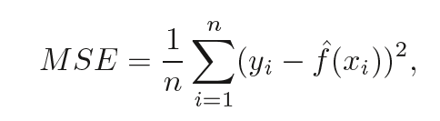
Measuring the Quality of Fit
In order to evaluate the performance of a statistical learning method on a given data set, we need some way to measure how well its predictions actually match the observed data.
In the regression setting, the most commonly-used measure is the mean squared error (MSE)
For good model, it should be as small as possible
We should always care about performance on test data.
Why we should check on test data?

Slide 22
Suppose that we are interested test data in developing an algorithm to predict a stock’s price based on previous stock returns.
We can train the method using stock returns from the past 6 months.
But we don’t really care how well our method predicts last week’s stock price.
We instead care about how well it will predict tomorrow’s price or next month’s price.
Suppose that we have clinical measurements (e.g. weight, blood pressure, height, age, family history of disease) for a number of patients, as well as information about whether each patient has diabetes.
We can use these patients to train a statistical learning method to predict risk of diabetes based on clinical measurements.
In practice, we want this method to accurately predict diabetes risk for future patients based on their clinical measurements. We are not very interested in train data, since we already know which of those patients have diabetes.

Slide 23
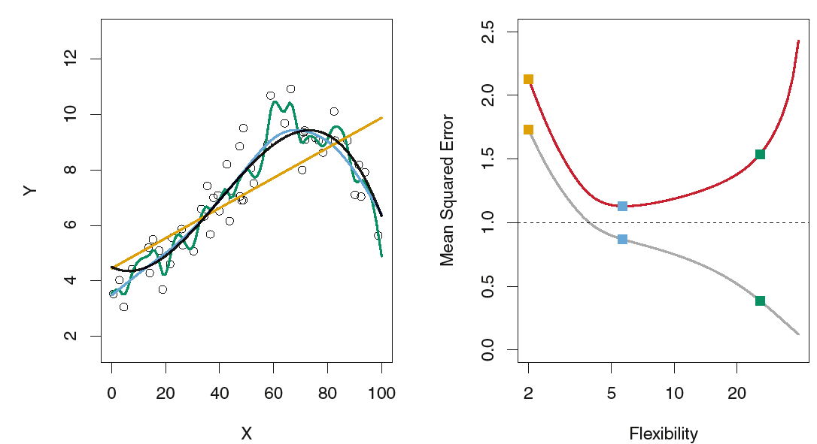
There is no guarantee that the method with the lowest training MSE will also have the lowest test MSE.
Three estimates of Y= f (X)are shown: the linear regression line (orange curve), and two smoothing spline fits (blue and green curves).
Right: Training MSE (grey curve), test MSE (red curve), and minimum possible test MSE over all methods (dashed line).
Squares represent the training and test MSEs for the three fits shown in the left-hand panel.

Slide 24
The Bias-Variance Trade-Off
In order to minimize the expected test error, we need to select a statistical learning method that simultaneously achieves low variance and low bias.
Variance refers to the amount by which f(X) would change if we use different training data set.
Since the training data are used to fit the statistical learning method, different training data sets will result in a different f(X). But ideally the estimate for f(X) should not vary too much between training sets.
However, if a method has high variance then small changes in the training data can result in large changes in f(X).
In general, more flexible statistical methods have higher variance. (like model with green line in previous graph)

Slide 25
Bias refers to the error that is introduced by approximating a real-life problem, which may be extremely complicated, by a much simpler model.
For example, linear regression assumes that there is a linear relationship between Y and X1,X2, . . . , Xp.
It is unlikely that any real-life problem truly has such a simple linear relationship, and so performing linear regression will undoubtedly result in some bias in the estimate of f(x).
In previous example linear regression(orange line) results in high bias
As a general rule, as we use more flexible methods, the variance will increase and the bias will decrease.
The relative rate of change of these two quantities determines whether the test MSE increases or decreases.
As we increase the flexibility of a class of methods, the bias tends to initially decrease faster than the variance increases.

Slide 26
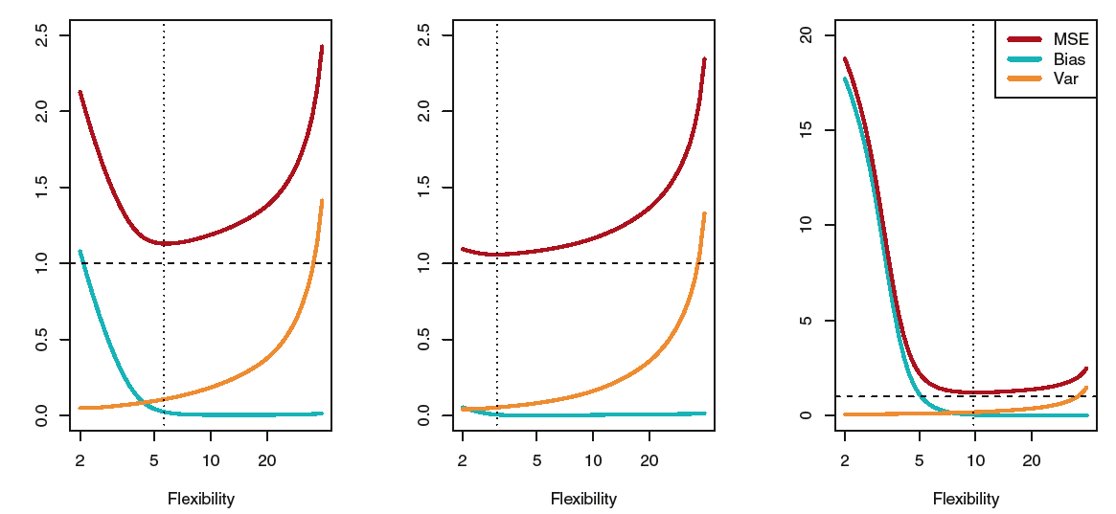
Good test set performance of a statistical learning method requires low variance as well as low squared bias.
This is referred to as a bias variance trade-off because it is easy to obtain a method with extremely low bias but high variance (for instance, by drawing a curve that passes through every single training observation) or a method with very low variance but high bias (by fitting a horizontal line to the data).
The challenge lies in finding a method for which both the variance and the squared bias are low.

Slide 27
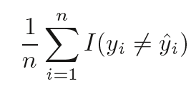
The Classification Setting
The error rate in classification (fraction of incorrect classifications):

Slide 28
Exercise
What we would generally expect the performance of a flexible statistical learning method to be better or worse than an inflexible method in each case. Justify your answer.
The sample size n is extremely large, and the number of predictors p is small.
The number of predictors p is extremely large, and the number of observations n is small.
The relationship between the predictors and response is highly non-linear.
The variance of the error terms, i.e. σ2 = Var(), is extremely high.

Slide 29
Explain whether each scenario is a classification or regression problem, and indicate whether we are most interested in inference or prediction. Finally, provide sample(n) and predictors(p).
We collect a set of data on the top 500 firms in the US. For each firm we record profit, number of employees, industry and the CEO salary. We are interested in understanding which factors affect CEO salary.
We are considering launching a new product and wish to know whether it will be a success or a failure. We collect data on 20 similar products that were previously launched. For each product we have recorded whether it was a success or failure, price charged for the product, marketing budget, competition price, and ten other variables.
We are interest in predicting the % change in the USD/Euro,exchange rate in relation to the weekly changes in the world stock markets. Hence we collect weekly data for all of 2012. For each week we record the % change in the USD/Euro, the % change in the US market, the % change in the British market, and the % change in the German market.

Slide 30
You will now think of some real-life applications for statistical learning.
Describe three real-life applications in which classification might be useful. Describe the response, as well as the predictors. Is the goal of each application inference or prediction? Explain your answer.
Describe three real-life applications in which regression might be useful. Describe the response, as well as the predictors. Is the goal of each application inference or prediction? Explain your answer.
Describe three real-life applications in which cluster analysis might be useful.

