Slide 1
Suppose you wanted to evaluate a recent statistic stating that SAMSUMG users 32% and Motorola 51% of active smart phones.
You would like to know if the statistic actually reflects the distribution of phones among your friends.
How could you evaluate the data you collect to see if it supports this hypothesis?

Slide 2
Chi Square Statistic
Chi square tests are for used for categorical data.
The chi-square test of independence is used to analyze the frequency table (i.e. contengency table) formed by two categorical variables.
The chi-square test can be used to estimate how closely the distribution of a categorical variable matches an expected distribution
The chi-square test evaluates whether there is a significant association between the categories of the two variables.(Test of independence)

Slide 3
The American Pet Products Association conducted a survey in 2011 and determined that 60% of dog owners have only one dog, 28% have two dogs, and 12% have three or more.
Supposing that you have decided to conduct your own survey to determine whether your data supports the results of the APPA study. Use a significance level of 0.05.
Data: Out of 129 dog owners, 73 had one dog and 38 had two dogs.

Slide 4

Goodness-of-Fit Test
It is concerned with the distribution of one categorical variable.

Slide 5

degrees of freedom are found by taking the number of levels in our categorical variable and subtracting one.

Slide 6
Assumptions of the Chi-Square test
Random sample.
Independent observations for the sample (one observation per subject).
No expected counts less than five.

Slide 7
The American Pet Products Association conducted a survey in 2011 and determined that 60% of dog owners have only one dog, 28% have two dogs, and 12% have three or more.
Supposing that you have decided to conduct your own survey to determine whether your data supports the results of the APPA study. Use a significance level of 0.05.
Data: Out of 129 dog owners, 73 had one dog and 38 had two dogs.

Slide 8



Slide 9
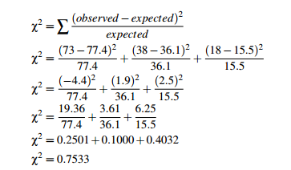

Slide 10
Now that we have our chi-square statistic, we need to compare it to the chi-square value for the significance level 0.05.
In this case, there are three category values: one dog, two dogs, and three or more dogs. The degrees for freedom, therefore, are 3−1 = 2.

Slide 11
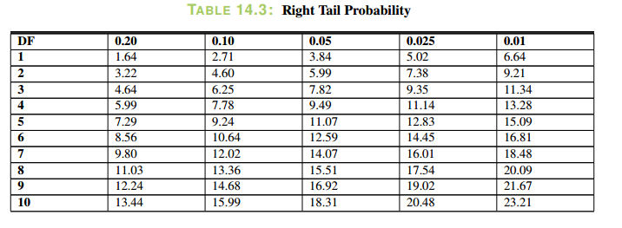

Slide 12
Critical value for a 0.05 significance level with d f = 2 is 5.99.
Our chi-square statistic is only 0.7533, so we will not reject the null hypothesis.

Slide 13
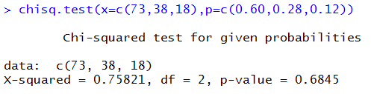
chisq.test(x=c(73,38,18),p=c(0.60,0.28,0.12))

Slide 14
Rachel told Eric that the reason her car insurance is less expensive is that female drivers get in fewer accidents than male drivers. Specifically, she says that male drivers are held responsible in 65% of accidents involving drivers under 23.
If Eric does some research of his own and discovers that 46 out of the 85 accidents he investigates involve male drivers, does his data support or refute Rachel’s hypothesis?

Slide 15
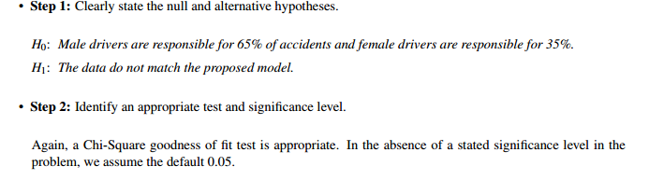

Slide 16

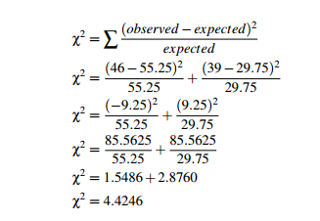

Slide 17
Dof=1
critical value to be 3.84

Slide 18


Slide 19

Test of Independence

Slide 20
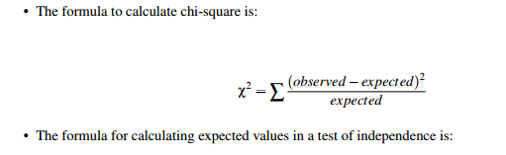

Where C is the observed column total for the cell, R is the observed row total for the cell, and n is the total number of samples.

Slide 21
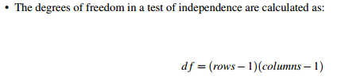

Slide 22
Assumptions
Random sample.
Independent observations for the sample (one observation per subject).
All expected counts greater than one.
No more than 20% of cells with an expected count less than five.

Slide 23
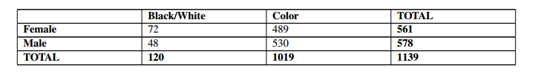
Rachel claims that girls take more black and white and color photographs than boys, but Jack (who is a photographer) is skeptical. If Jack collects the following data, would it be correct to say that he should reject Rachel’s claim that gender affects tendency to take photographs?

Slide 24

The question here is whether gender affects tendency to take more photographs, or, in other words, are gender and photograph-taking tendency dependent?
Table with Actual and Expected value

Slide 25
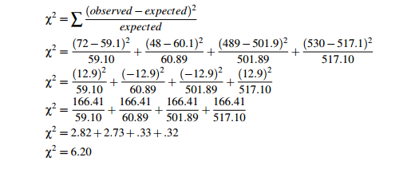

Slide 26


Slide 27
Example in R
Test the hypothesis whether the students smoking habit is independent of their exercise level at .05 significance level.
In the built-in data set survey, the Smoke column records the students smoking habit, while the Exer column records their exercise level.
The allowed values in Smoke are "Heavy", "Regul" (regularly), "Occas" (occasionally) and "Never".
As for Exer, they are "Freq" (frequently), "Some" and "None"

Slide 28
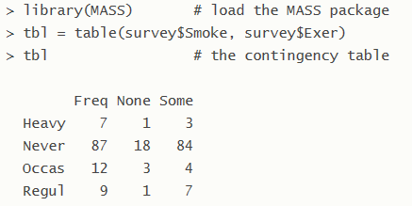

Slide 29
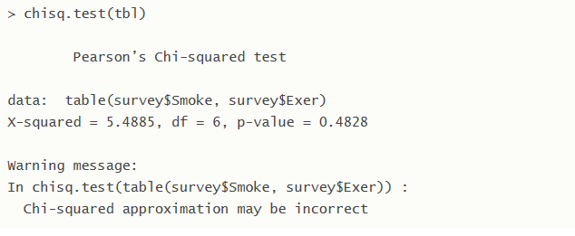

Notes:
http://www.r-tutor.com/elementary-statistics/goodness-fit/chi-squared-test-independence

Slide 30
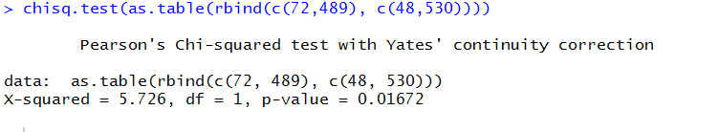

Slide 31

Akash claims that single people prefer different pizzas than married people do. Akash’s brother doesn’t think that is true, so he conducts some research of his own, and collects the data below.
Notes:
https://www.mathsisfun.com/data/chi-square-test.html
https://onlinecourses.science.psu.edu/statprogram/reviews/statistical-concepts/chi-square-tests

Slide 32
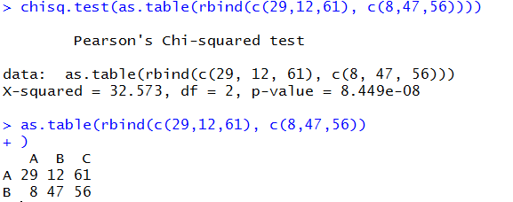

Slide 33
Links to Read
http://www.r-tutor.com/elementary-statistics/goodness-fit/chi-squared-test-independence
https://www.mathsisfun.com/data/chi-square-test.html
https://onlinecourses.science.psu.edu/statprogram/reviews/statistical-concepts/chi-square-tests
http://www.sthda.com/english/wiki/wiki.php?title=chi-square-test-of-independence-in-r

