Slide 1
Base Analytics

Slide 2
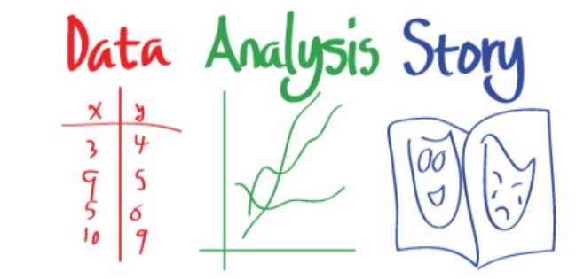
What is Analytics?
Obtain Good Data
Analyze
Turn into Human Readable format/insights

Slide 3

Applications
Health Care
Predict how long a patient will stay as soon as they are admitted
Predict what a patient has based on symptoms and past medical history
Manufacturing
Predict when a machine will need maintenance before it breaks down
Determine the reason behind failure
Banking
Loan default prediction from credit history
Location(Identifying best location for bank branch ATM)
Consumer
Pricing(Setting price for consumer and industrial goods)
Customer Segmentation(Identifying key customer groups in retail, insurance)
Notes:
Retailers, do in fact, routinely analyze their customers' transaction data. If you've ever used a shopper's loyalty card at your grocer, coffee shop, or another retailer, it is likely that your purchase data is being used for machine learning. Retailers use machine learning methods for advertising, targeted promotions, inventory management, or the layout of the items in the store.

Slide 4
To analysis business performance, we create charts related to budget, Sales, revenue and cost.
This will help managers to drill down and make queries like
How much did we sell in each region?
Which factory has the lowest productivity?
What was our revenue and profit last quarter?
How many and what kind of complaints we resolve?
Profit and loss trends

Slide 5
Problem
Imagine that you are interested in measuring the level of anxiety of college students during finals week in one of your courses.
You have 11 study participants rate their level of anxiety on a scale from 1 to 10, with 1 being 'no anxiety' and 10 being 'extremely anxious. You collect the ratings and review them.
The ratings are 8, 4, 9, 3, 5, 8, 6, 6, 7, 8, and 10. Your teacher asks you for a summary of your findings.
How do you summarize this data?

Slide 6
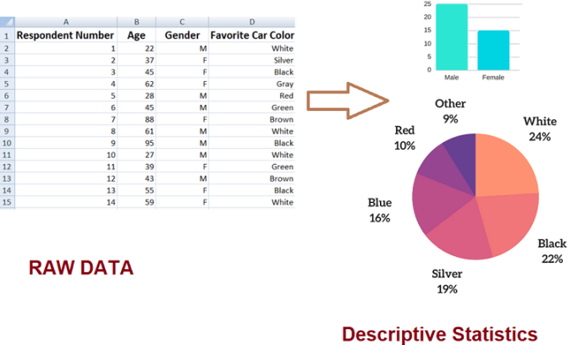
Descriptive Statistics
Summarize data into meaningful charts and reports
Measure of Central Tendency : Mean, Median, Mode
Measure of Spread : Variance, standard deviation
Clustering: customer Segments
Notes:
Retailers, do in fact, routinely analyze their customers' transaction data. If you've ever used a shopper's loyalty card at your grocer, coffee shop, or another retailer, it is likely that your purchase data is being used for machine learning. Retailers use machine learning methods for advertising, targeted promotions, inventory management, or the layout of the items in the store.
Retailers, do in fact, routinely analyze their customers' transaction data. If you've ever used a shopper's loyalty card at your grocer, coffee shop, or another retailer, it is likely that your purchase data is being used for machine learning. Retailers use machine learning methods for advertising, targeted promotions, inventory management, or the layout of the items in the store.

Slide 7
How do they arrive at this conclusion?
Doctors believes that the average teen sleeps on average no longer than 10 hours per day
A company has started that their straw machine makes straws that are 4 mm diameter. A worker believes that the machine no longer makes straw of 4 mm diameter
The school board claims that at least 60% of students bring a phone to school

Slide 8
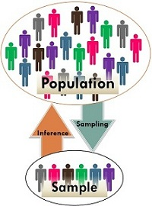
Inferential Statistics
It allows you to make inferences from that data. With inferential statistics, you take data from sample and make generalizations about a population.
For example, you might stand in a mall and ask a sample of 100 people if they like shopping at Levis.
You could make a bar chart of yes or no answers (that would be descriptive statistics) of the population (all shoppers in all malls)
Or you could use inferential statistics to reason that around 75-80% of the population like shopping at Levis taking multiple samples.
Hypothesis Testing

Slide 9
How to predict?
Find out whether someone will have a heart attack on the basis of demographic, diet and clinical measurements.
Establish the relationship between salary and demographic variables in population survey data.
Customize an email spam detection system.
Identify the numbers in a handwritten zip code.
Automate traffic signals according to road conditions

Slide 10
Predictive Statistics
Predict the future by examining historical data, detecting patterns and relationships, and extrapolating the relationships future in time.
Regression, Classification, forecasting
Predict apple sales on daily level for fruit shop
Predict the tree stress using leaf pressure and temperature sensor
Predict probability of loan default using loan amount, profession, education, gender

Slide 11
How to recommend?
Best price for Idly Sales in Restaurant?
Amount of cash to be stored in ATM
The optimal budget allocation for advertising combinations: TV, radio, and newspaper to maximize sales
Best route for fastest delivery
Influencing factors for product sales
Employee scheduling and supply chain designs
Optimization Problems
Prescriptive Statistics

Slide 12
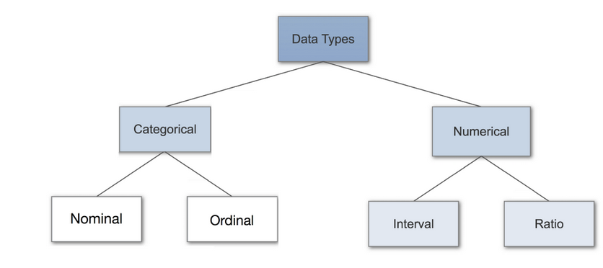
Data Types(measurement scales)

Slide 13
Categorical Data
Categorical data represents characteristics, things like gender, language etc.
Categorical data can also take on numerical values (Example: 1 for female and 0 for male). Note that those numbers don’t have mathematical meaning.
Nominal, Ordinal

Slide 14

Nominal Data
Nominal values represent discrete units and are used to label variables, that have no quantitative value.
Just think of them as “labels”, data that has no order. Therefore if you would change the order of its values, the meaning would not change.
dichotomous

Slide 15

Ordinal Data
Ordinal values represent discrete and ordered units.
It is therefore nearly the same as nominal data, except that it’s ordering matters.

Slide 16
Numerical Data
Discrete Data
Values are distinct and separate, data can only take on certain values.
This type of data can’t be measured but it can be counted.
An example is the number of heads in 100 coin flips.
2. Continuous Data
Continuous Data represents measurements, values can’t be counted but they can be measured.
An example would be the height of a person, which you can describe by using intervals on the real number line.

Slide 17
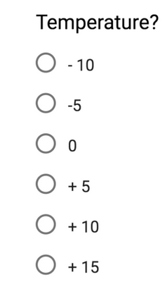
Interval Data
Interval values represent ordered units that have the same difference.
A variable contains numeric values that are ordered and where we know the exact differences between the values.
Problems:
Don’t have a “true zero”. to our example, that there is no such thing as no temperature.
We can add and subtract, but we cannot multiply, divide or calculate ratios. Because there is no true zero, a lot of descriptive and inferential statistics can’t be applied.

Slide 18
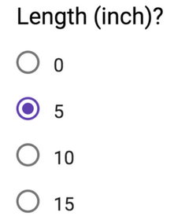
Ratio Data
Ratio values are also ordered units that have the same difference.
Ratio values are the same as interval values, with the difference that they do have an absolute zero.
Good examples are height, weight, length etc.
We can add, subtract, multiply, divide or calculate ratios.
Because there is true zero.
Notes:
https://towardsdatascience.com/data-types-in-statistics-347e152e8bee

Slide 19
A small Quiz!! – You get nothing if you win..
Example | Type of data
Classification of Departments- Eg – Marketing, Finance, HR, Operations | Nominal Data
Different suppliers | Nominal Data
Highest Educational Qualification | Ordinal Data
Cost incurred in Auto to travel from Silk board to Koramangala | Ratio Data
Time when to say Good morning/Afternoon or evening | Interval Data
Item Description | Nominal Data
Item Cost | Ratio Data
Order Date | Interval Data
Arrival Date | Interval Data
Quantity Ordered | Ratio Scale
The production quality rated from 1 to 5 | Ordinal Data
The ranking of top 10 students in a class | Ordinal Data
Vehicles classified as 2 wheeler, 4 wheeler, 8 wheeler | Nominal Data
No of wheels in a 2 wheeler, 4 wheeler, 8 wheeler | Ordinal Data

Slide 20
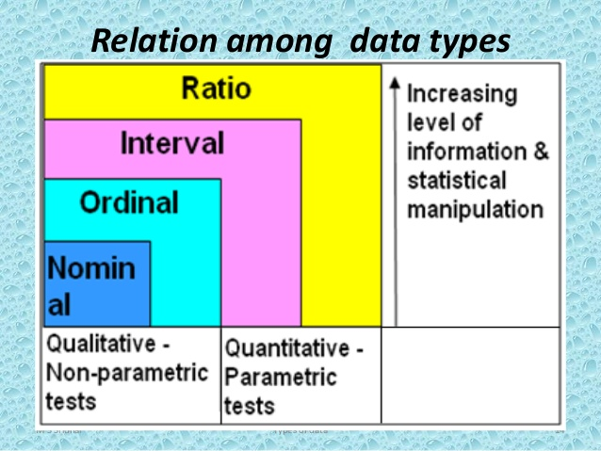
Why Data Types are important?
Datatypes are an important concept because statistical methods can only be used with certain data types.
You have to analyze continuous data differently than categorical data otherwise it would result in a wrong analysis.

Slide 21
Graphs
One Nominal/Ordinal variable : Bar Plot, Pie Chart
Two Nominal/Ordinal variable : table
One Continuous variable : Histogram
Two Continuous variable : Scatter Plot
One Continuous and one Categorical : Box Plot
One continuous with time : Line chart

Slide 22
Questions
Average weight of students in class
Average salary for data scientist
Average living cost in Bangalore
Average age group in party
Frequently used travel mode in Bangalore
Most popular laptop
Is there difference in color preference Pink/Blue between Male/Female

Slide 23
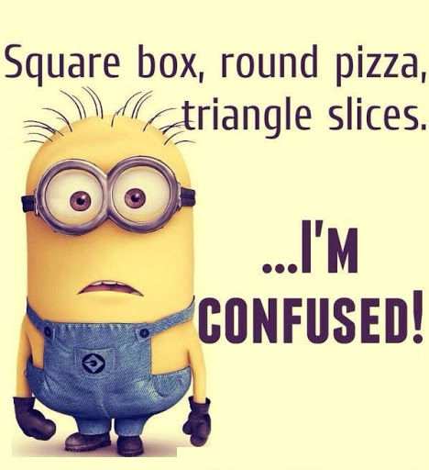
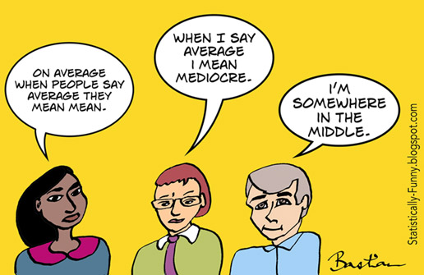
Where to start??
Categorical Data
Counts/frequency
Percentages
Crosstabs – Rows and Columns
Mode
Numerical Data- Most common way to summarize a numerical data is to describe where the center is:
Max, Min
Mean
Median, Quartile
Outliers – Numbers in a dataset that are
extremely high or low compared to the rest

Slide 24
Measures of Central Tendency
A measure of central tendency is a single value that attempts to describe a set of data by identifying the central position
Mean: Add up the numbers and divide by how many numbers.
Example: The mean of 4, 1, and 7 is (4+1+7)/3 = 12/3 = 4
Median: The middle number; found by ordering all data points and picking out the one in the middle (or if there are two middle numbers, taking the mean of those two numbers).
Example: The median of 4, 1, and 7 is 4 because when the numbers are put in order (1, 4, 7) , the number 4 is in the middle.
Mode: The most frequent number—that is, the number that occurs the highest number of times.
Example: The mode of {Bus,Car, Car, Bike, Bike, Car} is Car because it occurs three times, which is more than any other transport.

Slide 25
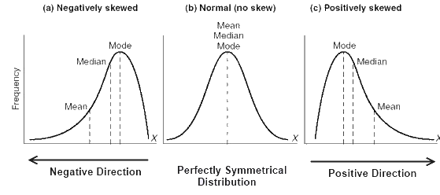
Empirical Relation Between Mean, Median And Mode
A distribution in which the values of mean, median and mode coincide (i.e. mean = median = mode) is known as a symmetrical distribution.
When values of mean, median and mode are not equal the distribution is known as asymmetrical or skewed distribution

Slide 26
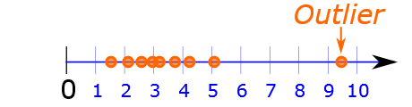
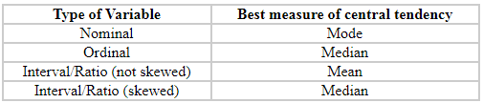
When to use what?
Mean:
An important property of the mean is that it includes every value in your data set as part of the calculation.
The mean is the only measure of central tendency where the sum of the deviations of each value from the mean is always zero.
The mean has one main disadvantage: it is particularly susceptible to the influence of outliers.
Median:
Not as strongly influenced by the outliers.
Time when we usually prefer the median over the mean (or mode) is when our data is skewed.
Mode:
Sometimes the mode is considered as being the most popular option.
Normally, the mode is used for categorical data where we wish to know which is the most common category
Problem with the mode is that it will not provide us with a very good measure of central tendency when the most common mark is far away from the rest of the data in the data set

Slide 27
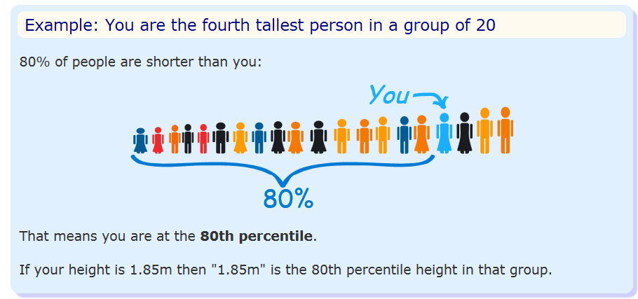
Percentile
Percentile: the value below which a percentage of data falls.
Example: Suppose the test scores were
22, 34, 68, 75, 79, 79, 81, 83, 84, 87, 90, 92 (12)
If your score was the 75, in what percentile did you score? – Ans 25 percentile
Which score will result in 60 percentile – Ans 83

Slide 28
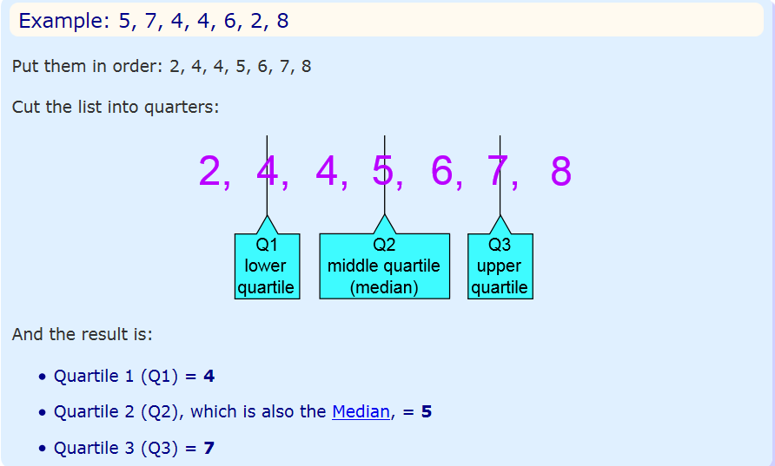
Quartile
Quartiles are the values that divide a list of numbers into quarters:
Put the list of numbers in order
Then cut the list into four equal parts
The Quartiles are at the "cuts"
quartiles (25th, 50th, and 75th percentiles) and the deciles (the 10th, 20th, …, 90th percentiles). Percentiles are especially valuable for summarizing the tails (the outer range) of the distribution.

Slide 29
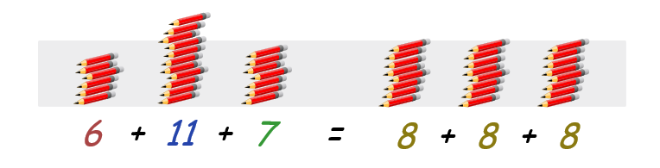
Problem
Two workers, on an average produce 8 pencils per day. And number of pencils produced the last 3 days given.
Which worker will you hire?

Slide 30
Problem
The scores of three batsman in the three matches played are as given below:
The average runs scored by all three is 100 runs.
If you have to pick only one batsman for the next match, which one will you pick and why??
 | Rohit Sharma | Virat Kohli | MS Dhoni
Match 1 | 5 | 95 | 50
Match 2 | 280 | 100 | 100
Match 3 | 15 | 105 | 150

Slide 31
Measure of Variability
Variability refers to amount of spread or variability within your data
There are four frequently used measures of variability:
Range,
Interquartile range
Variance
Standard deviation

Slide 32
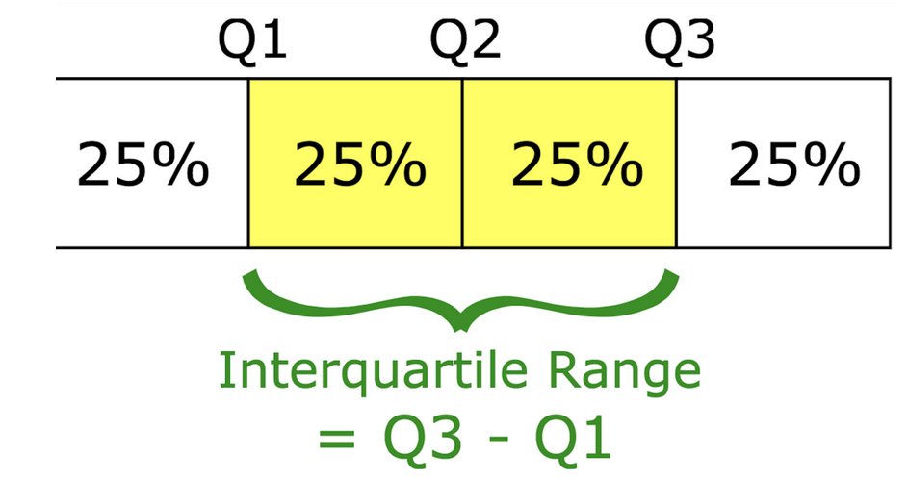
Measure of Variability
Range
Simplest measure of variability
Difference b/w highest score and lowest score
Lower the range, lower the variability in the data
Interquartile Range
Measure of statistical dispersion between upper (75th) and lower (25th) quartiles.

Slide 33
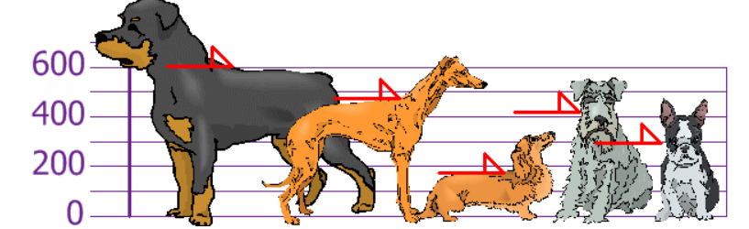
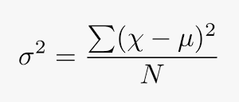
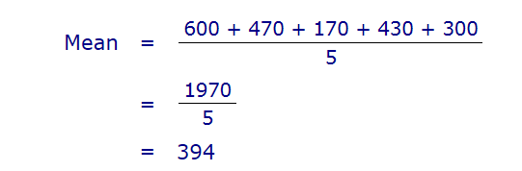
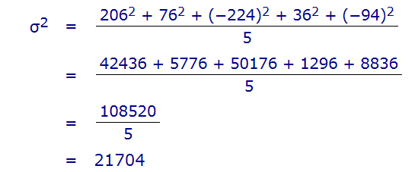
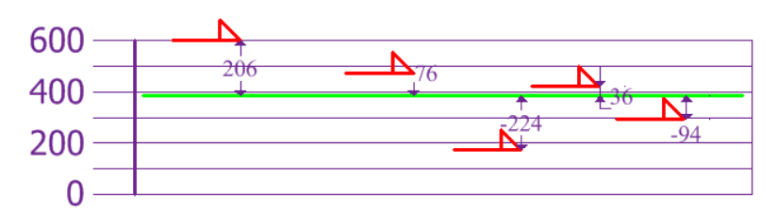
Variance
The average of the squared differences from the Mean
You and your friends have just measured the heights of your dogs (in millimeters):
The heights (at the shoulders) are: 600mm, 470mm, 170mm, 430mm, 300mm.
Notes:
https://www.mathsisfun.com/data/standard-deviation.html, The squares are used during the calculation because they weight outliers more heavily than points that are near to the mean.

Slide 34
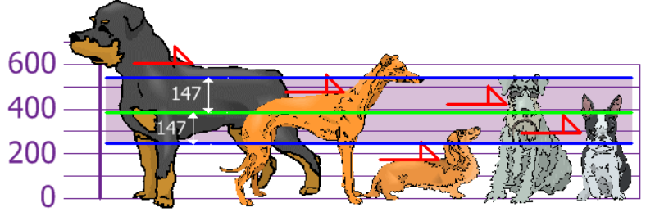
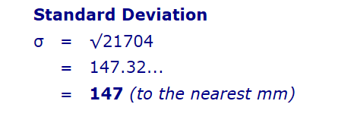
Standard deviation
The problem with Variance is that because of the squaring, it is not in the same unit of measurement as the original data.
Resolve using standard deviation the square root of Variance
So, using the Standard Deviation we have a "standard" way of knowing what is normal, and what is extra large or extra small.

Slide 35
Standard Deviation
Useful measure of variability when the distribution is normal or approximately normal
Standard deviation is also useful when comparing the spread of two separate data sets that have approximately the same mean
The data set with the smaller standard deviation has a narrower spread of measurements around the mean and therefore usually has comparatively fewer high or low values
An item selected at random from a data set whose standard deviation is low has a better chance of being close to the mean than an item from a data set whose standard deviation is higher.
Standard deviation is never negative.
Standard deviation is sensitive to outliers
If all values of a data set are the same, the standard deviation is zero
The standard deviation is expressed in the same units as the mean is, whereas the variance is expressed in squared units

Slide 36

Coefficient of variance
The coefficient of variation (CV) is a measure of relative variability. It is the ratio of the standard deviation to the mean (average).
The CV is particularly useful when you want to compare results from two different surveys or tests that have different measures or values.
For example, if you are comparing the results from two tests that have different scoring mechanisms. If sample A has a CV of 12% and sample B has a CV of 25%, you would say that sample B has more variation, relative to its mean.
Notes:
https://corporatefinanceinstitute.com/resources/knowledge/other/coefficient-of-variation/

Slide 37
Fred wants to find a new investment for his portfolio. He is looking for a safe investment that provides stable returns. He considers the following options for investment:
Stocks: Fred was offered stocks of ABC Corp. It is a mature company with the strong operational and financial performance. The volatility of the stock is 10% and the expected return is 14%.
ETFs: Another option is the Exchange-Traded Fund (ETF), which tracks the performance of the S&P 500 index. The ETF offers an expected return of 13% with a volatility of 7%.
Bonds: Bonds with excellent credit ratings offer an expected return of 3% with a 2% volatility.

Slide 38
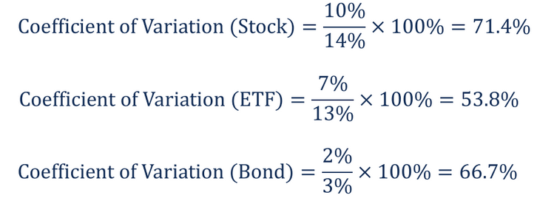
Based on the calculations above, Fred wants to invest in ETF because it offers the lowest coefficient (of variation) and the most optimal risk-to-reward ratio.

Slide 39
Analysis in employee data
Bar plot to find number of employee in each location
Then bar plot for each location and department wise number of employee
Which location has most loyal employees, high ratings, longer duration stay
Location has most star ratings
Coefficient of variance for particular department salary in different locations
Look calculations in Python

Slide 40
Exploring the Data Distribution
Each of the estimates we’ve covered sums up the data in a single number to describe the location or variability of the data. It is also useful to explore how the data is distributed overall
Boxplot :box and whiskers plot
Frequency table A tally of the count of numeric data values that fall into a set of intervals (bins).
Histogram A plot of the frequency table with the bins on the x-axis and the count (or pro‐ portion) on the y-axis.
Density plot A smoothed version of the histogram, often based on a kernel density estimate.

Slide 41
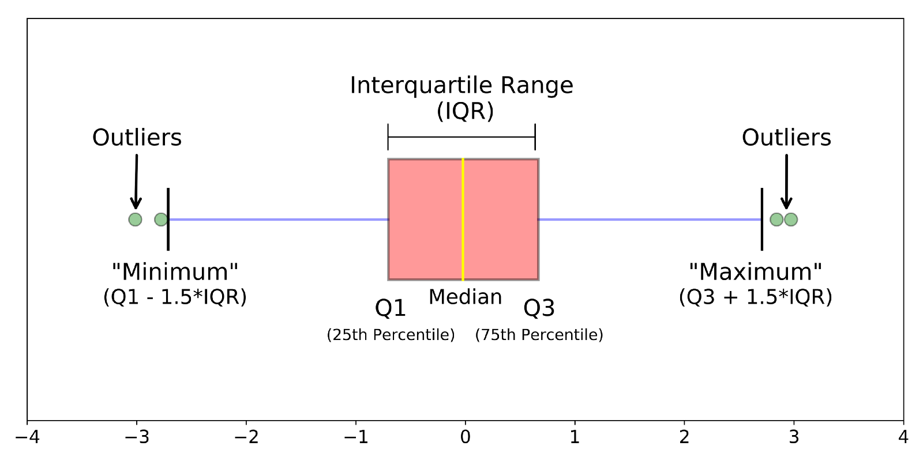
Boxplots are a standardized way of displaying the distribution of data based on a five number summary (“minimum”, first quartile (Q1), median, third quartile (Q3), and “maximum”).
with the top and bottom of the box at the 75th and 25th percentiles, respectively—gives a quick sense of the distribution of the data; it is often used in side-by-side displays to compare distributions.

Slide 42
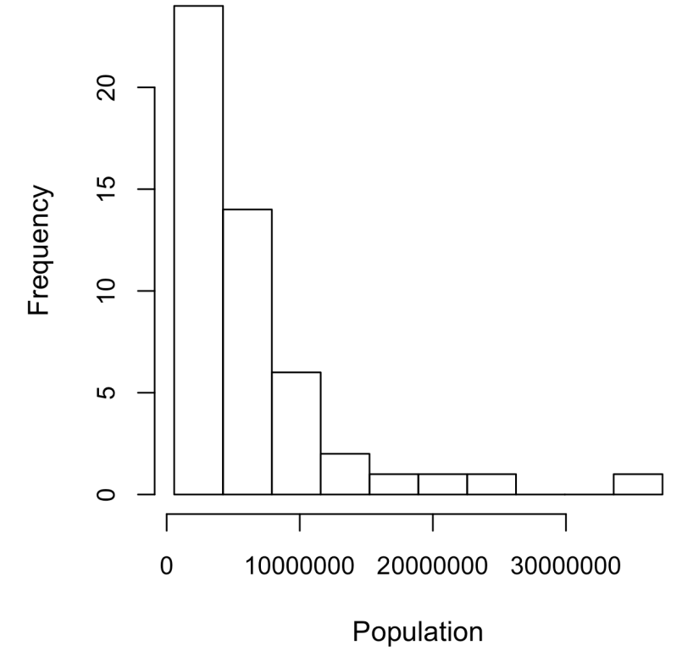
Frequency Tables and Histograms
A frequency table of a variable divides up the variable range into equally spaced segments and tells us how many values fall within each segment.
Empty bins are included in the graph.
• Bins are of equal width.
• The number of bins (or, equivalently, bin size) is up to the user.
• Bars are contiguous—no empty space shows between bars,
unless there is an empty bin.

Slide 43
Skewness and Kurtosis
In statistical theory, location and variability are referred to as the first and second moments of a distribution.
The third and fourth moments are called skewness and kurtosis. Skewness refers to whether the data is skewed to larger or smaller values
and kurtosis indicates the propensity of the data to have extreme values.
Generally, metrics are not used to measure skewness and kurtosis; instead, these are discovered through visual displays i.e. density plots

Slide 44
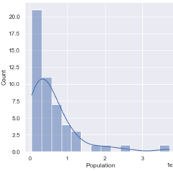
Density plot
Density plot, shows the distribution of data values as a continuous line. A density plot can be thought of as a smoothed histogram, although it is typically computed directly from the data through a kernel density estimate
A key distinction from the histogram plotted is the scale of the y-axis: a density plot corresponds to plotting the histogram as a proportion rather than counts
The total area under the density curve = 1, and instead of counts in bins you calculate areas under the curve between any two points on the x-axis, which correspond to the proportion of the distribution lying between those two points.

Slide 45
Exploring Binary and Categorical Data
For categorical data, simple proportions or percentages tell the story of the data.
Mode The most commonly occurring category or value in a data set.
Expected value When the categories can be associated with a numeric value, this gives an average value based on a category’s probability of occurrence.
Bar charts The frequency or proportion for each category plotted as bars.
Pie charts The frequency or proportion for each category plotted as wedges in a pie.

Slide 46
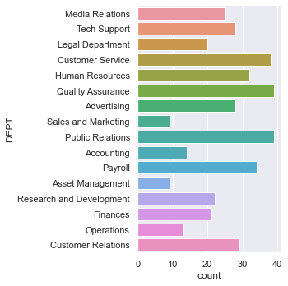
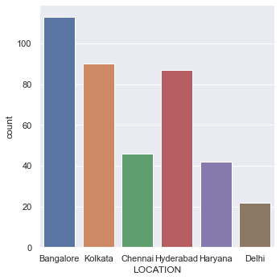
Note that a bar chart resembles a histogram; in a bar chart the x-axis represents different categories of a factor variable, while in a histogram the x-axis represents values of a single variable on a numeric scale.
In a histogram, the bars are typically shown touching each other, with gaps indicating values that did not occur in the data. In a bar chart, the bars are shown separate from one another.

Slide 47
Expected value
A special type of categorical data is data in which the categories represent or can be mapped to discrete values on the same scale.
A marketer for a new cloud technology, for example, offers two levels of service, one priced at $300/month and another at $50/month.
The marketer offers free webinars to generate leads, and the firm figures that 5% of the attendees will sign up for the $300 service, 15% will sign up for the $50 service, and 80% will not sign up for anything.
This data can be summed up, for financial purposes, in a single “expected value,” which is a form of weighted mean, in which the weights are probabilities
In the cloud service example, the expected value of a webinar attendee is calculated as follows: EV = 0 . 05* 300 + 0 . 15* 50 + 0 . 80 *0 = 22 . 5

Slide 48
In everyday life, we come across statements such as
It will probably rain today.
I doubt that he will pass the test.
Chances are high that the prices of diesel will go up.
There is a 50-50 chance of India winning a toss in today’s match.
Sports and games are more often expressed as odds, which are readily convertible to probabilities (if the odds that a team will win are 2 to 1, its probability of winning is 2/(2+1) = 2/3)

Slide 49
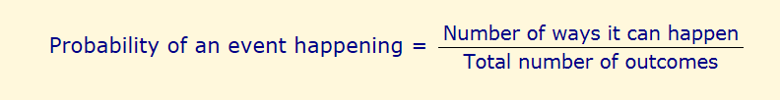
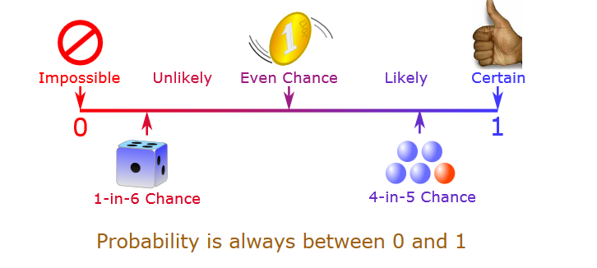
Probability
Many events can't be predicted with total certainty. The best we can say is how likely they are to happen, using the idea of probability.
Notes:
https://www.mathsisfun.com/data/probability.html
https://www.analyticsvidhya.com/blog/2017/09/6-probability-distributions-data-science/

Slide 50
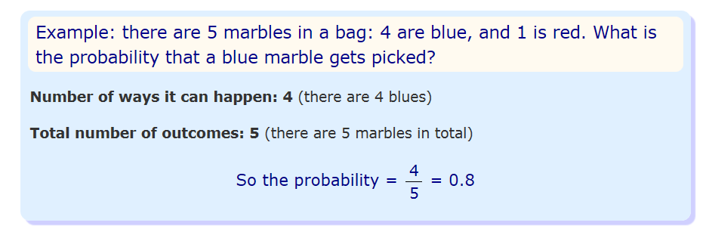
For our purposes, the probability is an event will happen is the proportion of times it will occur if the situation could be repeated over and over, countless times.

Slide 51
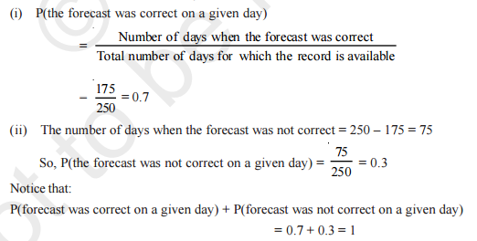
Example 1
The record of a weather station shows that out of the past 250 consecutive days, its weather forecasts were correct 175 times.
(i) What is the probability that on a given day it was correct?
(ii) What is the probability that it was not correct on a given day?

Slide 52

Example 2
A tyre manufacturing company kept a record of the distance covered before a tyre needed to be replaced. The table shows the results of 1000 cases
If you buy a tyre of this company, what is the probability that :
it will need to be replaced before it has covered 4000 km?
it will last more than 9000 km?
it will need to be replaced after it has covered somewhere between 4000 km and 14000 km?

Slide 53
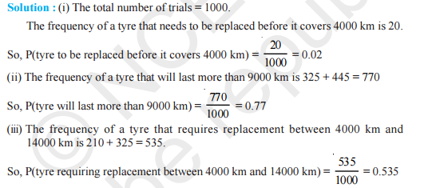
Example 2

Slide 54

Example 3
The percentage of marks obtained by a student in the monthly unit tests are given below
find the probability that the student gets more than 70% marks in a unit test.

Slide 55

Example 3

Slide 56
Example 4
An insurance company selected 2000 drivers at random (i.e., without any preference of one driver over another) in a particular city to find a relationship between age and accidents.
Age of Drivers (in Years) | Accidents in One year
 | 0 | 1 | 2 | 3 | Over 3
18-29 | 440 | 160 | 110 | 61 | 35
30-50 | 505 | 125 | 60 | 22 | 18
above 50 | 360 | 45 | 35 | 15 | 9
Find the probabilities of the following events for a driver chosen at random from the city
(i)being 18-29 years of age and having exactly 3 accidents in one year.
(ii) being 30-50 years of age and having one or more accidents in a year.
(iii) Having no accident in one year.

Slide 57
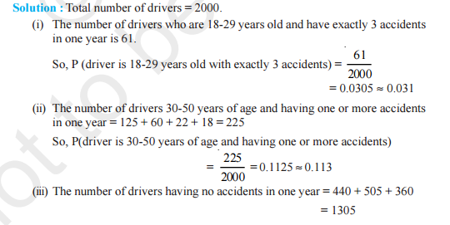

Example 4

Slide 58

Example 5
Fifty seeds were selected at random from each of 5 bags of seeds, and were kept under standardised conditions favourable to germination. After 20 days, the number of seeds which had germinated in each collection were counted and recorded
What is the probability of germination of
(i) more than 40 seeds in a bag?
(ii) 49 seeds in a bag?
(iii) more that 35 seeds in a bag?

Slide 59

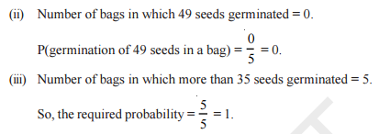
Example 5

Slide 60
Correlation
Exploratory data analysis in many modeling projects (whether in data science or in research) involves examining correlation among predictors, and between predictors and a target variable.
Variables X and Y (each with measured data) are said to be positively correlated if high values of X go with high values of Y, and low values of X go with low values of Y.
If high values of X go with low values of Y, and vice versa, the variables are negatively correlated

Slide 61
Key Terms for Correlation
Correlation coefficient A metric that measures the extent to which numeric variables are associated with one another (ranges from –1 to +1).
Correlation matrix A table where the variables are shown on both rows and columns, and the cell values are the correlations between the variables.
Scatterplot A plot in which the x-axis is the value of one variable, and the y-axis the value of another

Slide 62
Exploring Two or More Variables
Familiar estimators like mean and variance look at variables one at a time (univariate analysis).
Correlation analysis is an important method that compares two variables (bivariate analysis).
And at more than two variables (multivariate analysis).

Slide 63
Hexagonal binning and contour plots are useful tools that permit graphical examination of two numeric variables at a time, without being overwhelmed by huge amounts of data.
Contingency tables are the standard tool for looking at the counts of two categorical variables.
Boxplots and violin plots allow you to plot a numeric variable against a categorical variable.

Slide 64
Thank You

Slide 65
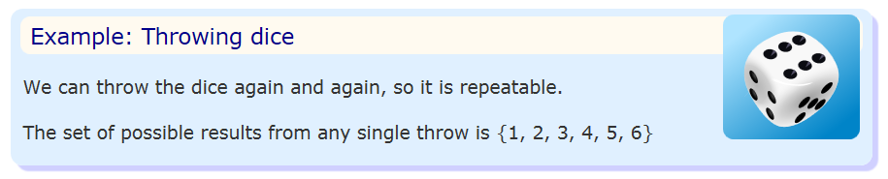
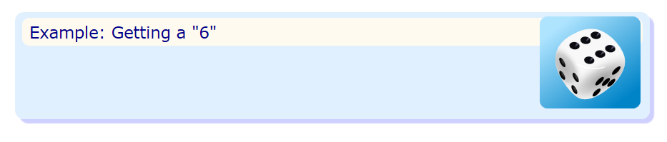
Terms
Experiment: a repeatable procedure with a set of possible results.
Outcome: A possible result of an experiment.

Slide 66
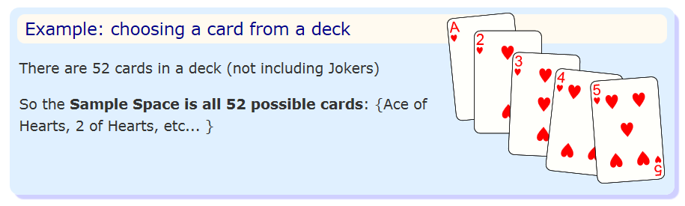
Terms
Sample Space: all the possible outcomes of an experiment.

Slide 67
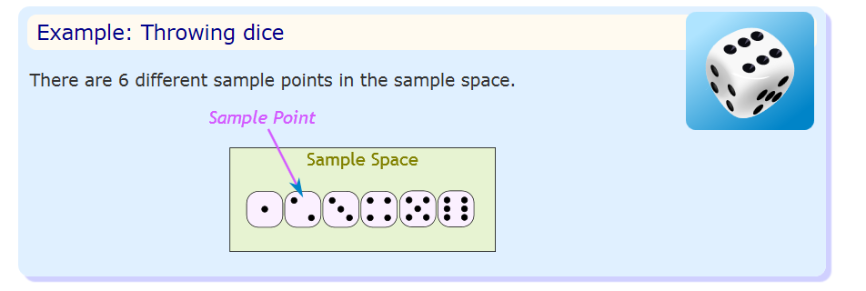
Sample Point: just one of the possible outcomes

Slide 68
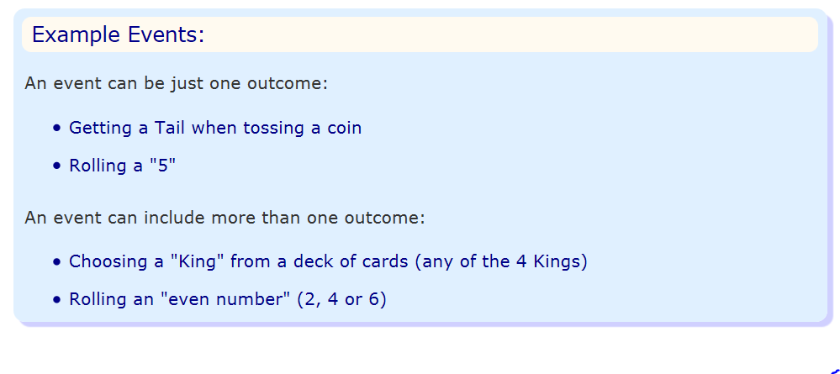
Event: one or more outcomes of an experiment

Slide 69
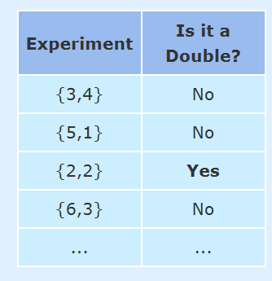
Example: Alex wants to see how many times a "double" comes up when throwing 2 dice.
The Sample Space is all possible Outcomes (36 Sample Points):
{1,1} {1,2} {1,3} {1,4} ... {6,3} {6,4} {6,5} {6,6}
The Event Alex is looking for is a "double", where both dice have the same number. It is made up of these 6 Sample Points:
{1,1} {2,2} {3,3} {4,4} {5,5} and {6,6}
After 100 Experiments, Alex has 19 "double" Events ...

Slide 70
Life is full of random events!
You need to get a "feel" for them to be a smart and successful person.
The toss of a coin, throw of a dice and lottery draws are all examples of random events.

Slide 71
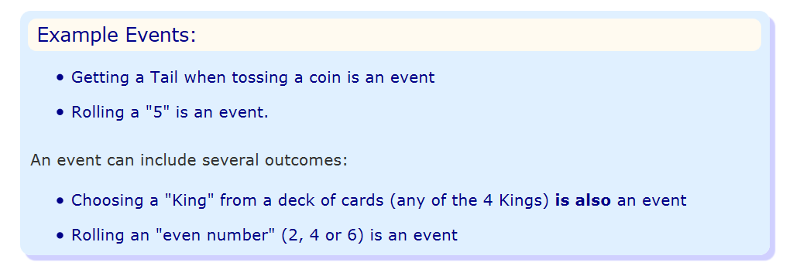
Events
When we say "Event" we mean one (or more) outcomes.

Slide 72
Events can be:
Independent (each event is not affected by other events),
Dependent (also called "Conditional", where an event is affected by other events)
Mutually Exclusive (events can't happen at the same time)
Equally Likely: probability is equal

Slide 73

Independent Events
Events can be "Independent", meaning each event is not affected by any other events.
Notes:
https://www.mathsisfun.com/data/probability-events-independent.html

Slide 74
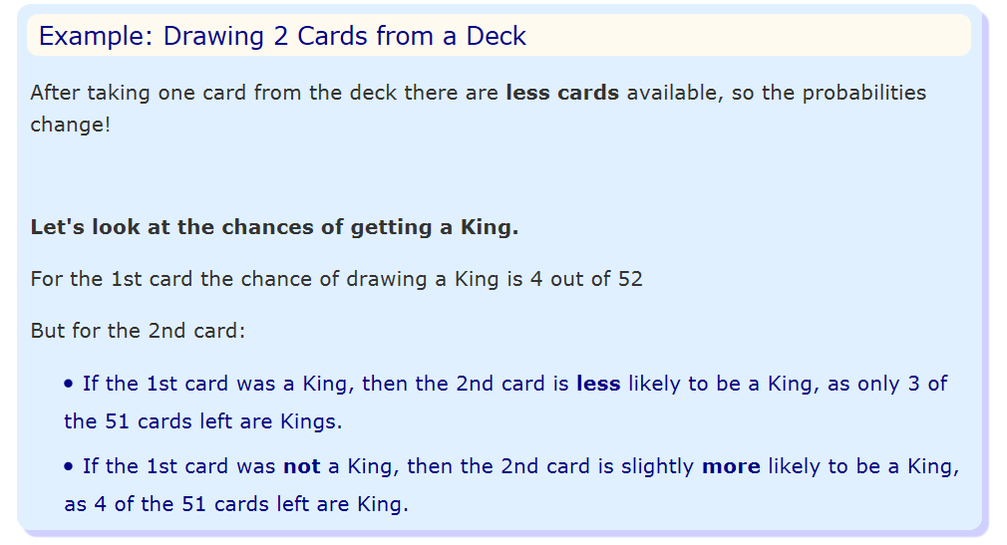
Dependent Events
"dependent“ event means they can be affected by previous events.
Notes:
https://www.mathsisfun.com/data/probability-events-types.html

Slide 75
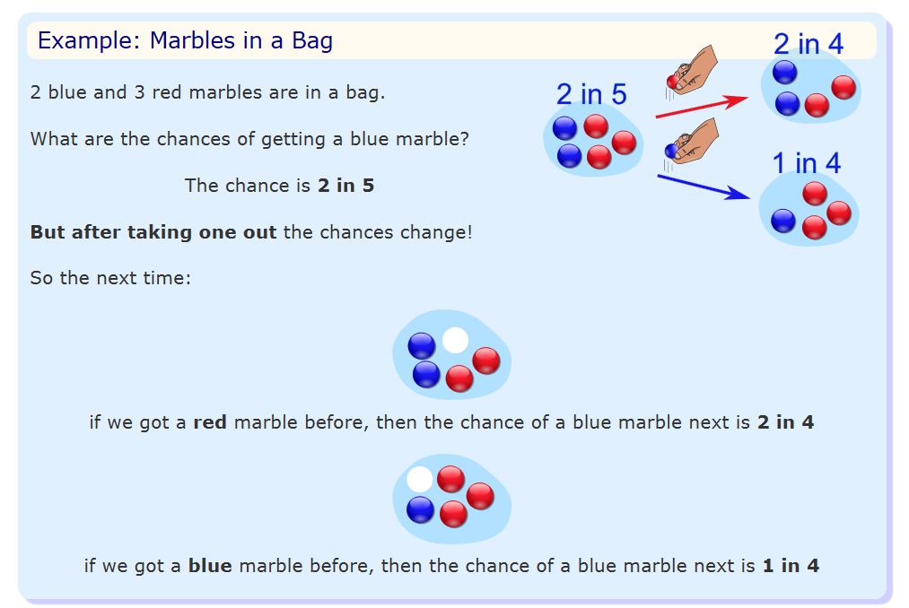

Slide 76
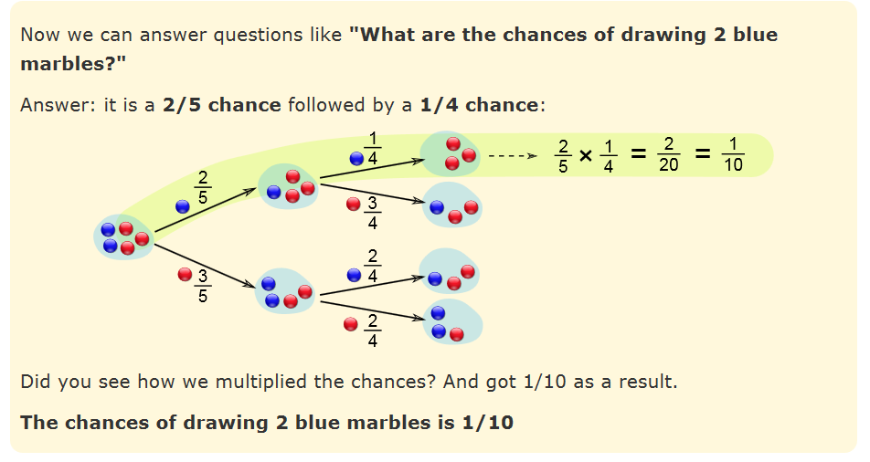

Slide 77


Slide 78
Three machines E1 , E2 , E3 in a certain factory produce 50%, 25% and 25%, respectively, of the total daily output of electric tubes.
It is known that 4% of the tubes produced one each of machines E1 and E2 are defective, and that 5% of those produced on E3 are defective.
If one tube is picked up at random from a day’s production, calculate the probability that it is defective.

Slide 79
D
4%
50%
ND
E1
D
4%
E2
Sample: 100%, all electric tubes
Event: tubes which are defective
50%*4% + 25%*4% + 25%*5%
25%
ND
E3
D
5%
25%
ND

Slide 80
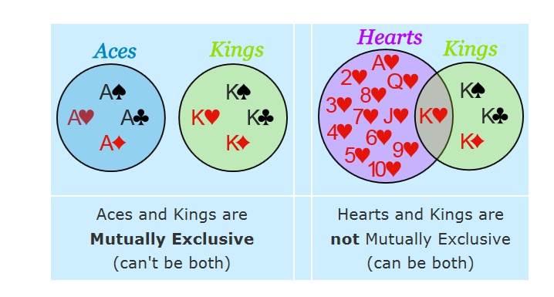
Mutually Exclusive
Mutually Exclusive means we can't get both events at the same time.
Notes:
https://www.mathsisfun.com/data/probability-events-mutually-exclusive.html

Slide 81
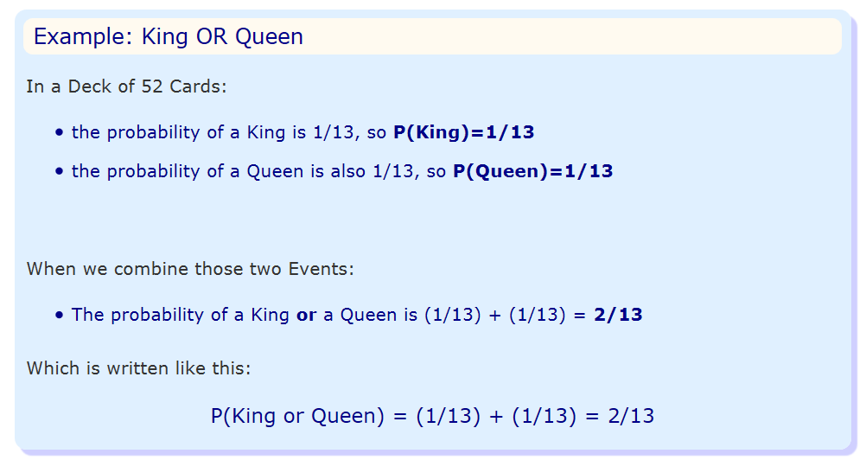
So, we have:
P(King and Queen) = 0
P(King or Queen) = (1/13) + (1/13) = 2/13

Slide 82
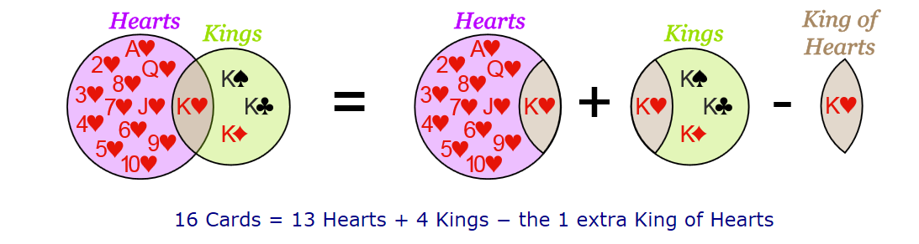

Slide 83
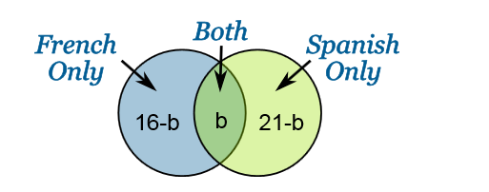





16 people study French, 21 study Spanish and there are 30 altogether. What is the probability selected person with speak French or Spanish?

Slide 84

Random Variables
A Random Variable is a set of possible values from a random experiment.

Slide 85
Random Variables
Something is random when it varies by chance
a numerical characteristic that takes on different values due to chance
Example: Rolling a die there are six equally possible outcomes, the observed outcome on any one roll is random.

Slide 86
Random Variable
To have a consistent mathematical basis for dealing with probability, we would like the outcomes of all experiments to be numerical.
A random variable is a numerical description of the outcome of an experiment
A random variable is a function that assigns a real number to each element of a sample space.
Discrete Random Variable:
It is one for which the number of outcomes can be counted.
Eg Customer reaction to a product, Outcomes of rolling two dice, No of hits on a website
Continuous Random Variable:
It has outcomes over one or more continuous intervals of real numbers.
Eg: The daily temperature, Time to complete a task, The time between failures

Slide 87
Types
A discrete random variable has a countable set of distinct possible values.
Number of classes missed last week (possible outcomes are 0, 1, 2, 3, ..., up to the maximum number of classes)
A continuous random variable is such that any value (to any number of decimal places) within some interval is a possible value.
Heights of individuals
Time to finish a test
Hours spent exercising last week

Slide 88
Probability distribution
A table, graph, or formula that gives the probability of a given outcome's occurrence

Slide 89
Probability distribution
For a discrete random variable, its probability distribution (also called the probability distribution function) is any table, graph, or formula that gives each possible value and the probability of that value.
Note: The total of all probabilities across the distribution must be 1, and each individual probability must be between 0 and 1, inclusive.

Slide 90
A census was conducted at a university. All students were asked how many tattoos they had.
Tattoos | 0 | 1 | 2 | 3 | 4
Probability | .850 | .120 | .015 | .010 | .005

Slide 91
Expected Value of a Discrete Random Variable
Tattoos | 0 | 1 | 2 | 3 | 4
Probability | .850 | .120 | .015 | .010 | .005
E(X)=0(.85)+1(.12)+2(.015)+3(.010)+4(.005)=.20
The mean number of tattoos per student is .20.

Slide 92
A fair six-sided die is tossed. You win $2 if the result is a “1,” you win $1 if the result is a “6,” otherwise you lose $1.
The Probability Distribution for X = Amount Won or Lost

Slide 93
The Probability Distribution for X = Amount Won or Lost
X | +$2 | +$1 | -$1
Probability | 1/6 | 1/6 | 4/6
E(X)

Slide 94

The Probability Distribution for X = Amount Won or Lost
X | +$2 | +$1 | -$1
Probability | 1/6 | 1/6 | 4/6
E(X)=$2(1/6)+$1(1/6)+(−$1)(4/6)
=$−1/6
=−$0.17
if you play many times, the average outcome is losing 17 cents per play.
Thus, over time you should expect to lose money.

Slide 95

Standard Deviation
For instance, you may "expect" to win $20 when playing a particular game (which appears good!), but the spread for this might be from losing $20 to winning $60. Knowing such information can influence you decision on whether to play.

Slide 96
A class has 15 students whose ages are 14, 17, 15, 14, 21, 17, 19, 20, 16, 18, 20, 17, 16, 19 and 20 years. One student is selected in such a manner that each has the same chance of being chosen and the age X of the selected student is recorded. What is the probability distribution of the random variable X?
Find mean, variance and standard deviation of X.

Slide 97
Statistical Experiment and Probability Distribution
All statistical experiments have three things in common:
The experiment can have more than one possible outcome.
Each possible outcome can be specified in advance.
The outcome of the experiment depends on chance.
Eg – Coin Toss, draw 1 card from a pack of cards.
A probability distribution is a table or an equation that links each outcome of a statistical experiment with its probability of occurrence. Suppose you flip a coin two times. The table below, which associates each outcome with its probability, is an example of a probability distribution.
Number of heads | Probability
0 | 0.25
1 | 0.5
2 | 0.25

Slide 98
Types of Distributions:
Discrete Probability Distribution
Bernoulli Distribution
Binomial Distribution
Continuous Probability Distribution
Uniform Distribution
Normal Distribution
Poisson Distribution
Exponential Distribution

Slide 99

Bernoulli Distribution
A random experiment that has only two outcomes (usually called a “Success” or a “Failure”)
Probability of success is denoted by p and probability of failure as (1-p)
The probability density function is given as below:

Slide 100
Binomial Distribution
A binomial experiment has four properties:
It consists of a sequence of n identical trials
Two outcomes, success or failure, are possible on each trial
The probability of success on any trial, denoted p, does not change from trial to trial
The trials are independent
Bernoulli is a special case of binomial with n = 1
The probability function is given as below:

Slide 101

Poisson Distribution
The Poisson probability distribution is often used as a model of the number of arrivals at a facility within a given period of time.
Examples –
No of customers arriving at a subway stores during lunch hour
No of errors per line of software code
It assumes no limit on no of occurrences ( X can assume any non negative integer value)
Occurrences are independent and avg no of occurrences per unit is constant.

Slide 102


Uniform Distribution
A uniform distribution, also called a rectangular distribution, is a probability distribution that has constant probability.
This distribution is defined by two parameters, a and b:
a is the minimum.
b is the maximum.

Slide 103


Exponential Distribution
It is often used to model the time elapsed between events.
Often used in such applications as modelling time between customer arrivals to a service system or the time to or between failures of machines.
If the number of events occurring during as interval of time has a Poisson distribution, then the time between events is exponentially distributed.

Slide 104

Normal Random Variables
A symmetric bell-shaped density function.
The distribution of IQ scores is normal
The total area under the curve is 1.00, or 100%.
In other words, 100% of observations fall under the curve.

Slide 105
The normal distribution has the following properties:
The distribution is symmetric, so its measure of skewness is zero
The mean, median, and mode are all equal. Half area falls above mean and half below
The range of X is unbounded. Meaning the tail extend to positive and negative infinity
The empirical rule apply exactly for normal distribution. The empirical rule tells you what percentage of your data falls within a certain number of standard deviations from the mean:
68% of the data falls within one standard deviation of the mean.
95% of the data falls within two standard deviations of the mean.
99.7% of the data falls within three standard deviations of the mean.
Standard normal distribution is a special case of normal distribution where mean = 0 and S.D = 1

Slide 106


Steps to solve a normal distribution problem:
Draw a bell shaped curve with a mean line. Shade the area or probability we are looking for by looking at the keywords – Between, Less than, greater than etc.
Find out the Z score –
subtract the mean from X
divide by the standard deviation.
Find corresponding probability from the Z table

Slide 107


Slide 108


Slide 109

µ can be any numerical value
Slides distribution side to side

Slide 110
This becomes very very important when you are trying to determine the two population/sample are statistically different or not.

Slide 111


Slide 112
probability that the IQ of a randomly selected individual will be less than 115

Slide 113

probability that the IQ of a randomly selected individual will be between 115 and 130

Slide 114
Scenario: Vehicle speeds at a highway location have a normal distribution with a mean of 65 mph and a standard deviation of 5 mph.
Question: What is the probability that a randomly selected vehicle will be going 73 mph or slower?

