Slide 1
Regression

Slide 2
Example
Problem : To provide advice to client on how to improve sales of a particular product.
Data : The Advertising data set consists of the sales of that product in 200 different markets, along with advertising budgets for the product in each of those markets for three different media: TV, radio, and newspaper.
Understanding:
It is not possible for our client to directly increase sales of the product. On the other hand, they can control the advertising expenditure in each of the three media.
Therefore, if we determine that there is an association between advertising and sales, then we can instruct our client to adjust advertising budgets, thereby indirectly increasing sales.
Advertising budgets are input variables while sales input is an output variable.
on the basis of this data, a marketing plan for next year that will result in high product sales.

Slide 3
Questions
Is there a relationship between advertising budget and sales?
How strong is the relationship between advertising budget and sales?
Which media contribute to sales? Do all three media—TV, radio, and newspaper—contribute to sales, or do just one or two of the media contribute?
How accurately can we estimate the effect of each medium on sales?
For every dollar spent on advertising in a particular medium, by what amount will sales increase?
How accurately can we predict future sales?
For any given level of television, radio, or newspaper advertising, what is our prediction for sales, and what is the accuracy of this prediction?

Slide 4
Questions
Is the relationship linear?
If there is approximately a straight-line relationship between advertising expenditure in the various media and sales, then linear regression is an appropriate tool.
If not, then it may still be possible to transform the predictor or the response so that linear regression can be used.
Is there synergy among the advertising media?
Perhaps spending $50,000 on television advertising and $50,000 on radio advertising results in more sales than allocating $100,000 to either television or radio individually.
In marketing, this is known as a synergy effect, while in statistics it is called an interaction effect.
We can use linear regression to answer each of these questions.

Slide 5

Regression
Supervised Approach for predicting a quantitative response Y on the basis of predictor variables X.
It assumes that there is approximately a linear relationship between X and Y .
Mathematically, we can write this linear relationship as

Slide 6
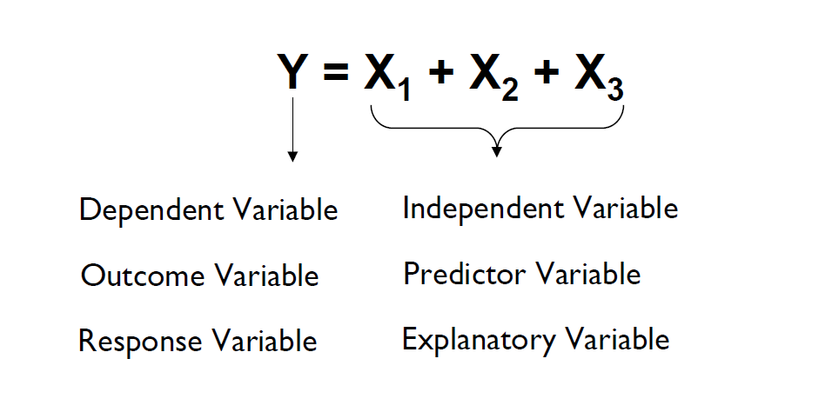

Slide 7
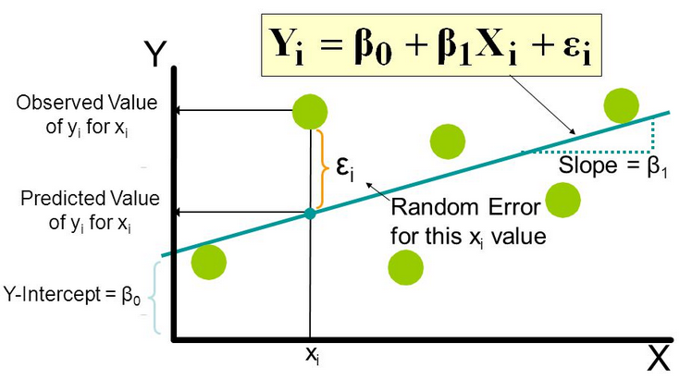
Explanation : Y = βo + β1X + ∈
Y - This is the variable we predict
X - This is the variable we use to make a prediction
βo - This is the intercept term. It is the prediction value you get when X = 0
β1 - This is the slope term. It explains the change in Y when X changes by 1 unit.
∈ - This represents the residual value, i.e. the difference between actual and predicted values.

Slide 8
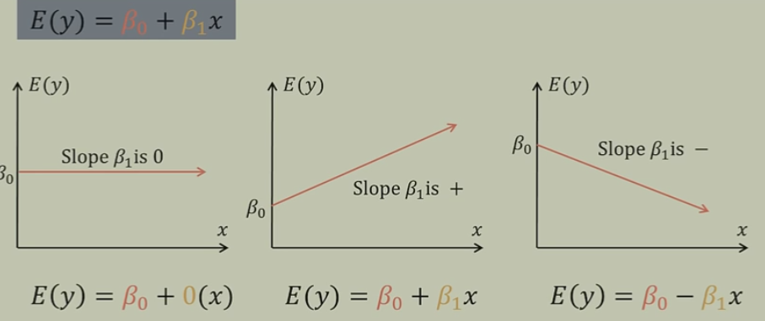

Slide 9
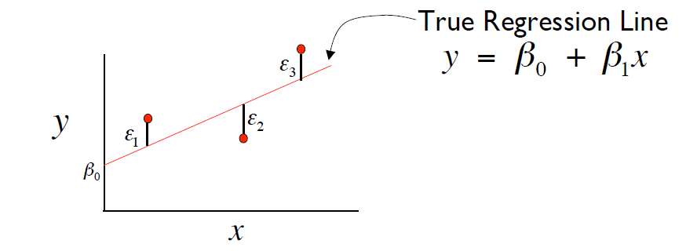
Least squares estimation
Determines the best fit line by minimizing the square of the vertical distance of all the points from the line.
Sum of square error

Slide 10
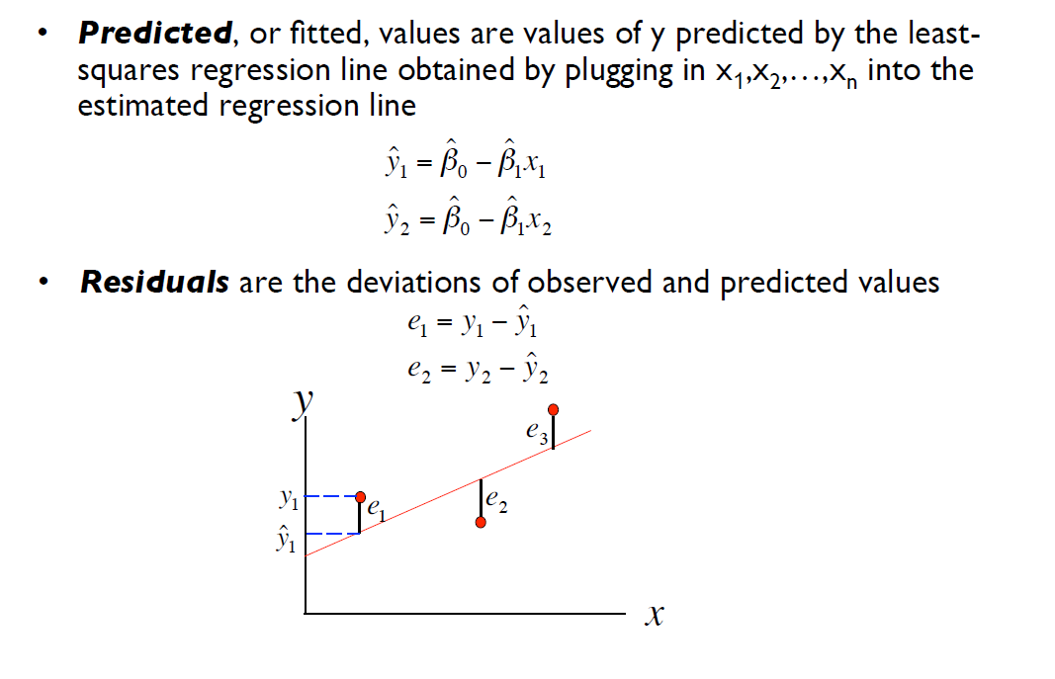

Slide 11
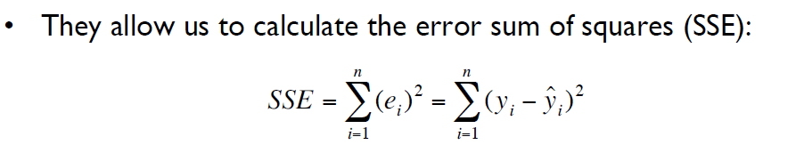
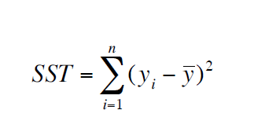
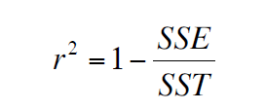

Slide 12
Assumptions
Regression is a parametric technique, so it makes assumptions.
There exists a linear and additive relationship between dependent (DV) and independent variables (IV).
By linear, it means that the change in DV by 1 unit change in IV is constant.
By additive, it refers to the effect of X on Y is independent of other variables.
There must be no correlation among independent variables. Presence of correlation in independent variables lead to Multicollinearity. If variables are correlated, it becomes extremely difficult for the model to determine the true effect of IVs on DV.
The error terms must possess constant variance. Absence of constant variance leads to heteroskedestacity.
The error terms must be uncorrelated i.e. error at ∈t must not indicate the at error at ∈t+1.
The dependent variable and the error terms must possess a normal distribution.

