Slide 1
Insurance Premium

Slide 2
Insurance Data
Predicting medical expenses using linear regression
In order for an insurance company to make money, it needs to collect more in yearly premiums than it spends on medical care to its beneficiaries.
As a result, insurers invest a great deal of time and money to develop models that accurately forecast medical expenses.
Notes:
Medical expenses are difficult to estimate because the most costly conditions are
rare and seemingly random. Still, some conditions are more prevalent for certain
segments of the population. For instance, lung cancer is more likely among smokers
than non-smokers, and heart disease may be more likely among the obese.

Slide 3
The goal of this analysis is to use patient data to estimate the average medical care expenses for such population segments.
These estimates could be used to create actuarial tables which set the price of yearly premiums higher or lower depending on the expected treatment costs.

Slide 4
Data Set
The insurance.csv file includes 1,338 examples of beneficiaries currently enrolled in the insurance plan
With features indicating characteristics of the patient as well as the total medical expenses charged to the plan for the calendar year.

Slide 5
age: This is an integer indicating the age of the primary beneficiary (excluding those above 64 years, since they are generally covered by the government).
sex: This is the policy holder's gender, either male or female.
bmi: This is the body mass index (BMI), which provides a sense of how over or under-weight a person is relative to their height. BMI is equal to weight (in kilograms) divided by height (in meters) squared. An ideal BMI is within the range of 18.5 to 24.9.
children: This is an integer indicating the number of children / dependents covered by the insurance plan.
smoker: This is yes or no depending on whether the insured regularly smokes tobacco.
region: This is the beneficiary's place of residence in the U.S., divided into four geographic regions: northeast, southeast, southwest, or northwest.

Slide 6
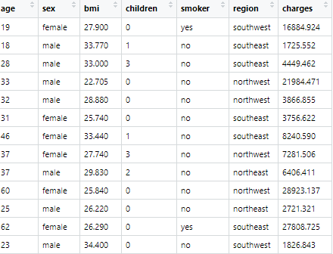

Slide 7
Step 1: Reading/ preparing the data
#predicting medical expenses using linear regression
insurance_data<- read.csv("D:/work/Shanu/ATI/Base_Analytics/class4/insurance.csv")
#Check the Structure of data
str(insurance_data)
#Check the summary of data, if any missing values NA
summary(insurance_data)
#Check first few rows
head(insurance_data)

Slide 8
Step 2: Data Exploration
It is important to give some thought to how these variables may be related to billed medical expenses.
We might expect that older people higher risk of large medical expenses
smokers are at higher risk of large medical expenses.
Over weight people has higher risk of medical expense
Use graphs to explore this

Slide 9
Step 3 : Model Building
ins_model <- lm(charges ~ age + children + bmi + sex +
smoker + region, data = insurance_data)
ins_model <- lm(charges ~ ., data = insurance)

Slide 10
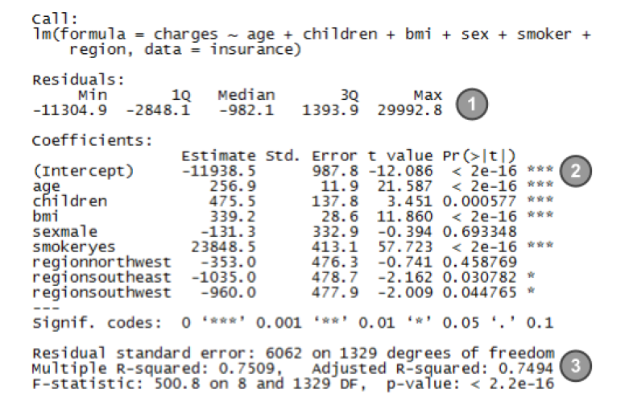
Step 4: Evaluate the model
Summary(ins_model)

Slide 11
The Residuals section provides summary statistics for the errors in predictions.
Since a residual is equal to the true value minus the predicted value, the maximum error of 29992.8 suggests that the model under-predicted expenses by nearly $30,000 for at least one observation.
On the other hand, 50 percent of errors fall within the 1Q and 3Q values (the first and third quartile), so the majority of predictions were between $2,850 over the true value and $1,400 under the true value.

Slide 12
The stars (for example, ***) indicate the predictive power of each feature in the model.
The presence of three stars indicates a significance level of 0, which means that the feature is extremely unlikely to be unrelated to the dependent variable.
If the model had few features that were statistically significant, it may be cause for concern, since it would indicate that our features are not very predictive of the outcome.
Here, our model has several significant variables, and they seem to be related to the outcome in logical ways.

Slide 13
The Multiple R-squared value (also called the coefficient of determination) provides a measure of how well our model as a whole explains the values of the dependent variable.
Since the R-squared value is 0.7494, we know that nearly 75 percent of the variation in the dependent variable is explained by our model.
Because models with more features always explain more variation, the Adjusted R-squared value corrects R-squared by penalizing models with a large number of independent variables.
It is useful for comparing the performance of models with different numbers of explanatory variables.

Slide 14
Step 5: Improving the model
Model specification – adding non-linear relationships
In linear regression, the relationship between an independent variable and the dependent variable is assumed to be linear, yet this may not necessarily be true.
For example, the effect of age on medical expenditures may not be constant throughout all age values; the treatment may become disproportionately expensive for the oldest populations.

Slide 15
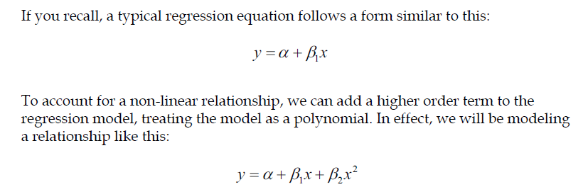
insurance$age2 <- insurance$age^2

Slide 16
Transformation – converting a numeric variable to a binary indicator
Suppose effect of a feature is not cumulative, but rather it has an effect only once a specific threshold has been reached.
For instance, BMI may have zero impact on medical expenditures for individuals in the normal weight range, but it may be strongly related to higher costs for the obese (that is, BMI of 30 or above).
insurance$bmi30 <- ifelse(insurance$bmi >= 30, 1, 0)

Slide 17
Model specification – adding interaction effects
So far, we have only considered each feature's individual contribution to the outcome.
What if certain features have a combined impact on the dependent variable?
For instance, smoking and obesity may have harmful effects separately, but it is reasonable to assume that their combined effect may be worse than the sum of each one alone.

Slide 18
When two features have a combined effect, this is known as an interaction.
If we suspect that two variables interact, we can test this hypothesis by adding their interaction to the model.

Slide 19
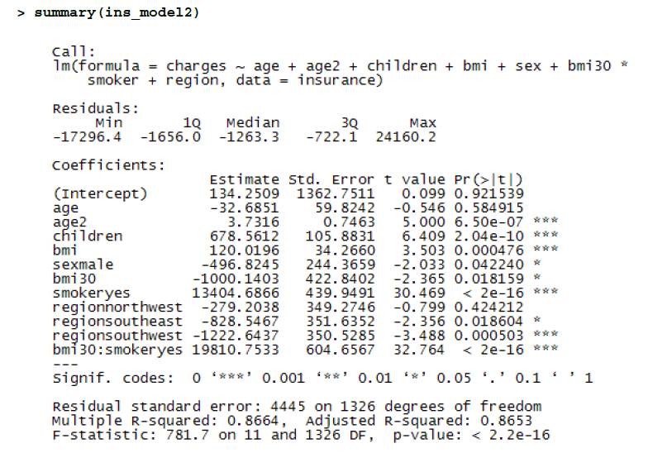

Slide 20
Interpretation
The model fit statistics help to determine whether our changes improved the performance of the regression model.
Relative to our first model, the R-squared value has improved from 0.75 to about 0.87. Our model is now explaining 87 percent of the variation in medical treatment costs.
The higher-order age2 term is statistically significant, as is the obesity indicator, bmi30.
The interaction between obesity and smoking suggests a massive effect; in addition to the increased costs of over $13,404 for smoking alone, obese smokers spend another $19,810 per year.
This may suggest that smoking exacerbates diseases associated with obesity.

Slide 21
Assignment
Buy cheap and sell dear is the fundamental goal for a market economy. If you purchase something at a lower market price, you have a higher leverage to make profit.
ByeBuyHome is a property listing site that aggregates ready-to-buy properties and quoted prices across the country. This is a good opportunity for property investors to identify properties that are selling at a lower premium. The question is how to identify if the property is up for grabs at a lower price than market?

Slide 22
Data Set
You are a data analytics consultant to one such investing firm. You have accumulated data for the properties sold this month along with the features of these properties:
Dist_Taxi – distance to nearest taxi stand from the property
Dist_Market – distance to nearest grocery market from the property
Dist_Hospital – distance to nearest hospital from the property
Carpet – carpet area of the property in square feet
Builtup – built-up area of the property in square feet
Parking – type of car parking available with the property
City_Category – categorization of the city based on the size
Rainfall – annual rainfall in the area where property is located
House_Price – price at which the property was sold

Slide 23
You have calculated the distance for the first 3 variables based on your proprietary algorithm and data from Google Maps. Now that you have some data with you, here are the two immediate goals for you:
Do an exploratory data analysis to identify the initial patterns in this data
Build the model for Predicting the House Price
Is your model good?
What are the problems?

