Slide 1
Clustering

Slide 2
What is Clustering?
Type of unsupervised learning method .
Clustering is the task of grouping together a set of objects in a way that objects in the same group are more similar to each other than to objects in other groups.
Similarity is a metric that reflects the strength of relationship between two data objects.
Clustering is mainly used for exploratory data mining.
Notes:
An unsupervised learning method is a method in which we draw references from datasets consisting of input data without labeled responses.

Slide 3
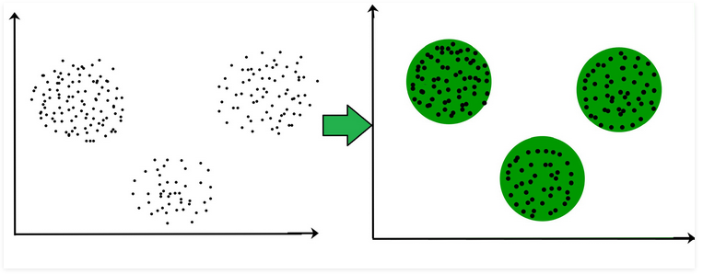

Slide 4
Applications
Marketing : It can be used to characterize & discover customer segments for marketing purposes.
Biology : It can be used for classification among different species of plants and animals.
Libraries : It is used in clustering different books on the basis of topics and information.
Insurance : It is used to acknowledge the customers, their policies and identifying the frauds.
City Planning : It is used to make groups of houses and to study their values based on their geographical locations and other factors present.
Earthquake studies : By learning the earthquake affected areas we can determine the dangerous zones.

Slide 5
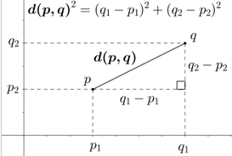


Distance Metric
Euclidean:
Scale variant, Sensitive to data dimensionality: Normalization (scaling) can solve this issue
Manhattan
• Sensitive to outliers but comparatively less in comparison to Euclidean

Slide 6
Algorithm
Given the cluster number K, algorithm is carried out in three steps after initialisation:
Initialisation: set seed points (randomly)
Assign each object to the cluster of the nearest seed point measured with a specific distance metric
Compute new seed points as the centroids of the clusters of the current partition (the centroid is the centre, i.e., mean point, of the cluster)
Go back to Step 1), stop when no more new assignment (i.e., membership in each cluster no longer changes)

Slide 7
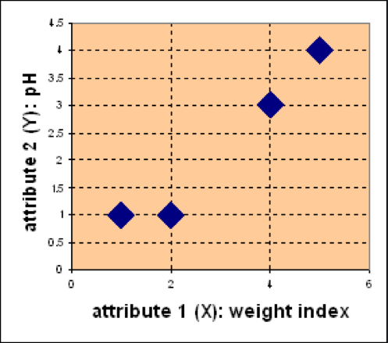
Example
Suppose we have 4 types of medicines and each has two attributes (pH and weight index). Our goal is to group these objects into K=2 group of medicine.
D
Medicine | Weight | pH-Index
A | 1 | 1
B | 2 | 1
C | 4 | 3
D | 5 | 4
C
A
B

Slide 8
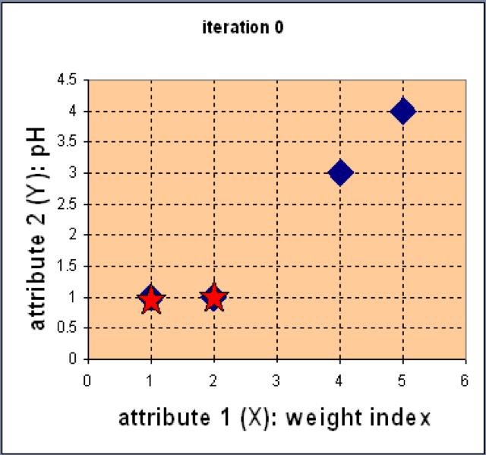
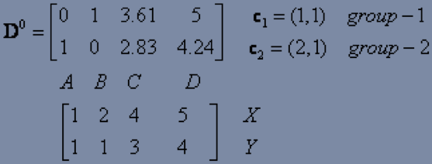
Example
Step 1: Use initial seed points for partitioning
D
C
Euclidean distance
A
B
Assign each object to the cluster
with the nearest seed point

Slide 9
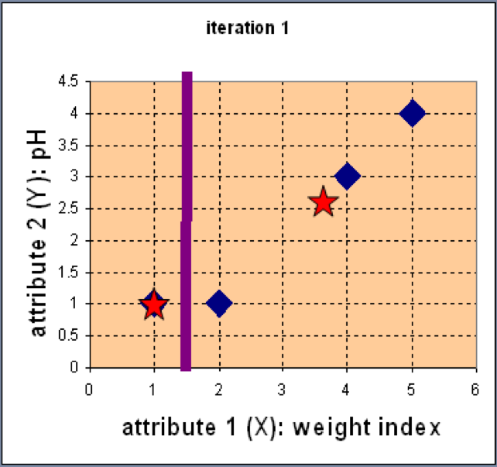
Example
Step 2: Compute new centroids of the current partition
Knowing the members of each
cluster, now we compute the new
centroid of each group based on
these new memberships.

Slide 10
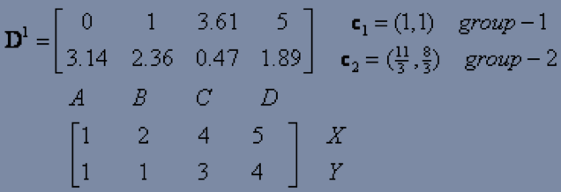
Example
Step 2: Renew membership based on new centroids
Compute the distance of all objects to the new centroids
Assign the membership to objects

Slide 11
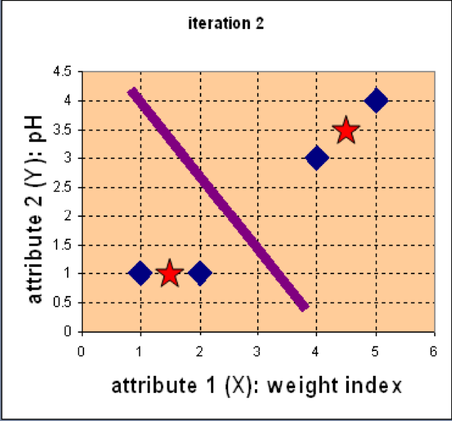
Example
Step 3: Repeat the first two steps until its convergence
Knowing the members of each
cluster, now we compute the new
centroid of each group based on
these new memberships.

Slide 12
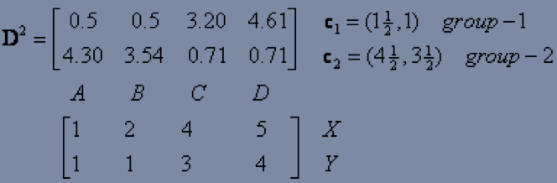
Example
Step 3: Repeat the first two steps until its convergence
Compute the distance of all objects to the new centroids
Stop due to no new assignment
Membership in each cluster no longer change

Slide 13
K-means Issues
Distance measure is squared Euclidean
Scale should be similar in all dimensions
Rescale data?
Not good for nominal data. Why?
Approach tries to minimize the within-cluster sum of squares error (WCSS)
Implicit assumption that SSE is similar for each group

Slide 14
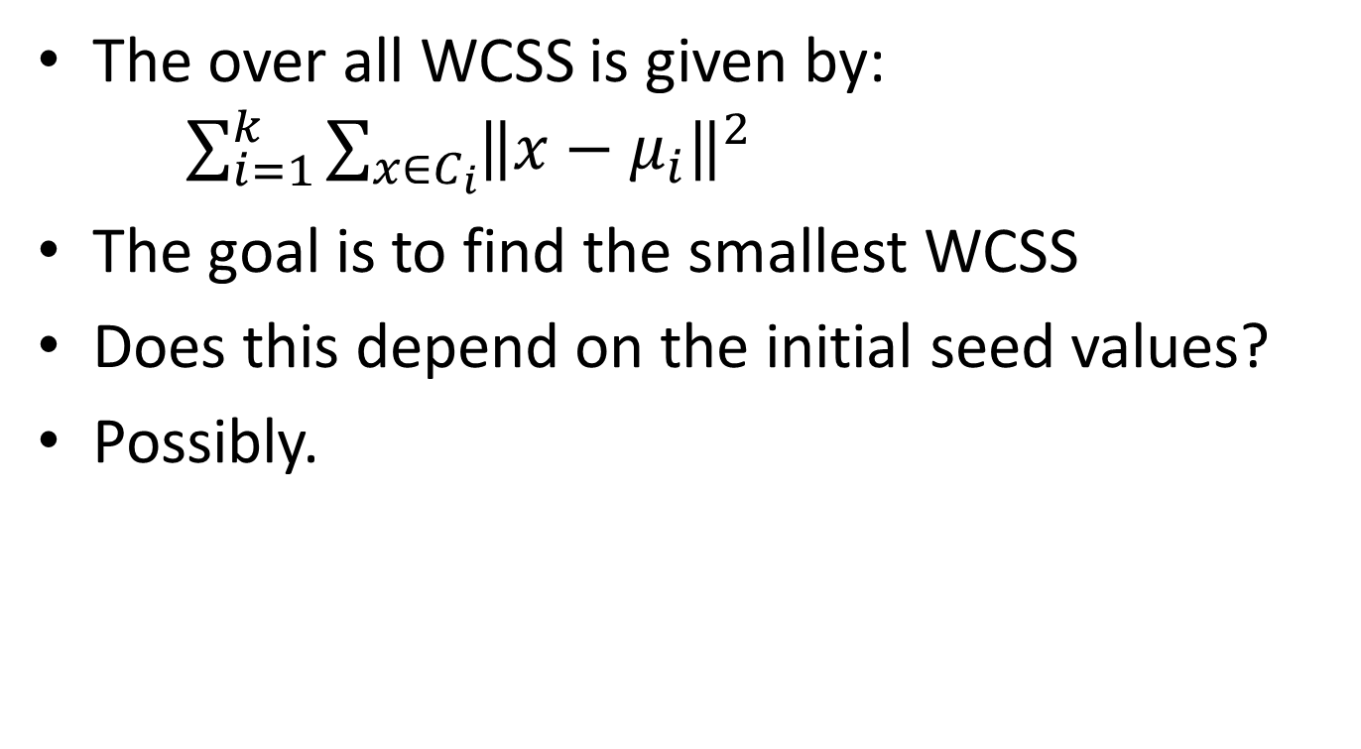
WCSS
The over all WCSS is given by: $\sum_{i=1}^{k}{\sum_{x∈C_{i}}{{\left\|x−μ_{i}\right\|}^{2}}}$
The goal is to find the smallest WCSS
Does this depend on the initial seed values?
Possibly.

Slide 15
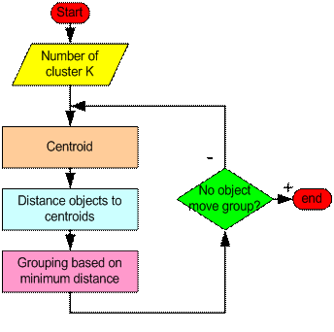
How the K-Mean Clustering algorithm works?

Slide 16
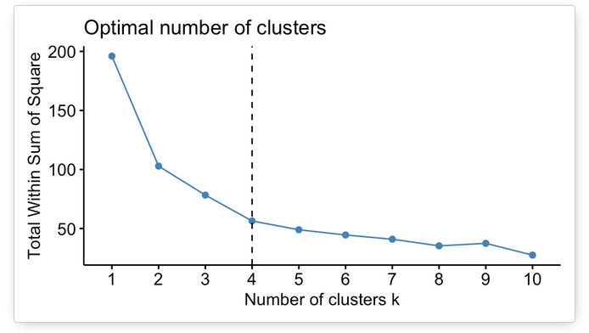
Optimal Number of Cluster( Elbow method)
The plot above represents the variance within the clusters.
It decreases as k increases, but it can be seen a bend (or “elbow”) at k = 4.
This bend indicates that additional clusters beyond the fourth have little value

Slide 17
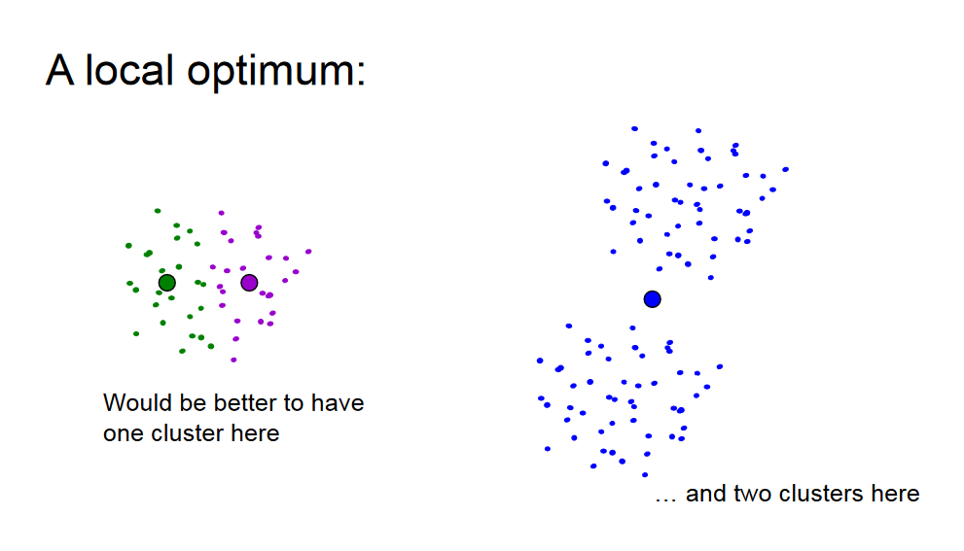

Slide 18
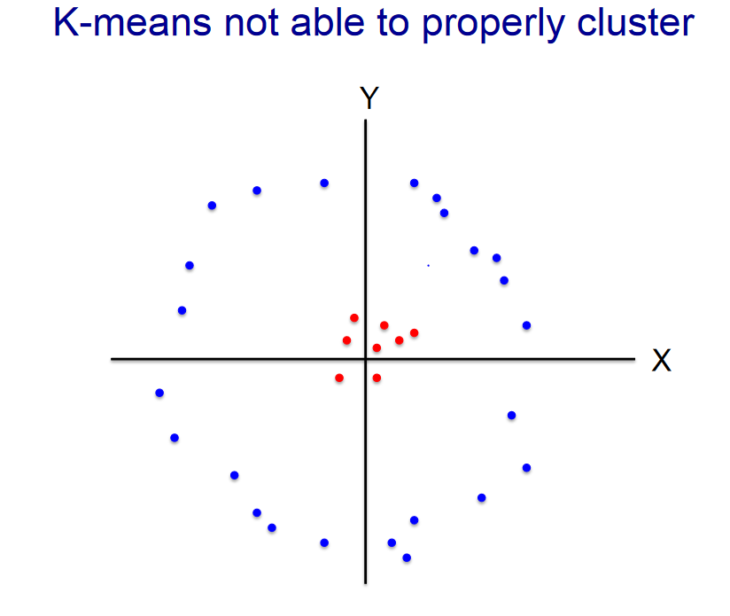

Slide 19
Advantages/Disadvantages
k-means
• Minimize sum of squared error
• Time and memory efficient
• Optimal k: knee or elbow-method or, Average Silhouette method (maximize),
• Cons: Converges to local minima, mean is not defined for categorical data , cannot handle noise/outliers, assume features are not correlated, clustering results depends on initial seed selection
k-medoid or PAM (Partitioning Around Medoids)
• Similar to k-means, but uses medoid as cluster representatives & minimizes sum of dissimilarities
• Handle noise/outlier better than k-means but does not scale for large data

Slide 20
K-Means falls under the category of centroid-based clustering.
A centroid is a data point (imaginary or real) at the center of a cluster.
In centroid-based clustering, clusters are represented by a central vector or a centroid. This centroid might not necessarily be a member of the dataset.
Centroid-based clustering is an iterative algorithm in which the notion of similarity is derived by how close a data point is to the centroid of the cluster.

Slide 21
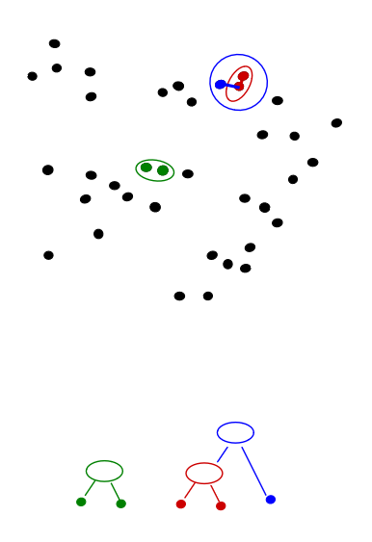
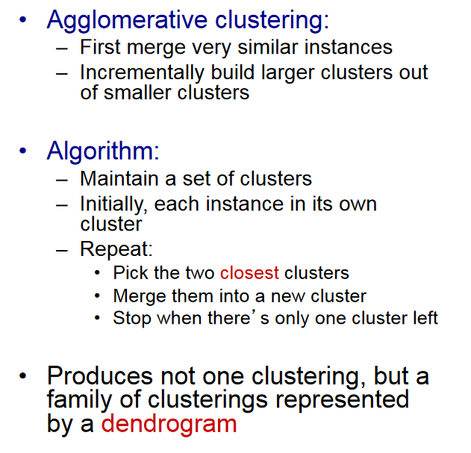

Slide 22
http://people.csail.mit.edu/dsontag/courses/ml12/slides/lecture14.pdf
https://rpubs.com/gabrielmartos/ClusterAnalysis

